Slide 1
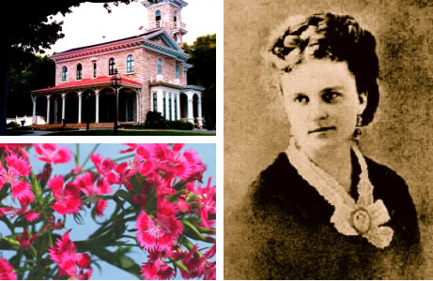
Kate Chopin 1850–1904

Slide 2
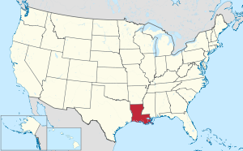
Most of her fiction is set in Louisiana
At eighteen, Kate was an “Irish Beauty”
Kate and Oscar Chopin were married in 1870
in 1882 he died of malaria–and Kate became a widow at age thirty-two, with the responsibility of raising six children. She never remarried
Influenced by Guy de Maupassant and other writers, French and American, Kate began to compose fiction,
in 1889 one of her stories appeared in the St. Louis Post Dispatch. In 1890 her first novel, At Fault, was published privately.
In 1904 Kate Chopin bought a season ticket for the famous St. Louis World’s Fair, located not far from her home.
when Chopin returned home from the fair, she was very tired. She called her son at midnight complaining of a pain in her head. Doctors thought that she had had a cerebral hemorrhage.
She lapsed into unconsciousness the next day and died on August 22.

Slide 3

In 1614, Captain John Smith (the same guy people mistakenly think married Pocahontas) and his men explored the shores of the region.
He is credited with coining the term “New England”.
Shortly after, New England would come to be settled by English Puritans, who came to the New World to escape religious persecution in England. They would establish the first colony in New England, eventually leading to further English settlement around Boston and Salem.

Slide 4
REALISM
"the faithful representation of reality" or "verisimilitude,"
Although realism is a technique, it also denotes a particular kind of subject matter, especially the representation of middle-class life.
A reaction against romanticism, an interest in scientific method, the systematizing of the study of documentary history, and the influence of rational philosophy all affected the rise of realism.
encompasses the period of time from the Civil War to the turn of the century during which William Dean Howells, Henry James, Mark Twain, and others wrote fiction devoted to accurate representation and an exploration of American lives in various contexts.
As the United States grew rapidly after the Civil War, the increasing rates of democracy and literacy, the rapid growth in industrialism and urbanization, an expanding population base due to immigration, and a relative rise in middle-class affluence provided a fertile literary environment for readers interested in understanding these rapid shifts in culture.

Slide 5
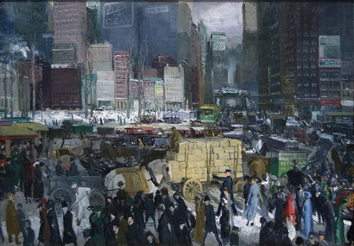

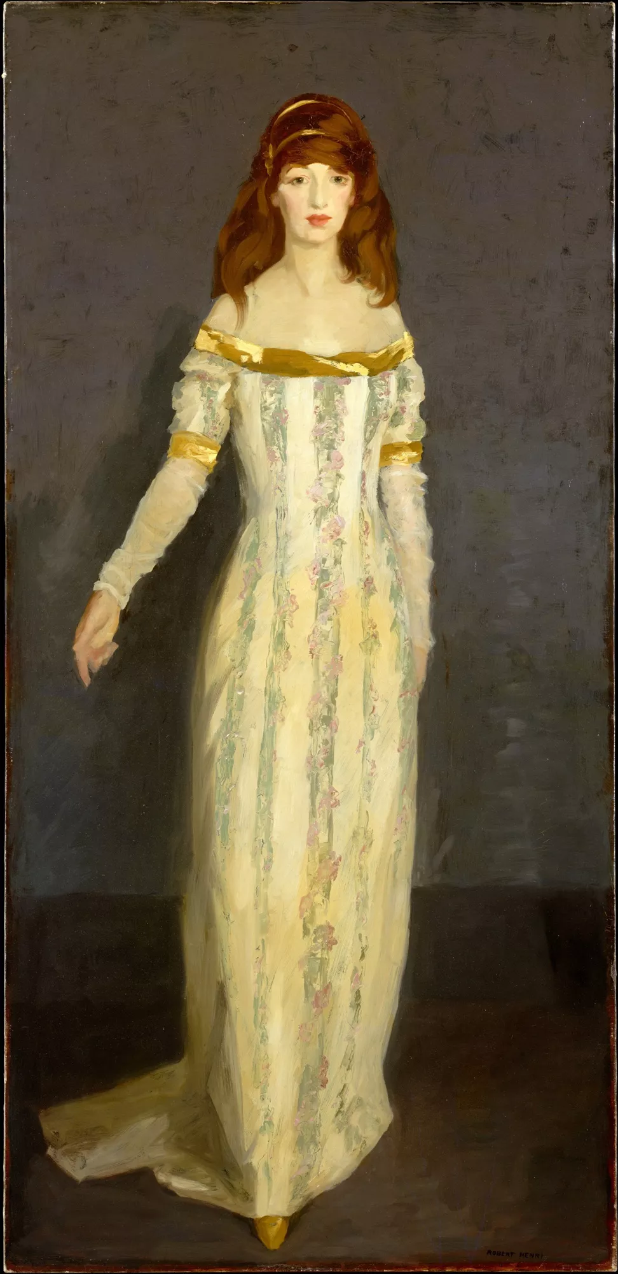
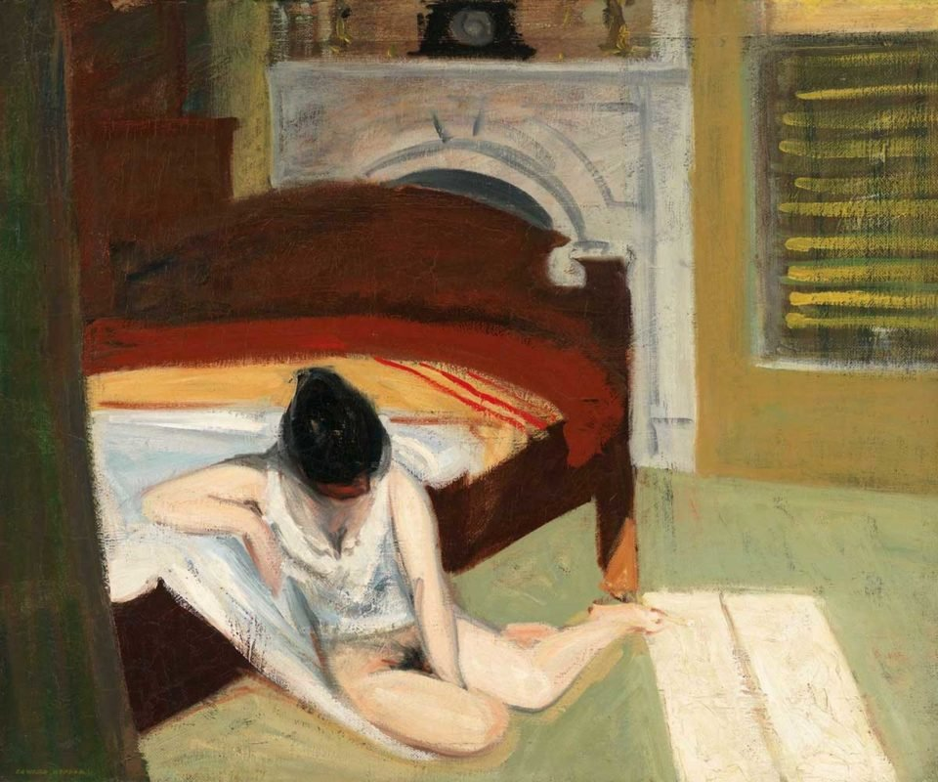
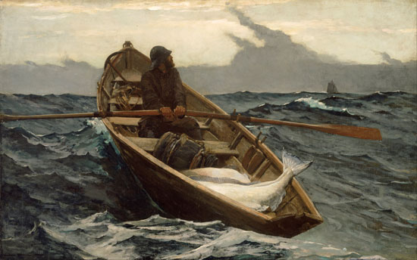
Nighthawks by Edward Hopper, 1942
New York by George Bellows,1911
Robert Henri, The Masquerade Dress, 1911
Summer Interior by Edward Hopper, 1909
The Fog Warning (1885) by Winslow Homer

Slide 6
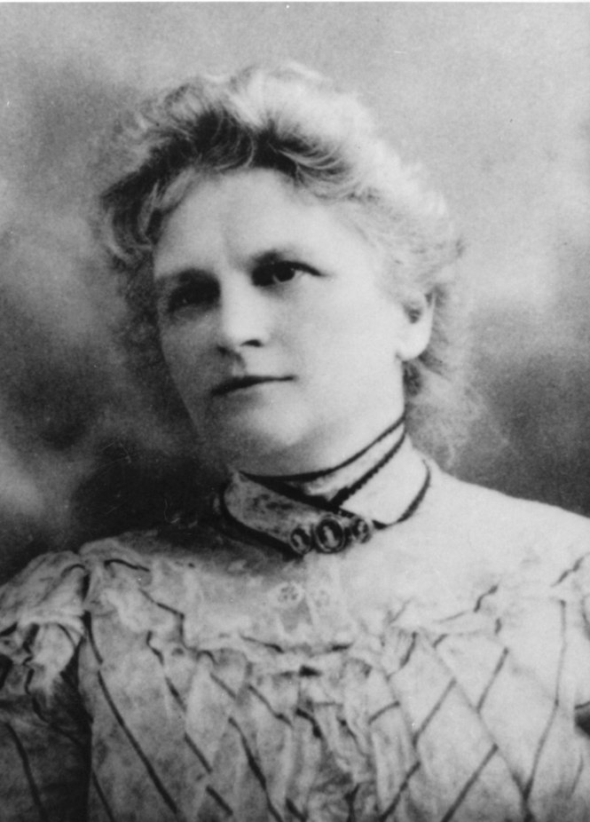
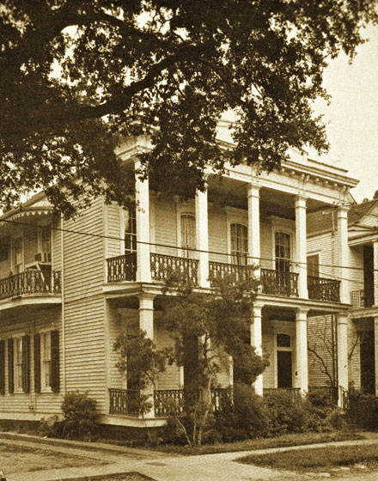
1413 Louisiana Avenue, New Orleans
a forerunner of American 20th-century feminist authors

Slide 7
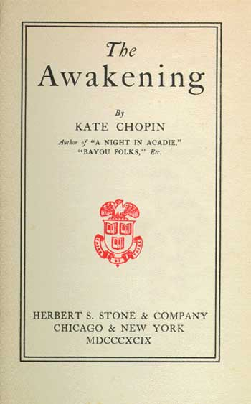
The Awakening (1899) was widely condemned. Critics called it morbid, vulgar, and disagreeable.
trite and sordid
“Chopin’s sense of a complex reality,” permits no easy answers to the moral questions raised by the conflict between the individual and social restraints
what makes the novel feel so modern is Edna Pontellier’s realization that “the physical component of love can stand apart from the spiritual one, that sensuous attraction is impersonal and can be satisfied by a partner she does not love.”

Slide 8
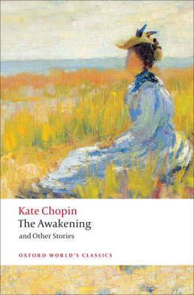
How does this novel frame the notions of freedom and responsibility?
What role do children play in Edna’s life?
Think about the three main women in the novel: Edna, Adele, and Mademoiselle Reisz. How are they different and how are they alike?
Does Edna undergo more than one awakening in this novel? What is she awakened to?
Imagine The Awakening set in today’s American society. How would it be different? How would it be the same?
What role does race and class play in this novel? Does Edna have anything in common with the poor black woman who serves her?
Is Edna’s act of suicide at the end of the novel an act of bravery or cowardice? Do you think it was an intentional or premeditated act on her part? Why does Chopin leave the answer to this question so vague?
tells of a woman's abandonment of her family, her seduction, and her awakening to desires and passions that threatened to consumer her. Originally entitled "A Solitary Soul," this portrait of 28 year-old Edna Pontellier is a landmark in American fiction. Here, a woman in search of self-discovery turns away from convention and society, and toward the primal, irresistibly attracted to nature and the senses

Slide 9
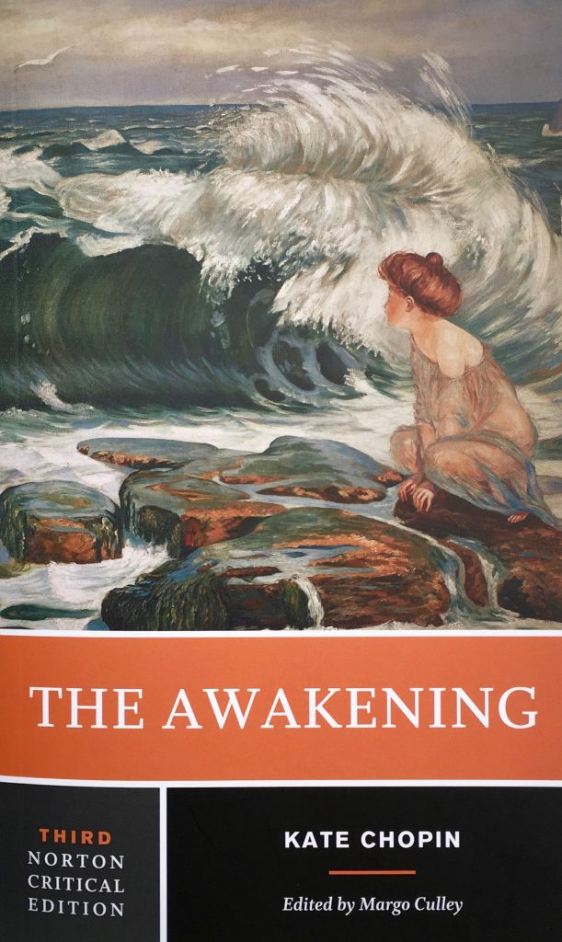
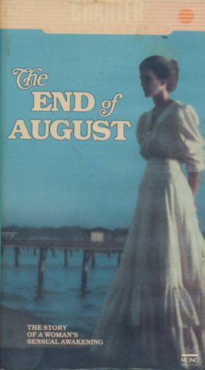
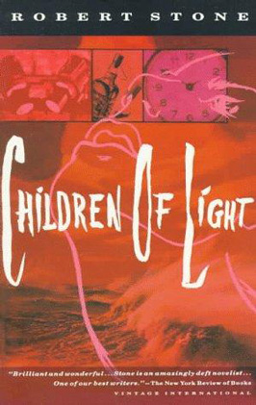


Slide 10
“The Storm” characters
Calixta: she appears also in Chopin’s “At the ‘Cadian Ball”
Bobinôt: husband of Calixta and father of Bibi. Bobinôt also appears in “At the ‘Cadian Ball”
Bibi: four-year-old son of Calixta and Bobinôt
Alcée Laballière: he and his brothers Didier and Alphonse appear in several Chopin stories. Like Calixta and Bobinôt, Alcée appears in “At the ‘Cadian Ball”

Slide 11
Setting
Themes
The story is set in the late nineteenth century at Friedheimer’s store in Louisiana,
and at the nearby house of Calixta and Bobinôt.
life as it comes
sex in this story is a force as strong, inevitable, and natural
human passion and desire, but not at the cost of marriage
the points of view of five different characters

Slide 12
Does “The Storm” stand by itself or does it need to be read with the earlier story?
Isn’t the phrasing of “The Storm” sexually explicit for something written in the 1890s?
Readers at the time were uncomfortable about explicit sex in short stories?

Slide 13
What kind of relationship exists between Calixta and Alcée? What can you infer from their past?
A: Much depends on whether you think of the two as characters who exist only in “The Storm” or if you see them as characters who exist also in “At The ‘Cadian Ball.” Assuming you are looking at both stories:
Αlcée and his wife Clarisse are Creoles, descendants of French settlers in Louisiana. Calixta and her husband Bobinôt are Acadians, descendants of French-American exiles from Acadia, Nova Scotia, who were driven from their homes by the British in 1755. Most of the Creoles in Kate Chopin’s stories are comparatively wealthy, usually landowners or merchants. Most of the Acadians (or ‘Cajuns) in the stories are much poorer, living off the land, farming or fishing or working for the Creoles.
So on the basis of the two stories together, you could describe Calixta as coming from a different social class than Alcée, and you could say that it’s in good part because of that difference in class that Calixta and Alcée are married to other people. And you could add that, unlike anyone else in either story, Calixta comes in part also from a Spanish-speaking cultural background (her mother is Cuban) and so, as Kate Chopin presents her, she has different ways of behaving, more sensual ways of expressing her sexuality–which is partly why she is so attractive for both Alcée and Bobinôt.
Calixta is an Acadian influenced by Cuban culture who had been attracted to Alcée–and he to her–long before either of them was married (they had passionate moments together one summer in Assumption Parish, moments that apparently scandalized some people). Calixta married Bobinôt, the earlier story suggests, because Alcée was not available as a marriage partner–at least partly because his Creole family, and certainly Clarisse, think of him as coming from a comparatively higher social class.
https://phdessay.com/questions-storm-kate-chopin/

