Slide 1
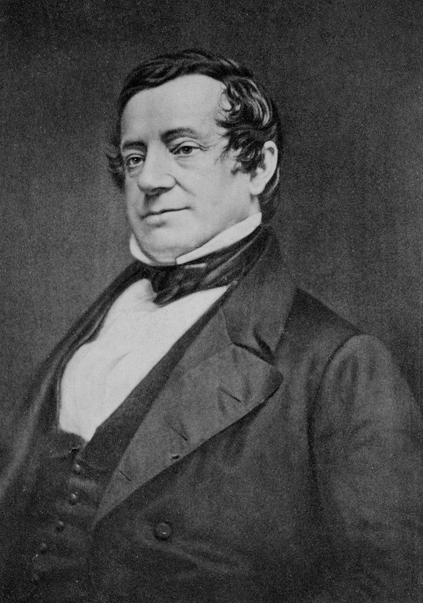
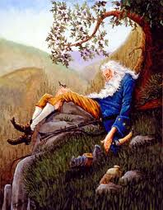
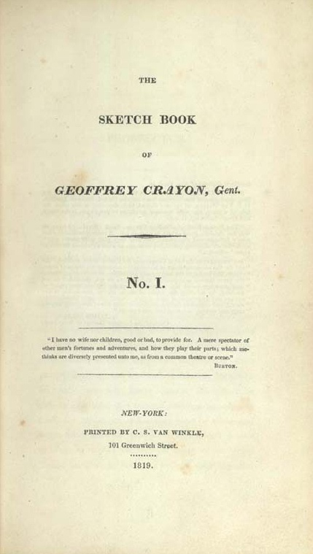
First published in the collection The Sketch Book 1820. .

Slide 2

American Romanticism 1820 -1865 described as an ideological shift on the grand scale from conservative to liberal ideas
succeeded the Age of Reason and Enlightenment (1750-1800)
reason and common sense rather than faith
poetry and fiction modeled on what was published overseas in Great Britain, and much of what American readers consumed also came from GB.
values the individual over the group,
the subjective over the objective,
a person’s emotional experience + imagination over reason
freedom for the individual

Slide 3
Romantic Influences
Reaction against the authority of reason: Rip leads an easygoing life despite his wife’s nagging.
supernatural element: appearance of dwarves in the woods, Rip's twenty-year sleep.
revived appreciation for natural beauty: beauty of natural landscapes is seen through the images of Catskill Mountains and their personification.
Interest in country, rural life and its people / rural versus urban setting
Interest in the past: stories about Henry Hudson and its crew.

Slide 4
Melancholy: Rip wanders in the Mountains, has difficulty communicating with people, his only company is his dog, ‘Wolf’.
Distrust of civilization
Concern for and emphasis on individual freedom
Characteristics of romantic characters:
innocence, love for nature,
distrust of women and civilization

Slide 5
A founding myth of American culture: WHY?
depicts American society and explores the American landscape
the belief in the fresh start, the new beginning, following the dream
tension between stasis and the future (assimilation vs separation, individualism vs community, westward expansion)
The conflict between nature and the “civilized” world of the marketplace at the heart of Rip Van Winkle.
shows distaste for the world before the Revolution
It foregrounds contradictions of American identity
fear of boundlessness and the need to impose form on space

Slide 6
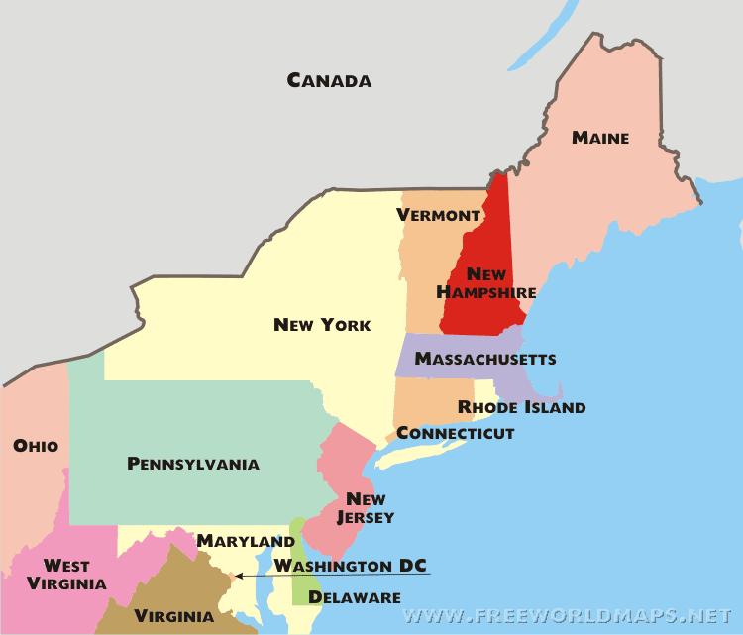

Slide 7
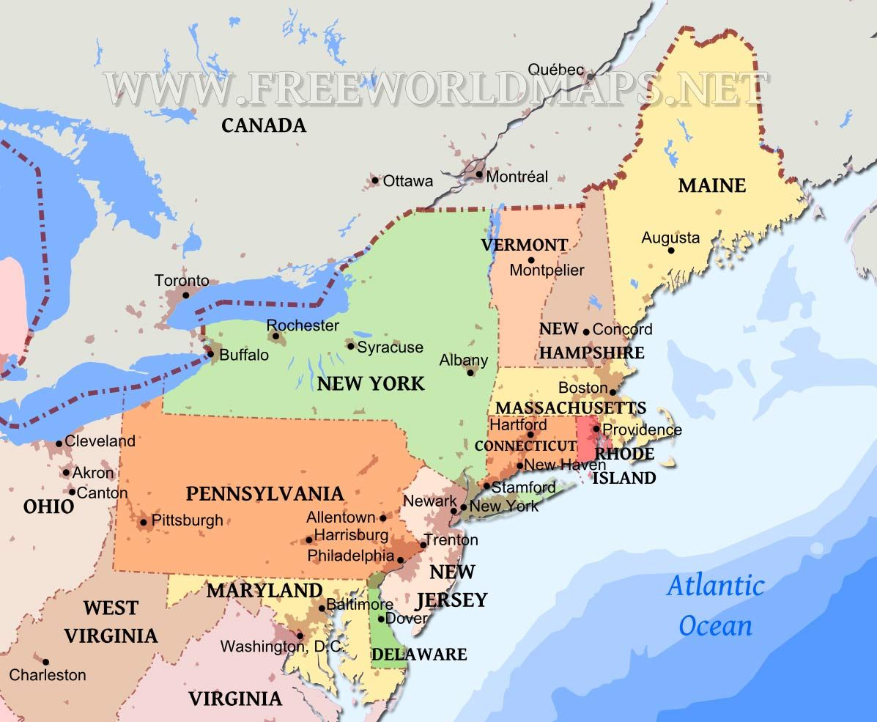

Slide 8
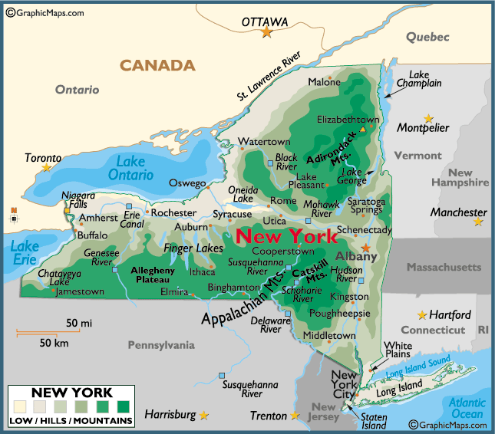

Slide 9

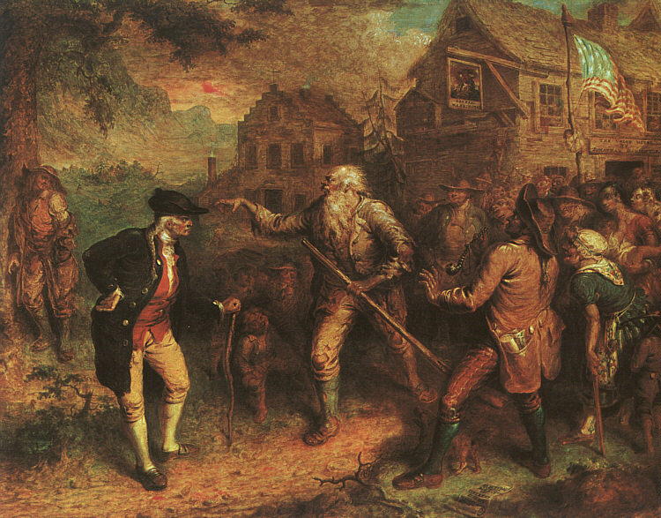
a village located in eastern New York, near the Hudson River up in the Catskill mountains. WHOEVER has made a voyage up the Hudson must remember the Kaatskill mountains Time, two periods: 1. 5 or 6 years before the American Revolution for Independence (1776-1783), when America was still a colony of the British Empire 2. 20 years after the American Revolution
A. Setting

Slide 10
Narrative viewpoint
Narrator: Diedrich Knickerbocker. Omniscient, external (he is not a character of the story)
The fact that Crayon distances himself from the act of storytelling makes the reader more suspicious (unreliable narrator).
[The following Tale was found among the papers of the late Diedrich Knickerbocker, an old gentleman of New York, who was very curious in the Dutch history of the province, and the manners of the descendants from its primitive settlers. ..]

Slide 11
“In that same village, and in one of those very houses (which, to tell the precise truth, was sadly time-worn and weather-beaten), there lived many years since… a simple good-natured fellow of the name of Rip Van Winkle”
_________________________________
re-appropriation of old literary techniques
a synthesis of German folklore and Indian legends.
Syntax of a campfire storytelling – narrator in the asides BUT narrative is characterized by “scrupulous accuracy” and must be read as an historical account with “unquestionable authority”

Slide 12
Rip Van Winkle was one of those happy mortals, of foolish, well-oiled dispositions, who take the world easy, eat white bread or brown, whichever can be got with least thought or trouble, and would rather starve on a penny than work for a pound. If left to himself, he would have whistled life away in perfect contentment; but his wife kept continually dinning in his ears about his idleness, his carelessness, and the ruin he was bringing on his family.

Slide 13

Rip Van Winkle -meek, easygoing, kind, amiable, good natured man neighborly man, descends from great soldiers, but peaceful, obedient to his domineering wife -an alcoholic characterized by idleness, unable to take on any responsibility. Everyone likes him, (esp. children) but rather isolated as he communicates better with his dog ‘Wolf’ than with the villagers -passive, paralytic attitude towards life, tendency to escapism makes him an anti-heroic character, but also dreamy alternative in a culture of social conformity.

Slide 14
Against Protestant work ethic
The great error in Rip’s composition was an insuperable aversion to all kinds of profitable labor.
he declared it was of no use to work on his farm; it was the most pestilent little piece of ground in the whole country; every thing about it went wrong, and would go wrong, in spite of him
Poor Rip was at last reduced almost to despair; and his only alternative, to escape from the labor of the farm and the clamor of his wife, was to take gun in hand and stroll away into the woods. Here he would sometimes seat himself at the foot of a tree, and share the contents of his wallet with Wolf, with whom he sympathized as a fellow-sufferer in persecution.

Slide 15
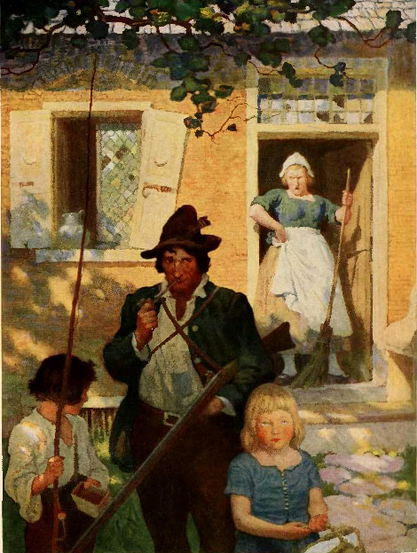
N. C. Wyeth, Washington Irving, Rip Van Winkle Philadelphia Date created 1921

Slide 16
Mrs. Van Winkle wants Rip to “improve himself,” to make a profit from his farm, to raise her and the children’s standard of living.
However, Rip is happy; his children are happy.
_______________________________________
Mrs. Van Winkle is the first of a long line of menacing “civilizers” in American literature, the most famous of whom is of course Tom Sawyer’s Aunt Sally. To escape her, Rip has to return to nature, to go up to the mountain and stay there for twenty years.

Slide 17
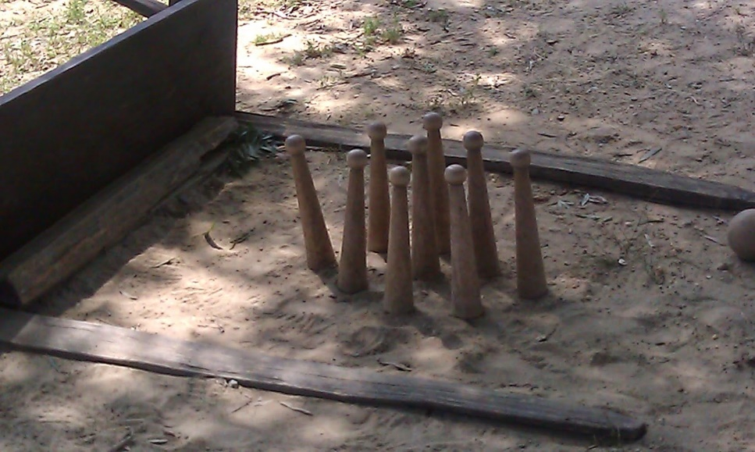
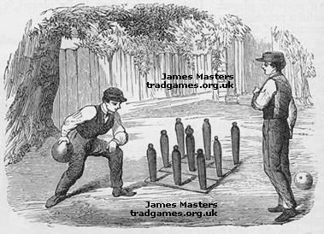
one of the most popular sports in England since at least medieval times. Many old pictures and books mention it. A study of old pictures of the Thames Frost fairs shows that Nine Pins was consistently one of the entertainments.
One of the many variations of the game came from Holland and was known as Dutch Pins. You can see from the picture that the balls have holes and it is this game that is believed to have been taken to America
a company of odd-looking personages playing at nine-pins. They were dressed in quaint outlandish fashion…Their visages, too, were peculiar; one had a large head, broad face, and small piggish eyes; the face of another seemed to consist entirely of nose… They all had beards, of various shapes and colors. There was one who seemed to be the commander.

Slide 18
What does the wife represent? What is her allegorical meaning? Why is she associated with the period before the war?
Dame Van Winkle may stand for the British Empire
Rip’s gun “old firelock” stands for his passivity and paralytic attitude towards things.
Rip’s night in the woods symbolizes the fantasy of escape through one’s imagination
The metamorphosis of king George to General Washington

Slide 19
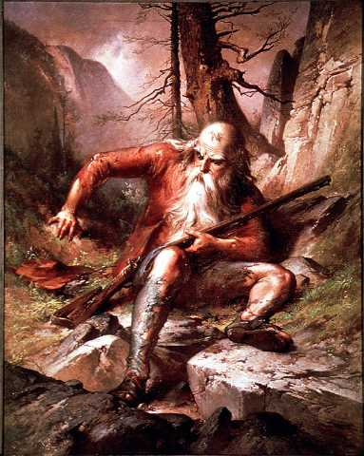
QUESTION: How has the artist shown us that Rip Van Winkle has been asleep for 20 years?
“Oh! that flagon! that wicked flagon!”
thought Rip—“what excuse shall I make to Dame Van Winkle?”
He looked round for his gun, but in place of the clean, well-oiled fowling-piece, he found an old firelock lying by him, the barrel incrusted with rust, the lock falling off, and the stock worm-eaten.
Wolf, too, had disappeared
As he rose to walk, he found himself stiff in the joints, and wanting in his usual activity

Slide 20
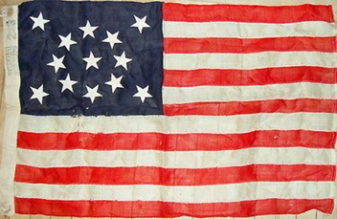

As he approached the village he met a number of people, but none whom he knew
Their dress, too, was of a different fashion from that to which he was accustomed. They all stared at him with equal marks of surprise
The very village was altered; it was larger and more populous
he began to doubt whether both he and the world around him
were not bewitched. Surely this was his native village,
which he had left but the day before
It was with some difficulty that he found the way to his own house
He found the house gone to decay—the roof fallen in, the windows shattered, and the doors off the hinges. A halfstarved dog that looked like Wolf
“My very dog,” sighed poor Rip, “has forgotten me!”

Slide 21
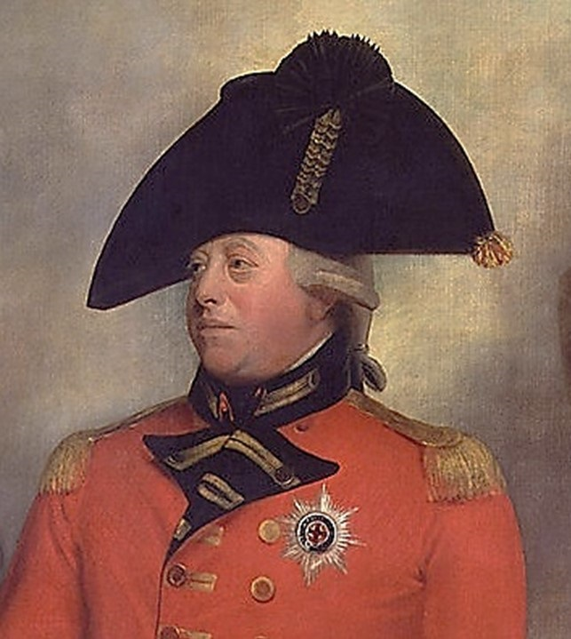
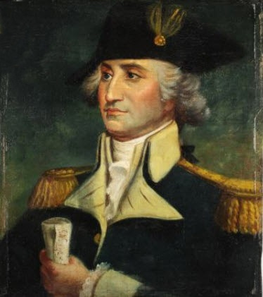
He now hurried forth, and hastened to his old resort, the village inn—but it too was gone. A large rickety wooden building stood in its place, with great gaping windows, … and over the door was painted, “The Union Hotel, by Jonathan Doolittle.”
there now was reared a tall, naked pole and from it was fluttering a flag, on which was a singular assemblage of stars and stripes
He recognized the ruby face of King George…but even this was singularly metamorphosed. The red coat was changed for one of blue and buff, a sword was held in the hand instead of a sceptre, the head was decorated with a cocked hat, and underneath was painted in large characters, GENERAL WASHINGTON.
The orator bustled up to him and inquired, “on which side he voted?” Rip stared in vacant stupidity. Another short but busy little fellow pulled him by the arm, inquired in his ear, “whether he was Federal or Democrat?”
“Alas! gentlemen,” cried Rip, somewhat dismayed, “I am a poor quiet man, a native of the place, and a loyal subject of the king, God bless him!”

Slide 22
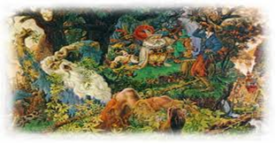
Lovable Rip vs alcoholic Rip
Skips middle age, time of responsibility, from childhood to 2nd childhood, vulnerable old age (how old is Rip?)
The old and the new = new nation’s rejection of its own past (rotted and gone)
Fashions success out of failure

Slide 23
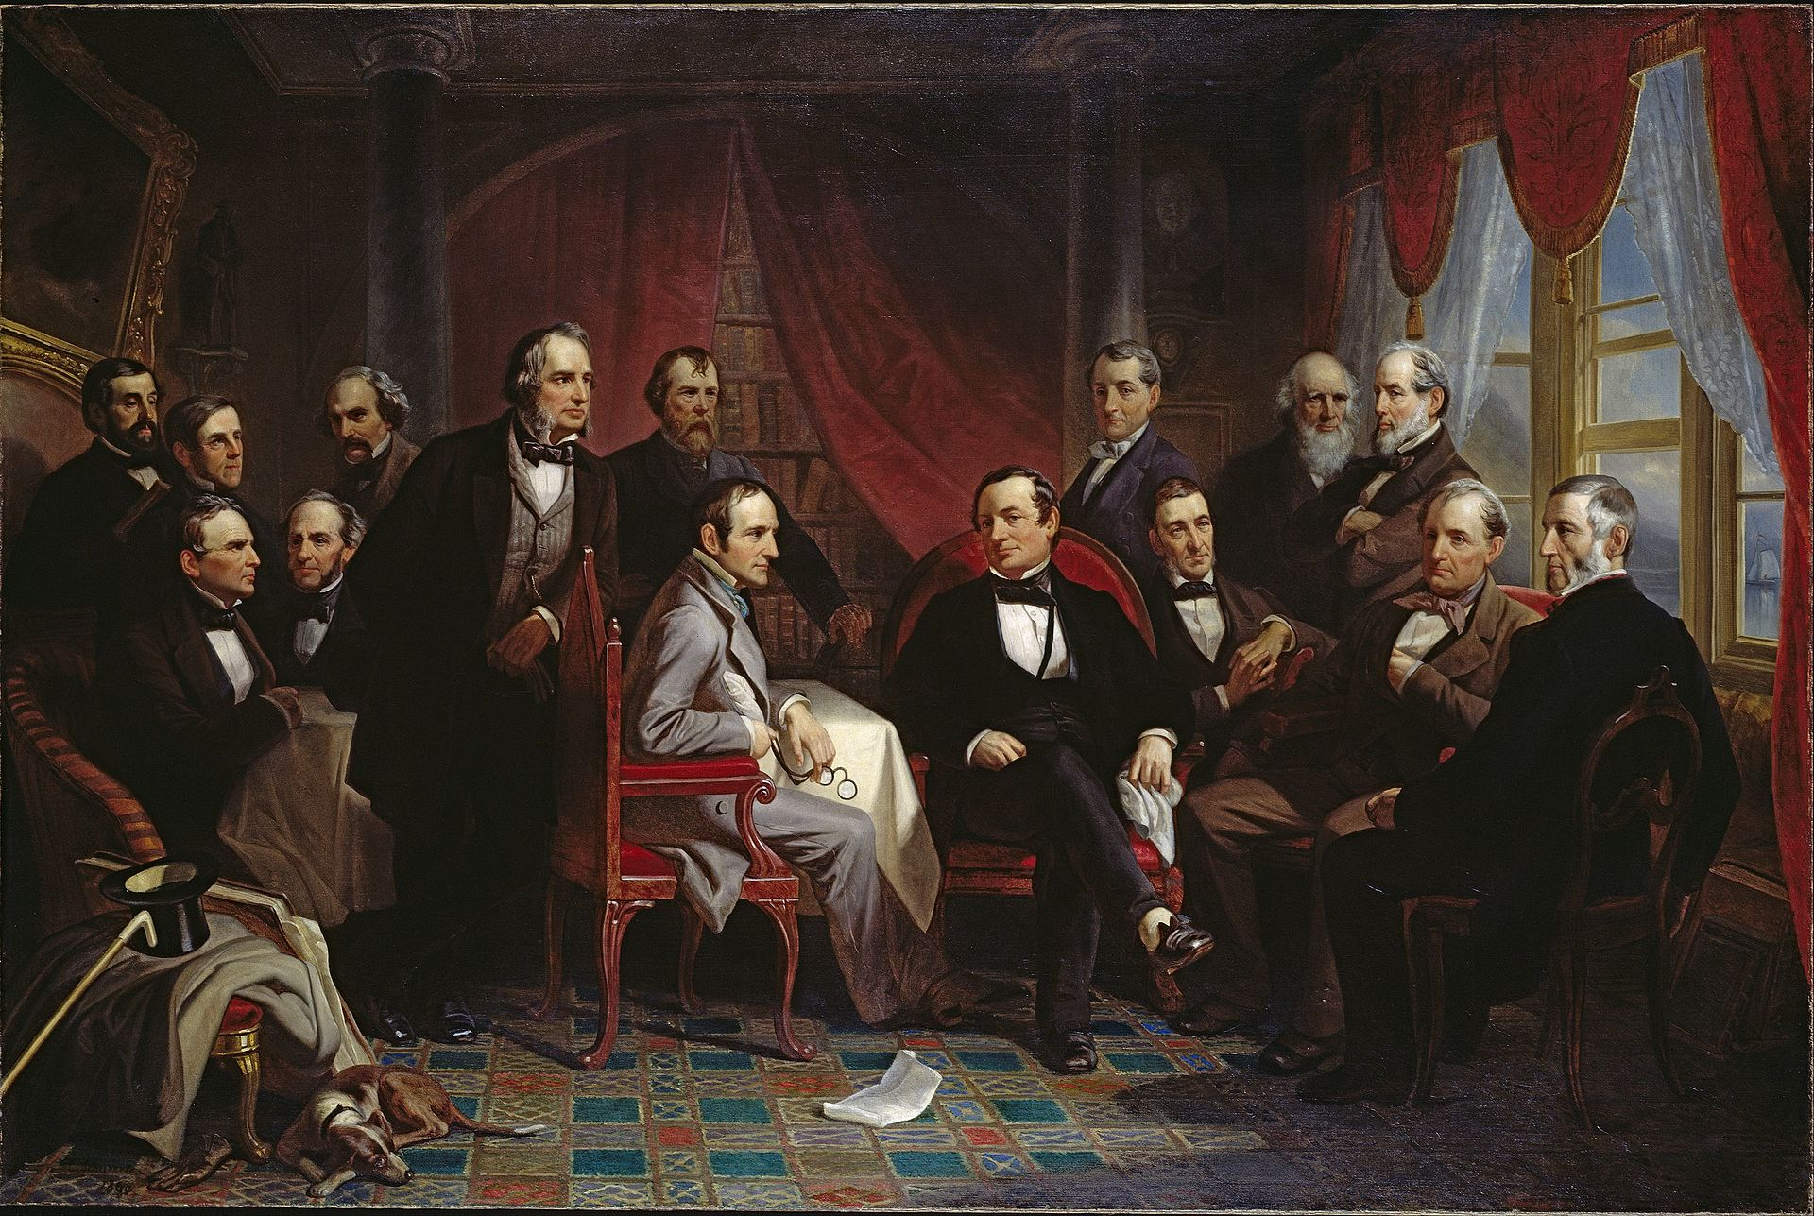
Irving and his friends at Sunnyside by Christian Schussele
Oil on canvas painting entitled Washington Irving and his Literary Friends at Sunnyside; original size without frame 134.6×199.4 cm. From left to right: Henry T. Tuckerman (1813-1871), Oliver Wendell Holmes (1809-1894), William Gilmore Simms (1806-1870), Fitz-Greene Halleck (1790-1867), Nathaniel Hawthorne (1804-1864), Henry Wadsworth Longfellow (1807-1882), Nathaniel Parker Willis (1806-1867), William H. Prescott (1796-1859), Washington Irving, James Kirke Paulding (1778-1860), Ralph Waldo Emerson (1803-1882), William Cullen Bryant (1794-1878), John Pendleton Kennedy (1795-1870), James Fenimore Cooper (1789-1851), and George Bancroft (1800-1891).

Slide 24
1.Discuss his notion of gender, and marriage
2.Why do children follow him
3.Why does meekness of spirit give him popularity
4. Compare the description of “amphitheatre” before and after his sleep. Strong imagery creates vivid settings
5. What does the wife represent? What is her allegorical meaning? Why is she associated with the period before the war?
6. Common features of Am. Romantic Lit include: Are all these found in the story?
Distrust of civilization
Nostalgia of the past
Concern for individual freedom
Interest in the supernatural
7. Romantic hero archetype: childlike/innocent/distrustful of women/fond of nature/in search of a higher truth/
8. Why does Irving frame the story?
9. How do we interpret RVW as an allegory representing Amer. History
10. How RVW exemplifies Amer. Romatic Lit.

Slide 25
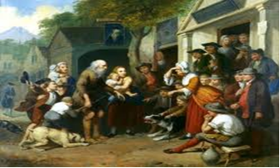
Told as if it were true
Perilous journey
Some parts of the story may not seem probable, but the reader is meant to overlook that.
It is set in historical time.
It may make reference to real people.
It may contain supernatural elements
A legend

