Slide 1
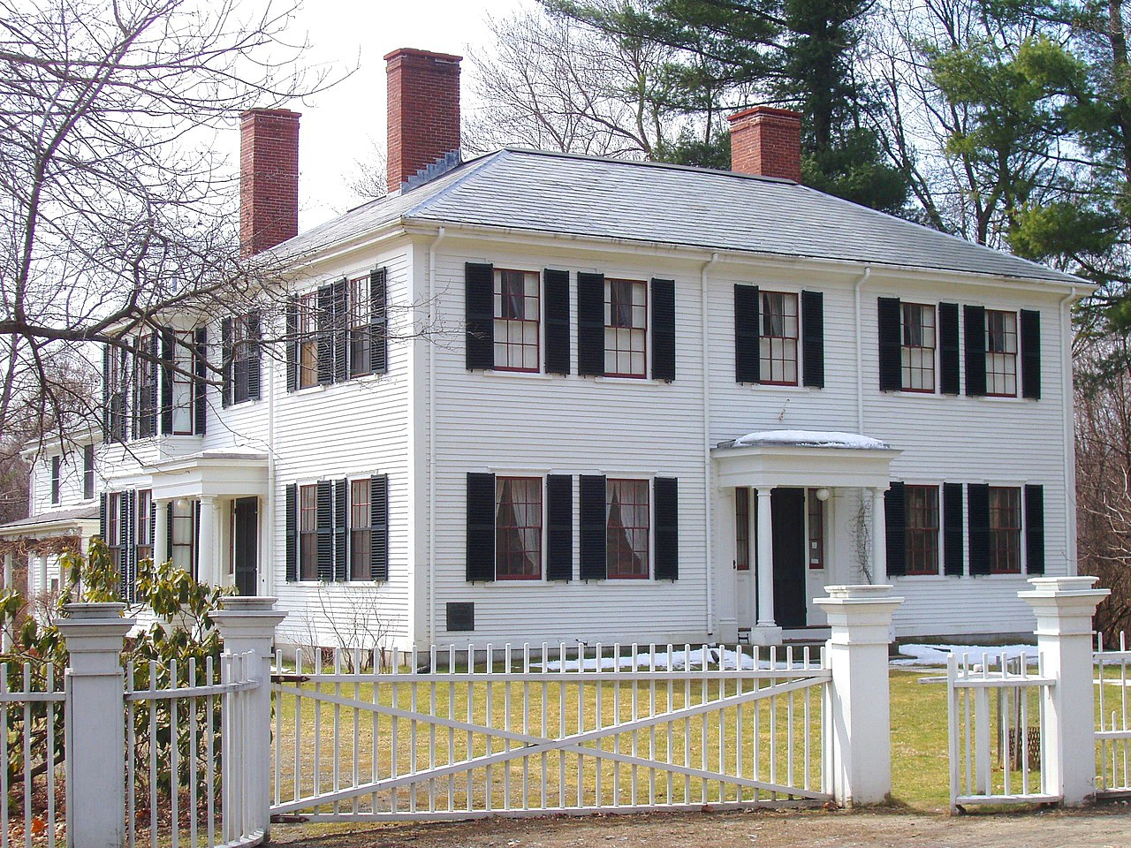
Emerson‘s hometown of Concord, MA becomes the epicenter, the meeting place for the Transcendental Club.

Slide 2
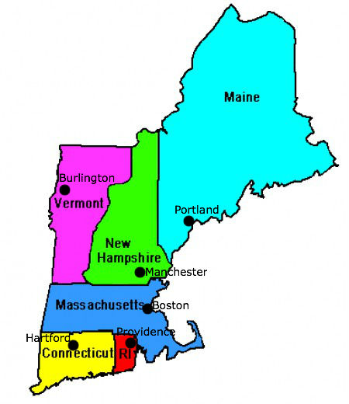
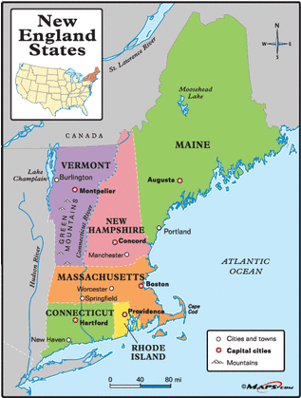

Slide 3
Transcendentalism’s questioning of established cultural forms, its desire to turn ideas into concrete action developed a momentum of its own, spreading from the spheres of religion and education to literature, philosophy, and social reform.
Transcendentalism is not as much concerned with a metaphysics that transcends our daily lives but rather with a new view of the mind that replaces Locke's empiricist, materialistic, and passive model with one emphasizing the role of the mind itself in actively shaping experience.
the mind can apprehend absolute spiritual truths directly without having to go through the detour of the senses, without the dictates of past authorities and institutions. In this sense particularly, it was the logical--or supralogical--extension of both the Protestant reformation and American democratic individualism

Slide 4
American transcendentalism
The American Renaissance was closely associated with an intellectual movement known as Transcendentalism, which is a philosophy or system of thought based on the idea that :
humans are essentially good,
humanity's deepest truths may be formulated through insight rather than logic,
there is an essential unity to all of creation.
an ideal spiritual state that 'transcends' the physical and empirical and realized through the individual's intuition, rather than through the doctrines of established religions.
-we are, if we only knew it, Gods in ruin
-venerate Nature
-obsession with and celebration of individualism

Slide 5
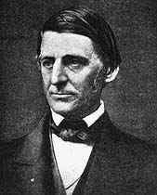
Emerson contributes to The Dial, the publication of the Transcendental Club, which included Bronson Alcott, Margaret Fuller, Elizabeth Peabody, and Henry David Thoreau. While the other Transcendentalists are instrumental in developing and sustaining the movement, Emerson‘s earlywork present the basic ideas which will serve as the underpinnings of the broader movement.
Nature (1836),
The American Scholar (1837),
An Address [commonly referred to as ―The Divinity School Address] (1838),
Essays (1841)
The Poet (1844)

Slide 6
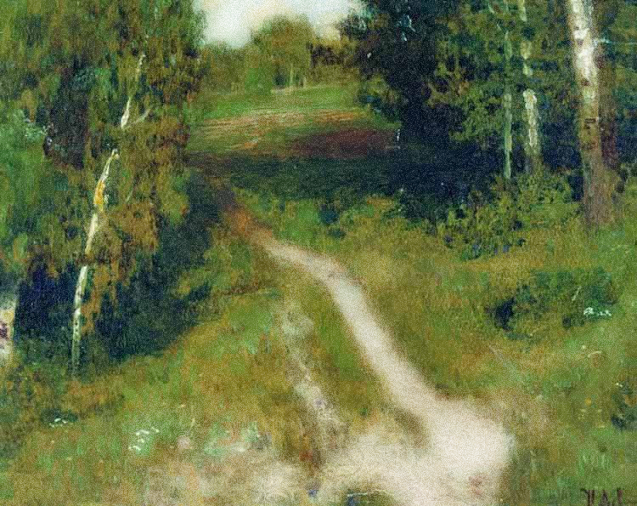
Nature
Our age is retrospective. It builds the sepulchers of the fathers. It writes biographies, histories, and criticism.
Why should not we also enjoy an original relation to the universe? Why should not we have a poetry and philosophy out of insight and not tradition, and a religion by revelation to us, and not the history of theirs?
Through individual experience with the natural world, each person has the possibility to elevate the soul to the level of divine interaction, to have an original relation to God

Slide 7
Nature, 1836
To go into solitude, a man needs to retire as much from his chamber as from society. I am not solitary whilst I read and write, though nobody is with me. But if a man would be alone, let him look at the stars. The rays that come from those heavenly worlds, will separate between him and what he touches."
So shall we come to look at the world with new eyes. It shall answer the endless inquiry of the intellect, — What is truth? and of the affections, — What is good? by yielding itself passive to the educated Will. ... Build, therefore, your own world. As fast as you conform your life to the pure idea in your mind, that will unfold its great proportions. A correspondent revolution in things will attend the influx of the spirit.

Slide 8
Ch VIII. Prospects, from Nature
So shall we come to look at the world with new eyes.
Every spirit builds itself a house; and beyond its house a world; and beyond its world, a heaven. Know then, that the world exists for you. For you is the phenomenon perfect. What we are, that only can we see. All that Adam had, all that Caesar could, you have and can do. Adam called his house, heaven and earth; Caesar called his house, Rome; you perhaps call yours, a cobler's trade; a hundred acres of ploughed land; or a scholar's garret.
Build, therefore, your own world. As fast as you conform your life to the pure idea in your mind, that will unfold its great proportions. A correspondent revolution in things will attend the influx of the spirit. So fast will disagreeable appearances, swine, spiders, snakes, pests, madhouses, prisons, enemies, vanish; they are temporary and shall be no more seen. The sordor and filths of nature, the sun shall dry up, and the wind exhale.

Slide 9
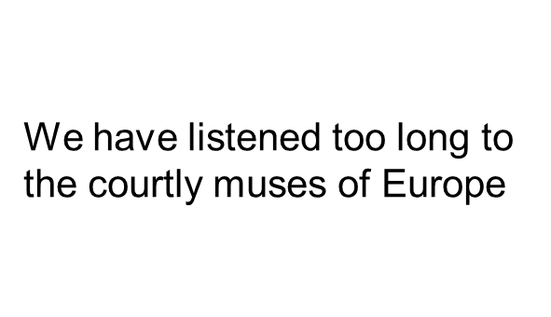

1837
Emerson states that the intellect of the true American scholar must consist of three key influences: Nature, Books, and Action
Nature is reflective of the soul and when we truly understand ourselves, we also truly understand nature: He shall see that nature is the opposite of the soul, answering to it part for part....Its beauty is the beauty of his own mind. Its laws are the laws of his own mind
”the mind of the Past –in whatever form, whether of literature, of art, of institutions” is a critical influence to the spirit of the scholar. [books have great potential to influence the new and divine scholarship, but they also have the potential to be a stopping point]
“Without [action] thought can never ripen into truth.” Emerson‘s scholar must take the next step and actually work to inspire change through action and experience in the world. [While stressing the importance of nature and literature on the mind and spirit of the scholar, Emerson argues that these inspirations are meaningless without subsequent action]

Slide 10

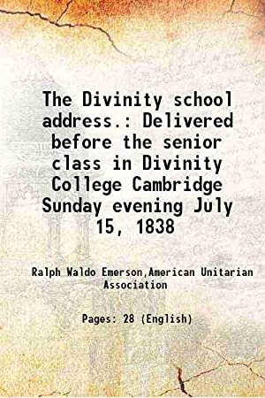
The Divinity School Address, 1838
1. Emerson argues that ―good is positive. Evil is merely privative, not absolute; it is like cold, which is the privation of heat.
Unlike the traditional Christian theology, with good and evil as two entities in opposition, Emerson presents good as the only entity that exists tangibly. This idea contributes to the generally optimistic feeling of Emersonian Transcendentalism. F.ex. a dark room is not dark by nature, but it merely lacks light. When a single ray of light is introduced to the room, things in the room begin to become visible, and with more light, more can be seen
2. The second major discussion is that of the failings of the current established church. Because the church does not seek to have each person find their own relationship to God, relying instead on the discussions of their predecessors. In place of truth, which should be the ultimate goal of one‘s spiritual search, the church substitutes language and rhetoric.

Slide 11

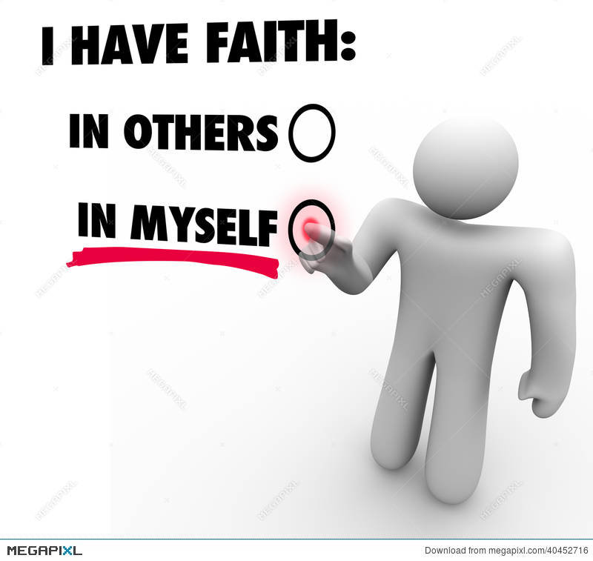

“Self-Reliance” and “Circles” in Essays, 1841
The key idea in both is that man must move forward, and build on that which has been done before in order to find and create those things that are new and unique in the world.
[i]t is easy in the world to live after the world‘s opinion; it is easy in solitude to live after our own; but the great man is he who in the midst of the crowd keeps with perfect sweetness the independence of solitude
Listen to things that reside in the individual and not rely on the influence of those in the community.
Nonconformity
New ideas will always seem to challenge the previously held beliefs

Slide 12
Self-Reliance, 1841
Trust thyself:
To believe your own thought, to believe that what is true for you in your private heart is true for all men, -- that is genius. Speak your latent conviction, and it shall be the universal sense; for the inmost in due time becomes the outmost.
What I must do is all that concerns me, not what the people think. This rule, equally arduous in actual and in intellectual life, may serve for the whole distinction between greatness and meanness. ... For nonconformity the world whips you with its displeasure."

Slide 13
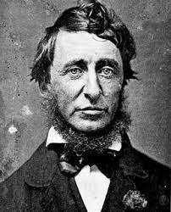
The Poet, 1844
Our logrolling, our stumps and their politics, our fisheries, our Negroes, and Indians, our boats, and our repudiations, the wrath of rogues, and the pusillanimity of honest men, the northern trade, the southern planting, the western clearing, Oregon, and Texas, are yet unsung.
Yet America is a poem in our eyes;
its ample geography dazzles the imagination, and it will not wait long for metres.

Slide 14
Over-Soul, 1841
We live in succession, in division, in parts, in particles. Meantime within man is the soul of the whole; the wise silence; the universal beauty, to which every part and particle is equally related, the eternal ONE. And this deep power in which we exist and whose beatitude is all accessible to us, is not only self-sufficing and perfect in every hour, but the act of seeing and the thing seen, the seer and the spectacle, the subject and the object, are one. We see the world piece by piece, as the sun, the moon, the animal, the tree; but the whole, of which these are shining parts, is the soul.

Slide 15
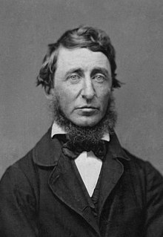
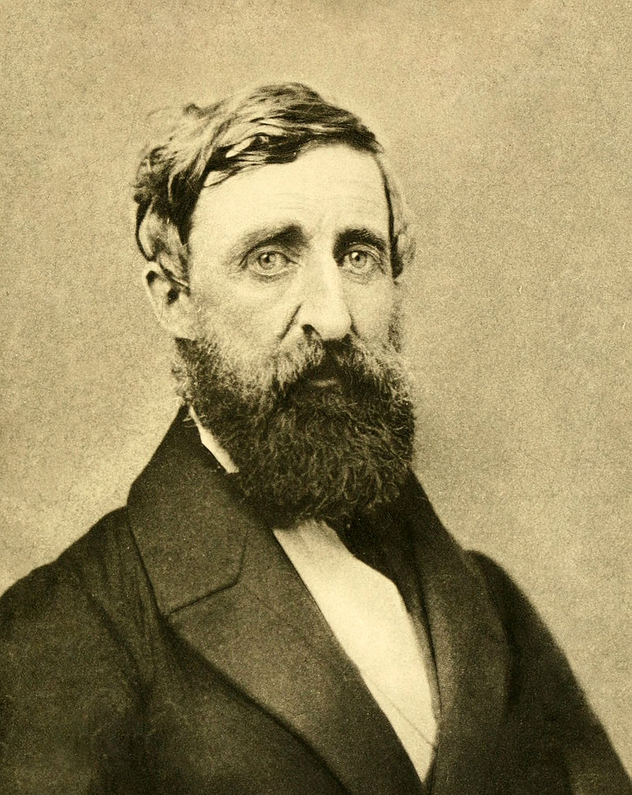
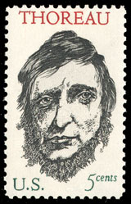
Henry David Thoreau
1817 – 1862
Thoreau in his second and final photographic sitting, 1861

Slide 16
Walden, 1854
Both Hawthorne and Thoreau spend a large amount of social and intellectual time walking, talking, even ice skating with Emerson, and they have similar foundations in Emersonian Transcendentalism. Thoreau begins his stay at Walden Pond just a few months before Hawthorne is forced to leave the Old Manse.
Thoreau lives for just over two years in relative solitude, conducting an experiment in what it means to truly live
On the pond, Thoreau has the opportunity to actually practice self-reliance, to discover what it means to provide food and shelter on his own while exploring the beauty and divinity in the natural world.

Slide 17
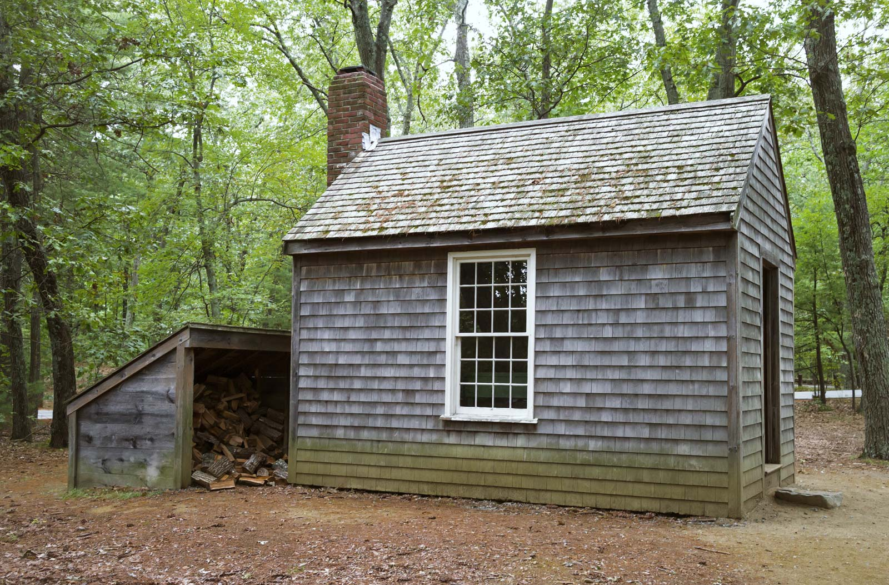
Walden, 1854 establishes a three-point analogy book, house, and narrator
the cabin as an embodiment of values
"When I wrote the following pages, or rather the bulk of them, I lived alone, in the woods, a mile from any neighbor, in a house which I had built myself, on the shore of Walden Pond, in Concord, Massachusetts, and earned my living by the labor of my hands only" (3)
"I wanted to live deep and suck out all the marrow of life, to live so sturdily and Spartan-like as to put to rout all that was not life, to cut a broad swath and shave close, to drive life into a corner, and reduce it to its lowest terms“ (81)

Slide 18
"I built it myself"
"Most of the luxuries, and many of the so-called comforts of life, are not only not indispensable, but positive hindrances to the elevation of mankind" (13).
"To be a philosopher is not merely to have subtle thoughts, nor even to found a school, but so to love wisdom as to live according to its trust. It is to solve some of the problems of life, not only theoretically, but practically" (13).
"One inconvenience I sometimes experienced in so small a house, the difficulty of getting to a sufficient distance from my guest when we began to utter the big thoughts in big words. You want room for your thoughts to get into sailing trim and run a course or two before they make their port. . . . Our sentences wanted room to unfold and form their columns in the interval" (127–128).
"I had three chairs in my house; one for solitude, two for friendship, three for society. When visitors came in larger and unexpected numbers there was but the third chair for them all, but they generally economized the room by standing up. It is surprising how many great men and women a small house will contain" (127).

Slide 19

"Resistance to Civil Government” also known as "Civil Disobedience, 1849
"I heartily accept the motto,—'That government is best which governs least;' and I should like to see it acted up to more rapidly and systematically. Carried out, it finally amounts to this, which also I believe,—'That government is best which governs not at all;' and when men are prepared for it, that will be the kind of government which they will have. [...] I ask for, not at once no government, but at once a better government."
Thoreau was a lifelong abolitionist, delivering lectures that attacked the Fugitive Slave Law (1793 and 1850) His philosophy of civil disobedience later influenced the political thoughts and actions of such figures as Leo Tolstoy, Mahatma Gandhi, and Martin Luther King Jr.

Slide 20
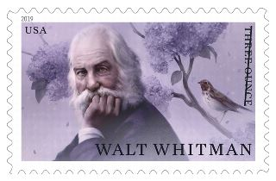
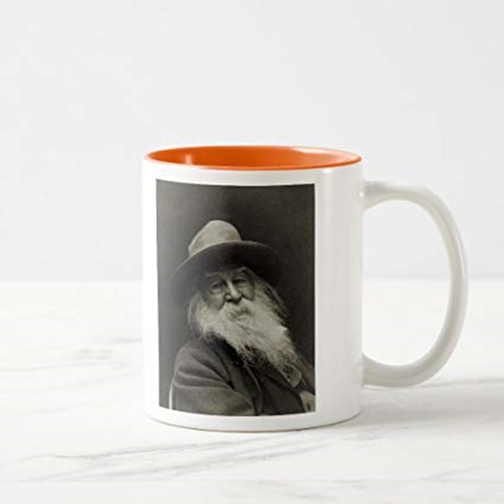

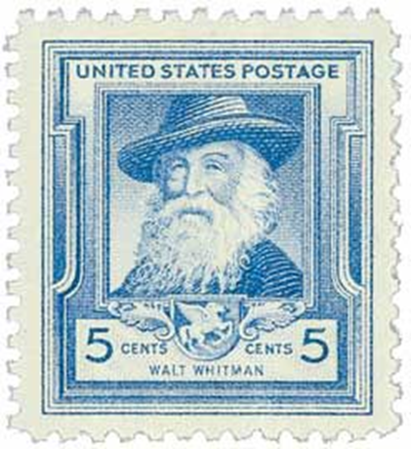
Walter Whitman, 1819 –1892
“Keep your face always toward the sunshine and shadows will fall behind you.”
“Resist much, obey little.”
“Be curious, not judgmental.”

Slide 21
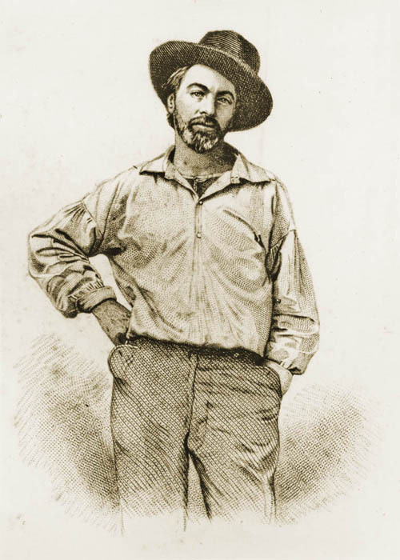
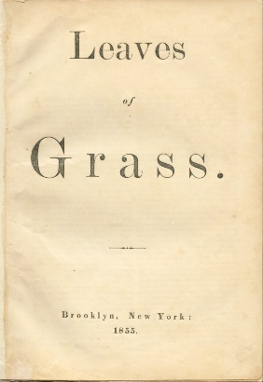
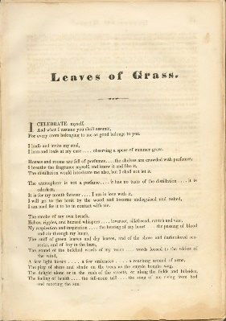
the carpenter portrait

Slide 22
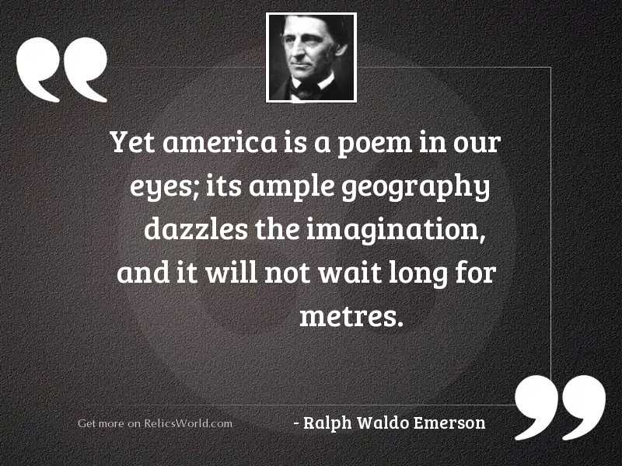

Slide 23
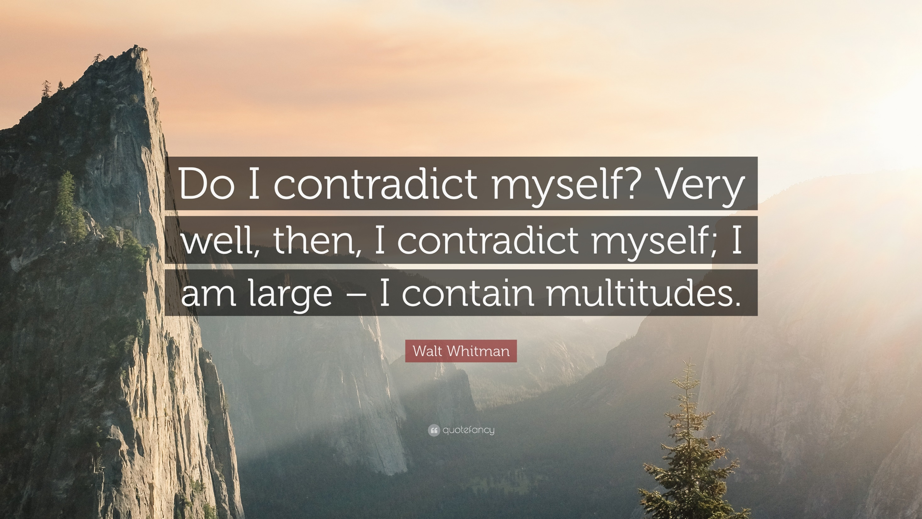
Αντιφάσκω άραγε?
Καλώς λοιπόν, αντιφάσκω,
(Eίμαι ευρύς, περιλαμβάνω πλήθη)

Slide 24
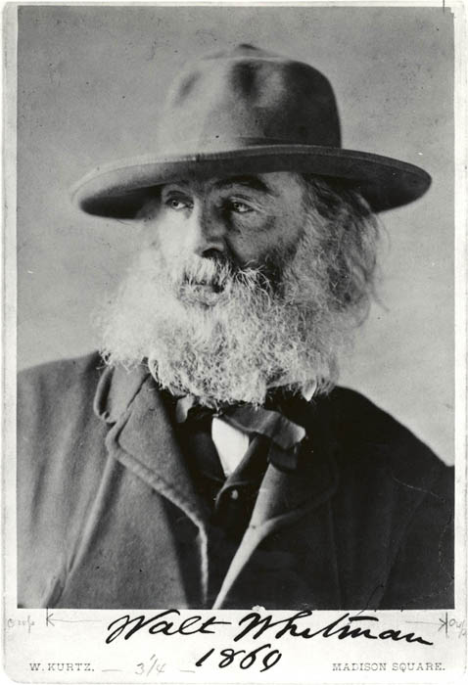
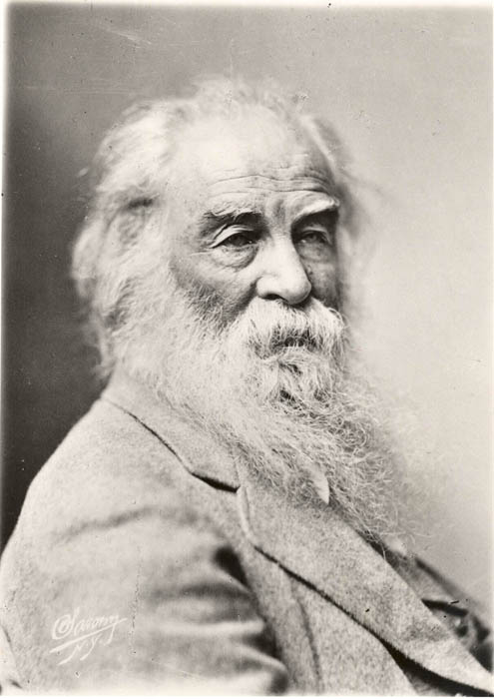
1863

Slide 25
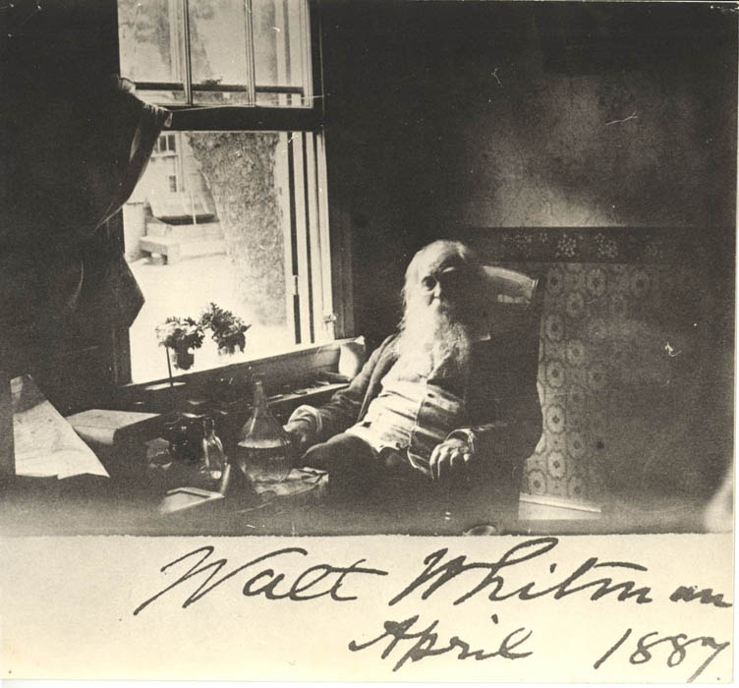

Slide 26
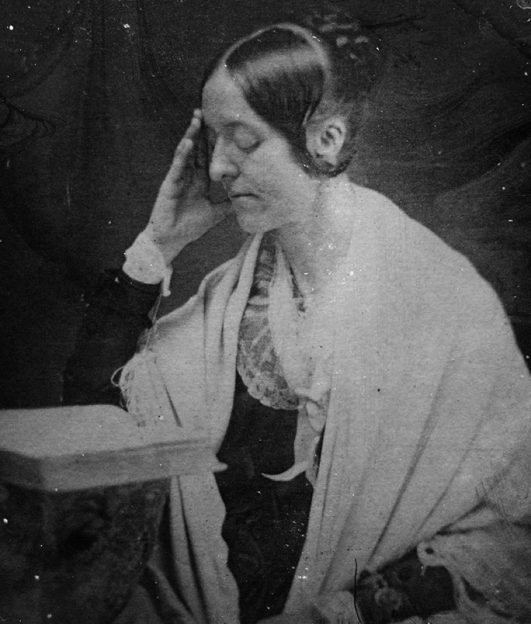
Margaret Fuller, 1810 –1850
She applied the notions of self-reliance and equality to gender roles in the first significant feminist essay in America, published in 1844 in The Dial, the Transcendentalist journal she edited and helped found in 1840. Later, the piece was expanded to the book Woman in the Nineteenth Century (1845). She then left New England scene completely to become first literary reviewer and then reporter on social issues for the New York Tribune, finally widening her circle even beyond America to become involved in the failed Italian revolution of 1848 and dying soon thereafter in a tragic shipwreck.

Slide 27
Women’s Nature and Rights
“Cult of True Womanhood”
Women socially and economically discriminated
supposed to be a symbol of moral strength and virtue,
women kept inside the domestic circle
she was depicted as delicate and fragile, prone to fainting and sickness
numerous social issues emerged
the sky rocketing population of immigrants
rapid urbanization
industrialization in the land
capitalism produced low wages and poor living conditions
the numbers of saloon increased and many men, especially poor immigrant laborers, spent their hard earned money to drink and gamble
urging for better education
men and women as “the two halves of one thought”
“I believe that the development of the one cannot be effected without that of the other. My highest wish is that this truth should be distinctly and rationally apprehended, and the conditions of life and freedom recognized as the same for the daughters and the sons.”

Slide 28
Transcendentalism was supportive of women’s rights
Hawthorne - Fuller
Emerson- Fuller
held to the idea of a woman’s moral nature and domestic role.
There appears to have been a total collapse in poor Margaret, morally and (Diaries)
Positive, respected Filler’s intellectual capacities
But his regard of feminine intuition over masculine reason &understanding reinforced conventional stereotypes of femininity and masculinity
encouraged women’s progress and the increase of their participation in society but did not question the idea that men and women have separate distinct and fundamental natures.
Fuller was both indebted to and departed from Transcendentalists

Slide 29
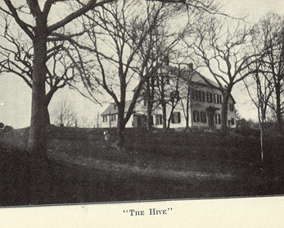
Brook Farm was based on the ideals of Transcendentalism; its founders believed that by pooling labor they could sustain the community and still have time for literary and scientific pursuits. The experiment was meant to serve as an example for the rest of the world, based on the principles of "industry without drudgery, and true equality without its vulgarity".
A founding member, Hawthorne later fictionalized his experience at Brook Farm in The Blithedale Romance.
the notion of a pastoral retreat of simplicity and cooperation confronting by example the capitalist industrialism of the larger society became fixed in the American imagination

Slide 30
The Hudson River painters :
Followed Emerson's call "to ignore the courtly Muses of Europe" and define a distinct vision for American art.
The artists who came to maturity in the years of egalitarian Jacksonian democracy and expansion translated these ideals into an aesthetic that was sweeping and spontaneous. Like the vast nation that lay before them, which they celebrated not chauvinistically but with a sense of awe for its majestic natural resources and a feeling of optimism for the huge potential it held, the Hudson River painters depicted a New World wilderness in which man, minuscule as he was beside the vastness of creation, nevertheless retained that divine spark that completed the circle of harmony.
Thomas Cole is generally acknowledged as the founder of the Hudson River School

Slide 31
Idealistic representation of nature
In the foreground stands one of the school's famous symbols--a broken tree stump-- what Cole called a "memento mori" or reminder that life is fragile and impermanent; only Nature and the Divine within the Human Soul are eternal.
Tiny as the human beings are in this composition, they are nevertheless elevated by the grandeur of the landscape in which they are in harmony. As Cole and Durand believed, if the American landscape was a new Garden of Eden, then it was they, as artists, who kept the keys of entry.
https://songofamerica.net/artists-movements-ideas/hudson-river-school/

Slide 32
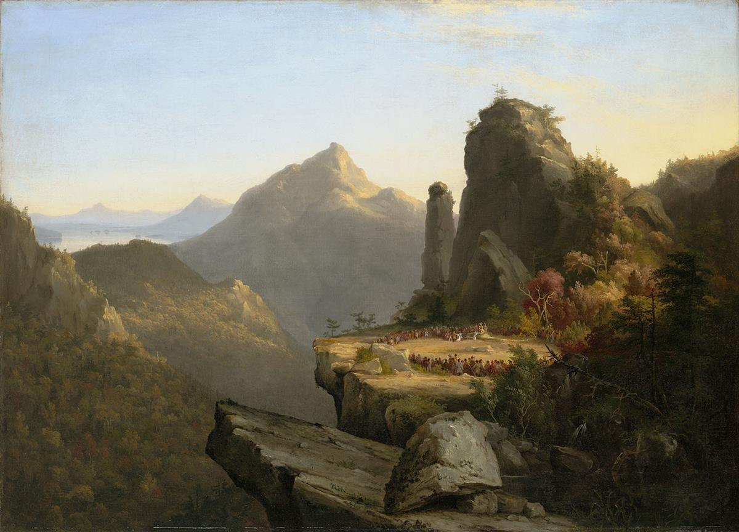
Thomas Cole,
The Last of the Mohicans
(1827)

Slide 33
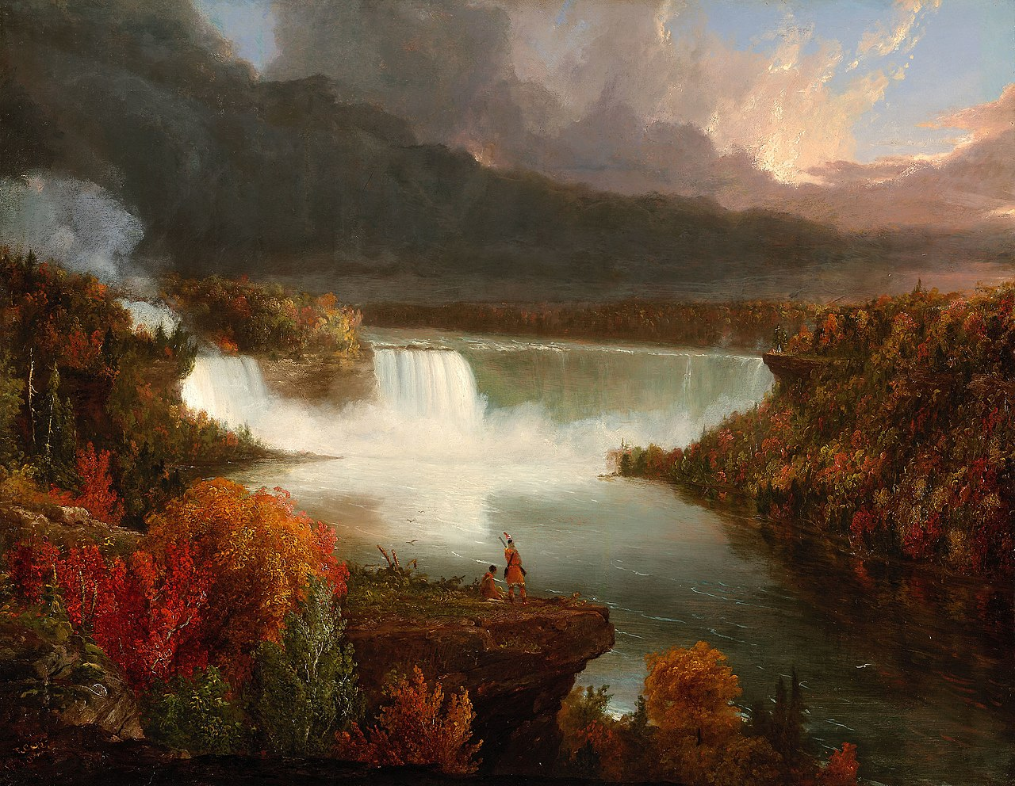
Cole, Distant View of Niagara Falls (1830)

Slide 34
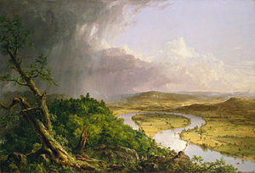
Thomas Cole , 1836
The Oxbow

Slide 35
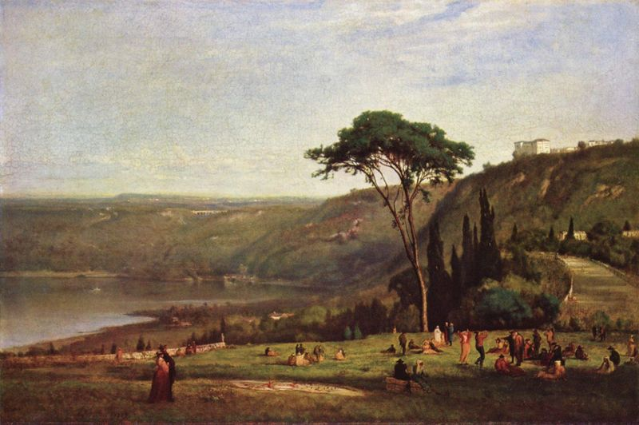
Lake Albano, 1869. Notice the composition, precision of drawing, and the emotive use of color

Slide 36
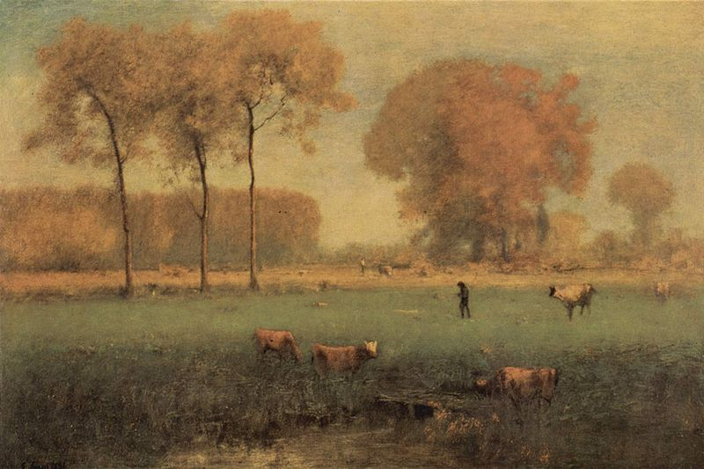
Summer Landscape, 1894. Increasingly personal, spontaneous, and often violent handling of paint

Slide 37
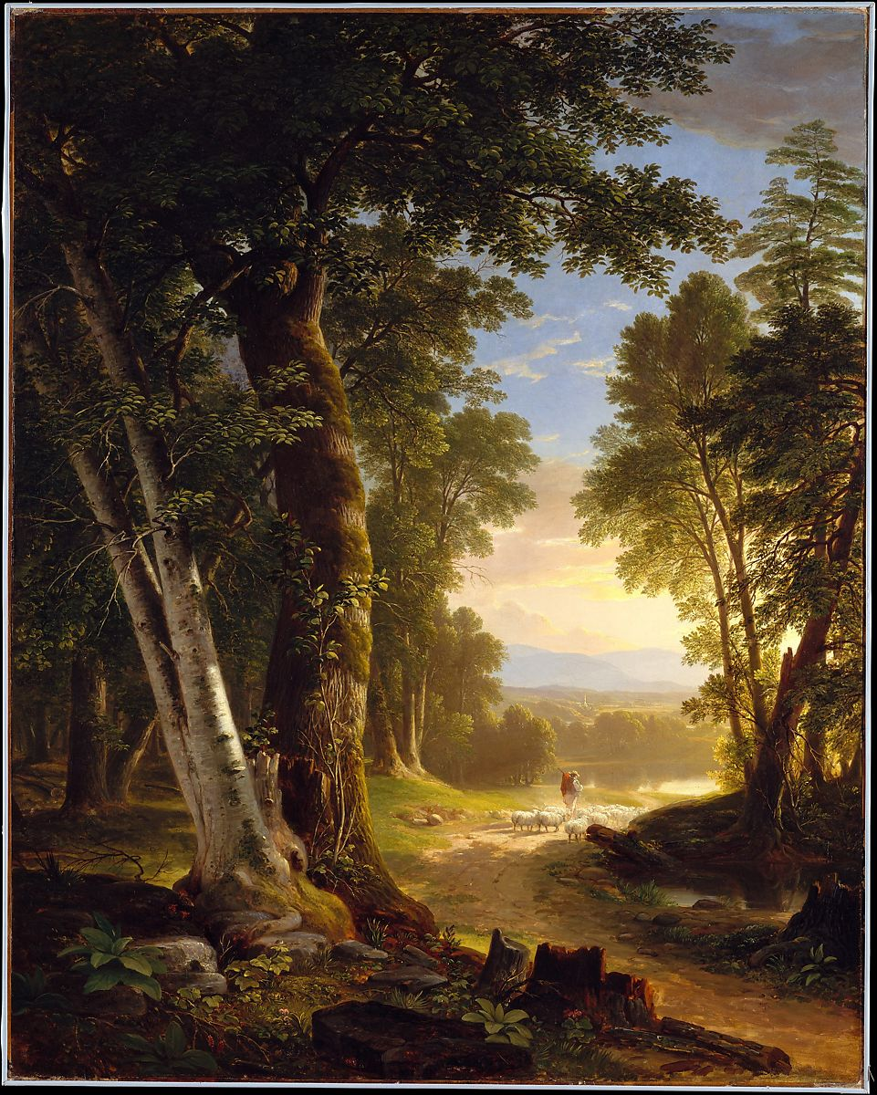
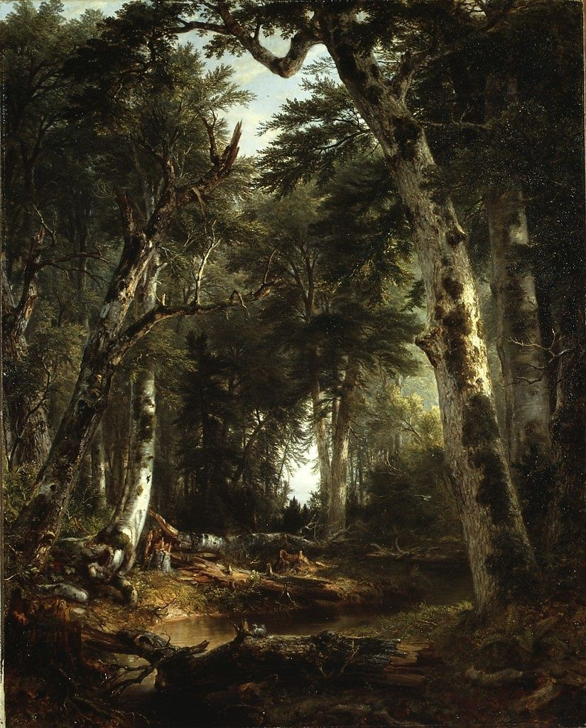
Asher Brown Durand
https://www.metmuseum.org/toah/hd/dura/hd_dura.htm

Slide 38
Anti-transcedentalism
Focused on the limitations and destructiveness of the human spirit, dark side of humanity
impossible to accept the optimistic view of the world
Could not get past puritan sin, guilt + belief of evil as a dominant force in the world
Dark and gloomy view of the world
“I do not want to be a doctor and live by man’s diseases, nor a minister to live by their sins, nor a lawyer and live by their quarrels. So, I don’t see that there is anything left for me but to be an author” Hawthorne, Letter to his wife, 1820

Slide 39
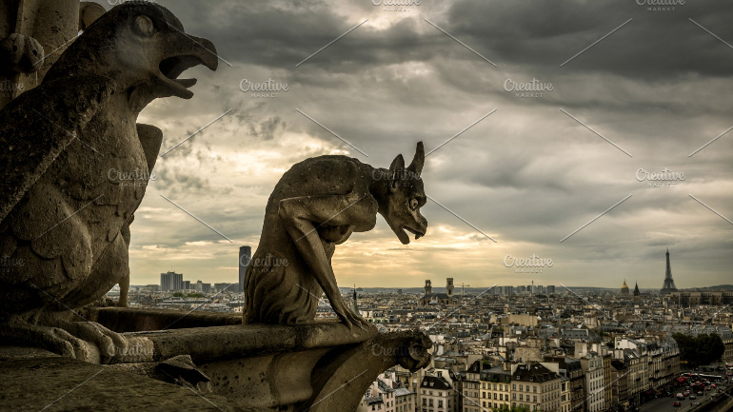
Gothic & Transcendentalist Literature
Similarities Differences
Valued intuition over reason
Saw signs and symbols in events
Spiritual facts lie behind physical appearances
Spiritual facts not necessarily good or harmless
Nature vast and incomprehensive
Focus on hero’s inner struggles
Scenes shrouded in mystery
Individuals failing in their attempts to make changes for the better

Slide 40
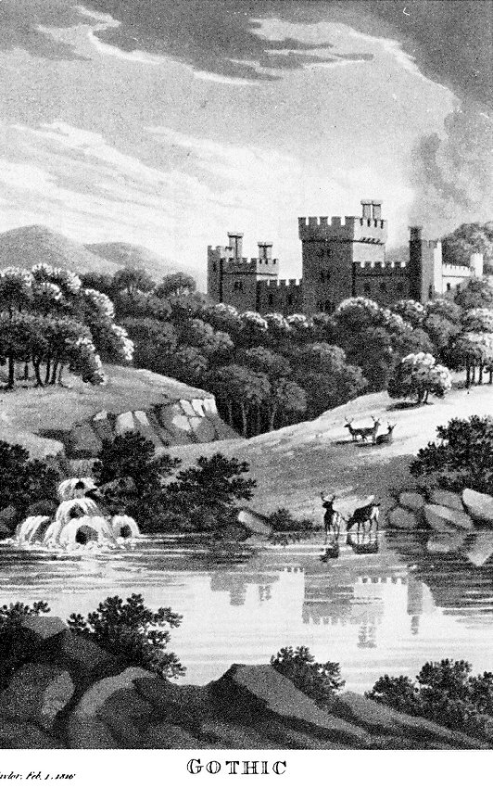
Gothic vs. Romantic Literature
importance of the individual as opposed to society’s values
questioning of the traditional authority of the ruling classes
the power of emotion and imagination
emphasis on the value of nature to evoke comfort and real communication
a striving for moral good in a generally corrupt world
less focused on character development and ideas
where the romantic novel is a middle class form, the gothic novel has always been regarded as popular, lower class fiction
emphasis on imagination, especially relating to fear, dread and the supernatural

