Slide 1
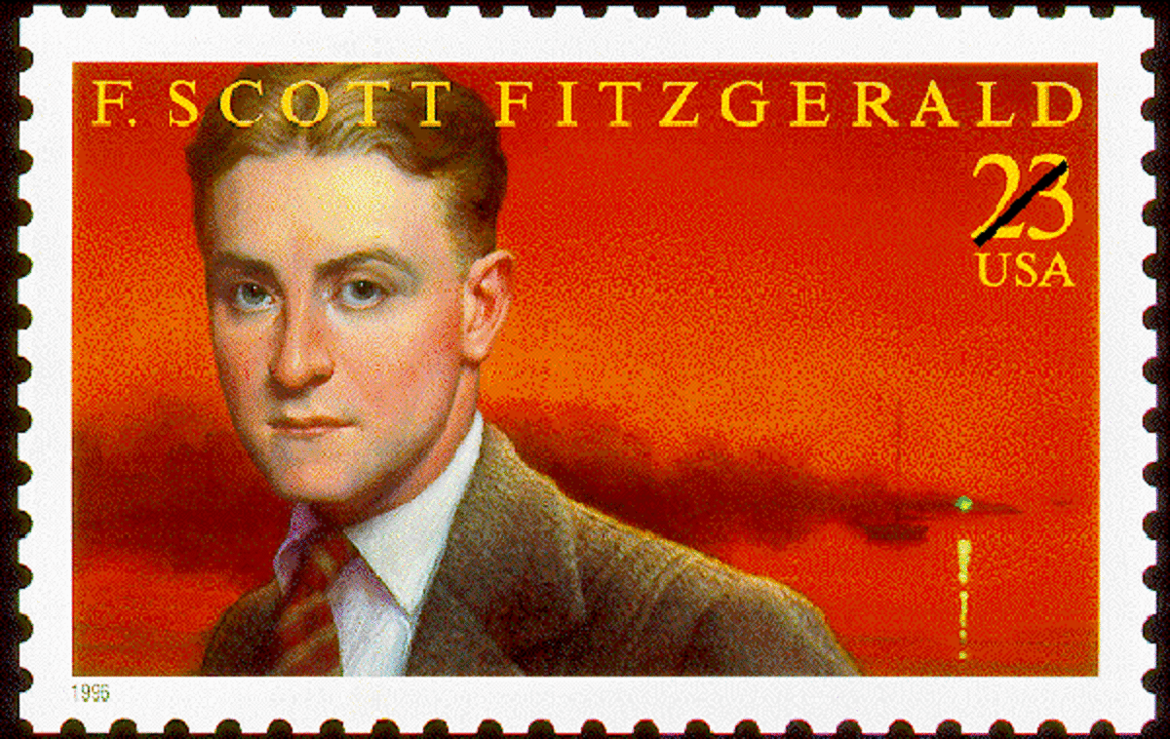

Slide 2
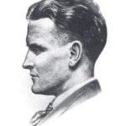
Born Sept. 24, 1896 in St. Paul, Minnesota the son of Edward Fitzgerald, owner of a furniture-making company
His alcoholism interfered with his life and work and it often required him to be hospitalized.
Suffered a heart attack and a month later he died of a second heart attack in 1940 at movie columnist Shielah Graham’s apartment in Hollywood, California while awaiting his doctor's arrival. He was 44 years of age.

Slide 3
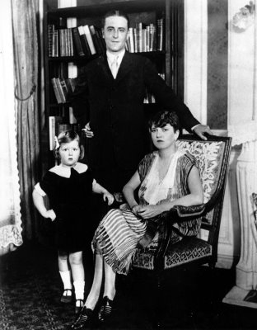
Fell in Love with Zelda Sayre
a tale of a poor writer who wanted to marry a girl from a rich family and somehow willed it to happen.
She agreed to marry him once he was a success
1920 This Side of Paradise
Instant success, Zelda marries him
Frances -daughter

Slide 4
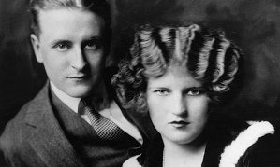

Slide 5
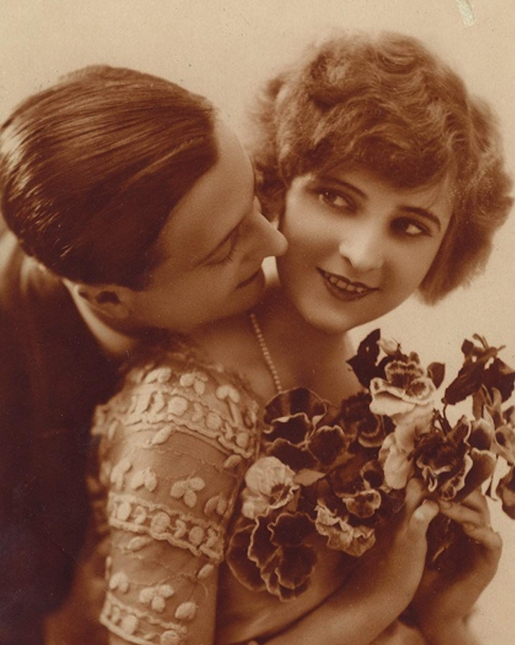
On April 3, 1920, the writer and Zelda Sayre exchanged vows at St. Patrick’s Cathedral in New York City in what would become one of the most iconic weddings of all time.
Dorothy Parker : "They did both look as though they had just stepped out of the sun; their youth was striking. Everyone wanted to meet him.“
Zelda and Scott had become icons of youth and success—enfants terribles of the Jazz Age.

Slide 6
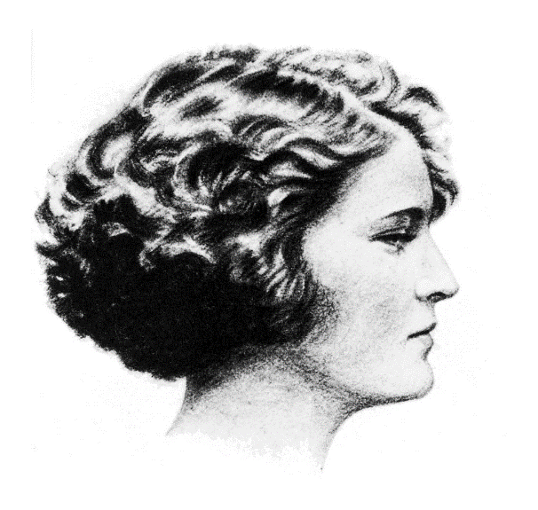
Zelda Fitzgerald (1900 – 1948)
The immediate success of Scott's first novel This Side of Paradise (1920) brought them into contact with high society, but their marriage was plagued by wild drinking, infidelity and bitter recriminations. Ernest Hemingway, whom Zelda disliked, blamed her for Scott's declining literary output. After being diagnosed with schizophrenia, she was increasingly confined to specialist clinics, and the couple were living apart when Scott died suddenly in 1940. Zelda died seven years later in a fire at the hospital in Asheville, North Carolina, in which she was a patient.

Slide 7

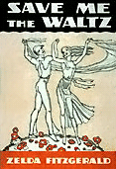

she made joking reference to the use of her diaries in Scott's work, but the lifted material became a genuine source of resentment:
It seems to me that on one page I recognized a portion of an old diary of mine which mysteriously disappeared shortly after my marriage, and, also, scraps of letters which, though considerably edited, sound to me vaguely familiar. In fact, Mr. Fitzgerald … seems to believe that plagiarism begins at home
In 1932, while being treated, Zelda had a burst of creativity. Over the course of her first six weeks at the clinic, she wrote an entire novel and sent it to Scott's publisher
When Scott finally read Zelda's book he was furious. The book was a semi-autobiographical account of the Fitzgeralds' marriage.
The failure of Save Me the Waltz, and Scott's scathing criticism of her for having written it—he called her "plagiaristic“ and a "third-rate writer"—crushed her spirits. It was the only novel she ever saw published.

Slide 8
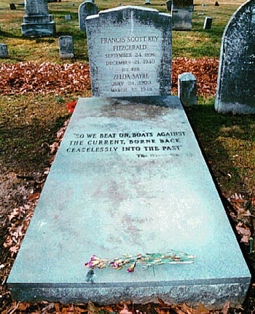
cemetery of St. Mary's Catholic Church, Rockville, Maryland
Inscription
Last line in GG:
So we beat on, boats against the current, borne back ceaselessly into the past

Slide 9
The presidency of Calvin Coolidge 1923-29
By the end of the 1920s, nearly half of the American population owned automobiles, radios, and durable consumer goods such as vacuum cleaners and washing machines. Chain stores and mail-order houses proliferated. New product offerings made their debut on the market each year, prompting companies to launch advertising and public-relations campaigns in an effort to stimulate consumption. Widespread electrification helped reduce the manufacturing costs of existing products. Consumer credit enabled many people to make purchases even before they had accumulated enough money to do so.

Slide 10
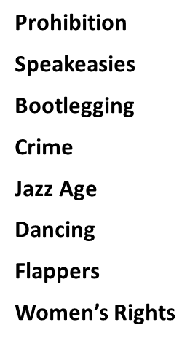
The Roaring Twenties
Main cultural features of the period:

Slide 11
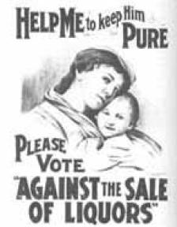
Prohibition of alcohol
The 18th Amendment (1919) to Constitution forbade the manufacture, sale, import or export of intoxicating liquors
The 21st Amendment (1933) repealed the 18th Amendment

Slide 12
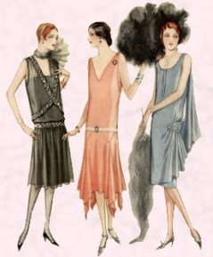
Flapper
a term applied to a "new breed“ of young Western women who wore short skirts, bobbed their hair, listened to jazz, and flaunted their disdain for what was then considered acceptable behavior. Flappers were seen as brash for wearing excessive makeup, drinking, treating sex in a casual manner, smoking, driving and flouting social and sexual norms
Zelda was dubbed by her husband as "the first American flapper

Slide 13


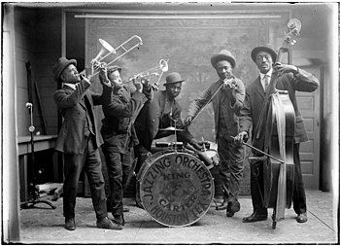
Jazz Age
a period in the 1920s and 1930s in which jazz music and dance styles rapidly gained nationwide popularity in the United States
Originating in New Orleans as a fusion of African and European music, jazz played a significant part in wider cultural changes in this period
often referred to in conjunction with the Roaring Twenties, and in the US it overlapped in significant cross-cultural ways with the Prohibition Era. The movement was largely affected by the introduction of radios nationwide.
F. Scott Fitzgerald is widely credited with coining the term, first using it in his 1922 short story collection titled Tales of the Jazz Age
became emblems of the Jazz Age, for which they are still celebrated.

Slide 14

“Urban car culture”
in 1923 Ford started the mass production of the Model T.
the era of the automobile had begun.
it was and still is a kind of status symbol to own the newest and fastest car.

Slide 15
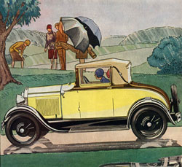
1920's Transportation Automobiles and Road
By 1925 there was one automobile for every six persons in the country (as compared to one for every one hundred in Great Britain), and by 1930 this had increased to one for every 4.6 people.

Slide 16
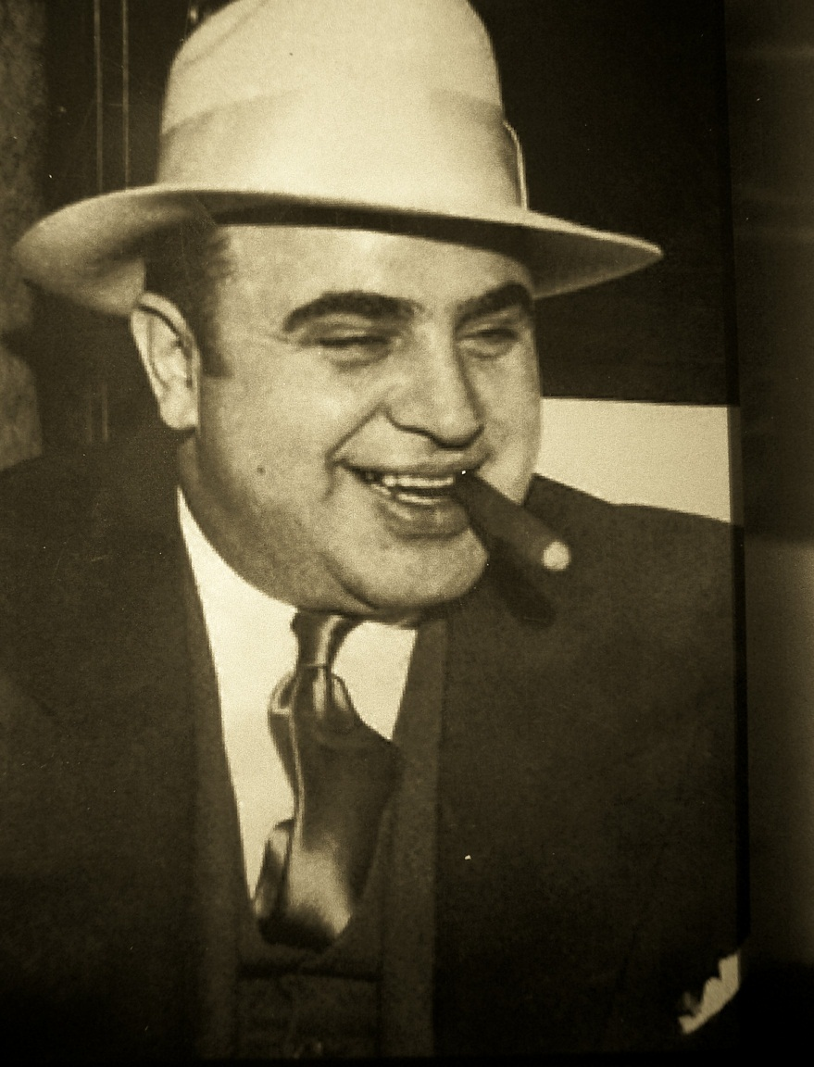
Al “Scarface” Capone
Top Chicago Gangster
promoted anti-prohibition acts.
broke the law several times for illegal booze creation, distribution, and consumption.
became an idol for liberation on the Prohibition stage
Alcohol sales
Protection business
Gambling
speakeasies

Slide 17
Al “Scarface” Capone
Top Chicago Gangster
promoted anti-prohibition acts.
broke the law several times for illegal booze creation, distribution, and consumption.
became an idol for liberation on the Prohibition stage
Alcohol sales
Protection business
Gambling
speakeasies

Slide 18
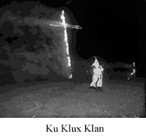
Second KKK, 1915
Founded as a small organization in Georgia. Starting in 1921, it grew rapidly nationwide at a time of prosperity. Reflecting the social tensions of urban industrialization and vastly increased immigration, its membership grew in cities, and spread to the Midwest and West out of the South. The 2nd KKK preached "One Hundred Percent Americanism" demanded the purification of politics, calling for strict morality and better enforcement of prohibition. Its appeal was directed exclusively at white Protestants. Some local groups took part in attacks on private houses and carried out other violent activities.

Slide 19
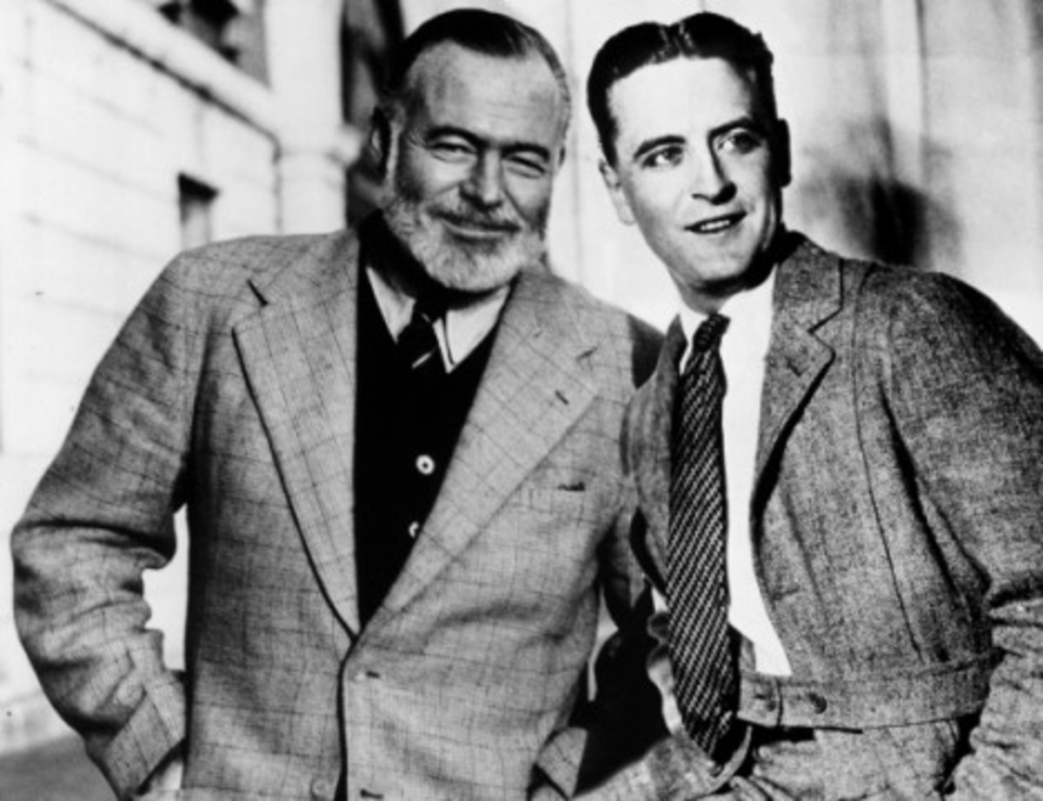
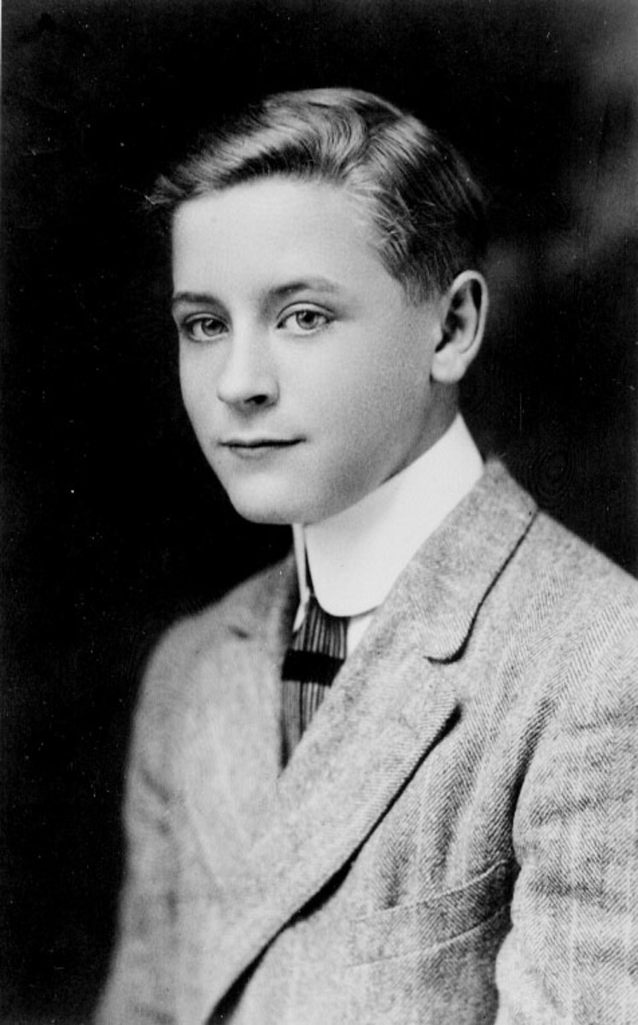

Slide 20
“The Rich Boy” 1926
“one of the best things I have ever done.”
Narrator: is far less involved with Anson Hunter than Nick Carraway is with Gatsby, and also less critical and more indulgent towards the hero.
Critique of the American rich and their inflated image of themselvesx

Slide 21
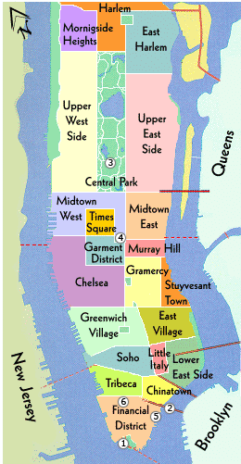
SETTING :
- the Gilded Age" (usually defined as 1870 through 1900, but sometimes expanded to the period 1865–1914).
-WWI
- Actual locations: Find in the map the locations mentioned in “The Rich Boy”

Slide 22
Characters
Self-indulgent
Alcoholic
Impatient
Emotionally lazy
Unreliable
Egocentric
Anson Hunter
Paula Legendre
Dolly Karger
Aunt Edna
Cary Sloane
narrator

Slide 23
“They are different from you and me.”
“Let me tell you about the very rich. They are different from you and me. They possess and enjoy early, and it does something to them, makes them soft where we are hard, and cynical where we are trustful, in a way that, unless you were born rich, it is very difficult to understand. “
Paula sees “two alternating personalities” within Anston.
1. “his strong, attractive presence”
2. tendency of “gross, humorous, reckless of everything but pleasure.”

Slide 24
PAULA: "I was infatuated with you, Anson--you could make me do anything you liked. But we wouldn't have been happy. I'm not smart enough for you. I don't like things to be complicated like you do." She paused. "You'll never settle down," she said.
The phrase struck at him from behind--it was an accusation that of all accusations he had never merited.
ANSON: "I could settle down if women were different," he said. "If I didn't understand so much about them, if women didn't spoil you for other women, if they had only a little pride. If I could go to sleep for a while and wake up into a home that was really mine--why, that's what I'm made for, Paula, that's what women have seen in me and liked in me. It's only that I can't get through the preliminaries any more."

Slide 25
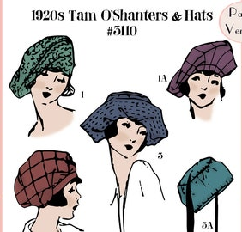
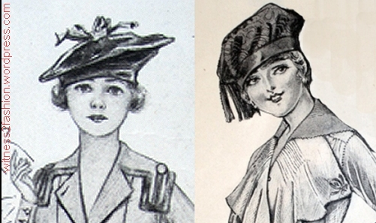

Slide 26
Why Anson cannot commit to any relationship?
What is his involvement in the illicit affair his uncle’s wife, Edna, has with Cary Sloane
What is the role of the narrator?

