Slide 1
ASSESSING WRITING
Evaluation and Testing in Language Education
Kia Karavas & Maria Stathopoulou

Slide 2
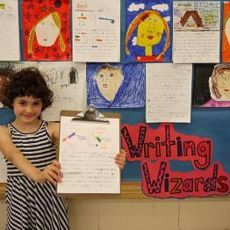
Aims of the presentation
to familiarize students with concepts related to the assessment of writing (performance based assessment, classroom based assessment, rating process, raters, evaluation criteria & grids)
to distinguish between different types of assessment tasks
to design their own tasks for
assessing written performance

Slide 3
The nature of writing ability
Defining the skill we wish to test is a critical starting point in designing a test

Slide 4
What is writing?…an act which takes place within a context
writing is a social act (socially and culturally shaped)
The purpose or function of the writing is defined by the context. This means that the features of the text may differ according to purpose
Learning to write is much more than simply learning the grammar and vocabulary of a language

Slide 5
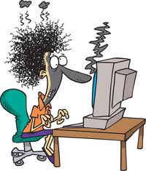
What is writing?…a cognitive activity
Encoding internal representations (ideas) into written text

Slide 6
What is a (written) text?
Texts are shaped by the social and cultural contexts in which they are produced. Text producers are influenced by a number of interrelated variables that define and characterize these contexts
a. purpose
b. text-type
c. subject matter / topic
d. role or perspective taken by the text producer
e. relationship with the intended audience
f. intended impact on the audience
g. medium through which the communication is undertaken
.
Knapp, P. and Watkins, M. 2005. Genre, text, grammar: Technologies for teaching and assessing writing. Sydney: UNSW Press.

Slide 7
Writing and foreign language teaching & testing
Teaching writing
Assessing writing

Slide 8
Writing and foreign language teaching & testing
Teaching writing
Assessing writing

Slide 9
Assessing writing skills through:
Classroom based assessment
Performance assessment through examination batteries
Assessment refers to the variety of ways used to collect information on a learner’s language ability or achievement. It is therefore an umbrella term which includes such diverse practices as once-only class tests, short essays, long project reports, writing portfolios, or large-scale standardized examinations (Hyland, 2003)

Slide 10
Achieving validity in writing assessment
Validity refers to whether the test actually measures what it is supposed to measure
If a test has content validity, we have enough language to make a judgement about the student’s ability. So if a writing test is to have content validity, we need to be confident we have asked the student to do enough writing to display their writing skills

Slide 11
INSTRUMENT: Designing writing tests & tasks
a) Test purpose (test specifications and can-do statements, target population)
c) Task characteristics
Test paper
Task

Slide 12
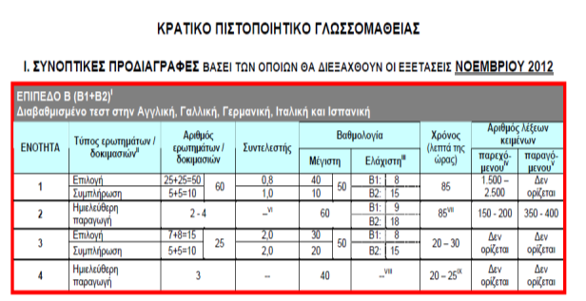
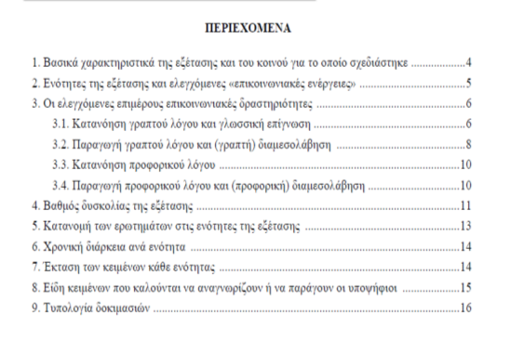
a1) Specifications
Test level
Description of the test content (number of activities, types of activities, types of texts)
Criteria for evaluation
KPG specifications
http://rcel.enl.uoa.gr/kpg

Slide 13
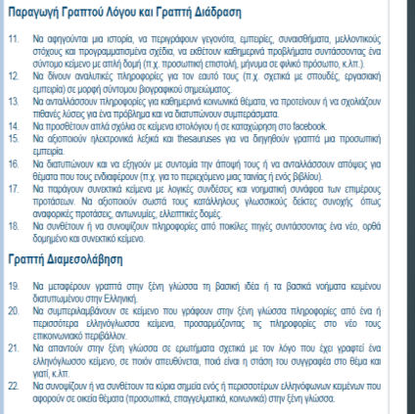
a2) Can-do statements
What types of skills and competences are assessed at each level?
EPS-XG , C1 level
http://rcel.enl.uoa.gr/xenesglosses

Slide 14
b) Task design: basic considerations (1)
Type of task: Controlled, guided or semi-guided?
Topics
Text type and function
Time allotment
Rubrics (or instructions): specify how the test taker is expected to perform
Stimulus material (visual, writing prompt): the stimulus the student must respond to.
DO TASK 1

Slide 15
b) Task design: basic considerations (2)
Expected response: what the teacher intends students to do with the task.
Post-task evaluation: assessing the effectiveness of the assessment task:
Did the task discriminate well among the student group?
Were the products easy to read and evaluate?
Were students able to write to their potential?
Adapted from Reid and Kroll (1995: 35)

Slide 16
Guidelines for the preparation of effective writing tasks
DO TASK 2
The content should be accessible to students, feasible given their knowledge and abilities
The language used should be unambiguous and comprehensible.
The task should be sufficiently focused to allow for completion in the given time and length.
The task should draw on and extend students’ knowledge of the genre and the topic.
The task should require a specific and relevant genre and indicate a specific audience.
There should be clear evaluation criteria so that students know how their work will be assessed
Reid and Kroll (1995)

Slide 17
How to select texts for writing tasks?
Texts should come from a wide variety of sources and discourse environments (articles, letters and emails, informative texts from different types of leaflets, instruction-manual texts, maps with commentaries, lyrics, book announcements, webpage texts, etc.
should be close to students’ interests and needs
Avoid texts:
with ‘sensitive’ issues, such as a description of a fatal accident,
with comments that might be perceived as politically incorrect or offensive
which stereotype ethnic groups and promote values of ethnicism, sexism, nationalism, linguicism, etc.
that are not well written, confusing, or incoherent
that outline many different basic subjects without focusing on something specific
are written in language that is either too difficult or too easy,
are too long and would require too much processing

Slide 18
FROM TASK DESIGN TO THE RATING PROCESS: ASPECTS OF RATING
‘reliability refers to the consistency with which a sample of student writing is assigned the same rank or score after multiple ratings by trained evaluators’ (Ferris & Hedgcock 1998: 230)
For example:
if we’re marking an essay out of 20, the test will be far more reliable if 2 markers both award an essay the same grade (or more or less the same grade), say 16 or 17. However, if 1 marker awards 10 and the other awards 15, the test isn’t reliable.
The obvious way to try to achieve reliability is by designing criteria (e.g. for content, organization, grammar, etc.) which the markers refer to when they’re marking the essay

Slide 19
From task design to the rating process: aspects of rating
Rating scale & grading
Rating process
Rating conditions (setting, pen-and-paper vs. electronic tests, time)
Rater characteristics
Rater training
(Weir 2005)

Slide 20
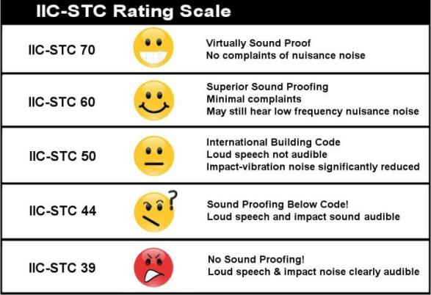
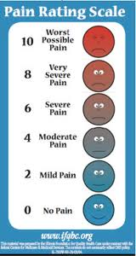
RATING SCALES
A rating scale is a set of categories designed to elicit information about an attribute

Slide 21
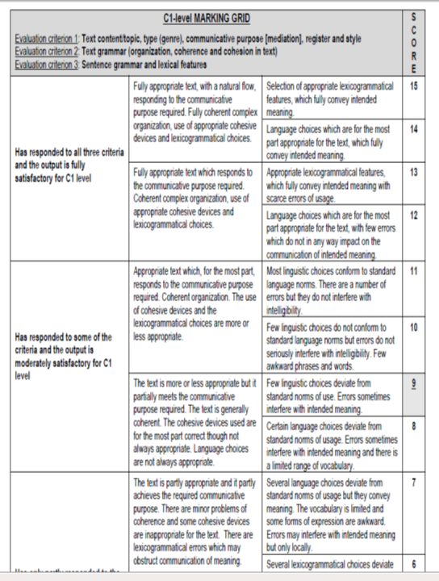
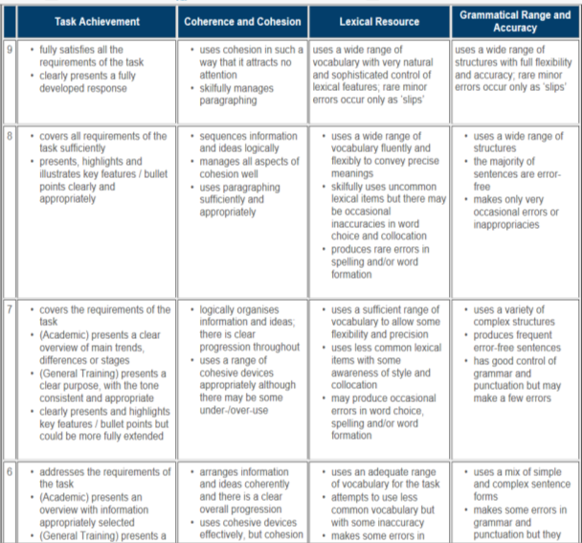
Evaluation criteria
Descriptor

Slide 22
Holistic scoring
Holistic scoring means that the assessor assesses the text generally, rather than focusing on 2 or 3 specific aspects
The idea is that the assessor quickly reads through a text, gets a global impression, and awards a grade accordingly
The holistic approach is supposed to respond to the writing positively, rather than negatively focusing on the things the writer has failed to do

Slide 23
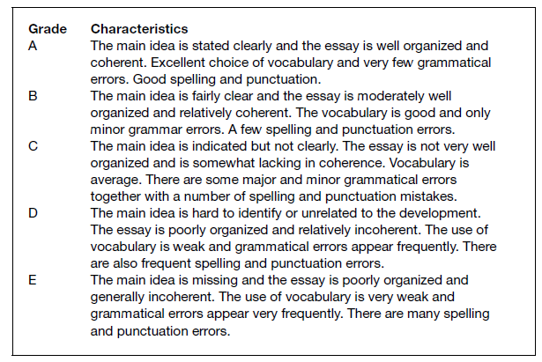
Types of scales: Holistic scoring
Intermediate learners, Hyland, 2003: 228

Slide 24
Holistic scoring is…
Quick and easy, because there are few categories for the teacher to choose from
BUT
can’t provide the writing teacher with diagnostic information about students’ writing, because it doesn’t focus on tangible aspects of writing (e.g. organization, grammar, etc.) A single score can be difficult to interpret for both teachers and students (‘What does 70% actually mean?’ ‘What did I do well?’ ‘What did I do badly?’)

Slide 25
Holistic scoring
Even though assessors are supposed to assess a range of features in holistic scoring (e.g. style, content, organization, grammar, spelling, punctuation, etc.), this isn’t easy to do. So some assessors may (consciously or unconsciously) value 1 or 2 of these criteria as more important than the others, and give more weighting to these in their scores (Lumley & McNamara 1995; McNamara 1996).

Slide 26
Analytic scoring
Analytic scoring separates different aspects of writing (e.g. organization, ideas, spelling) and grades them separately

Slide 27
Analytic scoring
Analytic schemes provide learners with much more meaningful feedback than holistic schemes. Teachers can hand students’ essays back with the criteria (e.g. marks out of 10 for organization, spelling, etc.) circled which the writing was awarded
Analytic schemes can be designed to reflect the priorities of the writing course. So, for instance, if you have stressed the value of good organization on your course, you can weight the analytic criteria so that organization is worth 60% of the marks

Slide 28
Analytic scoring
Because assessors are assessing specific criteria, it’s easier to train them than assessors who are using holistic schemes (Cohen 1994; McNamara 1996; Omaggio Hadley 1993; Weir 1990)
Analytic assessment is more dependable than holistic assessment (Jonsson & Svingby, 2007: 135)

Slide 29
Disadvantages of analytic scoring
Each of the scales may not be used separately (even though they should be). So, for instance, if the assessor gives a student a very high mark for the ‘ideas’ scale, this may influence the rest of the marks they award the student on the other scales
Descriptors for each scale may be difficult to use (e.g. ‘What does ‘adequate organization’ mean?’)

Slide 30
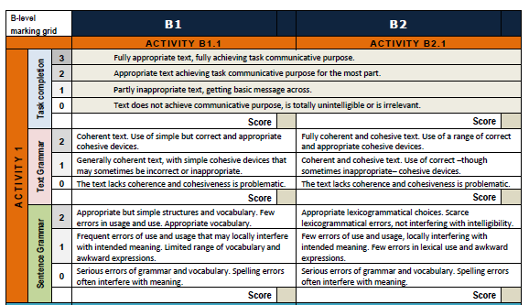
Types of scales: Analytic scoring
KPG exams, B level

Slide 31
Developing evaluation criteria
The description of tasks in terms of their characteristics and requirements is an important aspect when it comes to develop evaluation criteria or to mark learners’ scripts
Task characteristics (text length, time constraints etc)
Task requirements (what learners/candidates are expected to do)
TASK
Performance
Evaluation criteria

Slide 32
An example of task expectations
You are an advice columnist in an e-newspaper addressed to teens. Write an answer to a young man (“The Loner”), who asked for help because he is constantly arguing with his father, who keeps telling him to go out and make friends. The “loner” tells you he’s perfectly happy surfing the net, studying, speaking to imaginary friends…! In your advice letter, explain why friends are very important for young people, using the clues below (100 words).
CLUES
Feel accepted
Someone to confide in
Share experiences/things
Someone to count on for advice

Slide 33
Expectations regarding output
Criterion 1: Task Completion
Assuming the role of an advice columnist, candidates are expected to produce an advice letter (genre), responding to a young man (“The Loner”), who has asked for advice given that he is in bad terms with his father, who is always trying to get him to go out and be with friends, rather than stay home all day and surf the net. In the letter, they may try to explain to “the Loner” why it is important for young people to make friends. Although they are asked to use the clues provided, they may also include their own ideas regarding this topic. The tone of their scripts should be personal and direct (register & style).
Criterion 2: Text Grammar
Candidates’ scripts are expected to have the main body, an opening and a closing remark in one or two paragraphs. A concluding remark encouraging the addressee to go out and make friends is ideally expected. Ideas among paragraphs should be cohesively and coherently linked. A few simple and appropriate linking devices within and across sentences are expected.

Slide 34
Expectations regarding output
Criterion 3: Sentence Grammar
The choice of vocabulary and grammar should be conducive to the communicative purpose of the text. Candidates are expected to use argumentative language since they have to try to convince the young man that going out with friends spending is far better than spending time alone at home(e.g., one reason why we need friends….). Expressions appropriate to giving advice (It is important that…, you should..,) are also expected, as well as simple grammatical structures (most likely referring to the present).

Slide 35
Classroom based assessment: some basic considerations
ongoing or final?
In-class or out-of-class?
Focused on writing as an independent language skill or integrated with other language tasks?
Grading on analytic or holistic scales?

Slide 36
Dr Maria Stathopoulou
mastathop@enl.uoa.gr

