Slide 1
Poets of the American Grain: Chicago, the Harlem Renaissance, and New England
Carl Sandburg, Langston Hughes, Gwendolyn Brooks, Robert Frost

Slide 2
Robert Frost, “The Gift Outright”
The Gift Outright
The land was ours before we were the land’s.
She was our land more than a hundred years
Before we were her people. She was ours
In Massachusetts, in Virginia,
But we were England’s, still colonials,
Possessing what we still were unpossessed by,
Possessed by what we now no more possessed.
Something we were withholding made us weak
Until we found out that it was ourselves
We were withholding from our land of living,
And forthwith found salvation in surrender.
Such as we were we gave ourselves outright
(The deed of gift was many deeds of war)
To the land vaguely realizing westward,
But still unstoried, artless, unenhanced,
Such as she was, such as she would become.
https://www.poetryfoundation.org/poems/53013/the-gift-outright
https://poemanalysis.com/robert-frost/the-gift-outright

Slide 3
Robert Frost, “Fire and Ice”
Fire and Ice
Some say the world will end in fire,
Some say in ice.
From what I’ve tasted of desire
I hold with those who favor fire.
But if it had to perish twice,
I think I know enough of hate
To say that for destruction ice
Is also great
And would suffice.
https://www.poetryfoundation.org/poems/44263/fire-and-ice

Slide 4
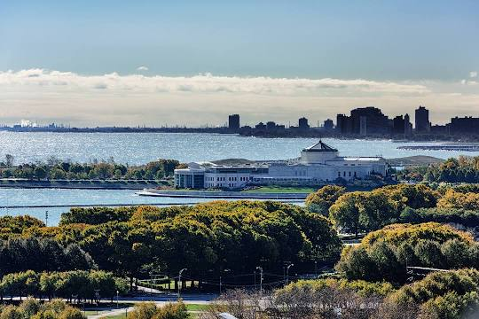
Fog

Slide 5
Fog
The fog comes
on little cat feet.
It sits looking
over harbor and city
on silent haunches
and then moves on.

Slide 6
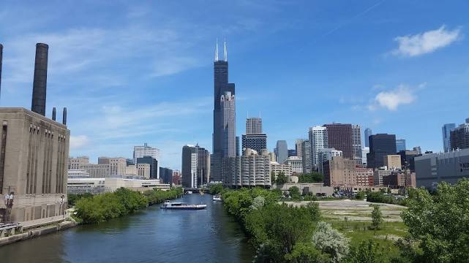
Carl Sandburg, “Chicago”
https://www.sps186.org/downloads/basic/370876/WEBQUEST_Chicago_CarlSandburg.pdf

Slide 7
Carl Sandburg Chicago
Hog Butcher for the World,
Tool Maker, Stacker of Wheat,
Player with Railroads and the Nation's Freight Handler;
Stormy, husky, brawling,
City of the Big Shoulders:
They tell me you are wicked and I believe them, for I have seen your painted women under the gas lamps luring the farm boys.
And they tell me you are crooked and I answer: Yes, it is true I have seen the gunman kill and go free to kill again.
And they tell me you are brutal and my reply is: On the faces of women and children I have seen the marks of wanton hunger.
And having answered so I turn once more to those who sneer at this my city, and I give them back the sneer and say to them:
Come and show me another city with lifted head singing so proud to be alive and coarse and strong and cunning.

Slide 8
Chicago cont/d
Flinging magnetic curses amid the toil of piling job on job, here is a tall bold slugger set vivid against the little soft cities;
Fierce as a dog with tongue lapping for action, cunning as a savage pitted against the wilderness,
Bareheaded,
Shoveling,
Wrecking,
Planning,
Building, breaking, rebuilding,
Under the smoke, dust all over his mouth, laughing with white teeth,
Under the terrible burden of destiny laughing as a young man laughs,
Laughing even as an ignorant fighter laughs who has never lost a battle,
Bragging and laughing that under his wrist is the pulse, and under his ribs the heart of the people,
Laughing!
Laughing the stormy, husky, brawling laughter of Youth, half-naked, sweating, proud to be Hog Butcher, Tool Maker, Stacker of Wheat, Player with Railroads and Freight Handler to the Nation.

Slide 9
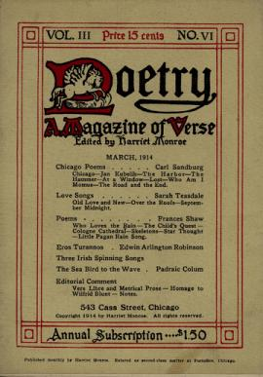
Poetry Magazine

Slide 10
Carl Sandburg, “Fog”
https://www.poetryfoundation.org/poems/45032/fog-56d2245d7b36c

Slide 11
Langston Hughes, “The Negro Speaks of Rivers”
I’ve known rivers:
I’ve known rivers ancient as the world and older than the flow of human blood in human veins.
My soul has grown deep like the rivers.
I bathed in the Euphrates when dawns were young.
I built my hut near the Congo and it lulled me to sleep.
I looked upon the Nile and raised the pyramids above it.
I heard the singing of the Mississippi when Abe Lincoln went down to New Orleans, and I’ve seen its muddy bosom turn all golden in the sunset.
I’ve known rivers:
Ancient, dusky rivers.
My soul has grown deep like the rivers.
https://www.poetryfoundation.org/poems/44428/the-negro-speaks-of-rivers
https://www.poetryfoundation.org/articles/88972/langston-hughes-101

Slide 12
Gwendolyn Brooks, To the Diaspora
you did not know you were Afrika
When you set out for Afrika
you did not know you were going.
Because
you did not know you were Afrika.
You did not know the Black continent
that had to be reached
was you.
I could not have told you then that some sun
would come,
somewhere over the road,
would come evoking the diamonds
of you, the Black continent--
somewhere over the road.
You would not have believed my mouth.

Slide 13
To the Diaspora cont/d
When I told you, meeting you somewhere close
to the heat and youth of the road,
liking my loyalty, liking belief,
you smiled and you thanked me but very little believed me.
Here is some sun. Some.
Now off into the places rough to reach.
Though dry, though drowsy, all unwillingly a-wobble,
into the dissonant and dangerous crescendo.
Your work, that was done, to be done to be done to be done.

Slide 14
Gwendolyn Brooks, “The Last Quatrain of the Ballad of Emmet Till”
(after the murder,
after the burial)
Emmett's mother is a pretty-faced thing;
the tint of pulled taffy.
She sits in a red room,
drinking black coffee.
She kisses her killed boy.
And she is sorry.
Chaos in windy grays
through a red prairie.

