Slide 1
MLA 8th Edition Formatting and Style Guide

Slide 2
MLA (Modern Language Association)
MLA Style formatting is used in humanities disciplines.
The style of documentation outlined in the 8th edition serves the needs of students who are writing research papers, as well as scholars who publish professionally.
MLA format provides writers with a uniform format for document layout and documenting sources. Proper MLA style shows that writers are conscientious of the standards of writing in their respective disciplines.
Properly documenting sources also ensures that an author is not plagiarizing.

Slide 3
In addition to the handbook, MLA also offers The MLA Style Center, a website that provides additional instruction and resources for writing and formatting academic papers. https://style.mla.org/

Slide 4
MLA regulates:
document format
in-text citations
works-cited list

Slide 5
This presentation will cover:
  How to format a paper in MLA style (8th ed.)
    General guidelines
    First page format
    Section headings
  In-text citations
    Formatting quotations
  Documenting sources in MLA style (8th ed.)
    Core elements
    List of works cited

Slide 6
Basic rule for any formatting style:
Always
Follow your instructor’s
guidelines
Many instructors who require their students to use MLA formatting and citation style have small exceptions to different MLA rules. Every bit of instruction and direction given in this presentation comes with this recommendation: ALWAYS follow the specific instructions given by your instructor.
Notes:
Many instructors who require their students to use MLA formatting and citation style have small exceptions to different MLA rules. Every bit of instruction and direction given in this presentation comes with this recommendation: ALWAYS follow the specific instructions given by your instructor.

Slide 7
Format: General Guidelines
  Double-space everything (including heading, block quotations, footnotes/endnotes, list of works cited)
  Use 12 pt. Times New Roman font
  Leave only one space after punctuation
  Set all margins to 1 inch (2.54 cm) on all sides
  Indent the first line of paragraphs one half-inch (1,27 cm)
Notes:
Indent the first line of paragraphs one half-inch from the left margin. MLA recommends that you use the Tab key as opposed to pushing the Space Bar five times.

Slide 8
Format: General Guidelines
An MLA Style paper should:
Have a header with page numbers located in the upper right-hand corner
Use italics for titles
Place endnotes on a separate page before the list of works cited. (Title the section Notes.)

Slide 9
Formatting the 1st Page
Have no title page (unless it is requested)
Double space everything
List your name, your instructor's name, the course, and date in the upper left-hand corner
Center the paper title (use standard caps but no underlining, italics, quote marks, or bold typeface) (not in all capital letters)
Create a header in the upper right corner at half inch from the top and one inch from the right of the page (list your last name and page number here)
Note: Your instructor may ask that you omit last name/page number header on your first page. Always follow instructor guidelines.)
Notes:
･Use quotation marks and/or italics when referring to other works in your title, just as you would in your text.
･Create a header in the upper right-hand corner that includes your last name, followed by a space with a page number; number all pages consecutively with Arabic numerals (1, 2, 3, 4, etc.), one-half inch from the top and flush with the right margin.
(Note: Your instructor or other readers may ask that you omit last name/page number header on your first page. Always follow instructor guidelines.)

Slide 10
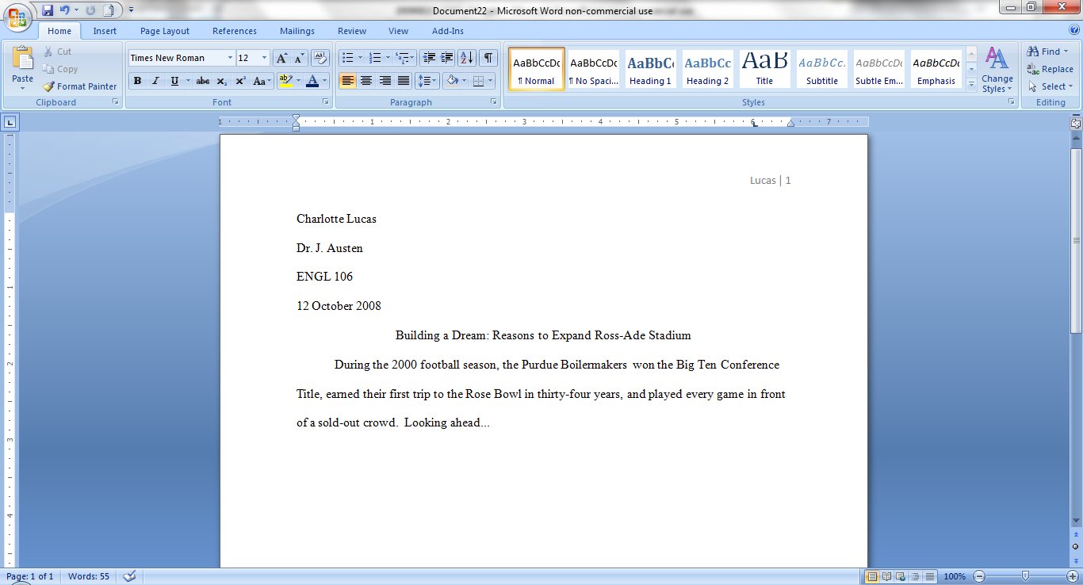
Sample 1st Page
Notes:
･Do not make a title page for your paper unless specifically requested
･In the upper left-hand corner of the first page, list your name, your instructor's name, the course, and the date. Again, be sure to use double-spaced text.
･Double space again and center the title.
Do not underline, italicize, or place your title in quotation marks; write the title in Title Case (standard capitalization), not in all capital letters.
･Use quotation marks and/or italics when referring to other works in your title, just as you would in your text: Fear and Loathing in Las Vegas as Morality Play; Human Weariness in “After Apple Picking“
･Double space between the title and the first line of the text.
･Create a header in the upper right-hand corner that includes your last name, followed by a space with a page number; number all pages consecutively with Arabic numerals (1, 2, 3, 4, etc.), one-half inch from the top and flush with the right margin. (Note: Your instructor or other readers may ask that you omit last name/page number header on your first page. Always follow instructor guidelines.)

Slide 11
Formatting Section Headings
    Writers sometimes use Section Headings to improve a document’s readability. These sections may include individual chapters or other named parts of a book or essay.
Section Headings are generally optional:
  Headings in an essay should usually be numbered
  Headings should be consistent in grammar and formatting
Notes:
Essays
MLA recommends that when you divide an essay into sections that you number those sections with an Arabic number and a period followed by a space and the section name.
Books
MLA does not have a prescribed system of headings for books. If you are only using one level of headings, meaning that all of the sections are distinct and parallel and have no additional sections that fit within them, MLA recommends that these sections resemble one another grammatically. For instance, if your headings are typically short phrases, make all of the headings short phrases (and not, for example, full sentences). Otherwise, the formatting is up to you. It should, however, be consistent throughout the document.
If you employ multiple levels of headings (some of your sections have sections within sections), you may want to provide a key of your chosen level headings and their formatting to your instructor or editor.

Slide 12
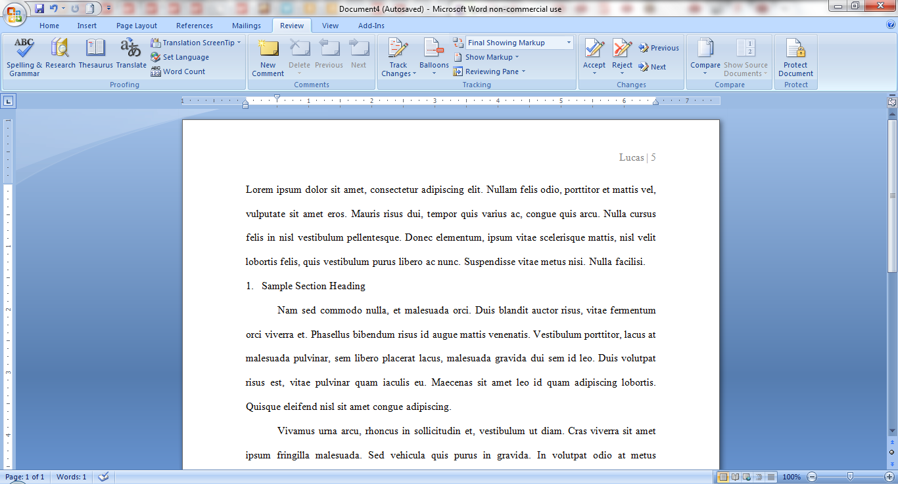
Sample Section Headings
Numbered (all flush left with no underlining, bold, or italics):
Example:
1. Soil Conservation
1.1 Erosion
2. Water Conservation
3. Energy Conservation

Slide 13
In-Text Citations: Basic Rules
An in-text citation is a brief reference in your text that indicates the source you consulted.
It should direct readers to the entry in your works-cited list for that source.
a natural pause to your text: provide the citation information without interrupting your own text.
In general, the in-text citation will be the author’s last name (or abbreviated title) with a page number, enclosed in parentheses.
Notes:
Any source information that you provide in-text must correspond to the source information on the works-cited page. More specifically, whatever signal word or phrase you provide to your readers in the text, must be the first thing that appears on the left-hand margin of the corresponding entry in the works-cited list (so the author’s last name or the title, usually, with no punctuation in between)

Slide 14
In-Text Citations: Basic Rules
“Quote when you can't say it any better than the author did, but paraphrase when you can.”

Slide 15
Author-Page Style
    MLA format follows the author-page method of in-text citation.
    This means that the author's last name and the page number(s) from which the quotation or paraphrase is taken must appear in the text, and a complete reference should appear in your works-cited page.
    The author's name may appear either in the sentence itself or in parentheses following the quotation or paraphrase, but the page number(s) should always appear in the parentheses, not in the text of your sentence.

Slide 16
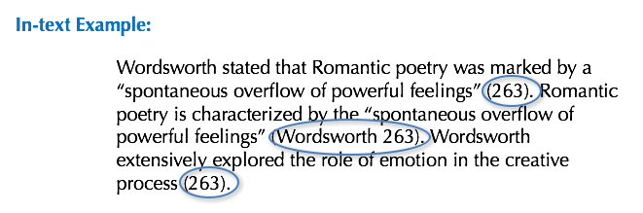
Author-Page Style
Wordsworth, William. Lyrical Ballads. Oxford UP, 1967.
Notes:
In-Text Citations: Author-Page Style
MLA format follows the author-page method of in-text citation. This means that the author's last name and the page number(s) from which the quotation or paraphrase is taken must appear in the text, and a complete reference should appear in your works-cited page. The author's name may appear either in the sentence itself or in parentheses following the quotation or paraphrase, but the page number(s) should always appear in the parentheses, not in the text of your sentence.
The both citations in the in-text examples on this slide, (263) and (Wordsworth 263), tell readers that the information in the sentence can be located on page 263 of a work by the author, William Wordsworth. If readers want more information about this source, they can turn to the works-cited list, where, under Wordsworth, they would find the information in the corresponding entry also shown on this slide.

Slide 17
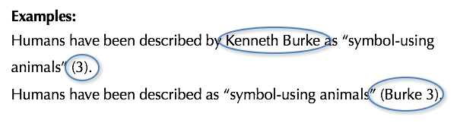
Print Source with Author
For the following print source
Burke, Kenneth. Language as Symbolic Action: Essays on Life, Literature, and Method. U of California P, 1966.
If the essay provides a signal word or phrase—usually the author’s last name—the citation does not need to also include that information.

Slide 18
Citing Works With Multiple Editions
In parenthetical citations of a literary work available in multiple editions, such as a commonly studied novel, it is often helpful to provide division numbers in addition to page numbers so that your readers can find your references in any edition of the work.
In-text example:
Marx and Engels described human history as marked by class struggles (79; ch. 1).

Slide 19
Citing Authors with Same Last Names
Make sure that your in-text citations refer unambiguously to the entry in your works-cited list. If you are citing from the works of two different authors with the same last name, include the author’s first initial in your reference).
In-text example:
Although some medical ethicists claim that cloning will lead to designer
children (R. Miller 12), others note that the advantages for medical research outweigh this consideration (A. Miller 46).

Slide 20
Citing Works by Multiple Authors
Two authors:
If the entry in the works-cited list begins with the names of two authors, include both last names in the in-text citation, connected by and.
A 2016 study suggests that stricter gun control in the United States will significantly prevent accidental shootings (Strong and Ellis 23).
Three or more authors:
If the source has three or more authors, the entry in the works-cited list should begin with the first author’s name followed by et al. The in-text citation should follow suit.
Smith et al. argues that tougher gun control is not needed in the United States (76).
The authors state: “Tighter gun control in the United States erodes Second Amendment rights” (Smith et al. 76).

Slide 21
Citing Multiple Works by the Same Author
If you cite more than one work by a particular author, include a shortened title for the particular work from which you are quoting to distinguish it from the others.
Lightenor has argued that computers are not useful tools for small children (“Too Soon” 38), though he has acknowledged elsewhere that early exposure to computer games does lead to better small motor skill development in a child's second and third year (“Hand-Eye Development” 17).

Slide 22
Citing Multiple Works by the Same Author 2
If the author's name is not mentioned in the sentence, format your citation with the author's name followed by a comma, followed by a shortened title of the work, followed, when appropriate, by page numbers. This is illustrated in the second example on this slide.
Visual studies, because it is such a new discipline, may be “too easy” (Elkins, “Visual Studies” 63).

Slide 23
Citing Indirect Sources
Sometimes you may have to use an indirect source. An indirect source is a source cited in another source. For such indirect quotations, use “qtd. in“ to indicate the source you actually consulted. This is illustrated in the first example on this slide. Note that, in most cases, a responsible researcher will attempt to find the original source, rather than citing an indirect source.
In-text example:
Ravitch argues that high schools are pressured to act as “social service centers, and they don't do that well” (qtd. in Weisman 259).

Slide 24
Citing Multiple Citations
If you borrow more than once from the same source within a single paragraph and no other source intervenes, you may give a single parenthetical reference after the last borrowing.
:
Romeo and Juliet presents an opposition between two worlds: “the world of the everyday… and the world of romance.” Although the two lovers are part of the world of romance, their language of love nevertheless becomes “fully responsive to the tang of actuality” (Zender 138, 141).

Slide 25
Formatting Short Quotations (in Prose)
If a prose quotation runs no more than four lines and requires no special emphasis, put it in quotation marks and incorporate it into the text.. Provide the author and specific page citation in the text, and include a complete entry in the works-cited page.
Punctuation marks such as periods, commas, and semicolons should appear after the parenthetical citation.
Question marks and exclamation points should appear within the quotation marks if they are a part of the quoted passage but after the parenthetical citation if they are a part of your text.

Slide 26
Formatting Short Quotations (in Prose)
Short prose quotations
In-text example:
According to some, dreams express “profound aspects of personality” (Foulkes 184), though others disagree.
According to Foulkes's study, dreams may express “profound aspects of personality” (184).
Is it possible that dreams may express “profound aspects of personality” (Foulkes 184)?
Notes:
Short Quotations
If a prose quotation runs no more than four lines and requires no special emphasis, put it in quotation marks and incorporate it into the text.. Provide the author and specific page citation in the text, and include a complete entry in the works-cited page. Punctuation marks such as periods, commas, and semicolons should appear after the parenthetical citation. Question marks and exclamation points should appear within the quotation marks if they are a part of the quoted passage but after the parenthetical citation if they are a part of your text.

Slide 27
Formatting Long Quotations
(Prose)
In quotations that are five or more lines of text, start the quotation on a new line, with the entire quote indented half an inch from the left margin; maintain double-spacing.
Do not indent the first line an extra amount or add quotation marks not present in the original.
Use a colon to introduce the quotation (unless your introductory wording does not require punctuation).
Your parenthetical citation should come after the closing punctuation mark.
Note: If a new paragraph begins in the middle of the quotation, indent its first line.

Slide 28
Formatting Long Quotations
(Prose)
Quoting more than four lines of prose
In-text example:
Nelly Dean treats Heathcliff poorly and dehumanizes him throughout her narration:
They entirely refused to have it in bed with them, or even in their room, and I had no more sense, so, I put it on the landing of the stairs, hoping it would be gone on the morrow. By chance, or else attracted by hearing his voice, it crept to Mr. Earnshaw's door, and there he found it on quitting his chamber. Inquiries were made as to how it got there; I was obliged to confess, and in recompense for my cowardice and inhumanity was sent out of the house. (Bronte 78)
Notes:
In quotations that are five or more lines of text, start the quotation on a new line, with the entire quote indented half an inch from the left margin; maintain double-spacing. Do not indent the first line an extra amount or add quotation marks not present in the original. Use a colon to introduce the quotation (unless your introductory wording does not require punctuation). Your parenthetical citation should come after the closing punctuation mark. Note: If a new paragraph begins in the middle of the quotation, indent its first line.

Slide 29
Formatting Short Quotations in Poetry
Quoting 1-3 lines of poetry
Examples:
Properzia Rossi tells the statue that it will be a container for her feelings: “The bright work grows / Beneath my hand, unfolding, as a rose” (lines 31-32).
In “The Thorn,” Wordsworth’s narrator locates feelings of horror in the landscape: “The little babe was buried there, / Beneath that hill of moss so fair. // I’ve heard the scarlet moss is red” (stanzas xx-xxi).
Notes:
If you quote part or all of a line of verse that does not require special emphasis, put it in quotation marks within your text, just as you would a line of prose. You may also incorporate two or three lines this way, using a forward slash with a space on each side ( / ) to indicate to your reader where the line breaks fall.
If a stanza break occurs in the quotation, mark it with two forward slashes ( // ).
If the edition of your text provides line numbers, identify them in your in-text citation. Do not count lines if numbers are not provided. Instead, cite page numbers or another explicit division numbering (such as stanzas, cantos, etc.).

Slide 30
Formatting Long Quotations in Poetry
Use block quotations for three or more lines of poetry.
If the poem is formatted in an unusual way, reproduce the unique formatting as accurately as possible.

Slide 31
Quotations: Drama
Italicize the titles of plays.
Richard III or Othello
Place a parenthetical reference after each quotation containing its act, scene, and line numbers separated by periods. Do not use page numbers.
Cite line-number ranges under 100 like this: 34–37. Above 100, repeat only the last two digits of the second number: 211–12 (but of course, 397–405 and 96–102).
Twelfth Night (1.5.268–76)

Slide 32
Quotations: Drama
Use arabic numerals for all reference numbers.
(Some older texts used roman numerals for act and scene references — like this: III.viii.7–34 — but modern scholars use arabic numerals.)
You may refer to a scene in the text with the act and scene numbers — in arabic numerals — separated by a period.
In 3.1, Hamlet delivers his most famous soliloquy.
Do not say: “In Act III, scene i, Hamlet delivers his most famous soliloquy.”

Slide 33
Quotations: Drama
Periods and commas always go inside quotation marks.
“Periods and commas,” says Dr. Womack, “always go inside quotation marks.”

Slide 34
Quotations: Drama (Verse Quotations)
If you quote all or part of a single line of verse, put it in quotation marks within your text.
Berowne’s pyrotechnic line “Light, seeking light, doth light of light beguile” is a text-book example of antanaclasis (1.1.77).
Incorporate two or three lines in the same way, using a slash with a space on each side [ / ] to separate them.
Claudius alludes to the story of Cain and Abel when describing his crime: “It hath the primal eldest curse upon’t, / A brother’s murder” (3.3.37–38).

Slide 35
Quotations: Drama (Verse Quotations)
Set verse quotations of more than three lines as block quotations.
Start a new line and set each line one inch in from the left margin, adding no quotation marks not appearing in the original.
If the quotation starts in the middle of a line of verse, reproduce it that way, don’t shift it to the left margin
In the parenthetical reference at the end of the quote, include the act, scene, and line(s) of your quote, instead of the page number(s):

Slide 36
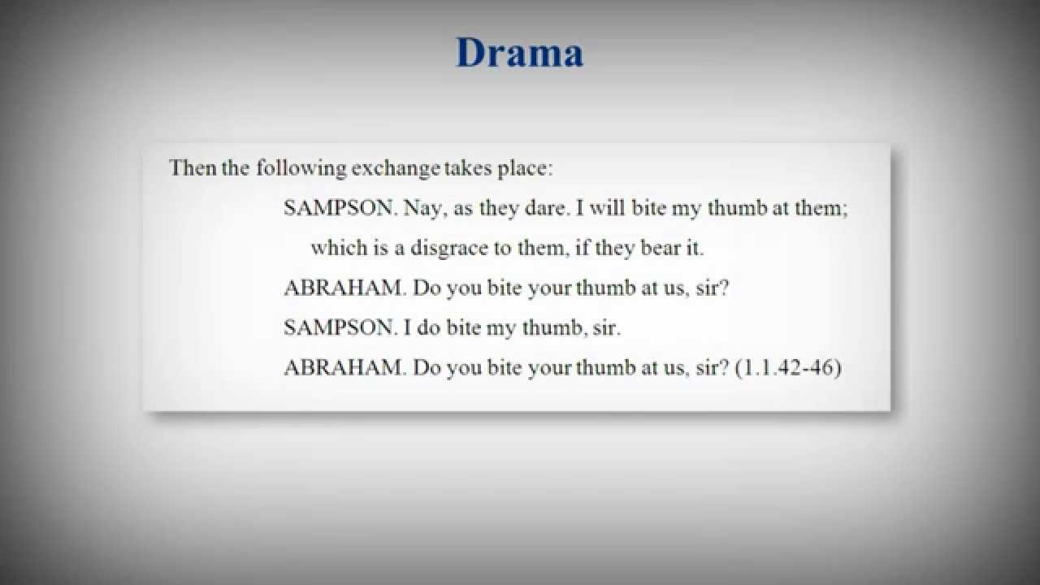

Slide 37
Quotations: Drama (Dialogue Quotations)
If you quote dialogue between characters in a play, set it as a block quotation as described above.
Begin each part of the dialogue with the appropriate character’s name written in all capital letters.
Place a period after the name; then start the quotation.
Indent any subsequent lines of the character’s speech an extra quarter inch.
When the dialogue shifts to a new character, start a new line. Maintain this pattern throughout the quotation.

Slide 38
Quotations: Drama (Dialogue Quotations)
SHYLOCK. She is damned for it.
SALARINO. That’s certain, if the devil may be her
judge.
SHYLOCK. My own flesh and blood to rebel!
SOLANIO. Out upon it, old carrion! Rebels it at
these years?
SHYLOCK. I say my daughter is my flesh and my
blood.
SALARINO. There is more difference between
thy flesh and hers than between jet and ivory, more between your bloods than there is between red wine and Rhenish. (3.1.29–38)

Slide 39
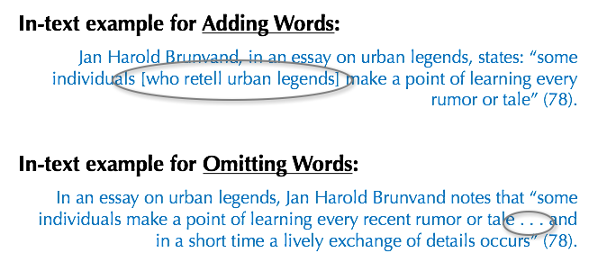
Adding/Omitting Words
If you add a word or words in a quotation, you should put brackets around the words to indicate that they are not part of the original text. This is illustrated in the first example on this slide.
If you omit a word or words from a quotation, you should indicate the deleted word or words by using ellipsis marks, which are three periods ( . . . ) preceded and followed by a space.
Notes:
Adding or Omitting Words In Quotations
If you add a word or words in a quotation, you should put brackets around the words to indicate that they are not part of the original text. This is illustrated in the first example on this slide.
If you omit a word or words from a quotation, you should indicate the deleted word or words by using ellipsis marks, which are three periods ( . . . ) preceded and followed by a space. Please note that brackets are not needed around ellipses. This is illustrated in the second example on this slide.

Slide 40
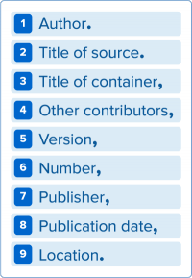
Works Cited: The Basics
Each entry in the list of works cited is made up of core elements given in a specific order.
The core elements should be listed in the order in which they appear here. Each element is followed by the punctuation mark shown here.

Slide 41
Works-cited List: Author
Begin the entry with the author’s last name, followed by a comma and the rest of the name, as presented in the work. End this element with a period.
Examples:
Baron, Naomi S. “Redefining Reading: The Impact of Digital Communication Media.” PMLA, vol. 128, no. 1, Jan. 2013, pp.193-200.
Jacobs, Alan. The Pleasures of Reading in an Age of Distraction. Oxford UP, 2011.
Notes:
.

Slide 42
Works-cited List: Title of Source
Books and websites should be in italics:
Linett, Maren Tova. Modernism, Feminism, and Jewishness. Cambridge UP, 2007.
Periodicals (journal, magazine, newspaper article) should be in quotation marks:
Goldman, Anne. “Questions of Transport: Reading Primo Levi Reading Dante.” The Georgia Review, vol. 64, no. 1, 2010, pp. 69-88.
Notes:
.

Slide 43
Works-cited List: Title of Container
Containers are the larger wholes in which the source is located. For example, if you want to cite a poem that is listed in a collection of poems, the individual poem is the source, while the larger collection is the container. The title of the container is usually italicized and followed by a comma, since the information that follows next describes the container.

Slide 44
Works-cited List: Title of Container
Examples:
Bazin, Patrick. “Toward Metareading.” The Future of the Book, edited by Geoffrey Nunberg, U of California P, 1996, pp. 153-68.
Hollmichel, Stefanie. “The Reading Brain: Differences between Digital and Print.” So Many Books, 25 Apr. 2013, somanybooksblog.com/2013/04/25/the-reading-brain-differences-between-digital-and-print/.
Notes:
In the first example, “Toward Metareading” is the title of an essay, and The Future of the Book is the title of the edited collection in which the essay appears.
The container may also be a website, which contains articles, postings, and other works.
The container may also be a television series, which is made up of episodes

Slide 45
Works-cited List: Other Contributors
In addition to the author, there may be other contributors to the source who should be credited, such as editors, illustrators, performers, translators, etc. If their contributions are relevant to your research, or necessary to identify the source, include their names in your documentation.
Note: In the eighth edition, terms like editor, illustrator, translator, etc., are no longer abbreviated.

Slide 46
Works-cited List: Other Contributors
Examples:
Chartier, Roger. The Order of Books: Readers, Authors, and Libraries in Europe between the Fourteenth and Eighteenth Centuries. Translated by Lydia G. Cochrane, Stanford UP, 1994.
Woolf, Virginia. Jacob’s Room. Annotated and with an introduction by Vara Neverow, Harcourt, Inc., 2008.

Slide 47
Works-cited List: Version
Books are commonly issued in versions called editions. A revised edition of a book may be labeled revised edition, or be numbered (second edition, etc.).
If a source is listed as an edition or version of a work, include it in your citation.
The Bible. Authorized King James Version, Oxford UP, 1998.
Newcomb, Horace, editor. Television: The Critical View. 7th ed., Oxford
UP, 2007.

Slide 48
Works-cited List: Number
If a source is part of a numbered sequence, such as a multi-volume book, or journal with both volume and issue numbers, those numbers must be listed in your citation.
Baron, Naomi S. “Redefining Reading: The Impact of Digital Communication Media.” PMLA, vol. 128, no. 1, Jan. 2013, pp. 193-200.
Wellek, René. A History of Modern Criticism, 1750-1950. Vol. 5, Yale UP, 1986.

Slide 49
Works-cited List: Publisher
The publisher produces or distributes the source to the public. If there is more than one publisher, and they are all are relevant to your research, list them in your citation, separated by a forward slash (/).
Example:
Jacobs, Alan. The Pleasures of Reading in an Age of Distraction. Oxford UP, 2011.
Notes:
Note: the publisher’s name need not be included in the following sources: periodicals, works published by their author or editor, a Web cite whose title is the same name as its publisher, a Web cite that makes works available but does not actually publish them (such as YouTube, WordPress, or JSTOR).

Slide 50
Works-cited List: Publication Date
The same source may have been published on more than one date, such as an online version of an original source. When the source has more than one date, use the date that is most relevant to your use of it.
(If you’re unsure about which date to use, go with the date of the source’s original publication.)
Belton, John. “Painting by the Numbers: The Digital Intermediate.” Film Quarterly, vol. 61, no. 3, Spring 2008, pp. 58-65.
“
Notes:
If you’re unsure about which date to use, go with the date of the source’s original publication.
In the first example, the periodical’s publication schedule goes by season. So document the volume (61), the issue number (3), and the issue (Spring 2008).

Slide 51
Works-cited List: Location
Be as specific as possible in identifying a work’s location.
An essay in a book, or an article in journal should include page numbers
Adiche, Chimamanda Ngozi. “On Monday of Last Week.” The Thing around Your Neck, Alfred A. Knopf, 2009, pp. 74-94.
The location of an online work should include a URL.
Deresiewicz, William. “The Death of the Artist—and the Birth of the Creative Entrepreneur.” The Atlantic, 28 Dec. 2014, www.theatlantic.com/magazine/archive/2015/01/the-death-of-the-artist-and-the-birth-of-the-creative-entrepreneur/383497/.
.

Slide 52
Works-cited List: Optional Elements
Date of original publication
If a source has been published on more than one date, the writer may want to include both dates if it will provide the reader with necessary or helpful information
Franklin, Benjamin. “Emigration to America.” 1782. The Faber Book of America, edited by Christopher Ricks and William L. Vance, Faber and Faber, 1992, pp. 24-26.
City of publication:
This is only necessary in particular instances, such as in a work published before 1900.
Goethe, Johann Wolfgang von. Conversations of Goethe with Eckermann and Soret. Translated by John Oxenford, new ed., London, 1875.

Slide 53
Works-cited List: Optional Elements
URLs (use at your instructor’s discretion)
DOIs (digital object identifier)
A series of digits and letters that leads to the location of an online source. If your source is listed with a DOI, use that instead of a URL.
Chan, Evans. “Postmodernism and Hong Kong Cinema.” Postmodern Culture, vol. 10, no. 3, May 2000. Project Muse, doi: 10.1353/pmc.2000.0021.
Date of access
When you cite an online source, always include the date on which you accessed the material, since an online work may change or move at any time.
“Under the Gun.” Pretty Little Liars, season 4, episode 6, ABC Family, 16 July 2013. Hulu, www.hulu.com/watch/511318. Accessed 23 July 2013.
Notes:
URLs: use at your instructor’s discretion.
DOIs: a series of digits and letters that leads to the location of an online source. Articles in journals are often assigned DOIs to ensure that the source is locatable, even if the URL changes. If your source is listed with a DOI, use that instead of a URL.
Date of access: When you cite an online source, always include the date on which you accessed the material, since an online work may change or move at any time.

Slide 54
Useful Presentations
MLA Style: List of Works Cited (8th Ed., 2016)
https://www.youtube.com/watch?v=Qq5Itf5Tg-U
MLA 8th Edition Online Workshop
https://www.youtube.com/watch?v=baTARdUdnfQ
MLA 8th Edition Online Workshop
https://www.youtube.com/watch?v=_Uudj03g5MY

Slide 55
Exercises and Quizzes
Quiz University of Illinois
http://www.uis.edu/ctl/wp-content/uploads/sites/76/2013/03/MLACitationMethodsQuiz.pdf
Norton Quiz
http://wwnorton.com/college/english/write/writesite/exercises/mla.aspx
Exercise MLA
https://style.mla.org/teaching-resources/

Slide 56
Sources
The Purdue OWL. Purdue U Writing Lab, 2016.
https://owl.english.purdue.edu/owl/resource/747/01/

