Slide 1
Postmodernism (since 1950)
Literature since WWII has been heavily influenced by studies of media, language, and information technology. It rejects the idea that anything is truly “unique,” proposing that culture endlessly duplicates itself. Postmodern literature especially is marked by irony in the form of parody, unreliable narrators, absurdity, self-awareness, and deconstruction. Postmodernist literature frequently reminds the audience that they are reading a work of fiction or supply other “meta” commentary. New literary forms and techniques focused on intense dialogue, blending fiction with nonfiction, and the overall appearance of the work.

Slide 2








Slide 3

a coming-of-age story (Bildungsroman) and family saga
Themes : nature versus nurture, rebirth, the experiences of what society constructs as polar opposites, the pursuit of the American Dream, gender identity, ethnic identity, race.
Cal Stephanides (initially called "Callie"): an intersex man of Greek descent with 5-alpha-reductase deficiency
5α-Reductase deficiency - form of genital ambiguity, manifested primarily in inbred, isolated population groups
the novel is epic in scope, tracing the lives of three generations of Greek Americans

Slide 4
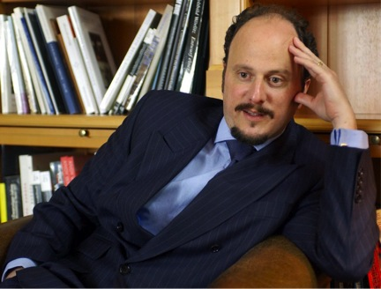
Because the story is so far from my own experience, I had to use a lot of details from my own life to ground it in reality, to make it believable for me and then hopefully for the reader, as well. So I would use my own physical appearance. I would use details from my grandparents' life, the streets they lived on, the kinds of places they lived. And all this made it real for me because it was a tall order to write such a story.
The voice "had to render the experience of a teenage girl and an adult man, or an adult male-identified hermaphrodite"

Slide 5

Like Cal, the author was born in 1960
His family moved to a house on Middlesex Road after the Detroit riot in 1967
Eugenides married a Japanese-American artist, Karen Yamauchi, and moved to Berlin.
Eugenides is of Greek heritage, albeit only through his father's side
Although his paternal grandparents were not siblings like the Stephanides, they were silk farmers like their fictional counterparts.
Like Cal, Eugenides learned some Greek customs to help himself understand his grandparents better.
Several aspects of Chapter Eleven were based on Eugenides' elder brother, who withdrew from society during a "hippie phase" in his life

Slide 6
Genres
Narrative perspective
a hybrid form, epic crossed with history, romance, comedy, tragedy
a historical novel = Cal, narrating his story in 2002, describes events from the early 1920s to the mid-1970s.
a family saga
an “ethnic” novel/ immigrant narrative
a queer novel, though it has been widely criticized for its heteronormativity
a picaresque novel = depicts the adventures of a roguish, but "appealing hero", usually of low social class
metafictional chronicle = emphasizes its own constructedness, reminds readers to be aware that they are reading or viewing a fictional work
a social novel about Detroit
James Wood, hysterical realism
Middlesex is written in the form of a memoir. Cal tells his story mostly in the present tense, but sometimes also in the past
switches between the 1st and the 3rd person
he speaks in an androgynous voice, with limited omniscience; he acknowledges that he is fabricating some of the details
At times it is the voice of a grown man, at others s/he is in the act of “becoming” or still just an innocent little girl.
contradictory statements highlight the unreliable nature of Cal's narration
narrator has a proclivity to reveal events that will happen in the future.

Slide 7
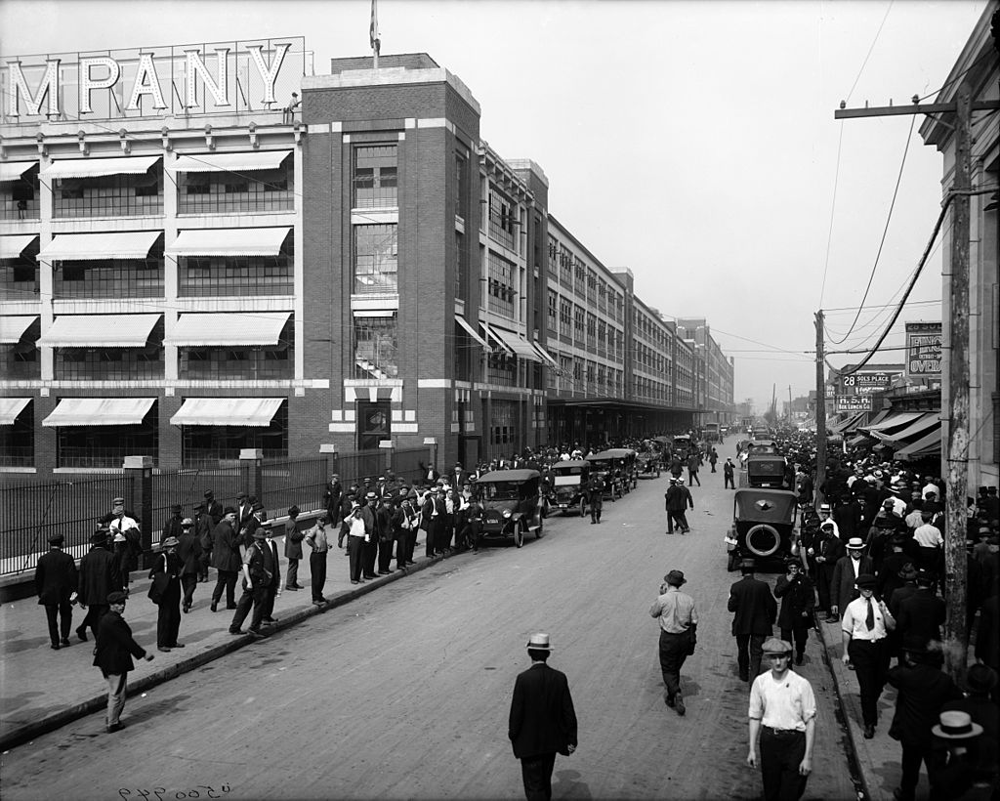
Middlesex sets up its characters to toil through history: Lefty first job in the United States is at Ford Motor Company (as pictured in the 1920s).
James Wood, hysterical realism, a literary genre typified by a strong contrast between elaborately absurd prose, plotting, or characterization, on the one hand, and careful, detailed investigations of real, specific social phenomena on the other.
***
Such moments in the book include how two cousins conceive "on the same night and at the same moment" and how years later, those children marry each other. Woods also pointed out the seeming coincidences that involved locales. Smyrna is the burning city from which she flees to start a new life; New Smyrna Beach is where she spends her retirement. Effectively serving as a double entendre, the title of the book refers to the name of the street where Cal stays at and describes his situation: a hermaphrodite brought up as a girl but who decides to become a boy. Cal's condition is also reflected in his choice of locale to narrate the novel: Berlin is a city formerly of "two halves or sexes" (East and West).

Slide 8
Sex vs Gender
Sex considered biologically classified: male and female, fixed and natural
Gender as socially constructed
Cal/lie sees him/herself dehumanized, objectified, othered and alone
Cal/lie’s discovery of how the world categorizes him/her also reveals the powers at play and the reason why s/he, in this condition of in-between sex, always will be in danger of being dehumanized and difficult to accept or love by almost anyone. (S)he runs away.
Μοreover, s/he denounces the clinical treatment of intersexuality via surgery
The adolescent ego is a hazy thing, amorphous, cloudlike. It wasn’t difficult to pour my identity into different vessels. In a sense, I was able to take whatever form was demanded of me. I only wanted to know the dimensions. Luce was providing them. My parents supported him. The prospect of having everything solved was wildly attractive to me, too, and while I lay on the chaise I didn’t ask myself where my feelings for the Object fit in. I only wanted it all to be over. I wanted to go home and forget it had ever happened. So I listened to Luce quietly and made no objections. (434)
Dear Mom and Dad,
I know you’re only trying to do what is best for me, but I don’t think anyone knows for sure what’s best. I love you and don’t want to be a problem, so I’ve decided to go away. I know you’ll say I’m not a problem, but I know I am. If you
want to know why I’m doing this, you should ask Dr. Luce, who is a big liar! I am not a girl. I’m a boy. (439)

Slide 9
Attending the Intersex and Hermaphrodite “School” of Zora in San Francisco
On the road, Cal sees himself with their eyes and comes to realize that he can pass quite easily.
“Can I ask you something, Cal? What are you anyway?” (463).
He is brutalized as the rage of his robbers echoes the basic instinct and strange entitlement to physically harm someone that is outside the norm: : “It’s a fucking freak! […] I’m gonna puke, man. Look!” (476)
On the way, Cal moves through one gender performance after another. Having tried first to live as a girl, Cal begins to live as a boy and accepts his uniqueness
Judith Butler: performativity has enabled a powerful appreciation of the ways
that identities are constructed iteratively through complex citational processes.
“Remember, Cal. Sex is biological. Gender is cultural.” (489)

Slide 10
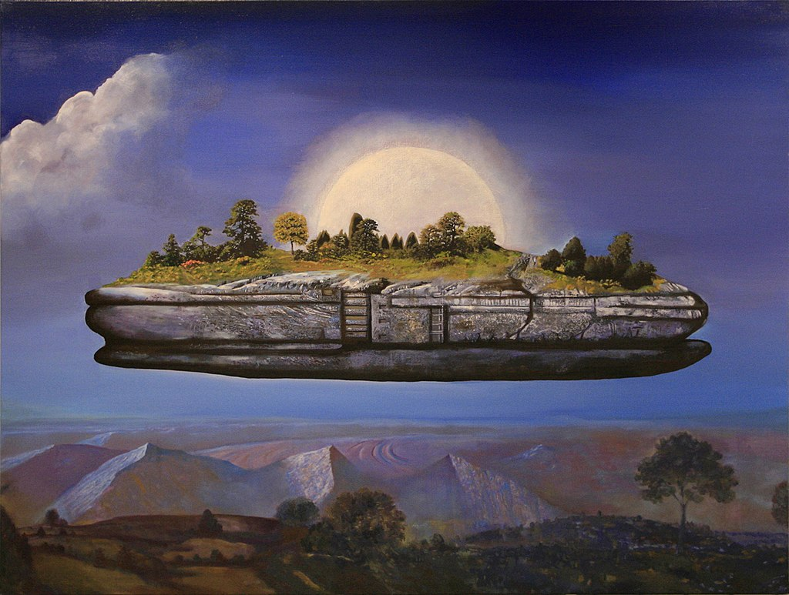
Michel Foucault, Of Other Spaces (1967) Heterotopia
a concept describing certain cultural, institutional and discursive spaces that are somehow 'other': disturbing, intense, incompatible, contradictory or transforming. Heterotopias are worlds within worlds, mirroring and yet upsetting what is outside. Foucault provides examples: ships, cemeteries, bars, brothels, prisons, gardens of antiquity, fairs, Muslim baths and many more.
the heterotopic character of the floating vessel is verified by its capacity to shape and even produce its own inhabitants.

Slide 11
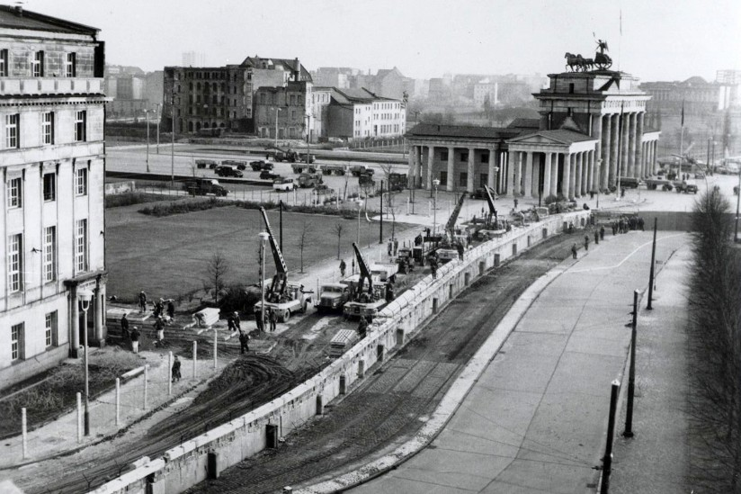
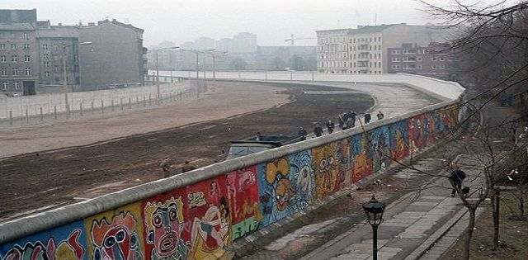
Berlin
If the parallel between sexed and cultural hybridity were to be pursued, this might seem a promising location from which to explore a post-sexed identity: ‘‘This once-divided city reminds me of myself. My struggle for unification, for Einheit. Coming from a city still cut in half by racial hatred, I feel hopeful here in Berlin’’ (106).
constant struggle for a unified self of multitudinous hybridity
the socialist government of East Germany had closed the eastern and western Berlin border on the night of 13 August 1961.
the total length of the Berlin Wall was 155 kilometers.

Slide 12
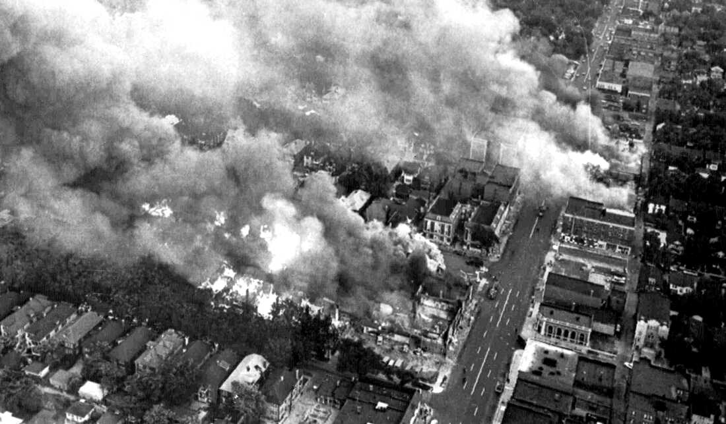
Detroit
The 1967 Detroit Riots were among the most violent and destructive riots in U.S. history. By the time the bloodshed, burning and looting ended after 5 days, 43 people were dead, 342 injured, nearly 1,400 buildings had been burned
The 12th Street Riot was considered one of the worst riots in U.S. history, occurring during a period of fever-pitch racial strife and numerous race riots across America.
the Kenner report declared that “Our nation is moving toward two societies, one Black, one white—separate and unequal. Reaction to last summer’s disorders has quickened the movement and deepened the division. Discrimination and segregation have long permeated much of American life; they now threaten the future of every American.”

Slide 13
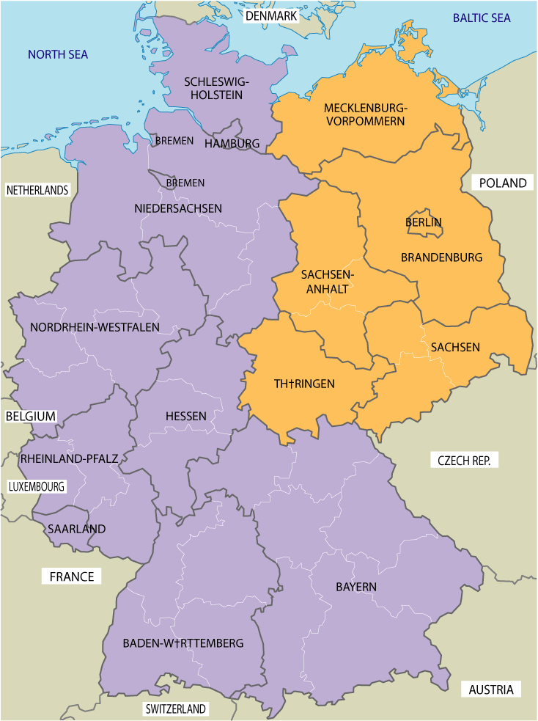
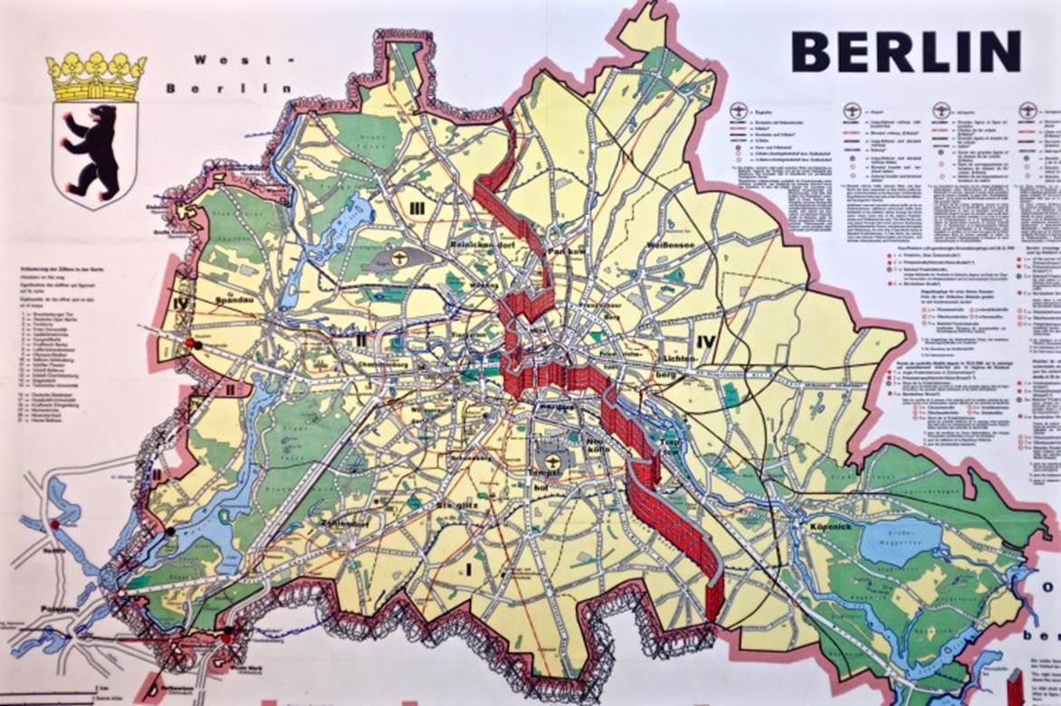

Slide 14

1974: the Turkish military invasion and occupation of the northern third of Cyprus. Only Turkey recognises the Turkish Republic of Northern Cyprus, while there is broad recognition that the ongoing military presence constitutes occupation of territories that belong to the Republic of Cyprus.
The 1974 Cypriot coup d'état, initiated by the Greek military junta, was followed five days later by Turkey's invasion

Slide 15
the “tragicomic novel” and the representation of trauma
DOMINICK LA CAPRA - writings on the Holocaust
“acting-out” -- in the form of denial, confusion and emotional outbursts related to repetition, and even the repetition-compulsion
-- the tendency to repeat something compulsively. This is very clear in the case of people who undergo a trauma. They have a tendency to relive the past, to exist in the present as if they were still fully in the past, with no distance from it. They tend to relive occurrences, or at least find that those occurrences intrude on their present existence. Ex. flashbacks; or nightmares; or words that are compulsively repeated, and that don't seem to have their ordinary meaning, because they're taking on different connotations from another situation, in another place .
“working through” -- to tentatively produce some “judgment that is not apodictic capable of demonstration but argumentative [or dialogic]
the person tries to gain critical distance on a problem, to be able to distinguish between past, present and future.
self-questioning, and related in mediated ways to action (LaCapra, 1994: 210).
it's via the working-through that one acquires the possibility of being an ethical agent

Slide 16
"Acting-Out" And "Working-Through" Trauma
INSEPARABLE PROCESS
Acting-out and working-through should not been seen in terms of “either-or” binary opposites (with one superseding the other); rather, in the minds of the traumatized, they are “countervailing forces” functioning simultaneously against, and even overlapping with, each other.
the acting out/working-through distinction is a distinction, not a separation into different kinds or totally different categories, but a distinction between interacting processes -- one way of trying to get back to the problem of the
relationship between theory and practice.
there has been too much of a tendency to become fixated on acting-out, on the repetition-compulsion, to
see it as a way of preventing closure, harmonization, any facile notion of cure.
But also, to eliminate any other possibility of working through, or simply to identify all working-through as closure, totalization, full cure, full mastery, so that there's a kind of all-or-nothing logic in which one is in a double bind: either the totalization or the closure you resist; or acting-out the repetition-compulsion, with almost no other possibilities.
WORKING-THROUGH & ACTING-OUT
Mourning and melancholia: mourning might be seen as a form of working-through, and melancholia as a form of acting-out.
Excerpt from interview with professor Dominick LaCapra
Cornell University, 1998

Slide 17
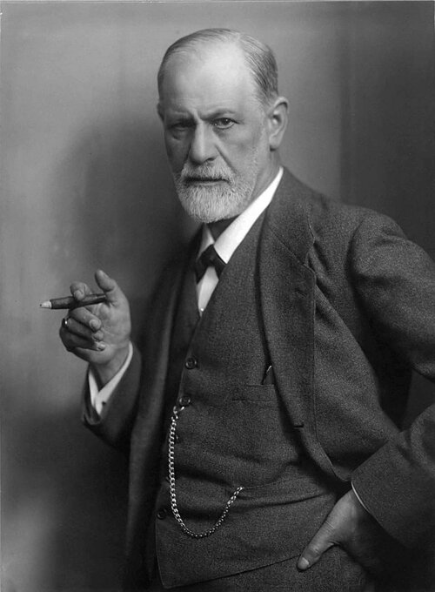
Sigmund Freud
Mourning and Melancholia (German: Trauer und Melancholie), 1918
Freud posits that there are two different kinds of responses to loss.
Both responses look similar as far as mood or expression, because they both deal in grief. But while mourning, in Freud’s view, is a finite and transforming process, melancholia is a persistent state, and takes root just outside of a person’s conscious understanding.
In mourning, a person feels their pain for the loss in an external way. The world around them may feel changed, bleak, or heartbreaking, but as they allow themselves to feel and process this change, they are able to reform their feelings of loss: their pain slowly turns into a positive motivation to replace or move away from what they’ve understood is gone. Freud describes mourning as a process which ends with a kind of acceptance, in that the mourner can eventually feel motivated to participate in the external world, even though the loss has ultimately changed it.
The way Freud describes melancholia, on the other hand, is a bit more complicated. In this response to loss, a person feels their pain in an internal way. Freud believed the pain of loss in melancholia is felt within the unconscious—meaning that the significance of the loss isn’t quite so apparent to the griever, even though the pain of it might still be deeply felt.

Slide 18
From Remembering Ethnicity in Middlesex Trauma and the Tragicomic
“the complexities of traumatic memory and the subject’s difficult relation to the past are suggested by the use of multiple voices and positioning within characters or narrators as well as between them” (Vickroy 2002, 27).
LaCapra contends that working through trauma is “an articulatory practice”
“the voice of the other,” the story of his grandparents’ immigration can be read as “the story of the way in which one’s own trauma is tied up with the trauma of another, the way in which trauma may lead to the encounter with another, through the very possibility and surprise of listening to another’s wound” (Cathy Caruth, 1996, 8). Here, to exploit the connective capacity of stories to bring together disparate elements.
Trauma critics have noted the need of an other, a listener, in the process of coming to terms with trauma
Cal’s orientation towards a narratee, whom he calls “reader:” “I feel you out there, reader. This is the only kind of intimacy I’m comfortable with. Just the two of us, here in the dark”
A bonding with this ideal reader can create bonding and encouragement for Cal to transmit his “unofficial truth,” which lies behind laughter
dealing with a traumatic past is “not implemented [so as] to memorialize an event of the past into an indefinite future but is introduced as a therapeutic tool to cleanse, to purge, to heal, to reconcile”
“remembering in order to overcome” Aleida Assmann
Creating “a community of laughter” Warner Sollors

Slide 19
Julia Kristeva’s Powers of Horror: An Essay on Abjection (1982)
“hermaphrodite” : “Anything comprised of a combination of diverse or contradictory elements. See synonyms at MONSTER”
the vague sense of horror that permeates the boundary between the self and the other. In a broader sense, the term refers to the process by which identificatory regimes exclude subjects that they render unintelligible or beyond classification. As such, the abjection of others serves to maintain or reinforce boundaries that are threatened.
- “draws me toward the place where meaning collapses” “what disturbs identity, system, order. What does not respect borders, positions, rules“
encompasses a kind of borderline uncertainty — ambiguous, horrifying, and polluting.
It is in this liminal space where the subject experiences a crisis of meaning in which transformation is possible — the difference between internal and external becomes unclear.
the best modern literature explores the place of the abject, a place where boundaries begin to breakdown, where we are confronted with an archaic space before such linguistic binaries as self/other or subject/object.

Slide 20
Narrative voice
Cal “occasionally admits he’s filling in details, extrapolating from the available evidence, making things up,” (72). The story that the reader is told is coherent in its relevance for Cal’s process of coming to terms with himself and establishing a coherent identity. The narrative with which the reader is presented does not differ remarkably from the one Cal produced for Dr. Luce:
“I quickly discovered that telling the truth wasn’t nearly as much fun as making things up. I also knew that I was writing for an audience – Dr. Luce. I fictionalized and it was amazing how it worked: the tiniest bit of truth made credible the greatest lies” (418). Cal’s present account is geared towards an audience: “If this story is written only for myself, then so be it. But it doesn’t feel that way. I feel you out there, reader” (319).
Middlesex is not about giving a truthful account of a family’s immigration and their successful integration into the new country, but rather about a coherent construction of identity to be achieved by the narrator.
autodiegetic
omniscient
described as “a position that might be called limited omniscience.”
“something like fantastic or speculative omniscience.” Even though Cal speaks of his “prenatal omniscience” (211), it soon becomes clear that his omniscience is not actually lost at birth.
Despite his being aware of the impossibility of remembering his first day, Cal’s first memory consists of being assigned feminine sexuality at birth: “I said it was impossible, but still I remember this” (215).
His ability to enter other people’s minds prevails so that he can “be honest and record Milton’s thoughts as they occurred to him” (511).
At other times, his memory fails him, when describing a childhood birthday with the obligatory candles on the birthday cake: “What did I wish for at seven? I don’t remember” (227).
At his birth, he does not lose his omniscience as he claims, but instead he takes on a more subjective perspective, allowing his account to become “colored by the experience of being part of the event” (217)

Slide 21
In a decade of solid, original research, Luce made his second great discovery: that gender identity is established very early on in life, about the age of two. Gender was like a native tongue; it didn’t exist before birth but was imprinted in the brain during childhood, never disappearing. Children learn to speak male or female the way they learn to speak English or French.” (411)
“Luce even analyzed my prose style to see if I wrote in a linear, masculine way, or in a circular, feminine one. All I know is this: despite my androgenized brain, there’s an innate feminine circularity in the story I have to tell”
"Living sends a person not out into the future but back into the past," Cal reflects, "to childhood and before birth, finally, to commune with the dead. You get older, you puff on the stairs, you enter the body of your father. From there it’s only a quick jump to your grandparents, and then before you know it you’re time-traveling.”

Slide 22
Judith Butler, Undoing Gender (2004)
She addresses the complex of bodies and gender, social and biological:
the debates concerning the theoretical priority of sexual difference to gender, of gender to sexuality, of sexuality to gender, are all cross-cut by another kind of problem, a problem that sexual difference poses, namely, the permanent difficulty of determining where the biological, the psychic, the discursive, the social begin and end ("End of Sexual Difference" 426)
Butler employs Kristeva's concept of abjection to discuss the often problematic embodiment of sexuality and gender. Specifically, Butler explores how normative heterosexual identities are circumscribed via a process that rejects and excludes “figures of homosexual abjection” that challenge heteronormative understandings of gender, sex, bodies, embodiment.

Slide 23
In choosing to become Americans, Cal’s grandparents acquiesce to the rules of the New World. However, their comic transformations hint at the impossibility of the ideal fusion of races and they only apparently abandon the mythic thinking of the Old World.
The textual implications of the novel go in a similar direction: the integrative wholeness of male and female is impossible. Going back to Cal’s performance at Sixty-Niners, his symbolic transformation does not lead to an adoption of a “middle sex” but to an acceptance of an identity that is until then only viewed in medical (at Dr. Luce’s clinic) and mythological (as Hermaphroditus) terms.
I opened my eyes underwater. I saw the faces looking back at me and I saw that they were not appalled. I had fun in the tank that night. It was all
beneficial in some way. It was therapeutic. Inside Hermaphroditus old tensions were roiling, trying to work themselves out. Traumas of the locker room were being released. Shame over having a body unlike other bodies was passing away. The monster feeling was fading. (Eugenides 2002, 494)

Slide 24
Sex is real Yes, there are just two biological sexes. No, this doesn’t mean every living thing is either one or the other.
Chromosomes aren’t ‘male’ or ‘female’ because these bits of DNA define biological sex. It’s the other way around
Many people assume that if there are only two sexes, that means everyone must fall into one of them. But the biological definition of sex doesn’t imply that at all. As well as simultaneous hermaphrodites, which are both male and female, sequential hermaphrodites are first one sex and then the other. There are also individual organisms that are neither male nor female. The biological definition of sex is not based on an essential quality that every organism is born with, but on two distinct strategies that organisms use to propagate their genes. They are not born with the ability to use these strategies – they acquire that ability as they grow up, a process which produces endless variation between individuals.

Slide 25
Paul Ricoeur, Time and Narrative, Oneself as Another
narrative identity mediates between different concepts of self. It is this mediating quality which makes the narrative indispensable to the process of identity construction.
experience shows that identities can change significantly without disrupting the coherent existence of an individual. This insight necessitates the idea of continuity through which a person can be recognized as the same, no matter what changes he or she goes through.
The use of a proper name suggests that despite the possibility of change, there is some sort of continuity that makes one recognizable to oneself and others as the same subject from birth throughout life until death.
only the narration of a life story can mediate between these conflicts of permanence and change, contingency and continuity
The narrator chooses 1922, the year his grandparents where driven out of Smyrna, as the beginning and 1975, the year of his father’s death, as the end of his story.
The fact that neither date correlates with his birth or death alludes to the contingency which characterizes common notions of the beginning and ending of a story, thereby enforcing the idea of identity as constructed and often imagined.
the life story is a type of narrative geared towards self-understanding, oftentimes appearing in “the novelistic style of imaginary autobiography”

Slide 26
The Future Anterior, the future to come
In the dominant modes of understanding, the present is seen as representing the absolute presence of now – a presence that surrounds us, a ‘pure present’, an ‘autonomous given’, pure presence. The past is seen as a ‘former present’, that which was once presence, but is no longer presence. The future is an ‘anticipated present’, that which will have presence, will be presence
But memory can only create a ‘trace’ of presence, an outline of a false presence, a presence that never was present. When we remember something, we are no longer the same ‘we’ that experienced the event. Memory is affected by the present, by present circumstances.
The concept of the future must be radically differentiated from the idea of the future as an ‘anticipated presence’, as something that can be thought of in terms of the present or of present experience. Instead, it is to be thought of as that which arrives without warning and without invitation, as the coming of an event that cannot and must not be anticipated. This is what Derrida calls the future ‘to come’. The future is thus the coming of an event that cannot be foreseen.
Bergson ‘I cannot predict what is going to happen, but I foresee that I am going to have known it.’
The future [the a-venir] can only be anticipated in the form of an absolute danger. It is that which breaks absolutely with constituted normality and can only be proclaimed, presented, as a sort of monstrosity. Of Grammatology, p.5
what will have happened : a prospective present and the retrospective future
a present moment always retains traces of the past and the future.

Slide 27

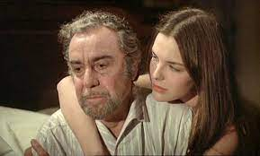
Luis Bunuel, That Obscure Object of Desire (1977) https://ok.ru/video/1265956752024
Mathieu, a wealthy middle-aged French sophisticate falls desperately in love with his 19-year old chambermaid Conchita. Thus begins a game of cat-and-mouse, with Mathieu attempting to win the girl’s affections as she manipulates his carnal desires, each vying to gain absolute control of the other.

