Slide 1








Slide 2
THE SILVER SPOON
I was born twice: first, as a baby girl, on a remarkably smogless Detroit day in January of 1960; and then again, as a teenage boy, in an emergency room near Petoskey, Michigan, in August of 1974. Specialized readers may have come across me in Dr. Peter Luce’s study, “Gender Identity in 5-Alpha-Reductase Pseudohermaphrodites,” published in the Journal of Pediatric Endocrinology in 1975. Or maybe you’ve seen my photograph in chapter sixteen of the now sadly outdated Genetics and Heredity. That’s me on page 578, standing naked beside a height chart with a black box covering my eyes.

Slide 3
But now, at the age of forty-one, I feel another birth coming on. After decades of neglect, I find myself thinking about departed great-aunts and -uncles, long-lost grandfathers, unknown fifth cousins, or, in the case of an inbred family like mine, all those things in one. And so before it’s too late I want to get it down for good: this roller-coaster ride of a single gene through time. Sing now, O Muse, of the recessive mutation on my fifth chromosome! Sing how it bloomed two and a half centuries ago on the slopes of Mount Olympus, while the goats bleated and the olives dropped. Sing how it passed down through nine generations, gathering invisibly within the polluted pool of the Stephanides family. And sing how Providence, in the guise of a massacre, sent the gene flying again; how it blew like a seed across the sea to America, where it drifted through our industrial rains until it fell to earth in the fertile soil of my mother’s own midwestern womb. Sorry if I get a little Homeric at times. That’s genetic, too.
Bildungsroman
National history + family saga
Metafictional

Slide 4

Uncle Pete was engaged with serious thought and Italian opera. He had a passion, in history, for Edward Gibbon, and, in literature, for the journals of Madame de Staël. He liked to quote that witty lady’s opinion on the German language, which held that German wasn’t good for conversation because you had to wait to the end of the sentence for the verb, and so couldn’t interrupt. Uncle Pete had wanted to become a doctor, but the “catastrophe” had ended that dream.
It was this kind of knowledge that led my father to trust what Uncle Pete said when it came to the reproductive timetable. His head on a throw pillow, his shoes off, Madam Butterfly softly playing on my parents’ stereo, Uncle Pete explained that, under the microscope, sperm carrying male chromosomes had been observed to swim faster than those carrying female chromosomes. My father, however, adopted the pose of his favorite piece of sculpture, The Thinker , a miniature of which sat across the room on the telephone table

Slide 5
Of course, a narrator in my position (prefetal at the time) can’t be entirely sure about any of this. I can only explain the scientific mania that overtook my father during that spring of ’59 as a symptom of the belief in progress that was ’59 as a symptom of the belief in progress that was infecting everyone back then. Remember, Sputnik had been launched only two years earlier.
In that optimistic, postwar America, which I caught the tail end of, everybody was the master of his own destiny, so it only followed that my father would try to be the master of his.
American belief to exercise their will

Slide 6
The timing of the thing had to be just so in order for me to become the person I am. Delay the act by an hour and you change the gene selection. …An infinite number of possible selves crowded the threshold, me among them but with no guaranteed ticket, the hours moving slowly, the planets in the heavens circling at their usual pace, weather coming into it, too, because my mother was afraid of thunderstorms and would have cuddled against my father had it rained that night. But, no, clear skies held out, as did my parents’ stubbornness.

Slide 7
In 1959, Assumption Greek Orthodox Church was located on Charlevoix. It was there that I would be baptized less than a year later and would be brought up in the Orthodox faith.
The congregation stood and sat. In the front pew, my cousins, Socrates, Plato, Aristotle, and Cleopatra, fidgeted.
All this led up to the day Desdemona dangled a utensil over my mother’s belly. The sonogram didn’t exist at the time; the spoon was the next best thing
Greek –American ethnicity

Slide 8
By six weeks, I have eyes and ears. By seven, nostrils, even lips. My genitals begin to form. Fetal hormones, taking chromosomal cues, inhibit Müllerian structures, promote Wolffian ducts. My twenty-three paired chromosomes have linked up and crossed over, spinning their roulette wheel, as mypapou puts his hand on my mother’s belly and says, “Lucky two!” Arrayed in their regiments, my genes carry out their orders. All except two, a pair of miscreants—or revolutionaries, depending on your view—hiding out on chromosome number 5. Together, they siphon off an enzyme, which stops the production of a certain hormone, which complicates my life.
Lawrence Stern

Slide 9

When this story goes out into the world, I may become the most famous hermaphrodite in history. There have been others before me. Alexina Barbin attended a girls’ boarding school in France before becoming Abel. She left behind an autobiography, which Michel Foucault discovered …(Her memoirs, which end shortly before her suicide, make unsatisfactory reading, and it was after finishing them years ago that I first got the idea to write my own.)
If you were going to devise an experiment to measure the relative influences of nature versus nurture, you couldn’t come up with anything better than my life. …Luce even analyzed my prose style to see if I wrote in a linear, masculine way, or in a circular, feminine one. All I know is this: despite my androgenized brain, there’s an innate feminine circularity in the story I have to tell. In any genetic history. I’m the final clause in a periodic sentence, and that sentence begins a long time ago, in another language, and you have to read it from the beginning to get to the end, which is my arrival.
And so now, having been born, I’m going to rewind the film…
Match
making

Slide 10
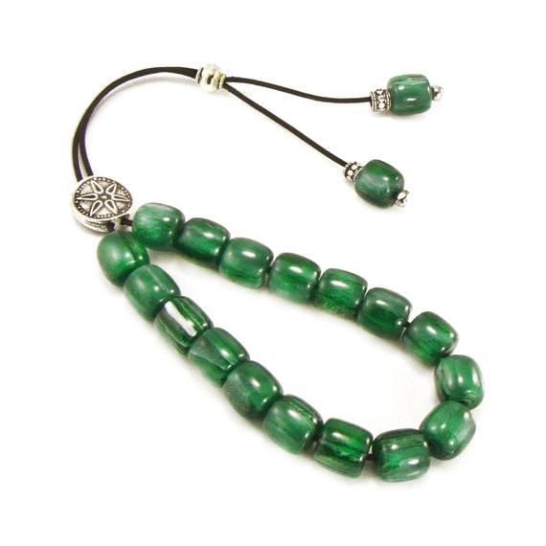
In the late summer of 1922, my grandmother Desdemona Stephanides wasn’t predicting births but deaths, specifically, her own.
It made her mad. Also, I suspect, a little jealous. Wasn’t she his best friend?
Desdemona, with her sad eyes, her face of a girl forced to grow up too fast, worried with her beads like all the Stephanides men before and after her (right down to me, if I count).
The ancients would have explained what Desdemona was feeling as the workings of Eros. Now expert opinion would put it down to brain chemistry and evolution. Still, I have to insist:

Slide 11
and [Victoria Pappas] turned to see that Lefty Stephanides, the only eligible bachelor in town, had taken off . . .
. . . Meanwhile, back at home, Desdemona opened her hope chest.
And my grandmother wept silently because she was going to spend the rest of her days counting worries that never went away . . .
. . . While in the meantime Lucille Kafkalis was standing exactly as she’d been told,
And so he had fled from Victoria Pappas to come down the street and find Lucille Kafkalis, just as disappointingly, failing to live up to page 22 . . . [of Lingerie Parisienne]
. . . And now it happens. Desdemona, weeping, takes off the corset, folds it back up, and returns it to the hope chest. She throws herself on the bed, Lefty’s bed, to continue crying. The pillow smells of his lime pomade and she breathes it in, sobbing . . .
. . . until, drugged by weeping’s opiates, she falls asleep. She dreams the dream she’s been having lately. In the
dream everything’s the way it used to be. She and Lefty are children again (except they have adult bodies). They’re lying in the same bed (except now it’s their parents’ bed).
They shift their limbs in sleep (and it feels extremely nice, how they shift, and the bed is wet) . . . at which point Desdemona wakes up, as usual. Her face is hot. Her stomach feels funny, way deep down, and she can almost name the feeling now . . .

Slide 12
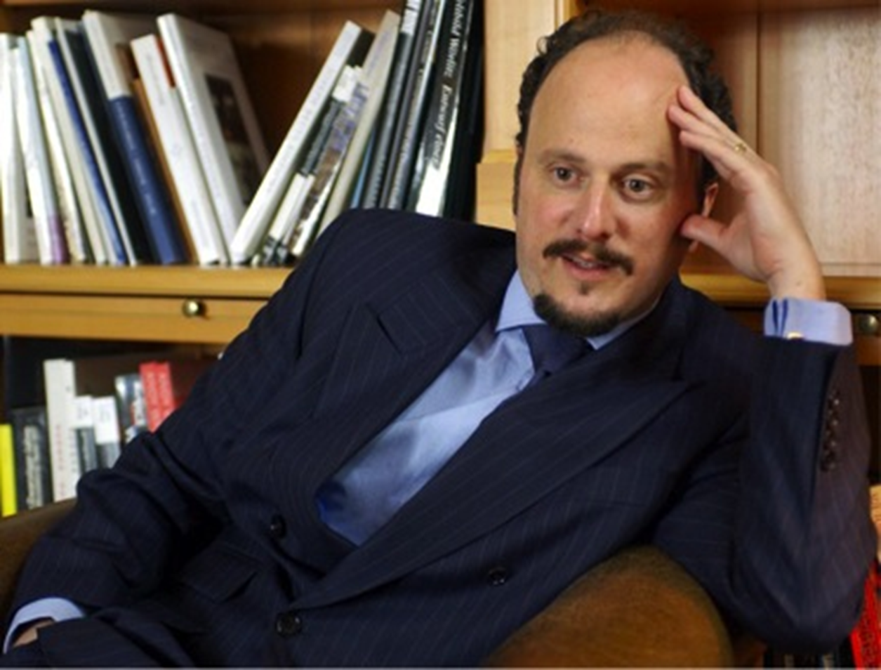
I can’t say. I try to go back in my mind to a time before genetics, before everyone was in the habit of saying about everything, “It’s in the genes.” A time before our present freedom, and so much freer! Desdemona had no idea what was happening. She didn’t envision her insides as a vast computer code, all 1s and 0s, an infinity of sequences, any one of which might contain a bug. Now we know we carry this map of ourselves around. Even as we stand on the street corner, it dictates our destiny. … Desdemona, who had no idea of the army inside her, carrying out its million orders, or of the one soldier who disobeyed, going AWOL . . .

Slide 13
AN IMMODEST PROPOSAL
Descended from Asia Minor Greeks, born in America, I live in Europe now. Specifically, in the Schöneberg district of Berlin. The Foreign Service is split into two parts, the diplomatic corps and the cultural staff.
You used to be able to tell a person’s nationality by the face. Immigration ended that. Next you discerned nationality via the footwear. Globalization ended that.
The bicyclist was Asian, at least genetically.
Something you should understand: I’m not androgynous in the least. 5-alpha-reductase deficiency syndrome allows for normal biosynthesis and peripheral action of testosterone, in utero, neonatally, and at puberty. In other words, I operate in society as a man. I use the men’s room. Never the urinals, always the stalls. In the men’s locker room at my gym I even shower, albeit discreetly. … When Calliope surfaces, she does so like a childhood speech impediment. Suddenly there she is again, doing a hair flip, or checking her nails. It’s a little like being possessed.

Slide 14
But that’s enough about me for now. I have to pick up where explosions interrupted me yesterday. After all, neither Cal nor Calliope could have come into existence without what happened next. [43]
Over a single week, the hundred or so remaining citizens of Bithynios packed their belongings and set out for mainland Greece, most en route to America. (A diaspora which should have prevented my existence, but didn’t.)
He came to a square with a fountain and washed his face. A breeze came up … And while Lefty stops to breathe it in, I’d like to take this opportunity to resuscitate—for purely elegiac reasons and only for a paragraph—that city which disappeared, once and for all, in 1922.
Smyrna endures today in a few rebetika songs and a stanza from The Waste Land :

Slide 15
The line was long and moved slowly. …and by the time he reached the official at the table, he was ready.
“Name?”
“Eleutherios Stephanides.”
“Place of birth?”
“Paris.”
The official looked up. “Passport.”
“Everything was destroyed in the fire! I lost all my papers!”
The official smiled wryly and stamped the papers. “Pass.”
“I have my wife with me.”
“I suppose she was born in Paris, too.”
“Of course.”
“Her name?”
“Desdemona.”
“Desdemona Stephanides?”
“That’s right. Same as mine.”
The anchors surged up out of the water. The deck rumbled underfoot as the destroyer’s engines were thrown into reverse. Desdemona and Lefty watched Asia Minor recede.

Slide 16
THE SILK ROAD
The voyage was supposed to take from twelve to fourteen days. Lefty and Desdemona had the schedule all worked out. On the second day at sea…
On the third day, Lefty took another after-dinner stroll
On the fourth day out, Lefty stopped and introduced himself
Rumors of the budding romance spread quickly through the ship. To pass the time, everybody was soon discussing how the tall young Greek with the elegant bearing had become enamored of the dark beauty who was never seen anywhere without her carved olivewood box. “They’re both traveling alone,” people said. “And they both have relatives in Detroit.”
On the fifth day, Lefty and Desdemona took a stroll on deck together. On the sixth day, he presented his arm and she took it.
Aware that whatever happened now would become the truth, that whatever he seemed to be would become what he was—already an American, in other words—he waited for Desdemona to come up on deck.
I feel a little like that Chinese princess, whose discovery gave Desdemona her livelihood. Like her I unravel my story, and the longer the thread, the less there is left to tell. Retrace the filament and you go back to the cocoon’s beginning in a tiny knot, a first tentative loop. And following my story’s thread back to where I left off, I see the Jean Bart dock in Athens. I see my grandparents on land again, making preparations for another voyage

Slide 17
They passed the voyage playing out this imaginary flirtation and, little by little, they began to believe it. They fabricated memories, improvised fate. (Why did they do it? Why did they go to all that trouble? Couldn’t they have said they were already engaged? Or that their marriage had been arranged years earlier? Yes, of course they could have. But it wasn’t the other travelers they were trying to fool; it was themselves.)
Bride and bridegroom performed the Dance of Isaiah. Hip to hip, arms interwoven to hold hands, Desdemona and Lefty circumambulated the captain, once, twice, and then again, spinning the cocoon of their life together. No patriarchal linearity here. We Greeks get married in circles, to impress upon ourselves the essential matrimonial facts:that to be happy you have to find variety in repetition
Or, in my grandparents’ case, the circling worked like this:
as they paced around the deck the first time, Lefty and Desdemona were still brother and sister. The second time, they were bride and bridegroom. And the third, they were husband and wife

Slide 18
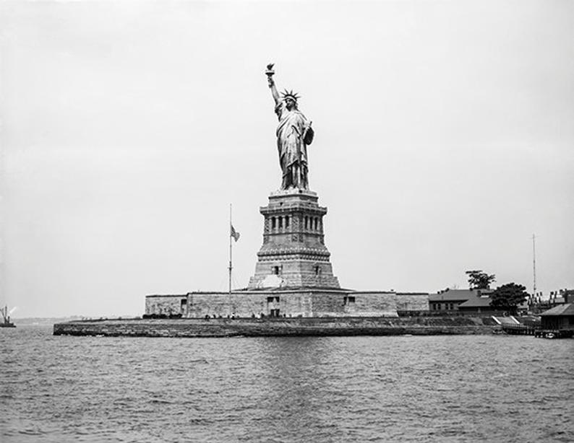
Anyone who attempted to smuggle silkworm eggs out of China faced punishment of death. In a.d. 550, the missionaries snuck silkworm eggs out of China
I’m the descendant of a smuggling operation, too. Without their knowing, my grandparents, on their way to America, were each carrying a single mutated gene on the fifth chromosome. It wasn’t a recent mutation.
Sporadic heredity is what the geneticists call it. A trait that goes underground for decades only to reappear when everyone has forgotten about it. That was how it went in Bithynios. Every so often a hermaphrodite was born, a seeming girl who, in growing up, proved otherwise.
Their honeymoon proceeded in reverse. Instead of getting to know each other, becoming familiar with likes and dislikes, ticklish spots, pet peeves, Desdemona and Lefty tried to defamiliarize themselves with each other.
Desdemona and Lefty sat up. In the distance, lit by the rising sun, was the skyline of New York. It wasn’t the right shape for a city—no domes, no minarets—and it took them a minute to process the tall geometric forms. Mist curled off the bay. A million pink windowpanes glittered. Closer, crowned with her own sunrays and dressed like a classical Greek, the Statue of Liberty welcomed them.
“How do you like that?” Captain Kontoulis asked.
Desdemona, for once, was more optimistic. “At least it’s a woman,” she said. “Maybe here people won’t be killing each other every single day.”

