Slide 1
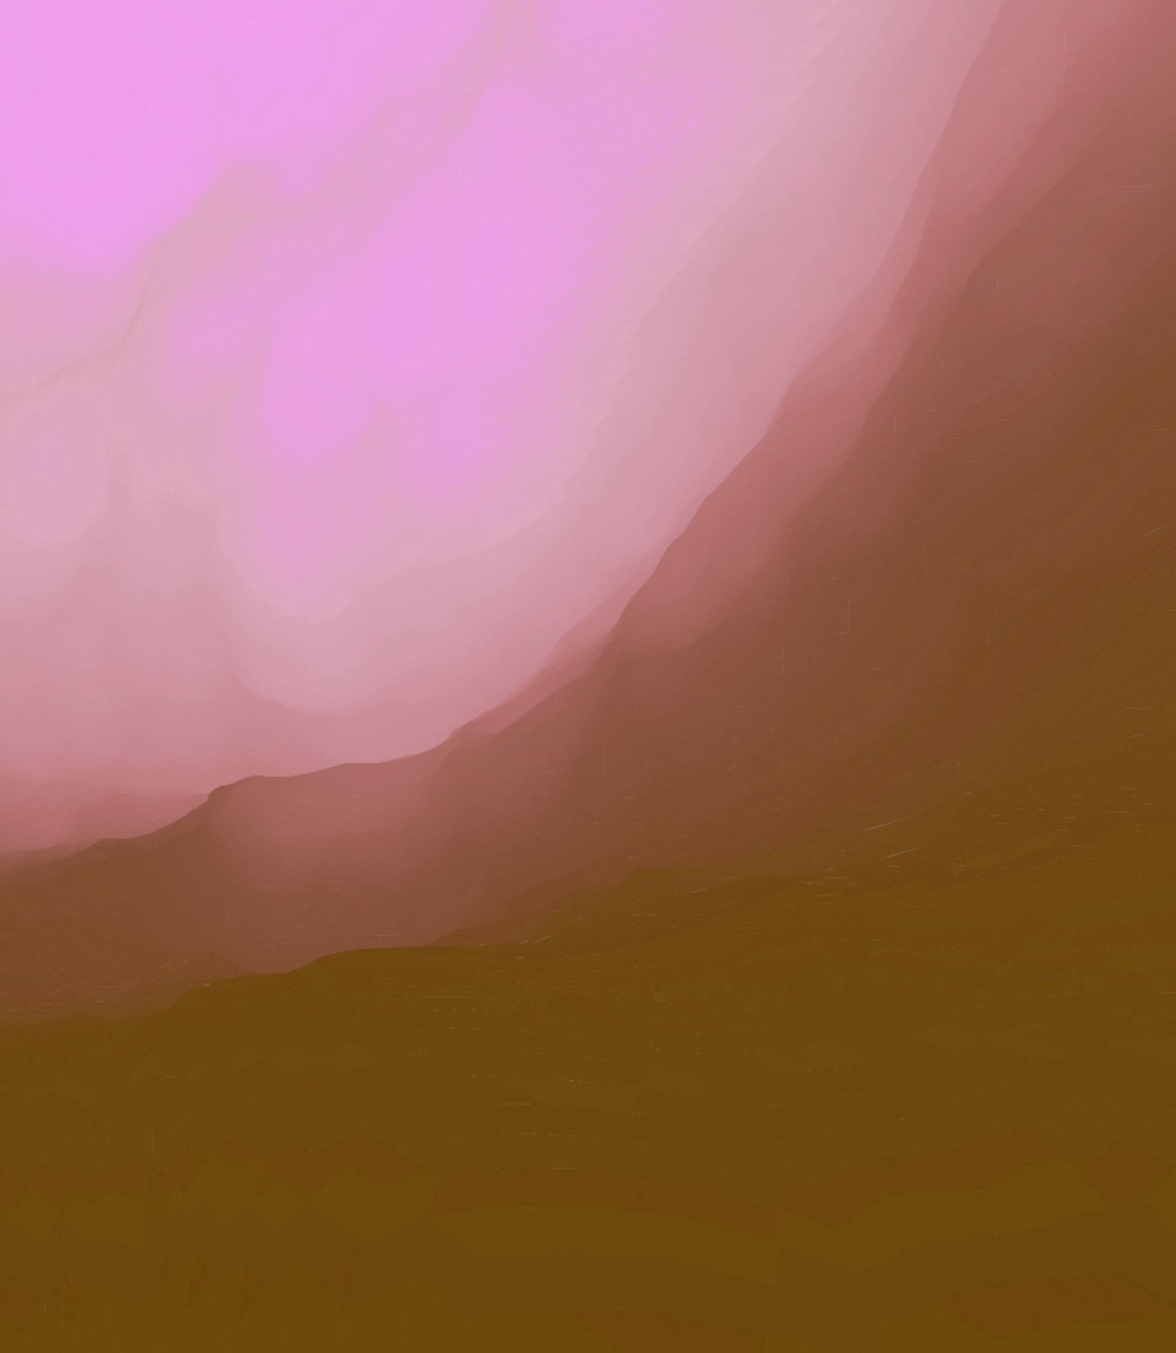
“Trauma in Jeffrey Eugenides’ Middlesex”
Trends in American Literature
Dr Dora Tsimpouki
Presentation by
Dr Lona Moutafidou

Slide 2
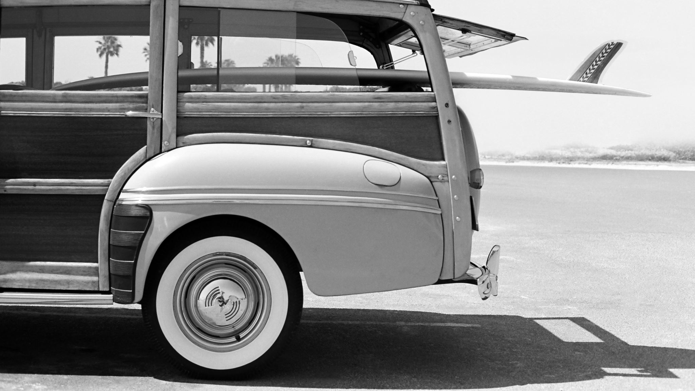
Book Two Main Events (1922-1959)
Lefty and Desdemona arrive in Detroit and live with Sourmelina and Zizmo
Minotaur show
Tess and Milton are born, Zizmo disappears
Lefty works at the Ford factory, opens the Zebra Room speakasy, shoots autoerotica photos, reopens the Zebra Room bar and grill
Great Depression
Desdemona works at the Black Bottom neighborhood and meets Zizmo
Milton and Tess flirt
Milton enlists in the navy and then marries Tess
Milton starts running the Zebra Room
Lefty retires and starts gambling
Chapter Eleven is born, Cal is conceived

Slide 3

Book Three Main Events (1959-1974)
Cal is born, Lefty suffers a stroke
Zebra Room profits decline
1967 Detroit Riots
The Stephanides move to Middlesex, Grosse Pointe
Lefty suffers a series of strokes
Callie frolics with Clementine
Lefty dies and Desdemona takes to the attic
Milton opens the Hercules Hot Dogs chain

Slide 4

Book Three Main Events (1959-1974)
Callie enters adolescence
Desdemona disappears from the scene
Callie falls in love with the Obscure Object
1974 Turkish invasion to Cyprus- Trip to Greece is cancelled
The Greeks turn their back on Middlesex
Callie has sex with Jerome and the Obscure Object
Jerome catches the girls unawares
Callie gets hit by a tractor
The Stephanides get ready for a visit to Dr Luce, in New York

Slide 5
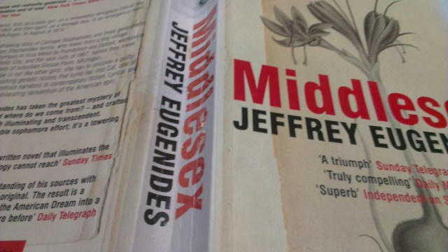
Slides contents
Trauma
Definition of trauma
Trangenerational trauma
Trauma in Middlesex
Narrative memory vs traumatic memory
Historical trauma
The Detroit Ford Factory
The 1929 Depression
The 1967 Detroit Riots
Familial trauma
Lefty and Desdemona’s love
The grandparents and Cal(lie)
From Callie to Cal
Recapitulation
Sources Excerpts Appendix

Slide 6
Trauma: a wound inscribed on the psyche, after a catastrophic event
Personal trauma
Loss of a beloved one
Chronic illness
Separation
Expatriation
Collective trauma
Accident
Natural catastrophe
War
Transgenerational trauma
Transmission of trauma

Slide 7
Transgenerational Trauma
“historical traumas of loss are passed down from one generation to another unconsciously . . . the hope for psychic health is stitched into the fabric of melancholia but only as an optative gesture that must be redeemed by subsequent generations” (Eng and Han 682).
“in transgenerational trauma subjects are haunted by tragedies affecting their parents, grandparents, or ancestors from far back without conscious knowledge . . . a kind of unconscious vicarious trauma” (Kaplan 106).
“the concept of the phantom brings the idea and importance of family history, in particular the secret history of families, to the forefront of psychoanalysis . . . the phantom represents the interpersonal and transgenerational consequences of silence” (Abraham and Torok 168).
What are the familial and historical traumas plaguing the Stephanides?

Slide 8
Trauma in Middlesex
Incest circumscribed by familial (personal) and historical (collective) trauma
Orphanhood
Expatriation
Historical atrocity
Cal’s Transgenerational Trauma
“to understand himself [Cal] must first understand his history”
(Athanassakis 220)
How can Cal understand this history?

Slide 9
Traumatic Memory vs Narrative Memory
Traumatic Memory
Ellipsis
Inability of speech
Solitary activity
(der Kolk, der Hart 160)
Narrative Memory
Telling and communicating the story of trauma
Healthy function
Addressee
(der Kolk, der Hart 163)
Cal’s Narrative
Repressed trauma resurfaces
Therapeutic process
Readers are secondary witnesses (LaCapra 191)

Slide 10

Historical Trauma

Slide 11
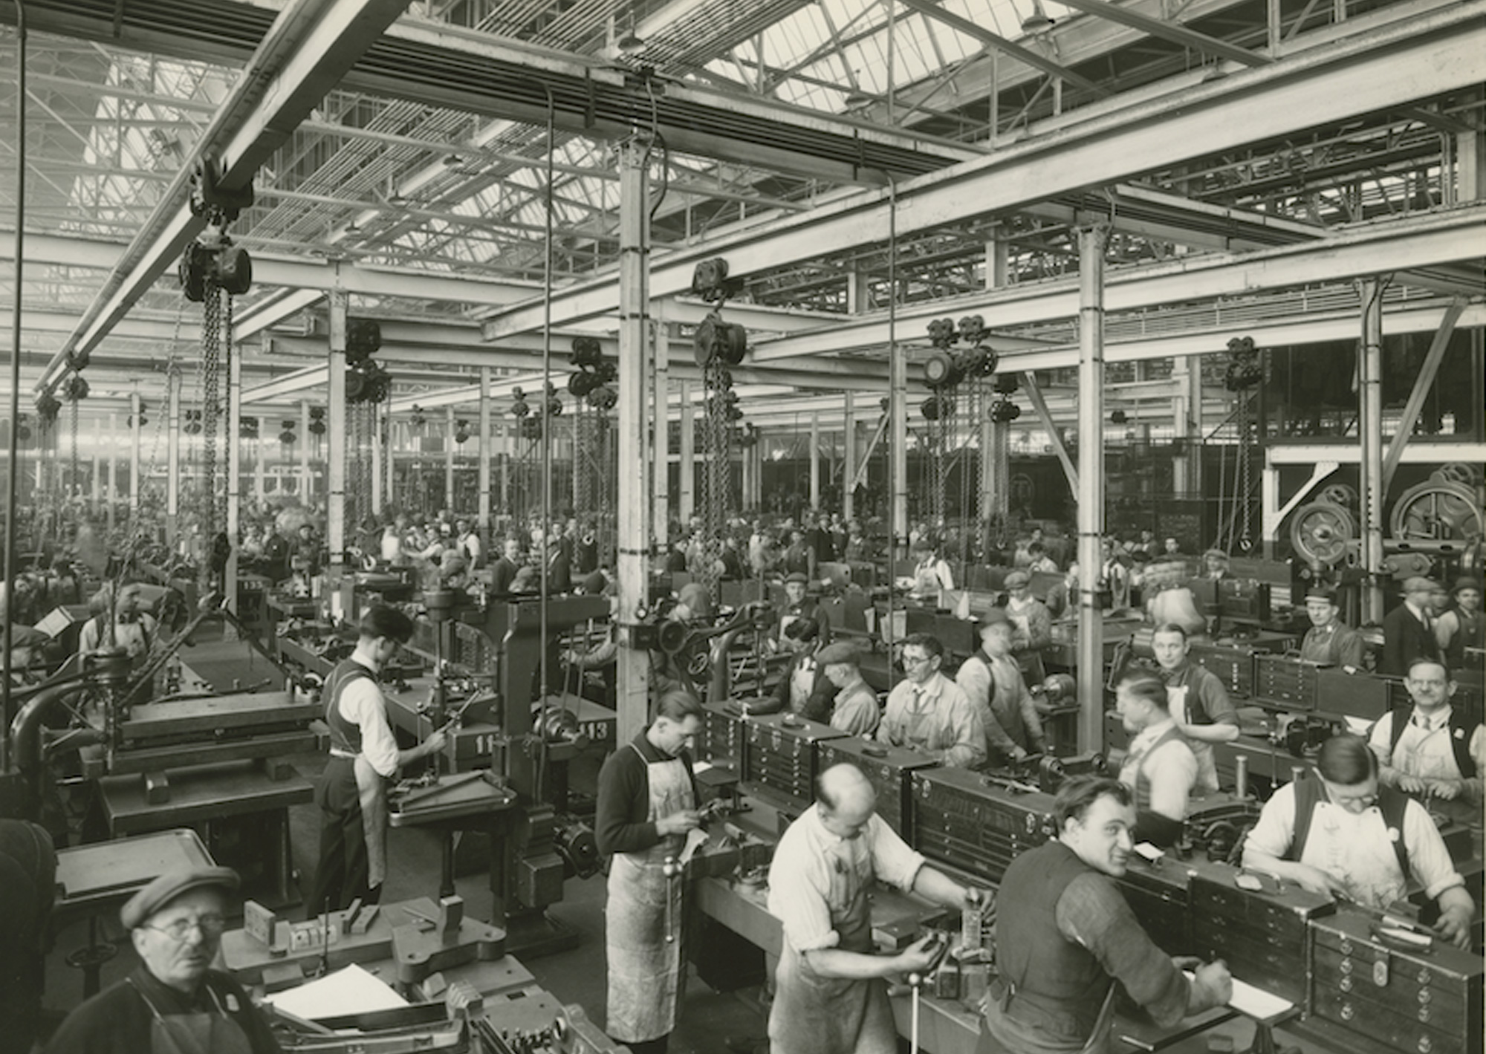
The Detroit Ford Factory
“Historical fact: people stopped being human in 1913. That was the year that Henry Ford put his cars on rollers and made his workers adopt the speed of the assembly line” (95).
“No one says a word” (95).
“[e]very fourteen seconds Wierzbicki reams a bearing and Stephanides grinds a bearing and O’Malley attaches a bearing to a camshaft” (95, x6).
“it was established by Mr. Ford . . . that no man is to receive the money who cannot use it advisedly and conservatively (100).
Lefty: a proletariat immigrant, an unclassifiable ethnic Other

Slide 12
“[t]he periods that witness the downfall of political and religious idols, periods of crisis, are particularly favourable to black moods” (Kristeva 8)
Alienation and guilt
Reduplication: hunger, displacement, trepidation, volatility
Desesdemona’s reduplicated trauma
“Look at that poor man. He looks like a refugee. Might as well be Smyrna, this city. What’s the difference?” (139).
“[e]verybody mixed. Turks, Greeks, the same” (145).
“[p]eople come in here, they say they know silk, but they don’t know nothing. Just hoping to get hired and fired,”
“No. I only want hire. No fire” (145).
The 1929 Depression

Slide 13

The Detroit Riots 1967
“history issues from a belated construction where bereaved memory and the spectrality of past suffering have the potential to disrupt any pretense to a homogeneous social totality and disclose ongoing form of social injustice” (Clewell 14-15). Which part of the novel refers to this pretense?
“Cal’s hermaphroditism emerges with the turmoil of Detroit and the family’s relocation” (Athanassakis 220).
a re-examination of historical/political processes can lead to a redefinition of a third generation’s fluid immigrant body

Slide 14
The Detroit Riots 1967
“We were ready to accept the Negroes. We weren’t prejudiced against them. We wanted to include them in our society if they would only act normal!” (Eugenides 240).
Normativity and normality
VS
chronic poverty and institutionalized marginalization
police brutality, discrimination and exploitation of the black prostitutes

Slide 15
Metamorphosis and Re-appropriation of trauma
Desdemona:
“Oh my God! Is like Smyrna! Look at the mavros! Like the Turks they are burning everything!” (240)
Callie:
“I’d already heard so much about Smyrna in my seven years that I watched closely to see what it has been like. But I didn’t understand. Sure, buildings were burning, bodies were lying in the street, but the mood wasn’t one of desperation. I’d never seen people so happy in my entire life . . . It looked more like a block party that it did a riot” (Eugenides 240).

Slide 16

The Second American Revolution
“[i]t’s impossible to know who all these [Black] snipers were. But it’s easy to understand why the police called them snipers . . . A sniper, by definition, acts alone. A sniper is cowardly, sneaky; he kills from a distance, unseen. It was convenient to call them snipers, because if they weren’t snipers, then what were they? The governor didn’t say it; the newspapers didn’t say it; the history book doesn’t say it, but I, who watched the entire thing on my bike, saw it clearly: in Detroit, in July of 1967, what happened was nothing less than a guerilla uprising. The Second American Revolution” (Eugenides 248).

Slide 17
Redefining Monstrosity
Hilary Malatino:
“[m]onstrosity [a]s a powerful trope that indexes categorical excess, liminality, and a refusal of neat identitarian codification . . . a phenomenological orientation that enables more liberatory ways of building and inhabiting spaces of resistance and flourishing (204, 209).
“Believe what you want. I was seven years old and followed a tank into battle and saw what I saw. It turned out that when it finally happened, the revolution wasn’t televised. On TV they called it only a riot” (Eugenides 250-1).

Slide 18
Middlesex
Historical- political trauma
Familial trauma

Slide 19
Lefty and Desdemona: Melancholia and a Life’s Love
Melancholic incorporation of the lost loved object
⬇️
The couple abstains from sex
Desire does not cease to exist
The Minotaur Show
“melancholic cannibalism “accounts for this passion for holding within the mouth (but vagina and anus also lend themselves to this control) the intolerable other” that, even though destroyed, it is “better [to] possess it alive . . . better fragmented than lost” (Kristeva12), with desertion, nourishment, separation, transformation and devouring figuring as protagonists in a cannibalistic melancholic act of intolerable grief

Slide 20
“A shattering testimony of love” (Bahun 27)
Lefty:
“look[s] up into the face of the woman who’d been the greatest love of his life and fail[s] to recognize her” (269).
Desdemona:
“[a]s far as Desdemona was concerned, death was only another kind of emigration. Instead of sailing from Turkey to America, this time she would be traveling from earth to heaven, where Lefty had already gotten his citizenship and had a place waiting” (275).
“even though it was only three in the afternoon, she got into bed. For the next ten years, except for a bath every Friday, she never got out again” (270).

Slide 21
The grandparents and Cal(lie) -death and life -space and time
Desdemona and Callie: Stasis and Present Absence
“Calliope feels gypped, cheated. ‘Remember me?’ she says, to nature. ‘I’m waiting. I’m still here. As was Desdemona on her bed” (286).
Death in life
Lefty and Callie: Inverted Time and Exchange
Lefty’s strokes 1. Callie is born 2. Callie frolics with Clementine
Lefty’s liminal survival:
“only a pause in the slow but inevitable dissolution of his mind . . . so that while we were moving ahead in time, he was moving back” (267).
Death

Slide 22
From Callie to Cal: puberty
Secrecy and silence ➡️
uncertaintly and fluidity ➡️
monstrosity and entrapment
“there remained a vague, indefinable gap” (330)
“what haunts are not the dead, but the gaps left within us by the secrets of others” (Abraham and Torok 171).
What tricks does teenage Callie employ to hide her developmental gap?

Slide 23
From Callie to Cal: the Object
Sex with the Object
Secrecy, ecstasy and fluidity
“The Object’s eyes remained closed throughout . . . she moved under me like a sleeping girl might while being ravished by an incubus. She was like somebody having a dirty dream, confusing her pillow for a lover” (387).
“My ecstatic intuition about myself was now deeply suppressed . . . [b]ut in the end it wasn’t up to me. The big things never are. Birth, I mean, and death. And love. And what love bequeaths to us before we’re born” (388).

Slide 24
From Callie to Cal: Jerome
“Jerome came after my in his Dracula getup” (392)
Monstrosity
Transgression
“The tractor had just made a turn on the road . . . I hit it dead on” (393)
The new era

Slide 25
Recapitulation
Familial trauma interacts with historical trauma
Callie bequeaths the gene and trauma(s)
The psychological interacts with the somatic
Key notions in Books Two and Three
Reduplication of trauma
Metamorphosis of trauma
Melancholic incorporation
Absence, guilt, secrecy
Exchange
Monstrosity

Slide 26
Sources
Abraham, Nicolas, and Maria Torok. The Shell and the Kernel: Renewals of Psychoanalysis, edited, translated and introduced by Nicholas T. Rand, vol 1, The U of Chicago P, 1994.
Athanassakis, Yanoula. “’The American girl I had once been’: Psychosomatic Trauma and History in Jeffrey Eugenides’ Middlesex.” European Journal of American Culture, vol.30, no.3, 2011, pp. 217-230.
Bahun, Sanja. Modernism and Melancholia: Writing as Countermourning. Oxford UP, 2014.
Butler, Judith. Precarious Life: The Powers of Mourning and Violence. Verso, 2004.
Clewell, Tammy. Mourning, Modernism, Postmodernism. Palgrave Macmillan, 2009.
Eugenides, Jeffrey. Middlesex. Bloomsbury, 2003.
Kolk, van der, and van der Hart. “The Intrusive Past.” Trauma: Explorations in Memory. edited by Cathy Caruth, John Hopkins UP, 1995, pp.158-182.
Kristeva, Julia. Black Sun: Depression and Melancholia. Translated by Leon S. Roudiez, Columbia UP, 1992.
LaCapra, Dominik. “Reflections on Trauma, Absence, Loss.” Whose Freud? The Place of Psychoanalysis in Contemporary Culture, edited by Peter Brooks and Alex Woloch. Yale UP, 1995, pp. 178-204, 2000.
---. Writing History, Writing Trauma. John Hopkins UP, 2014.
Malatino, Hilary. Queer Embodiment: Monstrosity, Medical Violence and Intersex Experience. University of Nebraska P, 2019. Expanding Frontiers: Interdisciplinary Approaches to Studies of Women, Gender, and Sexuality.

Slide 27

Thank you
kmoutafidou@enl.auth.gr

Slide 28
Excerpts Appendix
“And suddenly my father was shouting my name. “Callie!”
“What?”
“Get over here right now!”
Marius stood up awkwardly from his chair. “We were just talking,” he said. “Smart little girl you got here.”
“You stay away from her, you hear me?”
“Daddy!” I protested, appalled, embarrassed for my friend.
But Marius’s voice was soft. “It’s cool, little Cleo. Got this test and all. Go on back to your dad.”
For the rest of that day Milton kept after me. “You are never, ever, to talk to strangers like that. What’s the matter with you?”
“He’s not a stranger. His name is Marius Wyxzewixard Challouehliczilczese Grimes.”
“You hear me? You stay away from people like that.”
Afterward, Milton told my grandfather to stop bringing me down to the diner for lunch. But I would come again, in just a few months, under my own power.” (231)

Slide 29
Excerpts Appendix
“Middlesex! Did anybody ever live in a house as strange? As sci-fi? As futuristic and outdated at the same time? A house that was more like communism, better in theory than reality? The walls were pale yellow, made of octagonal stone blocks framed by redwood siding along the roofline. Plate glass windows ran along the front. Hudson Clark (whose name Milton would drop for years to come, despite the fact that no one ever recognized it) had designed Middlesex to harmonize with the natural surroundings. In this case, that meant the two weeping willow trees and the mulberry growing against the front of the house. Forgetting where he was (a conservative suburb) and what was on the other side of those trees (the Turnbulls and the Picketts), Clark followed the principles of Frank Lloyd Wright, banishing the Victorian vertical in favor of a midwestern horizontal, opening up the interior spaces, and bringing in a Japanese influence. Middlesex was a testament to theory uncompromised by practicality. For instance: Hudson Clark hadn’t believed in doors. The concept of the door, of this thing that swung one way or the other, was outmoded. So on Middlesex we didn’t have doors. Instead “Instead we had long, accordion-like barriers, made from sisal, that worked by a pneumatic pump located down in the basement. The concept of stairs in the traditional sense was also something the world no longer needed. Stairs represented a teleological view of the universe, of one thing leading to another, whereas now everyone knew that one thing didn’t lead to another but often nowhere at all. So neither did our stairs. Oh, they went up, eventually. They took the persistent climber to the second floor, but on the way they took him lots of other places as well. There was a landing, for instance, overhung with a mobile. The stairway walls had peepholes and shelves cut into them. As you climbed, you could see the legs of someone passing along the hallway above. You could spy on someone down in the living room.”
“What do you mean it doesn’t work?”
“Oh, this is wonderful, Milt. No closets, and now we have to call the fire department to get Callie out of the door.”
“It’s not designed to have someone’s neck in it.”
“Mana!”
“Can you breathe, honey?”
“Yeah, but it hurts.” (258-9)

Slide 30
Excerpts Appendix
“I am too stunned to move or speak. How long has he been there? What did he see? “We were just doing water ballet,” Clementine says lamely. The steam parts again. Lefty hasn’t moved. He’s sitting exactly as before, head tilted to one side. He looks as pale as Clementine. For one crazy second I think he’s playing our driving game, pretending to asleep, but then I understand that he will never play anything ever again . . .” (266)
“But this stage didn’t last long. My grandfather’s mind, locked in its graveyard spiral, accelerated as it hurtled toward its destruction, and three days later he started cooing like a baby and the next he started soiling himself. At that point, when there was almost nothing left of him, God allowed Lefty Stephanides to remain another three months, until the winter of 1970. In the end he became as fragmentary as the poems of Sappho he never succeeded in restoring, and finally one morning he looked up into the face of the woman who’d been the greatest love of his life and failed to recognize her. And then there was another kind of blow inside his head; blood pooled in his brain for the last time, washing even the last fragments of his self away.” (268-9)

Slide 31
Excerpts Appendix
“From the beginning there existed a strange balance between my grandfather and me. As I cried my first cry, Lefty was silenced; and as he gradually lost the ability to see, to taste, to hear, to think or even remember, I began to see, taste, and remember everything, even stuff I hadn’t seen, eaten, or done. Already latent inside me, like the future 120 mph serve of a tennis prodigy, was the ability to communicate between the genders, to see not with the monovision of one sex but in the stereoscope of both. (269)
“I am going to bed,” Desdemona said again. She turned and went inside. Beside the bed, her silkworm box was still open.
“For the next ten years, except for a bath every Friday, she never got out again.” (270)
“As far as Desdemona was concerned, death was only another kind of emigration. Instead of sailing from Turkey to America, this time she would be traveling from earth to heaven, where Lefty had already gotten his citizenship and had a place waiting.” (275)

Slide 32
Excerpts Appendix
“Passing by their lockers in seventh grade, I wasn’t aware of all this yet. I look back now (as Dr. Luce urged me to do) to see exactly what twelve-year-old Calliope was feeling, watching the Charm Bracelets undress in steamy light. Was there a shiver of arousal in her? Did flesh respond beneath goalie pads? I try to remember, but what comes back is only a bundle of emotions: envy, certainly, but also disdain. Inferiority and superiority at once. Above all, there was panic.” (297)
“Ethnic” girls we were called, but then who wasn’t, when you got right down to it? Weren’t the Charm Bracelets every bit as ethnic? Weren’t they as full of strange rituals and food? Of tribal speech? They said “bogue” for repulsive and “queer” for weird. They ate tiny, crustless sandwiches on white bread—cucumber sandwiches, mayonnaise, and something called “watercress.” Until we came to Baker & Inglis my friends and I had always felt “completely American. But now the Bracelets’ upturned noses suggested that there was another America to which we could never gain admittance. All of a sudden America wasn’t about hamburgers and hot rods anymore. It was about theMayflower and Plymouth Rock. It was about something that had happened for two minutes four hundred years ago, instead of everything that had happened since. Instead of everything that was happening now!” (298-299)
“I waited until they left before I undressed.”
“I wasn’t naked for a second.” (299)

Slide 33
Excerpts Appendix
“The basement bathroom was the opposite of our locker room. The stalls were seven feet high and extended all the way to the floor. Fossilized marble concealed me even better than my hair. In the basement bathroom was a time frame I felt much more comfortable with, not the rat race of the “school upstairs but the slow, evolutionary progress of the earth, of its plant and animal life forming out of the generative, primeval mud. The faucets dripped with the slow, inexorable movement of time and I was alone down there, and safe. Safe from my confused feelings about the Obscure Object; and safe, too, from the bits of conversation I’d been overhearing from my parents’ bedroom. Just the night before, Milton’s exasperated voice had reached my ears: “You still got a headache? Christ, take some aspirin.” “I took some already,” my mother replied. “Nothing helps.” Then my brother’s name, and my father grumbling something I couldn’t make out. Then Tessie: “I’m worried about Callie, too. She still hasn’t gotten her period.” “Hell, she’s only thirteen.” “She’s fourteen . And look how tall she is. I think something’s wrong.” Silence a moment, after which my father asked, “What does Dr. Phil say?” “Dr. Phil! He doesn’t say anything. I want to take her to someone else.” (328-9)

Slide 34
Excerpts Appendix
“Allow me an anachronism. Luis Buñuel’s That Obscure Object of Desire didn’t come out until 1977. By that time the redheaded girl and I were no longer in touch. I doubt she ever saw the movie. Nevertheless, that Obscure Object of Desire is what I think about when I think about her. I saw it on television, in a Spanish bar, when I was stationed in Madrid. I didn’t catch most of the dialogue. The plot was clear enough, though. An older gentleman played by Fernando Rey is smitten with a young and beautiful girl played by Carole Bouquet and Angela Molina. I didn’t care about any of that. It was the surrealist touch that got me. In many scenes Fernando Rey is shown holding a heavy sack over his shoulder. The reason for this sack is never mentioned. (Or if it is, I missed that, too.) He just goes around lugging this sack, into restaurants and through city parks. That was exactly how I felt, following my own Obscure Object. As though I were carrying around a mysterious, unexplained burden or weight.” (325)
“Which leads me to a terrible confession. It is this. While Mrs. Grossinger tried to breathe life back into Maxine’s body, while the sun set melodramatically over a death that wasn’t in the script, I felt a wave of pure happiness surge through my body. Every nerve, every corpuscle, lit up. I had the Obscure Object in my arms.” (339)

Slide 35
Excerpts Appendix
“The U.S. isn’t helping the Turks,” Milton went on. “They just don’t want the Junta to get out of hand.”
In 1922, while Smyrna burned, American warships sat idly by. Fifty-two years later, off the coast of Cyprus, they also did nothing. At least ostensibly.
“Don’t be so naïve, Milt,” Jimmy Fioretos again. “Who do you think’s jamming the radar? It’s the Americans, Milt. It’s us.”
“Were these accusations true? I can’t say for sure. All I know is this: on that morning, somebody jammed the Cypriot radar, guaranteeing the success of the Turkish invasion. Did the Turks possess such technology? No. Did the U.S. warships? Yes. But this isn’t something you can prove . . .” (359)

Slide 36
Excerpts Appendix
“Here were the freckles on the forehead, on the bridge of the nose, along the ears. But it wasn’t the right face; they weren’t the right freckles, and the hair was dyed black. Behind my impassive face my soul curled up into a ball, waiting until the unpleasantness was over.” (373)
“Ecstasy. From the Greek Ekstasis . Meaning not what you think. Meaning not euphoria or sexual climax or even happiness. Meaning, literally: a state of displacement, of being driven out of one’s senses. Three thousand years ago in Delphi the Oracle became ecstatic every single working hour. That night in a hunting cabin in northern Michigan, so did Calliope. High for my first time, drunk for my first time, I felt myself dissolving, turning to vapor. Like the incense at church my soul rose toward the dome of my skull—and then broke through. I drifted over the plank floor. I floated above the little camp stove. Passing by the bourbon bottles, I hovered over the other cot, looking down at the Object. And then, because I suddenly knew that I could, I slipped into the body of Rex Reese. I entered him like a god so that it was me, and not Rex, who kissed her.” (374)

Slide 37
Excerpts Appendix
“ Ιt was all over now. There was nothing I could do. Jerome would tell Rex. Rex would tell the Object. She would stop being my friend. By the time school started, everyone at Baker & Inglis would know that Calliope Stephanides was a freak. I was waiting for Jerome to jump up and run. I felt panicked and, at the same time, strangely calm. I was putting things together in my head. Clementine Stark and kissing lessons; and spinning together in a hot tub; an amphibian heart and a crocus blooming; blood and breasts that didn’t come; and a crush on the Object that did, that had , that looked as if it was here to stay” (375-6)
“I took off across the porch. I jumped down the steps and tore across the back lawn, barefoot. Jerome came after me in his Dracula getup. He stopped to fling off the coat and I increased the distance between us. Through the backyards of the neighboring houses I ran, ducking under pine branches. I dodged bushes and barbecues. The pine needles gave good traction under my feet. Finally I reached the open field beyond and fled into it. When I looked back Jerome was gaining on me.” (392)

