Slide 1
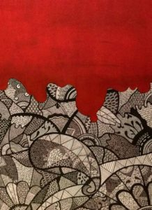
After Postmodernism: American Studies in the 21st Century December 17-19, 2020
International Conference
After Postmodernism: American Studies in the 21st Century December 17-19, 2020
Venue
Conference email address: afterpomo@enl.uoa.gr
Keynote Speakers
Organizing Committee
Home Page
Call for Papers
Speakers
Abstracts
Registration
Conference Venue
Accommodation
Program
Performance

Slide 2
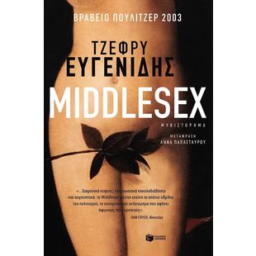
GENDER ISSUE discovery of his "true biological self”

Slide 3
There it was, monster, in black in white, in a battered dictionary in a great city library. […] Here was a book that contained the collected knowledge of the past while giving evidence of present social conditions. […] The synonym was official, authoritative; it was the verdict that the culture gave on a person like her. Monster. That was what she was. That was what Dr. Luce and his colleagues had been saying. It explained so much, really (M, 431, emphasis in the text).

Slide 4
[G]ender is not a noun, but neither is it a set of free-floating attributes […] the substantive effect of gender is performatively produced and compelled by the regulatory practices of gender coherence. Hence, within the inherited discourse of the metaphysics of substance, gender proves to be performative - that is, constituting the identity it is purported to be. In this sense, gender is always a doing. […] There is no gender identity behind the expressions of gender; that identity is performatively constituted by the very “expressions” that are said to be its results.
And names, according to Judith Butler:[…] sustain the integrity of the body. What constitutes the integral body is not a natural boundary or organic telos, but the law of kinship that works through the name. […] To be named is thus to be inculcated into that law and to be formed, bodily, in accordance with that law”

Slide 5
Cal makes clear: “I’m not androgynous in the least. […] In other words, I operate in society as a man [… ] I’ve lived more than half my life as a male, and by now everything comes naturally. When Calliope surfaces, she does so like a childhood speech impediment. Suddenly there she is again, doing a hair flip, or checking her nails. It’s a little like being possessed.”
"All I know is this: despite my androgenized brain, there's an innate feminine circularity in the story I have to tell" (p. 20).

Slide 6
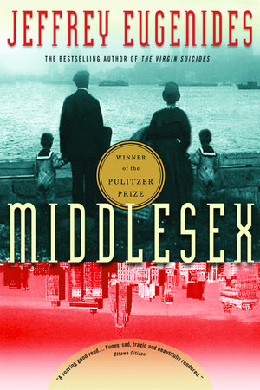
Middlesex as ethnic novel ? Eugenides, Interview: “[t]he book is really about American identity and the mongrels we all are”

Slide 7
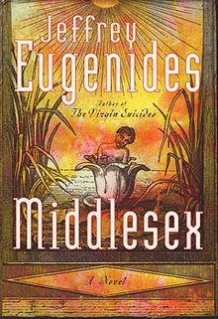
Myths of travel and border crossings are inevitable . . . But they are also laden with the histories of other identity negotiations, and they carry the burden of national and colonial discursive histories Judith Halberstam, Female Masculinity

Slide 8
Self –reflective narrative strategies
“Sing, Muse, of Greek ladies and their battle against unsightly hair! Sing of depilatory creams and tweezers! Of bleach and beeswax! Sing how the unsightly black fuzz, like the Persian legions of Darius, sweeps over the Achaean mainland of girls barely into their teens!” (p. 308).

Slide 9
Retrospective narration/logic complicit with a heteronormative temporality
When this story goes out into the world, I may become the most famous hermaphrodite in history
"To the extent that fetal hormones affect brain chemistry and histology, I've got a male brain. But I was raised a girl (19)
That summer - while the President's lies were also getting more elaborate - I started faking my period. With Nixonian cunning, Calliope unwrapped and flushed away a flotilla of unused Tampax. I feigned symptoms from headache to fatigue. I did cramps the way Meryl Streep did accents (361)

Slide 10
“Half the time I write like a bad George Eliot, the other half like a bad Salinger […] But on that Smith Corona I quickly discovered that telling the truth wasn’t nearly as much fun as making things up. I also knew that I was writing for an audience – Dr. Luce – and that if I seemed normal enough, he might send me back home” (418)

Slide 11
A discursive birth
Callie cannot have a baby. Instead of silence and aporia as typical effects of trauma, there is excess of information and details, a multiplicity of plots and subplots. In cinematographic terms, it could be defined as a “multiple-focus narrative”
heteroglossia in the novel, “a comic playing with languages, story ‘not from the author’(but from a narrator, posited author, or character), character speech, character zones and [. . .] various introductory or framing genres” (Bakhtin 1981)

Slide 12
Julie and Cal’s third birth I was born twice: first, as a baby girl, on a remarkably smogless Detroit January of 1960; and then again, as a teenage boy, in an emergency Petoskey, Michigan, in August of 1974 . . . But now, at the age of forty-one, another birth coming. “Asian chicks are the last stop. If a guy’s in the closet, he goes for an Asian because their bodies are more like boys”

Slide 13

I was born twice: first, as a baby girl, on a remarkably smogless Detroit January of 1960; and then again, as a teenage boy, in an emergency Petoskey, Michigan, in August of 1974 . . . But now, at the age of forty-one, another birth coming.
“Asian chicks are the last stop. If a guy’s in the closet, he goes for an Asian because their bodies are more like boys”

Slide 14
INTERVIEWS
“[t]he book is really about American identity and the mongrels we all are”
“In this life we grow backwards,” writes Eugenides. “Living sends a person not into the future but back into the past, to childhood and before birth, finally, to commune with the dead. You get older, you puff on the stairs, you enter the body of your father. From there it’s only a quick jump to your grandparents, and then before you know it you’re time-traveling.”

