Slide 1
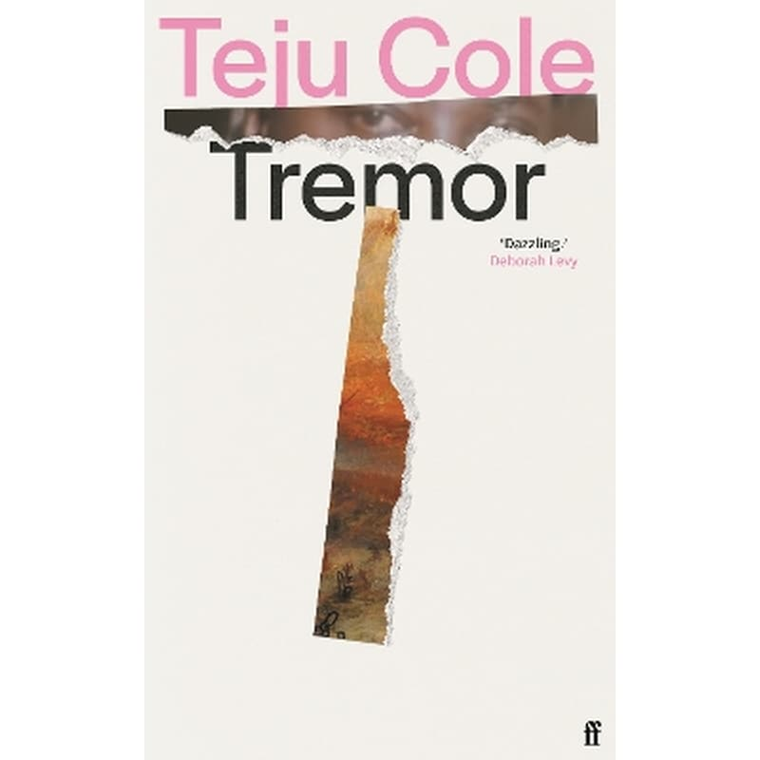
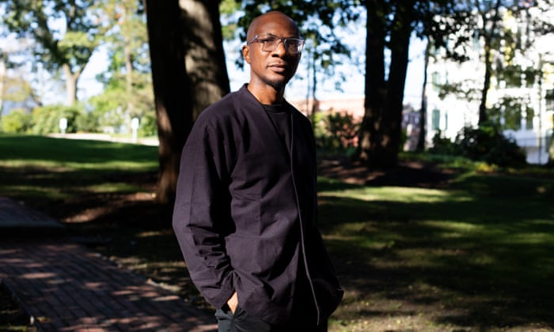

Slide 2
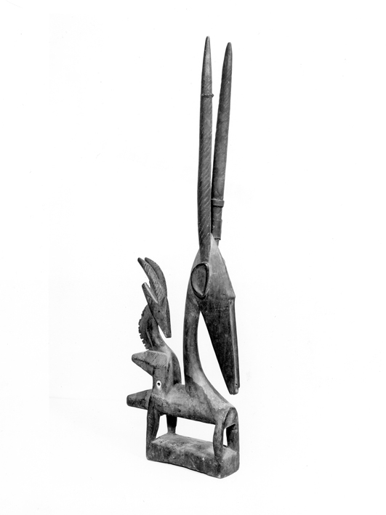
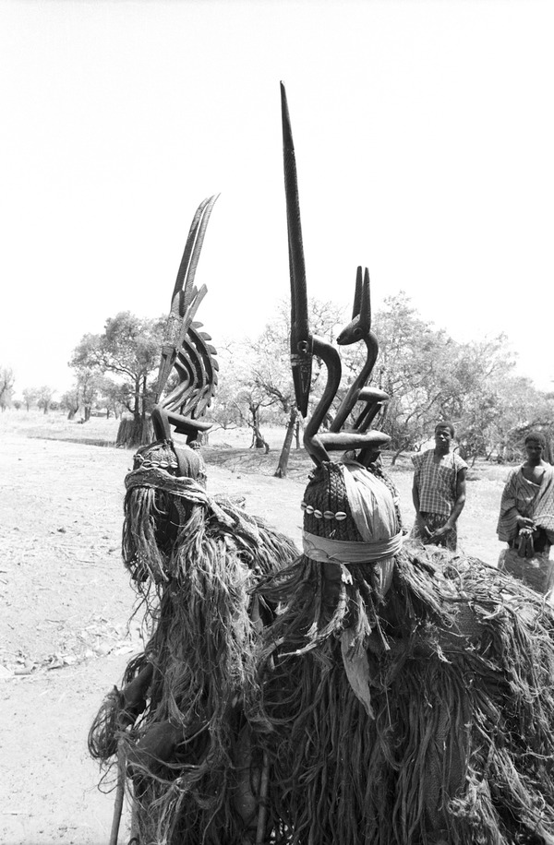
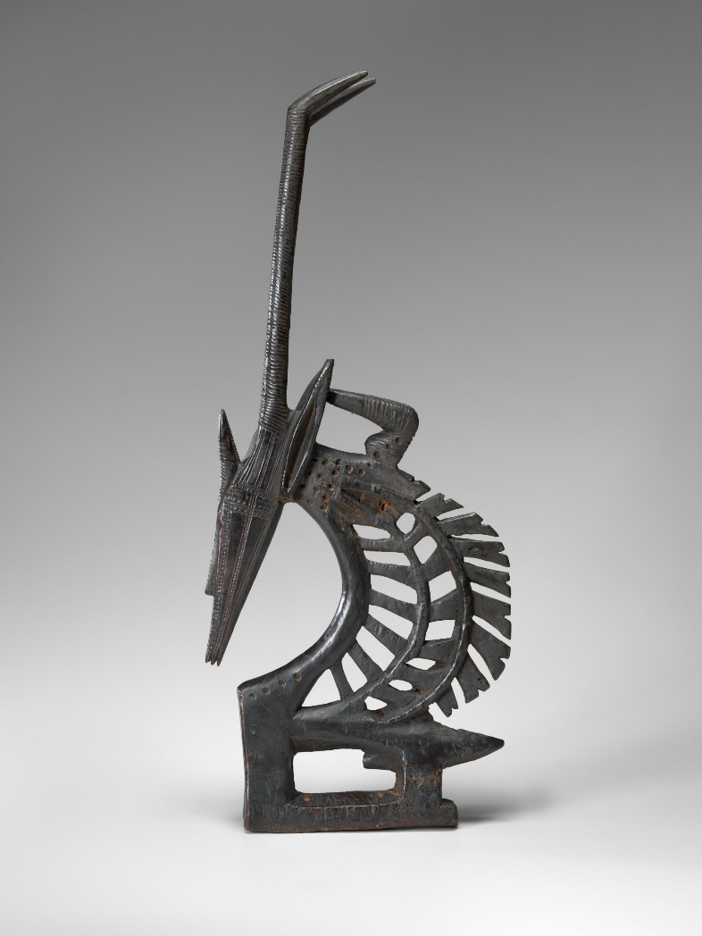
antelope headdresses
"Ci wara" headdresses

Slide 3
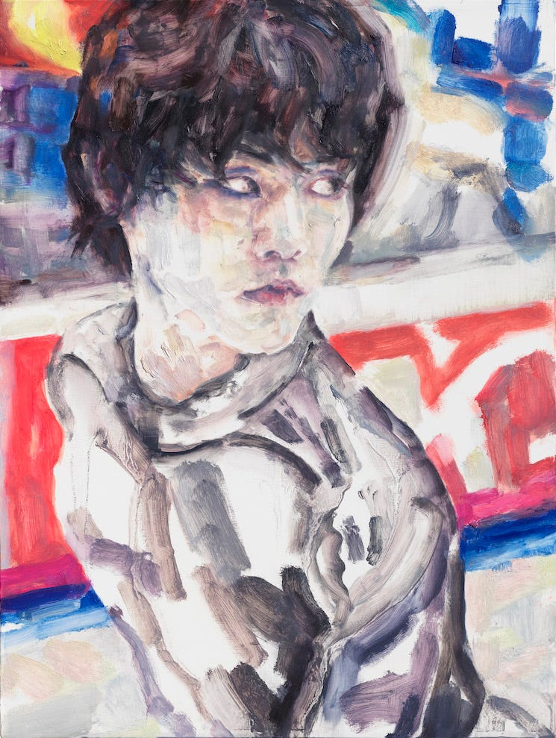

Elizabeth Joy Peyton (born 1965) is an American contemporary artist working primarily in painting, drawing

Slide 4
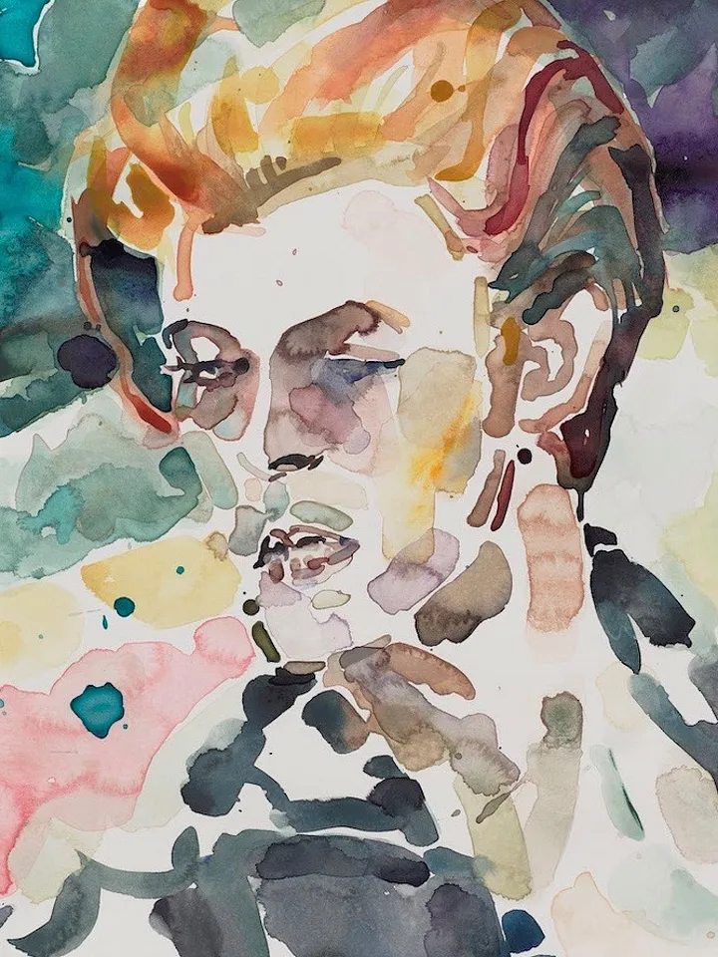
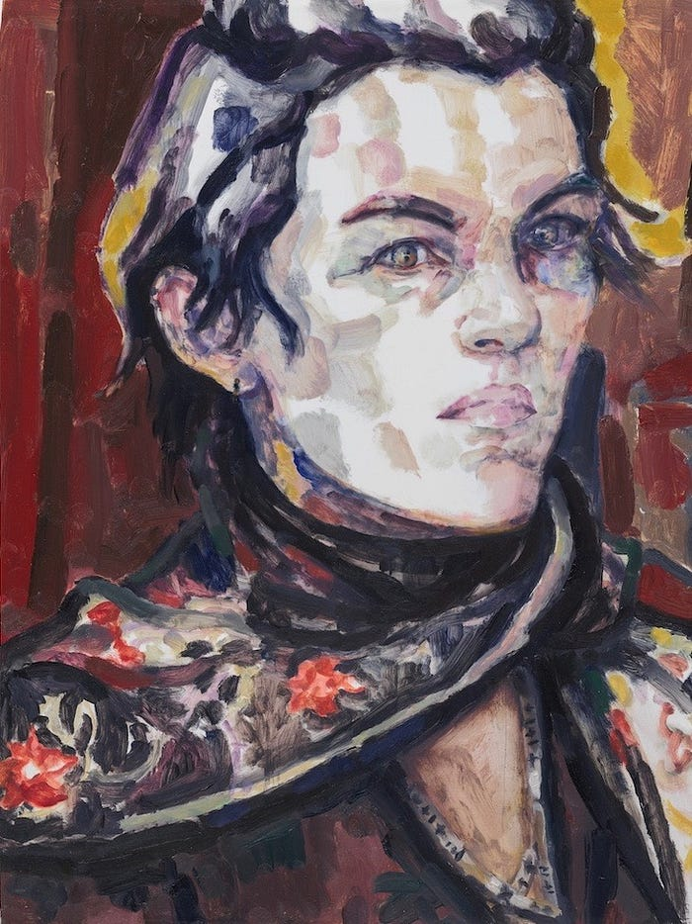
Peyton has painted Kurt Cobain and David Bowie, David Hockney and scenes from the Twilight films, as well as personal friends and lovers. Her eye tends towards the sheen of beauty, where cheekbones are elevated and noses are streamlined.

Slide 5

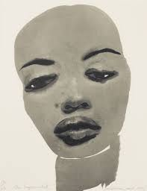
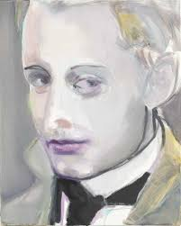
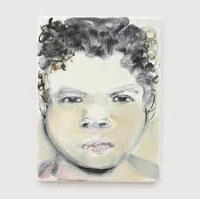
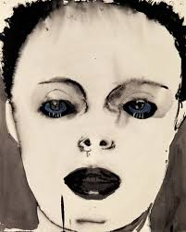
Marlene Dumas (born 3 August 1953) is a South African artist and painter based in the Netherlands.

Slide 6
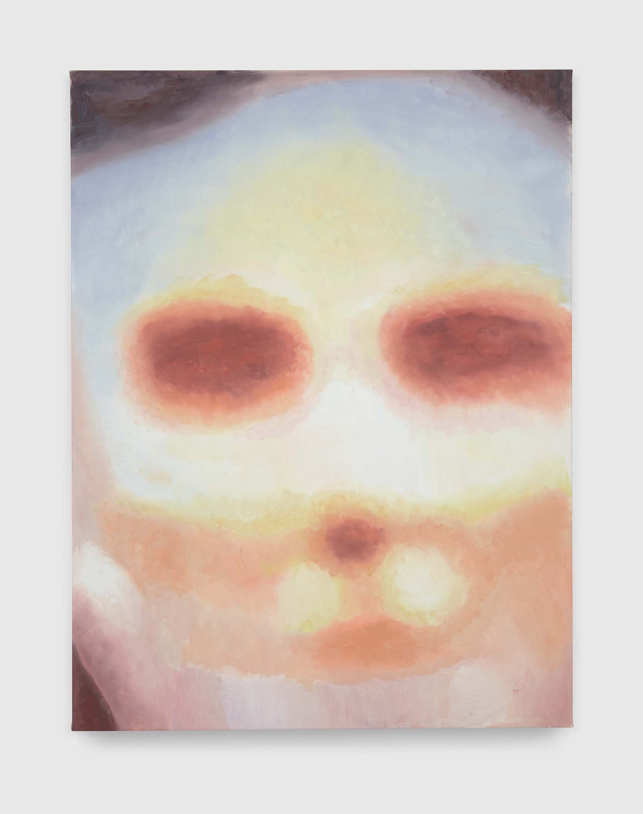
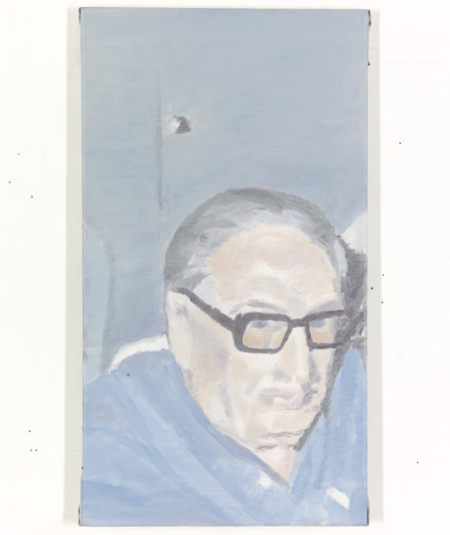
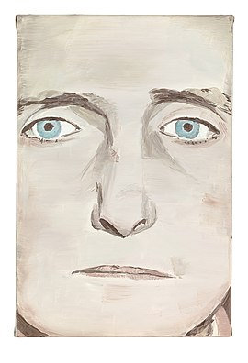

Luc Tuymans (born 14 June 1958) is a Belgian visual artist best known for his paintings which explore people's relationship with history and confront their ability to ignore it. as if they’ve been bleached-out. These are paintings that play on ideas of memory and history.

Slide 7


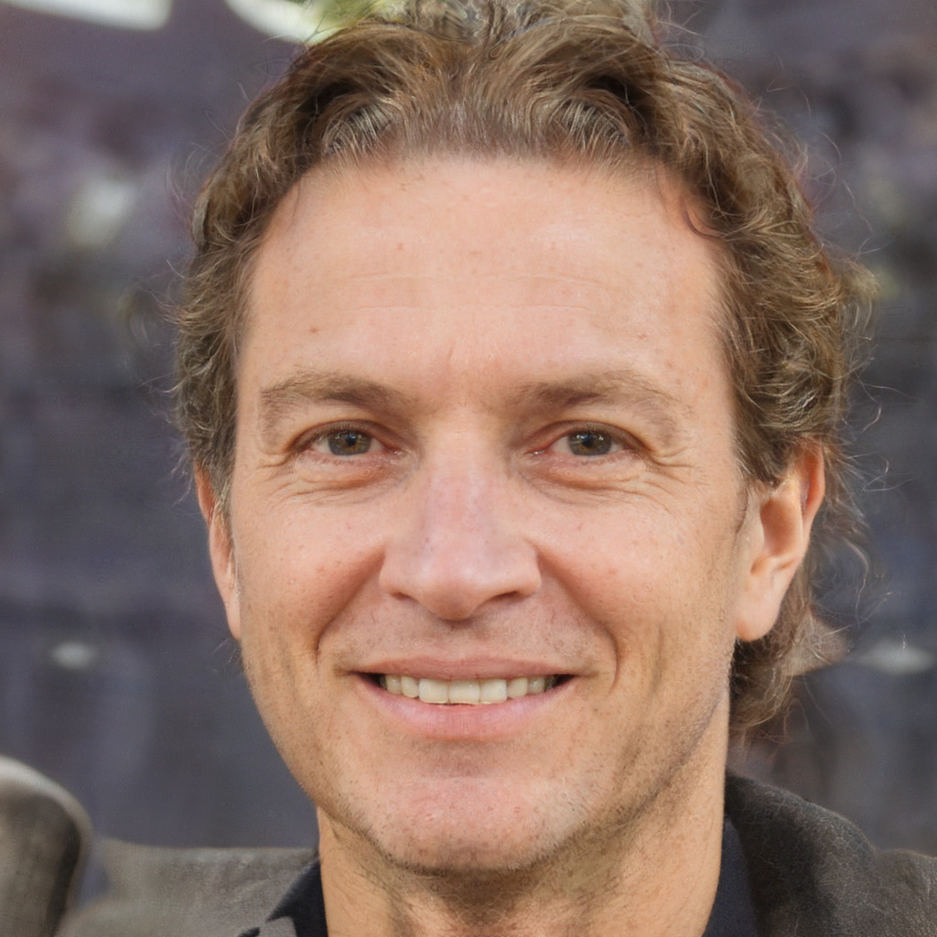


How to Generate a Person Who Doesn't Exist: https://thispersonnotexist.org/

Slide 8
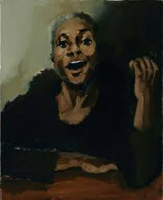
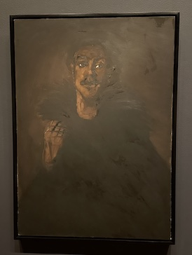
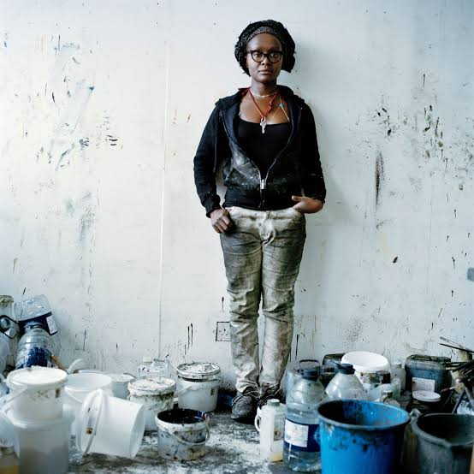
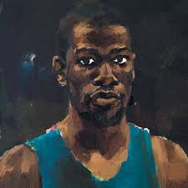

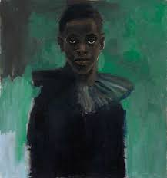
Lynette Yiadom-Boakye (born 1977) is a British painter and writer, of Ghanaian heritage. She is best known for her portraits of imaginary subjects, or ones derived from found objects, which are painted in muted colours.

Slide 9
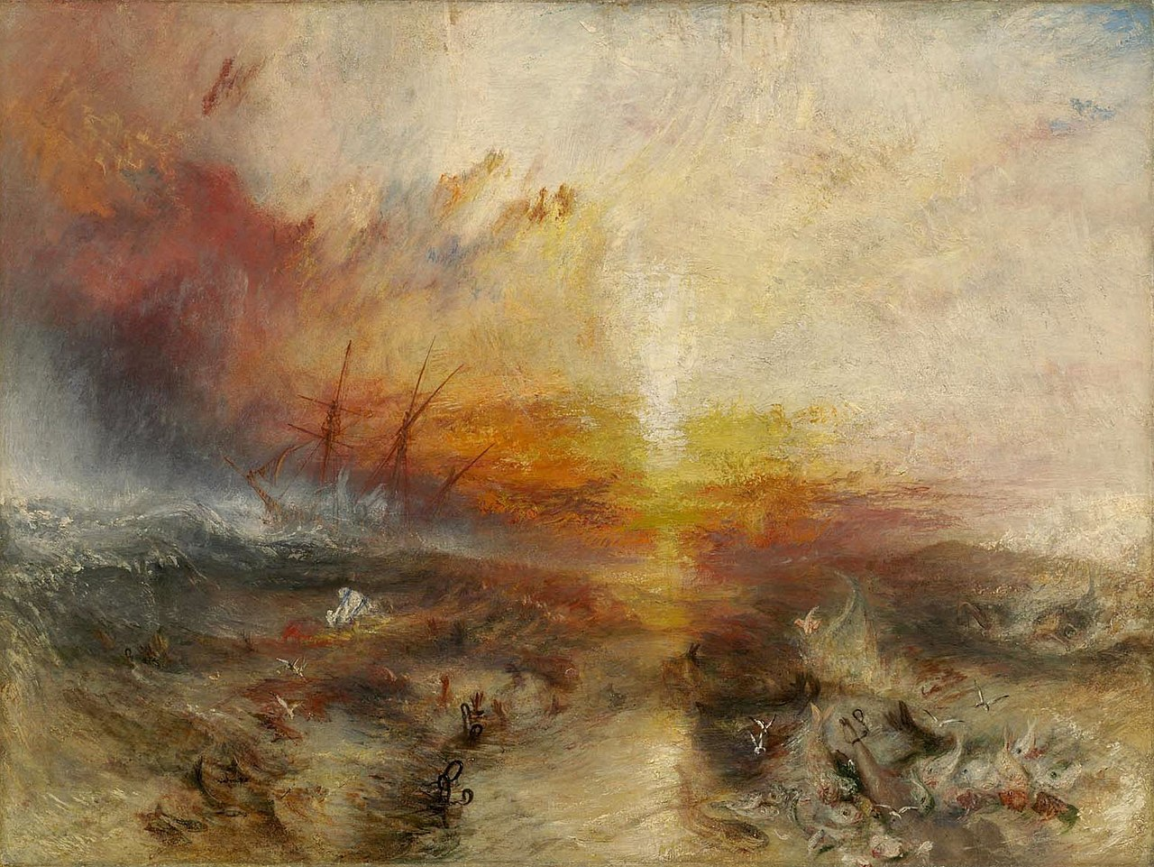
The Slave Ship,
originally titled
Slavers Throwing overboard the Dead and Dying—Typhon coming on

Slide 10
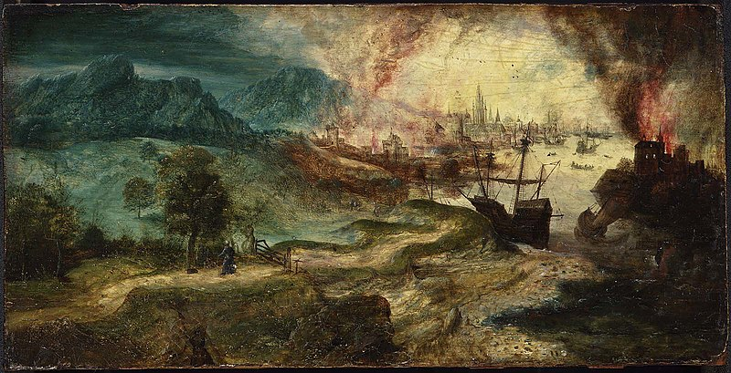
Herri Met De Bles - Landscape with Burning City

Slide 11
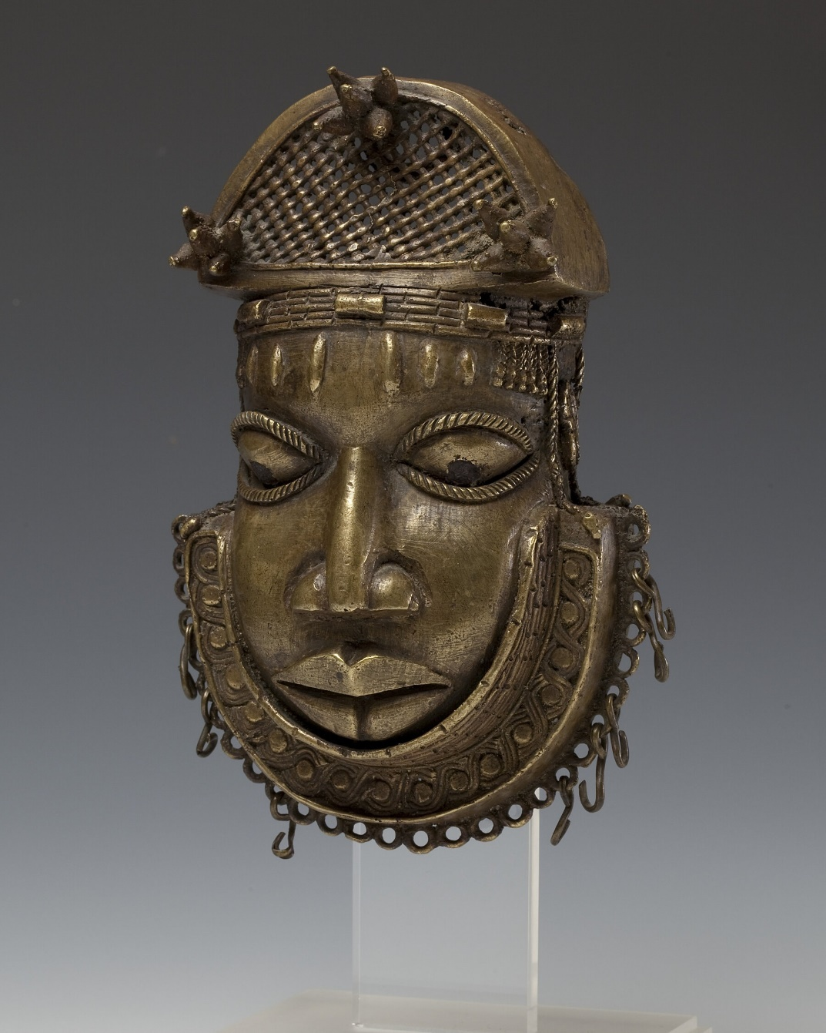
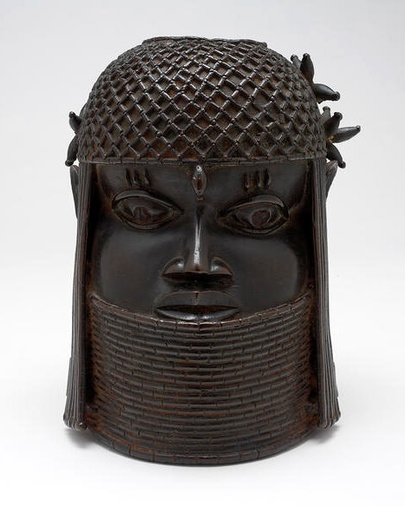

Benin Bronzes from six U.S. museums that have been returned, or have been designated to be returned. The artifacts were originally seized by British soldiers in 1897.

Slide 12
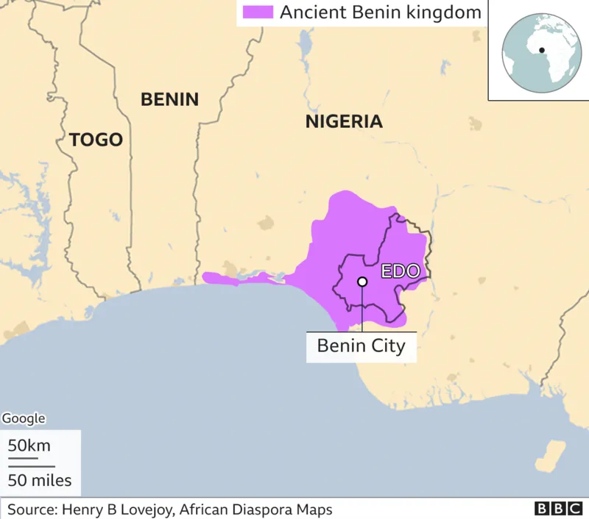
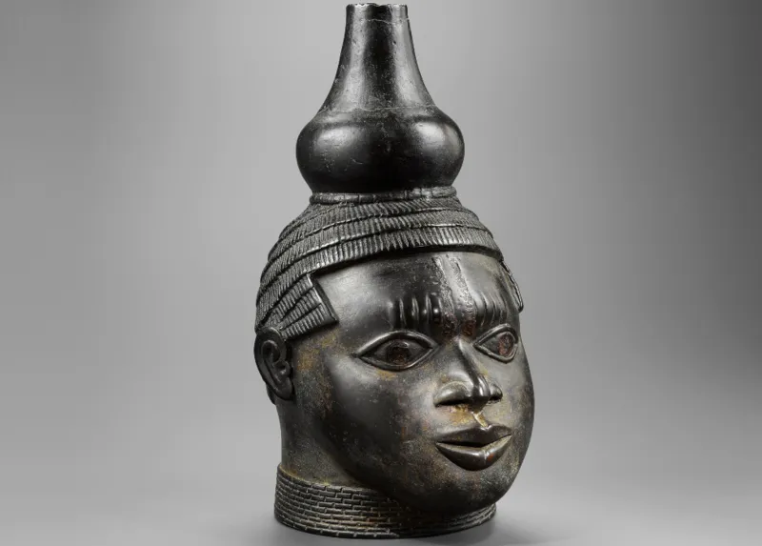
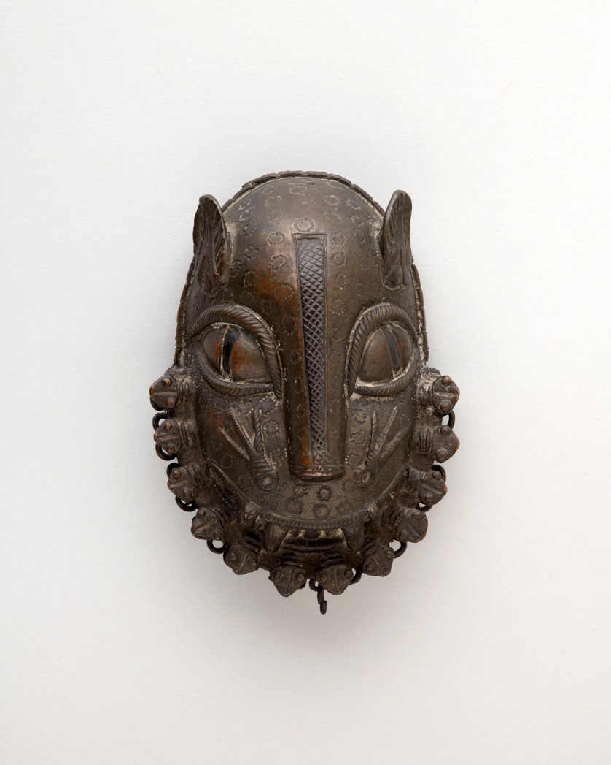
The Smithsonian Institution this year adopted an ethical returns policy that holds that issues of fairness could trump any legal title it might possess. Put forward as Exhibit A of its new seriousness was an announcement that it would return 29 Benin Bronzes to Nigeria.
The bronzes, which carry that name even though they were often made from brass, ivory or wood, are not being given back as a matter of law, but, experts say, as a matter of morality. The Kingdom of Benin, in what is now southern Nigeria, had no heritage law in place in 1897 when British soldiers seized thousands of them as trophies.
The bronzes have become a focal point for the repatriation debate. At least 50 American museums hold at least one Benin bronze and there are a total of roughly 1,100 in the U.S. So far, at least 10 museums have returned bronzes or are planning to.
Critics complain that, among other things, such returns take treasures that showcase a country’s artistic brilliance from an international capital like Washington, where they are much seen, and send them to remote, uncertain settings. One organization, the Restitution Study Group, has sued to block the Smithsonian’s transfers. Deadria Farmer-Paellmann, executive director of the group, said her ancestors were traded as slaves from ports controlled by the Kingdom of Benin, where colonial-era rulers participated in the slave trade. She views the artifacts, some of which are said to have been created from the very metal that was exchanged for slaves, as part of her heritage and often took her daughter to see them at museums.
https://www.nytimes.com/2022/12/13/arts/museums-looted-art-repatriation.html

Slide 13
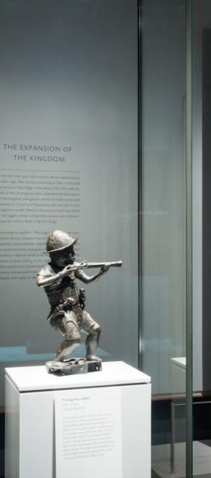
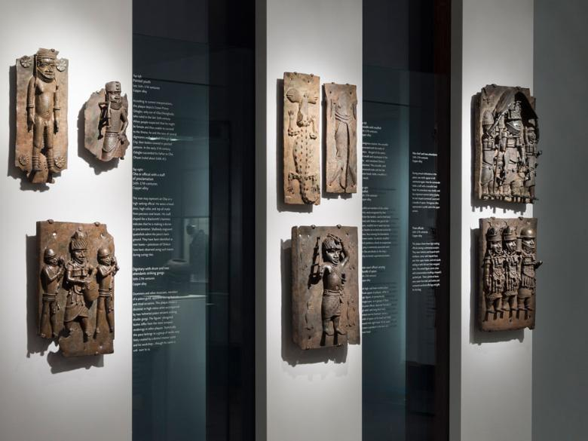
Benin
Kingdom
Gallery

Slide 14
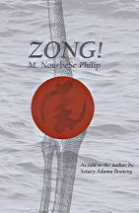
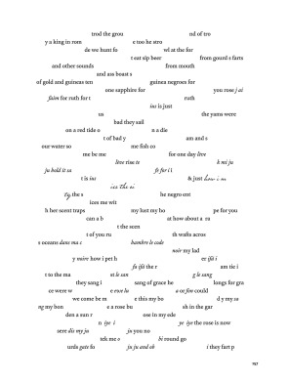

Slide 15
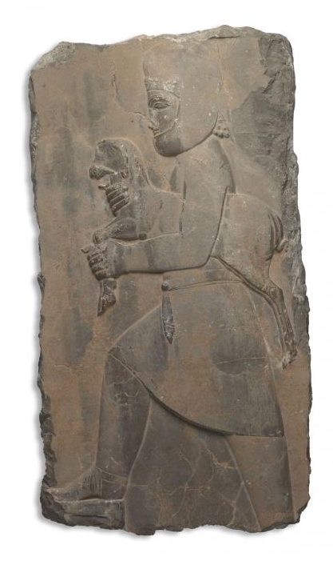
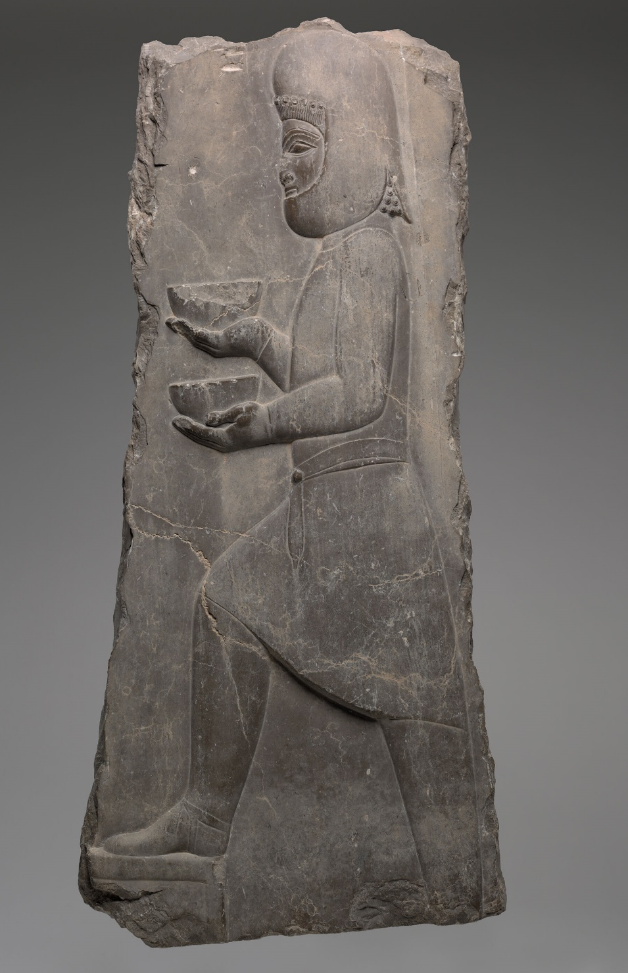
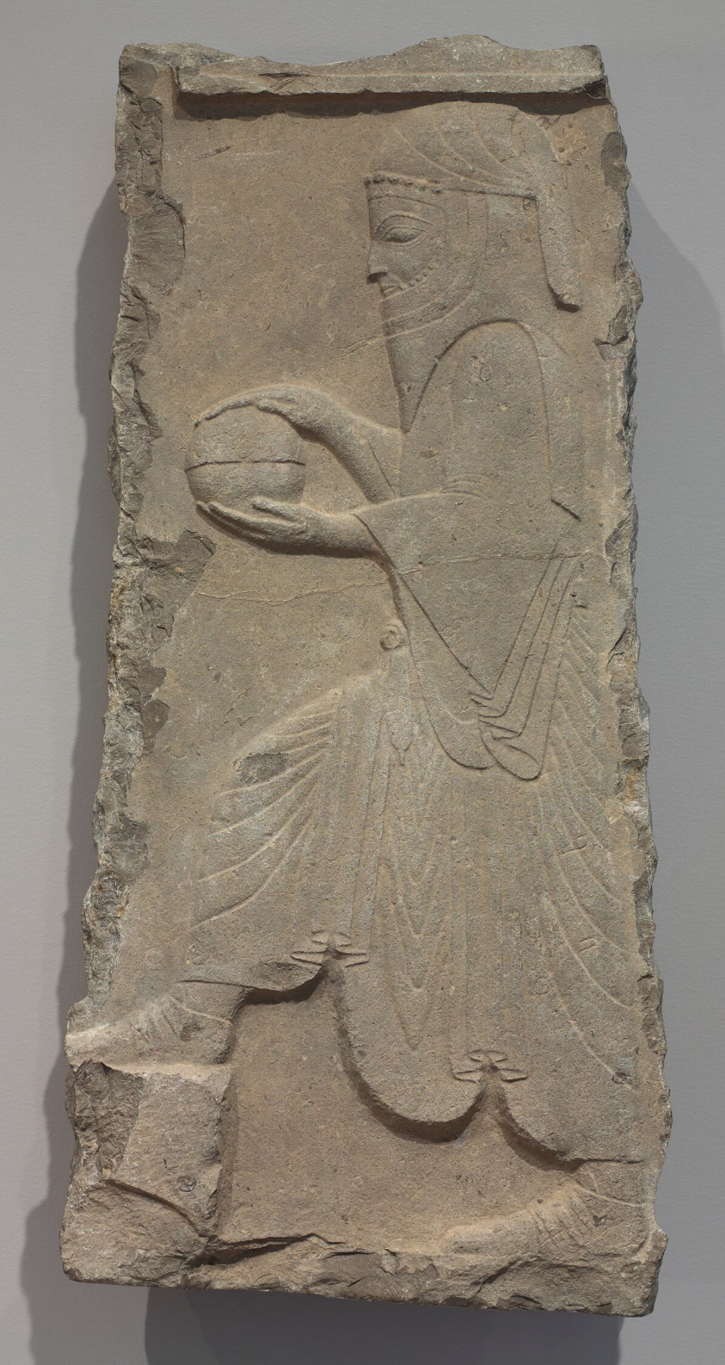
Page 197
Persepolis (City of the Persians) is the Greek name for one of the capitals of the Achaemenid Persian empire (c. 550–330 BCE). Page 197

Slide 16
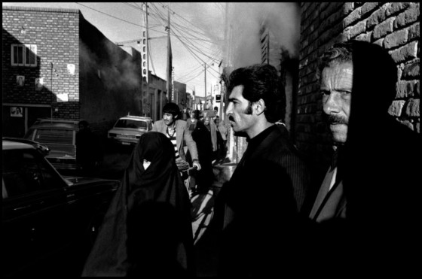
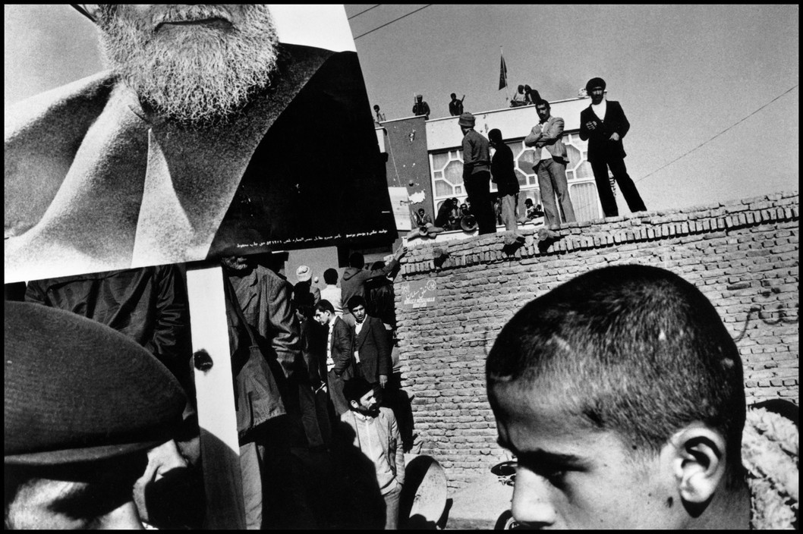
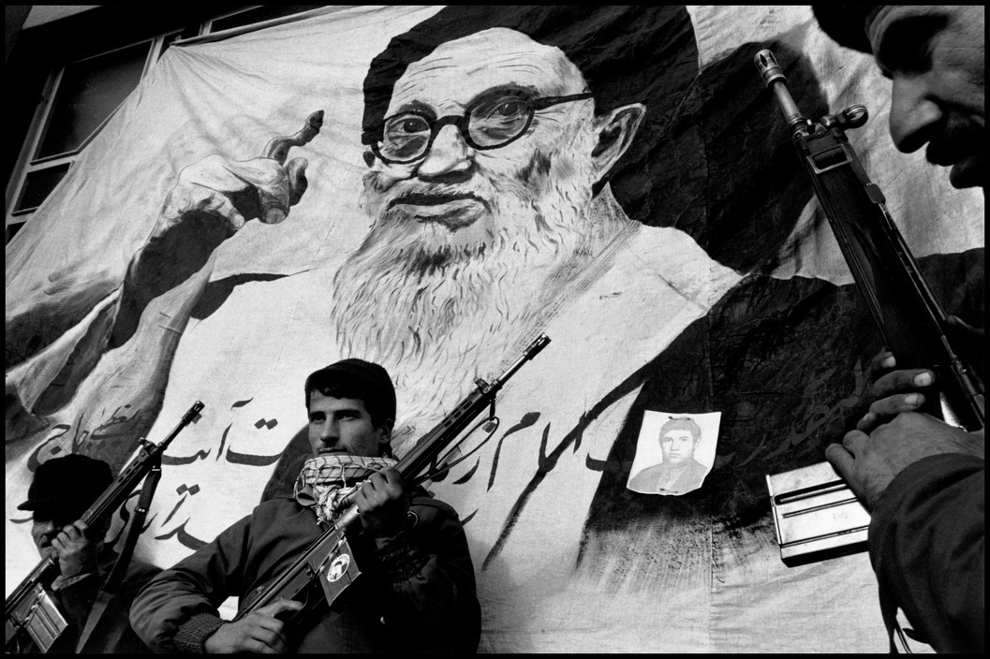
Page 197
Gilles Peress, Telex Iran: In the Name of Revolution (1984, 1997)

Slide 17
The world is tense. On social media are those who cheer for war. Reading these experts and those who only believe themselves to be experts I can see the blitheness of their tone, their detachment from the real consequences of war and the casual cruelty their detachment allows for. When these people declare that the important thing now is war with Iran they say it not at all caring how many people are already suffering in Iran or how many people are likely to suffer in the case of a war. What they seem to care about is not having to change their essential faith in American superiority, a superiority which can only imagine other people as disposable terms in the search for power and wealth. (p. 202)

Slide 18

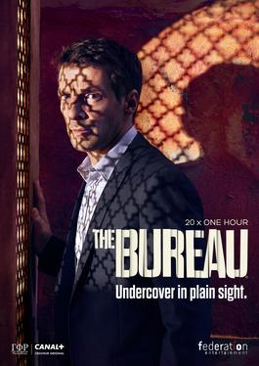
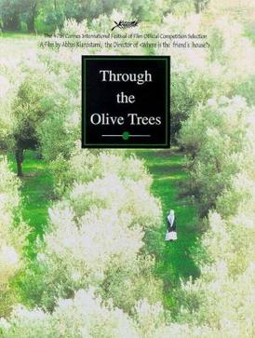
page 191-193
page 203-04
Iranian drama film by
Abbas Kiarostami, 1994
Page 234-235
Canal+ 2015–2020
a way of rethinking spy fiction
in its relation to the world

Slide 19
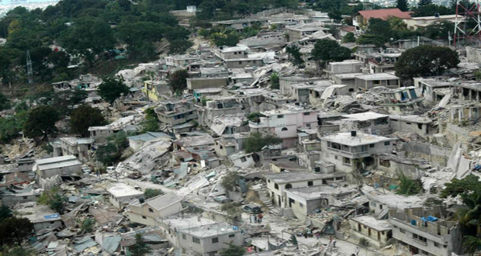
The 2010 Haiti earthquake was a catastrophic magnitude 7.0 Mw earthquake

Slide 20

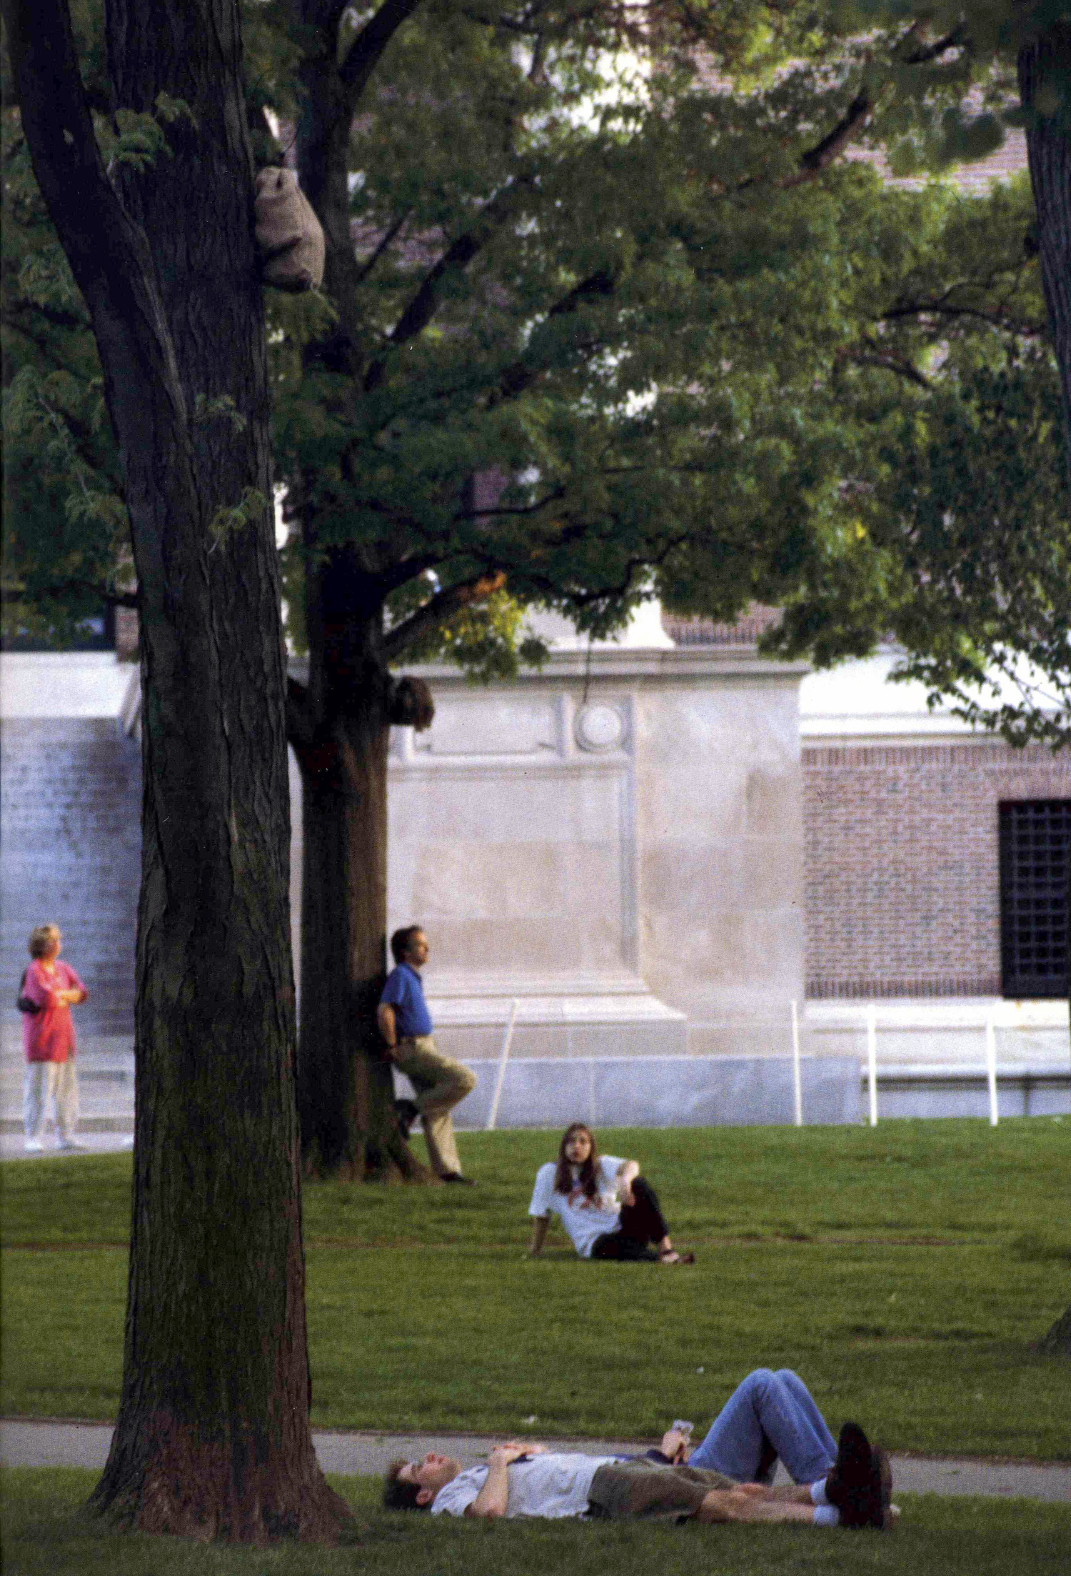
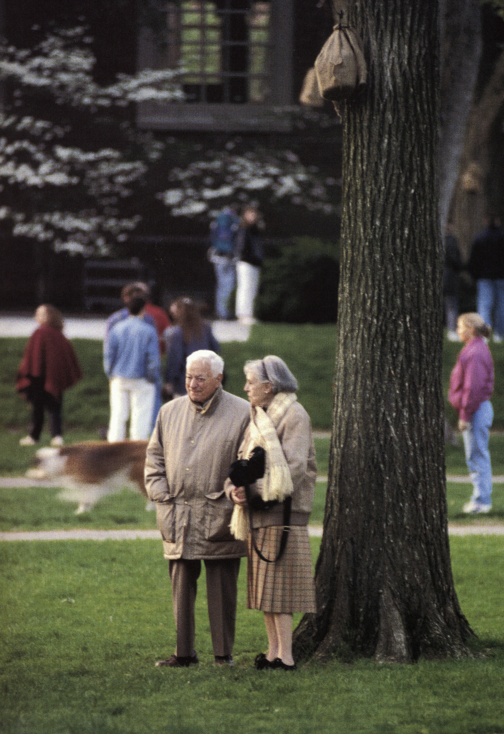
Canopy 1994
Harvard Yard, Cambridge, Massachusetts
Ward said he found himself presented with two options: to be positioned in the sense of appearing to celebrate the institution or to be positioned by somehow seeming to critique it. He didn’t want to be in either of those positions.
There is no view from nowhere
page 217 -218

Slide 21
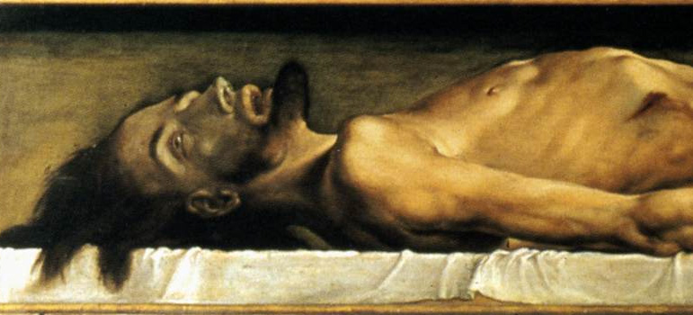
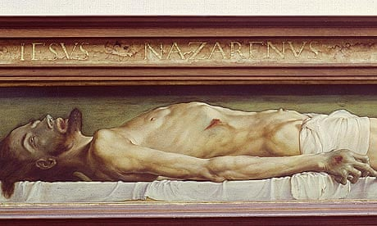
Hans Holbein the Younger,
The Dead Christ in the Tomb

Slide 22
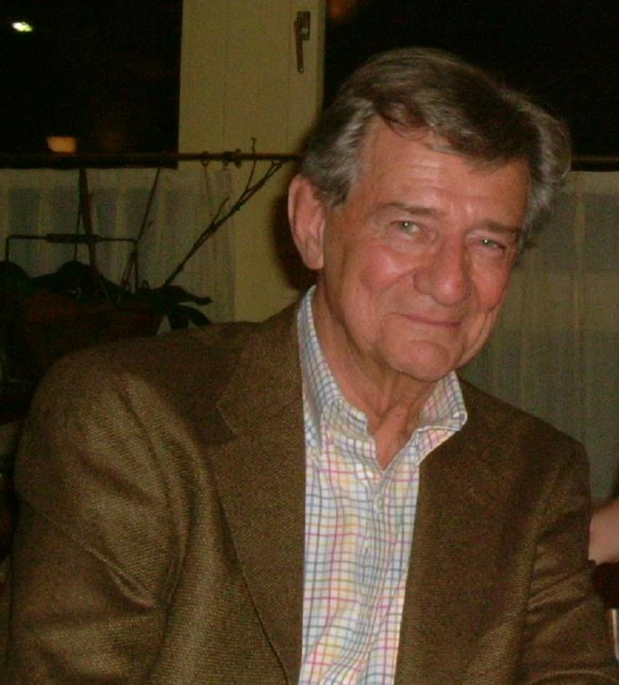
employed in the context of Native American studies by cultural theorist Gerald Vizenor (1993 Manifest Manners: Narratives on Postindian Survivance)
There he explains that "Survivance is an active sense of presence, the continuance of native stories, not a mere reaction, or a survivable name. Native survivance stories are renunciations of dominance, tragedy and victimry".
by changing the suffix from -al to -ance, Vizenor insists on an active survival, in which contemporary Native American peoples go beyond merely subsisting in the ruins of tribal cultures to actively inheriting and refashioning those cultures for the postmodern age.
The Cherokee-descent poet Diane Glancy demonstrates the ways that an imprecise term can inspire creativity by reconfiguring it: "Poetry is rebound. A turn of writing. (Sur)vivance: Sur – a survival outside survival. Vivance – the vitality of it."
Vizenor frequently defines "survivance" in opposition to "victimry“
Vizenor's "work aims to repair a peculiarly vicious consequence of genocidal attacks on native of the Americas: an inducing in them of their destroyers' view that they are mere survivors. By accepting this imposed definition of themselves as victims, natives complete psychologically the not-quite-entirely-successful physical genocide.“
"the condition of self-reliant or communal survival without the social or personal indulgence of victimization."
survivance
"survival + endurance,"
"survival + resistance,"

Slide 23
MASSACHUSETTS IS SIMPLY HOME for Sadako. It was different for me and moving here altered my sense of what it meant to live with history. I had experienced New York City as a place tense with the nineteenth century. In Massachusetts I am aware of deeper time and older layers. New York was anciently settled too and the colonial encounter there no less bruising but Massachusetts somehow seems to present a more apparent vertical plunge into time. To be here is to be reminded of first principles, of who founded what and where they did it, of whose life was made impossible once the whites began to immigrate into this territory. This terrain is the morning of the new country, its first few pages. The historical record everywhere present in these towns immerses each day in a distant past, marks each place with the hard lines of the seventeenth century, the eighteenth century, the nineteenth century, the twentieth century, the twenty-first century. (223)

Slide 24
One thing that is fascinating is how he obliquely figures the wounds of history. This is something that preoccupies Julius, the protagonist of Open City (2011).
He wonders at one point: ‘‘What was the use of going into these recesses of the human heart. Why show torture? Was it not enough to be told, in imprecise detail, that bad things happened?’

Slide 25
https://open.spotify.com/playlist/0HOeehaBeamUZ2L32va1ng?si=76e7a57bfe174a71&nd=1&dlsi=1a92c7835b294309
PLAYLIST A playlist to keep track while reading contains over 40 songs and artists from around the world in genres high and low, familiar and obscure.

Slide 26
The most perverse, most violent, most destructive of rogue states would thus be first and foremost the United States. . "Rebuilding America's Defenses: Strategy, Forces and Resources for a New Century,"
The world order, in its relative and precarious stability, depends largely on the solidity and reliability, on the credit, of American power ... To destabilize this superpower, which plays at least the 'role' of the guardian of the prevailing world order, is to risk destabilizing the entire world, including the declared enemies of the United States.
Philosophy in a Time of Terror: Dialogues with Jurgen Habermas and Jacques Derrida,111

Slide 27
Journal Article
From Life to Survival: Derrida, Freud, and the Future of Deconstruction. By Robert Trumbull Get access Arrow
Michael Syrotinski
French Studies, Volume 77, Issue 4, October 2023, Page 678, https://doi.org/10.1093/fs/knad140
Published: 05 August 2023

