Slide 1
Course: Research methodology in translation studies
Unit 1: Areas in Translation Research
Prof. Emerita M. Sidiropoulou
MA in TRANSLATION STUDIES AND INTERPRETING
MA in TRANSLATION: GREEK, ENGLISH, RUSSIAN
E-class platform: https://eclass.uoa.gr/courses/ENL441/

Slide 2
MA Timetables
Schedule, Fall 2022-2023
ΠΜΣ/ ΔΠΜΣ
MA, specialization ‘ Translation Studies and Interpreting’
MA ‘Translation: Greek, English, Russian’
 | Mon | Tue | Wed | Thu | Fri
9.00-12.00 | κα Κόρδα | κ. Ιντζίδης | 803 κα Σιδηροπούλου Research | κα Χατζηδάκη
 |  |  | Methodology in Translation Studies
12.00-3.00 |  |  | κα Μπορίσοβα

Slide 3
ΜΕΤΑΦΡΑΣΤΙΚΕΣ ΣΠΟΥΔΕΣ ΚΑΙ ΔΙΕΡΜΗΝΕΙΑ
ΜΕΤΑΦΡΑΣH: EAP
1. Αντωνάκη Γαρυφαλιά 2. ραμπατζή Ιωάννα 3. Γιαννακίδη Σαπφείρα 4. Κωστίκα Μάρθα 5. Μαγγανά Μαρία 6. Μαγουλά Νικολέτα 7. Παναγοπούλου Ανδριανή 8. Πετροπούλου Θεοδοσία 9. Πολυχρονιάδης Σωτήριος 10. Σταυρακίδου Γεωργία 11. Χερουβίμ Δέσποινα
1. ΑΡΓΥΡΟΥ Μ.
2. ΒΑΓΓΕΛΑΚΟΥΔΗ Α.
3. ΝΟΒΙΤΣΚΑ Α.
4. ΠΕΤΡΟΠΟΥΛΟΥ Σ.
5. ΡΑΠΑΝΟΣ Χ. – Γ.
6. ΧΡΥΣΙΚΟΥ Α.

Slide 4
Research methodology in translation studies
http://eclass.uoa.gr/courses/ENL441/

Slide 5
Focus areas in the course

Slide 6
 | Course Educational goals
1 | Research Methodology in Translation Studies
2 | Pragmatics advancements on a phenomenon
3 | Research on pragmatics through translation
4 | Practice with translation data
5 | Deliverable 1: A research title for presentation at a conference

Slide 7
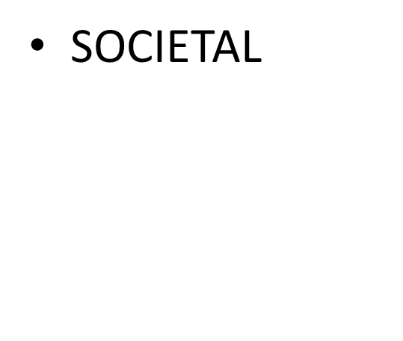
pragmatics
COGNITIVE
A set of data
A socially-oriented phenomenon

Slide 8

Research Planning
Introduction
Theory
Methodology
Data analysis
Findings
Significance of research

Slide 9
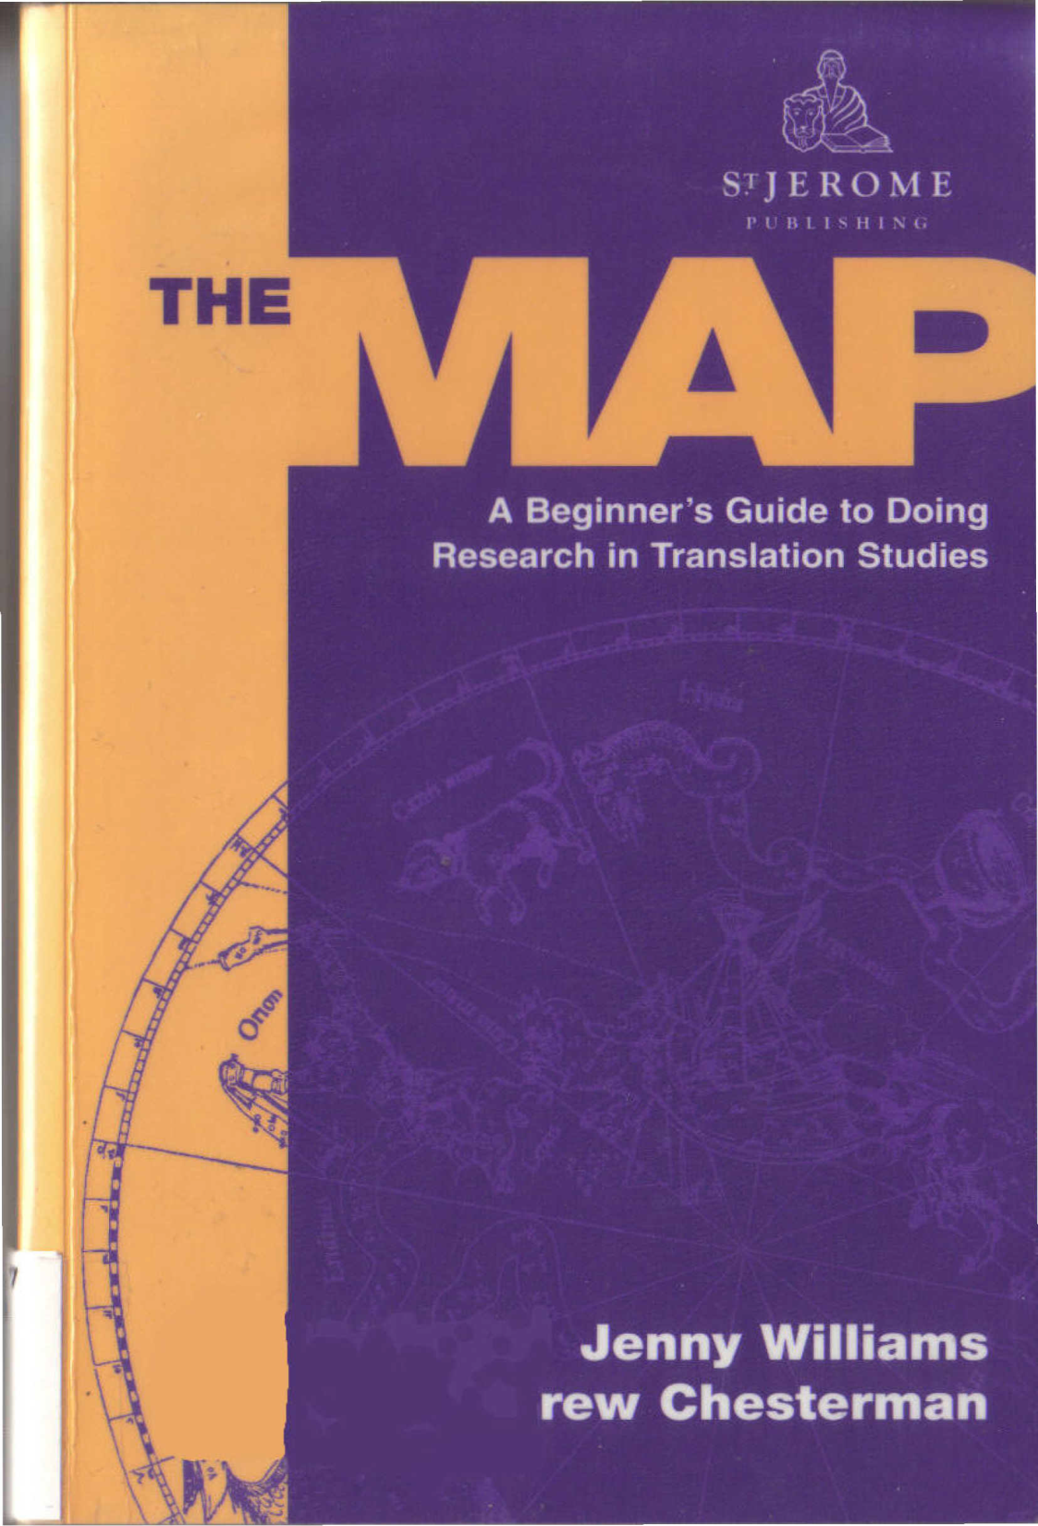
I. Areas in Translation Research
2. From the Initial Idea to the Plan
3. Theoretical Models of Translation
4. Kinds of Research
5. Questions, Claims, Hypotheses
6. Relations between Variables
7. Selecting and Analyzing Data
8. Writing Your Research Report
9. Presenting Your Research Orally
10. Assessing Your Research

Slide 10

The aim of Translation Studies research
To make a contribution to the field by
providing new data;
suggesting an answer to a specific question;
testing or refining an existing hypothesis, theory or methodology;
proposing a new idea, hypothesis, theory or methodology.

Slide 11
Stages of the RESEARCH PROCESS
Choosing an area/ Making a preliminary plan
Searching through the literature/ Reading and thinking
Defining the research question/ Revising the plan
Collecting data/ Analyzing the data
Processing the results/ Writing a draft
Evaluating, eliciting feedback
Thinking οf implications
Finalizing the text
Presenting your research report

Slide 12
Areas in translation research
Source text analysis
Comparison of translations and their Source texts
Comparison of translations and non-translated texts
Translation with commentary

Slide 13
Comparison of translations and their Source texts
several translations into the same language or into different languages, of the same original. You might take a particular aspect of the source text, such as a particular stylistic or syntactic feature, and examine the corresponding sections in the translations.
Or you could start with a kind of translation problem (the translation of passive sentences or dialect, or allusions, for instance), and see how your translator(s) have solved the problem, what translation strategies they have used. Or you could start with a kind of translation shift…
In all these cases, your aim would be to discover patterns of correspondence between the texts, possible regularities of the translator's behaviour, and maybe
principles that seem to determine how certain things get translated under certain conditions.

Slide 14

The Domain of Pragmatics 1
1. Implicature 3_Laurence R. Horn
2. Presupposition 29_Jay David Atlas
3. Speech Acts 53_Jerrold Sadock
4. Reference 74_Gregory Carlson
5. Deixis 97_Stephen C. Levinson
6. Definiteness and Indefiniteness 122_ Barbara Abbott
II Pragmatics and Discourse Structure 151
7. Information Structure and Non-canonical Syntax 153_Gregory Ward and Betty Birner
8. Topic and Focus 175_Jeanette K. Gundel and Thorstein Fretheim
9. Context in Dynamic Interpretation 197_Craige Roberts
Discourse Markers 221_Diane Blakemore
11. Discourse Coherence 241_Andrew Kehler
12. The Pragmatics of Non-sentences 266_Robert J. Stainton
13. Anaphora and the Pragmatics–Syntax Interface 288_Yan Huang
14. Empathy and Direct Discourse Perspectives 315_Susumu Kuno
15. The Pragmatics of Deferred Interpretation 344_Geoffrey Nunberg
16. Pragmatics of Language Performance 365_Herbert H. Clark
17. Constraints on Ellipsis and Event Reference 383_Andrew Kehler and Gregory Ward

Slide 15
III Pragmatics and its Interfaces 405
18. Some Interactions of Pragmatics and Grammar 407_Georgia M. Green
19. Pragmatics and Argument Structure 427_Adele E. Goldberg
20. Pragmatics and Semantics 442_François Recanati
21. Pragmatics and the Philosophy of Language 463_Kent Bach
22. Pragmatics and the Lexicon 488_Reinhard Blutner
23. Pragmatics and Intonation 515_Julia Hirschberg
24. Historical Pragmatics 538_Elizabeth Closs Traugott
25. Pragmatics and Language Acquisition 562_Eve V. Clark
26. Pragmatics and Computational Linguistics 578_Daniel Jurafsky
IV Pragmatics and Cognition 605
27. Relevance Theory 607_Deirdre Wilson and Dan Sperber
28. Relevance Theory and the Saying/Implicating Distinction 633_Robyn Carston
29. Pragmatics and Cognitive Linguistics 657_Gilles Fauconnier
30. Pragmatic Aspects of Grammatical Constructions 675_Paul Kay
31. The Pragmatics of Polarity 701_Michael Israel
32. Abduction in Natural Language Understanding 724_Jerry R. Hobbs
Bibliography 742
Index 820

Slide 16

The Routledge Handbook of Translation and Pragmatics
Edited by Rebecca Tipton and Louisa Desilla
PART I Influences and intersections
1 Speech acts and translation, Silvia Bruti
2 Im/politeness and interpreting, Rachel Mapson
3 Cognitive pragmatics and translation studies, Fabrizio Gallai
PART II Methodological issues
4 Corpus-based studies on interpreting and pragmatics, Bernd Meyer
5 Experimental pragmatics meets audiovisual translation: tackling methodological challenges in researching how film audiences understand implicatures, Louisa Desilla
6 Contrastive approaches to pragmatics and translation, Svenja Kranich
PART III. Applications
7 Critical pragmatic insights into (mis)translation in the news Jan Chovanec
8 Pointing, telling and showing: multimodal dietic enrichment during in-vision news sign language translation Christopher Stone
9 Advertising translation and pragmatics Cristina Valdés
10 “The relations of signs to interpreters”: translating readers and characters from English to Italian Massimiliano Morini
11 I’m so sorry to disturb you but I wonder if I could have your autograph versus ¿Me firma un autógrafo por favor? Contrastive (in)directness in subtitling Carlos de Pablos-Ortega
12 Sign language interpreting, pragmatics and theatre translation Siobhán Rocks
13 Poetry translation and pragmatics Marta Dahlgren
14 Vagueness-specificity in English–Greek scientific translation Maria Sidiropoulou
15 Pragmatic aspects of scientific and technical translation Federica Scarpa
16 Counselling and the translation brief: the role of the translation dialogue in the translation discourse material Sigmund Kvam
17 Pragmatics and agency in healthcare interpreting Claudio Baraldi
18 Public service interpreting in educational settings: issues of politeness and interpersonal relationships Mireia Vargas-Urpi
19 Action research and its impact on the development of pragmatic competence in the translation and interpreting classroom Ineke Crezee and Jo Anna Burn
20 Translation, pragmatics and social media Renée Desjardins
21 The role of non-verbal elements in legal interpreting: a study of a cross-border interpreter-mediated videoconference witness hearing Katalin Balogh and Heidi Salaets
22 Stating the obvious? Implicature, explicature and audio description Louise Fryer

Slide 17
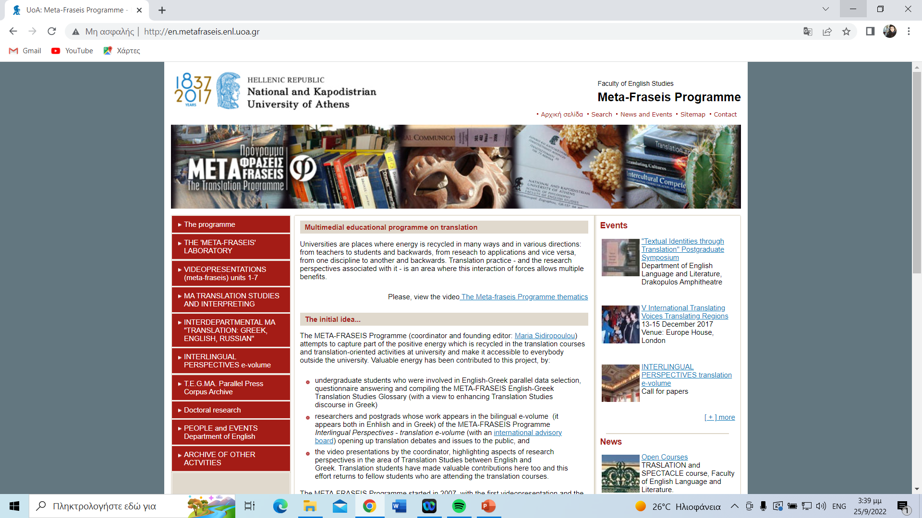
http://en.metafraseis.enl.uoa.gr/

Slide 18
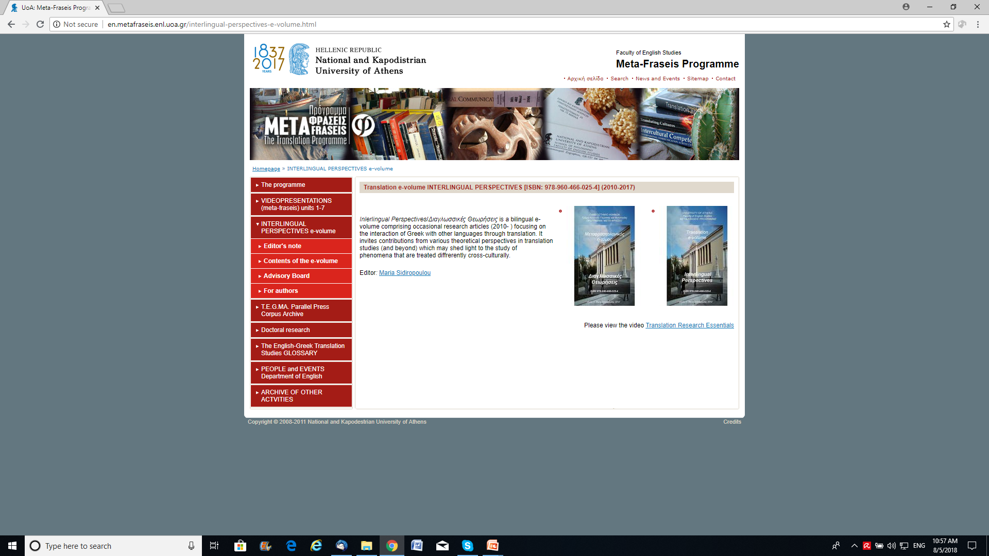
translations into the same language or into different languages http://en.metafraseis.enl.uoa.gr/interlingual-perspectives-e-volume/contents-of-the-e-volume.html
e-volume INTERLINGUAL PERSPECTIVES tranlation e-volume (ISBN: 978-960-466-025-4)

Slide 19
Discovering patterns of possible regularities http://en.metafraseis.enl.uoa.gr/interlingual-perspectives-e-volume/contents-of-the-e-volume.html
Special e-Issue LINGUISTIC PERSPECTIVE MATTERS:
[16] Shaping the epistemic: A TEFL view into parallel data Vasileia-Eirini Andriotou & Eriketti Metaxa (2016, 299-321).
[17] On the modal potential of items: A parallel-data approach Kyriakoula Drakaki, Dimitra Boudopoulou, Constantina Katsari, Vasileia Tsimi-Tsimidopoulou & Niki Tsioubleka (2016, 323-338).
[18] Material designing: A translation perspective to modal marker use Aglaia Rouki & Antigoni Diamantopoulou (2016, 339-358).

Slide 20
Comparison of translations and non-translated texts
The idea here is to examine the way in which translations tend to differ from other texts in the target language, the way they often turn out to be not quite natural. [contrastive text analysis]
This kind of research is quantitative, and usually deals with relative differences of distribution of particular textual features.

Slide 21
Translation Quality Assessment
source-oriented
target-language oriented
assessment of translation effects - on clients, teachers, critics and readers.
Juliane House. 2001. “Translation Quality Assessment: Linguistic Description versus Social Evaluation” Meta 46 (2) 243-257

Slide 22
Genre translation: Drama
The process of translation from page to stage' throws up many research questions - for example, the role(s) of the various participants: translator, director, actors.
There is plenty of scope for undertaking a case study of an individual production, researching the biography of an established drama translator, comparing different translations of the same play.

Slide 23
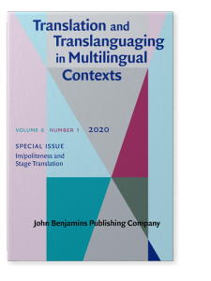
Postgraduate research in translation https://benjamins.com/catalog/ttmc.6.1
2020. Impoliteness and Stage Translation
Journal of translation and Translanguaging in multilingual contexts 6 (1)
Introduction: Im/politeness and theatre translation_Maria Sidiropoulou | pp. 1–8
ARTICLES
Who’s afraid of aggression: Gender and impoliteness through translation_Eirini Stamouli | pp. 9–25
Blaming, critique and irritation in the family through translation
Aristea Rigalou | pp. 26–44
Mask and face: Im/politeness in stage translations of Mourning Becomes Electra
Maria-Nikoleta Blana | pp. 45–63
Aggression and narrative in Edward Albee’s The Zoo Story
Maria Lamprou | pp. 64–78
Im/politeness, gender and power distance in Lady Windermere’s Fan
Chrysi Mavrigiannaki | pp. 79–91
Constructing leadership through translating im/politeness
Natalia Skrempou | pp. 92–108

Slide 24
Genre translation: poetry/prose
The aim of the translation - a prose version or a poem?
The translation of metre, cadence, rhythm, rhyme
The profile of the translator - can only poets translate poetry?
How do translators translate poetry?
As it is impossible to research the totality of a novel, or even a short story, it is important to select one aspect. This could be the narrative perspective of the author/translator, the translation of dialogue, the handling of culture-specific items or the translation of humour. Sometimes it can make sense to concentrate on the first chapter or opening scene, since this often sets the tone for the remainder of the work.

Slide 25
Genre translation: religious texts
The enormous temporal and cultural gap between societies for which these texts were written and the societies for which they have been translated
The tension between treating religious texts, such as the Bible, as a sacred text in which every word is holy (which requires a word -or-word translation) and using it as a missionizing text (which requires a target-culture-centred approach).
In European societies the Reformation was a crucial and dangerous time for Bible translators. and the writings of Wycliffe, Tyndale, Luther, Calvin and others provide material for research questions such as: how did these translators go about their work?

Slide 26
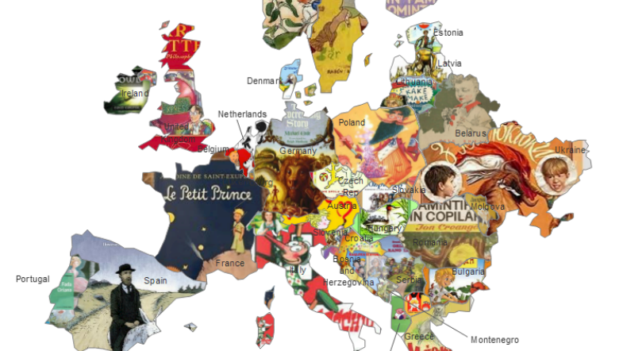
Genre translation: children’s literature
Are you dealing with literature (designed to be) read by children or to children? What age group(s) do you mean?
Does 'literature' include only books or could it also include TV programmes, films and software?
Children's literature spans many genres - from poems and fairy tales to fiction and scientific writing.
It is also expected to fulfill a number of different functions. e.g. entertainment, socialization, language development, as well as general education.

Slide 27

Genre translation: tourism texts
There is enormous scope here for different kinds of research:
what is the current provision of translated material in a particular locality? How does this match the needs of the sector?
What kinds of strategies are appropriate in the translation of material for tourists?

Slide 28

Genre translation: technical texts
Technical translation covers the translation of many kinds of specialized texts in science and technology, and also in other disciplines such as economics and medicine.
In the business sector, this work is often referred to as multilingual documentation. The translation of these texts needs a high level of subject knowledge, and a mastery of the relevant terminology.
Some research topics concern problems of style and clarity, text-type conventions, culture specific reader expectations and the special problems of particular document types

Slide 29
Genre translation: multimedia
Audiovisual texts are primarily spoken texts - radio/TV programmes, films, DVDs, videos, opera, theatre - which are translated either by revoicing or sur-/sublitling (Luyken 1991).
Revoicing replaces the original spoken text with a translation in the target language; sur-/sublitling leaves the original spoken or sung text intact and adds a written translation on screen.
The choice of translation procedure depends on a variety of factors - and is itself a topic for research.

Slide 30
Genre translation: multimedia
Revoicing
Revoicing includes voice-over, narration, free commentary and lipsync dubbing. Major research questions include:
Which type of revoicing is appropriate in which circumstances?
Which type of synchrony should have precedence in particular circumstances? Case studies of revoiced material (e.g. Herbst 1994)
What role does the translator play in the revoicing process?

Slide 31
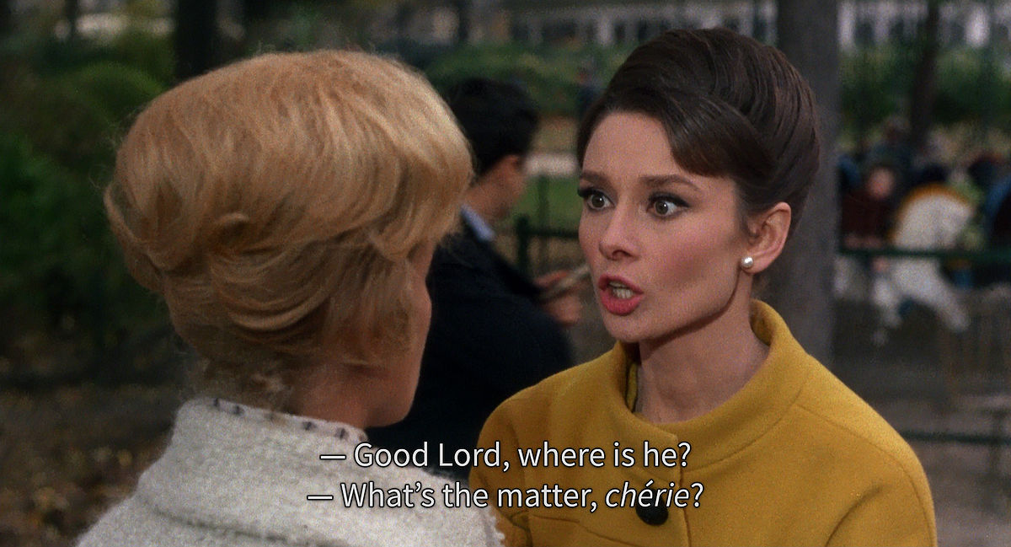
Genre translation: multimedia
Sur-/subtitling: Ivarsson (1992) provides a good overview of a field where research deals with
The technical constraints of sur-/subtitling
The training of sur-/subtitlers (see also Gambier 1998)
Analyses of sur-/subtitled material
Subtitling as a language learning/teaching tool
Subtitling for the deaf & hard-or-hearing or for the blind & visually impaired
Common to both areas of audiovisual translation is an interest in audiovisual translation in a minority language context. Gambier and Gottlieb (2001) provide an introduction to the whole emerging field of Multimedia Translation.

Slide 32

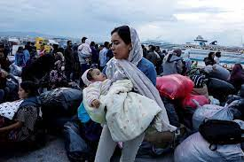
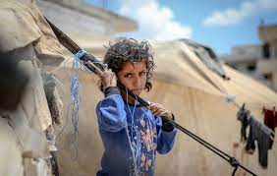
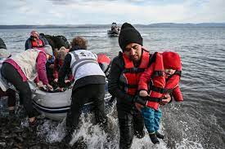
Multimodality IN THE NEWS

Slide 33
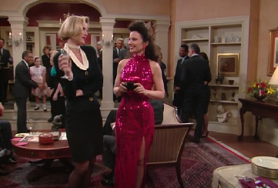
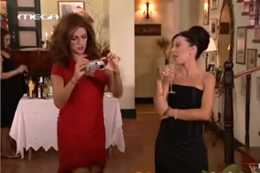

MULTIMODALITY IN TV REMAKES
Showing and implicating_(Aikaterini Gavra 2022)

Slide 34
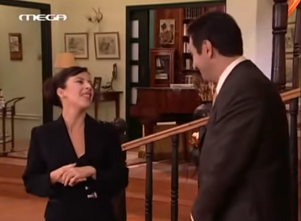


(Aikaterini Gavra 2022)

Slide 35

Roisin-Dermody-listening-to-audio-description-of-the-Abbey-Theatre-production-of-The-Playboy-of-the-Western-World-2007

Slide 36

Phone chats between deaf and non-deaf

Slide 37
Genre translation: technology
Evaluating Software. Language Engineering is producing more and more software for Machine Translation and Computer-Aided Translation, such as terminology management programs and translation memory systems. The evaluation of this software can take the form of a small-scale or large-scale research project.
Software Localization. Software localization is the process which adapts a software product for a target language and culture. This includes adapting the interface, online help files as well a the accompanying documentation.

Slide 38
Genre translation: technology
Effects of Technology. Although Translation Memory systems are now widely used. There is relatively little research on the impact they have, either on the way translators work or on translation output. Kenny (1999) and Bowker (2002) contain discussions of the effects of technology on the translation process. Using a questionnaire you could establish the attitudes of translators to this type of software; or you could obtain permission from a translation company to analyze aspects of texts translated in this way.
Website Translation. Here you could: (1) establish the current practice in website translation, (2) investigate the effect or website constraints and user demands, on translators' decisions (3) evaluate the product, (4) explore the feasibility of using controlled languages in website design to facilitate translation.

Slide 39


Website Translation

Slide 40
Translation History
Translations can have long-term effects on whole languages and cultures, and these too can be assessed in a historical or cultural study.
Who? Focusing on translators themselves: their backgrounds, their relations and how it affected their work…
What? How did the social and political upheavals in eastern Europe in the early 1990s affect the volume and nature of translations into Polish, Slovak, Czech, Russian and so on? Translation can also shed light on relations between majority and minority language communities, between imperial centres and colonial fringes.
Why? why particular texts are translated at particular times.
How? Translators' strategies through the ages have varied depending on the demands of commissioners, publishers, readers as well as their own personal preferences.

Slide 41


Translation History

Slide 42

Translation Ethics
Faithful representations of the original/service to the client/understanding and cooperation?
Influenced by cultural/ideological factors? (power, gender, post-colonialism, nationalism, minority, hegemony, cultural identity
How translators should behave and how society should behave towards translation
Boundaries of translator responsibility

Slide 43
Terminology and Glossaries
Understanding the difference between technical language and domain-restricted one
Learning how to use Trados MultiTerm (developed specifically for terminilogical work)

Slide 44
Interpreting
MODE Simultaneous/consecutive
SOCIAL SITUATION
conference interpreting (usually simultaneous one-directional)
Liaison/community/dialogue interpreting (usually bi-directional)
Medical interpreting/Court interpreting (usually bi-directional)

Slide 45
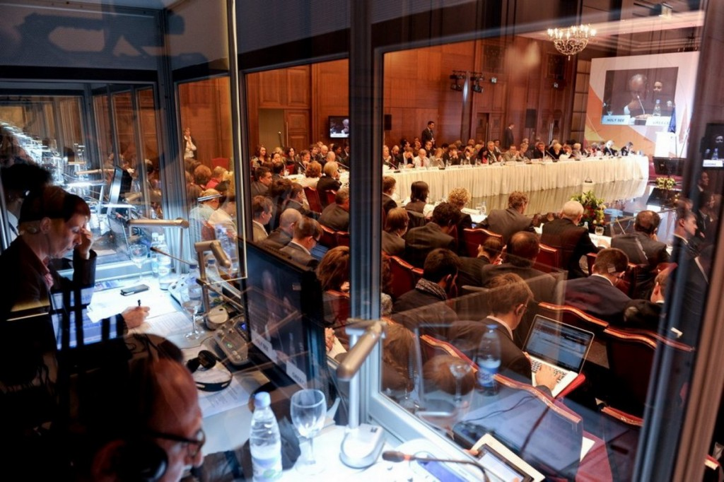

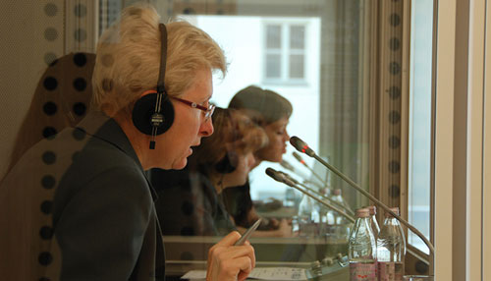
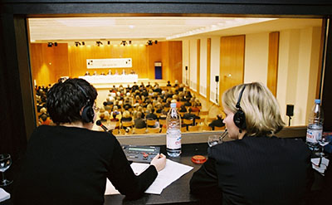
Simultaneous Interpreting

Slide 46


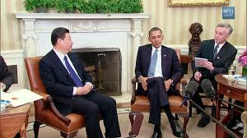
Consecutive Interpreting

Slide 47
Interpreting studies
Cognitive Studies. Neurological studies of the interpreter’s brain/ the functioning of memory in simultaneous interpreting/ the effect of time lag on the final quality of the interpretation in simultaneous interpreting
Behavioural studies. Note-taking techniques in consecutive interpreting/strategizing to prepare for the task/ unusual stress conditions or time constraints…/ eye contact between interpreter and other participants…
Linguistic Studies. Language specific studies of hoe interpreters tend to render/omit/condense various structures, under certain conditions/ style shifts (in/formal…)
Sociological Studies, Ethics, History. Negotiation of power and politeness relations among participants in dialogue interpreting/ethical responsibility of the translator: whose side s/he is on/history of interpreting
Interpreter training. Comparative studies of trainee and professional translators under similar conditions.
Quality assessment. Studies of hearer reactions to a special intonation, voice quality, speed, pauses, grammatical errors
Special kinds of interpreting. Special requirements of medical/court interpreting/interpreting for the deaf/sign-language interpreting/ Interpreting for the Blind (simultaneous oral narration of films…)/the use of whisper interpreting

Slide 48
The Translation Process
Workplace studies
Observing translators at work,
taking interviews (the sociology of translation) and giving questionnaires,
formulating/testing hypothesis of how translators behave at an institutional level,
measuring quality etc.
Protocol studies
TAPS (Think-aloud Protocols)
Computer records of key-stroke usage (use of time)
Corrections and alterations…

Slide 49
Translator training
Curriculum Design
The content of translator-training programmes
e.g. What is the relative importance of training mother-tongue competence/field knowledge

Slide 50
The shared project
It is widely acknowledged that discoursal features within a language vary with respect to genre, let alone across cultures.
it intends to examine the use of pragmatic features across genres (through translation) to show that certain discourse preferences are so strongly rooted in a cultural context that permeate the discourse of quite a few genres in present day translated communication practice.
This positioning may seem to contradict the theoretical significance of the notion of ‘community of practice’ and to point towards a holistic perception of culture.
However, it only aims at creating awareness of discoursal preferences which permeate genres cross-culturally and are manifested through translation.

Slide 51
Potential topics of the project
DEIXIS
The topic raises awareness of the different use of deixis through English-Greek translation material by examining parallel data sets in various genres. The approach raises awareness of a different use of deictic features across English and Greek.

Slide 52
Potential topics of the project
IN/DEFINITENESS
The phenomenon of in/definiteness displays subtle differences across English and Greek and bears consequences for the way learners’ of English or of Greek use it in their foreign language production. The chapter makes use of the source authors’ insight into a source language and the translators’ insight into a target language to raise awareness of the cross-cultural difference in the use of the phenomenon.

Slide 53
Potential topics of the project
SPEECE ACTS
The way speech acts are performed across-cultures, in various genres, is another intercultural variable which is manifested through translation. The chapter highlights contexts, across genres, which display a different tendency in the use of speech acts, to suggest that although the tendency may not have currency for the whole of culture, it does permeate quite a few genres.

Slide 54
Potential topics of the project
DISCOURSE COHERENCE
Another pragmatic feature which is used differently across English-Greek is how discourse coherence is achieved across cultures. Translation practice offers a data set type, different from the monolingual data of intercultural studies where phenomena are examined through comparable (rather than parallel) data. The chapter raises awareness different ways achieving appropriateness at the level of discourse coherence.

Slide 55
Potential topics of the project
SAYING AND IMPLICATING
Real life translation practice may also show discrepancies in the way what is said and what is implicated may be manipulated across cultural contexts to ensure calculation of the appropriate implicatures in a target cultural context.

Slide 56


Postgraduate research in translation
2020-2022
MA in English Language, Linguistics and Translation,
- Linguistics: Theory and Applications
- Translation Studies and Interpreting
MA Translation: Greek, English, Russian

Slide 57
Transferring Relational Dynamics
Approaching the Consumer in Russian-English Tourism Promotion .Elina. Melikidou & Sofia Malamatidou
Interpreted vs. Translated Political Talk: President Putin on the Coronavirus Outbreak Elena Alafuzova
Shaping the Detective in Murder on the Orient Express Charikleia Smyrli
Constructing Relational Dynamics in Translating Fiction Svitlana Volchenko
Transferring Aggression and Offensiveness
The Madness Narrative in Edgar Allan Poe’s The Fall of the House of Usher Konstantina Kyriakou
Offensiveness in Target Versions of Wuthering Heights Sofia-Konstantina Zacharia
Shaping the Hedonistic Protagonist Marina-Sofia Vlachou
Comedy of Menace: The Birthday Party on the Greek Stage Athina Sarafi
In-Yer-Face Theatre on Greek Stage Constantinos Dimitrakakis
Transferring Socio-Cultural Values
Translating Destiny in Greek Versions of Macbeth Athanasios Vasileiadis
Trivizas’ The Last Black Cat in Mandarin Chinese Zhan Zhang
Sociocultural Awareness Through Dubbing Disney Film Songs Konstantinos Karantzis
Gender in Translation: The Handmaid’s Tale in Greek Aspasia Koutsoumpogera
Revolution and Oppression in Russian/Greek Versions of Animal Farm Aikaterini Gavra
Ideological Perspectives in Translated Museum Discourses Eleftherios Antoniou. .

Slide 58
Approaching the Consumer in Russian-English Tourism Promotion Elina Melikidou & Sofia Malamatidou
The study explores the Russian source and the English target version of the official tourism website Russia Travel regarding cultural dimensions and cosmopolitan orientations and reveals aspects of cultural identity, preferred ways of self-representation and ways of approaching the consumer. Texts are taken from the Nature, Health, and Food section of the website and source and target texts are compared for identifying translation shifts that reflect changes in power distance, risk-taking, and openness to the Other’s culture. Findings indicate that, compared to Russian, English texts place more emphasis on active tourism, where the visitor is in charge of the trip and engages fully with the destination in a search for authentic experiences and encounters with the Other. This study highlights the central role that translation plays as a means for (self-)reflection and (self-)transformation in tourism discourse.

Slide 59
Interpreted vs. Translated Political Talk: President Putin on the Coronavirus Outbreak Elena Alafuzova
The paper attempts to show how meaning transfer may shape the image of a political leader. It analyses the translated and interpreted English versions of four speeches by President Putin on the coronavirus (COVID-19) outbreak delivered at the beginning of the pandemic (March–June 2020). The study focuses on pragmatic phenomena like power distance between speaker and audience, building trust in the power of the state, the conceptualization of the pandemic, which shape the roles of society members and the image of the President. The analysis demonstrates that while the official written translations are close to the source speech in most respects, interpreting displays a higher negotiating intention. It shapes a positive public image of the President and the authority he represents, which the study claims to be emerging from an awareness of audience profile, the complexity of interpreting or both. Translating and interpreting on the political stage assume an interdisciplinary perception of cross-cultural and political awareness which permeates the communicative situation.

Slide 60
Shaping the Detective in Murder on the
Orient Express Charikleia Smyrli
The study attempts to explore variation in the way a Greek and a Russian target version of Agatha Christie’s novel Murder on the Orient Express shapes the detective, Hercules Poirot. The data derived from the two last chapters of the novel, where the tension escalates before the detective unveils the truth. The study uses identity theory (Schwartz et al., in Handbook of Identity Theory and Research. Springer, New York, 2011) to highlight aspects of the detective’s identity as manifested in the two translations. Most of the findings are confirmed by a questionnaire addressing seven trilingual respondents, aged 22–40. The study shows how Greek and Russian translators are renegotiating Poirot’s figure: the detective appears more polite, elegant and gentle, in Greek, while in Russian he is more humorous, comprehensive and simple. The study suggests that translation practice is a rich resource for studying identity construction in fiction, raising awareness of the translators’ potential to interfere with identities.

Slide 61
Constructing Relational Dynamics in Translating Fiction Svitlana Volchenko
The paper tackles cross-cultural pragmatics through translation, namely, how the relational dynamics between fictional characters are constructed through rendition of speech acts, in the Russian and Greek target versions of an English novel, The Shell Seekers by R. Pilcher. The study uses naturalistic evidence (the Russian and Greek target versions of the novel) to trace relational shifts in speech act performance and highlight the appropriate relational dynamics between characters, across the parallel versions. It also uses experimental research methodology in that it elicited data, through questionnaires, from bilingual or trilingual respondents with respect to the appropriateness of the relational dynamics portrayal in a target version. Findings show that speech act performance, in the three data distance (Brown and Levinson in Politeness: Some universals in language use. Cambridge sets, manifests itself through variation in interpersonal University Press, Cambridge, 1987) between interlocutors or in the dimension of power distance (Hofstede et al. in Cultures and organizations: Software of the mind. McGraw Hill, New York, 2005). Questionnaire respondents confirm that power distance is, rightfully, highest in Russian, in the communicative context of the novel, and lowest in Greek (manifesting itself through idiomatic expressions and lower tenor vocabulary allowing the characters to express opinions and feelings more freely). The significance of the study lies in that it shows translation to be a sensitive indicator of variation in the relational dynamics between characters, thus offering a novel arena for measuring pragmatic phenomena.

Slide 62
The Madness Narrative in Edgar Allan Poe’s
The Fall of the House of Usher
Konstantina Kyriakou
The study attempts to trace diachronic evidence of attitudes towards madness in literature translated into Greek. It explores three Greek translations of Edgar Allan Poe’s short story The Fall of the House of Usher (Kennedy in A historical guide to Edgar Allan Poe. Oxford University Press, Oxford, 2001), spanning from 1995 to 2013. Foucault’s (Madness and civilization: A history of insanity in the age of reason. Routledge, London, 1965) Madness in Civilization is a theoretical background regarding shifting attitudes towards madness from a historical perspective. In discourse, attitudes towards madness may be manifested through pragmatic phenomena like impoliteness (Culpeper in Impoliteness: Using language to cause offence. Cambridge University Press, Cambridge, 2011), a pragmatic theoretical framework used for testing the following hypothesis: Using the notions of offensiveness, interpersonal distance and explicit references to mental illness, the study shows that the degree of impoliteness of the first-person narrator towards the mentally ill protagonist, Roderick Usher, decreases in the latest translation, as a result of the disability movement, suggesting that the attitude of the Greek public towards mental illness is becoming more tolerant and inclusive. Α questionnaire distributed to Greek-English bilinguals, of twenty to thirty years of age, confirms the findings, suggesting that representations of mental illness in fiction undergo a major shift towards inclusion and solidarity during the twenty-first century. Τhe research suggests that translators need to be aware of societal tensions to regulate the implications they allow from the verbal choices they make.

Slide 63
Offensiveness in Target Versions of Wuthering Heights Sofia-Konstantina Zacharia
The aim of this study is to study how Heathcliff and Catherine’s unfulfilled love, in Wuthering Heights by Emily Brontë, and its dramatic consequences, hatred and revenge, can be shaped cross-culturally and inter-culturally through rendition of impoliteness. The study also considers the role of gender and social class in shaping the reality of the novel in target versions, which may have emotional consequences and cause offence (Culpeper in Impoliteness: Using Language to Cause Offence. Cambridge University Press, Cambridge, 2011). To this end, the study examines two Greek versions of the novel which are 36 years apart (Καζαντζής 1984; Μαντόγλου 2020) and a recent theatrical adaptation with respect to the level of impoliteness the target versions employ. The 1984 version seems to make use of a language which is less offensive and aggressive, in contrast to the more recent version of 2020. As the use of impoliteness may reflect conventions of the period a target version emerges in, potential shifts in the rendition of impoliteness could suggest a change in how society caused offence in 1984, as opposed to nowadays. Α questionnaire addressing 13 postgraduate students at NKUA confirmed the interpretation of findings. The study shows that impoliteness is a significant tool for shaping identities in translated fiction and seems to creatively interact with pragmatic parameters like gender and social class

Slide 64
Shaping the Hedonistic Protagonist
Marina-Sofia Vlachou
The theme of identity is immensely important in translating fiction. The study explores Oscar Wilde’s novel The Picture of Dorian Gray (1890), with respect to how the identity of the main character emerges in two Greek translations of the novel (To Πoρτραίτο τoυ Nτόριαν Γκρέι trans. A. Alexandrou 1947 & T. Theodorakopoulos, 1989) and with respect to which aspects of identity may be highlighted in each one of them. The study makes use of (Brewer and Gardner’s three levels of identity: the individual, interpersonal and group levels, drawing on a rhetorical and critical perspective (Martin and Nakayama in Intercultural communication in contexts. McGraw Hill, New York, 2010), which focuses on contextual and social factors, by manipulating the use of a number of pragmatic phenomena. Findings show that each translator intuitively draws on a different level of the model, diversifying the social reality which Dorian Gray’s character emerges from. The 1947 (Alexandrou) version rather highlights the interpersonal level of identity while the 1989 version (Theodorakopoulos) highlights the individual level, presumably drawing on prevailing ideological positions emerging in the context of their time of publication. The study is an attempt to apply Brewer and Gardner’s theory in the translation of fiction and advances understanding of aspects of culture which may contribute to improving audience reception of fiction.

Slide 65
In-Yer-Face Theatre on Greek Stage
Constantinos Dimitrakakis
During the 1990s a new innovative kind of drama started to show up in Great Britain, known as in-yer-face theatre, originating from young writers who challenged conventional theatrical codes and presented provocative and aggressive material on stage in order to shock audiences and raise public consciousness (Sierz 2001). They were innovative in terms of content and form and established a new theatre language which was more direct, raw and offensive. This study examines a representative play of this genre, Attempts on her Life by Martin Crimp (1997) and two Greek translations of it (1999, 2007). The aim is to investigate how impoliteness and the shock effects are rendered and if the primary aim of in-yer-face theatre is achieved in these two Greek texts. Τhe study elicits data through a questionnaire addressing (a) translation postgraduates and (b) professionals related to the theatre industry. Results show that both groups perceive impoliteness in both stage translations in a similar way: the latest translation (2007) seems to fulfill the goals of in-yer-face theatre, a bit more eloquently. The significance of this study lies in highlighting the educational value of stage translation data: they can shed light on pragmatic phenomena (like impoliteness) cross-culturally which fit the needs of theatre genres for the benefit not only of researchers but also of theatre practitioners.

Slide 66
Comedy of Menace: The Birthday Party on the Greek Stage Athina Sarafi
The study examines three translations of Harold Pinter’s The Birthday Party for the Greek stage. The essence of the comedy of menace is the ominous, threatening feeling in the subtext, while the dialogue is mundane with some humorous moments. The question arises as to how the three Greek versions (1969, 2013, 2016) transfer this “ominous threatening feeling”, in a language—like Greek, which favours positive politeness in interaction (Sifianou in J Pragmat 17:155– 173, 1992). Results indicate that the translators adjust aggression and interpersonal dynamics in order to render the violence in the subtext. A questionnaire, addressing 15 English-Greek bilingual postgraduate researchers, examines target reception of these devices. The significance of the study lies in that it shows how pragmatic variables in social interaction are highly significant in establishing communication with a target audience

Slide 67
Translating Destiny in Greek Versions of Macbeth Athanasios Vasileiadis
Destiny has been a troubling concept through the ages. Scholars have examined degrees of people’s relying on fate and destiny: Hampden-Turner and Trompenaars (2000) have measured inner/outer direction (in corporate cultures) by asking questions highlighting the advantages of self-determination and inner control vs. the advantages of contingency, luck, fate and circumstance. The aim of the study is to show how notions of destiny and fortune travel through Greek versions of Shakespeare’s The Tragedy of Macbeth. In comparing four target versions of the text in Greek, two of which were performance versions, the study shows how the concept of destiny is one of major significance in the target context. Findings indicate that the target versions favour impactful items when referring to fate, whereas Shakespeare’s ST used more loose terms. Results show that, especially performance versions, seem to assign high significance to the notion of destiny, while others may tone it down appearing more optimistic as to whether people can determine their own future. The study relies on both unelicited and elicited data (through a questionnaire eliciting information on whether the current Greek reader would appreciate awareness of destiny in fiction and theatre). Translation seems to be a powerful channel conveying aspects of ideological meaning and registering widespread narratives

Slide 68
Trivizas’ The Last Black Cat in Mandarin Chinese Zhan Zhang
Innovative proper names, whimsical employment of wordplay and acoustic features of a language are highlights of children’s literature in terms of creating childness, constructing characters and producing humour. Such linguistic creativity, however, is language-specific and could not be easily transferred to other languages in a similar vein. This study examines translation strategies employed in Hu’s (2013) Mandarin Chinese version of Eugene Trivizas’ Greek children’s story, The Last Black Cat, attempting to shed light on a less-widely examined language pair, like Greek-Chinese. Specifically, it discusses translation techniques of proper names, transfer of wordplay and sound-play, with respect to the effectiveness of the translation strategies involved. Adopting firstly an etic approach, the current study observes that the original work exploits nonsensical content in combination with rhyming in slogans to demonstrate the irrationality of social discrimination and the beast in humankind, whereas the Chinese translation prioritizes semantic rendering due to linguistic constraints. The study then takes an emic stance by distributing questionnaires to 10 second-year Chinese university students of Greek language major to examine target reader reception of the strategies. Participants had to choose from two Chinese options according to their own liking: one is Hu’s translation which focuses on semantic meanings, the other is my creative translation version emphasizing fluency and naturalness through linguistic and cultural adaptation. Results suggest an overall preference for localized rendering over a faithful representation of semantic meanings. The paper draws attention to the interaction between GreekChinese through translation, a language pair that has less widely attracted the attention of scholars, and suggests directions for future research regarding pragmatic issues in children’s literature

Slide 69
Sociocultural Awareness Through Dubbing Disney Film Songs Konstantinos Karantzis
Given the universal appeal of animation films and the importance of the messages they convey to a young audience, songs play a significant role in the filmmaker’s intention to summarize the plot of animation films for young audiences and convey the film message. The question arises as to how target cultures may receive pragmatic meaning associated with such film parts. The case study focuses on the ways sociocultural awareness is raised through songs in children’s films, which address a rather ambivalent audience, namely, children and parents. The study analyzes four Disney film songs and their Greek dubbed versions to examine if and how sociocultural values have been transferred in the dubbed Greek versions. It focuses on pragmatic shifts which translators allowed into the target versions to enhance the summarizing function of the songs in a culturally familiar manner. Findings show that dubbers interfere with the religion, race and gender narratives of animation films to match those circulating in target environments. The significance of the research lies in that it shows the liberties dubbers take in rendering animation film songs, making it a subgenre of its own.

Slide 70
Gender in Translation: The Handmaid’s Tale in Greek Aspasia Koutsoumpogera
The study explores the representation of women in two Greek translation versions (1990, 2018) of Margaret Atwood’s novel The Handmaid’s Tale. Drawing upon feminist theories of language and translation, and feminist practices in translation, the study critically examines how female identities are shaped in the Greek versions, to elucidate translator decision-making. The data show that the 1990 translator seems to have the tendency to neutralize female power, by raising religious connotations in shaping them, whereas the 2018 translator enforces the representation of powerful female identities, through items which highlight their power. Respondents confirmed the findings of the study through a questionnaire asking them to identify the powerful female representation, thus verifying that the second translation takes a more feminist translation approach, critically adjusting the representation of female identities. The significance of the study lies in that it shows the potential of discourse and translation to reshape identities and perpetuate or resist intended ideologies.

Slide 71
Revolution and Oppression in Russian/Greek Versions of Animal Farm Aikaterini Gavra
The paper examines the portrayal of two central topics in George Orwell’s novel Animal Farm (1945), namely, ‘oppression’ and ‘revolution’. It focuses on Old Major’s speech, who is the wisest and oldest of the animals. He unites the farm against humans inspiring the animals’ rebellion. The aim of the study is to contrast the Russian (1989) and Greek (2005) target versions of Old Major’s speech, where references to oppression and revolution peak. The study intends to highlight differences in the way the target versions shape oppression and revolution and to account for these differences in terms of pragmatic theoretical concepts. Findings show that oppression and revolution are more vividly shaped in the Russian target version than in the Greek one, along with pessimism for the farm’s current situation, enforced implications of hard work and exhaustion, collective awareness and optimistic prospects of a revolution. Multilingual respondents answered questionnaires to confirm the findings of data analysis. A criterion governing translator behaviour is assumed to be translators’ awareness of ST relevance to the target environment. The research offers insight into narratives in target cultural environments and enriches cross-cultural understanding of variation in relational patterns

Slide 72
Ideological Perspectives in Translated Museum Discourses Eleftherios Antoniou
The research focuses on translation as a tool for analyzing ideological narratives found in the Russian and English versions of two museum websites, namely, The ‘Bunker 42’ Museum of Cold War in Moscow and The Museum of the Occupation of Latvia. Critical Discourse Analysis and the discourse historical approach (Fairclough, Critical Discourse Analysis, The Critical Study of Language, Routledge, London, 1995; Wodak and Meyer (eds), Methods of Critical Discourse Analysis, Sage, London, 2001) have been instrumental in identifying discursive manifestations of ideologies in museum contexts. The approach examines linguistic features in texts and the social, political, and historical contexts of text production and reception. The data sets, selected in 2020 for the purposes of the study, comprised a source text of 1,965 words translated into English (another 2,413 words). They show how translators favour intended meaning, through discoursal choices and lexical item selection, disseminating intended historical narratives, which are aligned with the ideological transition of societies. The study shows that the English translations are ‘westernized’ versions of the source slavo-centric Russian discourses, manifesting that the ‘iron curtain between East and West’ has been drawn, regardless of substantial ideological shifts traced in Russian and English translated museum discourses.

Slide 74
Translating customer identity in male cosmetics advertising Aikaterini Eikosideka
Addressee identity awareness often affects how speakers structure discourses. The study views male cosmetics advertising through a pragmatic lens to investigate how customer identity is shaped cross-culturally through men’s deodorant advertisements on the English and Greek market. The study uses communication styles (Hofstede, Hofstede, and Minkov 2010) to account for (a) naturalistic translation shifts in verbal or multimodal data which tend to improve product reception in the Greek target context and (b) experimental data to confirm how masculinity is shaped and attributed to male customers by well renowned deodorant companies. The data analysis reveals that socio-pragmatic parameters are operative in accounting for differences in the two contexts. Findings show cross-cultural variation along three of Hofstede, Hofstede, and Minkov’s (2010) communication styles, namely, individualism/collectivism, masculinity/femininity and uncertainty avoidance/tolerance, correlating it with a fourth dimension of the framework, the high/low power distance one. The significance of the research lies in that it shows how commercial content producers register locally shared gender identity assumptions relevant to the audience type they address. Translation is another platform where pragmatic variation may be fruitfully explored cross-culturally

Slide 75
Transferring the unfamiliar in Russian and Greek AVT Alfia Khusainova
The study examines transfer strategies in identity construction instances, in Greek and Russian audio-visual translation (AVT) modalities (subtitling and dubbing), of the English animated film for children, The Rise of the Guardians (2012). It explores whether and how translator awareness of target cultural background may affect the strategies used in the transfer. Results suggest that the level of un/familiarity of a target culture with a source-text (ST) cultural item affects the translation strategies across English-Russian and English-Greek differently, on the basis of preferred politeness orientations (negative and positive, respectively) prevailing in the target environments. Testimonies of film viewers and questionnaire respondents who are unfamiliar with the cultural items confirm aspects of the analysis. The significance of the research lies in that it provides further insight into the way Greek and Russian AVT practices handle and transform English audio-visual unfamiliar entities, which may advance understanding of cross-cultural processes in AVT

Slide 76
Teaching cross-cultural pragmatics through AVT Vasiliki Papakonstantinou
There is fairly little research on using translation to advance pragmatic competence in learners of English and highlight how translation can advance cross-cultural pragmatic awareness in EFL. The study attempts to explore how audio-visual translation (AVT) can introduce cross-cultural pragmatics to Greek learners of English. The data derive from the animated f ilm Inside Out (Pixar 2015). The study takes dubbed dialogues to be a target-oriented data set, with the subtitles as an intermediate, constrained type of transfer where pragmatic shifts may be least visible or not at all. The research uses (a) the positive/negative politeness distinction as manifested through interpersonal proximity/distance (Brown and Levinson 1978; Sifianou 1992; Yule 1996; Horn and Ward 2006), and (b) the un/certainty avoidance communication style (Hofstede, Hofstede, and Minkov 2010). The aim is to familiarize learners with the significance of cross-cultural pragmatic awareness and its use in EFL teaching and learning. Analysis of the data is followed by a questionnaire addressing bilingual participants who confirmed the findings of the study. Results show types of pragmatic variation across English and Greek: for instance, the subtitles showed less signs of positive politeness strategies and more uncertainty features, while dubbing manifested more positive politeness strategies and stronger uncertainty avoidance, i.e., in alignment with features of the target language. Findings allow learners to look beyond grammaticality, at the level of pragmatic preference

Slide 77
Story-telling perspectives in translating Aesop’s fables Maria Kostaragkou
Aesop’s fables have been multiply adapted and translated over the years to meet the needs of intended audiences. The study selects two Modern Greek (1993, 2011) and two English (1991, 2013) versions of Aesop’s fable The Woodcutter and Mercury to trace intra- and cross-cultural pragmatic variation in story-telling perspectives. Analysis of the four versions suggests that the Modern Greek versions of the fable seem to be more aware of the power differentials between Mercury and the Woodcutter, whereas the English versions rather focus on the woodcutter, somewhat blurring the figure of the god. A questionnaire addressing 15 respondents confirmed (a) power distance variation cross-culturally (with visuals in two of the versions conforming to intended power distance dynamics), and (b) variation in addressee age group identity. The significance of the research lies in that pragmatic aspects of meaning-making become cross-culturally visible in versions of the fable and draw attention to the potential of translation to advance understanding of what is adjusted in cross-cultural transfer.

Slide 78
Aesop’s fable The Lion and the Mouse:
Μulticultural perspectives Olga Marinova
Aesopic tradition has been highly adaptive (Lefkowitz 2006) as manifested
in multicultural versions of fables. The study explores shifts in Aesop’s fable
The Lion and the Mouse to highlight shifts in the representation of
characters, in agreement with pragmatic tendencies across cultures, as — for instance — in the power distance between the lion and the mouse. It
examines two Modern Greek (2003 and 2012), an English (1996), a Russian
(2012) and a Ukrainian (1990) version of the fable to trace local perceptions
of it. Analysis shows that translators (as storytellers) transform aspects of
the fable in pragmatically meaningful ways: they add up to the adaptation
process conforming to locally appreciated values. The significance of
research lies in that translation is seen as another layer of adaptation which
a source fable may undergo intra- and inter-culturally.

Slide 79
W.B. Yeats Unrequited love and gender identity Eleni Nasi
The study analyzes three Greek versions of two of W.B. Yeats’ poems, ‘When You Are Old’ and ‘No Second Troy’, both related to the theme of unrequited love, merging feelings of bitterness and love. It examines how power distance manifests itself in the three versions of the poems. The study designed a questionnaire to evaluate potential variation in the type and intensity of feelings shaped in the three Greek versions of the two poems. Findings show that there is variation in the interpersonal distance between the poet and the beloved: some translators seem to emphasize bitterness and empathy on the part of the disappointed poet, while others assume more equal power distribution between the poet and the beloved.

Slide 80
Disillusionment and impoverishment in a Greek version of Waiting for Godot Aliki Kliafa
The study examines how impoverishment and disillusionment in Samuel Beckett’s Waiting for Godot (1949) have been rendered on the Greek stage (transl. Papathanassopoulou 1984). Ιt examines the use of impoliteness which renders the protagonists’ outcast identity and frustration, as Godot is not showing up. Findings show that respondents appreciated both foul language (impoliteness) and humour (low-power distance) in the Greek version of the play. The significance of the study lies in that target audiences may enjoy aspects of characters’ identities perhaps unsuspected in the ST, because local contexts may prioritize codes manifesting intended attitudes

Slide 81
The Winter’s Tale on the Greek stage: Shaping gender intra-culturally Iokasti-Rigopoula Stagaki
The study examines two Greek target versions (1952, 2004) of Shakespeare’s The Winter’s Tale (1611) in order to examine how politeness orientations and awareness of power distance change to shape the relational dynamics between characters. In the two target versions male characters vary intra culturally and interculturally, while themes such as female submissiveness and gender relations show intra-cultural variation. Analysis of naturalistic translation data shows variation in the way certain characters are reshaped in the two versions, which is confirmed by experimental data elicited by a questionnaire. The significance of the research lies in that pragmatics may provide a basis for the study of intra-cultural variation in characters’ identities in a play, and in that translation is a rich resource for tracing pragmatic variation in the manifestation of pragmatic phenomena

Slide 82
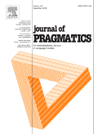
Journals on pragmatics
Journal of Pragmatics
An Interdisciplinary Journal of Language Studies
Co Editors-in-Chief:
Michael Haugh,
Marina Terkourafi
View Editorial Board
https://www.journals.elsevier.com/journal-of-pragmatics > articles and issues

Slide 83
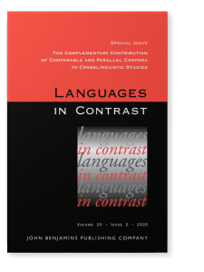
Languages in Contrast publishes contrastive studies of two or more languages. Any aspect of language may be covered, including vocabulary, phonology, morphology, syntax, semantics, pragmatics, text and discourse, stylistics, sociolinguistics and psycholinguistics.
Languages in Contrast welcomes interdisciplinary studies, such as those that make links between contrastive linguistics and translation, lexicography, corpus linguistics, language teaching and learning, genre studies and cultural studies. However, the main emphasis of each study should be on the comparison of languages.
https://benjamins.com/catalog/lic
> issues

Slide 84
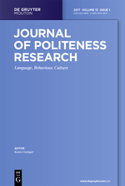
Journals on pragmatics
https://www.degruyter.com/view/j/jplr

Slide 85
Check out other resources https://benjamins.com/catalog/serials/current
Talk to colleagues in translation studies
Talk to the University librarian, interlibrary loan
Check out Translation Studies Journals (at least the last 5 years)
Join the national Translator’s Association
Meta - Journal des traducteurs https://www.erudit.org/fr/revues/meta/#back-issue s
JoSTrans - Journal of Specialized Translation http://www.jostrans.org/
Translation Studies https://www.tandfonline.com/toc/rtrs20/current
Τhe Translator https://www.tandfonline.com/loi/rtrn20/current
Translation and Translanguaging in Multilingual Contexts https://benjamins.com/#catalog/journals/ttmc/issues
The Interpreter and Translator Trainer https://www.tandfonline.com/toc/ritt20/current
Across Languages and Cultures - A Multidisciplinary Journal for Translation and Interpreting Studies https://akademiai.com/loi/084
Languages in Contrast | International Journal for Contrastive Linguistics https://benjamins.com/catalog/lic
Journal of Language and Politics https://benjamins.com/#catalog/journals/jlp
Journal of Politeness Research - Language, Behaviour, Culture https://www.degruyter.com/view/j/jplr
Pragmatics and Society http://www.ingentaconnect.com/content/jbp/ps
Intercultural Pragmatics https://www.degruyter.com/view/j/iprg
Journal of Pragmatics https://www.sciencedirect.com/journal/journal-of-pragmatics/issues
Journal of Intercultural Communication Research https://www.tandfonline.com/loi/rjic20

Slide 86
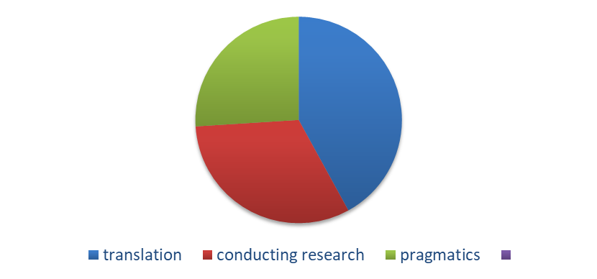
Pragmatic phenomena
Im/politeness
Implicatures

Slide 87
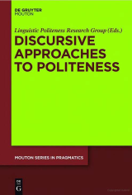
Discursive approaches to politeness and impoliteness -Sara Mills (continued)
Relation between politeness and impoliteness
Not pre-formed identities for individuals
Co-construction
If the judgements of the interactants are the key element in assessments of politeness, then the role of the analyst may appear to be downgraded.

Slide 88
'First order' and 'second order' politeness:
Institutional and intercultural contexts
Karen Grainger
Three 'waves' of politeness theory
2.1. First wave: Gricean approaches
Brown and Levinson's theory of politeness: the strategic management of face needs
2.2. Second wave: the post-modern approach I discursive politeness
The main thrust of this approach, developed initially by Watts (2003, 2005) Locher (2004, 2006) and Locher and Watts (2005) is that the study of politeness should focus on the 'discursive dispute' (Watts 2003) of what it means to participants to be polite.
2.3. Third wave: sociological I interactional approaches
Whereas the post-modem approach to politeness theory can be characterised as a reaction to the Gricean approach, the interactional approach cannot accurately be said to contrast with either the post-modern approach or the Gricean approach since it overlaps with both.

Slide 89
On Apologising in Negative and Positive Politeness Cultures_
Eva Ogiermann
Cross-cultural pragmatics is a subdiscipline of pragmatics that closely follows the original thought of ordinary language philosophy.
Austin’s, Searle’s and Grice’s contributions to the development of the field of pragmatics are also central to the politeness theories on which most research conducted in cross-cultural pragmatics is based.

Slide 90
DATA TYPES for your audiovisual research
Advertising (multimodality, AVT)
Subtitled/Dubbed films
Aristocats - Tsifths gatos moustakatos (Greek)
https://www.youtube.com/watch?v=zH7f5RPRxpA

Slide 91
Culpeper, Jonathan. 2011. Impoliteness – using language to cause offence. Cambridge: Cambridge University Press.
Duszak, Anna (ed.). 1997. Culture and styles of academic discourse. Berlin: Mouton de Gruyter.
Economidou-Kogetsidis, Maria. 2011. “Please answer me as soon as possible”: pragmatic failure in non-native speakers’ e-mail requests to faculty. Journal of Pragmatics. 43. 3193–3215.
Fairclough, Norman. 1995. Media Discourse. London: Edward Arnold.
Fairclough, Norman. 2006. Language and globalization. Routledge: London.
Garces-Conehos Blitvitch, Pilar. 2013. Introduction: Face, identity and im/politeness. Looking backward, moving forward: From Goffman to practice theory Journal of Politeness Research 9(1). 1–33.
Halliday M. A. K. & J. R. Martin. 1993. Writing Science: Literacy and Discursive Power. London: Routledge/Falmer. http://books.google.gr/books/about/Writing_Science.html?id=ttI9AAAAIAAJ&redir_esc=y (accessed March 3, 2015)

Slide 92
Your assignment for next time
Please visit the Journal of Pragmatics or any of the John Benjamins journals and skim as many abstracts as possible to identify two projects you could possibly conduct between English-and mother tongue.
Please answer as follows:
present the abstract which inspired you (copy-paste)
explain how you could collect your data
say what research question you could ask which would be relevant to pragmatics research
And why you think this set of data is appropriate for your purpose.

Slide 93


