Slide 1
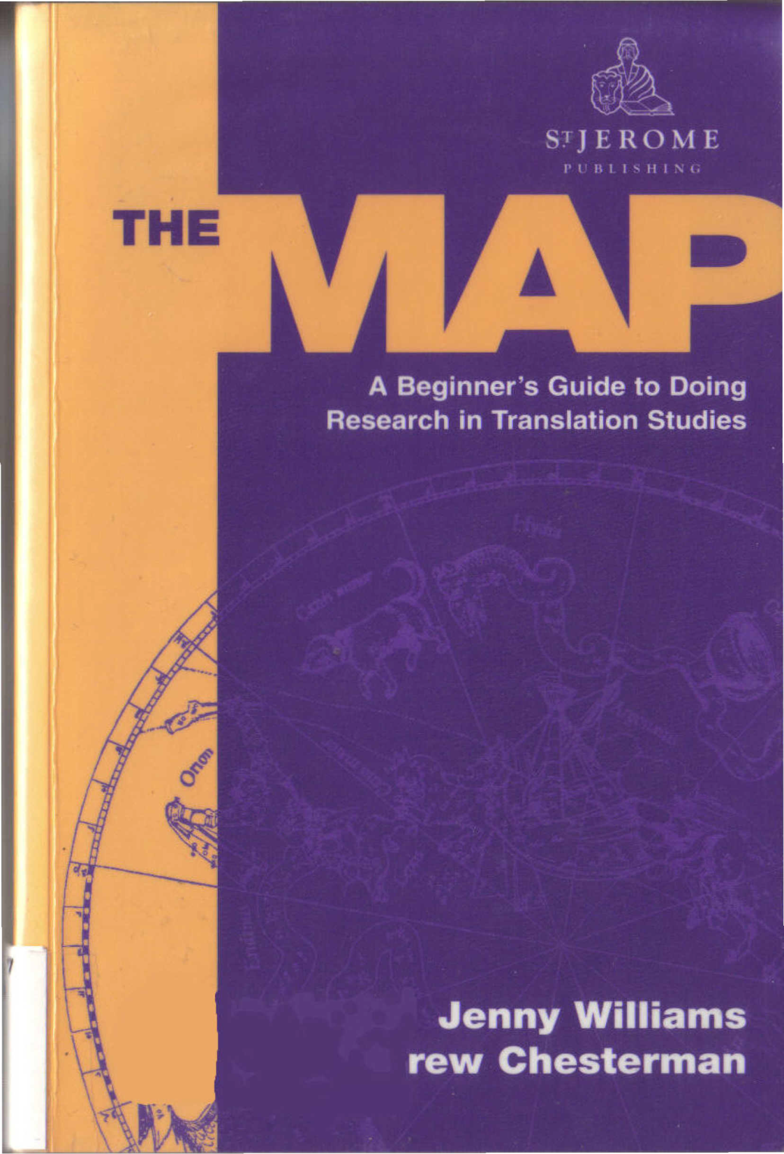
Course: Research methodology in translation studies Unit 2: From the Initial Idea to the Plan Prof. Emerita M. Sidiropoulou
MA in TRANSLATION STUDIES AND INTERPRETING
MA in TRANSLATION: GREEK, ENGLISH, RUSSIAN

Slide 2
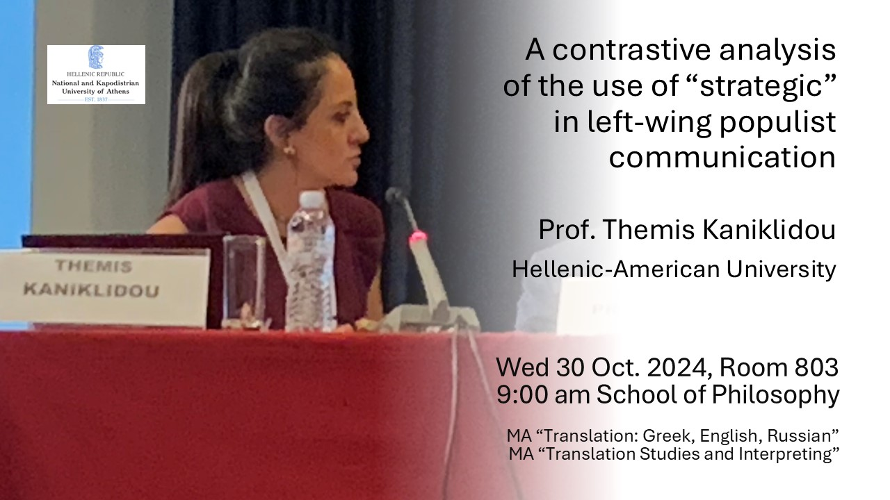

Slide 4
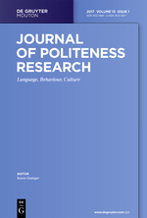
Journals on pragmatics
https://www.degruyter.com/view/j/jplr

Slide 5
Politeness theoretical trends
1st wave theorists (Brown and Levinson 1978/1987) etic perspective (the scholars’ view)
2nd wave theorists (2000 onwards…discursive approaches) emic perspective (the hearers’ view)
3rd wave theorists

Slide 6
The Brown and Levinson model (1978/1987:107) Positive politeness
Claim common ground
Notice, attend to H (his interests, needs…)
Exaggerate (interest, approval, sympathy with H)
Intensify interest to H
Use in-group identity markers
Seek agreement
Avoid disagreement
Raise/assert common ground
joke
Convey that S/H are cooperators
9. Assert S’s concern for H
10. Offer, promise
11. Be optimistic
12. Include both S and H in the activity
13. Give (or ask) for reasons
14. Assume/assert reciprocity
Fulfill gifts to H (for some X)
7. 15. Give gifts to H (goods, sympathy, understanding, cooperation)

Slide 7
The Brown and Levinson model (1978/1987:136) Negative politeness
Be indirect
Be conventionally indirect
Don’t presume/assume
2. Question, hedge
Don’t coarse
3. Be pessimistic
4. Minimize the imposition
5. Give deference
Communicate S’s want to not impinge on H
6. Apologize
7. Impersonalize S and H
8. State the FTA as a general rule
9. Nominalize
Redress other wants of H’s
10 Go on record as in incurring a debt, or as not indebting H

Slide 8
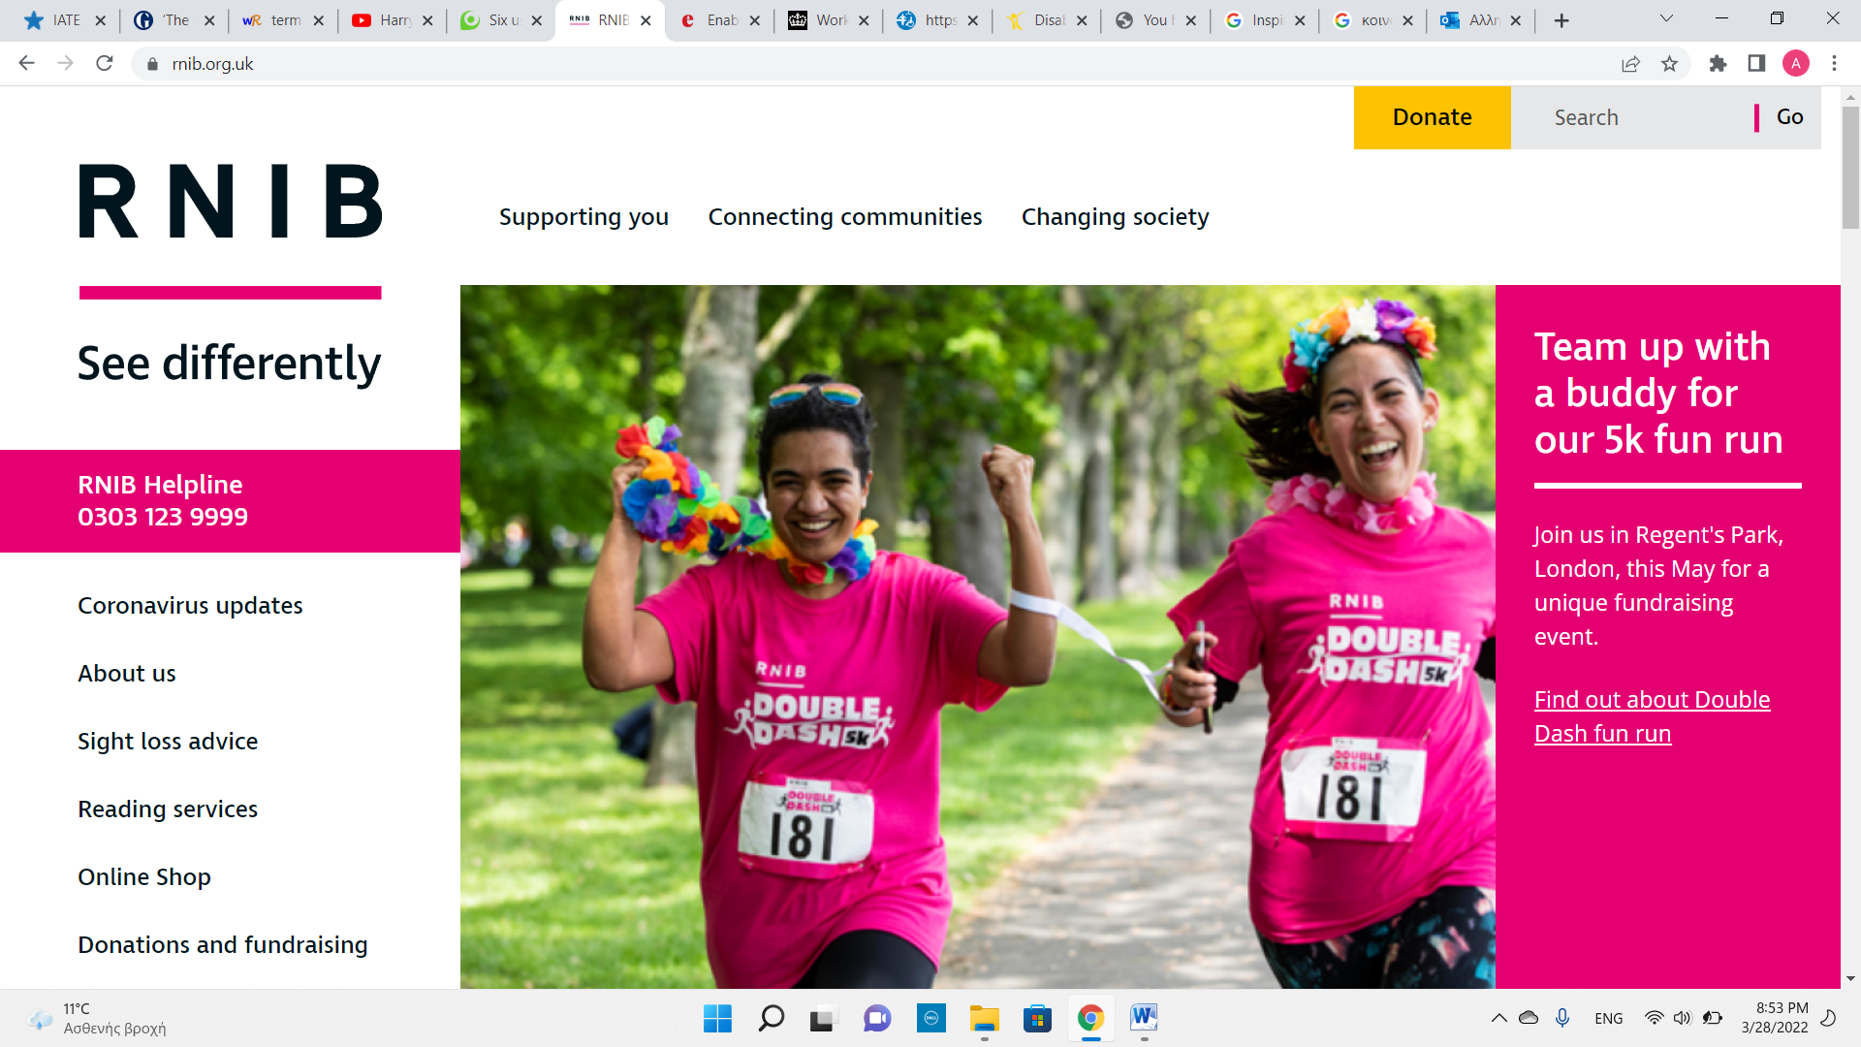
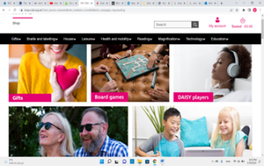
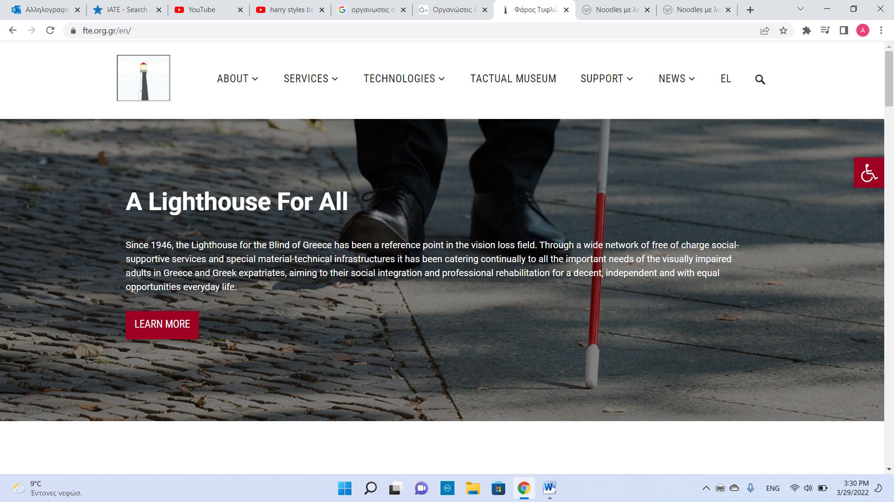
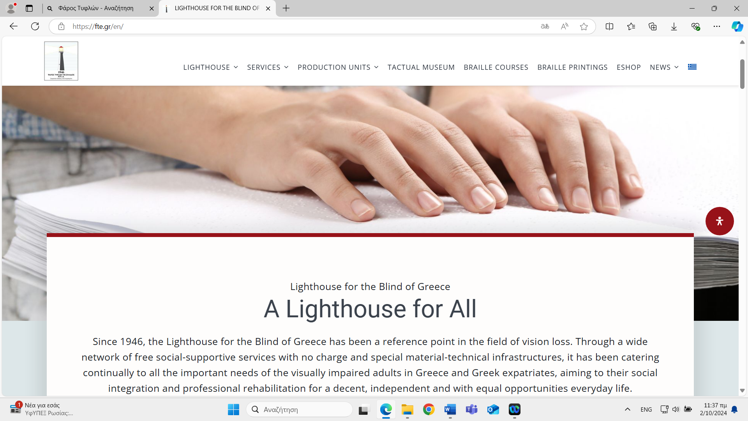

Slide 9


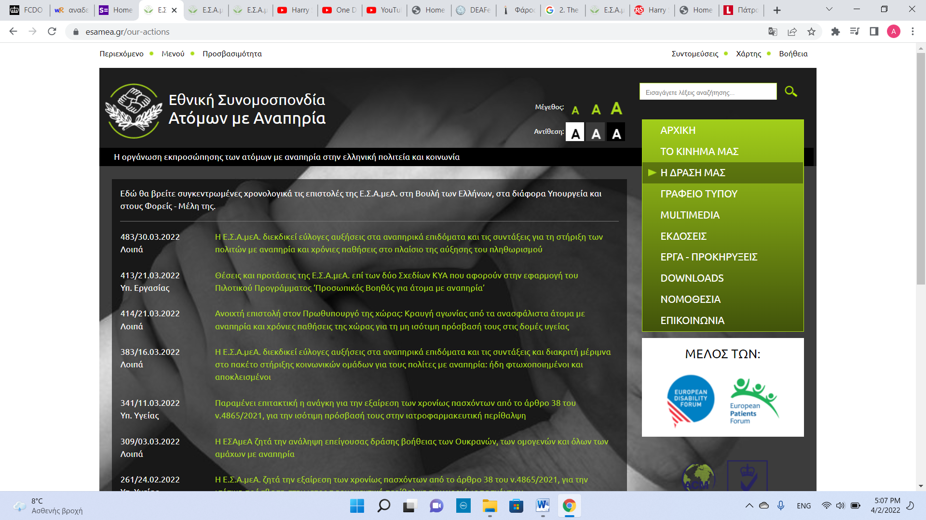


Slide 10
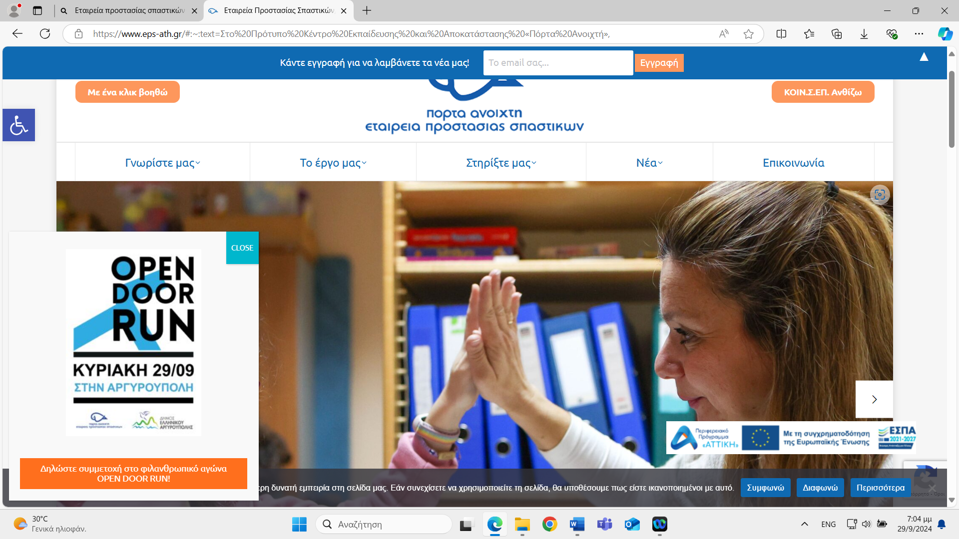
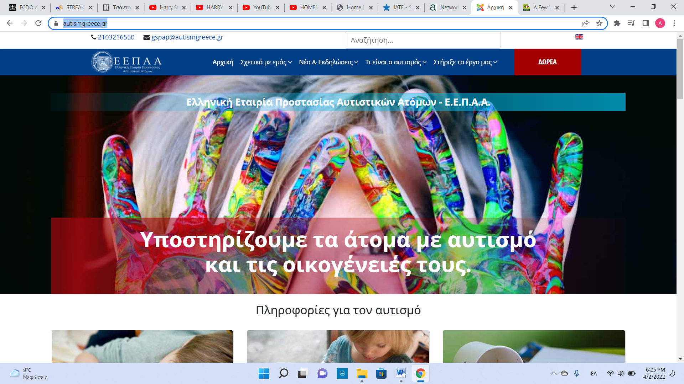

Slide 11
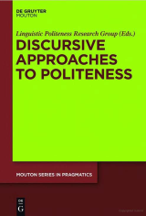
'First order' and 'second order' politeness: Institutional and intercultural contexts Karen Grainger
Three 'waves' of politeness theory
2.1. First wave: Gricean approaches
Brown and Levinson's theory of politeness: the strategic management of face needs
2.2. Second wave: the post-modern approach I discursive politeness
The main thrust of this approach, developed initially by Watts (2003, 2005) Locher (2004, 2006) and Locher and Watts (2005) is that the study of politeness should focus on the 'discursive dispute' (Watts 2003) of what it means to participants to be polite.
2.3. Third wave: sociological I interactional approaches
Whereas the post-moderm approach to politeness theory can be characterised as a reaction to the Gricean approach, the interactional approach cannot accurately be said to contrast with either the post-modern approach or the Gricean approach since it overlaps with both.

Slide 12
On Apologising in Negative and Positive Politeness Cultures_ Eva Ogiermann
Cross-cultural pragmatics is a subdiscipline of pragmatics that closely follows the original thought of ordinary language philosophy.
Austin’s, Searle’s and Grice’s contributions to the development of the field of pragmatics are also central to the politeness theories on which most research conducted in cross-cultural pragmatics is based.

Slide 13
On Apologising in Negative and Positive Politeness Cultures_ Eva Ogiermann
While cross-cultural pragmatic studies look at how politeness is realized in different cultures, which are treated as static and homogeneous entities, postmodern research examines language use in particular ‘communities of practice’ (Eckert & McConnell-Ginet 1992) or ‘emergent networks’ (Watts 2003), which are
continually re-constructed through interaction. The speakers’ social identities and their relationships, as well as concepts such as face or social distance and power, that appear to be static in Brown and Levinson’s theory, are viewed as dynamic. The possibility that there are particular linguistic structures that can be used to make communication more polite is rejected and politeness becomes unpredictable.

Slide 14
cross-cultural pragmatics through translation
cross-cultural pragmatics aims at establishing general patterns and the extent to which they are shared or different across cultures.

Slide 15
On Apologising in Negative and Positive Politeness Cultures_ Eva Ogiermann
The study of cultures can involve qualitative or quantitative research methods, and their choice is closely linked with taking either an emic or an etic approach. The focus on one culture, typical of the emic approach, favours qualitative methods, while the etic approach involves the comparison of several cultures, for which comparable, ideally universal criteria are needed (Gudykunst 2000: 294).
Cross-cultural data can serve as a baseline for interlanguage pragmatic studies and as pragmatic input for teaching materials. In the context of second language acquisition, prediction and prescription are highly desirable since they can help the L2 learner avoid being unintentionally rude.

Slide 16
non-predict
On Apologising in Negative and Positive Politeness Cultures_ Eva Ogiermann
Cross-cultural data can serve as a baseline for interlanguage pragmatic studies and as pragmatic input for teaching materials. In the context of second language acquisition, prediction and prescription are highly desirable since they can help the L2 learner avoid being unintentionally rude.

Slide 17
DATA TYPES for research
Academic writing in translation
Stage Translations of the same ST
Advertising (multimodal)
Dubbed films (multimodal)
Thomas O'Malley Cat Lyrics | Disney Song Lyrics (disneyclips.com)
Aristocats - Tsifths gatos moustakatos (Greek)
https://www.youtube.com/watch?v=zH7f5RPRxpA

Slide 18
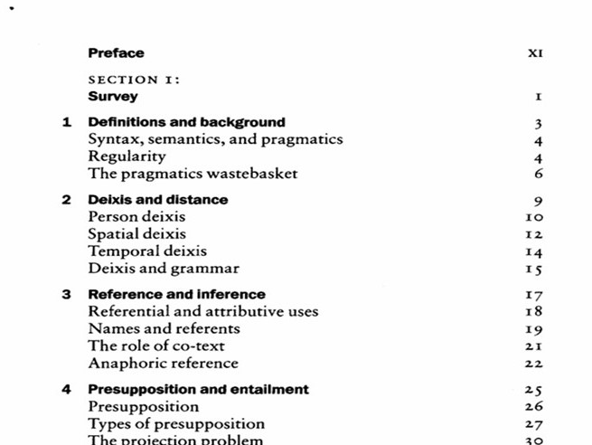
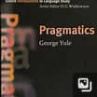

Slide 19

Translating Client Identity in Male Cosmetics Advertising
Aikaterini Eikosideka
National and Kapodistrian University of Athens
TEP II Online Postgraduate Symposium, 24 Feb 2023

Slide 20
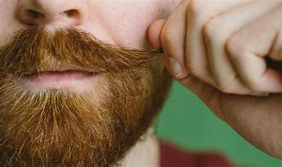
Goal of Study
Unfolding male identity perception
cross-culturally via advertisements:
English VS Greek

Slide 21
Literature Review
Hofstede, Hofstede & Minkov (2010)
Individualism VS collectivism
Information & Communication Technologies
Masculinity VS Femininity
Uncertainty avoidance/ tolerance
Notes:
As stated by Hofstede, et al. (2010), these are the three dimensions from which the use of information and communication technologies (ICT) are affected. Starting with individualism versus collectivism, they say that ICT “...tools originated in a highly individualist society: the United States. ICT tools link individuals, so these tools are more easily, frequently and eagerly used in individualist societies than in collectivist societies.” (ibid: 123) Continuing with the masculinity versus femininity, the differences that have been noted are with regards to the roles men and women have as buyers, as well as the types of purchases that take place in each respective culture (status purchases versus home products)(Hofstede, et al., 2010). Last, regarding the uncertainty avoidance, Hofstede, et al. (2010) outline how the dimension affects the decision making process in the type of product consumers will prefer to purchase.

Slide 22

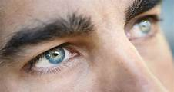


Methodology
Quantitative analysis
Brand selection & collection of data
Old Spice
AXE
Nivea
Questionnaires
15 Greek and English bilinguals

Slide 23

Example 1
Source Text | But if he stopped using lady-scented body spray and switched to Old Spice, he could smell like me.
Target Text | Αλλά αν χρησιμοποιούσε Old Spice, θα μπορούσε να μυρίζει σαν εμένα.
Back Translation | But if he used Old Spice, he could smell like me.

Slide 24

Example 2
Source Text | A scent gives him all the confidence
Target Text | Γιατί με Old Spice μοσχομυρίζει
Back Translation | Because he smells great with Old Spice

Slide 25

English
Greek
Uncertainty tolerance → less analytical descriptions of products
Neutral expert authority → Mentions collection name
Uncertainty avoidance → more analytical description of products
Heightened expert authority → Adds name of product

Slide 26
Communication Styles in translating Pushkin’s Fisherman and the Goldfish
Eleni Piperidou

Slide 27
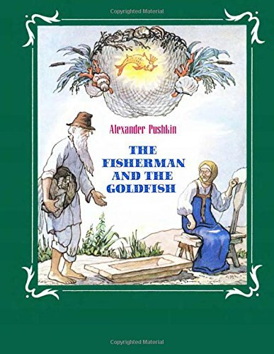
Introduction
This study is to examined pragmatic shifts in rendering Pushkin’s story ‘The fisherman and the goldfish’ in two Greek (1962, 2006) and two English (1962, 2011) versions written almost fifty years apart.
The study highlighted how the identities of the fisherman and his wife were portrayed.
The data analysis suggests heightened aggressiveness and offensiveness in the latest versions and a lowering hierarchy awareness

Slide 28
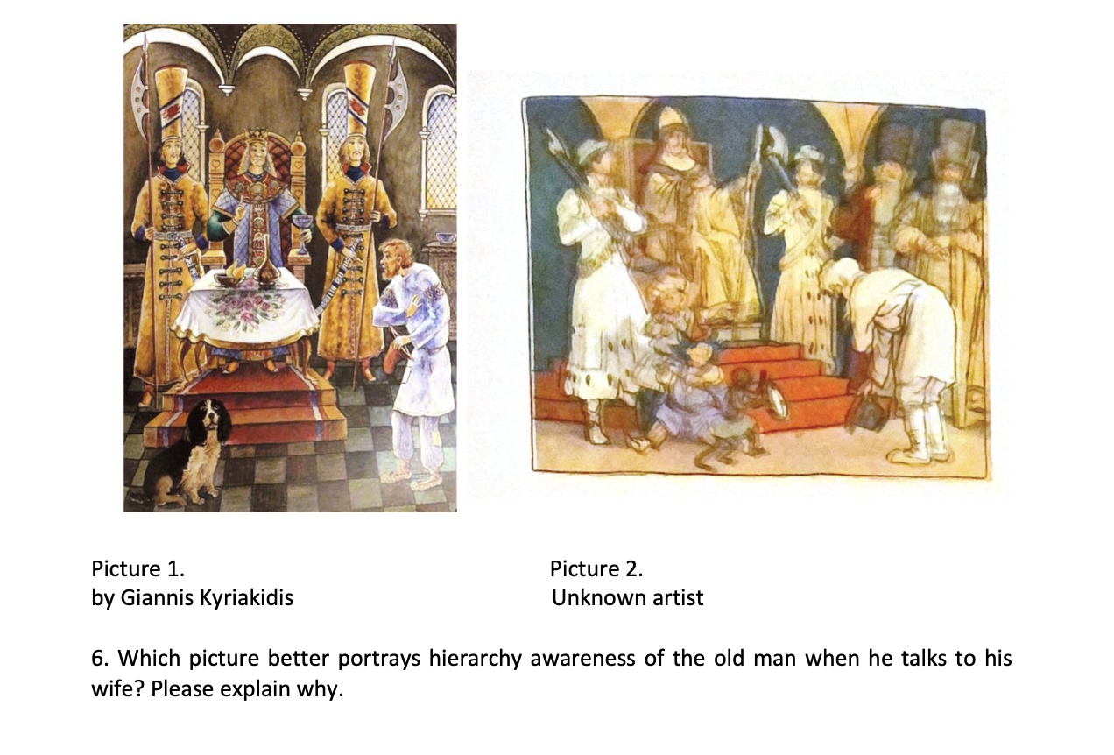
Question 6 from the Questionnaire

Slide 29

Translation, Education and Pragmatics (TEP) TEP II online postgraduate symposium, 24 Feb 2023
Character portrayal
in Russian and Greek
AVT modalities:
The Rise of the Guardians
Alfia Khusainova

Slide 30
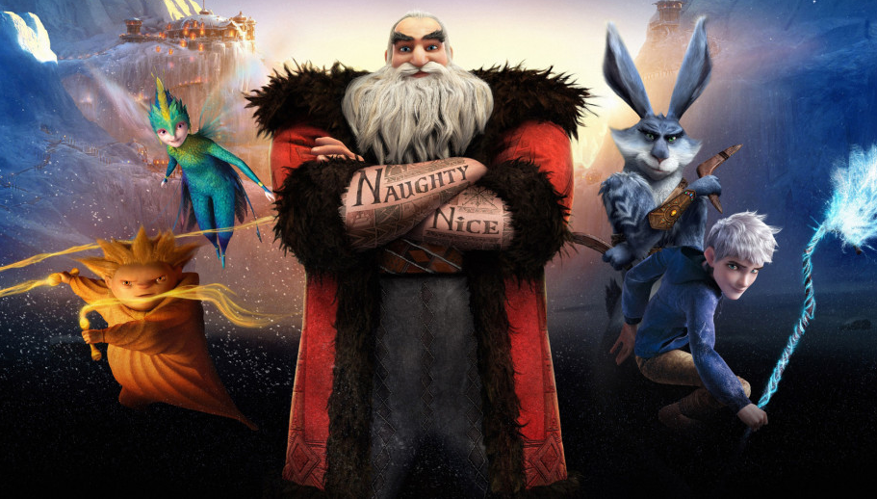
abundance of fantasy characters shared by the target audiences to a different degree.
- a cognitive criterion: un/familiarity
target audience – children.
Rise of the Guardians (2012)
DreamWorks Animation

Slide 31
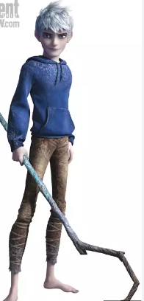
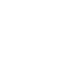
Jack Frost
English (ST)
To spend eternity like you guys cooped up in some, some hideout thinking of, of new ways to bribe kids? No, no, that's not for me. No offense.
RUd | Провести вечность (x) , прячась в тайных логовах и выдумывая новые способы подкупа детей? Нет, нет. Это не для меня! Не обижайтесь. (To spend eternity, hiding in secret dens and making up new ways of bribing kids? No, no. It is not for me. Do not be offended.)
RUs | (X) Целую вечность за компанию с вами (X) придумывать новые способы подкупать детишек? Нет, нет. Это не для меня! Без обид.(Eternity in your company, making up new ways of bribing little kids? No, no. This is not for me! No offence.)
GRd | Να μαντρωθώ αιώνια σαν εσάς, παίδες, κάπου στην ερημιά, για να βρίσκω πώς να καλοπιάνω τα παιδιά; Όχι, όχι, αυτό δεν μου αξίζει! Με το συμπάθιο. (To hunker down forever like you, guys, somewhere in the wilderness, figuring out how to play up to kids? No, no. I don’t deserve this. No offence.
GRs | Να γίνω σαν ένας από εσάς; Να ζω περιορισμένος στο να σκαρφίζομαι τρόπους να καλοπιάνω τα παιδιά; Όχι, όχι. Δεν είμαι από δαύτους εγώ. Μην παρεξηγείστε όμως. (To become like one of you? To live confined to making up ways to play up to kinds? No, no. I am not of the kind. Do not be offended, though.)

Slide 32
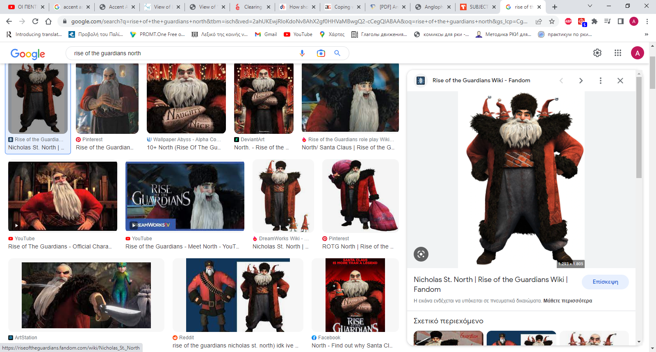
North
English (ST)
Give me (-) break! You know how many toys I deliver in one night?
RUd | Да это пустяки! Знаешь, сколько игрушек я доставляю за одну ночь? (this is nothing! Do you know how many toys I deliver in one night?)
RUs | Да брось. Знаешь, сколько игрушек я развожу всего за одну ночь? (Oh, please! Do you know how many toys I deliver in one night?)
GRd | Σιγά (-) αυγά! Ξέρεις πόσα δώρα μοιράζω σε μια νύχτα; (Big dealing! Do you know how many gifts I give in one night?)
GRs | Σιγά το δύσκολο. Ξέρεις πόσα δώρα μοιράζω σε μια νύχτα; (Big deal! Do you know how many gifts I give in one night?)

Slide 33
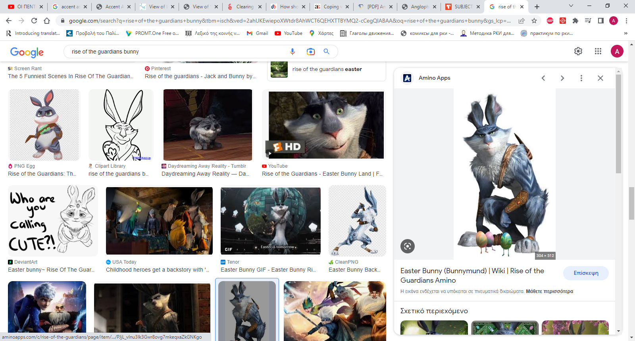
E.Aster Bunnymund
English (ST)
North: Buckle up!
Bunny: Whoa, whoa, whoa, where are the bloody seatbelts?
North: Ha! That was just expression!
RUd | North: Пристегнитесь! (Buckle up) Bunny: _____А (X) ремни-то у тебя где? (where are the seatbelts?) North: Да это я для красного словца. (that (remark) was just for the sake of eloquence)
RUs | North: пристегнись! (Buckle up) Bunny: ______А где тут (X) ремни? (where are the seatbelts?) North: Это я образно сказал. (I meant that figuratively)
GRd | North: Προσδεθείτε! (Buckle up) Bunny: _____Που είναι οι ριμάδες οι ζώνες; (Where are the bloody seatbelts?) North: Ο τρόπος του λέγειν δηλαδή. (That was just a figure of speech)
GRs | North: Προσδεθείτε! (Buckle up) Bunny: ______Πού είναι οι (X) ζώνες; (Where are the seatbelts?) North: Τρόπος του λέγειν. (Just an expression)

Slide 34
Αpproaching the unfamiliar
Russian
Negative
politeness
Non-interfering
Greek
Positive
politeness
interfering

Slide 35

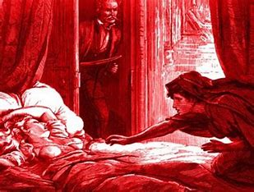
Carmilla: horror & queerness in two Greek TTs
Maria Episkopou
Post-graduate researcher

Slide 36
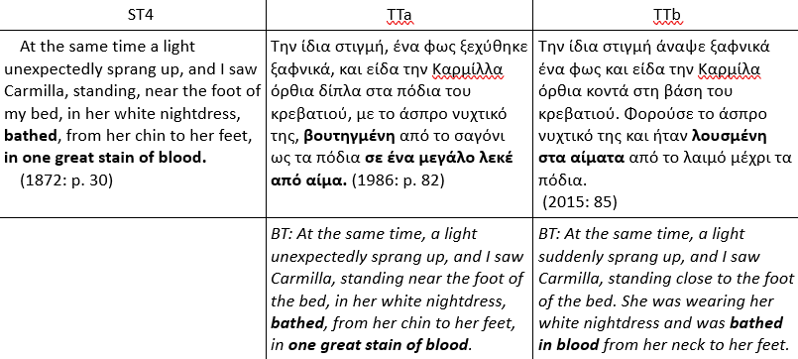
DATA ANALYSIS

Slide 37


The tT covers
(1986 version)
(2015 version)

Slide 38
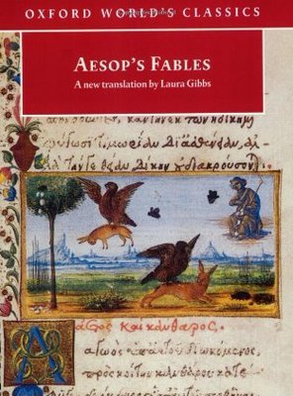
Translation, Education and Pragmatics (TEP) TEP II online postgraduate symposium, 24 Feb 2023
STORY-TELLING PERSPECTIVES IN TRANSLATING
AESOP’S FABLES
MARIA KOSTARAGKOU

Slide 39
Aesop fables Power differentials in narrative perspectives
1993
Mod. Greek TTs
1991
English TTs
2013
2011

Slide 40
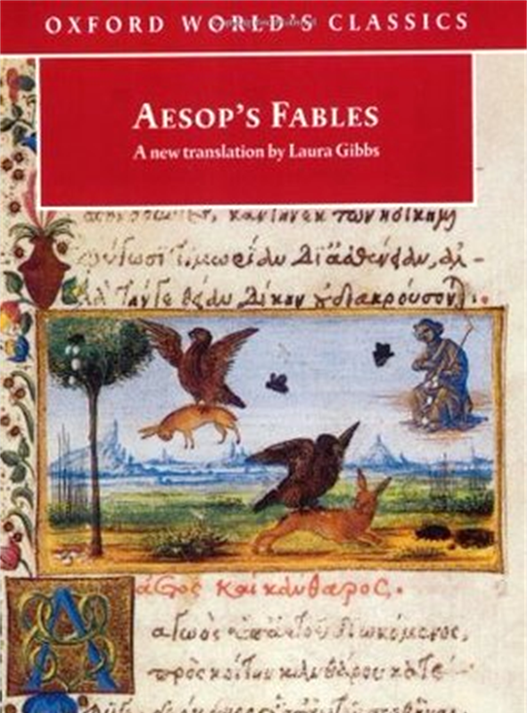
Power differentials in narrative perspectives M. Greek English
M. Greek English
Notes:
Power distance is heightened in Greek, downplayed in English

Slide 41
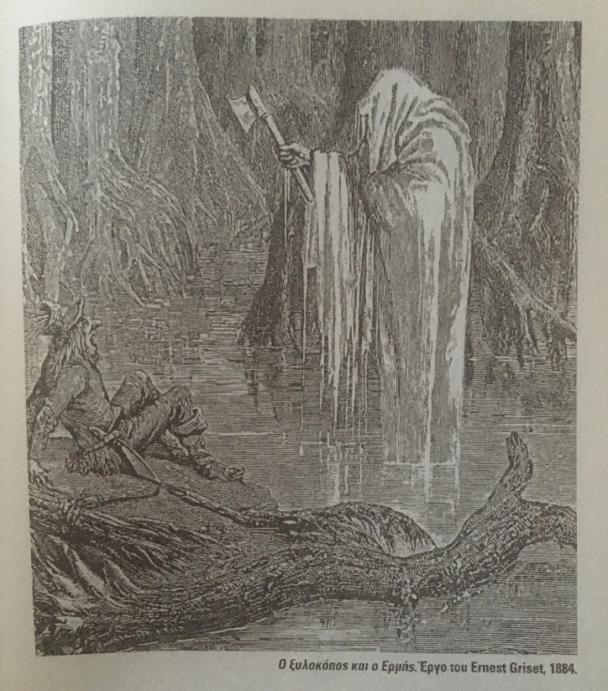
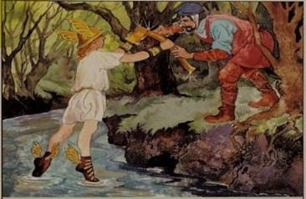
Pragmatic matters: POWER DISTANCE ADDRESSEE AGE AWARENESS

Slide 42


Translation, Education and Pragmatics (TEP)
Shaping political ideologies in the UK BBC and the Russian BBC Service
Pigi Haidouli

Slide 43
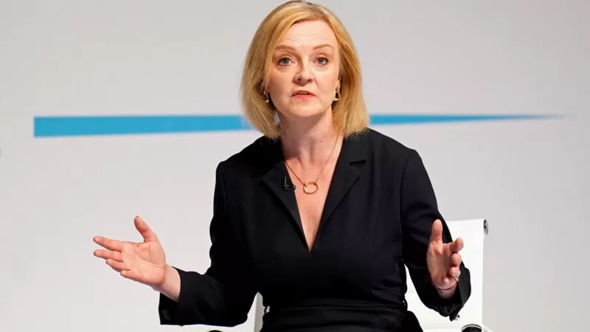
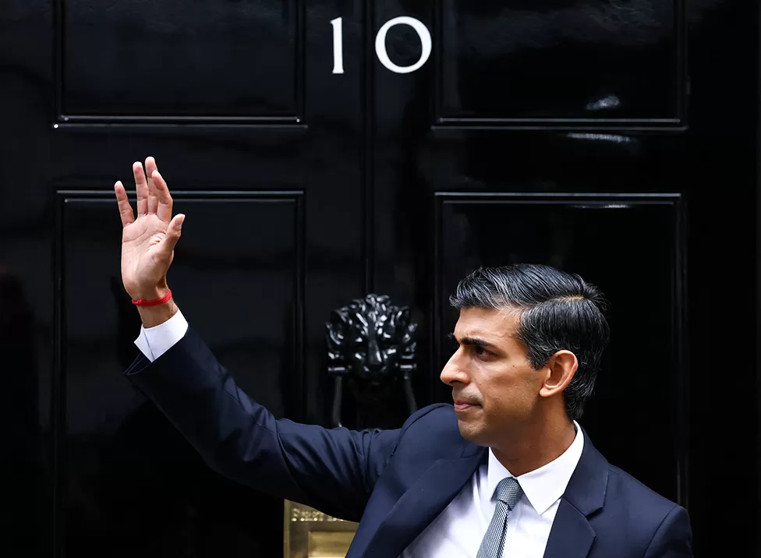
Liz Truss and Rishi Sunak on BBC NEWS
6 articles 3 pairs
1 on Liz Truss becoming the new Prime Minister and 1 on her resignation
1 on Rishi Sunak becoming the new Prime Mini­ster.

Slide 44
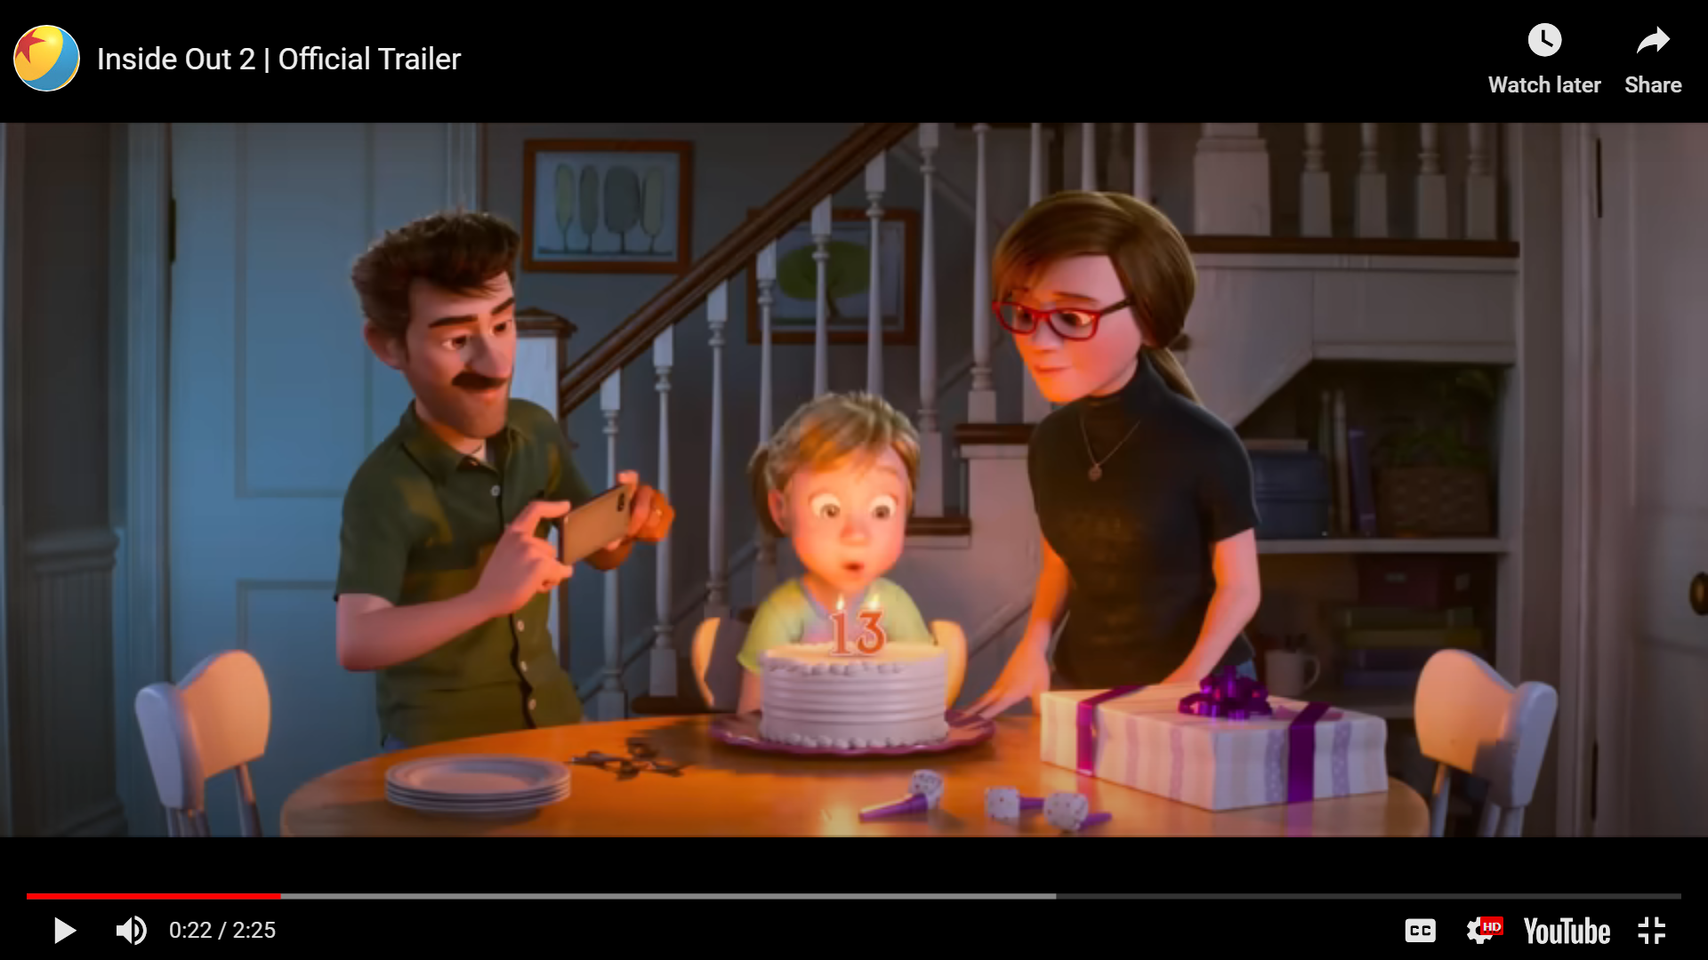
Teaching cross-cultural pragmatics through AVT Vasiliki Papakonstantinou
Inside Out 2015

Slide 45
The study theoretically analyzed the types of variation between the original English script of the film, the Greek subtitles, and the Greek dubbed script. The intention was to make learners/students aware of un/naturalness in discourse.
Dubbing data seem to be rich in pragmatic shifts which may be used for conducting exercises, thus highlighting cross-cultural pragmatic variation.

Slide 46
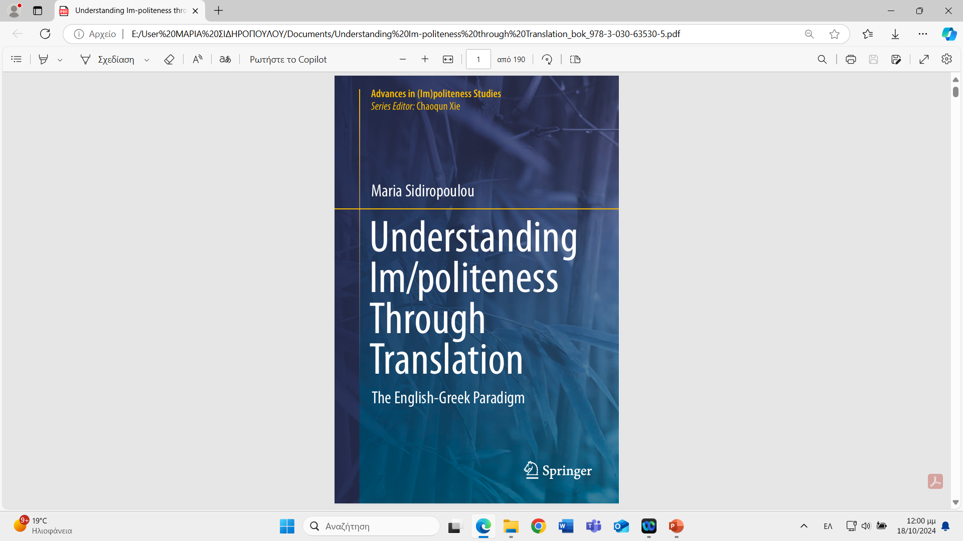

Slide 47
Chapter 6 Im/Politeness, Fiction and AVT
The study first reviews issues in pragmatics relevant to AVT and reception studies and then it explores a mini corpus of twenty-one pairs of English source film trailers and their dubbed or subtitled versions, for tracing manifestations of im/politeness and audience reception of them. Extra-textual data elicited through a questionnaire (in part a and part b) show that respondents appreciated im/politeness rendition as realized in the dubbed version, rather than through the subtitles, and explained why dubbing enforced their engagement with the trailer narration, in the multimodal viewing experience.

Slide 48
SUBTITLED VS DUBBED TRAILERS
CHARMING | Official Trailer | 2018 [HD] (youtube.com)
Ο ΜΑΓΕΜΕΝΟΣ ΠΡΙΓΚΙΠΑΣ (CHARMING) - TRAILER (ΜΕΤΑΓΛ.) (youtube.com)
Elena of Avalor | Don't Look Now | Song | Official Disney Channel Africa (youtube.com)
H Έλενα του Άβαλορ - Μην Κοιτάς Τώρα | Elena of Avalor - Don't Look Now Song (youtube.com)
Tall Tales Trailer #1 (2018) | Fandango Family (youtube.com)
Ο ΜΑΓΙΚΟΣ ΚΗΠΟΣ (TALL TALES) - TRAILER (ΜΕΤΑΓΛ.) (youtube.com)
The Aristocats: Thomas O'Malley (youtube.com)
Aristocats - Tsifths gatos moustakatos (Greek) (youtube.com)

Slide 50
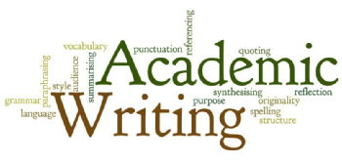
in translation

Slide 51
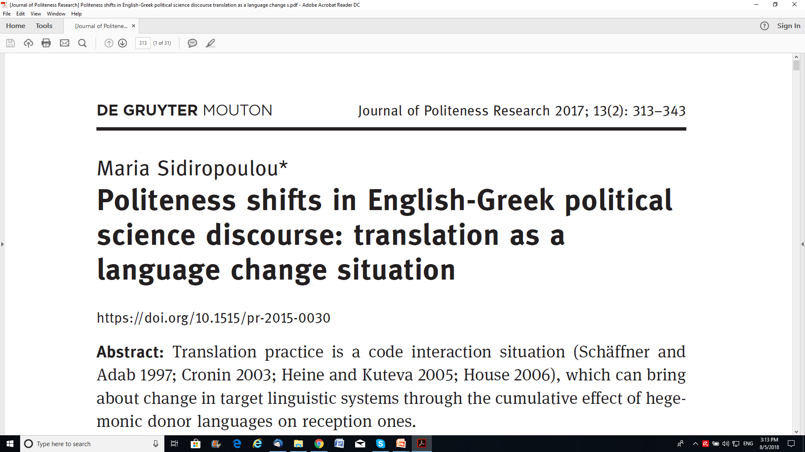

Slide 52


Slide 53
3.1 A pilot empirical investigation: a 1983 transfer situation
Mill’s essay On Liberty
celebrates the liberal notion of negative liberty of non-interference,
as opposed to the concept of positive liberty, which emphasizes self-mastery.

Slide 54
3.1 A pilot empirical investigation: a 1983 transfer situation Rationality and objectivity
ST1 Men’s opinions, accordingly, on what is laudable or blamable, are affected by the multifarious causes, … (§ 6)
TT1 Συνεπώς, οι γνώμες των ανθρώπων για το τι είναι αξιέπαινο ή αξιόμεμπτο, επηρεάζονται από τις πολυποίκιλες αιτίες, …(1983: 27)
ST2 Apart [X] from the peculiar tenets of individual thinkers, there is … (§ 15)
TT2 Εκτός, όμως, από τις επιμέρους θεωρίες των μεμονωμένων στοχαστών, παρατηρείται … (1983: 37)
ST3 The only part of the conduct of any one, for which he is amenable to society, is that which concerns others. [X] In the part which merely concerns himself, his independence is, of right, absolute. … (§ 9)
TT3 Η μόνη συμπεριφορά για την οποία ο άνθρωπος είναι υπόλογος στην κοινωνία, είναι αυτή που αφορά τους άλλους. Ενώ ως προς τη συμπεριφορά που αφορά τον εαυτό του, η ανεξαρτησία του είναι δικαιωματικά απόλυτη. … (1983: 31)

Slide 55
3.1 A pilot empirical investigation: a 1983 transfer situation 3.1.2 Collective awareness
ST4 It is so far from being new, that, [X] in a certain sense, it has divided mankind, almost from the remotest ages; (§ 1)
TT4 Υπάρχει μάλιστα από τόσο παλιά, ώστε μπορούμε να πούμε ότι, κατά κάποιον τρόπο έχει διχάσει την ανθρωπότητα από αρχαιοτάτων χρόνων (1983: 19)
ST5 there needs protection also against the tyranny of the prevailing opinion and feeling … (§5)
ST6 Another grand determining principle of the rules of conduct, both in act and in forbearance, which have been enforced by law or opinion, has been the servility of mankind … (§ 7)
feeling >του δημόσιου αισθήματος /ST6 opinion >της κοινής γνώμης [1983: 28]).
ST7 It will be convenient for the argument, if, instead of at once entering upon the general thesis, we confine ourselves in the first instance to a single branch of it, on which the principle here stated is, if not fully, yet to a certain point, recognized by the current opinions. (§ 15)
ST8 [...] the prevailing moral sentiments frequently bear the impress of impatient dislike of superiority.
the argument>του επιχειρήματός μας [1983: 39] /superiority >την ταξική της ανωτερότητα

Slide 56
3.1 A pilot empirical investigation: a 1983 transfer situation
3.1.3 Collective & hierarchy awareness
ST9 The ancient commonwealths thought themselves entitled to practice [...] directly opposed to the general tendency of existing opinion and practice. (§ 14)
TT9 Οι αρχαίες πολιτείες θεώρησαν ότι είχαν δικαίωμα να επιβάλουν [...] αντιτίθεται πιo άμεσα στη γενική τάση των κυρίαρχων δομών και συνηθειών. (1983: 37)
ST10 Some of those former reformers […] have been noway behind either churches or sects ... Επίσημες εκκλησίες [1983: 21]
3.1.4 Passivization
ST11 [...] the age which the law may fix as that of manhood or womanhood(§ 9)
TT11 [...] το όριο ενηλικίωσης, το οποίο ορίζεται από το νόμο (1983: 32)
ST12 They preferred endeavouring to alter the feelings of mankind (§ 7)
TT12 Προτίμησαν να αγωνιστούν για την αλλαγή των πεποιθήσεων των ανθρώπων (1983: 28)
The Greek version of Mill’s essay showed a rather broad set of positive politeness devices, which are occasionally balanced by the use of passivizations/nominalizations.

Slide 57

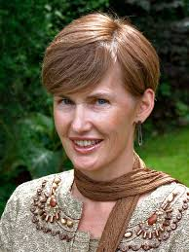

Slide 58
Karen Bennett Faculdade de Letras da Universidade de Lisboa, Alameda da Universidade,1600-214 Lisboa Research Group: Translation and Reception Studies
(2013). “English as a lingua franca in academia: combating epistemicide through translator training”. Stefania Taviano (Ed.) English as a Lingua Franca: Implications for Translator and Interpreter Education, special issue of The Interpreter and Translator Trainer (ITT).7(2): 169-193.
(2011). “The Scientific Revolution and its repercussions on the translation of technical discourse.” Myriam Salaama-Carr and Maeve Olohan (Eds.) . 17 (2): 189-210.
Science in Translation, special issue of The Translator

Slide 59
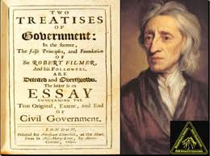

Slide 60
John Locke’s The Second Treatise contrasted to the 1990 and 2005 Greek versions
Table 1: Shifts in the two Greek versions of a 1000-word sample from John Locke’s The Second Treatise
 | 1990 | 2005
Objectivity/rationality | •• * * | •••••••• * *
Collective awareness | * | *
Nominalization/Passivization | ** Nominalization | * Passivization
* shows ‘added feature of the relevant type’/ • shows enforced link
Translation students agreed on the communicative potential of the 2nd version through a questionnaire.

Slide 61
Face work enactment through translation diachronically
The study further traces the treatment of the three phenomena in two sets of source/target pairs of political science discourse, published between 1983–1990 and 2006–2011, with a view to examining aspects of the development of these features in target versions of political science discourse.
Kadar and Mills (2011: 40) argue that “it is intriguing to briefly explore whether politeness can diachronically decrease or degenerate in a certain society”.

Slide 62
three aspects of self-representation and face
which Spencer-Oatey borrows from Brewer and Gardner (1996, in Spencer-Oatey 2007: 641) for her identity theory and analysis of face, namely, “quality face”, “social identity face” (Spencer-Oatey 2002: 540) and the “relational” one (Spencer-Oatey 2007).

Slide 63
Spencer-Oatey 2007
Quality Face (individual level) satisfies our fundamental desire for people “to evaluate us positively, in terms of our personal qualities; our competence, abilities, appearance etc.” (Spencer-Oatey 2002: 540).
Social Identity Face (collective level) satisfies our fundamental desire for people “to acknowledge and uphold our social identities or roles, e.g., as group leader, valued customer, close friend” (ibid).
Relational Face (interpersonal level) may realize the “relationship between the participants (e.g., distance–closeness, equality–inequality, perceptions of role rights and obligations), and the ways in which this relationship is managed or negotiated” (Spencer-Oatey 2007: 647); the use of passivizations/nominalizations is assumed to realize the relational perspective…

Slide 64
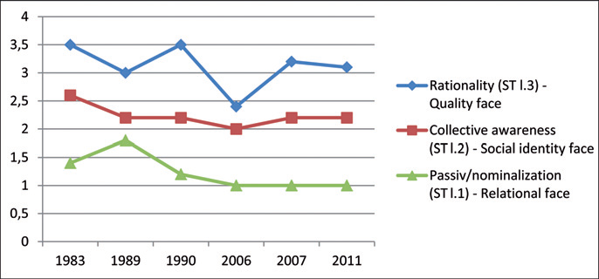
Figure 1: Degeneration of tendencies in the use of phenomena, across target samples

Slide 65
Significance of findings
These findings are assumed to suggest a “growing openness to Anglophone textual connections” (Bennett 2012: 279) and perhaps a shifting culture-/genre-specific salience hierarchy among these aspects of facework, which possibly explains their different potential for resisting the influence of English.

Slide 66
Checking salience of features in native users’ mind
[+passive, −we] | [−passive, +we]
The state of nature is governed by a natural law, which teaches everyone that since all men are equal and independent, one’s freedom , health and property should not be harmed | A natural law governs the state of nature, and teaches us that since we are all equal and independent, we should not harm one’s freedom, health and property.
[−connective, +we] | [+connective, −we]
This natural equality of men is unquestionable. [Χ] It is the basis on which we build the obligations we owe our fellow people] | This natural equality of men is unquestionable, so that it is the basis on which one builds the obligations one owes our another]
[+passive, −connective] | [−passive, +connective]
[In order for the nature of political power to be understood correctly and its source to be examined, the state all men are naturally in must be considered. [X] Nothing is clearer that creatures of the same kind should be equal among themselves, without subjugation | [For a person to understand political power correctly and examine it from its source, s/he must consider what state all men are naturally in, because nothing is clearer that creatures of the same kind should be equal among themselves, without .. subjugation

Slide 67
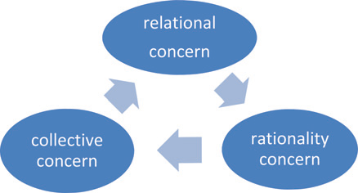
Face researchers have highlighted the significance of first-order emic perspectives into face, in addition to second-order theoretical conceptualizations of it.
[ we, passive]
[passive, connective]
[we, connective]

Slide 68
Table 3: Test results on facework enactment priorities in the Greek academic context
1. relational vs. quality | [+passive, −connective] | 58,33% | [−passive, +connective] | 41,67%
2. relational vs. quality |  | 83,33% |  | 16,67%
3. quality vs. social identity | [+connective, −we] | 4,26% | [−connective, +we] | 56,74%
4. quality vs. social identity |  | 72,16% |  | 27,84%
5. relational vs. social identity | [+passive, −we] | 61,46% | [−passive, +we] | 38,54%
6. relational vs. social identity |  | 67,70% |  | 32,30%

Slide 69
moments of social practice
Discourses are abstract entities registering moments of social practice. They can represent globalization and contribute to the understanding of it (Fairclough 2006). Fairclough (2006: 144–145) argues that “[w]hat is missing from the existing literature on globalization is a systematic approach to theorizing and analysing discourse as a moment of globalization” (emphasis added).

Slide 70
References
Bella, Spyridoula & Maria Sifianou. 2012. Greek students’ e-mail requests to faculty members. In Leyre Ruiz de Zarobe and Yolanda Luiz de Zarobe (eds.) Speech Acts and Politeness Across Languages and Cultures. 89–112. Bern: Peter Lang.
Bennett, Karen (ed.). 2014. The semiperiphery of academic writing – Discourses, communities and practices. London: Palgrave Macmillan.
Bennett, Karen. 2012. Footprints in the text: Assessing the impact of translation on Portuguese historiographical discourse. Anglo-Saxonica 3(3). 265–290.
Coupland, Nikolas. 2010. The handbook of language and globalization. Oxford: Wiley-Blackwell.
Cronin, Michael. 2003. Translation and globalization. London: Routledge.

Slide 71
Culpeper, Jonathan. 2011. Impoliteness – using language to cause offence. Cambridge: Cambridge University Press.
Duszak, Anna (ed.). 1997. Culture and styles of academic discourse. Berlin: Mouton de Gruyter.
Economidou-Kogetsidis, Maria. 2011. “Please answer me as soon as possible”: pragmatic failure in non-native speakers’ e-mail requests to faculty. Journal of Pragmatics. 43. 3193–3215.
Fairclough, Norman. 1995. Media Discourse. London: Edward Arnold.
Fairclough, Norman. 2006. Language and globalization. Routledge: London.
Garces-Conehos Blitvitch, Pilar. 2013. Introduction: Face, identity and im/politeness. Looking backward, moving forward: From Goffman to practice theory Journal of Politeness Research 9(1). 1–33.
Halliday M. A. K. & J. R. Martin. 1993. Writing Science: Literacy and Discursive Power. London: Routledge/Falmer. http://books.google.gr/books/about/Writing_Science.html?id=ttI9AAAAIAAJ&redir_esc=y (accessed March 3, 2015)

Slide 72
The Brown and Levinson model (1978/1987:136) Negative politeness
Be direct
Be conventionally indirect
Don’t presume/assume
2. Question, hedge
Don’t coarse
3. Be pessimistic
4. Minimize the imposition
5. Give deference
Communicate S’s want to not impinge on H
6. Apologize
7. Impersonalize S and H
8. State the FTA as a general rule
9. Nominalize
Redress other wants of H’s
10 Go on record as in incurring a debt, or as not indebting H

Slide 73
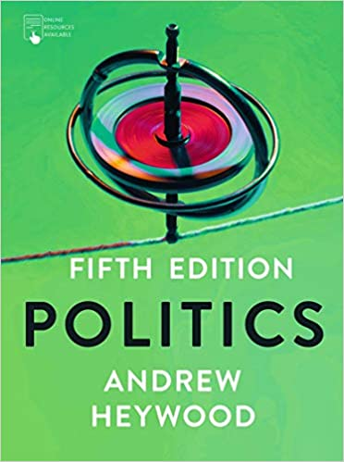



Types of variation you may come across when contrasting English and Greek parallel data

Slide 74
pronoun expansion (+) /entity omission (-)
it>το κεφάλαιο/ it>πολιτισμικής θεωρίας/it> το ίδιο παράδειγμα/He> ο Φουκώ/ Τhis> το φαινόμενο αυτό/ He writes>γράφει ο μελετητής

Slide 75
connective added (+)/ omitted (-)
0> όμως/for example>0/0>Τέλος,…/ :>δηλαδή/ :>όπως για παράδειγμα/,>καθώς και/

Slide 76
connective enforced (+)/ weakened (-)
or>τόσο…όσο και…/ to see>προκειμένου να διαπιστωθεί/ put simply>για να το θέσουμε απλά/ then> επομένως/ as S.Hall puts it>για να χρησιμοποιήσουμε την ορολογία του/and>καθώς και/ but no> χωρίς / and> αφενός ...και αφετέρου/ …thus> Επομένως…/ S also Χ>o Σ εξέτασε επίσης/ to carry out>προκειμένου να πραγματοποιήσει/rather than indicating> επομένως δεν δηλώνει/ and>καθώς και/to rewrite>προκιμένου να ξαναγραφτούν/ while> ενώ συγχρόνως/and>καθώς και/ Αs> όπως...έτσι και../and>καθώς και/ and> και συγχρόνως/but unable to tell>χωρίς να ξέρουν/

Slide 77
adverbial preposed (<)/ postposed (>)
..and..<απεναντίας/ and>ενώ/ Αmong other things…>….μεταξύ άλλων/ For example…> …για παράδειγμα/ Colin similarly<Κατά ανάλογο τρόπο…/

Slide 78
Σύμφωνα με…" adverbial formed out of ST sentence content (+)
his concept of epistemes>οι κατά Φουκώ έννοιες της επιστήμης/Bennett argues that>Σύμφωνα με την Bennett/

Slide 79
Specificity marker added (+) /omitted (-)
0>μέσω της έκθεσης/ this>αυτός ακριβώς/ this labelling>ο συγκεκριμένος χαρακτηρισμός / this one> το συγκεκριμένο/ the term>ο συγκεκριμένος όρος/it also>επιπλέον ο συγκεκριμένος τρόπος/

Slide 80
certainty marker added (+)/ omitted(-)
likely to be>0/ one single> ένας μοναδικός απόλυτος/

Slide 81
certainty marker enhanced (+)/ weakened (-)
sometimes>συχνά/ especially valuable>πολύτιμη/0>πραγματι/ is valuable>είναι ιδιαίτερα χρήσιμη/ crucial> Εξαιρετικά σημαντικό/is significant>είναι ιδιαίτερα σημαντικό

Slide 82
surfacing negation (+)/ concealed negation (-)
is only> δεν είναι παρά/ it should come as little surprise> δεν είναι παράδοξο/ less structured>όχι τόσο αυστηρά δομημένη/ rather than indicating> επομένως δεν δηλώνει/rather than/

Slide 83
passive (+) addition/ omission (-)
to see>να διαπιστωθεί/ displays>εκτίθεται/ treats> αντιμετωπίζεται/ focus>επικεντρώνονται/ involves> συνεπάγεται/ it says>αποφαίνονται/ was involved>συμμετείχε/ 0>που συντελείται>was an exhibit>εκτίθετο/to rewrite>προκιμένου να ξαναγραφτούν/

Slide 84
we-inclusive personalization (+)/ impersonalization (-)
put simply> για να το θέσουμε απλά/

Slide 85
lexical item of higher (+) formality/ lower (-) formality
looking>εστιάζοντας/

Slide 86
I. Areas in Translation Research 2. From the Initial Idea to the Plan 3. Theoretical Models of Translation 4. Kinds of Research 5. Questions, Claims, Hypotheses 6. Relations between Variables 7. Selecting and Analyzing Data 8. Writing Your Research Report 9. Presenting Your Research Orally 10. Assessing Your Research

Slide 87
Refine the initial idea
Once you have decided on a general idea, narrow it down to a plausible research topic. Questions to be asked:
How could you divide the topic into parts? What part is it of a bigger issue?
What is the history of your topic?
What are its main concepts?
What kind of variation does your topic show?
What is the value of the topic in respect to its usefulness?
Are some parts of it more valuable than other parts?

Slide 88
Steps while defining the main aim of your research (Booth et al 1995)
Step 1 (WHAT YOU ARE INTERESTED IN)
Name your general topic: I am working on translation history…
Step 2 (WHAT YOU DON’T KNOW ABOUT IT)
Suggest a question: …because I want to find out how translator x, translated y
Step 3 (THE RATIONALE OF YOUR RESEARCH)
Motivate the question:…in order to find out how translators translate their texts in a specific historical context
Step 4
What links your question to things that interest others (readers or research community)

Slide 89
Talk to someone who knows
Researchers are delighted to talk to somebody who are interested in their work
Read critically
Skimming a newspaper, gist-reading a report, reading repeatedly, sampling a history book to ascertain if it contains relevant information, reading intensively…
You will probably need all these reading techniques as a researcher

Slide 90
Keep complete bibliographic records: References to a
Book
Baker, Mona. 1992. In Other Words. London: Routledge.
Contribution in a book
Belsey, Catherine. 1992. “Revenge in Hamlet” in Coyle, Martin (ed) Hamlet. 154-159. London: MacMillan.
Article in a journal
Asimakoulas, Dimitris. 2005. “Brecht in dark times: Translations of his work under the Greek junta (1967–1974)”. Target 17 (1) 93-110.
Electronic source
Stone, Alan: Sense and Sensibility – Jane Austen’s funniest book; Emma Thompson’s greatest triumph. Online: http://bostonreview.net/BR21.1/stone.html (accessed 9/10/2011).

Slide 91
Plan your time
Course paper: You normally have 4-8 weeks to complete the project
Dissertation for a taught MA programme: 3 months to complete the project
Failure to meet the deadline may have serious consequences: marks deducted for late submission.

Slide 92
Determine the scope of your project
For a corpus-based translation studies project you need to
Decide on the criteria for including texts in your corpus
To select your texts
To obtain permission from the copyright holder to use them for your research
To build your corpus
To pre-process your corpus if necessary (e.g. to align a parallel corpus or to annotate the corpus with part-of-speech tags
Only then you will be able to exploit your corpus for research purposes

Slide 93
Work with the supervisor
Frequency/length of consultations
Methodology of the project
Submission of work and feedback
Set priorities for each week
Note questions you need to reflect on as well as ideas that occur to you
Keep a research diary

Slide 94
The Research Plan
Introduction: your topic, its background and the significance of the topic to science and society
Aim and scope of the research: clear research questions and how you restrict the scope of your project
Theoretical background: brief literature survey, main relevant sources, concepts and definitions
Material: what kind of data, where from…?
Methodology
Findings
Significance of findings, significance of research
Limitations of research, Open research problems

Slide 95
References
Blaxter, Loraine, Christina Hughes & Malcolm Tight, (2006/2010). How to Research (3rd ed.) Philadelphia: Open University Press.
Booth, Wayne C., Gregory G. Colomb, Joseph M. Williams (1995/2003/2008.) The Craft of Research. Chicago and London: The University of Chicago Press.
Williams, Jenny and Andrew Chesterman. 2002. The Map – A Beginners Guide to Doing Research in Translation Studies. Manchester: St Jerome.

Slide 96


Slide 97
Course: Research methodology in translation studies Unit 3: Theoretical Models of Translation Prof. Emerita M. Sidiropoulou
MA in TRANSLATION STUDIES AND INTERPRETING
MA in TRANSLATION: GREEK, ENGLISH, RUSSIAN

Slide 98
I. Areas in Translation Research 2. From the Initial Idea to the Plan 3. Theoretical Models of Translation 4. Kinds of Research 5. Questions, Claims, Hypotheses 6. Relations between Variables 7. Selecting and Analyzing Data 8. Writing Your Research Report 9. Presenting Your Research Orally 10. Assessing Your Research

Slide 99
Models representations of some aspect of reality
Theoretical models represent their objects in more abstract ways
They are like maps representing what is thought to be the most basic features of an object
In your research, you may take a ready model of translation and simply use its concepts unchanged or you can modify the model for your own purposes
Comparative-Process-Causal

Slide 100
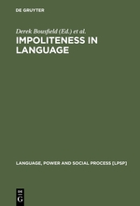
Relational work and impoliteness: Negotiating norms of linguistic behaviour Miriam A. Locher and Richard J. Watts
Impolite inappropriate/non-politic + negatively marked
(non-polite) appropriate/politic + unmarked
polite appropriate/politic + positively marked
over-polite inappropriate/non-politic + negatively marked

Slide 101
Understanding im/politeness through translation Maria Sidiropoulou (academic)
 |  |  | English |  |  | Greek
impolite | (negatively marked, inappropriate/ non-politic)
non-polite | (unmarked, appropriate/politic) | certainty |  | high-tenor
polite | (positively marked, appropriate/politic) | hedging |  | low-tenor |  | certainty | high-tenor
 |  |  |  |  |  | hedging | low-tenor
over-polite | (negatively marked, inappropriate/ non-politic)

Slide 102
1/3 types of models traditionally
Comparative models:
product-oriented, based on equivalence ST/TT, Catford 1965, Vinay and Darbelnet 1958/1995 (parallel texts)
A more recent variant of the comparative model, in corpus studies, compares translated with non-translated texts in the TL (comparable texts)

Slide 103
2/3 types of models traditionally
Process models: Introduce the concept of time.
Psycholinguists assume a model ‘Input→black box→Output;
Sager (1993) represents the main phases of a translation task including the client’s instructions, ‘Specification→Preparation→Translation→Evaluation’

Slide 104
3/3 types of models traditionally
Causal models: explain why the translation looks the way it does, or what effects it causes Causes→Translation→Effects’.
Causation:
translator’s cognition;
conditions of the translation task (the ST, client’s instructions, translator’ computer programmes, dictionaries, the deadline…)
Socio-cultural norms, history, ideology, status of languages involved
Effects:
Translations have effect on readers,
influence readers behaviour (advertising),
translator attitudes are influenced by existing norm

Slide 105
Causal model theorizing
Nida (1964): achieving a similar effect
Vermeer (1996), Nord (1997) skopos theory
Polysystem approach (Hermans 1999), ‘norm’ is a causal concept
Gutt (2000), ‘optimum relevance’ accounts for communicative choices
Toury (1995), laws of interference explain choices…
Tirkkonen-Condit and Jääskeläinen (2000), protocol studies look for the (cognitive etc) causes of translator choices…

Slide 106
Causal model question raising
Why is this translation like it is?
Why do people react like this to that translation?
Why did the translator write that?
Why did translators at that time in that culture translate like that?
How do translators affect cultures?
What causal conditions give rise to translations that people do/not like?
Why do people think this is a translation?
What will follow if I translate like this?
Choose your model type according to the kind of data you have selected

Slide 107
Eric B. Shiraev and David A. Levy. 2004/2007/2010. Cross-Cultural Psychology - CRITICAL THINKING AND CONTEMPORARY APPLICATIONS. 27-52. Boston: Allyn & Bacon
adverbial preposed (<)/ postposed (>)
however…>…όμως…/
In a representative sample…>…ενός αντιπροσωπευτικού δείγματος…
Specificity marker added (+) /omitted (-)
an article>ένα σχετικό άρθρο/
0>ακριβή/
0>την εξής συνθήκη/
0>την εξής περίπτωση/

Slide 108
Eric B. Shiraev and David A. Levy. 2004/2007/2010. Cross-Cultural Psychology - CRITICAL THINKING AND CONTEMPORARY APPLICATIONS. 27-52. Boston: Allyn & Bacon
certainty marker added (+)/ omitted(-)
0>Πράγματι…/
certainty marker enhanced (+)/ weakened (-)
will require>απαιτεί/
χ>πιθανώς χ/
surfacing negation (+)/ concealed negation (-)
not long ago>πριν λίγο καιρό/

Slide 109
On im/politeness theory
Impoliteness in Language
Studies on its Interplay with Power in Theory and Practice
edited by
Derek Bousfield
Miriam A. Locher

Slide 110
Relational work and impoliteness: Negotiating norms of linguistic behaviour Miriam A. Locher and Richard J.Watts
Impolite inappropriate/non-politic + negatively marked
(non-polite) appropriate/politic + unmarked
polite appropriate/politic + positively marked
over-polite inappropriate/non-politic + negatively marked

Slide 111
Understanding im/politeness through translation Maria Sidiropoulou (in press)
 |  |  | English |  |  | Greek
impolite | (negatively marked, inappropriate/ non-politic)
non-polite | (unmarked, appropriate/politic) | certainty |  | high-tenor
polite | (positively marked, appropriate/politic) | hedging |  | low-tenor |  | certainty | high-tenor
 |  |  |  |  |  | hedging | low-tenor
over-polite | (negatively marked, inappropriate/ non-politic)

Slide 112
Political campaign debates as zero-sum games: Impoliteness and power in candidates’ exchanges Maria Dolores Garcia-Pastor
Table 1. Face Aggravating Strategies
Positive face-oriented strategies Negative face-oriented strategies
State the communicative act(s) as common or shared knowledge.
Indebt H.
Refer to rights, duties and rules not respected, fulfilled or complied with respectively.
Increase imposition weight.
Refuse H and H’s things, actions, values and opinions.
Challenge.
Frighten.
Dare.
Convey dislike for, and disagreement with
H* and close others (his/her/their things,
actions, values and opinions).
Use aggressive punning.
Be ironic/sarcastic.
Deny in-group status.
Disassociate, distance from H.
Ignore H.
Belittle or diminish the importance of H
and H’s things, actions, values and opinions

Slide 113
Threats in conflict talk: Impoliteness and manipulation Holger Limberg
Verbal aggression and impoliteness:
Related or synonymous?
Dawn Elizabeth Archer
courtroom
Impoliteness as a means of contesting power
relations in the workplace
Stephanie Schnurr, Meredith Marra and Janet Holmes
“Stop hassling me!” Impoliteness, power and gender
identity in the professional workplace
Louise Mullany

Slide 114
A manual for (im)politeness?:The impact of the FAQ in an electronic community of practice Sage Lambert Graham
“You’re screwed either way”: An exploration of code-switching, impoliteness and power Holly R. Cashman

Slide 115
Reflections on the relational in translation as mediated interaction
The study attempts to broaden the conceptualization of the relational to include stage translation situations. It uses translator-- trainees’ evaluations (as the hearers’ view) to assess rendition of im/polite exchanges in three retranslations of a twentieth century English play. Findings show that translator--trainees’ evaluations of the way intimacy and offensiveness values are rendered in the three target versions of the play are a function of trainees’ level of awareness with respect to the relational dynamics between characters in the play. Translator trainees seem to increasingly prefer heightened intimacy (connectedness) and offensiveness (separateness), as they become aware of the relational dynamics in the play. Translator-- trainees (native speakers of the target language) seem to appreciate instances manifesting the politeness orientation attributed to the target language (Sifianou, 1992), while awareness of the relational dynamics in the play seems to override the importance of polarity orientation concerns. Translation is claimed to be able to provide settings where the relational and the cognitive may be fruitfully researched.

Slide 116
Exchange 1: Rendition of intimacy and offensiveness
ST | mom | intimacy | my baby | intimacy | the jerk | offensiveness
TT1 | μητέρα | - | μικρό μου | + | τον τρελό | -
TT2 | μάνα | + | χρυσό μου | - | ο βλάκας | +
TT3 | μαμά | + | μωρό μου | + | α το μαλάκα | +

Slide 117
Exchange 2: Rendition of intimacy and offensiveness
ST | pop | intimacy | Go back | offensiveness
TT1 | Πατέρα | - | Τότε πήγαινε… | -
TT2 | Πατέρα | - | Δεν πηγαίνεις καλύτερα … | +
TT3 | μπαμπά | + | Άντε τράβα… | +

Slide 118
Exchange 3: Rendition of intimacy and offensiveness
ST | mom | intimacy | babe | Offens. | Goddam | Offens.
TT1 | μητέρα | - | μικρούλα | - | άτιμο | -
TT2 | μάνα | + | ομορφούλα | - | καταραμένο | +
TT3 | μαμά | + | γκόμενα | + | μαλάκας | +

Slide 119
Exchange 4: Rendition of intimacy and offensiveness
ST | pal | Intim | mom | Off. | screw | Off. | don’t care | Off.
TT1 | φίλε | + | μητέρα | - | Στο διάολο | - | Δε δίνω φράγκο | -
TT2 | φιλενάδα | + | μητέρα | - | Να πηδηχθεί | + | Δε με νοιάζει | -_
TT3 | κορίτσι μου | + | μαμά | + | Δε γαμ… | + | Χέστηκα

Slide 120
Translator-trainee evaluations of the dialectic tension between intimacy and offensiveness
Version | Offensive-ness /separate-ness | Intimacy/ connected-ness | Exchange 1 | Exchange 2 | Exchange 3 | Exchange 4
TT1 1963 | - | - | 3.7% | 14.9% | 5.7% | 11.5%
TT2 1986 | + | + | 67.8% | 20.7% | 21.8% | 2.3%
TT3 2002 | + | + | 29.8% | 64.3% | 70.1% | 86.2%

Slide 121
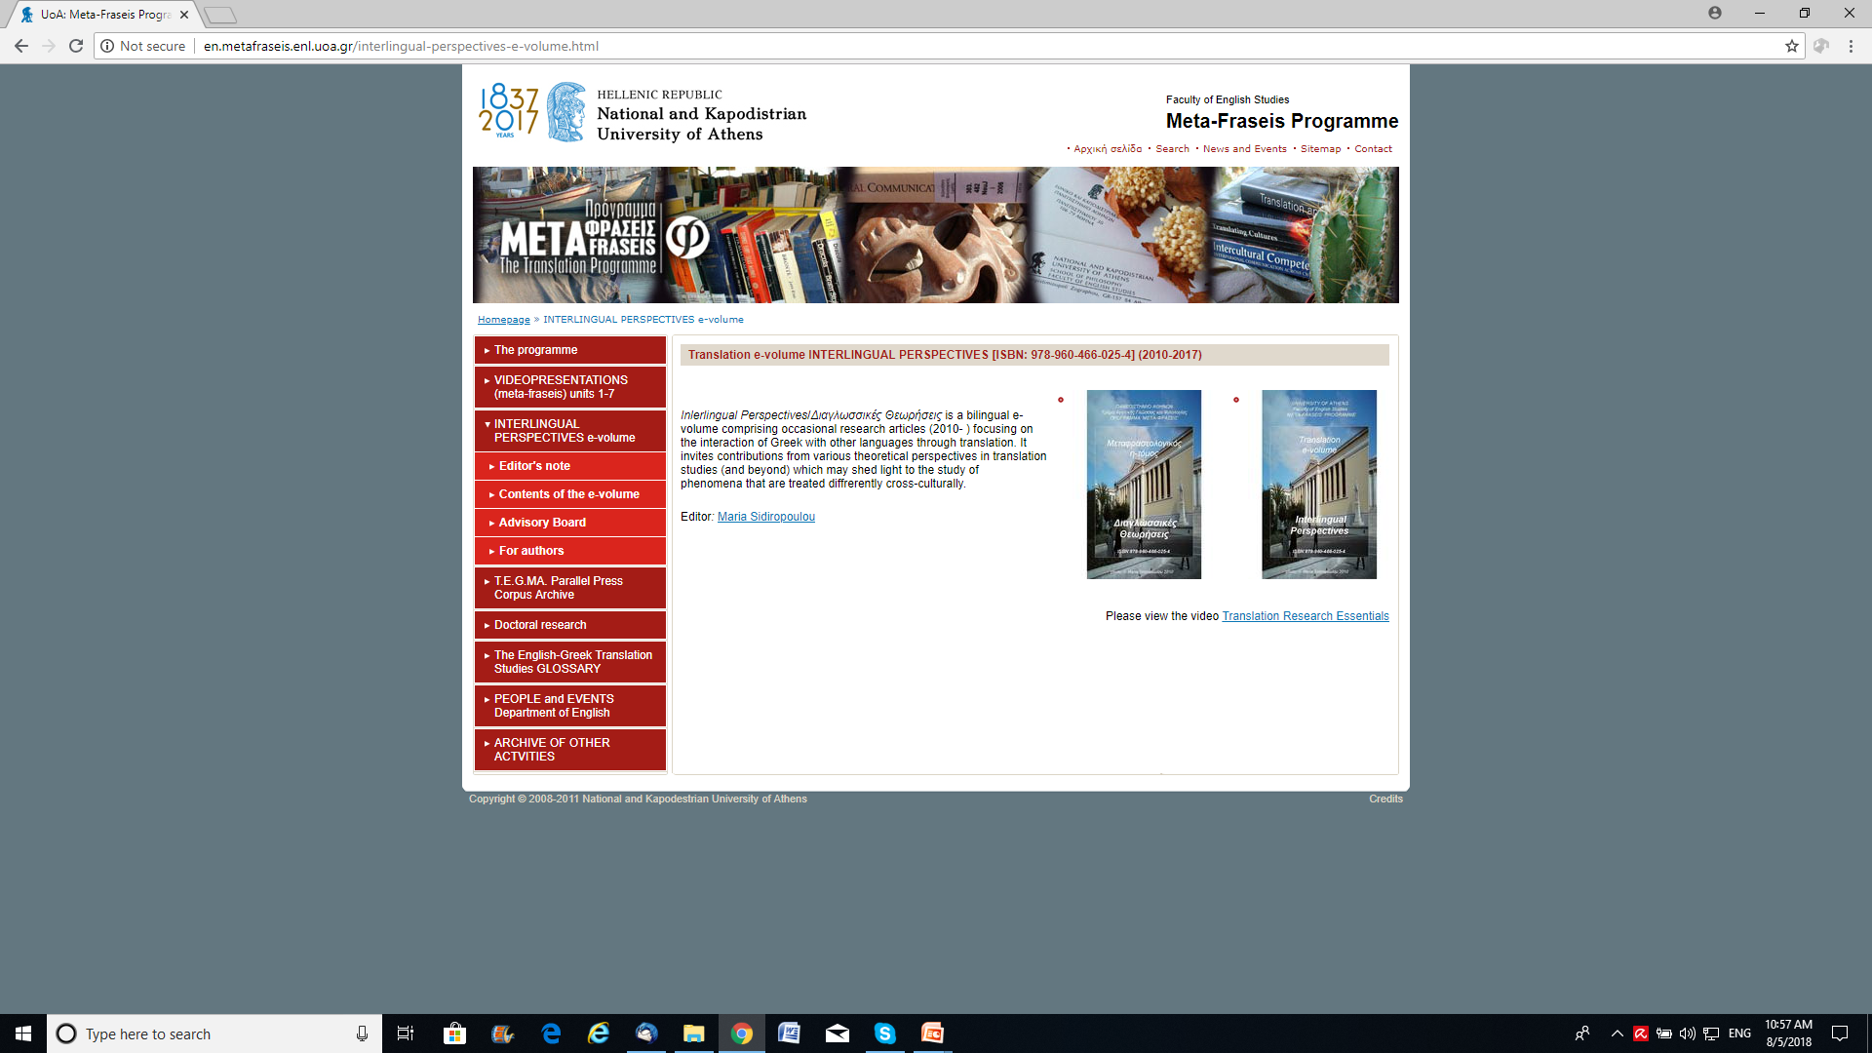
translations into the same language or into different languages http://en.metafraseis.enl.uoa.gr/interlingual-perspectives-e-volume/contents-of-the-e-volume.html
e-volume INTERLINGUAL PERSPECTIVES tranlation e-volume (ISBN: 978-960-466-025-4)

Slide 122
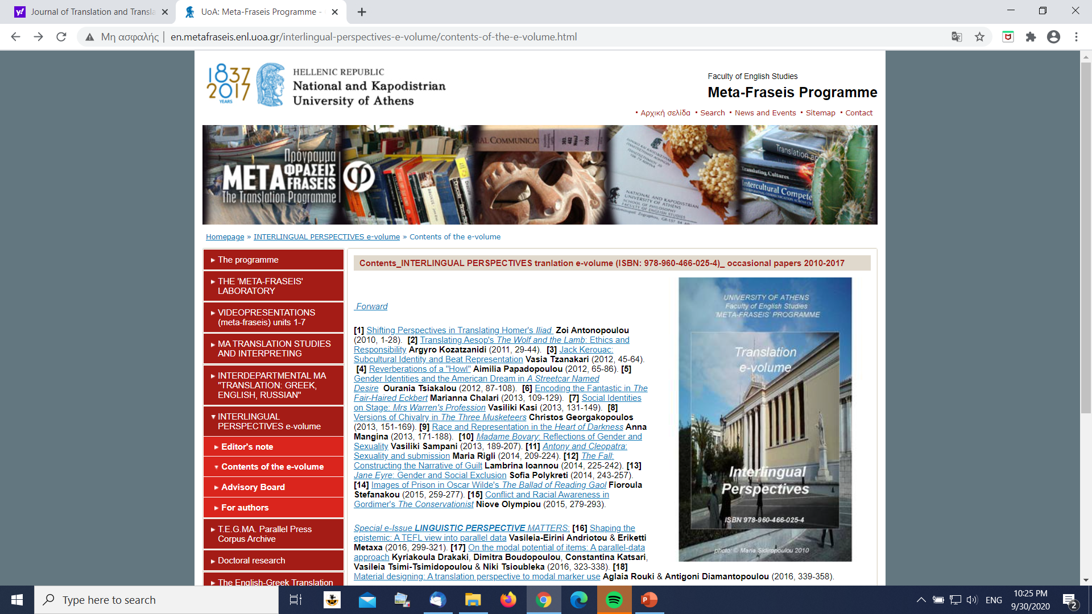

Slide 123
Politeness issues in stage translation
GENDER IDENTITIES AND THE AMERICAN DREAM IN A STREETCAR NAMED DESIRE/Ourania Tsiakalou
ST Williams, Tennessee. 2003. A Streetcar Named Desire. In Reidhead, Julia (ed.)
TT1 Τέννεσση Ουίλιαμς. 1998. Λεωφορείον ο Πόθος. Αθήνα: Καστανιώτης (translation by Μάριος Πλωρίτης)
TT2 Τενεσί Ουίλιαμς. 2008. Λεωφορείο ο Πόθος. Εταιρεία Ελληνική Θεαμάτων. Unpublished translation by Angela Brouskou and Olia Lazaridou.

Slide 124
A STREETCAR NAMED DESIRE
Mitch: I'm out again. I oughta go home pretty soon
Stanley: Shut Up
Mitch: I gotta sick mother. She don't go to sleep and I come in at night.
Μιτς: Εγώ, πάσο. Πρέπει να γυρίσω νωρίς σπίτι.
Στάνλεϋ: Σκασμός!
Μιτς: Έχω άρρωστη τη μάνα μου. Δεν κλείνει μάτι αν δεν γυρίσω.
Μιτς: Και πάλι πάσο. Πρέπει να του δίνω σε λίγο.
Στάνλεϋ: Κόφτο.
Μιτς: Έχω άρρωστη μάνα. Δεν κοιμάται μέχρι να γυρίσω.

Slide 125
A STREETCAR NAMED DESIRE
Pablo: Why don't somebody go to the Chinaman's and bring back a load of chop suey?
TT1 Πάμπλο: Δεν πετιέται κάποιος στου Κινέζου να φέρει λίγη μάσα;
TT2 Πάμπλο: Πάει κάποιος μέχρι τον κινέζο να φέρει κάνα τσοπ σουι;

Slide 126
Politeness issues οn stage
ΚΟΝΩΝΙΚΟ-ΠΟΛΙΤΙΚΕΣ ΟΠΤΙΚΕΣ ΣΤΟΝ ΚΥΚΛΟ ΜΕ ΤΗΝ ΚΙΜΩΛΙΑ ΤΟΥ ΜΠΡΕΧΤ/ Ανδρομάχη Μαλακάτα
ST Bertold Brecht, brecht_derkaukasische_kreidekreis.pdf http://ciml.250x.com/archive/literature/german/
TT1 Μπέρτολντ Μπρεχτ [1957], 2010, Ο Κύκλος με την Κιμωλία στον Καύκασο, Μετάφραση Οδυσσέα Ελύτη για το Θέατρο Τέχνης, Αθήνα:΄Υψιλον .
TT2 Μπέρτολντ Μπρεχτ, 1994, Ο Κύκλος με την κιμωλία, Μετάφραση Πέτρου Μάρκαρη, Ανοιχτό Θέατρο, Θεατρική περίοδος 1994-1995. Πρόγραμμα του Ανοιχτού Θεάτρου.
http://en.metafraseis.enl.uoa.gr/fileadmin/metafraseis.enl.uoa.gr/uploads/Greek_Andromachi_Malakata_PUBLICATION.pdf

Slide 127
Ο ΚΥΚΛΟΣ ΜΕ ΤΗΝ ΚΙΜΩΛΙΑ
Η μελέτη ερευνά διαφοροποιήσεις σε δύο ελληνικές μεταφράσεις (1957, 1994) του θεατρικού έργου Ο κύκλος με την κιμωλία ή Ο καυκασιανός κύκλος με την κιμωλία (Der kaukasische Kreidekreis, 1944)…Η ανάλυση δείχνει μια κοινωνικο-πολιτική επίγνωση στο ΚΥ2 των θεμάτων που απασχολούν το κράτος την περίοδο δημιουργίας του ΚΥ2, και μια επαναστατική διάθεση στο ΚΥ1, που συνάδει με τις κοινωνικο-πολιτικές συνθήκες της μετεμφυλιακής Ελλάδας.
http://en.metafraseis.enl.uoa.gr/fileadmin/metafraseis.enl.uoa.gr/uploads/Greek_Andromachi_Malakata_PUBLICATION.pdf

Slide 128
Ο ΚΥΚΛΟΣ ΜΕ ΤΗΝ ΚΙΜΩΛΙΑ
ST Aus dem Torbogen eines Palastes quellen Bettler und Bittsteller, magere Kinder, Kruecken (Από την αψιδωτή πύλη ενός παλατιού ξεχύνονται ζητιάνοι και ικέτες, ισχνά παιδιά, ανάπηροι …)
TT1 Από την αψιδωτή πύλη ενός Παλατιού ξεχύνονται ξαφνικά σωρός ζητιάνοι, παιδάκια ξεψυχισμένα από την πείνα …
TT2 Από την πύλη ενός ανακτόρου ξεχύνονται ζητιάνοι και ικέτες, αδύναμα παιδιά, σακάτηδες …
http://en.metafraseis.enl.uoa.gr/fileadmin/metafraseis.enl.uoa.gr/uploads/Greek_Andromachi_Malakata_PUBLICATION.pdf

Slide 129
Politeness issues in stage translation
ΚΟΙΝΩΝΙΚΕΣ ΤΑΥΤΟΤΗΤΕΣ ΕΠΙ ΣΚΗΝΗΣ: ΤΟ ΕΠΑΓΓΕΛΜΑ ΤΗΣ ΚΥΡΙΑΣ ΓΟΥΩΡΡΕΝ/Βασιλική Κάση
ΚΑ Mrs. Warren’s Profession (2000), George Bernard Shaw, London: W.W. Norton & Company
ΚΥ1 Το Επάγγελμα της κας Γώρρεν: Σάτυρα σε Τέσσερις Πράξεις (1946), μεταφρ. Άρης Αλεξάνδρου, Αθήνα: Γκοβόστης.
ΚΥ2 Το Επάγγελμα της κυρίας Γουώρρεν (2005), μεταφρ. Εύα Γεωργουσοπούλου, Αθήνα: Δωδώνη.
http://en.metafraseis.enl.uoa.gr/fileadmin/metafraseis.enl.uoa.gr/uploads/English_Kasi_PUBLICATION.pdf

Slide 130
Shaping the epistemic: a TEFL view into parallel data Vasileia-Eirini Andriotou and Eriketti Metaxa
The paper is a report on a project examining the usefulness of translation data as a resource for studying aspects of language phenomena for teaching purposes.
The paper draws on a set of 44 English-Greek press article pairs from the T.E.G.MA. archive to highlight shifts in epistemic marker rendition across English-Greek versions of the data.
It shows that there is considerable variation in the way epistemic modal options are treated across versions, which is claimed to have the potential to inform the approach of language educators to cross-cultural variation in TEFL.
The project proposes a set of exercises which implement this cross-cultural perspective in the EFL classroom
http://en.metafraseis.enl.uoa.gr/

Slide 131
On the modal potential of items: A parallel-data approach Kyriakoula Drakaki, Dimitra Boudopoulou, Constantina Katsari, Vasileia Tsimi-Tsimidopoulou & Niki Tsioubleka
The study draws on a collaborative project examining the translation shifts English modal operators undergo in the course of translation from English into the Greek press.
It uses Halliday’s modality value model (1985) to account for typical tendencies in the parallel data with respect to modal marker rendition, namely, a tendency for favouring high modality values in the Greek data. The study further focuses on a set of items which may not be readily identifiable as conveying modality, because they do not fall into the categories ‘modal verb’ and ‘modal adverb’.
The study intends to broaden learners’ perception of modal markers and show the potential of parallel data to enhance EFL learners’ understanding of how modal notions may permeate discourse to construct socio-cultural appropriateness.
http://en.metafraseis.enl.uoa.gr/

Slide 132
Material designing: A translation perspective to modal marker use Aglaia Rouki & Antigoni Diamantopoulou
The paper examines the potential of parallel corpora to reveal aspects of cultural preference in the use of language phenomena, with a view to informing TEFL.
It claims that the use of two parallel mini corpora compiled for the purposes of the present research provide interesting evidence of cross-cultural tendencies in the use of the modal system, which the educator may draw on, in material designing.
The paper proposes a set of sample exercises tackling aspects of modal marker use, drawing on raw data from the English and Greek press.
It argues that such tailor-made approaches to intercultural variation can adequately meet the needs of culture specific learner groups.
http://en.metafraseis.enl.uoa.gr/

Slide 133
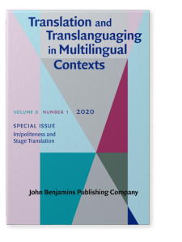
TABLE OF CONTENTS
Introduction: Im/politeness and theatre translation
Maria Sidiropoulou | pp. 1–8
ARTICLES
Who’s afraid of aggression: Gender and impoliteness through translation/ Eirini Stamouli | pp. 9–25
Blaming, critique and irritation in the family through translation/ Aristea Rigalou | pp. 26–44
Mask and face: Im/politeness in stage translations of Mourning Becomes Electra/ Maria-Nikoleta Blana | pp. 45–63
Aggression and narrative in Edward Albee’s The Zoo Story/ Maria Lamprou | pp. 64–78
Im/politeness, gender and power distance in Lady Windermere’s Fan/ Chrysi Mavrigiannaki | pp. 79–91
Constructing leadership through translating im/politeness/ Natalia Skrempou | pp. 92–108

Slide 134
Who’s afraid of aggression Gender and impoliteness through translation Eirini Stamouli
Impoliteness scholars have drawn attention to the fact that any deviation from the stereotypical ‘polite’ and ‘feminine’ behaviour, in certain communities of practice, is considered impolite and offensive (Mills 2005).
The aim of the study is to investigate how im/politeness constructs gender identities in two Greek stage translations (1977, 2006) of Edward Albee’s Who’s Afraid of Virginia Woolf? (1962), through analysis of how the translators reshape the im/polite behaviour in the interaction of the main couple to capture the audience’s attention.
An emic approach to the analysis of the two translations, along with a glimpse into multimodal aspects of interaction, namely, the body language as manifested in the film adaptation of the play (1966), indicate subversion of gender roles and different levels of aggression in the two Greek versions, highlighting the significance of the chronological distance between the two translations.
The study reveals that impoliteness theories can be applicable to stage translation, that body language may be another factor contributing to the shaping of im/politeness, while there is a growing awareness that relationships and gender roles, in the sphere of the spectacle, continuously embrace aggression for entertainment purposes.

Slide 135
Blaming, critique and irritation in the family through translation Aristea Rigalou
This study intends (a) to heighten awareness of how impoliteness scholarship may enlighten translation research and practice, and (b) to broaden the scope of research in impoliteness studies by considering stage translation data. It examines Tennessee Williams’ play The Glass Menagerie ([1944] 2018) and two of its Greek translated versions (by Nikos Spanias, 1946/1987, Γυάλινος Κόσμος [Glass World] and by Errikos Belies, 2001/2014, Ο Γυάλινος Κόσμος [The Glass World]).
It attempts an intra-cultural comparison of the two translations to examine how translators rendered impoliteness in family interaction, taking into account their chronological gap.
The study takes an emic perspective to the data, designs a questionnaire eliciting respondents’ evaluation of impolite options and uses Garcia-Pastor’s (2008) model of face-aggravating strategies to account for the findings.
Findings show that the second translation conveys the conflict between the main characters in more concrete terms, exploiting more face-aggravating strategies in relation to the first translation. The study also shows that the respondents seem to favour more impolite renderings by considering the characters’ intimate relationships, confirming the connection between intimacy and impoliteness.
The significance of the research lies in the fact that it broadens the scope of (im)politeness theory and studies to include another field that could provide data for the research of such instances of interaction, namely translation studies and in that it shows the validity of pragmatics in enlightening translation practice.

Slide 136
Mask and face Im/politeness in stage translations of Mourning Becomes Electra Maria-Nikoleta Blana
Im/politeness scholars have highlighted the significance of ideology in the use of im/politeness phenomena, as the very notion of im/politeness presupposes a mental filtering of discourse through preconceptions that already exist in the mind (Terkourafi 1999, 2001, 2005; Mills 2003; Culpeper 2011; Kádár and Haugh 2013).
The study aims at demonstrating how im/politeness can be manifested in two Greek versions of a dramatic dialogue that has its roots in the ancient theatre, where masks may be thought to undertake functions of face/identity formation in (im)politeness theory. The focus is on Eugene O’Neil’s dramatic trilogy Mourning Becomes Electra (1931) and on two Greek stage translations of the play that are twenty-one years apart (1986 and 2007).
The study adopts both a second/ first order (Grainger 2011, or etic/emic) approach to the data, to gain further insight into how im/politeness plays out in the target versions and also considers in/appropriateness of social behaviour (Locher and Watts 2008) to further understanding of aspects of the relational work enacted by the protagonist. The analysis accentuates the significance of the narrative or the point of view of the target versions of the play.
Findings highlight the use of different im/politeness strategies in the translated interaction between the siblings, Orin and Lavinia, which affect respondents’ appropriateness judgements. Respondents appreciated a higher tension between intimacy and aggression as manifested in one of the two translations.
The study underscores the value of translation data in im/politeness research by drawing attention to intra-cultural variation with regards to the use of im/politeness manifesting a different narrative/point of view (e.g. non/religious, non/allusive to the ancient theatre). Conversely, im/politeness research contributes to translation practice by showing that im/politeness options may exert influence on audience response.

Slide 137
Aggression and narrative in Edward Albee’s The Zoo Story Maria Lamprou
The study draws on scholars (Leech and Short 1981; Wales 1994; Fowler 1996; Ball 1997; Semino 2002; Leech and McIntyre 2006) who focused on the ‘point of view’ in dramatic texts as a concept which permits an authoritative voice to enter the narrative and arise in discourse.
It intends to examine how im/politeness contributes to renegotiating some special themes in fiction like, for instance, how the human-animal relationship is to be portrayed in two Greek translations (1995, 2015) of Edward Albee’s play The Zoo Story (1958). The claim is that translators’ ideological positioning regulates pragmatic aspects of meaning-making like the use of aggression and intimacy in reshaping the identity of characters and entities in the translated versions. Τhe study traces how the two translators attributed aggression to humans/animals in the universe of The Zoo Story by taking into account lay people’s evaluation of the two translations.
Results show that TTa (by Kaiti Chistodoulou 1995) uses im/politeness strategies which indicate lower esteem for animals and higher esteem for humans. By contrast, TTb (by Errikos Belies) shapes a different identity of the human-animal relationship: it indicates higher esteem for animals, doing justice to the zoo imagery.
The findings suggest that the narratives that permeate discourse crucially affect the use of im/politeness of the fictional interactants and that im/politeness is a powerful tool in the hands of translators. Im/politeness research may also benefit from translational data in that they can provide multiple contexts in which im/politeness can be studied in interaction cross-culturally.

Slide 138
Im/politeness, gender and power distance in Lady Windermere’s Fan Chrysi Mavrigiannaki
Im/politeness has attracted considerable attention over the past decades (starting with Lakoff 1973; Brown and Levinson 1978; Leech 1983) and has kept expanding rapidly with the discursive turn (Eelen 2001; Mills 2003; Watts 2003; Bousfield 2008; Locher 2008). There is a growing interest in examining im/politeness from a number of perspectives, e.g. society, gender, cross-cultural etc., and multiple definitions have been proposed, however, impoliteness as such has not had a distinct theoretical framework yet.
This study investigates impoliteness through drama translation data. It focuses on manipulation of im/politeness in target versions of a playtext, in terms of gender, and examines how humour may be facilitated through such shifts. The aim is to confirm that impoliteness does interact with gender (Mills 2003), and that humour creation draws on reversed gender stereotypes. It also shows that power (ensuing from reversed gender stereotypes) interacts with impoliteness strategies, to manifest humour in the target versions. The study uses Bousfield’s (2008) model to account for im/politeness shifts, between the two versions.
Oscar Wilde’s Lady Windermere’s Fan (1892) is a comedy and a satire targeting the aristocratic society of the time. The two Greek translations of the play (2006 by Karhadakis and 2010 by Belies) are a most suitable context for examining how impoliteness interacts with power distance and gender to create humour, because of its humorous aspects and cross-gender talk. The paper also intends to show impoliteness scholarship that translation has a rich potential for deciphering or confirming pragmatic aspects of the phenomenon, which are elsewhere pursued through monolingual research.

Slide 139
Constructing leadership through translating im/politeness Natalia Skrempou
The use of im/politeness in political discourse has attracted relatively little attention in im/politeness scholarship (Tracy 2017). The study examines how the character of a leader may be intra-/cross-culturally reshaped, in translated drama, through the use of im/politeness strategies.
To this end, the study examines the use of im/politeness strategies in two Greek versions (Belies 1997; Karthaios 2004) of William Shakespeare’s play Julius Caesar. Etic and emic approaches to the data show differences in the way the character of Brutus is portrayed, by the translators’ manipulating im/politeness strategies in his discourse.
The study uses the ‘horizontal’ dimension of intimacy/distance and the ‘vertical’ dimension of power (Spencer-Oatey 1996) to show that the first translation (Karthaios 2004) shows Brutus to be making use of a less impressive persuasive strategy when addressing the public, the second translation (Belies 1997) seems to show Brutus’ potential to express intimacy towards the public, which made the persuasive force of his discourse more convincing.
The study shows that im/politeness is a significant tool in the hands of translators who shape the identity of the leader and that translated versions of a playtext can fruitfully show preferred patterns of behaviour which may be pointing to cultural patterns of interaction.

Slide 140
Your assignment
Please, contrast a multimodal sample to see what types of shifts you may identify….
Please skim through Laurence Horn and Gergory Ward’s “Handbook_of_Pragmatics” to identify phenomena you could focus on, in your imminent course assignment.

