Slide 1
Course: Research methodology in translation studies Week Abstract writing Prof. Emerita M. Sidiropoulou
MA in TRANSLATION: GREEK, ENGLISH, RUSSIAN
MA in TRANSLATION STUDIES AND INTERPRETING

Slide 2
How to Write an Abstract
First, decide what will be the aim of your paper and what your data show.
While the abstract will be at the beginning of your paper, it should be wrotten much later.
Once you have completed the final draft of your paper, use it as a guide for writing your abstract.

Slide 3
Know your target word count.
An abstract should be between 150 and 250 words. (300)
﻿ Organizers may have specific word requirements
An abstract should be written as only one paragraph with no indentation.

Slide 4
Structure the abstract
Introductory sentence
Aim of the paper
Lit review
Methodology
Brief presentation of results
Significance of findings

Slide 5
Write a rough draft of your abstract
Try to write one to two sentences summarizing each section of your paper. Once you have a rough draft, you can edit for length and clarity.

Slide 6
Describe the problem of interest. In other words, what is it that you set out to investigate in your analysis or review?
Explain the criteria used to select the studies included in the paper. There may be many different aspects devoted to your topic. Your analysis or review probably only looks at a portion of these studies. For what reason did you select these specific studies to include in your research?
Identify the methodology. Un/elicited data. Inform the reader about who the participants were in the study. Were they college students? Older adults? How were they selected and assigned?
Provide the main results. Again, this is essentially a quick peek at what readers will find when they read your results section. Don't try to include everything. Just provide a very brief summary of your main findings.
Describe any conclusions or implications. What might these results mean and what do they reveal about the body of research that exists on this particular topic?

Slide 7
Archive of past issues ISSUE 33 - JANUARY 2020 Straight from the horse’s mouth: children’s reception of dubbed animated films in Spain
Julio de los Reyes Lozano, Universitat Jaume I, Castellón
ABSTRACT
Reception studies in the field of audiovisual translation (AVT) have increased considerably in the last two decades, including the target viewer in the picture.
This paper presents the results of a study exploring young children’s reactions to some of the translation strategies regularly adopted in dubbed animated films.
A total of 163 participants were shown nine animated film clips dubbed from English into Spanish, which included cultural references, colloquial language, educational content and songs. Data were then collected through a questionnaire adapted to the participants’ level of cognitive development and the analysis was based on two independent variables: the participants’ year in school and the number of previous viewings of the films. The results show that children do not seem to have much trouble understanding cultural, educational and musical content that is specific to the source culture and is kept in the target text.
Interestingly, having previously watched the films does not appear to be a determining factor in children’s ability to identify these elements.

Slide 8
Issue 40 –July 2023 Translating non-binary coming-out reports: Gender-fair language strategies and use in news articles art_lardelli.pdf
ABSTRACT - Manuel Lardelli, University of Graz Dagmar Gromann, University of Vienna
With the increased visibility of non-binary people, more and more strategies have been proposed for gender-fair language in languages that have grammatical gender, such as German. Gender-fair is used as an umbrella term for gender-inclusive, the explicit inclusion of all genders beyond the binary, and gender-neutral strategies, which omit any gender specific references in language. An in-depth overview of these strategies has not yet been provided and very few studies analyse their use.
This article proposes an in-depth introduction to gender-fair language strategies in German and Italian and their use in news articles.
To this end, we compiled a corpus of news articles on the coming out of Demi Lovato as non-binary in both languages, which were all based on and translated from Lovato’s original Twitter post in English. To investigate translation strategies for gender fair language, we analyse which gender-fair language strategy was applied to translate the tweet. Furthermore, the use and frequency of gender-fair pronouns, nouns, and adjectives were investigated in each article.
Results show that misgendering is still very common, especially in Italian. A dominant strategy was not found in German or in Italian; a mix of gender-neutral and gender-inclusive forms was used instead.
XXXXX

Slide 9
The Journal of Specialised Translation Issue 40 – July 2023 How a Chinese social media platform recontextualises Russian strategic narratives: A case study in news translation Rui Wang, University of Manchester
ABSTRACT
The free circulation of online videos across platforms, languages and cultures due to their low-cost and easy-to-produce characteristics allows participatory media agents (Jenkins 2004) to reuse and repurpose ready videos for their own political and commercial aims.
This paper explores this understudied phenomenon through a case study of news videos which were originally produced by a Russian international broadcaster for YouTube but were later recontextualised by a Chinese state-aligned media agent, The Observer, for Bilibili.
Using a contrastive analysis, this paper examines the translation strategies that the video uploader adopted in its appropriation of the source videos for Bilibili users. This paper also examines how the uploader’s edits, like the selection of videos, contribute to changes to the Russian strategic narratives (Miskimmon et al. 2013, 2017) in the target context.
The data analysis demonstrates that by adopting suitable editing techniques the Chinese media agent has significantly changed the Russian strategic narratives to serve its own political and market agendas. As part of its translation process for the target media context, the uploader has taken various factors into account, such as the Bilibili audiences’ consumption habits, their entertainment needs, their pre-existing stereotypes of Putin, Russia and China, and its own propaganda missions.
XXXX

Slide 10
Markets and the creative paradigm: Identity variability in English-Greek translated promotional material Maria Sidiropoulou, National and Kapodistrian University of Athens
ABSTRACT
The study uses as a starting point a set of value dilemmas traced in corporation management strategies worldwide;
these dilemmas can offer a rationale for exploring whether and how automo­bile industry advertising on UK-Greek corporation homepages crea­tively employs values inherent in relevant management strategies.
Findings show that automo­bile digital advertising is an eloquent paradigm of cross-cultural variation in entre­pre­neurial communication with clients.
The study encourages focus on cultural aspe­cts of commercial material mediation in accounting for variation in the implementation of value dilemmas in intercultural transfer. A tension between global and local cultu­ral variabilities is emerging which highlights the socially aware aspect of innovation.
'Culturalising' eco­no­­­mic life, in terms of raising awareness of culture-specific norms in communication, seems to be of paramount importance in wealth creating environments, as is argued in the conclusion.

Slide 11
Issue 20 (July 2013) Special issue: The translation of multimodal texts Language With out Words: Light and Contrast in Audio Description Anna Maszerowska, Universitat Autònoma de Barcelona
Abstract
The importance of the inclusion of directorial vision and cinematographic language cues in film audio description scripts is a claim that has long been maintained in the literature related to media accessibility.
This article aims to analyse the existing audio descriptions of light and contrast patterns.
The first part presents an overview of the functions attributed to luminance in the field of Film Studies. The author then investigates the state of the art in the related literature on media accessibility and audio description. Guidelines and research papers are consulted in order to establish the stance on the issue from both a practical and scholarly point of view. The second part presents an analysis of a corpus of six professionally audio described films and discusses the strategies employed by the describers when confronted with certain lighting set-ups.
Finally, the article concludes with a set of recommendations for future research in the area.
XXXX

Slide 12
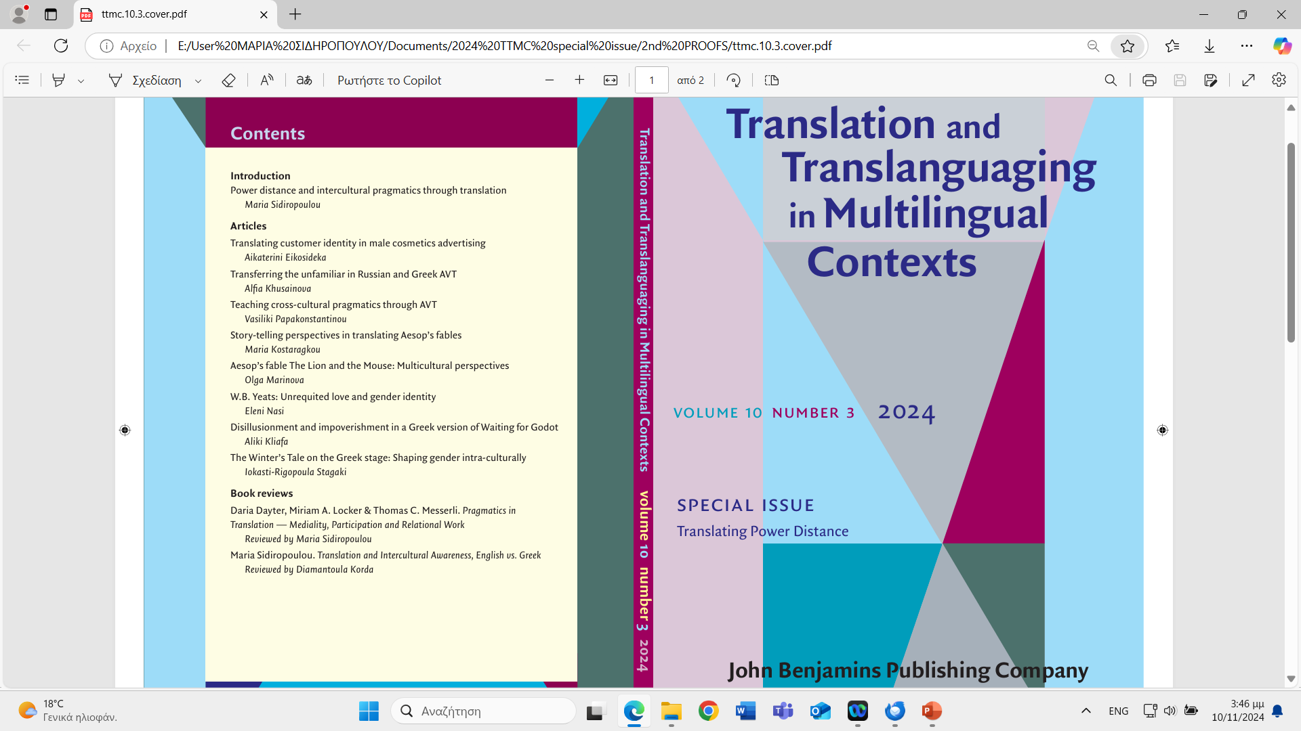

Slide 13
Translating customer identity in male cosmetics advertising Aikaterini Eikosideka, National and Kapodistrian University of Athens
Addressee identity awareness often affects how speakers structure discourses.
The study views male cosmetics advertising through a pragmatic lens to investigate how customer identity is shaped cross-culturally through men’s deodorant advertisements on the English and Greek market.
The study uses communication styles (Hofstede, Hofstede, and Minkov 2010) to account for (a) naturalistic translation shifts in verbal or multimodal data which tend to improve product reception in the Greek target context and (b) experimental data to confirm how masculinity is shaped and attributed to male customers by well renowned deodorant companies.
The data analysis reveals that socio-pragmatic parameters are operative in accounting for differences in the two contexts. Findings show cross-cultural variation along three of Hofstede, Hofstede, and Minkov’s (2010) communication styles, namely, individualism/collectivism, masculinity/femininity and uncertainty avoidance/tolerance, correlating it with a fourth dimension of the framework, the high/low power distance one.
The significance of the research lies in that it shows how commercial content producers register locally shared gender identity assumptions relevant to the audience type they address. Translation is another platform where pragmatic variation may be fruitfully explored cross-culturally

Slide 14
Transferring the unfamiliar in Russian and Greek AVT Alfia Khusainova National and Kapodistrian University of Athens
The study examines transfer strategies in identity construction instances, in Greek and Russian audio-visual translation (AVT) modalities (subtitling and dubbing), of the English animated film for children, The Rise of the Guardians (2012).
It explores whether and how translator awareness of target cultural background may affect the strategies used in the transfer.
Results suggest that the level of un/familiarity of a target culture with a source-text (ST) cultural item affects the translation strategies across English-Russian and English-Greek differently, on the basis of preferred politeness orientations (negative and positive, respectively) prevailing in the target environments. Testimonies of film viewers and questionnaire respondents who are unfamiliar with the cultural items confirm aspects of the analysis.
The significance of the research lies in that it provides further insight into the way Greek and Russian AVT practices handle and transform English audio-visual unfamiliar entities, which may advance understanding of cross-cultural processes in AVT

Slide 15
Teaching cross-cultural pragmatics through AVT Vasiliki Papakonstantinou National and Kapodistrian University of Athens
There is fairly little research on using translation to advance pragmatic competence in learners of English and highlight how translation can advance cross-cultural pragmatic awareness in EFL.
The study attempts to explore how audio-visual translation (AVT) can introduce cross-cultural pragmatics to Greek learners of English. The data derive from the animated f ilm Inside Out (Pixar 2015).
The study takes dubbed dialogues to be a target-oriented data set, with the subtitles as an intermediate, constrained type of transfer where pragmatic shifts may be least visible or not at all. The research uses (a) the positive/negative politeness distinction as manifested through interpersonal proximity/distance (Brown and Levinson 1978; Sifianou 1992; Yule 1996; Horn and Ward 2006), and (b) the un/certainty avoidance communication style (Hofstede, Hofstede, and Minkov 2010). The aim is to familiarize learners with the significance of cross-cultural pragmatic awareness and its use in EFL teaching and learning. Analysis of the data is followed by a questionnaire addressing bilingual participants who confirmed the findings of the study.
Results show types of pragmatic variation across English and Greek: for instance, the subtitles showed less signs of positive politeness strategies and more uncertainty features, while dubbing manifested more positive politeness strategies and stronger uncertainty avoidance, i.e., in alignment with features of the target language.
Findings allow learners to look beyond grammaticality, at the level of pragmatic preference

Slide 16
Story-telling perspectives in translating Aesop’s fables Maria Kostaragkou National and Kapodistrian University of Athens
Aesop’s fables have been multiply adapted and translated over the years to meet the needs of intended audiences.
The study selects two Modern Greek (1993, 2011) and two English (1991, 2013) versions of Aesop’s fable The Woodcutter and Mercury to trace intra- and cross-cultural pragmatic variation in story-telling perspectives.
Analysis of the four versions suggests that the Modern Greek versions of the fable seem to be more aware of the power differentials between Mercury and the Woodcutter, whereas the English versions rather focus on the woodcutter, somewhat blurring the figure of the god. A questionnaire addressing 15 respondents confirmed (a) power distance variation cross-culturally (with visuals in two of the versions conforming to intended power distance dynamics), and (b) variation in addressee age group identity.
The significance of the research lies in that pragmatic aspects of meaning-making become cross-culturally visible in versions of the fable and draw attention to the potential of translation to advance understanding of what is adjusted in cross-cultural transfer.

Slide 17
Aesop’s fable The Lion and the Mouse: Μulticultural perspectives Olga Marinova, National and Kapodistrian University of Athens
Aesopic tradition has been highly adaptive (Lefkowitz 2006) as manifested in multicultural versions of fables.
The study explores shifts in Aesop’s fable The Lion and the Mouse to highlight shifts in the representation of characters, in agreement with pragmatic tendencies across cultures, as — for instance — in the power distance between the lion and the mouse.
It examines two Modern Greek (2003 and 2012), an English (1996), a Russian (2012) and a Ukrainian (1990) version of the fable to trace local perceptions of it.
Analysis shows that translators (as storytellers) transform aspects of the fable in pragmatically meaningful ways: they add up to the adaptation process conforming to locally appreciated values.
The significance of research lies in that translation is seen as another layer of adaptation which a source fable may undergo intra- and inter-culturally

Slide 18
W.B. Yeats Unrequited love and gender identity Eleni Nasi National and Kapodistrian University of Athens
The study analyzes three Greek versions of two of W.B. Yeats’ poems, ‘When You Are Old’ and ‘No Second Troy’, both related to the theme of unrequited love, merging feelings of bitterness and love.
It examines how power distance manifests itself in the three versions of the poems. The study designed a questionnaire to evaluate potential variation in the type and intensity of feelings shaped in the three Greek versions of the two poems.
Findings show that there is variation in the interpersonal distance between the poet and the beloved: some translators seem to emphasize bitterness and empathy on the part of the disappointed poet, while others assume more equal power distribution between the poet and the beloved.
XXX

Slide 19
Disillusionment and impoverishment in a Greek version of Waiting for Godot Aliki Kliafa, National and Kapodistrian University of Athens
The study examines how impoverishment and disillusionment in Samuel Beckett’s Waiting for Godot (1949) have been rendered on the Greek stage (transl. Papathanassopoulou 1984).
Ιt examines the use of impoliteness which renders the protagonists’ outcast identity and frustration, as Godot is not showing up.
Findings show that respondents appreciated both foul language (impoliteness) and humour (low-power distance) in the Greek version of the play.
The significance of the study lies in that target audiences may enjoy aspects of characters’ identities perhaps unsuspected in the ST, because local contexts may prioritize codes manifesting intended attitudes.

Slide 20
The Winter’s Tale on the Greek stage: Shaping gender intra-culturally Iokasti-Rigopoula Stagaki, National and Kapodistrian University of Athens
The study examines two Greek target versions (1952, 2004) of Shakespeare’s The Winter’s Tale (1611) in order to examine how politeness orientations and awareness of power distance change to shape the relational dynamics between characters.
In the two target versions male characters vary intra-culturally and interculturally, while themes such as female submissiveness and gender relations show intra-cultural variation.
Analysis of naturalistic translation data shows variation in the way certain characters are reshaped in the two versions, which is confirmed by experimental data elicited by a questionnaire.
The significance of the research lies in that pragmatics may provide a basis for the study of intra-cultural variation in characters’ identities in a play, and in that translation is a rich resource for tracing pragmatic variation in the manifestation of pragmatic phenomena.

Slide 21
The pragmatics of flattery: The strategic use of solidarity-oriented actions
Flattery is a social phenomenon that treads a fine line between acceptable and unacceptable social behavior and brings forward the strategic element of language use. Although flattery has been studied in other areas of the social sciences (namely marketing and social psychology), pragmatic literature has not addressed the phenomenon, despite its potential to inform the interpretive process participants engage in when evaluating politeness strategies in interactions. This study aims to understand what flattery is by examining its perception and uses in a specific speech community – native Hebrew speakers in Israel. A meta-pragmatic methodology was used to collect two complementary corpora: solicited reports of flattery events for an interpersonal level analysis, and public flattery events from a large online database for a societal level analysis. Findings indicate how participants judge an action to be flattery, what (verbal) acts count as flattery, and the functions of flattery in interactions. Ultimately, a definition is offered against the backdrop of flattery being perceived as the dark side of sociability.

Slide 22
Marking the unexpected: The case of ba in Greek talk-in-interaction
This article examines the Greek particle ba in naturally occurring talk, adopting a conversation analytic perspective. The analysis reveals that it is systematically involved in two different types of social action, depending on prosodic variation and sequential position. Overall, ba appears as either a repair initiator expressing surprise, or a negative token in polar answers and disagreements. It is shown that these seemingly different uses are united by an indexical anchor of unexpectedness that is realized differently prosodically and adopts an either backward- or forward-looking orientation. The article gives further insight into how one's knowledge is related to one's expectations, thus contributing to a better understanding of the epistemics of (un)expectedness. It also enriches growing cross-linguistic literature on epistemic particles from a Greek perspective. Data are drawn from 40 recorded ordinary conversations included in the Corpus of Spoken Greek and 8 focus groups conducted in Greece.

