Slide 1
A contrastive analysis of the use of “strategic” in left-wing populist communication
Political Discourses in Contrast
Themis Kaniklidou
tkaniklidou@hauniv.edu

Slide 2
comparing across languages in corpus & discourse analysis
some issues and approaches

Slide 3
Multidisciplinarity
CDA
Political Discourse Analysis (PDA)
Corpus Analysis

Slide 4
Multidisciplinarity
Explore approaches and synergies that can bring closer together CDA approaches and corpus linguistics (Taylor 2014)
Appropriateness of PDA: a “spectrum of social interactions [that] people will at one time or another, or in one frame of mind or another, think of as ‘political’ (Chilton 2004 p. 3).

Slide 5
Mixing methods

Slide 6
Backdrop - Populism
“society is ultimately separated into two homogenous and antagonistic groups, ‘the pure people’ and ‘the corrupt elite’.
“politics to be an expression of the volonté générale of the people”
(Mudde and Kaltwasser 2012 p. 21)

Slide 7
POPULISM- two traditional varieties
Right-wing agenda
Anti-Elite
Key threat: immigration/refugees
“Scapegoating” (Wodak 2017) – immigrants, foreigners, EU
Disaffection with the “Establishment” who often embrace minorities
Dissemination of fear politics (Wodak 2015)
Left-wing agenda
Anti-Elite
Key enemy: capitalism/globalization/capitalist centers
“Scapegoating”– Lobbies, capitalist decision- making centers
Disaffection with the “Establishment” who do not protect tax payers and ordinary people
Politics of hope/anger

Slide 8
Neopopulism
Neoliberalism
Contractual bond between individuals and the free economy (Arnomy 2005)
State: minimal – open to privatization
  Open to globalization- Free markets as the optimal way of organizing economy (Friedman 1980)
Traditional Populism
Romanticized view of the People- leader relationship
State – maximal – against privatization
Globalization and free economy are seen as threats to society
Neopopulism - Technopopulism
Populist hybrid

Slide 9
Neopopulist / technocratic dimension
The neopopulist or centrist dimension appears “as a sort of ‘superstructure’ that facilitates the application and reduces societal resistance to costly –market –oriented reforms” (Armony 2000; 2005)
Neopopulism occurs from the strange convergence of neoliberalism with populism in the sense that the latter starts departing from its “classic" form.
Technopopulism uses the appeal of technical expertise to connect directly with the people, promising to run the state as a firm (Buštíková & Guasti 2018)

Slide 10
Aims of this paper
Qualitative study to identify elements “technocratic” or “neopopulist” dimensions in the discursive template of left-wing populism drawing on Greek, English and French text.
Look at the use of the lexical items strategic/strategy as a part of the source domains of BUSINESS is WAR and POLITICS is WAR and see there are neopopulist or technocratic overtones to LWP rhetoric.
Heavy interest in the local example of Greece investigated in contrast to UK and French discourses
Look where the rhetoric either forgets or combines the vague appeal to ordinary people and their grievances and moves to a more expert-technocratic appeal.

Slide 11
Data set
Multilingual Mini corpora analyzed 69, 786 words using the freeware corpus tool AntConc
Greece: i) 4 speeches of Prime Minister Alexis Tsipras (15,619 words), including of two parliamentary party addresses on 23. 4. 2018 and 12.2.2018 two speeches in the Delphi Economic Forum (March 2018 and March 2019) ii) Syriza’s program platform (10, 405 words)
UK: 1speech by J. Corbyn (party conference speech in 2018, wordcount 5,368 words) and party manifesto for Labour party (word count 23,910 words)
France: Party program of La France Insoumise (23. 079 words) presenting platform for J. L. Mélenchon

Slide 12
Methodologies and Levels of analysis
Analysis at lexical level
Analysis at supra-lexical level
Reflexivity

Slide 13
Analysis at lexical level
Discourse keywords are lexical items that:
Occur frequently in period of salience of the discourse to which they belong
Can be part of an ensemble of other lexical items that feature prominently in the same discourse
Sometimes signify controversially debated issues (illegal immigrants vs legalized immigrants (Taylor 2014)

Slide 14
Analysis at lexical level
Phase 1: Identification of instance (lexical item/clusters/collocations)
Phase 2: Consultation of a range of sources (potentially draw on multilingual comparable corpora)

Slide 15
Keywords
Discourse keywords for RWP
Discourse keywords for LWP
Elites
Lobbies
Households
Families
Austerity
People
Refugees
People
Nation
Country

Slide 16
Frequencies of Keywords- making up “the Ordinary People in Greek LWP”
Frame | Linguistic realization /phrase token | 2014 | 2015 | 2016 | 2017
Household /family | The housewife's basket | 67 | 45 | 5 | 20
 | The housewife's wallet | 8 | 8 | 0 | 4
 | The Greek family | 34 | 20 | 19 | 15
 | The family men | 4 | 4 | 0 | 9
 | Working class family | 6 | 2 | 4 | 5
 | The Greek houses | 14 | 8 | 9 | 3
Kaniklidou, Themis (2019). Left-wing populist discourses in the press. In Hidalgo Tenorio, Benítez-Castro, De Cesare (Eds). Unravelling Populist Discourse: A Methodological Synergy. 286-314. Routledge

Slide 17
Frequencies of Keywords- making up “the Establishment in Greek LWP”
Kaniklidou, Themis (2019). Left-wing populist discourses in the press. In Hidalgo Tenorio, Benítez-Castro, De Cesare (Eds). Unravelling Populist Discourse: A Methodological Synergy. 286-314. Routledge

Slide 18
Why strategic/Strategy
From the Greek word transliterated as strategos, i.e. a military general and stratos ‘army’ and ago ‘to lead’.
Part of the repertoire of WAR metaphors which are pervasive in strategic management theory, building on the source domains of BUSINESS is WAR and POLITICS is WAR that goes back to the ARGUMENT is WAR metaphor ( Lakoff & Johnson 2003: 62)
Very frequent both in business and political discourse, close to be conventionalized
Metaphor “courted” by business, corporate talk, mergers and acquisitions and politics
Use of the lexical item strategy/strategic appropriated from the business domain to evoke a sense of knowing-what-we-are -doing. Provides an impression of rationality, efficiency, and universality (Barry & Elmes, 1997)
It could be assumed that the strong connections that the lexical item/metaphor has with the business domain would not make it an LWP-friendly metaphor

Slide 19
Methodologies and Levels of analysis
Analysis at lexical level
Analysis at supra-lexical level
Reflexivity

Slide 20
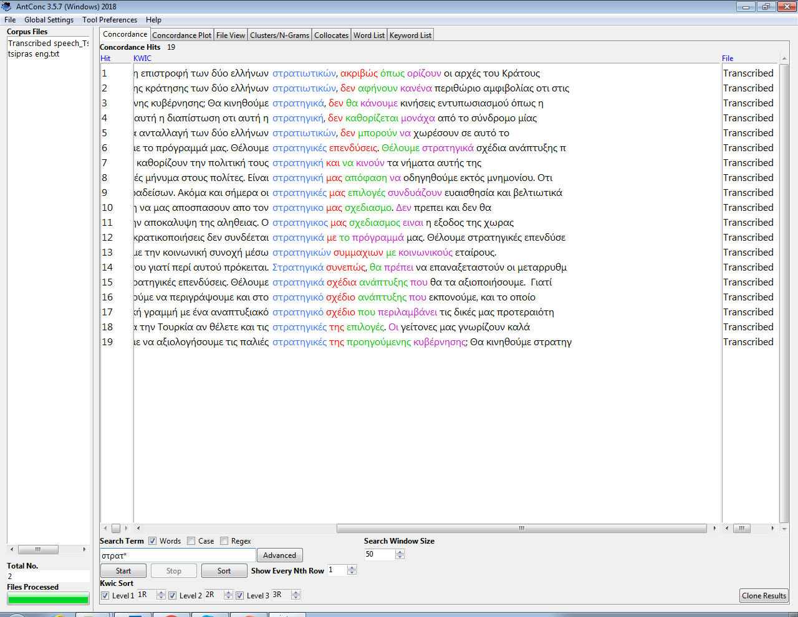
Tsipras -Syriza

Slide 21
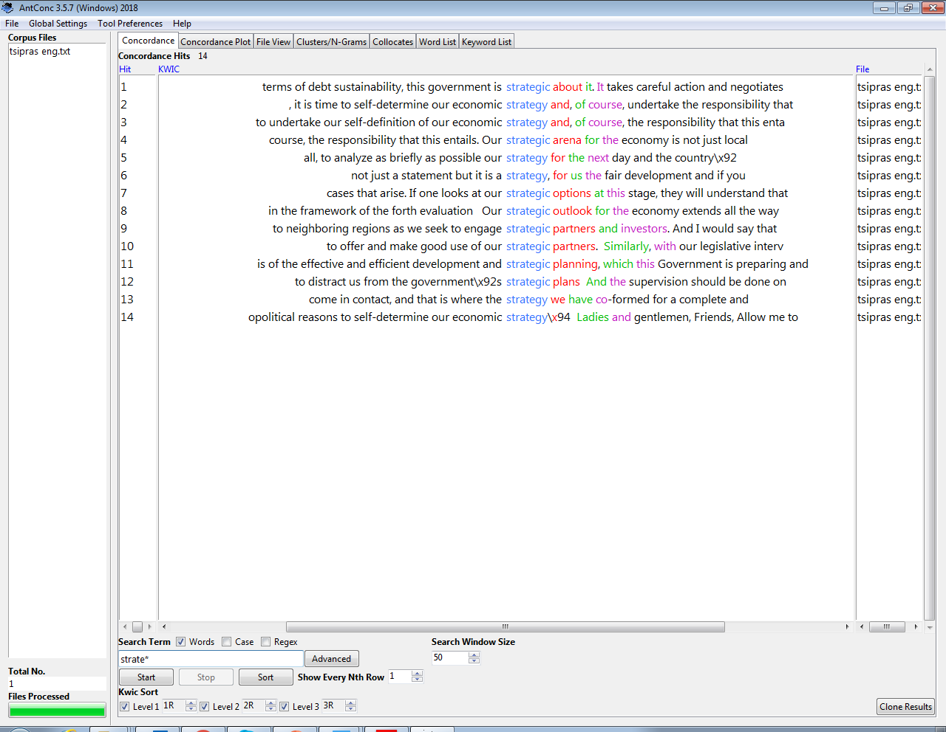
Tsipras- Syriza

Slide 22
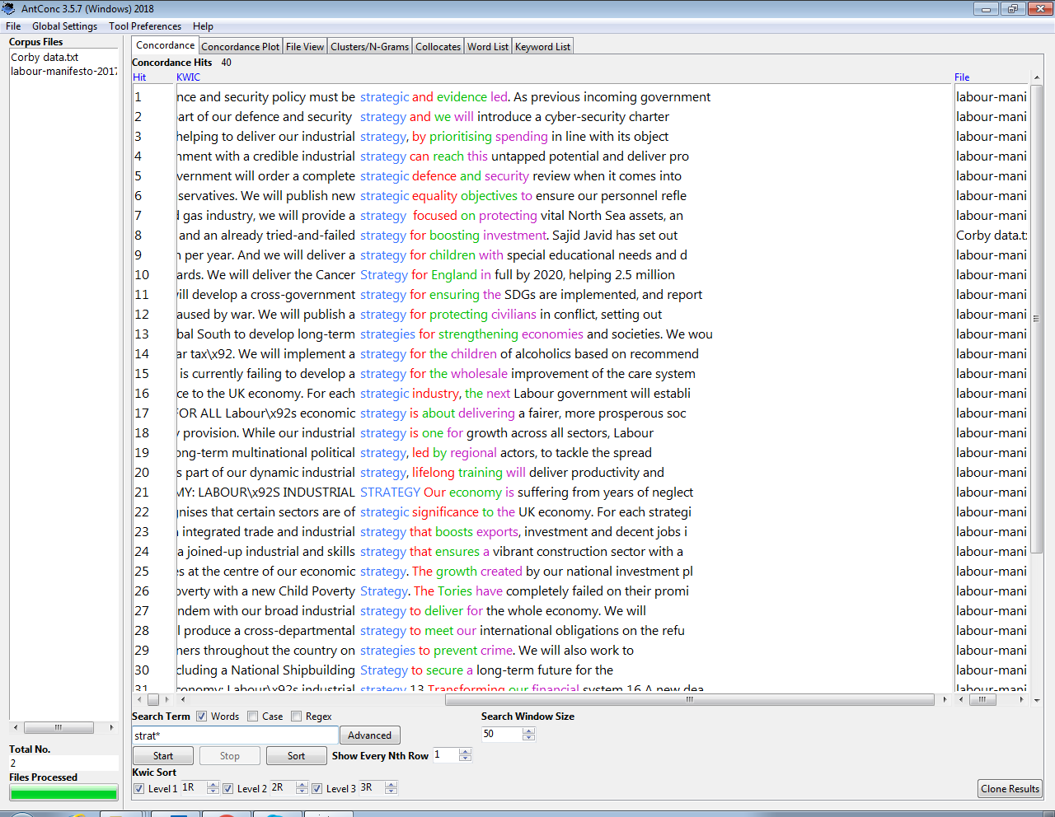
Labour – Corbyn

Slide 23
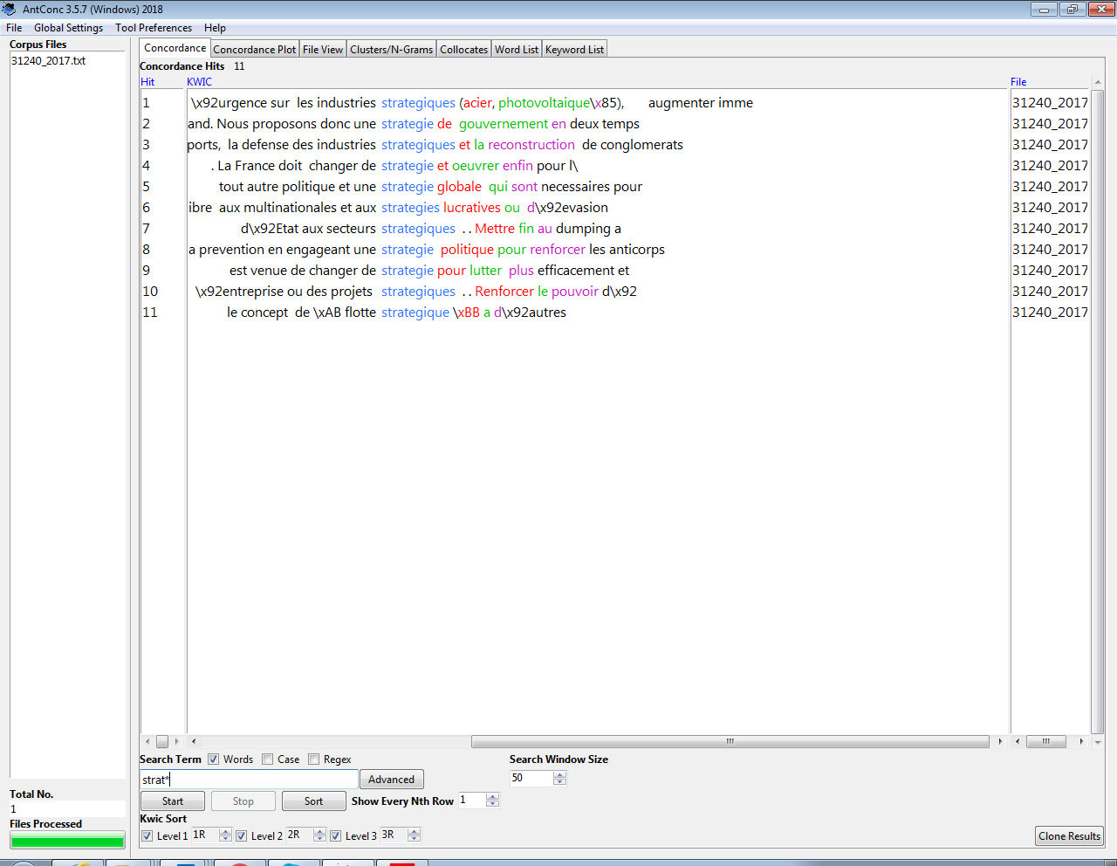
J. L. Mélencon- France insoumise

Slide 24
Discourses in contrast
 | A. Tsipras ~25,000 | J. L Mélenchon ~23,000 | J. Corbyn ~24,000
Instances | 33 | 11 | 40
Strategic + noun | 15 | 5 | 6
Strategy for (something) Future orientation | 7 | 6 | 7
Sector + Strategy | 3 | N/A | 18
**Remaining instances reflect adverbial phrases i.e. strategically or single use of the word strategy i.e. our current strategy

Slide 25
Methodologies and Levels of analysis
Analysis at lexical level
Analysis at supra-lexical level
Reflexivity

Slide 26
Tools for abstraction
Metaphors : “central to critical discourse analysis since it is concerned with forming a coherent view of reality” (Charteris-Black 2004, p. 28) and also understood in cognitive terms not only linguistic ones (Chilton and Lakoff 1995; Chilton and Ilyin 1993)
Trust building i) See how these metaphors “carry” the aspects of trustworthiness i.e. Benevolence, Integrity, Competence (Gillespie & Dietz 2009; Ingenhoff & Sommer 2010)
Trust building ii) modesty – exam metaphors

Slide 27

SYRIZA- main communication moto
Take SYRIZA in your hands – a new relationship with politics

Slide 28
i) Examples - Delphi Economic Forum speech
The striking developments of the past days should not distract us, and we will not let them to distract us from the government’s strategic plans
And the supervision should be done on the basis of the effective and efficient development and strategic planning, which this Government is preparing and will win in the forth evaluation
Competence

Slide 29
i) Examples - Delphi Economic Forum speech
If one looks at our strategic options at this stage, they will understand that what we propose for the economy is a plan with solid outcomes and results that can last.
Competence

Slide 30
Intermixing of traditional LWP with neopopulist elements
All this time, we have been defined as a society and as productive forces in the compulsion of the memorandum and loan contracts. Now that we have proven our credibility, it is time to undertake our self-definition of our economic strategy and, of course, the responsibility that this entails.
Delphi Economic Forum, 2018
Speaks to the People by appealing to their need for emancipation
Passive voice in the beginning implying oppression (not self-determination)

Slide 31
i) Examples – Parliamentary Group
And this is the Greece, this nation, that we are trying to describe in the strategic development plan that we are drafting and will present in the following Eurogroup. We will proceed with sincerity to strategic reforms that our people ask, only for the people’s sake – 23.4.2018 –
Our strategic reforms have helped the economy come back to life and the country to stand on its feet – 23.4.2018
Integrity, benevolence

Slide 32
ii) Examples – Parliamentary Group
In trying to sum up therefore, I state that we are continuing on our path towards the exit from this dark austerity tunnel, with a strong strategic development plan which includes our winning strategic policy priorities. At the same time we are advancing our efforts to implement the requirements of the fourth assessment from our creditors and intensify our efforts to strategically regulate the Greek dept in the most efficient ways and satisfy the supervisory authorities in the framework of current European challenges.
Tsipras 23.4. 2018
Competence

Slide 33
Labour-Corbyn
It turns out that the billionaires who own the bulk of the British press don’t like us one little bit
J. Corbyn - September 2018
Twitted – October 2018

Slide 34
Labour-Corbyn
With a serious industrial strategy and a radical Labour government, the economy can be a tool in our hands rather than the master of our fate. And with a government that’s prepared to intervene we can prioritize the things that matter most. 24 September 2019
Emancipation/Competence

Slide 35
Labour-Corbyn
Our strategy will help us upgrade industry to secure good jobs, win public contracts and compete on the international stage.
Build it in Britain’ speech at the EEF Technology Hub.
Neopopulist/Competence

Slide 36
Labour-Corbyn – Intermixing
It’s because a new customs union and a radical Labour government with an active industrial strategy will allow a renaissance in our manufacturing sector, which will create good, secure jobs and help restore pride and prosperity to parts of our country that have been ignored for too long
Neopopulist/Competence

Slide 37
Weird co-existence - Corbyn
We will publish new strategic equality objectives to ensure our personnel reflect our diverse society.
Equality is reduced into being objectified and something “managed”

Slide 38

Mélenchon – La France insoumise -
Nous sommes l’alternative à votre monde
[BT: We are the alternative to your world]

Slide 39
J. L. Melénchon – La France insoumise
Nous proposons donc une stratégie de gouvernement en deux temps avec un plan A et un plan B en cas d’échec du plan A
[BT: We are therefore, proposing a strategy of governing in two stages having a plan A and a plan B in case plan A fails]. –
Technocratic populism

Slide 40
J. L. Melénchon – La France insoumise
Instaurer le droit pour les salariés à un vote de défiance à l’égard des dirigeants d’entreprise ou des projets stratégiques
[BT: Reinstate the employees’ right to a vote of confidence against corporate managers or strategic projects ]
L’heure est venue de changer de stratégie pour lutter plus efficacement et plus humainement contre les addictions –
[BT: The time has come to change strategy and fight more efficienty and humanely against addictions.]
More traditional LWP
Competence and benevolence

Slide 41
Tools for abstraction
Metaphors : “central to critical discourse analysis since it is concerned with forming a coherent view of reality” (Charteris-Black 2004, p. 28) and also understood in cognitive terms not only linguistic ones (Chilton and Lakoff 1995; Chilton and Ilyin 1993)
Trust building i) See how the aspects of trustworthiness i.e. Benevolence, Integrity, competence (Gillespie & Dietz 2009; Ingenhoff & Sommer 2010) are materialized
Trust building ii) : modesty – how – exam metaphors

Slide 42
Delphi Economic Forum speech- trust building ii)
Exam metaphors – apologetic discourse
“we gave exams”,
“we have proven our credibility”,
“we have established credibility”
With corollaries
1. Greece in this post-Memoranda era has demonstrated that is a reliable partner, a “trustworthy country” and “pillar of stability and security” and that
2. now can “stand on its own feet” and determine its own strategy (which is obviously one of a clean exit—a “complete and self-reliant return to the markets”).

Slide 43
Corbyn- ii) trust building
But Labour is ready to put fairness and humanity back at the heart of our public services
“If we are to get the chance to put those values into practice in government ”
Privatization and outsourcing are now a national disaster zone. And Labour is ready to call time on this racket.
With corollaries
Readiness (i.e. competence combined with Integrity)
You (the People) will give Labour the chance to access the government

Slide 44


Slide 45
Reflexivity and further considerations
Tsipras: changes between the institutional setting - more technocratic and distant with “the people” especially in the Delphi Economic Forum
Elements of a pragmatic Administration – technocratic populism
More emphasis on competence rather than integrity-benevolence
Intermixing of discourses, more for Tsipras and Corbyn than Mélenchon

Slide 46
Considerations
Vigilance around what Chilton (2005) makes reference to i.e. that readers/audiences do not naively accept content i.e. more work with reception studies
Work more on juxtaposing business and political discourses in relation to the future-oriented sensemaking (Clarke 1999) with strategy being part being part of the lexical items that construct future-orientated discourse
More interaction between Corpus Analysis and C(DA) or CADS (corpus-assisted discourse studies) (Baker 2006; Taylor 2014)
Take into consideration whether we are talking about parties in power or in opposition, what discourses are reproduced from each position?

Slide 47
Q & A

Slide 48
References
Armony, V. (2005). Populism and Neopopulism in Latin America. Paper prepared for: After Neo-liberalism? Consequences for citizenship, Workshop #2 in the series Claiming Citizenship in the Americas, organised by the Canada Research Chair in Citizenship and Governance, Université de Montréal. www.cccg.umontreal.ca
-------. (2000). Is There an Ideological Link between Neopopulism and Neoliberalism? Paper for XXII LASA Congress, Miami, 16-18 March
Baker, P. (2006).Using corpora in discourse analysis. Continuum
Barry, D., & Elmes, M. 1997. Strategy retold: Toward a narrative view of strategic discourse. Academy of Management Review, 22(2): 429–452
Buštíková & Guasti (2018). The State as a Firm: Understanding the Autocratic Roots of Technocratic Populism. East European Politics and Societies and Cultures Volume 33 Number 2 May 2019 302–330
Charteris-Black, J. (2004). Corpus approaches to critical metaphor analysis. Basingstoke, UK: Palgrave Macmillan.
Chilton, P. (2005). Missing links in mainstream CDA: Modules, blends and the critical instinct. In R. Wodak and P. chilton (eds.), A New Research Agenda in (Critical) Discourse Analysis: Theory, Methodology and Interdisciplinarity. Amsterdam: John Benjamins. pp.19-52.
Chilton, P (2004) Analyzing political discourse: Theory and practice. London &. New York: Routledge.
-----------& Lakoff G. (1995) ‘Foreign policy by metaphor’ in C. Schäffner and A. Wenden (eds), Language and Peace, Aldershot, Ashgate
-----------& Ilyin, M. ( 1993) Metaphor in political discourse. The case of the 'Common European House'. Discourse and Society 4 (1):7-31.
Clarke, L. (1999). Mission Probable: Using fantasy documents to tame disaster. Chicago, IL: University Chicago Press.
Friedman, M. (1980): Free to Choose. New York: Harcourt Brace Jovanovich.
Fuoli, M. & Hart, C. (2018). Trust-building strategies in corporate discourse: An experimental study. Discourse & Society 29 (5): 514-552.
Gillespie, N., & Dietz, G. (2009). Trust repair after an organization-level failure. Academy of management review, 34(1), 127-145
Ingenhoff, D., & Sommer, K. (2010). Trust in companies and in CEOs: A comparative study of the main influences. Journal of business ethics, 95(3), 339-355.
Lakoff, G & Johnson, M. (2003). Metaphors we live By. Chicago. The University of Chicago Press.
Mudde, C. (2004) ‘The Populist Zeitgeist’, Government and Opposition, 39(3), 541–563.
Mudde, C. & Kaltwasser C.. (2012) Populism in Europe and the Americas. Threat or Corrective for Democracy? Cambridge: CUP.
Pasi S. et al (2016) Strategy implementation as fantasising – becoming the leading bank, Accounting and Business Research, 46:3, 303-325, DOI: 10.1080/00014788.2015.1112764
Schröter, M. and Storjohann, P., 2015. Patterns of discourse semantics: A corpus-assisted study of financial crisis in British newspaper discourse in 2009.Pragmatics and Society,6(1), pp.43-66.
Schröter, M. and Veniard, M., 2016. Contrastive analysis of keywords in discourses: integration and integration in French and German discourses about migration. International Journal of Language and Culture,3(1), pp.1-33.
Taylor, C. (2014) Investigating the representation of migrants in the UK and Italian press: A cross-linguistic corpus-assisted discourse analysis. International Journal of Corpus Linguistics, 19 (3). pp. 368-400.
Wodak, R. (2015). The Politics of Fear: What Right-Wing Populist Discourses Mean. London: Sage. doi: 10.4135/9781446270073
Wodak R. (2017) ‘The “Establishment”, the “Elites”, and the “People” Who’s who?’ Journal of Language and Politics, 16 (4), 551–565

