Slide 1
African-American Literature
Toni Morrison & Alice Walker
American Fiction
Spring 2020

Slide 2
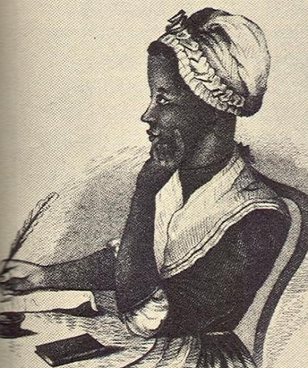
18th Century
The earliest African American writers sought to demonstrate that the proposition “all men are created equal” in the Declaration of Independence required that black Americans be extended the same rights as those claimed by white Americans.
Phillis Wheatley
Poems on Various Subjects, Religious and moral (1773)

Slide 3
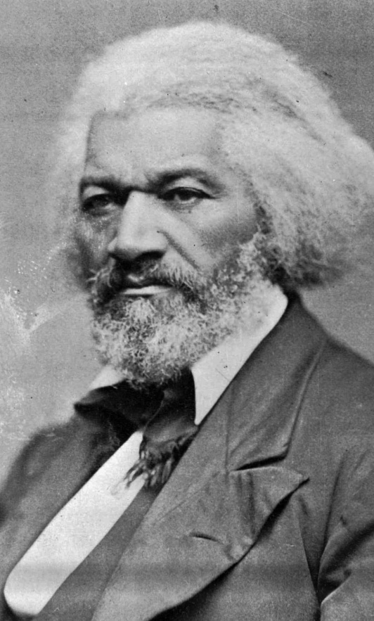
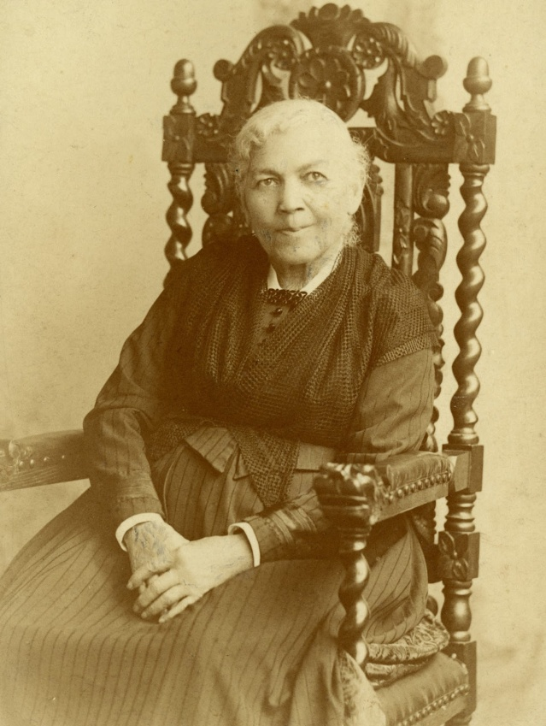
19th Century
Whites need to address the terrible sin of slavery
Warning white America of impending racial violence if slavery were not abolished.
Slave Narratives: firsthand autobiographical accounts of slavery by fugitives from the South
Narrative of the Life of Frederick Douglass, an American Slave, Written by Himself (1845)
Incidents in the Life of a Slave Girl (Harriet Jacobs, 1861)

Slide 4
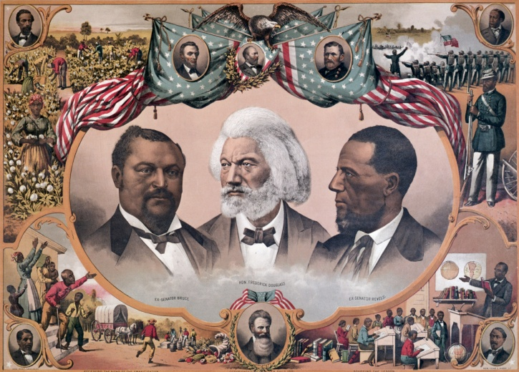
Civil War and Reconstruction
With the outbreak of the Civil War, many African Americans deployed their pens and their voices to convince President Abraham Lincoln that the nation was engaged in nothing less than a war to end slavery, which black men, initially barred from enlisting, should be allowed to fight.
The short-lived era of Reconstruction (1865–77) elicited an unprecedented optimism from African American writers; a spirit of sectional reconciliation anticipating progress for the newly freed men and women of the South.

Slide 5
The late 19th and early 20th centuries
Emergence of a self-conscious black middle class with serious literary ambitions.
The novel became an instrument of social analysis and direct confrontation with the prejudices, stereotypes, and racial mythologies that allowed whites to ignore worsening social conditions for blacks.
Countering notions of slavery popularized by white writers who idealized plantation life, while offering models of socially committed middle-class African Americans who exemplify the ideals of uplift.
Stressing the need for educated middle-class heroes and heroines to turn away from whiteness as a standard of value and rely instead on self-determination and racial solidarity.

Slide 6
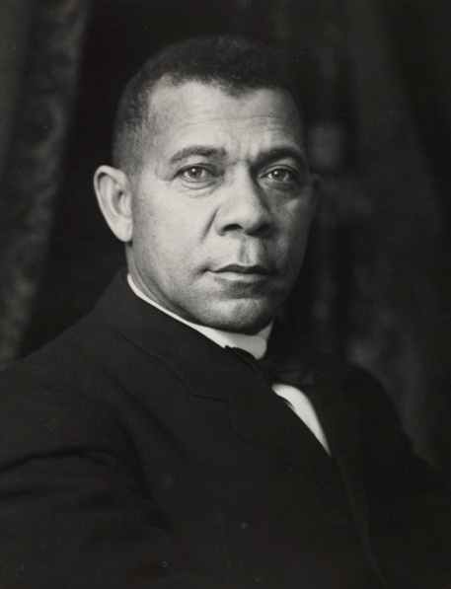
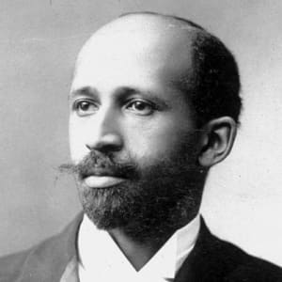
Booker T. Washington
W.E.B. DuBois
even the most disadvantaged of black people could attain dignity and prosperity in the South by proving themselves valuable, productive members of society deserving of fair and equal treatment before the law.
through “work, culture, and liberty” the dual heritage of African Americans—their called “double-consciousness”—could be melded into a force for positive social and cultural change in the United States.

Slide 7
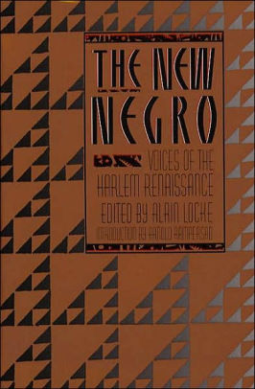
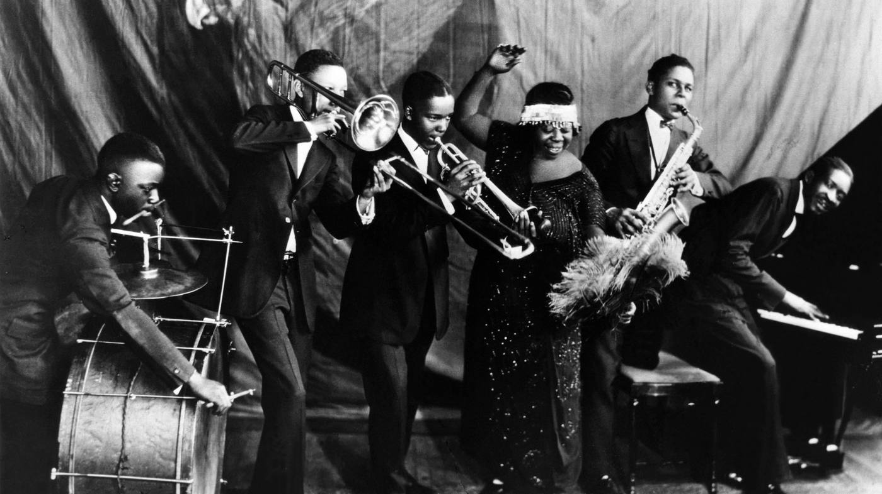
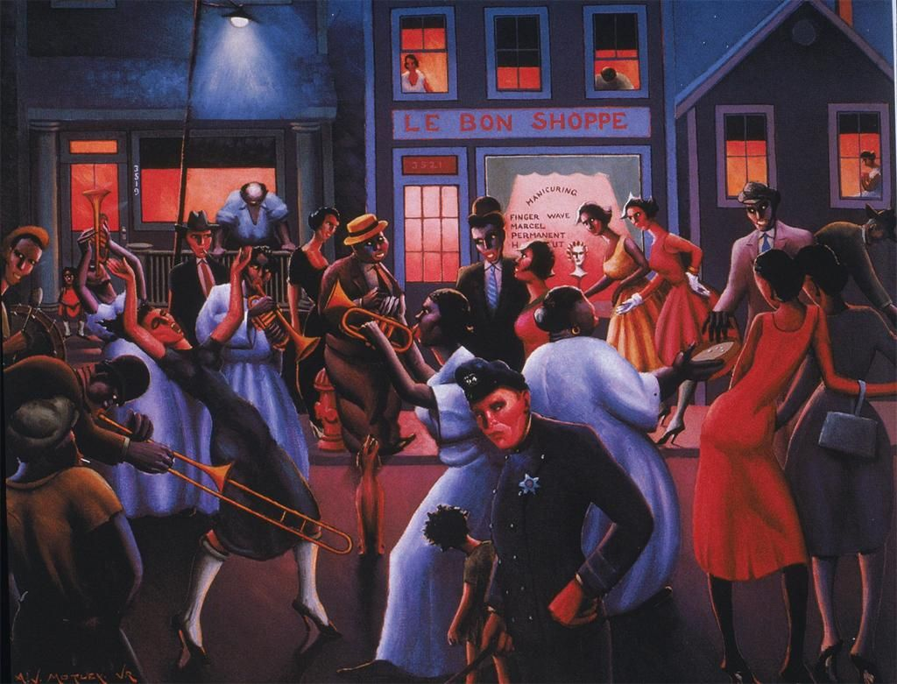
1920s - Harlem Renaissance
The “New Negro,” differed from the “Old Negro” in assertiveness and self-confidence.
New Negro writers questioned traditional “white” aesthetic standards, and cultivated personal self-expression, racial pride, and literary experimentation.
Claude McKay, Langston Hughes, Jean Toomer, Zora Neale Hurston, Nella Larsen

Slide 8
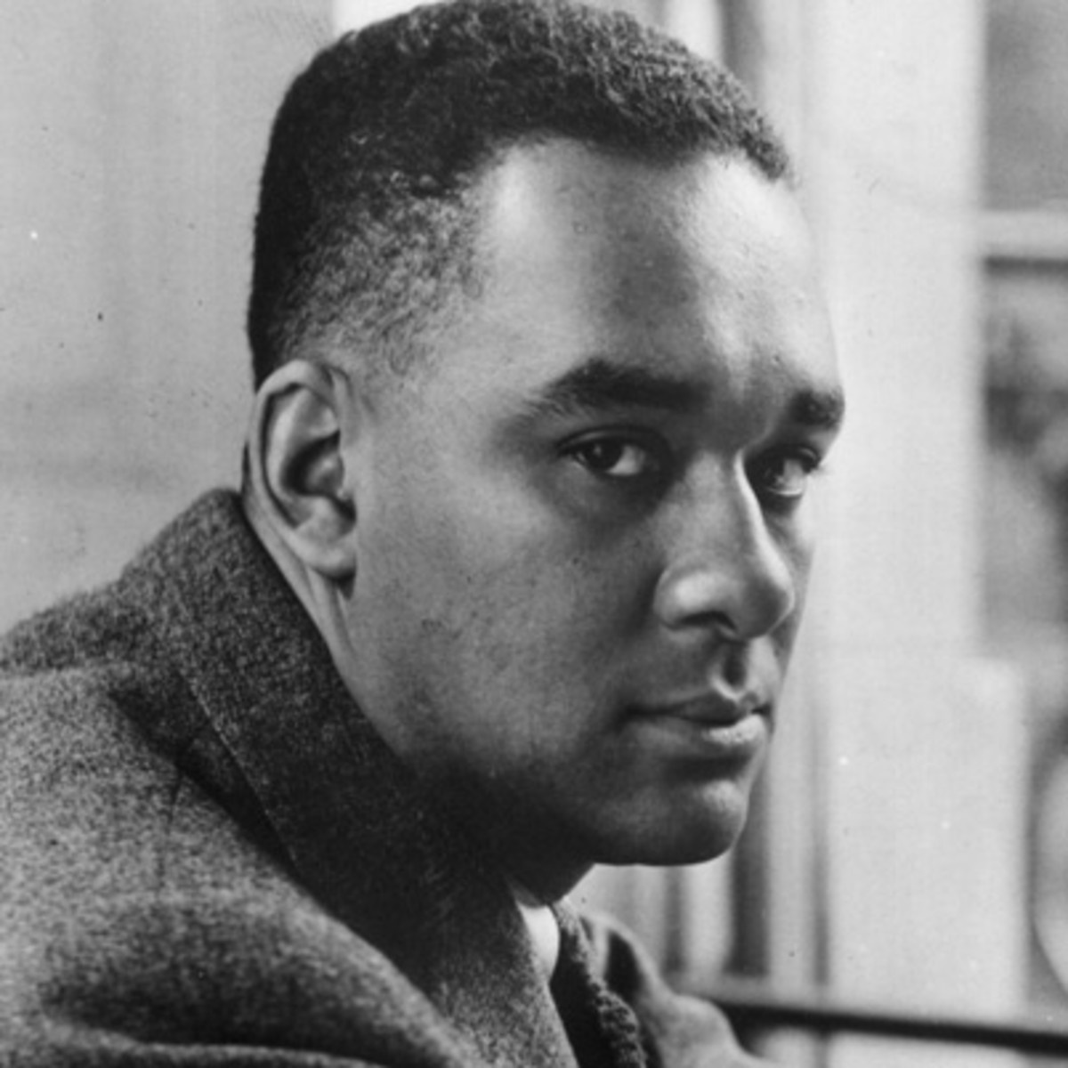
1940s – Urban Realism
Influence of American realists (Dreiser) – calling for a more politically engaged, socially critical realism in literature.
Richard Wright: reviving the protest tradition of 19th-century African American literature / revisiting slave narratives while eschewing its moralizing, sentimentality, and political conservatism.
Formal innovation: how the vernacular tradition could be adapted to modernist experimentation.

Slide 9
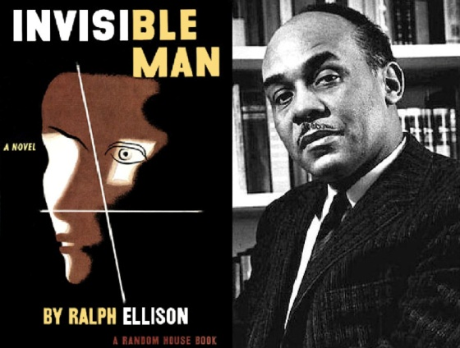
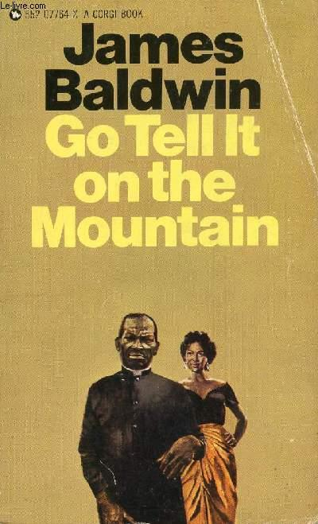
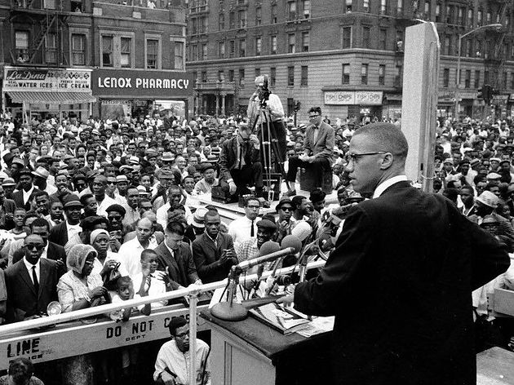
1950s
1960s – 1970s: The Black Arts Movement / Literature of Civil Rights
“All art is ultimately social”
Rejecting any notion of an artist that separates him from African-American community
Literature was the most immediate way to model and articulate the new Black consciousness.

Slide 10
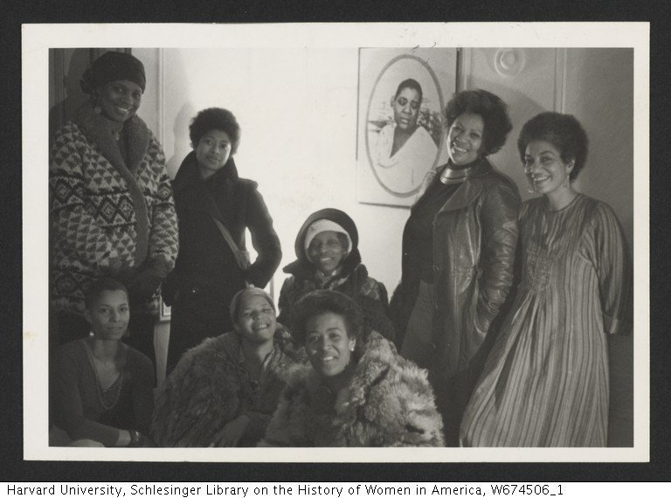
“The Sisterhood” (1970s-1980s)
Black Women’s Literary Renaissance in the 1970s
Fostered by a variety of literary, cultural, and political developments during the 1950s and ’60s, the expanding presence of black women’s experience and expressive traditions in African-American writing (Black Arts movement), and the impact of the women’s movement on African American women’s consciousness.
Women writers determined to help one another publish and affirm the value of each other’s voices.
June Jordan, Toni Morrison, Alice Walker, Nana Maynard, Ntzoke Shange, Vertamae Grosvenor, et. Al.

Slide 11
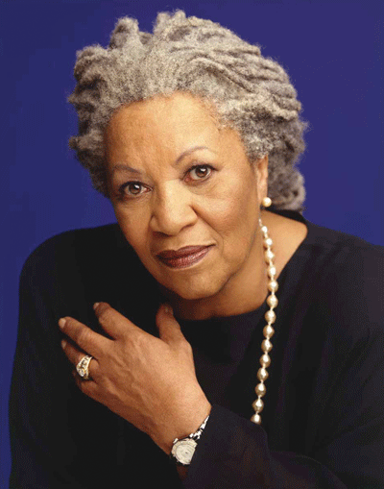
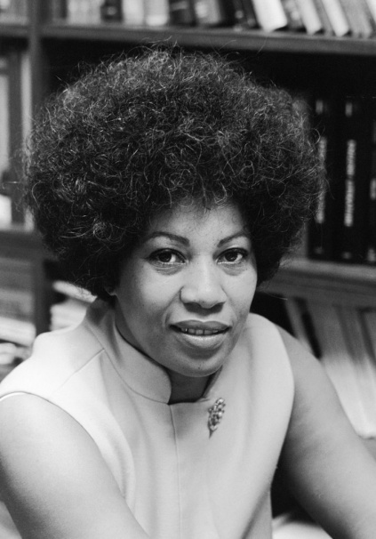
Toni Morrison (1931 – 2019)
Nobel Prize for Literature, 1993
Pulitzer Prize for Fiction, 1987 (Beloved); French Legion of Honor (2010); Presidential Medal of Freedom (2012)
Noted for her examination of Black experience (particularly female) within Black community
"In order to be as free as I possibly can, in my own imagination, I can't take positions that are closed. Everything I've ever done, in the writing world, has been to expand articulation, rather than to close it, to open doors, sometimes, not even closing the book — leaving the endings open for reinterpretation, revisitation, a little ambiguity.”

Slide 12
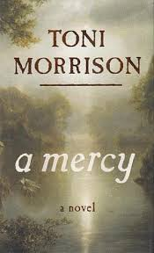
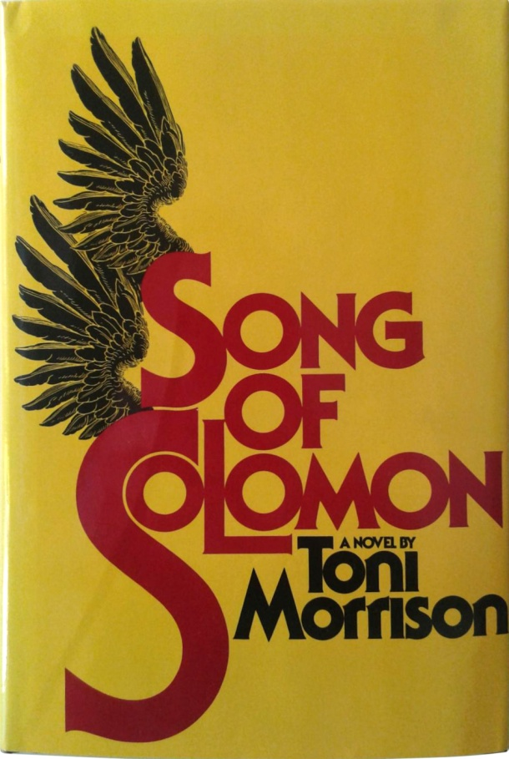
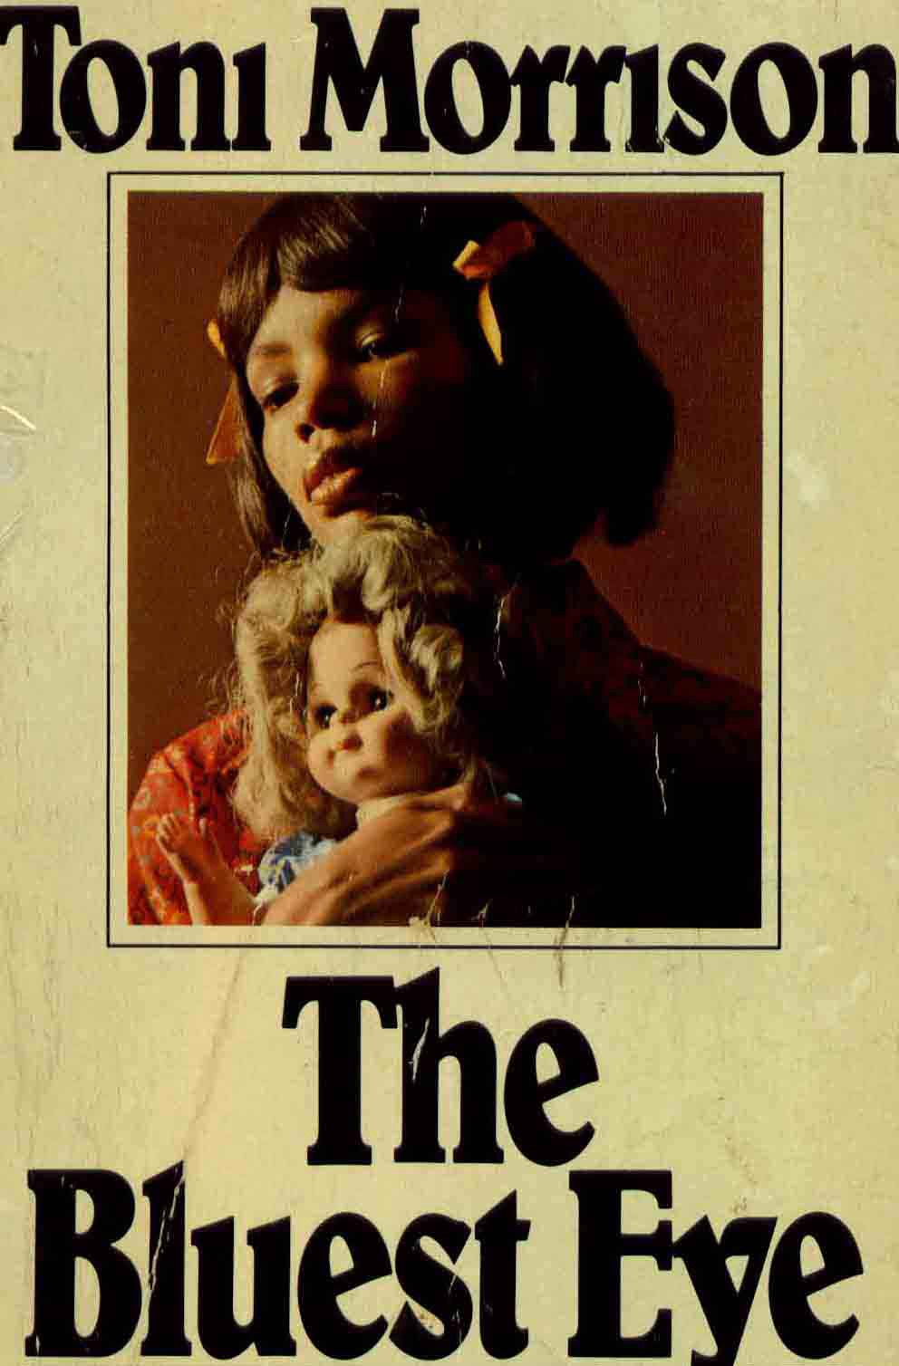
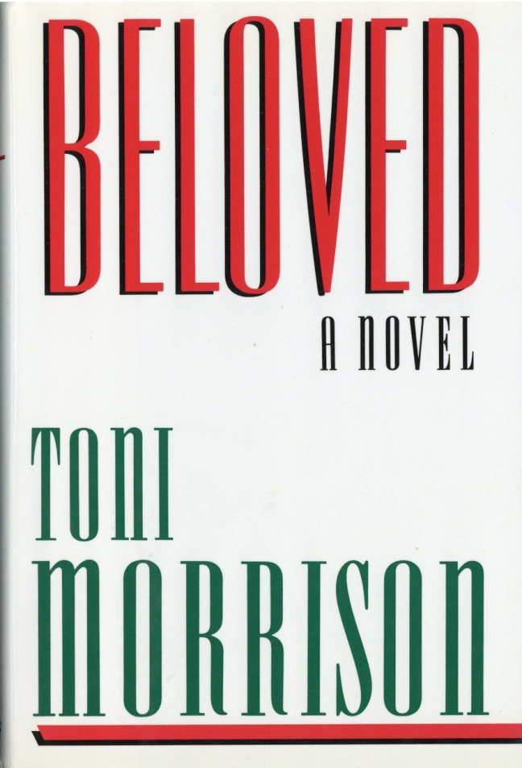
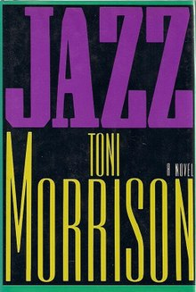
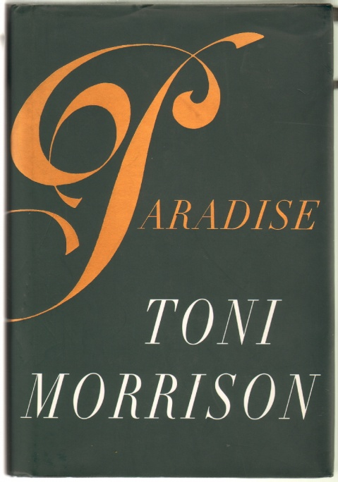
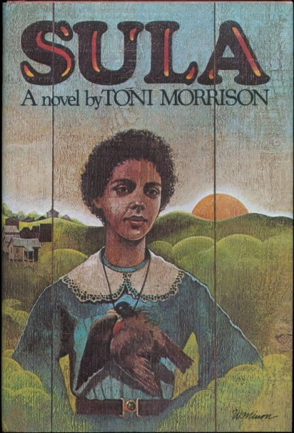

Slide 13
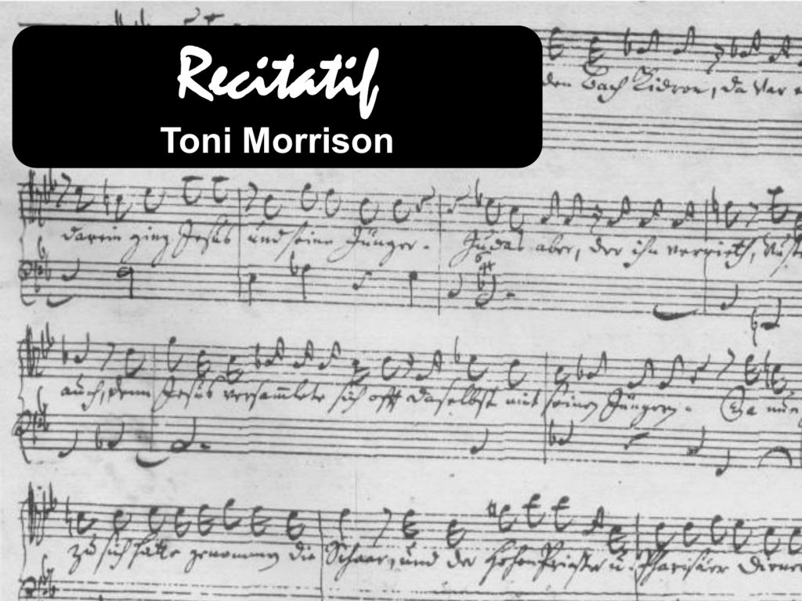
“an experiment in the removal of all racial codes from a narrative about two characters of different races for whom racial identity is crucial”

Slide 14
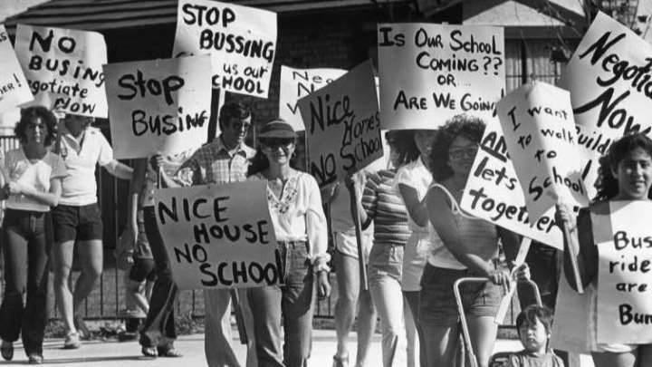
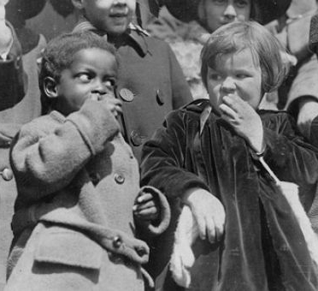
Title relates to episodic style of the story; five acts -vignettes bringing together the rhythms of two lives for five short moments. Narratives structurally intertwined
Themes: friendship, motherhood, history/memory, stereotyping, race; external conflict (racism, class) vs. Internal conflict (search for truth).
Interstices:
Maggie: mute, “sandy-colored,” “legs like parentheses”; shared past; surrogate.
“Whatever happened to Maggie?”
The Orchard: centerpiece, in-between space

Slide 15
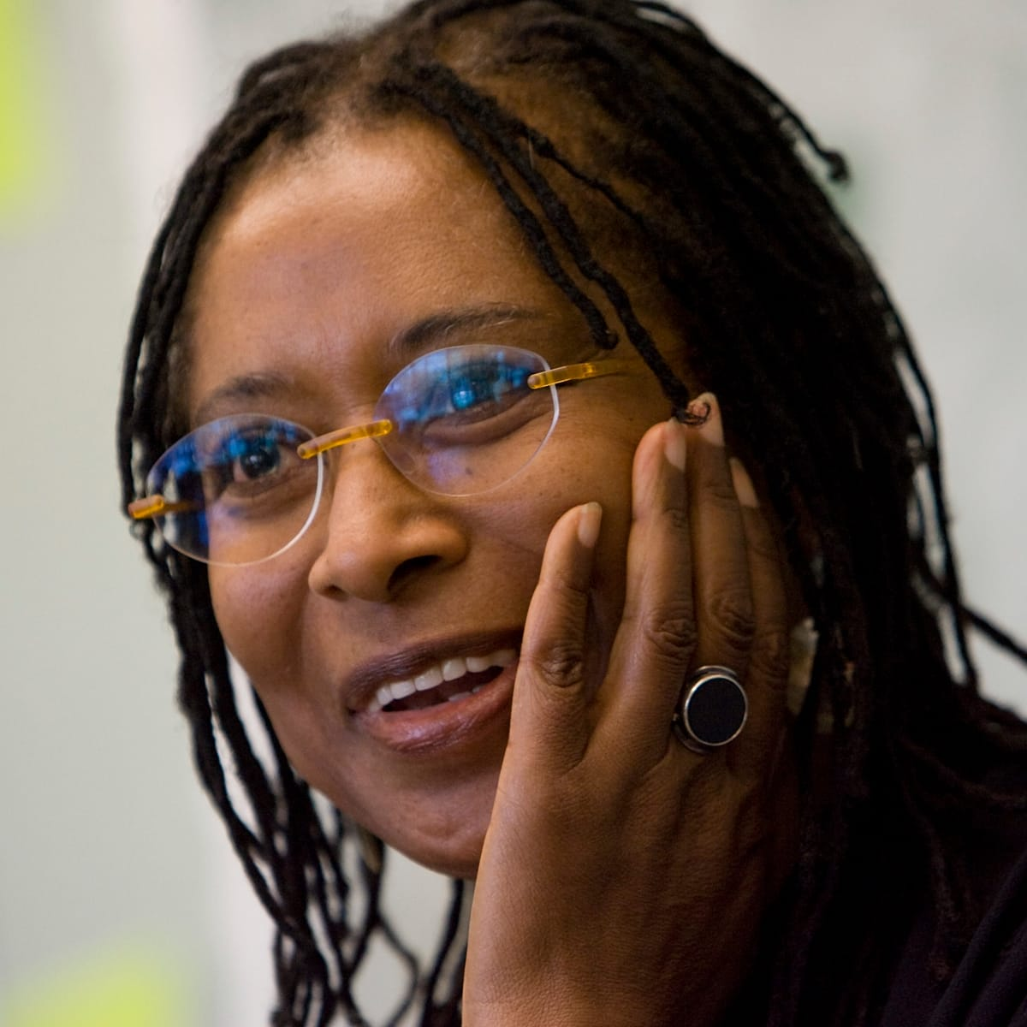
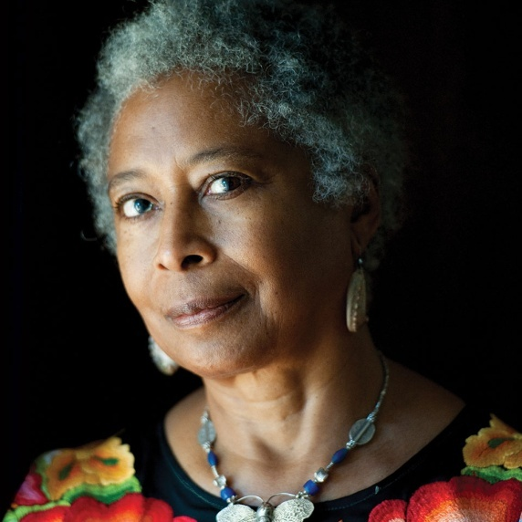
Alice Walker (1944 - )
Born to African-American sharecroppers, began writing as a child due to partial blindness – novelist, essayist, poet, civil rights movement.
The first African – American woman to win the Pulitzer Prize for Fiction; The Color Purple (1982) – coming-of-age novel in epistolary mode / folk language
Taught the first US course in black women's literature, at Wellesley College, in 1972; “In Search of Our Mothers' Gardens” (essays, 1983) unearth a buried tradition, from the 18th-century poet Phillis Wheatley to Gwendolyn Brooks and Nella Larsen.
Championing racial and gender equality
Never wrote for a particular group: "It was about expressing my views and trusting there were people who would understand. I used to read Somerset Maugham all the time, even though he was white and English. Nobody has ever convinced me that race is real.“
“Womanist” - “a black feminist or feminist of color … a woman who loves other women, sexually and/or nonsexually … committed to survival and wholeness of entire people, male and female.”

Slide 16
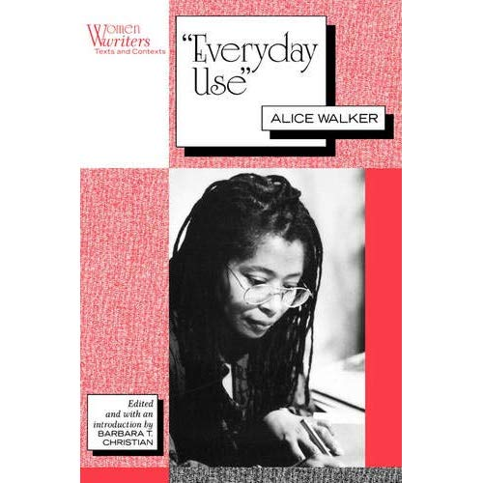
“Everyday Use” (1973)
Dee/Wangero
Black Pride (clothes) vs. actual ignorance of her American heritage. Objects as art = distancing from this heritage / aestheticizing the past.
Maggie
silence: reflecting the past
awareness of family history and origins.
Mama

Slide 17
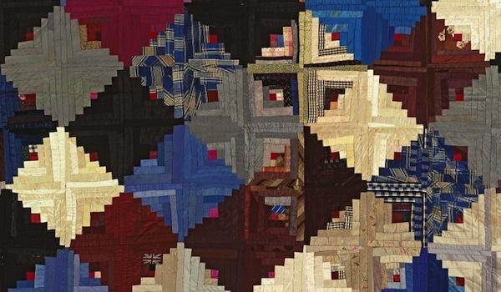
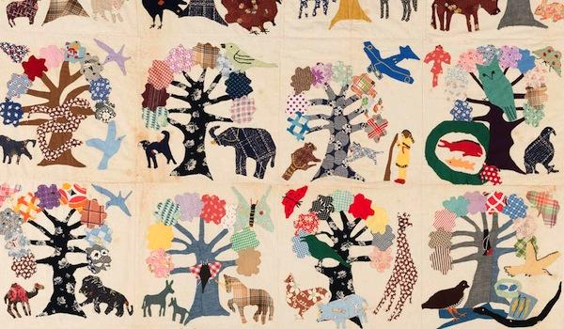
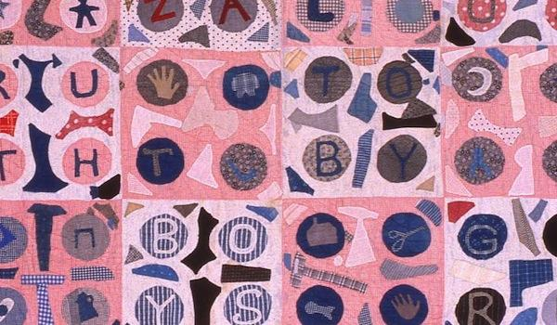
The Quilt
European tradition adopted by African-American women during times of slavery; art handed down from one generation to the next.
Symbol: Cultural Heritage (authenticity vs. superficiality, idealism vs. pragmatism).
Symbol: Familial heritage / relations
Dee: “old quilts” vs. “priceless”
Maggie: “knows how to quilt” = part of the heritage

Slide 18
