Slide 1
Postmodernism
American Fiction
Spring 2020

Slide 2
Periodisation
The Colonial Period (1500-1830)
The Post-Revolutionary Period of Romanticism and Transcedentalism leading almost up to the end of the 19th century.
Realism and Naturalism (1870-1910)
The Modernist period spanning roughly from the pre-WWI (turn of the century) years through to the interwar period and leading up to WWII
The Post-war / contemporary period.

Slide 3
Postmodernism
Reaction to “high” modernism
There is no objective, natural reality; reality is a conceptual construct, an artifact of scientific practice and language.
Language is self-contained and self-referential, not a “mirror of nature.” / Discourses of particular communities and traditions.
Literature highlighting the possibility of multiple meanings or complete lack of meaning.

Slide 4
Postmodern Literature Characteristics
fragmentation,
paradox,
unreliable narrators,
unrealistic and downright impossible plots,
games,
parody,
paranoia,
dark humor,
authorial self-reference,
multiple meanings, or a complete lack of meaning, within a single literary work

Slide 5
Postmodernist Narratives
Pastiche
Intertextuality
Metafiction
Temporal Distortion
Paranoia
Technoculture and Hyperreality (Cyberpunk)
Minimalism / Maximalism
Magical Realism
Reader Involvement

Slide 6
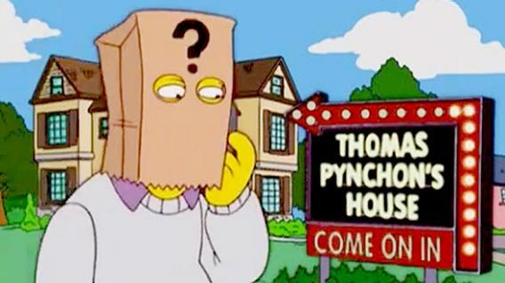
Thomas Pynchon (1937 - )
Rejected the novel as mirroring society - Novels covering a vast array of subject matter and genres – inspiration by ancestry.
Sociopolitical, philosophical, theological themes; exploration of psychology, sexuality, science and technology; affinity with popular culture.
Complexity of plots and themes
Progenitor of cyberpunk fiction.
V. (1963), The Crying of Lot 49 (1966), Mason & Dixon (1997), Inherent Vice (2009), Bleeding Edge (2013)
Gravity’s Rainbow (1973): “visionary apocalyptic masterpiece” – National Book Award
Absence from media and public life – “recluse”

Slide 7
Slow Learner (1984) - Introduction
“The story is a fine example of a procedural error beginning writers are always being cautioned against. It is simply wrong to begin with a theme, symbol or other abstract unifying agent, and then try to force characters and events to conform to it.”
“I wrote ‘Entropy’ in ‘58 or ‘59—when I talk about ‘57 in the story as ‘back then’ I am being almost sarcastic. One year of those times was much like another. One of the most pernicious effects of the ‘50’s was to convince the people growing up during them that it would last forever.”
“I was more concerned with committing on paper a variety of abuses, such as overwriting … my specific piece of wrong procedure back then was, incredibly, to browse through the thesaurus and note words that sounded cool, hip, or likely to produce an effect, usually that of making me look good, without then taking the trouble to go and find out in the dictionary what they meant.”

Slide 8
“people think I know more about the subject of entropy than I really do … Since I wrote this story I have kept trying to understand entropy, but my grasp becomes less sure the more I read.”
Entropy as Metaphor or Theme: Two opposing worldviews within the context of entropy (in juxtaposition) to illustrate that they are both subject to the laws of nature, and thus, equally meaningless; all states of matter are temporary and subject to entropy. - “Heat-death”
Thermodynamics and Information Theory
Parallel development of relationships.
Party guests as synecdoche for types.

Slide 9
“Entropy” - Language
Free Indirect Style: Objective reports interlaced with personal thoughts.
Seamless transitions between storylines.
Music –
Fugue structure
white noise, rain and sounds of traffic.

Slide 10
“Entropy” - Epigraph
“Boris has just given me a summary of his views. He is a weather prophet. The weather will continue bad, he says. There will be more calamities, more death, more despair. Not the slightest indication of a change any- where. [The cancer of time is eating us away. Our heroes have killed themselves, or are killing themselves. The hero, then, is not Time, but Timelessness.] We must get into step, a lock-step, toward the prison of death. There is no escape. The weather will not change. “
Henry Miller, Tropic of Cancer
Tropic / entropy tropein = trope
Intertextuality
Shared themes and concerns
Introduction to metaphor of the weather: “the weather will not change”

Slide 11
Utopian / Dystopian – Speculative Fiction
Speculative Fiction: blanket term for a broad range of narrative forms that embrace a different version of reality than the empirical-materialist one (fantasy, dystopia, post-apocalyptic fiction, steampunk et.al)
Utopia / Dystopia (late 19th c): exploring social and political structures/reform brought about by advent of technology
Future worlds, alien worlds, imaginary inventions, new weapons
Modern concerns: totalitarian governments and anarchism, but also pollution, global warming, climate change, health, the economy and technology.
Cyberpunk: post-humanism, post-industrialism, post-nationalism

Slide 12
Kurt Vonnegut Jr. (1922 – 2007)
Novels, short stories, plays, poems, works of non-fiction
Descendant of German immigrants – parents abandoned German culture after WWI, leaving youngest son “ignorant and rootless.”
POW in Dresden during WWII – Slaughterhouse 5 (1969)
Humor and satire to critique contemporary society and its frailness – fatalistic worldview
Social themes/loss of purpose in postmodern tropes (fantasy, science fiction, dys/utopian)

Slide 13
“Welcome to the Monkey House” (1968)
1968: Cold War = fear of nuclear annihilation
Dystopian setting underlines socio-political critique
Christian morality intertwined with communist-like, oppressive system / crafted into American soil through parallel images: “J. Edgar Nation”; “champagne was as illegal as heroin”
An ethically dubious future crafted by the (World) government
Themes: totalitarianism, egalitarianism, moral dilemmas, automatisation, sexuality, rape

Slide 14
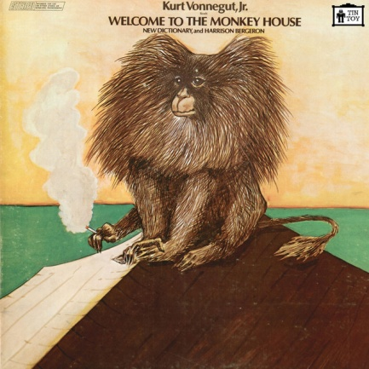
Irony, Satire, Humor
Visual imagery:
“The people were virtually packed together like drupelets. Drupelets are the pulpy little knobs that compose the outside of a raspberry”
Easter family vs copulating monkeys
Howard Johnson’s design /tape of silverware sounds
Hostesses’ “uniforms”
Billy’s pyjamas
Kennedy statues
Green, yellow, blue cement
“Her office was in the Taj Mahal”
Exaggeration
“the two six-foot Hostesses”
Euphemisms
“deflowering” “Wedding night”
Juxtaposing diction
“splendid with anger and disgust”
Verbal Irony
“America had changed in many ways, but it had yet to adopt the metric system”
“Thank the pills for that”
Absurd
Father of ethical birth control had eleven kids
“Bombed out of their skulls with the sex madness that came from taking nothing”

