Slide 1
Post - 9/11 Literature

Slide 2
“[W]hen we watched the oft-repeated shot of frightened people, running towards the camera ahead of the giant cloud of dust from the collapsing tower, was not the framing of the shot itself reminiscent of spectacular shots in catastrophe movies, a special effect which outdid all others?”
Slavoj Žižek, Welcome to the Desert of the Real 11

Slide 3
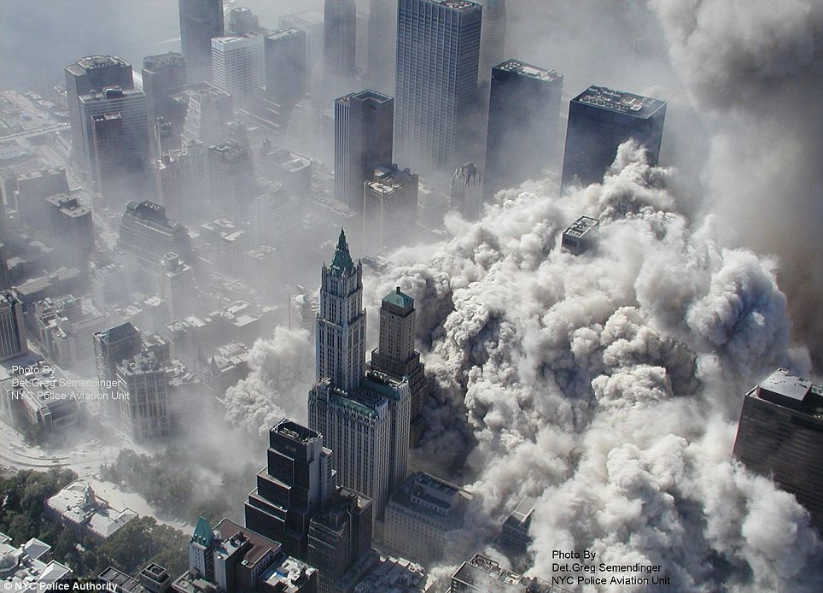
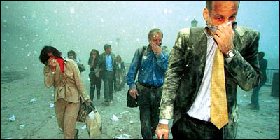
Literature of Crisis
Nature of the Crisis
War at Home
Totemic significance of the WTC
War on Terror Melancholia
Media Intervention
Writers’ Response
Disorientation, Loss
Failure of Language – Obliteration of Meaning
Interest in the paradox of speaking the silence

Slide 5
Lynne Sharon Schwartz “Near November”
“[W]e don’t know what the next sentence should be. We have tried to proceed to the next sentence. But to write, you must know something, and we know nothing beyond the intolerable questions that assail us. Grief, at an infernal temperature, has burnt knowledge out of us.”

Slide 6
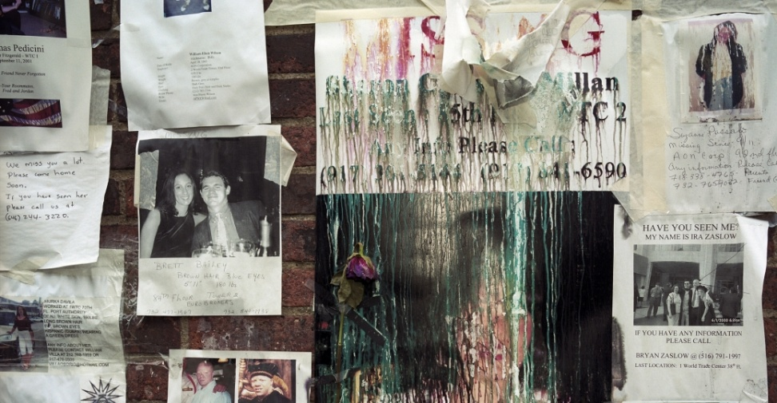
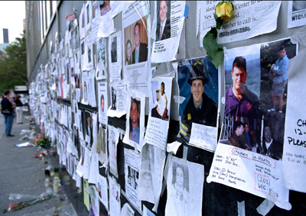
Privileged narrative forms/genres
Poetry (neither silence nor fully-fledged expression)
Postcards to the missing, unrealized film scripts, instructions for responses to disaster, imagined encounters with the bereaved, urban legends, explorations of a terrorist’s mind, paeans to the city etc.
Hybrid forms privileging Image over Story (new kinds of images and iconography in written texts, graphic novels, comics).

Slide 7
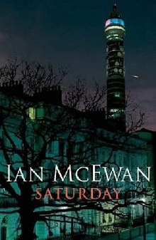
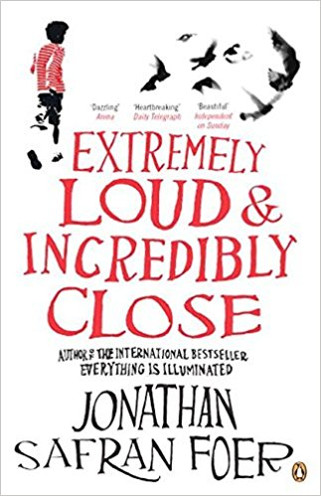
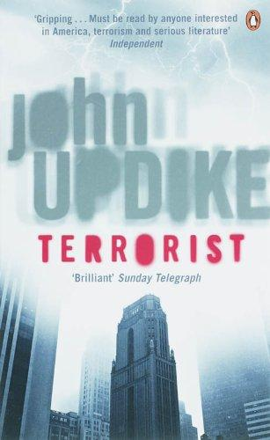
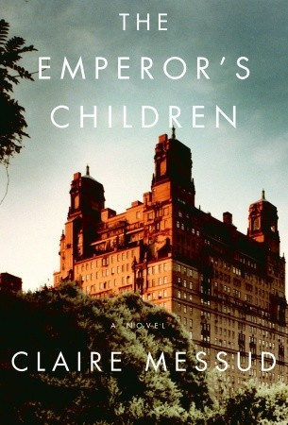

Slide 8
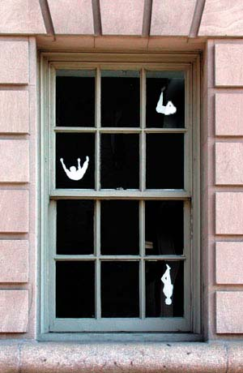
LITERATURE AFTER 9/11
Employing representational strategies that emphasize the desire for meaning
Creating a counter-narrative that consists of multiple narratives: No single story to contain the event
Interrogating mechanisms and ethics of witnessing
Revealing the impossibility of knowing or conveying meaning
Discussing the ways in which 9/11 affected chronology and memory
Explanatory narratives as a means of:
countering trauma
refusing incommensurability
placing 9/11 in historical framework

Slide 9
Main Themes
Father – Son Bond
(Frederic Beigbeder, Windows on the World (2004); Jonathan Safran Foer, Extremely Loud & Incredibly Close (2005))
Shattered Family Lives
(Ken Kalfus, A Disorder Peculiar to the Country (2006); Don DeLillo, Falling Man (2007))
Amnesia
(Don DeLillo, Falling Man (2007); Khaled Hosseini, The Kite Runner (2004))
Hostile Intruder / The Terrorist Other
(Don DeLillo, Falling Man (2007); John Updike, Terrorist (2006); Mohsin Hamid, The Reluctant Fundamentalist (2007); Ian McEwan, Saturday (2005))
Marginalisation of female and racial subject
(Joseph O’Neill, Netherland (2008), Amy Waldman, The Submission (2011)

Slide 10
“Impossible“ Representation
Circularity of narrative
Disruption of linear temporality / superficial chronological confusion
Achronicity: incompletion of knowledge, belatedness, mechanism of memory, trauma
“Dual Temporality” (trauma) – potentially a 3rd timeline: present narrative time
Arrest of narrative: to examine a photo, a report or another trifle
Contradicting accounts
Stylistic Effects / Metafictional elements / Dominance of the image

Slide 11
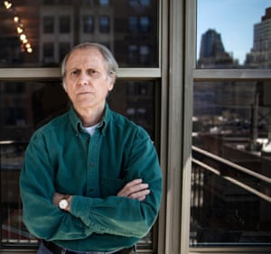
Don DeLillo (1936 -)
Novels, essays, short stories, plays, scripts.
Influences: modernist fiction, abstract impressionism, jazz music, European/Asian cinema of the 60s.
Subjects: television, nuclear war, the Cold War, sports, the complexities of language, performance art, mathematics, the advent of the digital age, politics, economics, and global terrorism.

Slide 12
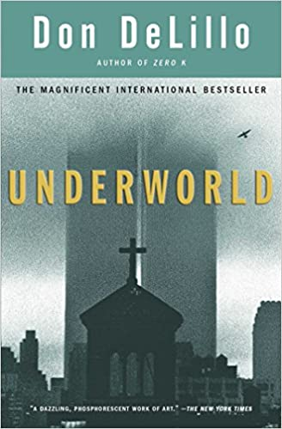
“It's no accident that my first novel was called Americana. This was a private declaration of independence, a statement of my intention to use the whole picture, the whole culture. America was and is the immigrant's dream, and as the son of two immigrants I was attracted by the sense of possibility that had drawn my grandparents and parents.”
--Don DeLillo, from the 1993 interview with Adam Begley

Slide 13
Don DeLillo’s “The Starvelling”
Depictions of post-9/11 world: melancholy, tedium, withdrawal, stillness.
Failure of language – searching for the right word
Fear of the threatening Other
Cinema:
Ritual = trauma
Importance of images in narratives of 9/11 (televised images merging reality with fantasy)
Image over words (journals)

