Slide 1
Week 2
Rip van winkle , WASHINGTON Irving
The way to wealth , BENJAMIN franklin
By Aggeliki Tsagari

Slide 2
American literature periodization
PRE-COLUMBIAN PERIOD
The Colonial Period (1500-1830)
The Post-Revolutionary Period of Romanticism and Transcendentalism leading almost up to the end of the 19th century.
Realism and Naturalism (1870-1910)
The Modernist period spanning roughly from the pre-WWI (turn of the century) years through to the interwar period and leading up to WWII
The Post-war / contemporary period.

Slide 3
Rip van winkle
WASHINGTON Irving
The sketch book of Geoffrey Crayon(1819)
Recovered text

Slide 4
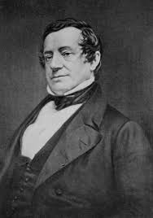
Washington Irving (1783-1859)
Influential Horror and Humor
Wrote biographies (Columbus &Muhammad)
Romantic influence, American elements (folklore, history, local color)
World-wide influence
Rip Van Winkle was influenced by a Faux Dutch historian: Diedrich Knickerbocker

Slide 5
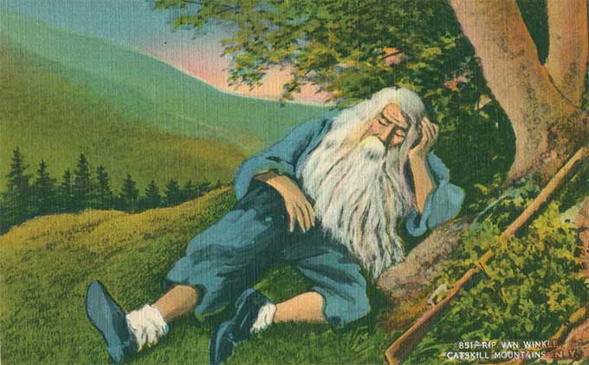
Rip van Winkle
Escapist Fantasy
Framed tale
Rip sleeps through the defining moment of American history
Rural utopia / Nature
Rip as an anti-Franklean hero

Slide 6
themes
FREEDOM VS TYRRANY=freedom to be his kind simple self and live the idle life he wants. His wife is the form of tyranny constraining his freedom as she nags him constantly and ferociously to work on the farm. Neither domestic nor civic responsibility intrude on Rip’s lifelong freedom.
CONSTANCY AND CHANGE=Rip is the embodiment of constancy - regardless of the vast changes that occur he remains the same. The village represents drastic change .

Slide 7
COLONIAL TRADITION=Rip is the embodiment of early colonial and its simple way of life before an increasingly intense focus on work for money and profit became a hallmark of the U.S.A
VOLUNTEERISM VS WORK FOR PROFIT=Rip loves to work but only when he volunteers his labor to others. He does not willingly work for his own or his family profit or benefit; though he really helps his neighbors he refuses to farm his own land
HISTORY AND FICTION=It is the theme that opens and closes the narrative with the elaborate promise of Irving’s made up narrator Diedrich Knickerbocker that the story represents historical facts. Irving wrote both fiction and well researched history. In Rip Van Winkle he explores the divide between fact and fiction and the location of truth in both.
He also examines the value of fiction as a compliment to historical fact

Slide 8
symbols
The Catskill (Catskill) Mountains: they represent mysterious magical or supernatural forces of change that affect human life they are described as having magical hues and shapes and as fairy mountains. They provide refuge to Rip when we wants to escape his wife and family responsibilities The supernatural quality of the mountains is reinforced by the ghostly visitation of Hendrick Hudson’s crew. Rip “reborn” by Nature.
Inn&Union Hotel : represents the idleness and rejection of profitable work that is the core of Rip’s life. The other men also sit there and gossip. The inn stand for laziness and unproductive lives. The hotel represents the values of Commerce, political engagement and money making, in direct contract to the inn it replaced.

Slide 9
characters
The Stranger
RIP VAN WINLKE
Kind and gentle
Generous(eager and willing to help his neighbors)
Hates to work
Liked by his fellow villagers
Isn’t sufferable to his nagging wife (does not support his family by farming)
Seeks calmness in the mountains or the Inn
Dressed in old-fashion clothes
Seems to be a member of Explorer Hendrik Hudson’s crew
Maybe a ghost
Dame Van Winkle(The wife)
Judith Gardenier
Mother of Rip’s son and daughter
A terrible nag - Antagonist
Harsh, loud, intolerant woman who speaks her mind
His grown daughter
Peter Vanderdonk
Descendant of a historian who wrote about the towns history, confirming the story about Hudson

Slide 10
The way to wealth
BENJAMIN Franklin

Slide 11
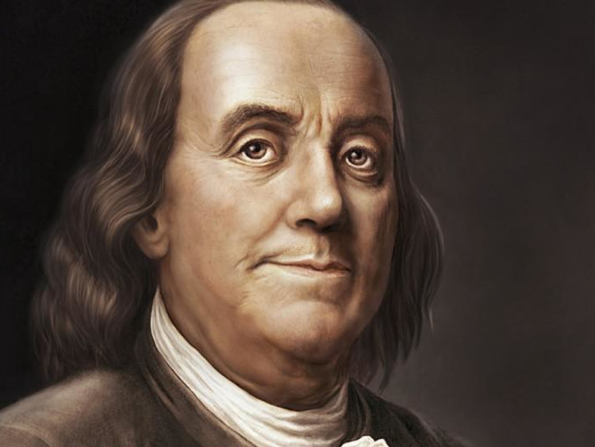
BENJAMIN FRANKLIN(1706-1790)
He was a statesman, author, publisher, scientist, inventor and diplomat, printer. Native Americans call him “The 1St American”
Born in Boston
During the American Revolution, he served in the Second Continental Congress and helped draft the Declaration of Independence in 1776
Had only 2 years of formal education
First attempt to write: at the age of 12
He adopted a character of a middle aged woman as 14 year old to write about themes such as love, using a satirical tone. His brother published his writings without having knowledge of the writer.
He became an abolitionist in Pennsylvania

Slide 12
The 2 most important texts by Franklin
Franklins autobiography: Established what we call “The American dream”. Benjamin Franklin writes about himself but to describe the opportunities he found, how he took advantage of them and to express that every man can make his dreams come true.
Poor Richard’s Almanack: First almanac-first demographic survey. Benjamin creates Richard Saunders, a persona which he kept for 25 years. He sold more than 10.000 copies. Richard became B.F or B.F became Richard. A compilation of calendars, weather forecasts, poems, sayings and aphorisms, mathematical exercises, astrology, news stories et.al. A reflection of norms and social mores of the times. Using other people’s ideas and aphorisms: what’s important is not who the author is but how the idea is put into use.
Firstly BF had slaves, but then changed his mind and fought slavery.

Slide 13
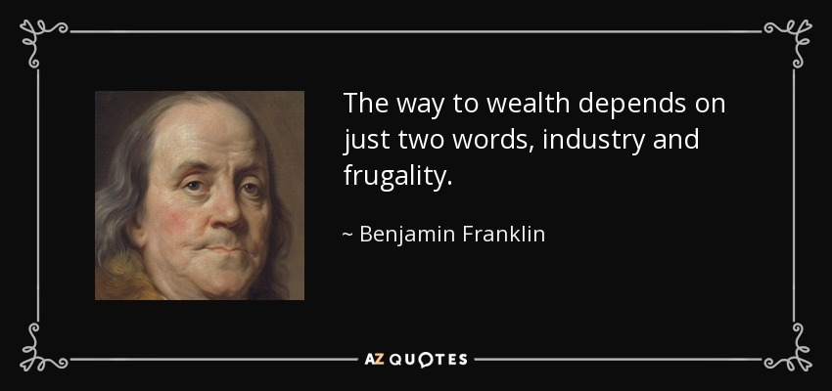
THE WAY TO WEALTH
12-page preface for the final 1758 edition, originally titled “Father Abraham’s Speech”
In this preface Father Abraham cites only those proverbs that concern hard work, thrift, and financial prudence.
Preface = ironic critique on authorship / parts removed in 1770s rewriting to emphasize on the maxims about industry.
The Franklinian Work Ethic
Industry
Frugality
Productivity
This text exemplifies Franklin’s work ethic(except for industry). There’s direct reporting of an incident.

Slide 14
The way to wealth characters
Father Abraham
Poor Richard
Almanac
Read many books and was interested in Poor Richard’s works
Has been quoting him for almost 25 years
The almanac is like a life guide to him
The author of an almanac
Wise
Shares his wisdom ,which he gained from going through hard times
Could be taken as a character ,although it’s a book
Priceless information
teaches about using time, the value of money, and the cost of achievements
praises labor and exposes laziness

Slide 15
themes
WISDOM AND FOLLY: the people represent a state of folly and they are in a state of gaining wisdom
SAVING MONEY AND HARD WORK: there are 2-equal- ways of gaining wealth, making money and saving money. They are of equal value because even if one is working all the time but never saves money he will never be rich.
COMPLAINING: there is no room for complaining if one is taking responsibility for their progress in life.
“There will be sleeping enough in the grave” – Poor Richard

Slide 16
SYMBOL
THE WAY TO WEALTH: it is a path from one form of life to another
FORMAL ELEMENTS:
SETTING Colonial America
TONE: Advisory and humorous, also use of irony
MOTIF
RECOMMENDATIONS that concern every aspect of a man’s life which are focused on self-development and self-improvement
IRONY
“We are taxed twice for our idleness”: we should fight laziness
“Lost time is never found again": time is valuable and we should take advantage of it
“Troubles springs from idleness”
ALLEGORY
THE STORY is like a didactic guide for people who need encouragement. A book that contains answers to all the questions. It it like a ‘bible’

