Slide 1
American Fiction
(Dark) Romanticism
&
Gothic Fiction

Slide 2
Periodisation
The Colonial Period (1500-1830)
The Post-Revolutionary Period of Romanticism and Transcedentalism leading almost up to the end of the 19th century.
Realism and Naturalism (1870-1910)
The Modernist period spanning roughly from the pre-WWI (turn of the century) years through to the interwar period and leading up to WWII
The Post-war / contemporary period.

Slide 3
Romanticism
Art, Literature, Music, Philosophy
Rising in reaction to:
Industrial Revolution / Enlightenment
the dominance of scientific thought
rationalism, social and political norms
Europe = late 18th c America = early 19th c
American Lit. = 1830-1865 (Transcedentalism)

Slide 4
Romantic Sensibilities
Emphasis on: Imagination, Intuition, Feeling
Spontaneity, individual freedoms, and nature are of greater value than reason, logic, planning, and cultivation:
Individual comes first and is primarily good
Nature is to be worshipped
Reason is limited; the imagination is able to discover “truths”
Asking readers to ‘suspend their disbelief’

Slide 5
American Romantic Literature
Disdain for city or distrust of civilization
Journey from city to world of nature
Depicts a wilderness experience, idealizes frontier life, and coincides with westward expansion and the growth of a nationalist spirit
Love for the beauties of the natural landscape
Concern for individual freedom
Hero may have youthful qualities, innocence, love of nature, and distrust of women (thought by male writers to represent civilization and domestication)
Interest in the supernatural

Slide 6
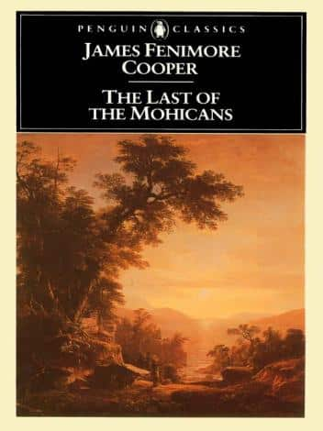
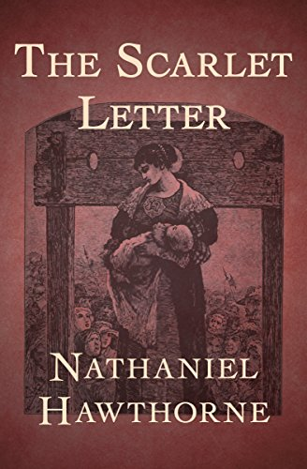
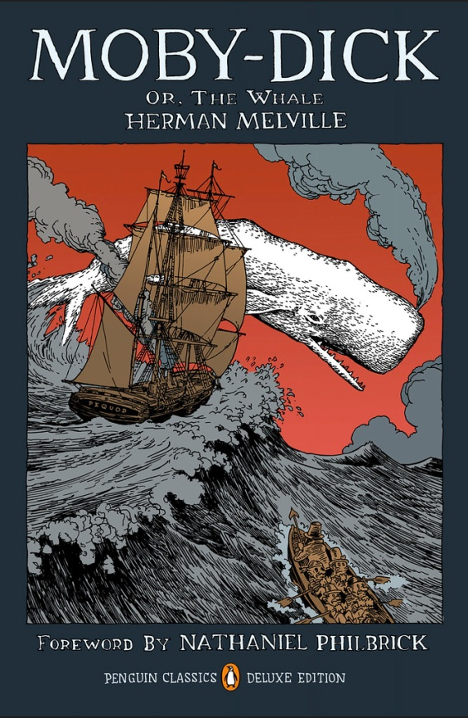

Slide 7
Dark Romanticism
Drawing from the darker elements of human psyche
Humans gravitate to evil and self-destruction (striving for utopian society is waste of time)
Emphasis on human fallibility giving rise to lapses in judgment / punishment
Focusing on psychological effects of guilt and sin

Slide 8
Nathaniel Hawthorne (1804-1864)
Short stories, Novels and (lesser known) Poems which exemplify Dark Romanticism
Contemporary of fellow Transcedentalists, part of prominent circle of Massachusetts writers and philosophers.
Experimented with a broad range of styles and genres
Writing often set in New England and heavily weighted with moral complexity of Puritan background

Slide 9
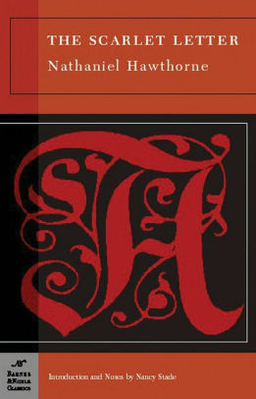
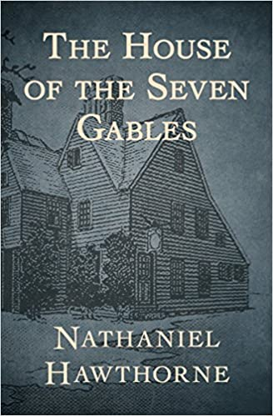
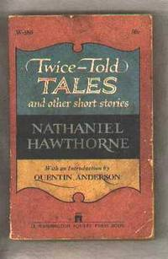
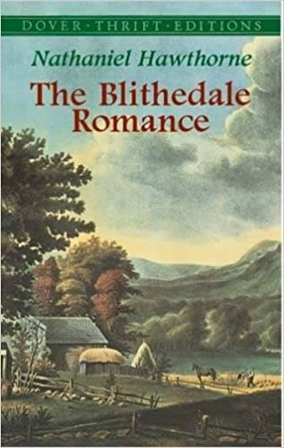
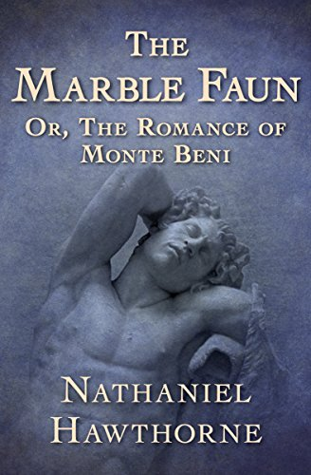
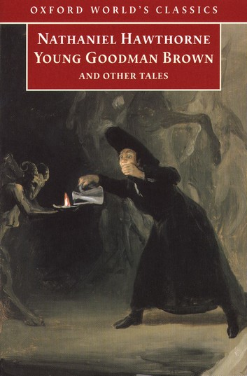

Slide 10
The Minister’s Black Veil (1836)
In Twice-Told Tales
Based on the true story of Reverend Joseph Moody, a Puritan preacher in colonial Maine who wore a black silk handkerchief
Subtitle: “A Parable”
Mystery without a solution, reasons are not important.

Slide 11
Plot
Rising Action: Veil brings out deep-seated horror, everyone in town talks about Hooper but no one dares speak directly to him
Climax: Elizabeth’s visit – “Do not leave me in this miserable obscurity forever!”
Falling Action: Reactions of sorrow and dread settle, “a man apart from men, shunned in their health and joy, but ever summoned to their aid in mortal anguish.” Father Hooper.
Resolution: Father Hooper’s death chamber, everyone has returned to his side. Refuses to lift the veil. Mystery unsolved.

Slide 12
Character – Mr. Hooper
Complex character revealed through:
(a) physical characteristics
(b) writer’s attitude
(c) other characters’ comments and reactions
(d) character’s speech

Slide 13
Symbol – the veil
Hanging between him and the world
Double effect
Obscurity = failure to communicate
Symbolic meaning revealed:
through parishioner’s reactions
through Hooper’s own words

Slide 14
In Context
How does “The Minister’s Black Veil” relate to the Puritans?
How does the story reflect the characteristics of the literary period?

Slide 15
Gothic Fiction
Medieval style of art and architecture that emerged in Northern Europe in the 1640s and, by the 19th c, became a literary style that used medieval settings to suggest mystery and horror.
Takes Dark Romanticism further: horror, terror, death, the supernatural, heroines in distress.

Slide 16
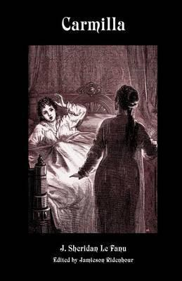
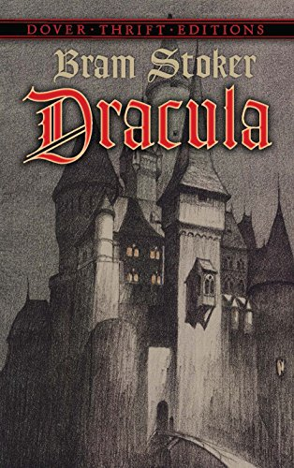
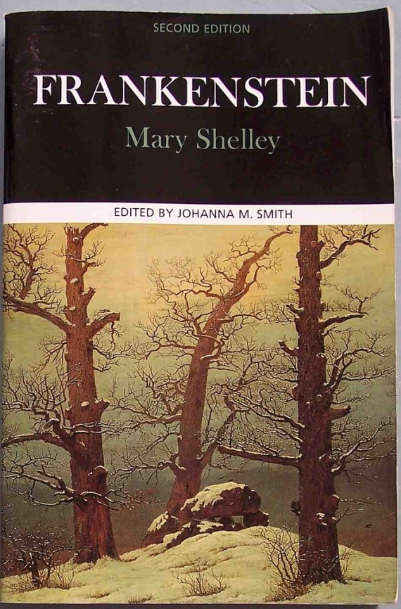
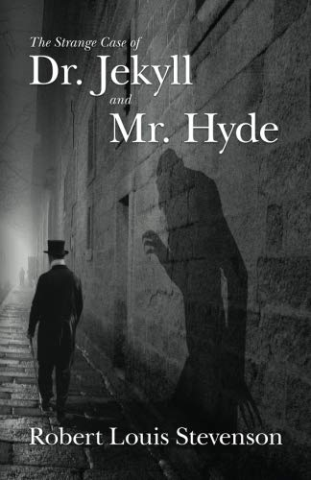

Slide 17
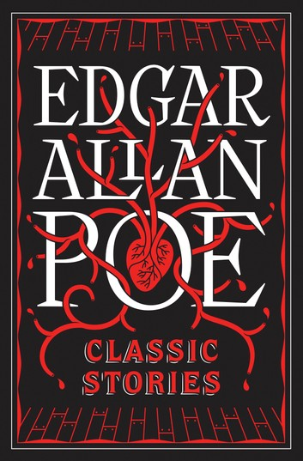
American Gothic
Exploring cultural anxieties and fears of an expanding nation
Rational vs Irrational
Individualism (self-made individual and free will)
True womanhood
Puritanism – guilt
Caves and dark basements (instead of castles and dungeons)

Slide 18
Edgar Allan Poe (1809 – 1849)
Poet, short story writer, editor, literary critic
Invented detective fiction
Articulated conventions of the short story, making it America’s most identifiable homegrown genre.
Made American Gothic distinctive from European by emphasizing on psychological aspect: "What you mistake for madness is but over-acuteness of the senses." (Tell-Tale Heart)

Slide 19
Poe and the human psyche
Characters and settings removed from larger social, religious, moral whole - placed outside frame of community (҂ Hawthorne)
Human beings cannot change or improve
There is no fixed moral sense – there is no knowing why one chooses Good or Evil
Perversity: the overwhelming tendency to do wrong for wrong’s sake (primitive impulse)
Human beings are tripartite: body, mind, spirit

Slide 20
“The Fall of the House of Usher” (1839)
Opening paragraph: Gothic mood and tone
Exemplifies Poe’s principle of short story composition = creating single, unified effect: FEAR
Unity of design and atmosphere rather than plot
Dislocation, Disintegration, the Dual Self

Slide 21
Plot

Slide 22
Characters
Narrator
Roderick Usher
Madeline Usher
?

Slide 23
The House of Usher
Both the actual structure and the family
A humanized description
Signals the decay of the Usher family

Slide 24
Doppelgänger
“German word meaning “look-alike,” or “double walker,” originally referred to a ghost, or shadow of a person; In literature, a doppelganger is usually shaped as a twin, shadow, or a mirror-image of a protagonist. In literature, It may be used to show the “other self” of a character, which he or she has not discovered yet. This “other self” could be the darker side of the character that troubles, or the brighter side that motivates. Hence, the use of doppelganger helps writers to portray complex characters. Moreover, doppelganger gives rise to a conflict in a story. The doppelganger acts in a way that promises dire consequences for the main character, who puts in efforts to undo the actions of his double. Sometimes, the conflict is an inner one, where a character tries to understand himself by understanding his doppelganger. (www.literarydevices.net)
Roderick and Madeline Usher
Doubles in the Story
House of Usher
House image doubling in lake (opening scene)

Slide 25
Other Narrative Elements
Foreshadowing
Poem
Inverted image of house in tarn
Roderick’s painting
Symbols
Eyes
Crack

