Slide 1
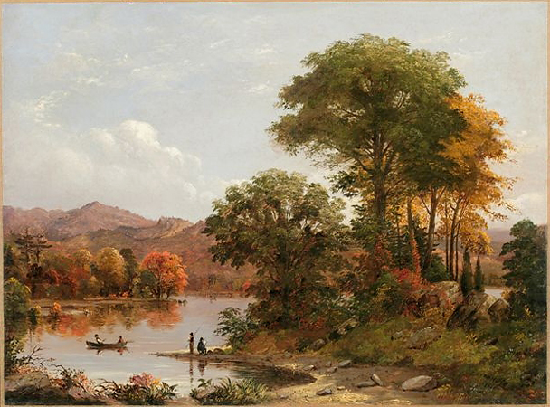
American Transcedentalism
Ralph Waldo Emerson (1803- 1882)
Henry David Thoreau (1817-1862)

Slide 2
Periodisation
The Colonial Period (1500-1830)
The Post-Revolutionary Period of Romanticism and Transcedentalism leading almost up to the end of the 19th century.
Realism and Naturalism (1870-1910)
The Modernist period spanning roughly from the pre-WWI (turn of the century) years through to the interwar period and leading up to WWII
The Post-war / contemporary period.

Slide 3
For all men live by truth, and stand in need of expression. In love, in art, in avarice, in politics, in labor, in games, we study to utter our painful secret. The man is only half himself, the other half is his expression…
R.W. Emerson, The Poet, 1844

Slide 4
American Transcedentalism
A literary, intellectual and social movement advocating spiritual ideals that “transcend” the physical world. It asserts that God is realized by means of intuition and through nature, rather than through books or doctrines of any established religion.
Spirituality, ethics and politics meet in the pursuit of social reform.

Slide 5
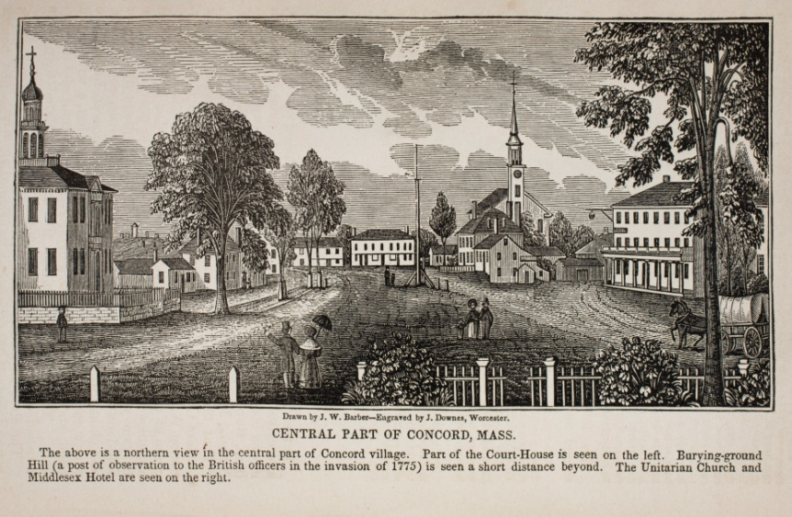
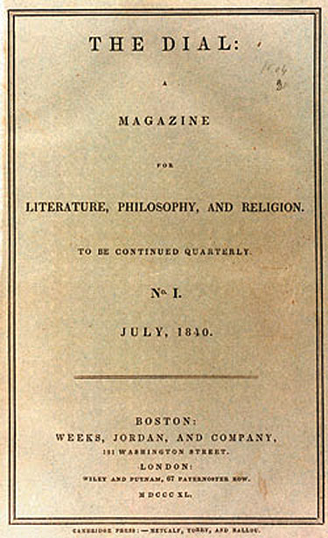
The Transcedental Club
Loosely organized in 1836, in Concorde, Massachusetts
Inspiration from:
  Vedic philosophy in India
  German Idealism
  English Romanticism
  The American Landscape
Liberality and breadth of mind as hallmark / different meanings for different individuals

Slide 6
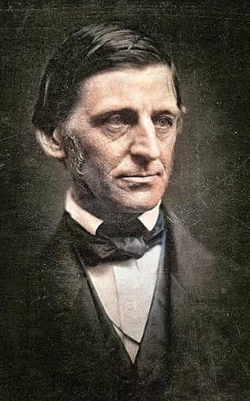
Ralph Waldo Emerson (1803=1882)
Lecturer, essayist, thinker
Started as Unitarian minister
Founder of the Transcedental Club and editor of The Dial journal
Profound inspiration for many writers, incl. Walt Whitman, H.D. Thoreau, Emily Dickinson, Herman Melville, Nathaniel Hawthorne
  It is said that Friedrich Nietzsche never travelled without carrying a volume of Emerson’s essays with him

Slide 7
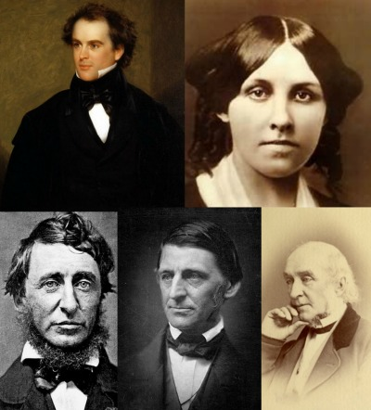
The Concorde Writers
Top Left: Nathaniel Hawthorne. Top Right: Louisa May Alcott. Bottom Left: Henry David Thoreau. Bottom Center: Ralph Waldo Emerson. Bottom Right: William Ellery Channing

Slide 8
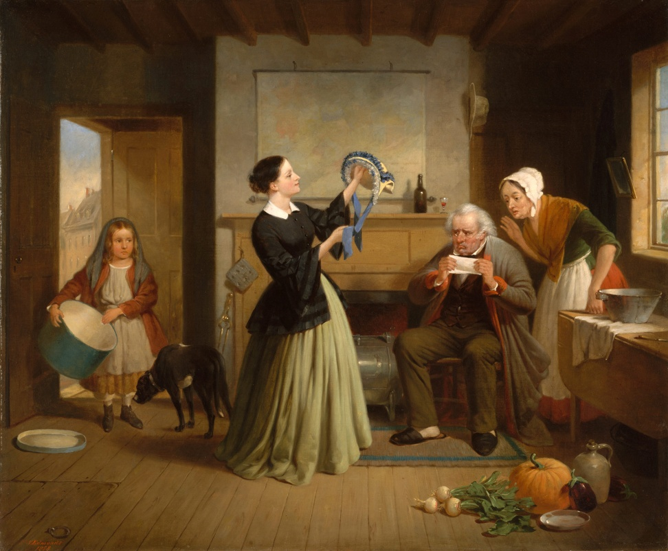
Transcedentalism AS American Romanticism
Rising in reaction to Industrial Revolution, the Age of Reason but also:
  Protestant work ethic,
  Puritan depreciation of writers and the arts,
  Degradation ensued by urban modernization

Slide 9
Emerson – “The American Scholar” (1837)
“Perhaps the time is already come, when it ought to be, and will be, something else; when the sluggard intellect of this continent will look from under its iron lids, and fill the postponed expectation of the world with something better than the exertions of mechanical skill. Our day of dependence, our long apprenticeship to the learning of other lands, draws to a close. The millions, that around us are rushing into life, cannot always be fed on the sere remains of foreign harvests. Events, actions arise, that must be sung, that will sing themselves.”

Slide 10
The American Scholar Key points
“The old fable covers a doctrine ever new and sublime; that there is One Man, ⎯ present to all particular men only partially, or through one faculty; and that you must take the whole society to find the whole man.”
“In this distribution of functions, the scholar is the delegated intellect. In the right state, he is, Man Thinking. In the degenerate state, when the victim of society, he tends to become a mere thinker, or, still worse, the parrot of other men's thinking.”

Slide 11
The American Scholar’s Influences
“The first in time and the first in importance of the influences upon the mind is that of nature… Nature then becomes to him the measure of his attainments. So much of nature as he is ignorant of, so much of his own mind does he not yet possess.”
“The next great influence into the spirit of the scholar, is, the mind of the Past, ⎯ in whatever form, whether of literature, of art, of institutions, that mind is inscribed. Books are the best type of the influence of the past, and perhaps we shall get at the truth, ⎯ learn the amount of this influence more conveniently, ⎯ by considering their value alone.”
“Action is with the scholar subordinate, but it is essential. Without it, he is not yet man. Without it, thought can never ripen into truth... The preamble of thought, the transition through which it passes from the unconscious to the conscious, is action. Only so much do I know, as I have lived. ”

Slide 12
The American Scholar’s Duties
“They are such as become Man Thinking. They may all be comprised in self-trust. The office of the scholar is to cheer, to raise, and to guide men by showing them facts amidst appearances.”
The scholar must be:
  Free from outside constraints
  Brave enough to withstand public disapproval
  Self-trusting to follow the dictates of his own nature
  Focused on the private life of the single person

Slide 13
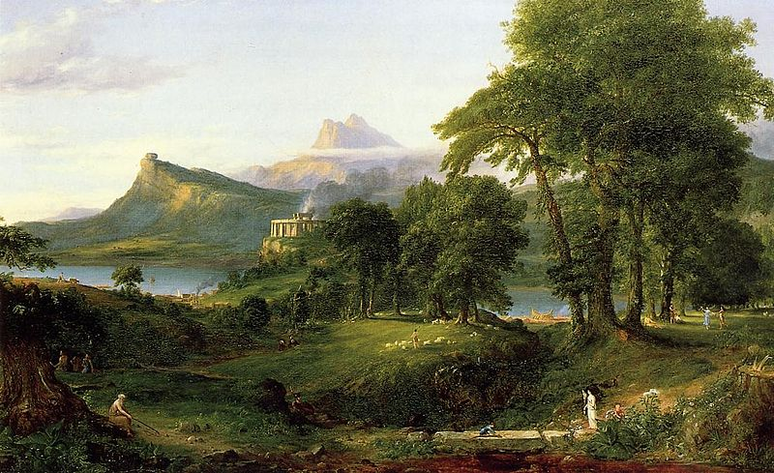
Transcedentalism AS American Romanticism
Emphasis on Imagination, Intuition, Feeling but also Revival of the Pioneer Spirit:
  Self-reliance
  Simple Living / Frugality
  Right of the individual to self-government

Slide 14
Emerson – “Self-Reliance” (1841)
“Trust thyself: every heart vibrates to that iron string.”
“These are the voices which we hear in solitude, but they grow faint and inaudible as we enter into the world. Society everywhere is in conspiracy against the manhood of every one of its members.”
“Whoso would be a man must be a nonconformist. He who would gather immortal palms must not be hindered by the name of goodness, but must explore if it be goodness. Nothing is at last sacred but the integrity of your own mind.”

Slide 15
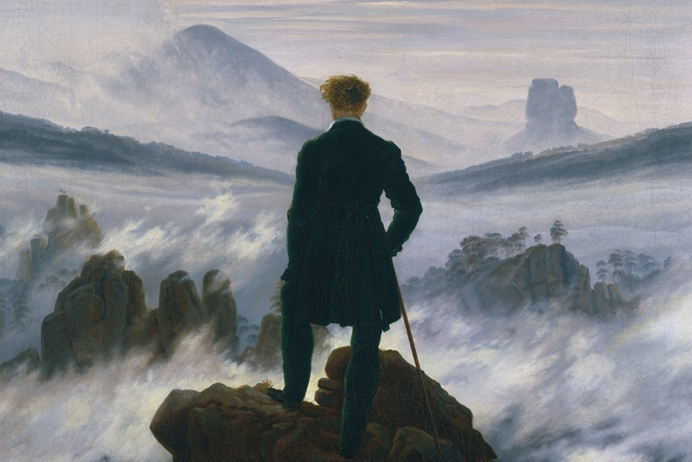
Transcedentalism AS American Romanticism
Individual comes first and is primarily good
Man is inherently good, seeking to create.
Values: individual freedom, self-awareness, conscience
The necessity of non-conformity; individuals are at their best when independent and self-reliant.

Slide 16
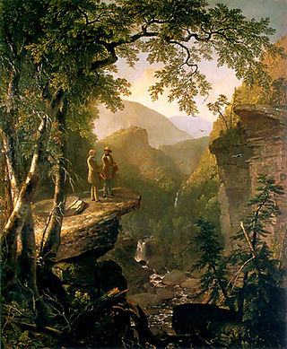
Transcedentalism AS American Romanticism
Love for the beauties of the natural landscape
Nature is to be worshipped
Leads to personal serenity and spiritual growth
One can only find God in and through nature (physical nature and nature as Oversoul)

Slide 17
Emerson – “Over-Soul” (1841)
“that Unity, that Over-soul, within which every man's particular being is contained and made one with all other”
“We live in succession, in division, in parts, in particles. Meantime within man is the soul of the whole; the wise silence; the universal beauty, to which every part and particle is equally related; the eternal ONE”

Slide 18
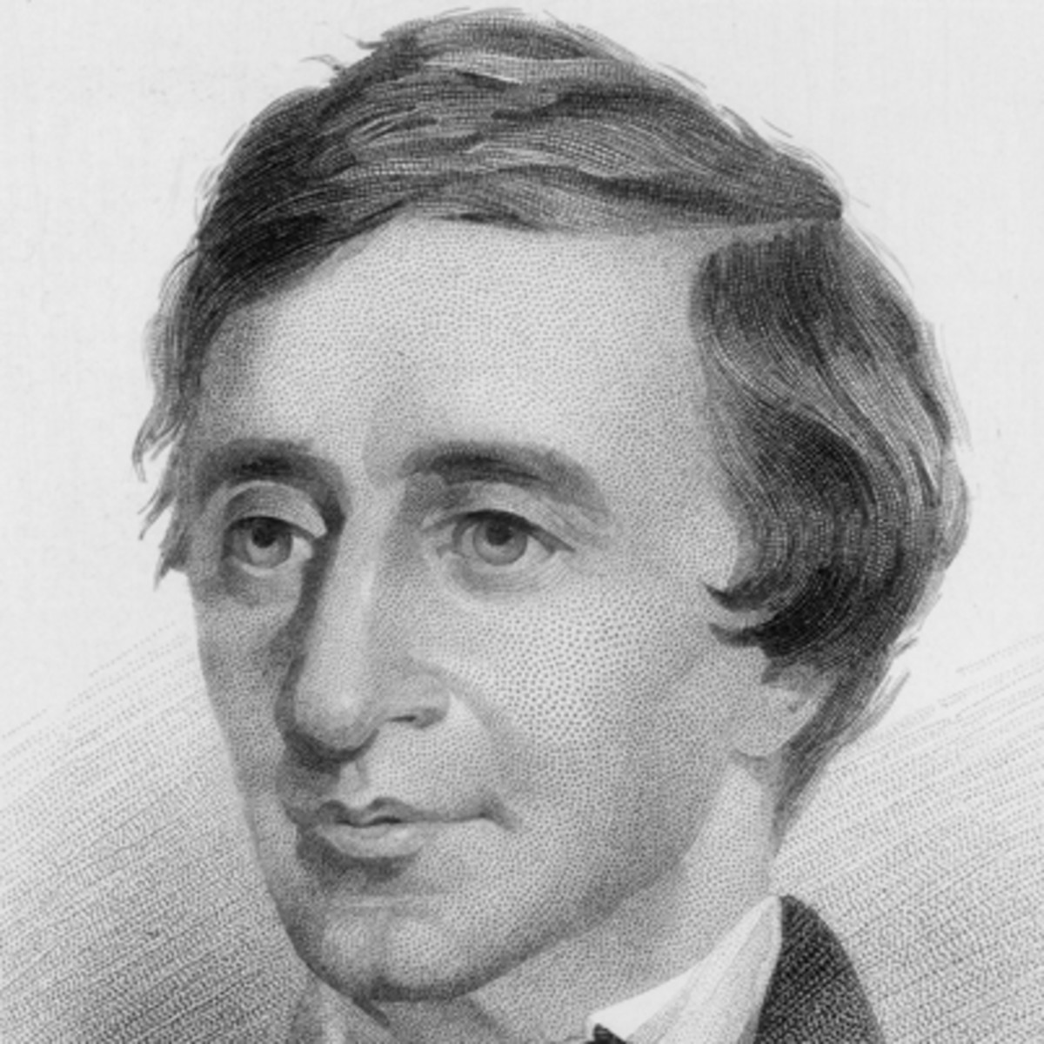
Henry David Thoreau (1817-1862)
Orator, essayist, thinker, abolitionist, poet of nature
Student and friend of W. Emerson
July 4th 1845 moved to small self-built hut around the shores of Walden pond for two years.
Spent a day in prison for refusing to pay poll tax
Spent final years of his life preparing journals for publication

Slide 19
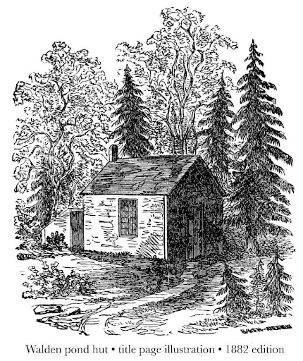
“Walden” (1854)
Questions of provenance, questions of genre
Chapters focused on scenery observation, a single activity, description of a location
  Each adding to his understanding of the natural world
“Why should we live with such hurry and waste of life?”

Slide 20
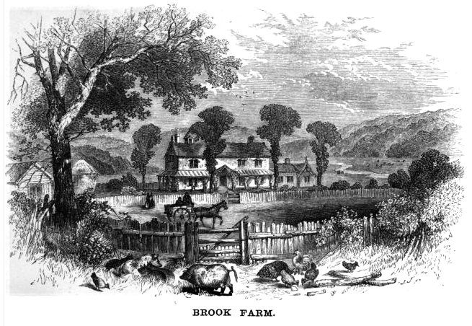
“Walden” = an exercise in solitude
Transcedentalism – Individualistic in character

Slide 21
“Resistance to Civil Government”/
“On Civil Disobedience” (1849)
‘The government is best which governs least’
‘This American government … how successfully men can be imposed on, even impose on themselves, for their own advantage.’
  imposes taxes/labor for its own advantage
  impedes enterprise and education
  Engages in conflict and war (westward expansion, Mexican-American War)
  substitutes conscience
  Endorses and practices slavery = legal yet unjust and disgraceful
  ‘All men recognize the right of revolution; that is, the right to refuse allegiance to and to resist the government, when its tyranny or inefficiency are great and unendurable.’
  a slave’s government, shameful to obey it
  right and DUTY to revolution (fear, apathy, compliance
  make one part of the problem)
‘I ask for, not at once no government, but at once a better government.’
  Passive Resistance and Civil Disobedience as a means of withdrawing support from the Government
  no taxes given = disabling the State from ‘commit[ting] violence and shed[ding] innocent blood
  Accepting repercussions - freedom, obedience to a Higher Law
‘There will never be a really free and enlightened State, until the State comes to recognize the individual as a higher and independent power, from which all its own power and authority are derived, and treats him accordingly.’

Slide 22
