Slide 1
HERMAN MELVILLE Bartleby, the Scrivener A Story of Wall Street
American Fiction
Spring 2020

Slide 2
Periodisation
The Colonial Period (1500-1830)
The Post-Revolutionary Period of Romanticism and Transcedentalism leading almost up to the end of the 19th century.
Realism and Naturalism (1870-1910)
The Modernist period spanning roughly from the pre-WWI (turn of the century) years through to the interwar period and leading up to WWII
The Post-war / contemporary period.

Slide 3
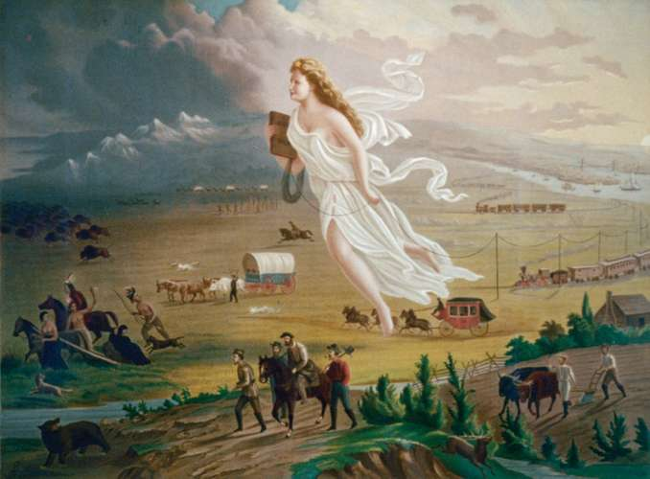
American Renaissance
Development of ‘American’ culture/identity which influenced literature
Valuing feeling and intuition over reason
Placing faith in inner experience and imagination
The worth of the individual
We will walk with our own feet
We will work with our own hands
We will speak our own minds
Ralph Waldo Emerson

Slide 4
Herman Melville (1819 – 1891)
Born into a socially connected New York family
Sailed on whalers to the South Seas and described his travels in writing
Bitterly aware of hustling, aggressive civilization endangering idyllic sanctuaries and debasing native peoples
Heavily influenced by Nathaniel Hawthorne / attracted by his tragic vision and “power of blackness”
Stories reflecting an increasing despair and contempt for human hypocrisy and materialism
Melville more interested in how we see rather than what we see
Abandoned novel in favor of poetry-return to prose culminated in Billy Budd.

Slide 5
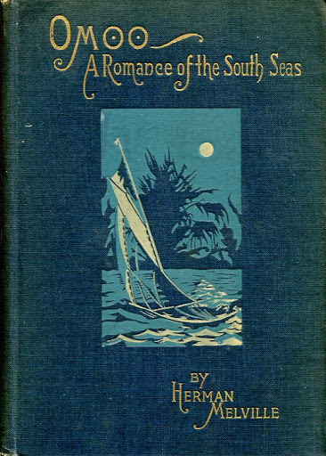
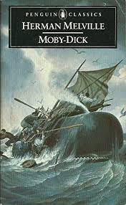
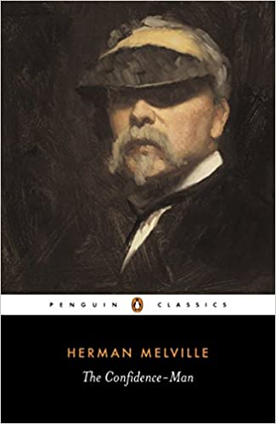
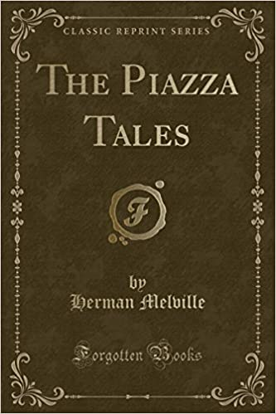
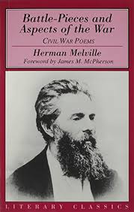
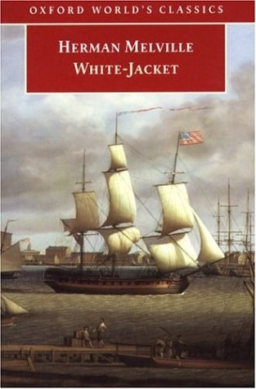

Slide 6
Bartleby, The Scrivener
First published in two parts in 1853 in Putnam’s Magazine, and then as one of the stories in Melville’s collection The Piazza Tales (1856)
A static story; the action is a function of intellectual motion
Two parts
“A Story of Wall Street”

Slide 7
New York, 1853

Slide 8
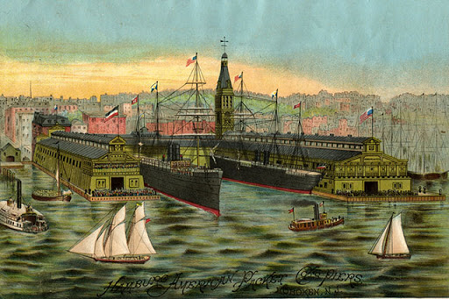
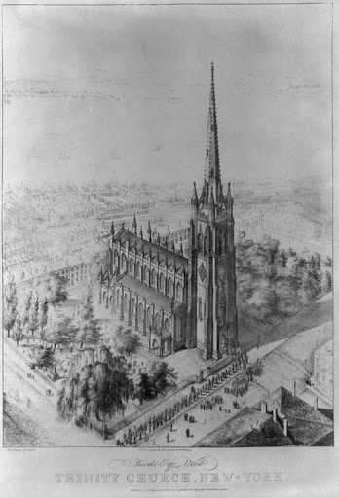
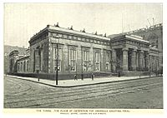
New York References
http://www.loyolanotredamelib.org/en203/melville-bartleby

Slide 9
Setting: The Office
“At one end they looked upon the white wall of the interior of a spacious sky-light shaft, penetrating the building from top to bottom. … the view from the other end of my chambers … my windows commanded an unobstructed view of a lofty brick wall, black by age and everlasting shade; which wall required no spy-glass to bring out its lurking beauties, but for the benefit of all near-sighted spectators, was pushed up to within ten feet of my window panes.”

Slide 10
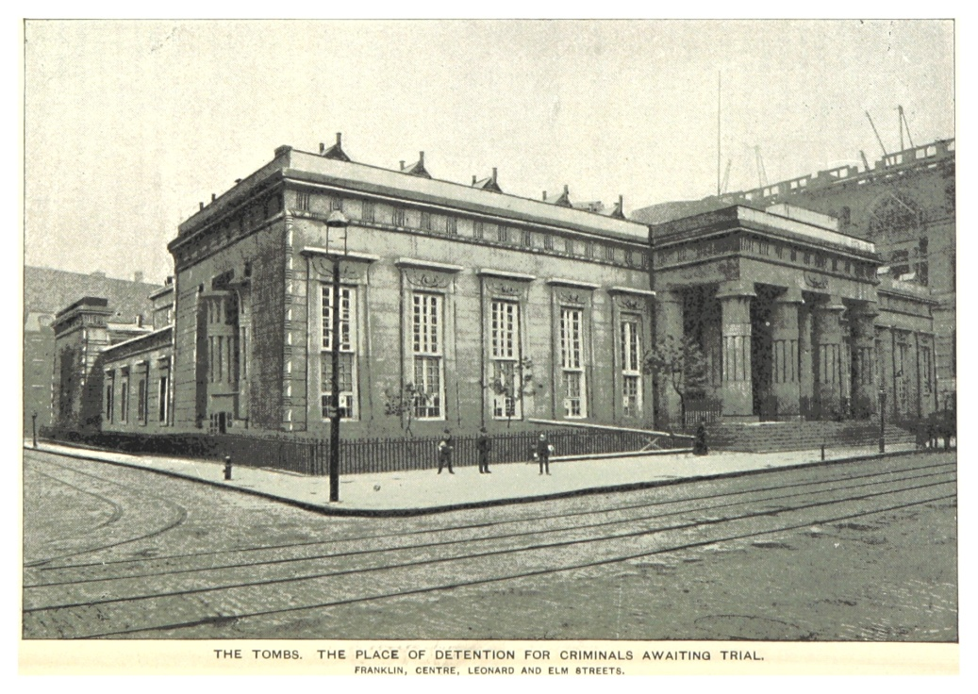
Setting: The Prison
“The yard was entirely quiet. It was not accessible to the common prisoners. The surrounding walls, of amazing thickness, kept off all sounds behind them. The Egyptian character of the masonry weighed upon me with its gloom. […] Strangely huddled at the base of the wall, his knees drawn up, and lying on his side, his head touching cold stones, I saw the wasted Bartleby.”

Slide 11
Characters: The Narrator
What do we know about the narrator? What information does he intentionally reveal about himself and what do we infer? How reliable a narrator is he?
For what reasons does he want to help Bartleby and how? What finally motivates him to “do something” about Bartleby?
Round Character
Detached,
Non-confrontational,
Prudent and unambitious
Level-headed, industrious
Increasing emotional
and moral entanglement

Slide 12
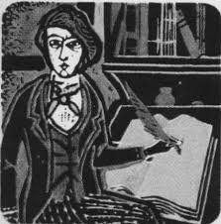
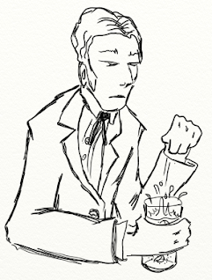
Turkey/Nippers as doubles
Characters: Three Clerks
Turkey: reasonably productive before noon, disruptive and sloppy after lunch – “blazed like a grate full of Christmas coals.”
Nippers: “I always deemed him the victim of two evil powers—ambition and indigestion.”
Ginger Nut: “student at law, errand boy and cleaner and sweeper.”

Slide 13
Metaphor: eating and digestion
“At first, Bartleby did an extraordinary quantity of writing. As if long famishing for something to copy, he seemed to gorge himself on my documents. There was no pause for digestion.”
"My mind then ran on in reveries concerning the probable effects upon the human constitution of living entirely on ginger-nuts what was ginger? A hot, spicy thing. Was Bartleby hot and spicy? Not at all. Ginger, then, had no effect upon Bartleby. Probably he preferred it should have none."

Slide 14
Characters: Bartleby
“In answer to my advertisement, a motionless young man one morning, stood upon my office threshold, the door being open, for it was summer. I can see that figure now- pallidly neat, pitiably respectable, incurably forlorn! It was Bartleby.”

Slide 15
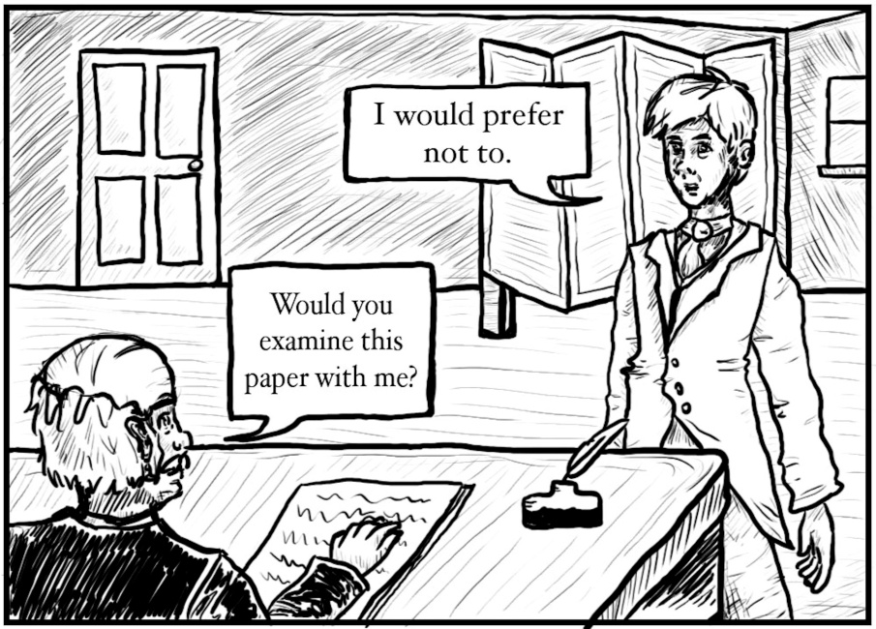
Characters: Bartleby
How much do we know about Bartleby?
Physical appearance – foreshadowing?
Motionless, doesn’t like change.
“I would prefer not to.”
“You will not?”
“I prefer not.”
Gilles Deleuze, “the formula”
Passive Resistance
Bartleby’s refusal to accept authority does not free him, it results in his death. His passive resistance affirms the control that society has over him.

Slide 16
Symbols: Death
Bartleby consistently associated with Death
“cadaverous”
Dead Letters
ending

Slide 17
Symbols: The Wall
Leitmotif pointing to Isolation / Separation
Five different walls (physical walls and psychological walls)
Bartleby withdraws to “dead-wall reveries”

Slide 18
Themes
Isolation
Physical and mental loneliness
Rebellion and Rejection (passive resistance)
Choices and free will
Language and Communication
Responsibility

Slide 19
Bartleby Readings
“Bartleby” as a response to Transcedentalism
Biographical Reading
Existentialist Reading
Psychoanalytic Reading
Marxist Reading
Deconstructionist / Semiotics Reading
Christianity
How does ‘Bartleby’ offer a fine example of Dark Romanticism?

Slide 20
