Slide 1
REALISM
Henry James – The Aspern Papers
American Fiction
Spring 2020

Slide 2
Periodisation
The Colonial Period (1500-1830)
The Post-Revolutionary Period of Romanticism and Transcedentalism leading almost up to the end of the 19th century.
Realism and Naturalism (1870-1910)
The Modernist period spanning roughly from the pre-WWI (turn of the century) years through to the interwar period and leading up to WWII
The Post-war / contemporary period.

Slide 3
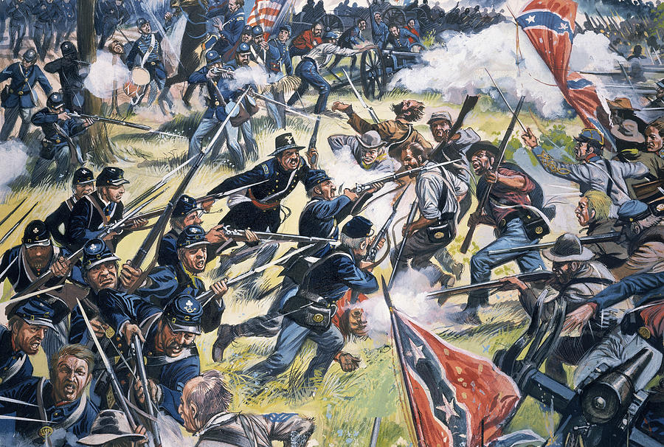
1859: Charles Darwin, On the Origin of the Species
1862: Henry David Thoreau dies
1864: Nathaniel Hawthorne dies
1861: American Civil War
“Let fiction cease to lie about life … let it portray men and women as they are, actuated by the motives and the passions in the measure we all know; … let it not put on fine literary airs; let it speak the dialect, the language that most Americans know—the language of unaffected people everywhere.”
William Dean Howels, Criticism and Fiction, 1891.

Slide 4
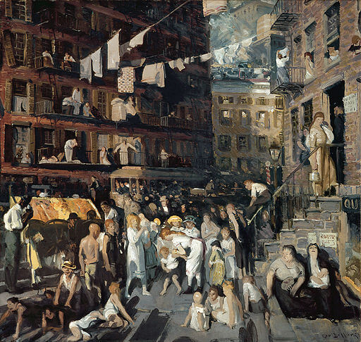
George Bellows, “The Cliff Dwellers”, 1913
Post Civil-War America
American idealism rechanneled: idealizing progress and the self-made man (rather than focusing on human rights-esp. abolition)
The era of the millionaire manufacturer – business boom
The survival of the fittest
Constant influx of immigrants
Problems of urbanization and industrialization: overcrowded housing, poor sanitary conditions, “wage slavery”
America transformed into a huge, modern, industrial nation

Slide 5
REALISM
Attention to detail; an effort to replicate true nature of reality, emphasis on verisimilitude, even at the expense of a well-made plot.
Objectivity in representation becomes increasingly important; The function of the novel is to instruct and entertain – reporting rather than judging, progressively less authorial comments.
Subject matter drawn form real-life experience; emphasis on “the norm of daily experience” – setting is familiar to the author.
Diction: natural vernacular (not poetic), often reflecting particular class or geographical dialect; marriage between literature and journalism
Narrative Style: unreliable narrators
“Where Romanticists transcend the immediate to find the ideal … realists center their attention to a remarkable degree on the immediate, the here and now, the specific action, and the verifiable consequence.”
William Harmon and Hugh Holman, A Handbook to Literature

Slide 6
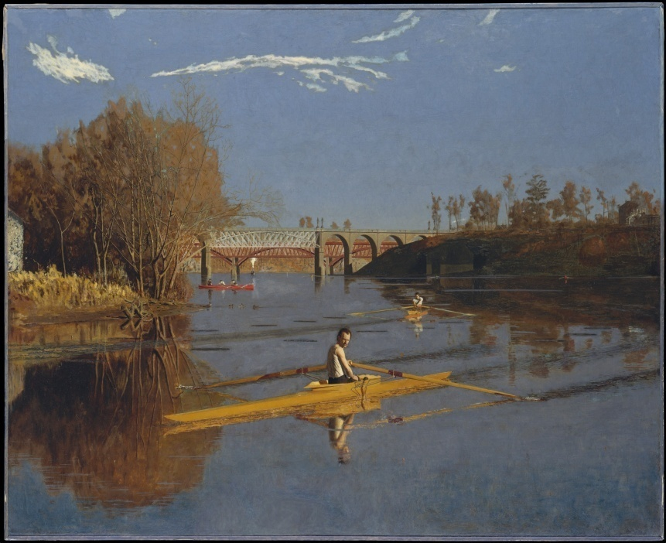
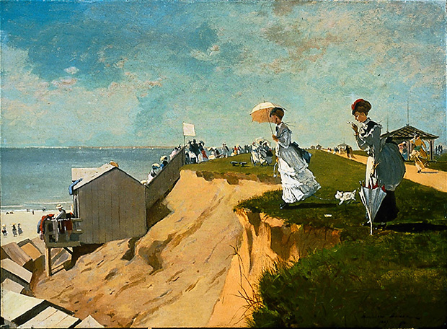
REALISM
Character more important than action and plot:
complexity of temperament and motive, conflicting impulses
ethical choices and internal struggles as subject matter
In relation to nature and to each other, to their social class, to their background
Changes in mood, perceptions or opinions constitute climax

Slide 7
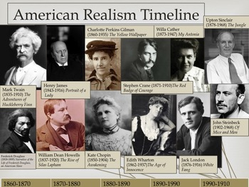

Slide 8
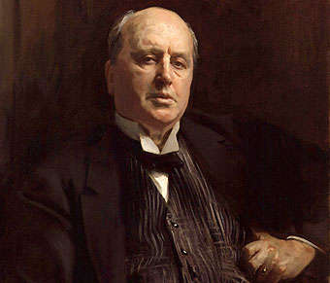
Henry James (1843 – 1916)
American expatriate – became British subject
“International theme” = the complex relationships between naïve Americans and cosmopolitan Europeans
Three periods / phases
American Travel Genre

Slide 9
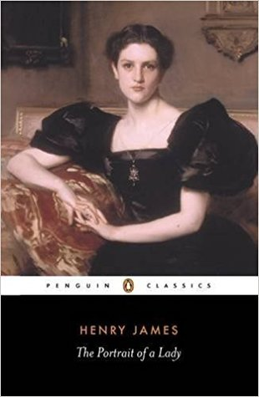
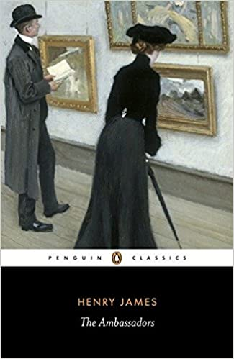
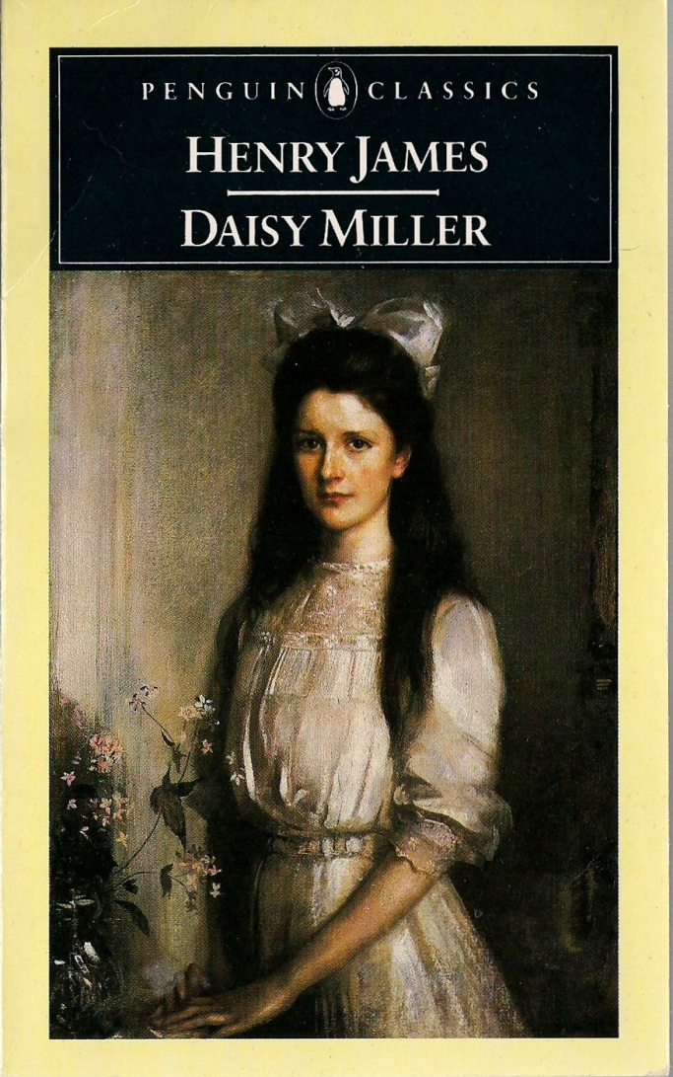
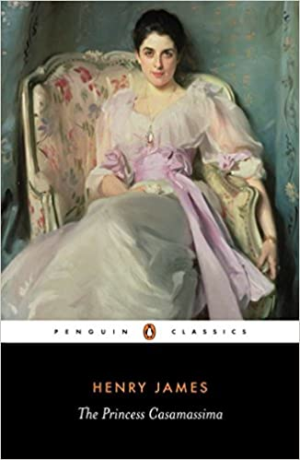
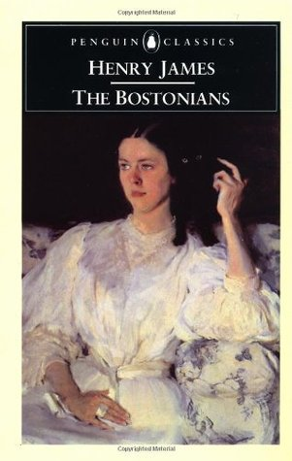

Slide 10
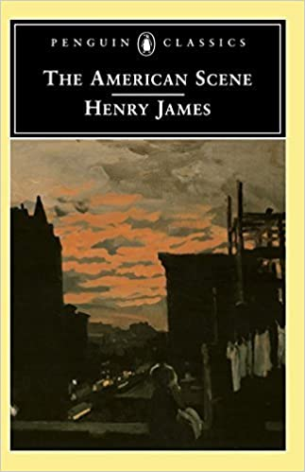
The American Scene (1907)
Travel notes during a lecture tour in the US (1904-1905)
Reversing the traditional theme of American writers discovering the Old World
Returning to places changed beyond recognition / obliterated in the name of progress
Evoking his personal past while criticizing America for undervaluing / destroying reminders of the past

Slide 11
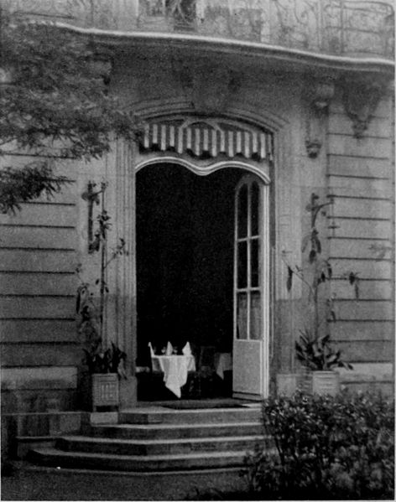
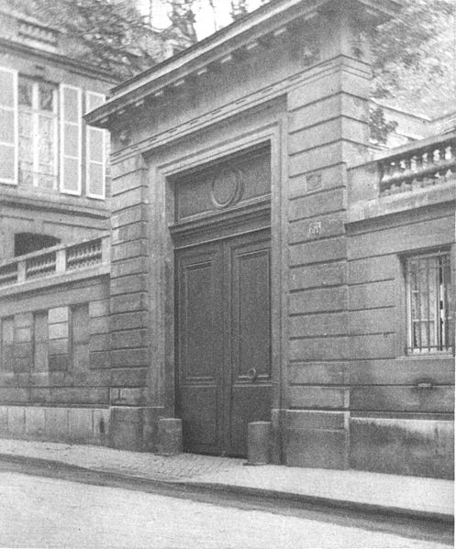
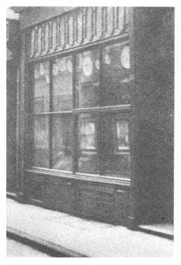
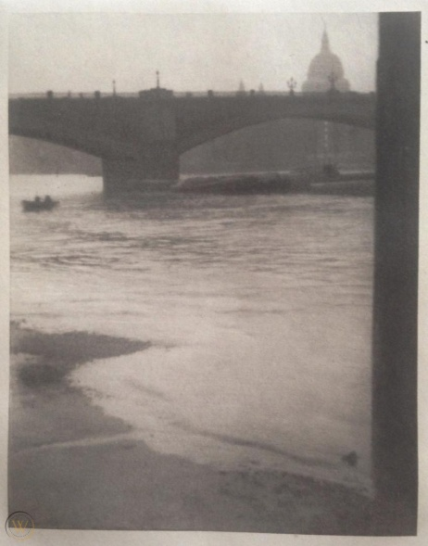
The New York Edition
24-volume collection of James’s works (US and UK, 1907-1909)
Photo-gravure frontispiece for each volume by Alvin Langton Coburn
Prefaces – discussing writing of fiction, exploring origins of his fictions, recounting personal experiences while writing

Slide 12
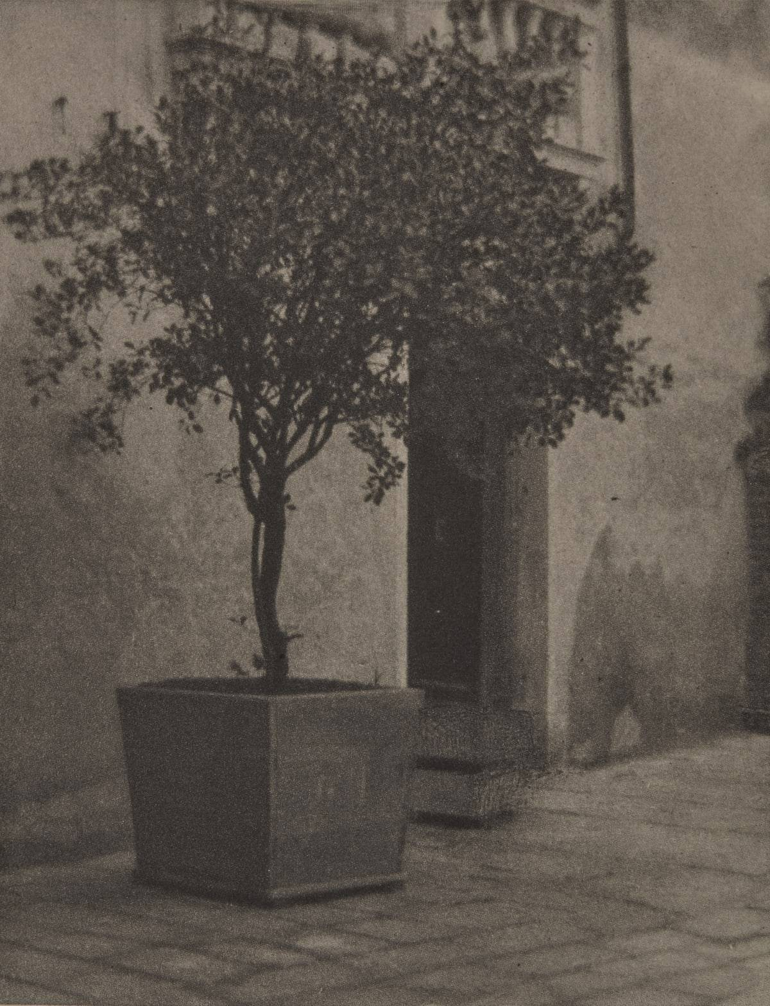
Alvin Langton Coburn, “Juliana’s Court”

Slide 13
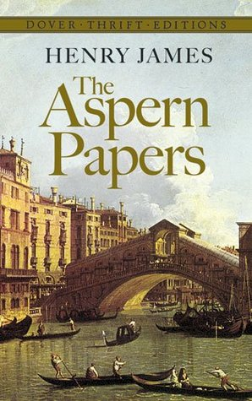
The Aspern Papers (1888)
Inspired by a true story
Inward rather than outward development, narrative moved forward through characters
Double Climax

Slide 14
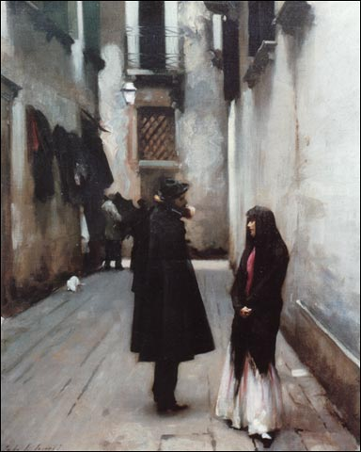
John Singer Sargent,
“Venetian Street, 1880-1882”
Setting:
The Palazzo
The Garden
Venice

Slide 15
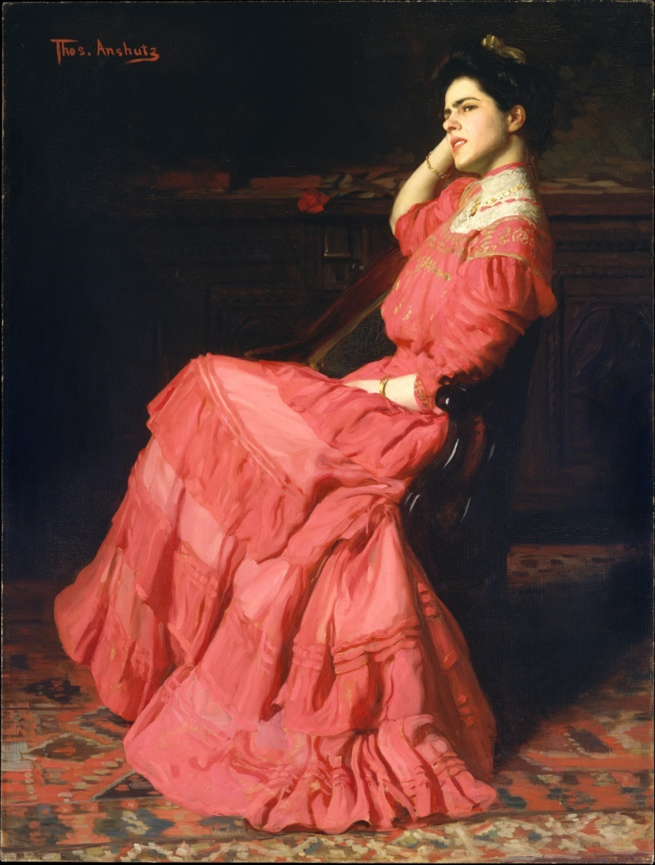
Characters
Narrator (protagonist)
Juliana Bordereau (antagonist)
Miss Tina Bordereau
Mrs Prest / John Cumnor

Slide 16
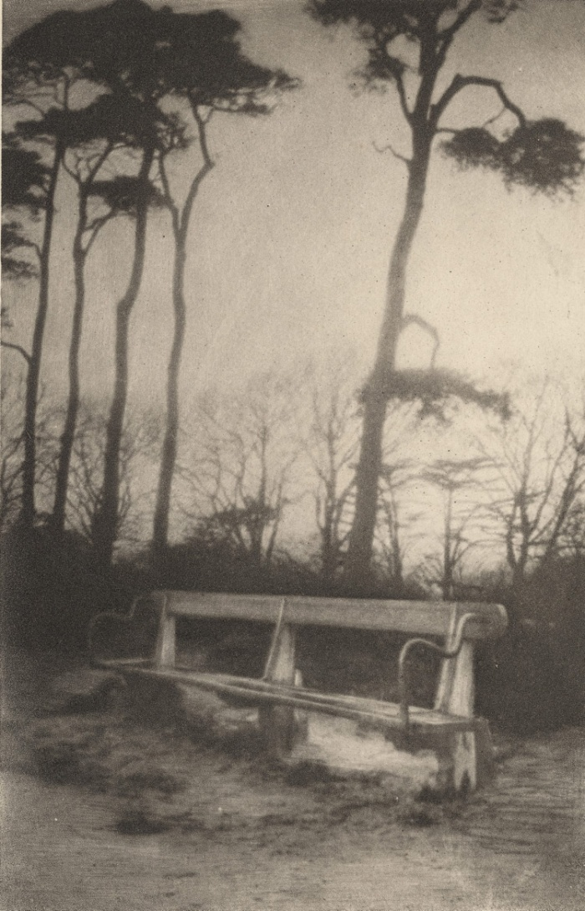
Symbols
The Papers
The Garden vs. Venice
Juliana’s green shade

Slide 17
It was a chance, an instinct, for I had not heard anything. I almost let my luminary drop and certainly I stepped back, straightening myself up at what I saw. Miss Bordereau stood there in her nightdress, in the doorway of her room, watching me; her hands were raised, she had lifted the everlasting curtain that covered half her face, and for the first, the last, the only time I beheld her extraordinary eyes. They glared at me, they made me horribly ashamed. I never shall forget her strange little bent white tottering figure, with its lifted head, her attitude, her expression; neither shall I forget the tone in which as I turned, looking at her, she hissed out passionately, furiously: ‘Ah, you publishing scoundrel!’

Slide 18
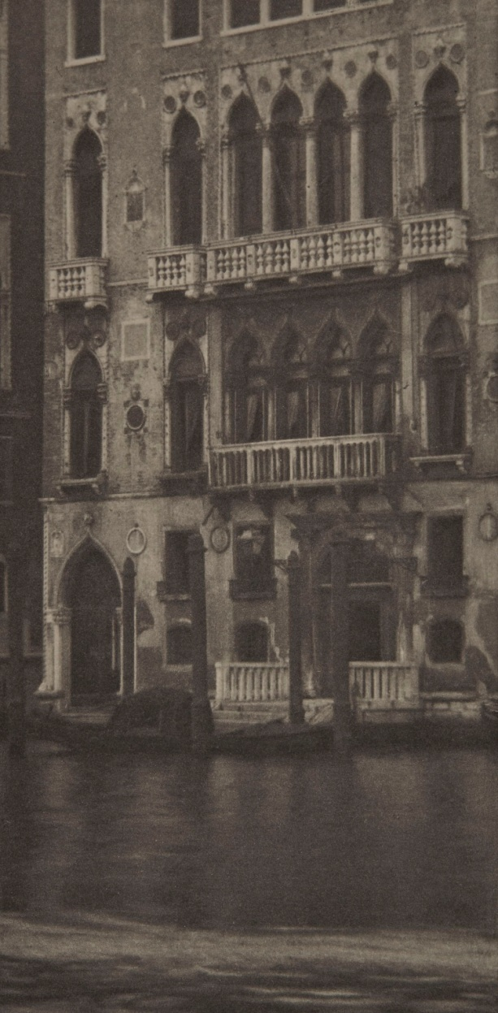
Themes
Obsession (price of)
The Protégé vs. The Master
Vision and Blindness
Loneliness / Solitude
Invasion of Privacy / The Ethics of Literary Biography

Slide 19
“I scrutinized every article of furniture, every conceivable cover for a hoard, and noticed that there were half a dozen things with drawers, and in particular a tall old secretary, with brass ornaments of the style of the Empire—a receptacle somewhat rickety but still capable of keeping a great many secrets.”

Slide 20
