Slide 1
Women’s Writing -
First Feminist Wave
Charlotte Perkins Gilman
& Kate Chopin

Slide 2
First–Wave Feminism (~1848 – 1920)
suffrage, legal rights (property and voting)
Margaret Fuller, Woman in the Nineteenth Century (1843/45)
Charlotte Perkins Gilman - essays
Notable connection to the slavery abolition movement, yet essentially “white feminism”
Second Feminist Wave (~1960s –early 1980s)
critiquing patriarchal, male-dominated social structures and cultural practices (family, workplace, reproduction)
Betty Friedan, The Feminine Mystique (1963)
Gloria Steinem
Engagement in politics, legal victories (e.g. Equal Pay Act)
Third-Wave Feminism (~ early 1990s … ?)
fighting against workplace sexual harassment, working to increase number of women in positions of power
Judith Butler, Kimberlé Crenshaw (intersectionality)
Riot Grrrl movement

Slide 3
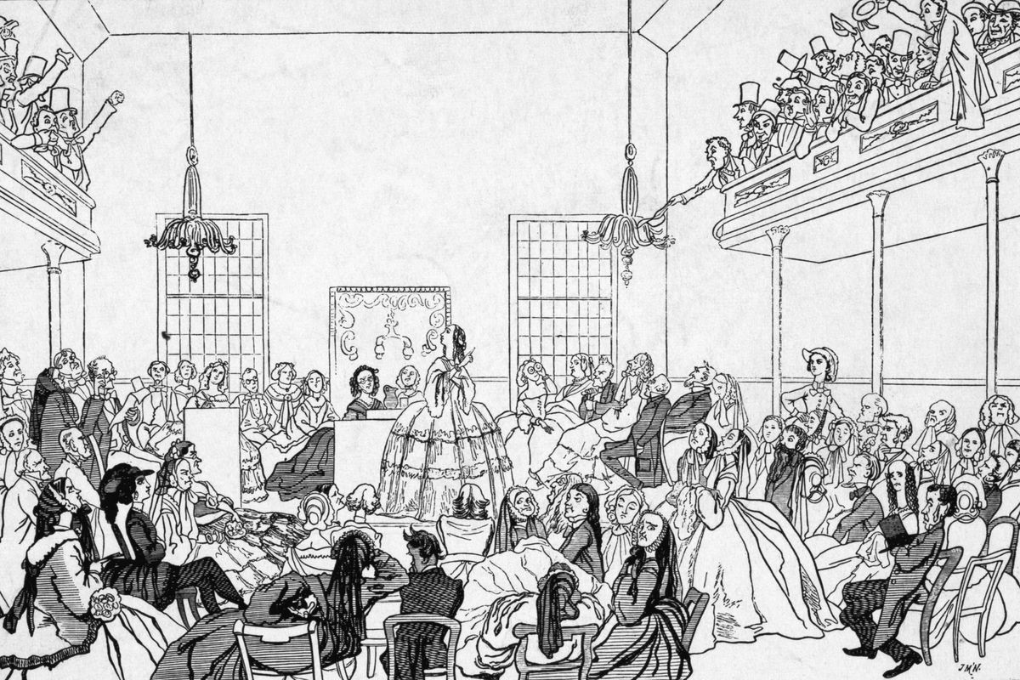
Women in late 18th – early 19th c
No civil status under the law
Education = embroidery, china painting, French
Role = “instruments of spiritual and moral refinement, existing to ennoble and spiritualize men” (E. Showalter) – confined in the domestic sphere
Freedom of slaves = freedom of women

Slide 4
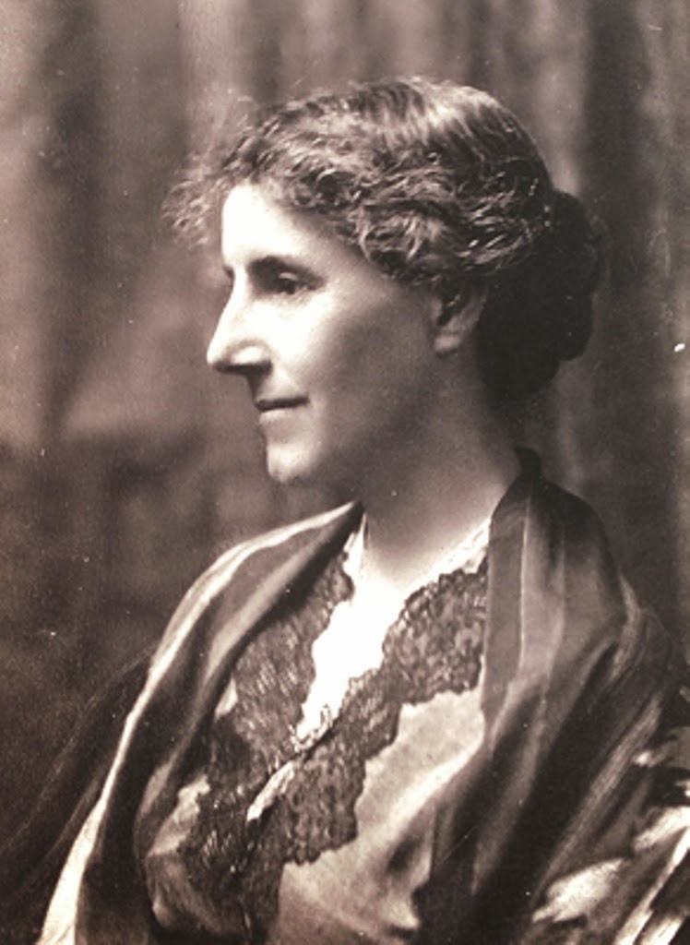
Charlotte Perkins Gilman(1860 – 1935)
Feminist, socialist, humanist, lecturer, essayist, novelist, caricaturist, publisher
Women and Economics, 1898
(women’s economic dependency on men stunts not only the growth of women but the whole human species)
Proposed re-definition and re-structuring of domestic and child-care chores
The Man-Made World (1911); His Religion and Hers (1923)
“preferred chloroform to cancer”

Slide 5
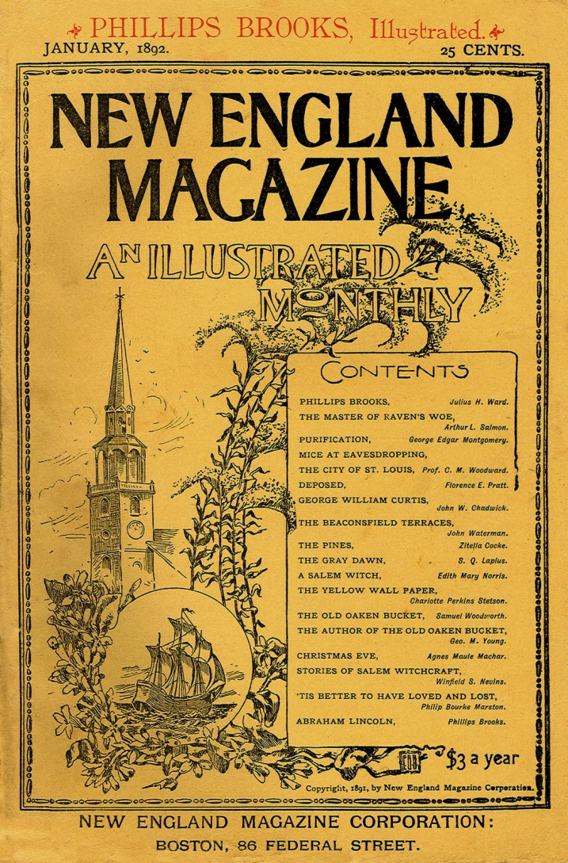
The Yellow Wallpaper
Reflection on the writer’s life
Illustration of 19th c attitudes towards women’s mental and physical health
Collection of journal entries written by a woman in rest cure – recuperating from a “slight hysterical tendency”
Despite Gilman's widely known credentials as a feminist thinker, author, and speaker of her day, "The Yellow Wallpaper" was not approached as a feminist work until the 1970s.

Slide 6
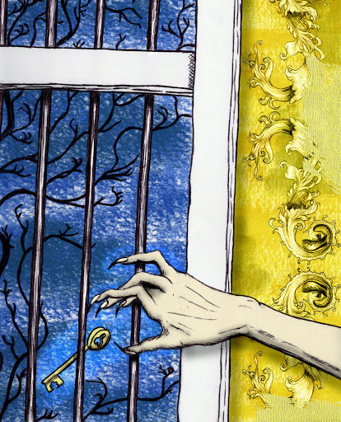
Female Gothic
Setting: ancestral colonial, “haunted” mansion
Themes: confinement, oppression, madness and disjuncture
Male antagonist
Fear and the uncanny (“bulbous eyes”; “absurd unblinking eyes … everywhere”)
Transformation: from writer to wife to mother to ‘invalid’ to ‘lunatic’ to creeping woman
The moon

Slide 8
Authentic Realism (1970s)
Critical approach that emphasizes on exchange between writer, text and reader – the experiential nature of literature.
Reading strategy – transformative: relating to women’s experiences and female consciousness-rising and possibly creating alternative models of living.

Slide 9
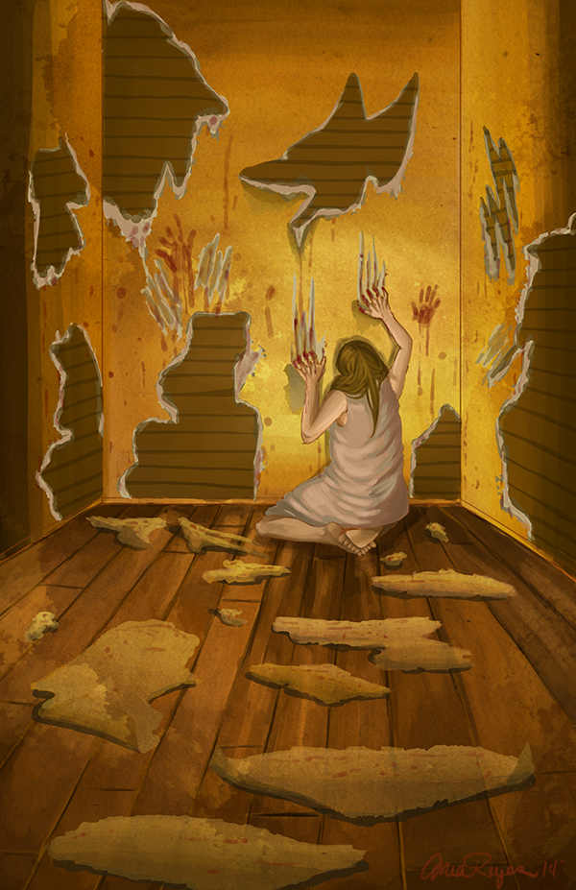
Narrative Voice
First person narrator – unreliable – WHY?
Epistolary style – journal
Fragmented; short paragraphs and dashes mimicking shifts in thought; inner monologue
Split voice = carrying the conflict between the male, patriarchal line and the female, complex description (imagination)
Artistic consciousness: “I know the principles of design”

Slide 10
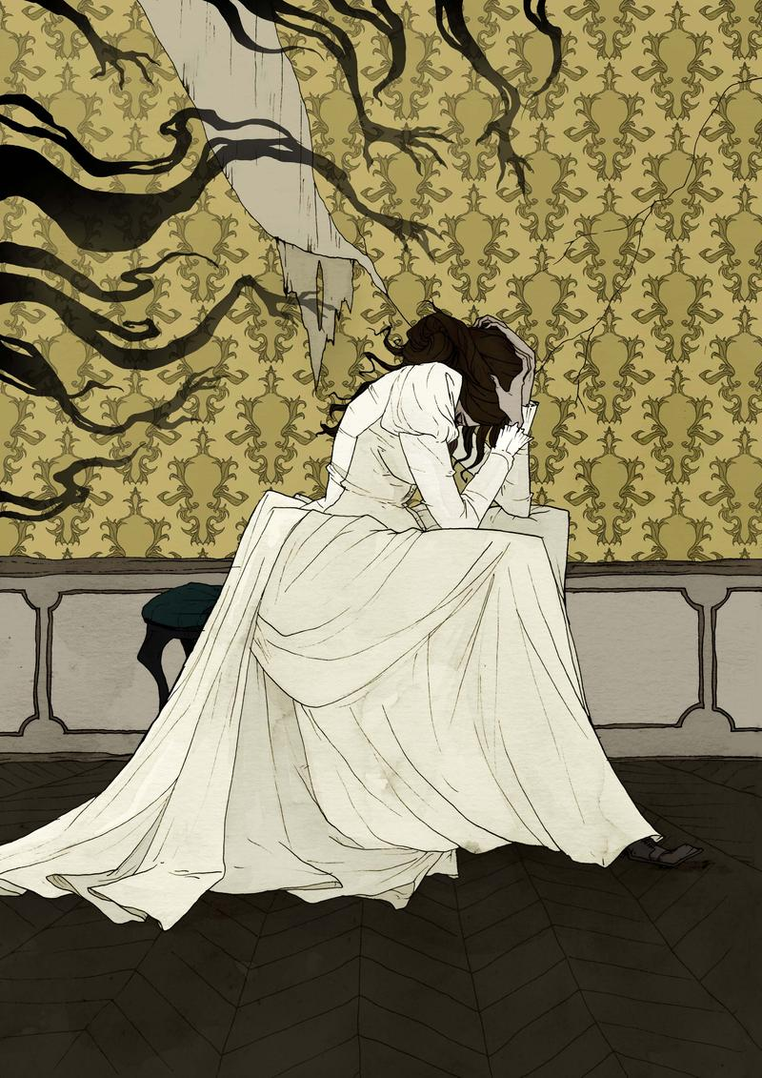
Is the narrator mad?
Imagination rather than hallucination
Artistic consciousness
Paradox (?): while the narrator’s perception of the wallpaper reflects an increasing madness, the deeper she looks the better she feels.
“I never saw so much expression in an inanimate thing before, and we all know how much expression they have! I used to lie awake as a child and get more entertainment and terror out of blank walls and plain furniture than most children could find in a toy-store.
I remember what a kindly wink the knobs of our big, old bureau used to have, and there was one chair that always seemed like a strong friend.”

Slide 11
The Wallpaper
“The paint and paper look as if a boys’ school had used it. It is stripped off—the paper in great patches all around the head of my bed … I never saw a worse paper in my life.
One of those sprawling flamboyant patterns committing every artistic sin.
It is dull enough to confuse the eye in following, pronounced enough to constantly irritate and provoke study, and when you follow the lame uncertain curves for a little distance they suddenly commit suicide—plunge off at outrageous angles, destroy themselves in unheard of contradictions.
The color is repellent, almost revolting; a smouldering unclean yellow, strangely faded by the slow-turning sunlight.
It is a dull yet lurid orange in some places, a sickly sulphur tint in others.”
“I know a little of the principle of design and I know this thing was not arranged on any laws of radiation, or alternation, or repetition, or symmetry, or anything else that I ever heard of.”

Slide 12
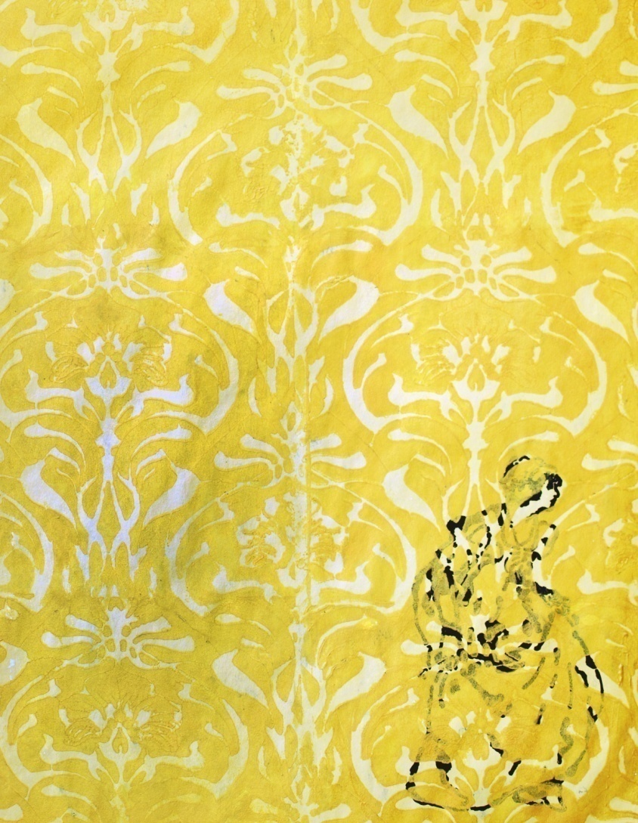
The Wallpaper
Symbol: the woman in her traditional , domestic role
Pattern: containment, imprisonment, women in the background
Colour: Sickness, Age and deterioration, Dullness ≠ Brightness of the yellow sun (“old foul, bad yellow things”)
Language: (male) words / rational discourse vs. (female) patterns and design / imagination and creativity
Representing escape from social (oppressive) norms

Slide 13
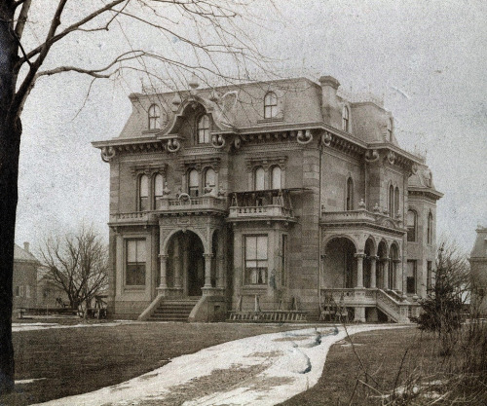
The House (superimposed views)
“A colonial mansion, a hereditary estate, I would say a haunted house…there is something queer about it.”
“a big, airy room … it was nursery first and then playroom and gymnasium. I should judge, for the windows are barred for little children, and there are rings and things in the walls.” “The floor is scratched and gouged and splintered, the plaster itself is dug out here and there.”
“This great heavy bed which is all we found in the room, looks as if it had been through the wars … I lie here on the great immovable bed—it is nailed down, I believe.”

Slide 14
Other Formal Elements
Characters: John, Jennie, Mary (nanny)
Doppelgänger
Imagery: Wallpaper
Delicious garden
“yellow smell”
Irony: Verbal (“John laughs at me, of course, but one expects that in marriage.” )
Dramatic/of situation (the room)
Diction: “a woman stooping down and creeping about”
“[the smell] creeps all over the house. I find it hovering in the dining room, skulking in the parlor, hiding in the hall, lying in wait for me on the stairs.”
“[the woman] crawls around fast
Repetitions (creeping)

Slide 15
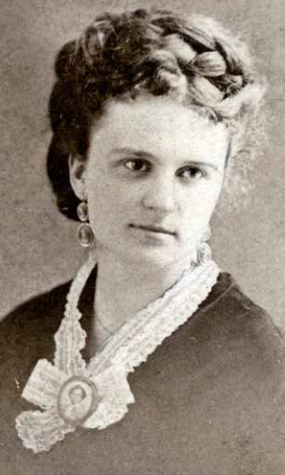
Kate Chopin (1850 - 1904)
Writing career began once widowed
Two novels; prolific short story writer (also children’s); articles and translations; well known to readers of magazine fiction.
Often credited for introducing the modern feminist literary movement (impressive revival in the 1950s)
Dominant theme = freedom / escaping the confines of a stifling marriage, through:
notions of ‘open marriage’
love affairs with passionate men
separation and divorce
art, writing or music

Slide 16
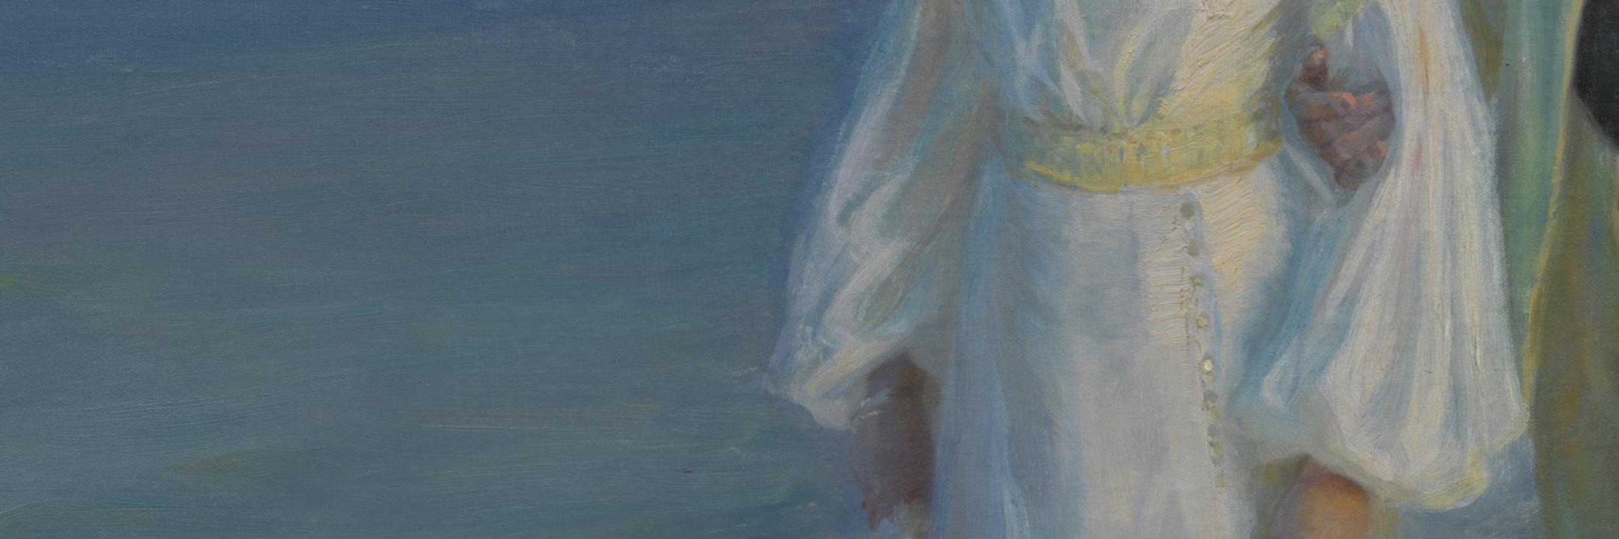
Literary Influences
The Bildungsroman
Guy de Maupassant stories
Three phases of American women’s writing:
The ‘domestic’ novel (1850s and 1860s)
The ‘local color’ novel (1870s and 1880s)
The ‘New Women’ writers (1890s)
Challenging American literary tradition by bold expression of women’s longing for sexual and personal freedom/searching for independence and self-realization in an unprecedented way.

Slide 17
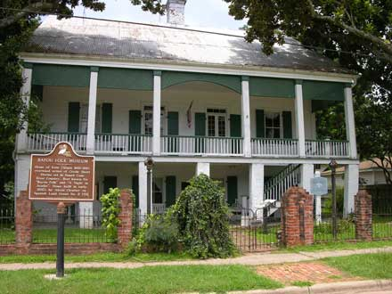
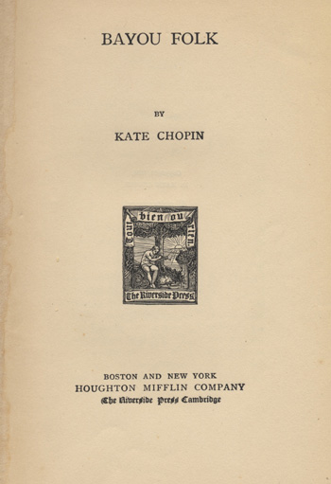
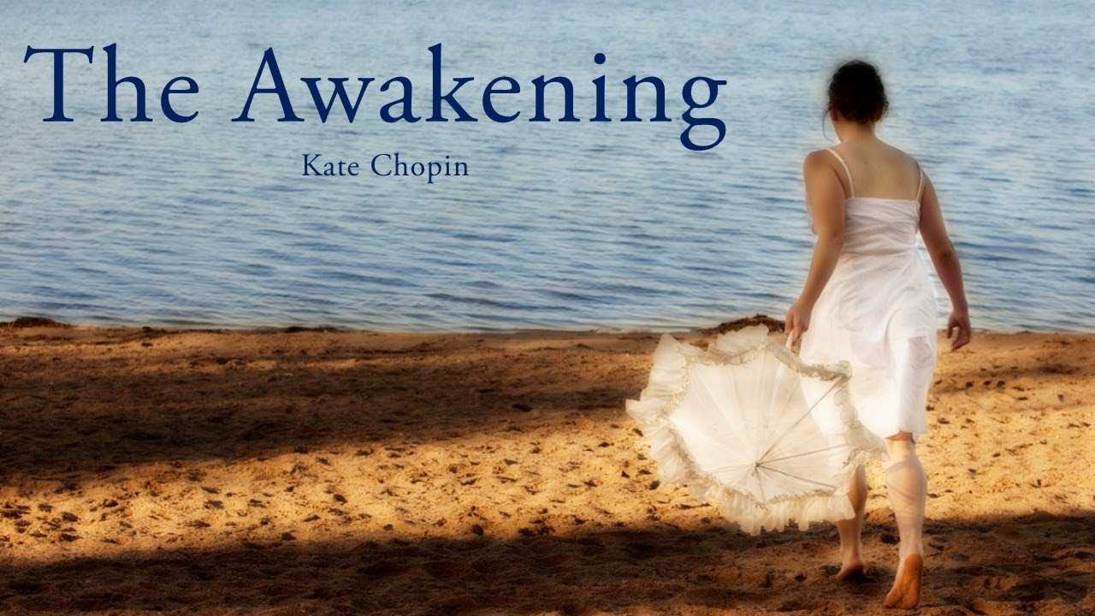
The Awakening (1899)
Edna Pontellier’s struggle between her increasingly unorthodox views on femininity and motherhood and the social conventions / constraints of turn-of-the-century South (set in Louisiana and New Orleans)
Particular controversy upon its publication – censored, considered immoral. Chopin had difficulty publishing stories after its release.
Revival in the 1970s
Varied interpretations and discussions on the novel’s themes.
Regionalism / “local color” writer
setting mostly in north/central Louisiana / Natchitoches
Creole and Cajun influences in her writing style

Slide 18
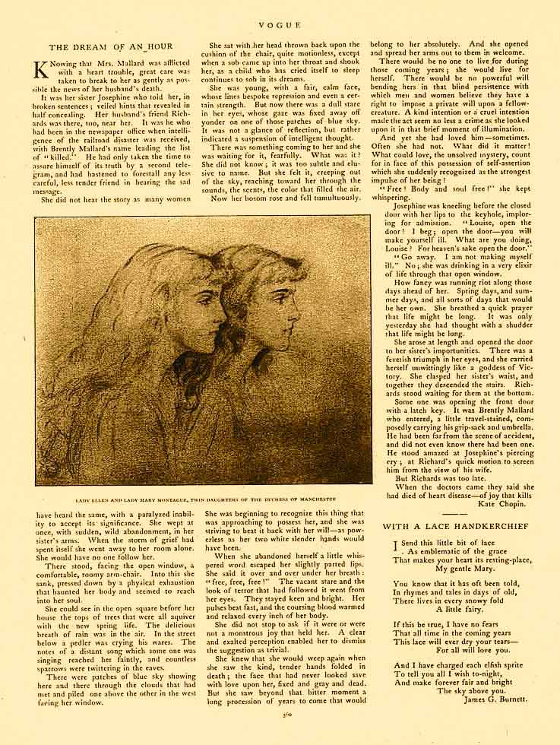
Vogue, December 6, 1894

Slide 19
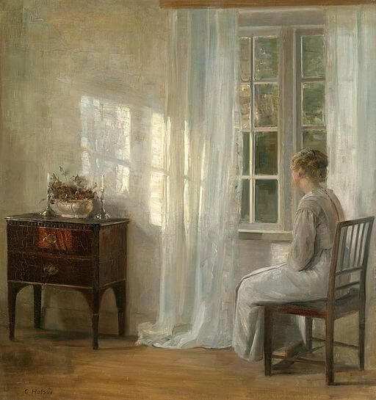
“The Story of an Hour”
3rd person narrative but also represented speech: “What was it? She did not know, it was too subtle and elusive to know.”
Composition: events cover one hour in the life of the protagonist / circle
Tone follows protagonist’s psychological progress
Lack of specific spatial setting
Time: Spring
Irony: verbal, dramatic, situational

Slide 20
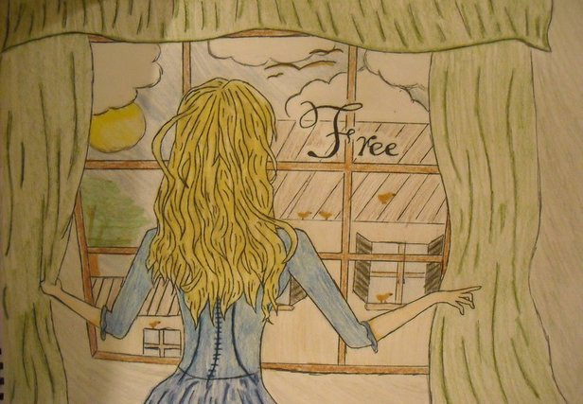
Poetic Writing Style
Syntax: as the story unravels, shorter sentences, more pauses (commas, semicolons) = rhythm
Repetition to highlight important points (‘free,’ ‘open’; ‘that life might be long’)
Adjectives: “a comfortable, roomy armchair;” “the delicious breath of rain;” “a paralyzed inability;” “the kind, tender hands.”
Metaphor: “the notes of a distant song which someone was singing reached her faintly;” “there were patches of blue sky showing here and there through the clouds that had met and piled one above the other in the west facing her window.”

Slide 21
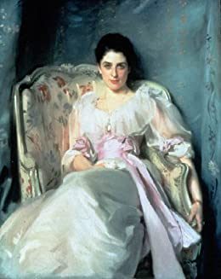
Louise Mallard
From “Mrs Mallard” to “Louise”
Psychological process
Conditioned by society
Happily married?
Heart condition
Why this ending?
She breathed a quick prayer that life might be long. It was only yesterday she had thought with a shudder that life might be long.

Slide 22
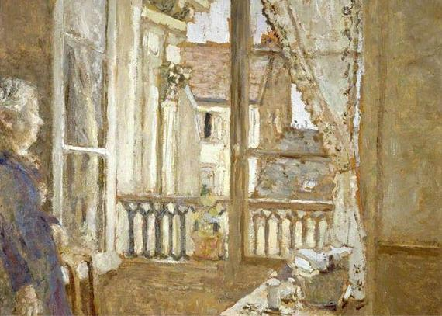
The Open Window
Representing freedom and opportunities awaiting
Imagery–synaesthesia: “she could see in the open square before her house the tops of trees … The delicious breath of rain was in the air. In the street below a peddler was crying his wares. The notes of a distant song … and countless sparrows were twittering ... there were patches of blue sky.”
Sense experience = spring and joy = new life

Slide 23
