Slide 1
Southern Renaissance
William Faulkner & Eudora Welty
American Fiction
Spring 2020

Slide 2
Periodisation
The Colonial Period (1500-1830)
The Post-Revolutionary Period of Romanticism and Transcedentalism leading almost up to the end of the 19th century.
Realism and Naturalism (1870-1910)
The Modernist period spanning roughly from the pre-WWI (turn of the century) years through to the interwar period and leading up to WWII
The Post-war / contemporary period.

Slide 3
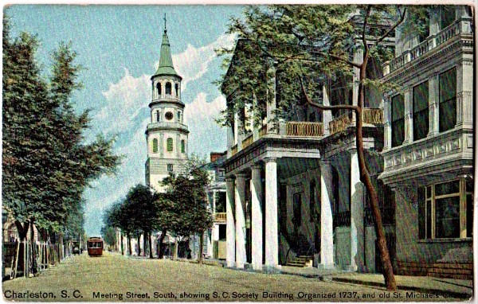
Southern Renaissance
Reinvigoration of American Southern Literature in the 1920s and 1930s - William Faulkner, Thomas Wolfe, Eudora Welty, Katherine Anne Porter, Robert Penn Warren, Tennessee Williams
Response to the notion that the South was left behind – reasserting Southern uniqueness, culture and identity

Slide 4
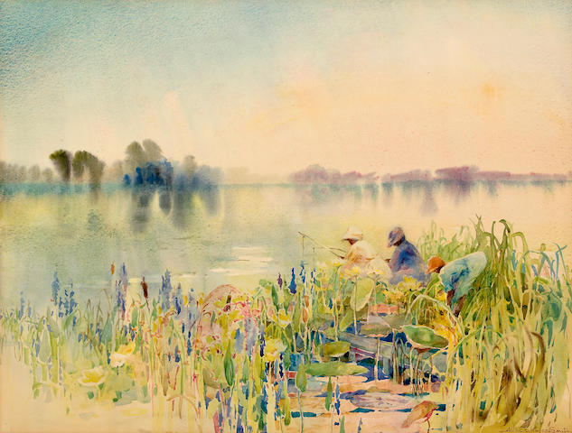
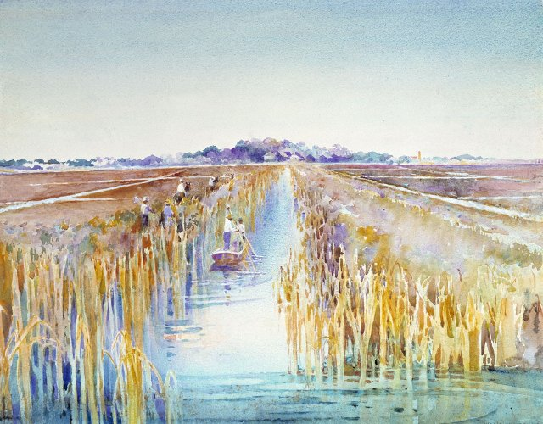
Southern Renaissance Themes
  Three major themes:
  the burden of history related to slavery and loss,
  conservative southern culture,
  the region's association with racism and slavery.
  (Exclusively white authors.)
  Opposition to industrialization in the South following World War I was a popular theme among Southern Renaissance writers, who became known as Southern Agrarians.

Slide 5
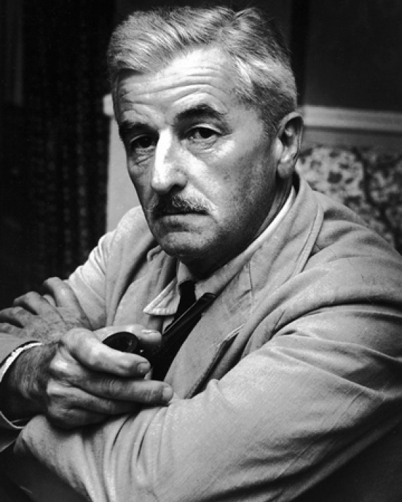
William Faulkner (1897-1962)
Nobel Prize 1949
“undirected reading”
Yoknapatawpha County (a deeply conservative rural world, conscious of its past and remote from urbanisation / modernisation – recurrence of characters)
Technical innovations:
  Stream of consciousness
  Complicated timelines
  Multi-perspectival narration

Slide 6

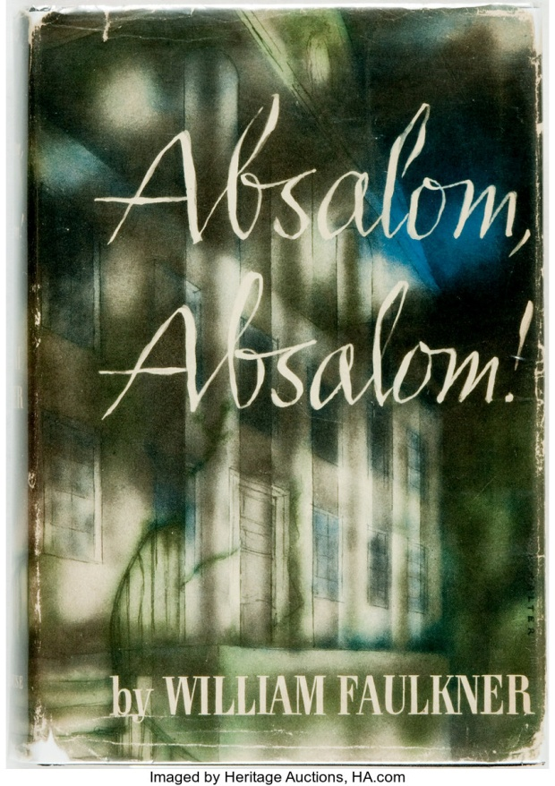

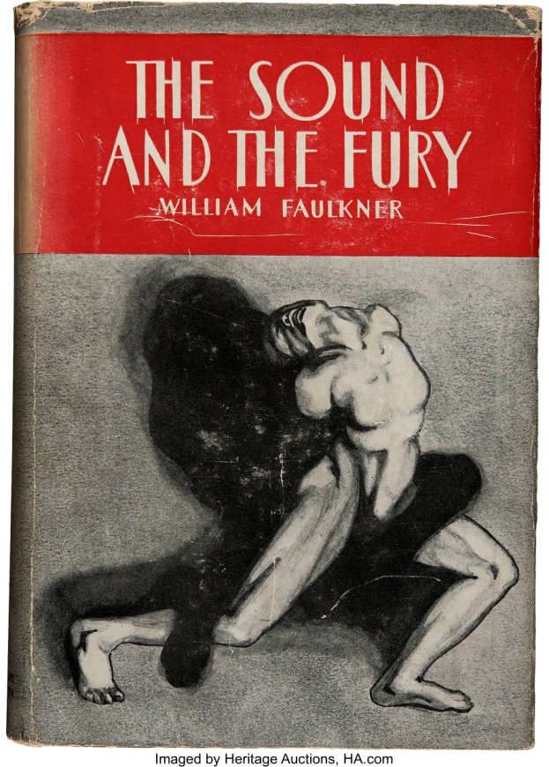



Slide 7
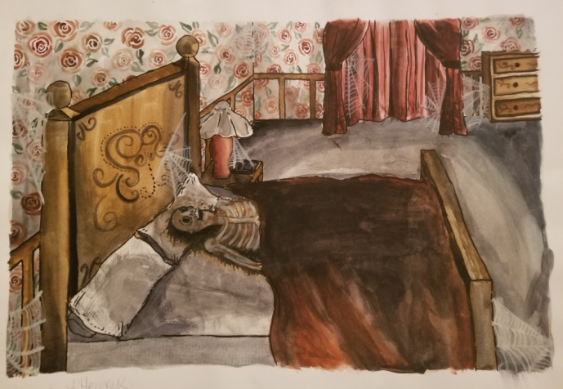
“A Rose for Emily” (1930) - Modernism
“When Miss Emily Grierson died, our whole town went to her funeral” … “We did not say she was crazy then. We believed she had to do that. We remembered all the young men had driven away, and we knew …”
“Already we knew that there was one room in that region above stairs … They waited until Miss Emily was decently in the ground before they opened it.”
Fractured chronology / episodic, non-linear narrative
First-person collective and multi-generational narrator
Theme: modernisation

Slide 8
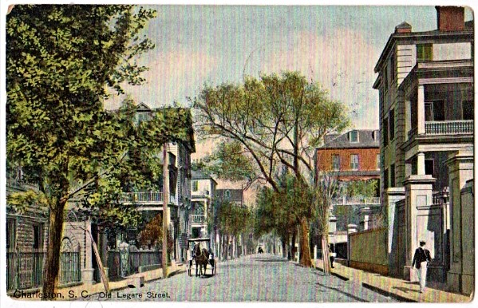
“A Rose for Emily” – Southern Renaissance
Faulkner draws attention to the changing South and aims to honor the old traditions
“and the very old men –some in their brushed Confederate uniforms—on the porch and the lawn, talking of Miss Emily as if she had been a contemporary of theirs, believing that they had danced with her and courted her perhaps, confusing time with its mathematical progression”
Homer Baron symbolism:
The North, “a Yankee”; “the ladies all said, ‘Of course a Grierson would not think seriously of a Northener, a day laboorer.’ But there were still others, older people, who said that even grief could not cause a real lady to forget noblesse oblige.”
Death = the ideals of the North should not replace those of the South

Slide 9
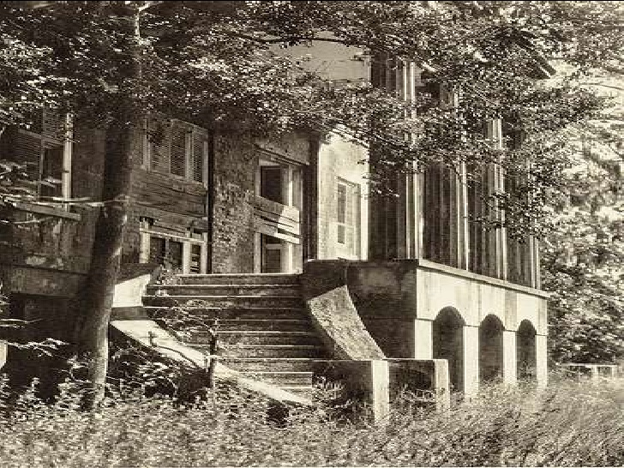
“A Rose for Emily” - Southern Gothic
A Gothic story taking place in the American South, centering on Southern traditions and character types.
Mysterious secrets, supernatural occurrences, characters in duress.
Realist rather than romantic account of events: interest in Gothic as revealing human psychology and dark motives that push individuals to the fringes of society.
Crumbling old mansion
Decay, putrefaction, grotesque
Forbidding atmosphere
Mental instability / necrophilia
Protagonist struggling against oppressive society

Slide 10
“A Rose for Emily” - Formal Elements
Setting: the town (two phases) / the house
“It was a big, squarish frame house that had once been white, decoaretd with cupolas and spires and scrolled balconies in the heavily lightsome style of the seventies, set on what had once been our most select street. But garages and cotton gins had encroached and obliterated even the august names of that neighbourhood; only Miss Emily’s house was left, lifting its stubborn and coquettish decay above the cotton wagons and the gasoline pumps=an eyesore among eyesores.”
Foreshadowing: “Thus [Miss Emily] passed from generation to generation—dear, inescapable, impervious, tranquil, and perverse.”
Motifs: watching / Dust
Symbolism: Miss Emily, the House, the mailbox, new sidewalks, strand of hair

Slide 11

“A Rose for Emily”
“Here was a woman who has had a tragedy, an irrevocable tragedy and nothing could be done about it, and I pitied her and this was a salute … to a woman you would hand a rose.”
William Faulkner
Rose-colored room
Homer as a dried rose – remnant of the past
Southern ideals fading away
The rose as a token of love
Metaphor for the story itself

Slide 12
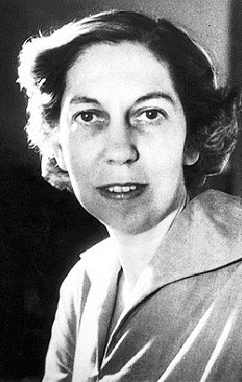
Eudora Welty (1909 – 2001)
Writer, photographer, columnist, lecturer, essayist
Photographer for Roosevelt’s WPA during the Great Depression
Pulitzer Prize for Fiction, 1973, for Optimist’s Daughter ; Presidential Medal of Freedom, 1980
First writer to be published by Library of America
Fiction as “a personal act of vision”
Writing about Mississippi region
Theme: intricacies of human relationships particularly interactions in intimate social encounters.
For Toni Morrison, Welty wrote “about black people in a way that few white men have ever been able to write. It’s not patronizing, not romanticizing – it’s the way they should be written about”

Slide 13
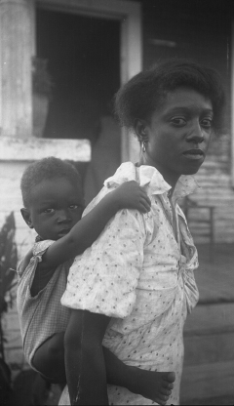
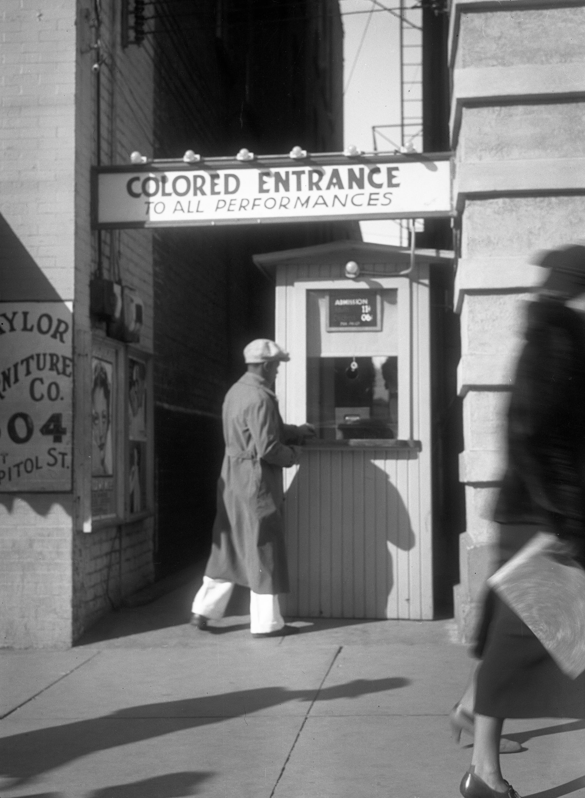
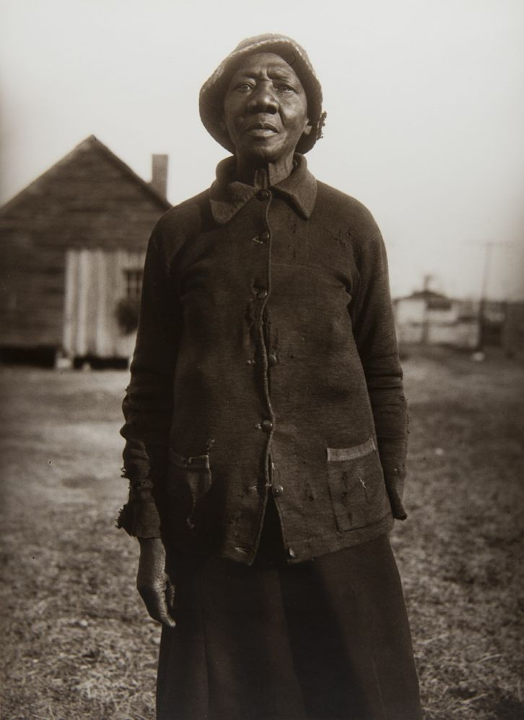
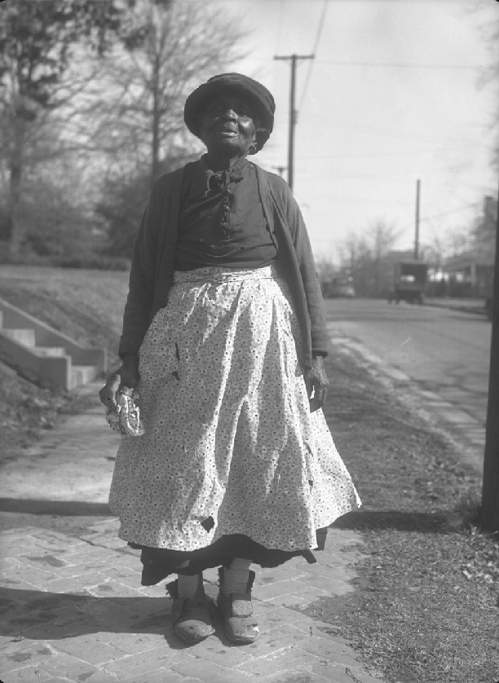
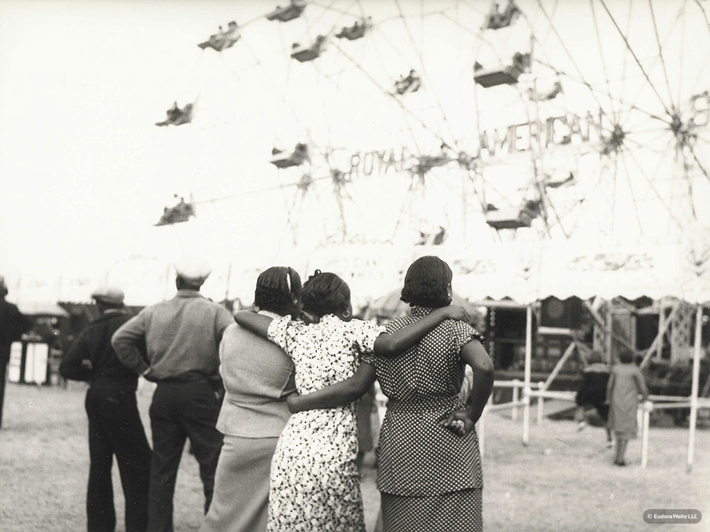
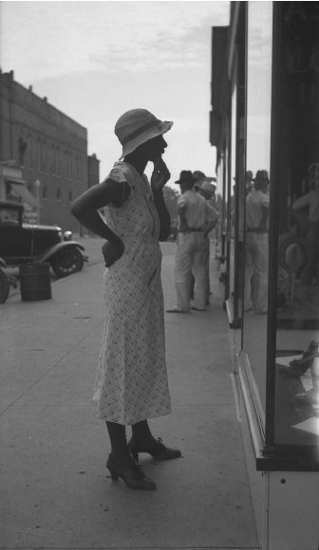

Slide 14
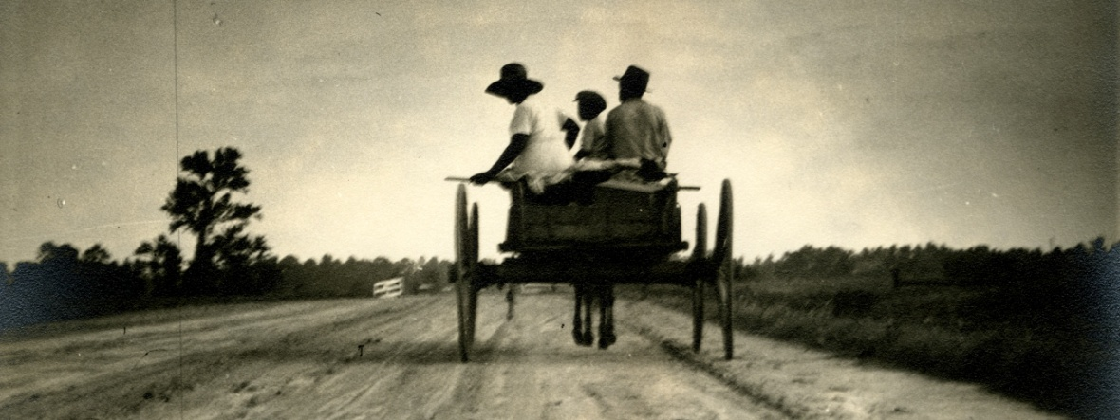
“Why I Live at the P.O.”
A Curtain of Green (1941)
Point of View
Humorous tone, puns, exaggeration – deflecting reality
Motifs: Repetition (structural and thematic); Denial
Symbols: radio, P.O., green tomatoes

Slide 15
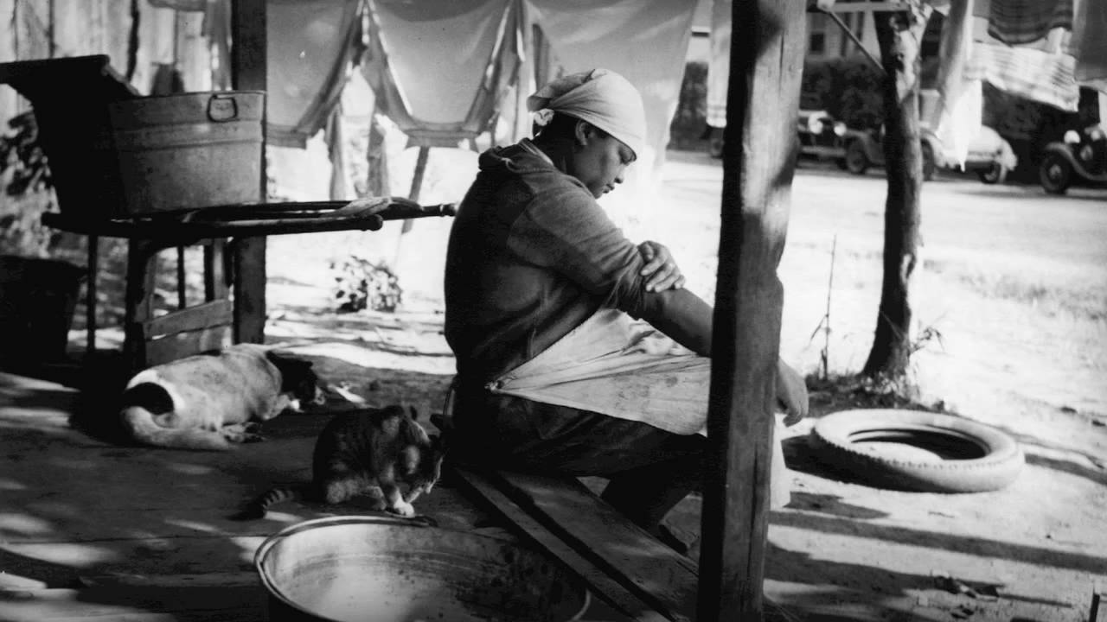
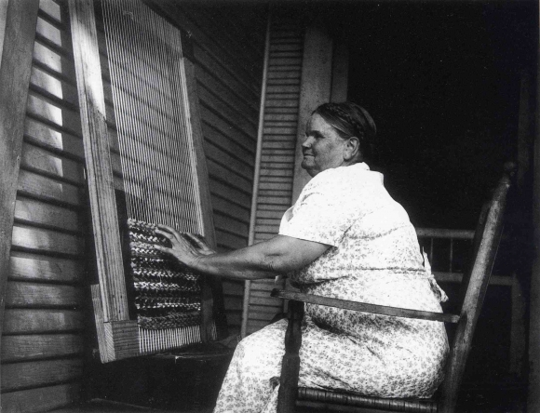
Objects - Photographic Writing
“So … I marched in and got that radio … And I very politely took the sewing machine motor … and a good big calendar, with the first-aid remedies on it. The thermometer and the Hawaiian ukulele … all my watermelon-rind preserves and every fruit and vegetable I’d put up, every jar…the bluebird wall vases on the archway to the dining room.”
“Radio, sewing machine, book ends, ironing board and that great big piano lamp.”

Slide 16
Diction
Recording speech patterns or choosing words to situate characters firmly in their local setting / creating rhythm:
“must of”; “would of”; “any such of a thing”
“I says”; “word…don’t mean”
“I ought to of known by that he was fixing to do something perfectly horrible”; Butter-bean vines
“Stella Rondo just calmly takes off this hat”
“Papa-Daddy “l-a-y-s” down his knife and fork”
Shirley-T: “OE’m Pop-OE the Sailor-r-r-r Ma-a-an”
“Stella-Rondo? O-o-o-o-o! Stella Rondo!”

