Slide 1
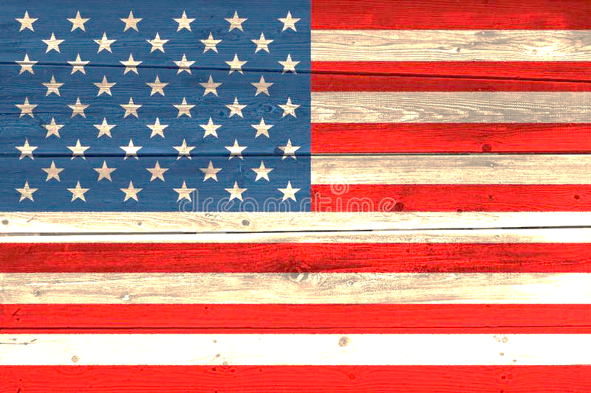
American Poetry
A Welcome!

Slide 2
What Is Poetry?
“It's an art that looks beyond the words used”
“a kind of art for expressing our inner world”
“Personal expression of feelings or perceptions of things”
“it usually has some sort of effect on the reader, different for each reader obviously, someone may find pleasure, some may feel angry etc”
“a compact way of communication riddled with hidden meanings and symbols that requires some kind of work from the reader in order to understand it”
T.S. Eliot, from “East Coker”: “a raid on the inarticulate/ with shabby equipment always deteriorating”

Slide 3
Formal Elements of Poetry
Genre (epic-lyric-dramatic) and subgenre
Subject (explicit image) and Theme (implicit idea)
Medium: dialogue, narrative, description
Form: open, closed; fixed (sonnet, ballad, epigram, haiku, sestina, limerick...); prose poem; concrete or visual poetry
Parts: stanza, verse/line, refrain, octet/octave, septet, sestet, quintet, quatrain, tercet, couplet
Rhythm (stress/pause) or Prosody: iambic/ trochaic/ dactylic/ anapaest/ spondee meter
Rhyme/rime: blank verse (unrhymed iambic 5meter), heroic couplet (2x iambic 5meters), villanelle (aba, aba...), rubai (aaba), terza rima (aba, bcb...), alexandrine (2x15syllables); internal rhyme, enjambment.
Persona (mask) and point-of-view
Tone (attitude of poem communicated to audience)
From Kennedy, X. J., and Dana Gioia, eds. Literature: An Introduction to Fiction, Poetry and Drama.

Slide 4
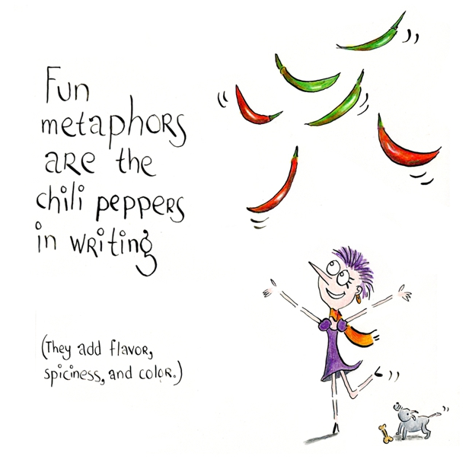
Formal Elements of Poetry
Imagery (visual, auditory, tactile, olfactory)
Diction: connotation/denotation
abstract VS concrete
irony (cosmic, tragic/dramatic, verbal)
onomatopoeia
style: formal, standard, colloquial, vulgate, slang, dialect, jabberwocky (nonce words)
Figures of speech:
personification
apostrophe
symbol
allegory
allusion
metaphor
simile
paradox
pun
hyperbole and understatement (litotes)
metonymy (substitution by association)
synecdoche (portion for whole)
alliteration (vowels) and assonance (consonants)

Slide 5
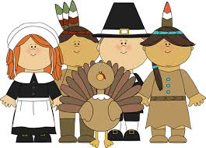
What Is American Poetry? Literary Traits
Native American “orature”: diverse, highly poetic and incantatory, nature-worshipping, used for speeches, myths, ritual chants
Awe of land (nature poetry; Transcendentalism; regionalism)
Puritan substratum
European influence (early stages, reversed with Modernism)
Democratic spirit (folk poems/ballads, pop, rap/hip hop, hyperfiction)
Diversity (no epic; multiculturalism; social protest/minority poetry)

Slide 6
Chronological Periods Schools
Pre-Colombian (-1492)
Colonial (1607-1765)
Revolutionary and Early National (-1830)
Romantic (-1865)
Realist (-1900)
Naturalist and Symbolist (-1930)
Period of Conformity and Criticism (-1960)
Period of the Confessional Self (-1970)
Multi-culturalism and minorities
Post-modern language experiments, performance poetry (2000-)
Puritans (17th c.): Anne Bradstreet, Edward Taylor
The 18th century: Phyllis Wheatley, Philip Freneau
Hartford (Connecticut) Wits (1770s): Joel Barlow’s Columbiad
Schoolhouse Poets (early 19th c.): Henry Wadsworth Longfellow
Transcendentalists: Ralph Waldo Emerson, Henry David Thoreau
19th century: Emily Dickinson, Walt Whitman
The Lost Generation (1912--Poetry magazine): Modernists, Imagists, Symbolists
Harlem Renaissance (1920s): The New Negro Anthology
New York Poets (1950-70): Frank O’ Connor
The Beats (1950-60): Allen Ginsberg, Gregory Corso
Black Mountain School (1960): Charles Olson, Robert Creeley, Denise Levertov
Postmodern Language poets (George Oppen)

