Slide 1
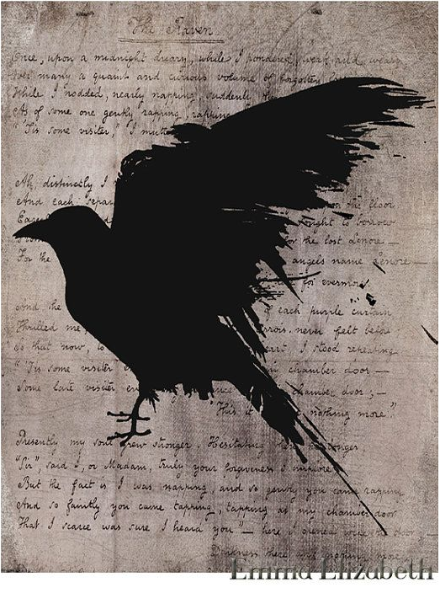
From Revolution to U.S. Romanticism

Slide 2
cultural context
War of Independence (1775-83) introduces themes of:
American secular character (VS previous Colonialist Puritanism or adventurous spirit of discovery)
Liberty, sovereignty, national glory (attempted epics, domestic poetic styles)
Domestic problems: abolitionism, the Civil War (1861-65), the loss of “wild” America to urban capitalism
European Romanticism (turn to the medieval/exotic past and emphasis on wild, tremendous, hidden aspects of human soul→
American Gothic (exploration of Darkness, often metaphysical)
Transcendentalism (return to Nature’s supernatural power, nobility of natural man)

Slide 3
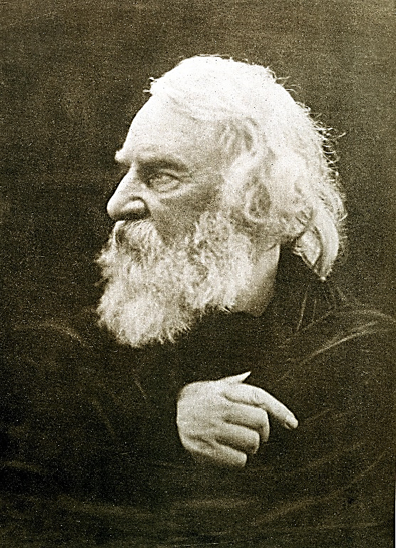
Henry Wadsworth Longfellow i807-82
Harvard professor, one of the extremely popular New England “Fireside/Household Poets” (didactic, adventurous, affective, nationalist poems, easy forms)
Evangeline—A Tale of Acadie
“Paul Revere’s Ride”
Song of Hiawatha
“The Wreck of the Hesperus”
Poetry for the people, not the critics
Highest honors: Longfellow in Hall of Fame of Great Americans, bust in Westminster Abbey Poet’s Corner
Two wives dead influenced his art (translated Divine Comedy)
Decline with modernity; reevaluation now

Slide 4
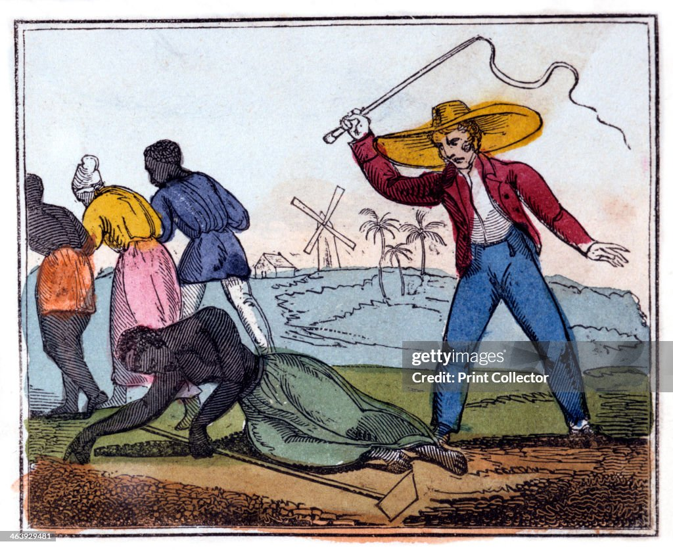
“The Slave’s Dream” (1842)
Form, topic and theme
The dream versus reality
Inner vs outer images
Humans vs animals
Auditory vs visual images
Conclusion: “A worn-out fetter”; death, dream, sleep
Amelia Opie, “The Exhausted Slave Whipped” (1826)

Slide 5
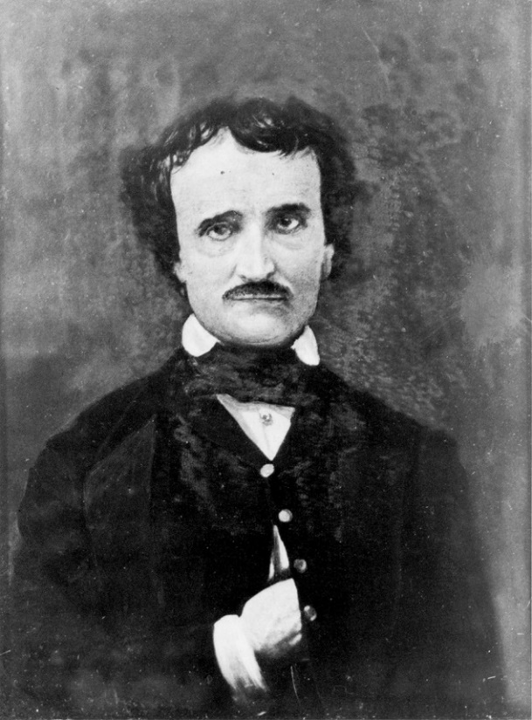
EDGAR ALLAN POE (1809-1849)
Abandoned orphan, adopted by Allan family; teen bride died of poverty; literary enemies (via criticism), alcoholism and illness led to late fame and early death.
Gothic Romanticism, Aestheticism
Elaborate (“baroque”) syntax and diction, poetic devices
Definition of the short story
Creation of detective story (“Murders at Rue Morgue”)
Metaphysics, psychological horror/terror,
mystery

Slide 6
“The Raven” (1845)
Effect of alliteration, rhyme, long lines
Theme (and biographical analogy)
Symbols:
Midnight hour, December
Attic with purple curtains
bust of Pallas
the raven
Metaphysical elements: “Nevermore”
Psychoanalytic explanation

