Slide 1
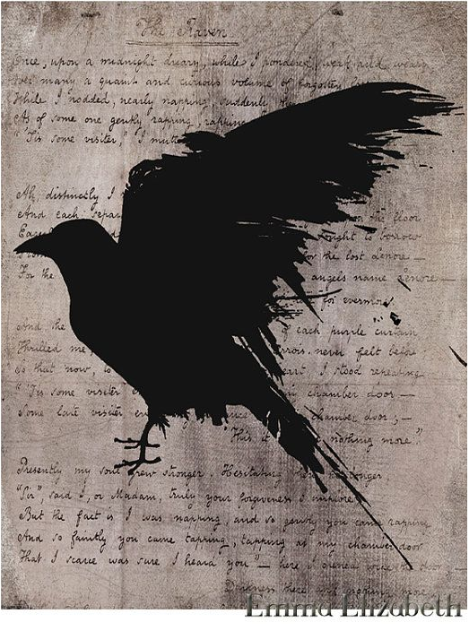
From Revolution to U.S. Romanticism

Slide 2
cultural context
War of Independence (1775-83) introduces themes of:
American secular character (VS previous Colonialist Puritanism or adventurous spirit of discovery)
Liberty, sovereignty, national glory (attempted epics, domestic poetic styles)
Domestic problems: abolitionism, the Civil War (1861-65), the loss of “wild” America to urban capitalism
European Romanticism (turn to the medieval/exotic past and emphasis on wild, tremendous, hidden aspects of human soul→
American Gothic (exploration of Darkness, often metaphysical)
Transcendentalism (return to Nature’s supernatural power)

Slide 3
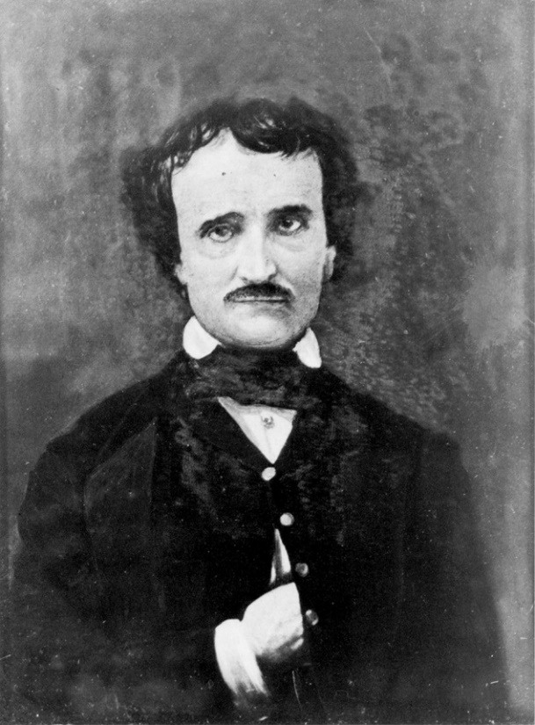
EDGAR ALLAN POE (1809-1849)
Abandoned orphan, adopted by Allan family; teen bride died of poverty; literary enemies (via criticism), alcoholism and illness led to late fame and early death.
Gothic Romanticism, Aestheticism
Elaborate (“baroque”) syntax and diction, poetic devices
Definition of the short story
Creation of detective story (“Murders at Rue Morgue”)
Metaphysics, psychological horror/terror,
mystery

Slide 4
“The Bells” (1849)
How many kinds of bells?
Silver (merriment)
Golden (wedding)
Brazen (fire alarm)
Iron (funeral/ “happy” “paean”)
Constant:
night (light of: stars, moon, fire, darkness)
Meaning of sequence?

Slide 5
“The Raven” (1845)
Effect of alliteration, rhyme, long lines
Theme (and biographical analogy)
Symbols:
Midnight hour, December
Attic with purple curtains
bust of Pallas
the raven
Metaphysical elements: “Nevermore”
Psychoanalytic explanation

