Slide 1
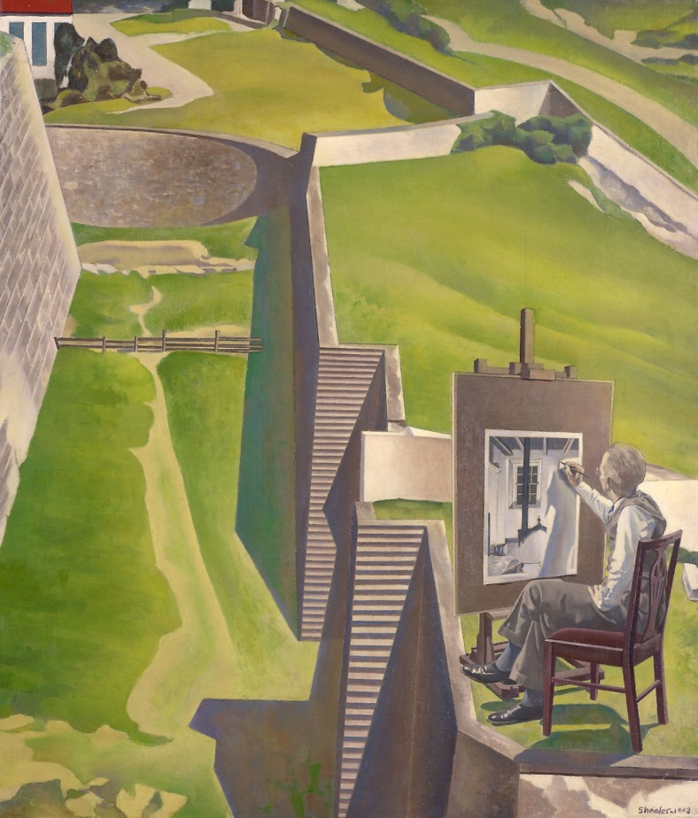
MODERNISM IN THE U.S.A.
Charles Sheeler,
“The Artist Looks at Nature” (1943)
The Home Poets

Slide 2
Modernism
Charles Darwin, Ford assembly line (Karl Marx), Sigmund Freud’s unconscious→ new, unsettling view of the human being
Trauma of wars (especially World Wars) leads to: a. embrace, b. denial/escape, c. understanding and redress
  A. love of “make it new” (Ezra Pound, 1934) and worship of machine, youth, war (Tommaso Marinetti’s “Manifesto of Futurism”: “A locomotive is more beautiful than the Mona Lisa”); pop(ular) and mass art →fascism, Low Modernism
  B. classic culture, oriental influence, elaborate craftsmanship (poem as puzzle) and erudition VS fragmentation, degradation→ High Modernism
  C. exploration of the unconscious (automatic writing, surrealism, language experiments) and socialism/innovation against establishment values: poetry for the masses (minorities, the proletariat), symbolism, avant-garde, agrarian/regional themes

Slide 3
“The Lost Generation” vs
“Home” poets
American expatriates (Ezra Pound, Amy Lowell, T.S. Eliot) incept modernism in Europe
The Prohibition (1920-33) in “The Roaring Twenties” (extravagant mafia capitalism)
New York Dada (1915-1923) and the Harlem Renaissance (1918-1929)
The “Agrarians”/ “Home Poets”: praise of quiet rural America and its regional differences
The Great Depression (1929-1939) ends first phase of U.S. modernism, but feeds its future

Slide 4
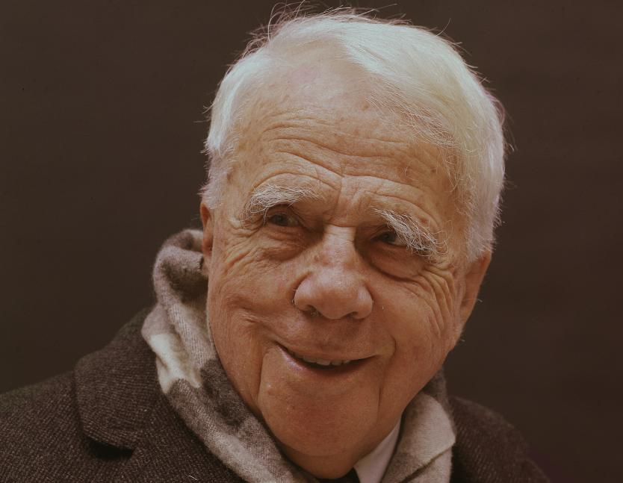
Robert Frost (1874-1963)
Regionalism (New England
rural), symbolism,
modernist themes and
diction but traditional forms
Moved to England briefly to find fame, came back at 40 with it; read poet for JFK’s inauguration, enjoyed favored poet status and household-brand name, 4 Pulitzers; lifelong battle against depression
From epigrams (“Fire and Ice”) to short emblematic poems (“Stopping by the Woods on a Snowy Evening,” “The Road Less Travelled”) to long dramatic poems (“Death of a Hired Man”) with natural/ist themes
Poetry as “a momentary stay against confusion”

Slide 5
“The Road Not Taken”
Two roads diverged in a yellow wood,
And sorry I could not travel both
And be one traveler, long I stood
And looked down one as far as I could
To where it bent in the undergrowth;
Then took the other, as just as fair,
And having perhaps the better claim,
Because it was grassy and wanted wear;
Though as for that the passing there
Had worn them really about the same,
And both that morning equally lay
In leaves no step had trodden black.
Oh, I kept the first for another day!
Yet knowing how way leads on to way,
I doubted if I should ever come back.
I shall be telling this with a sigh
Somewhere ages and ages hence:
Two roads diverged in a wood, and I—
I took the one less traveled by,
And that has made all the difference.
    From The Poetry of Robert Frost, edited by Edward Connery Lathem. Copyright 1923, © 1969 by Henry Holt and Company, Inc., renewed 1951, by Robert Frost. Reprinted with the permission of Henry Holt and Company, LLC.

Slide 6
“Stopping by the Woods on a Snowy Evening”
Whose woods these are I think I know.
His house is in the village though;
He will not see me stopping here
To watch his woods fill up with snow.
My little horse must think it queer
To stop without a farmhouse near
Between the woods and frozen lake
The darkest evening of the year.
He gives his harness bells a shake
To ask if there is some mistake.
The only other sound’s the sweep
Of easy wind and downy flake.
The woods are lovely, dark and deep,
But I have promises to keep,
And miles to go before I sleep,
And miles to go before I sleep.
  From The Poetry of Robert Frost, edited by Edward Connery Lathem. Copyright 1923, © 1969 by Henry Holt and Company, Inc., renewed 1951, by Robert Frost. Reprinted with the permission of Henry Holt and Company, LLC.

Slide 7
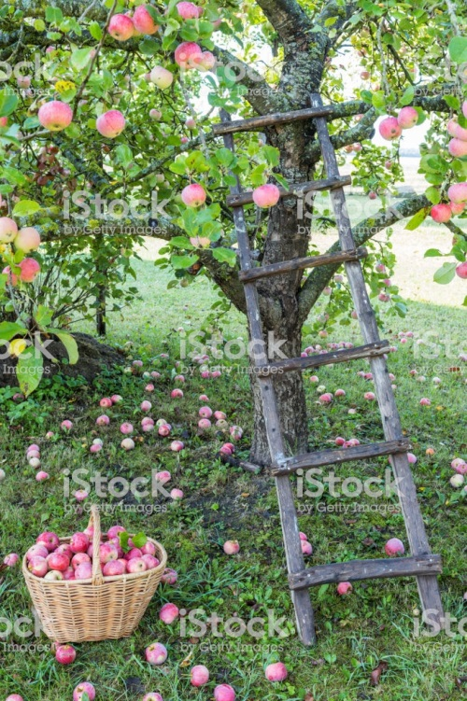
“After Apple Picking”
Symbols: various apple(s)
Ladder
Coming winter season
Apple-picking activity
Final “sleep” as“woodchuck” or as human? What’s the difference?

Slide 8
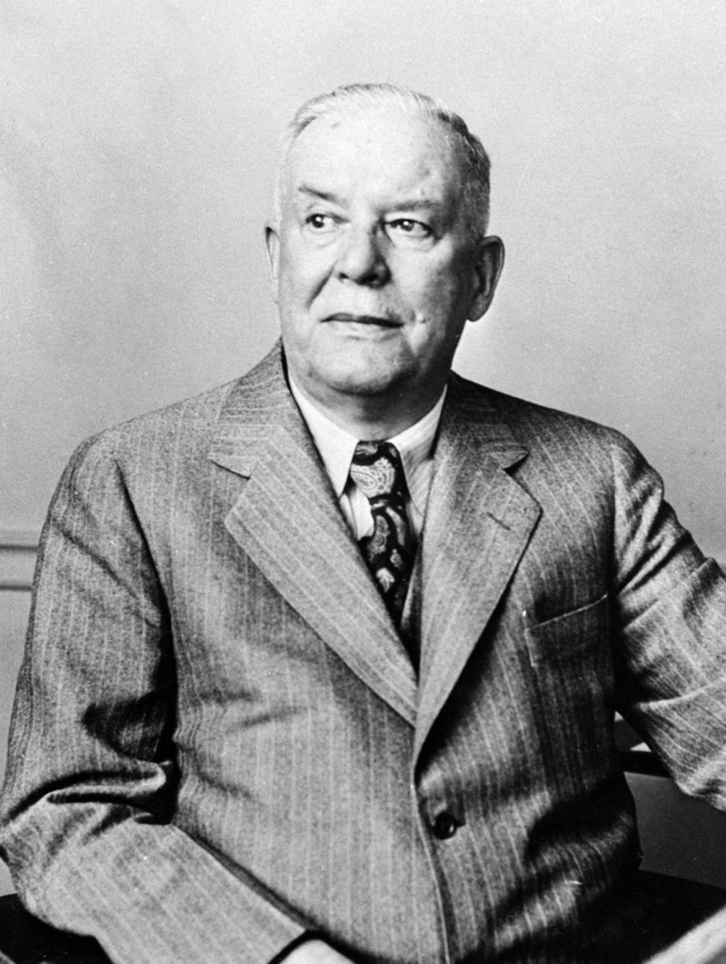
Wallace Stevens
(1879-1955)
-Insurance company lawyer in Hartford, Connecticut
-Late call to vocation but lasting fame--> Pulitzer prize
-Fought with Frost and Hemingway
-Poetry an often playful oscillation between the mundane and the imaginative (in a secular way)

Slide 9
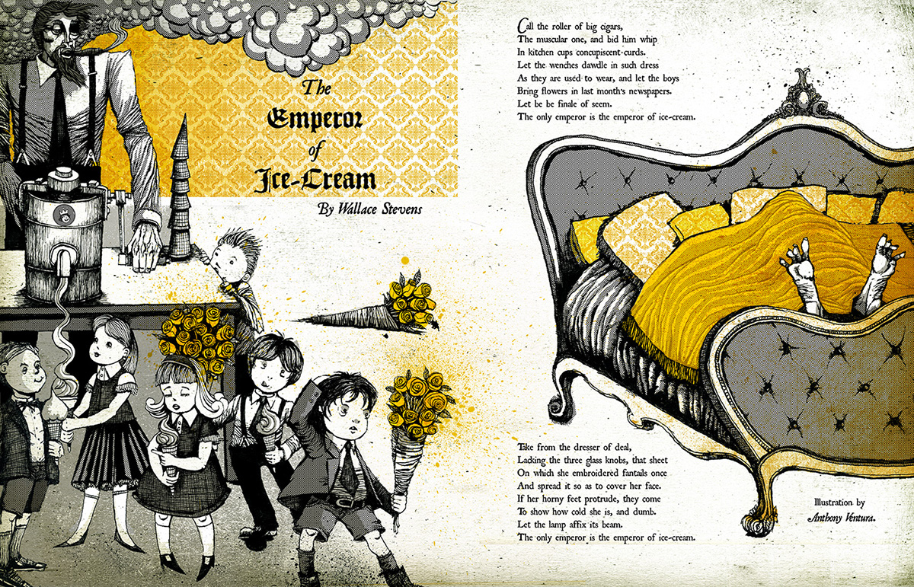

Slide 10

“The Emperor of Ice-Cream”
Vocabulary and tone
Symbols and metaphors:
  “muscular” “roller of big cigars”
  “concupiscent curds” “in kitchen cups” (alliteration)
  “wenches” nicely dressed and dawdling
  “flowers in last month’s newspapers”
  “dresser of deal” lacking “glass knobs”
  Embroidered sheet
  “horny feet,” “dumb”
  Lamp
  “Emperor of Ice-cream
What is the purpose of irreverence?
What is the theme?

Slide 11
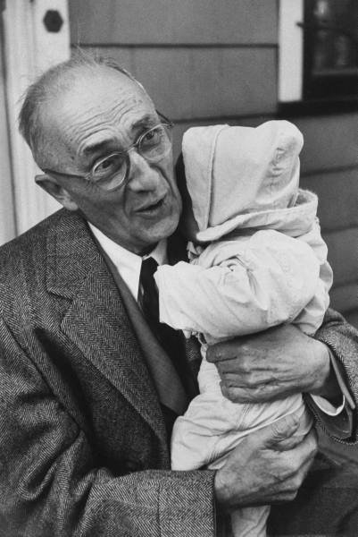
William Carlos Williams
(1883-1963)
Pediatrician (and philanderer…)
“No ideas but in things” (simple, everyday American language and themes) VS movements, theories, YET experimental and fresh
Member of NY’s “The Others” (with Stevens, Marianne Moore, Mina Loy, et al.) VS High Modernism
Paterson, epic poem for Jersey town
Great influence on the Beats and the Black Mountain School

Slide 12
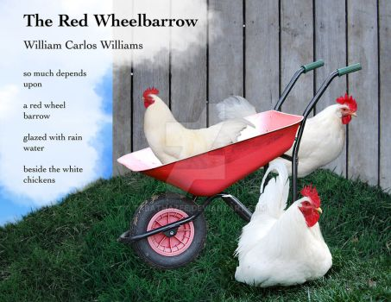
“The Red Wheelbarrow”
From image to inference of story
Symbols of color and item contrast:
  Red wheelbarrow
  Rain water
  White chickens
What depends on the scene? Why is it “so much”?

