Slide 1
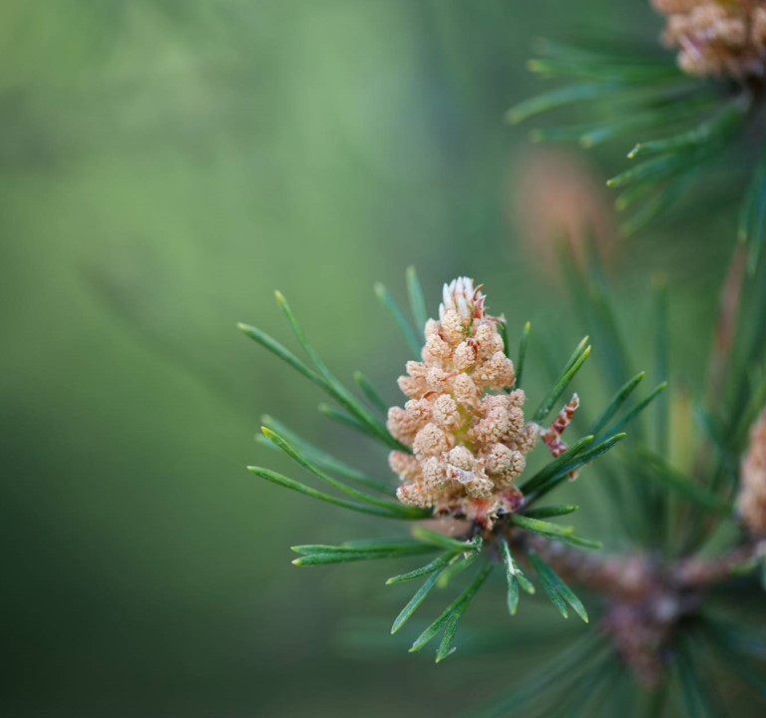
The origins of American poetry: THE colonial PERIOD
Presenter Name

Slide 2
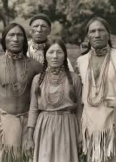
Native American orature
-Origins from Siberia, cir. 11.000 B.C.E.; in the next 2.000 years, descent and population of American continent
-At least 2.000 separate tribal/national cultures ίn North America alone; great empires in South America (Maya, Incas, Aztec)
-Ν.Α. culture was not seen as worthy of consideration until into the 19th century (H.R. Schoolcraft), and then mostly non-Native folklorists transcribed what was not extinct by then
-Nature-oriented way of life and religion
-Νο notion of land ownership, individual property
-Widely varied tribal ways of life
-Poems as part of ritual, communal life (sung at ceremonies for purposes of war, hunt, healing, community identity)

Slide 3
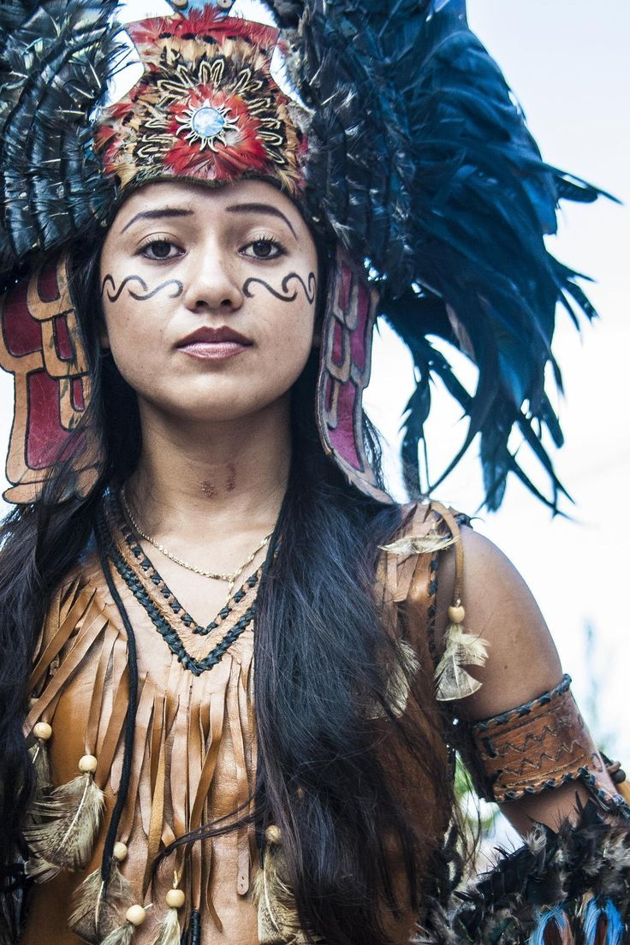
The Nahua
Largest indigenous Mexican (and in South American countries) tribe, segment of larger Aztec empire (extinct)
Various groups united by Nahuatl language
Until the 19th century vassals of the Spanish, systematic cultural
eradication by national governments

Slide 4
“Two Songs”
Will my fame end here on earth?
At least the flower, at least the song remains!
What shall my heart do?
In vain we come to this place,
We come to live on earth.
Let us be content, O my friends!
Here there is embracing.
In a world of flowers we are living.
Of these not one will be destroyed,
The flower, the song.
They live in the house of the Giver of Life.
How brief an instant here on earth!
Will it be like this also in the next place of living?
Will there be rejoicing there? Friends?
Is it only here we come to know ourselves,
On earth?
1
We came only to sleep,
We came only to dream.
It is not so, it is not so,
That we came to endure on earth.
II We become as the verdant spring.
Our hearts are rejuvenated,
Burst forth anew.
But our bodies are as the flowers:
Some blossom; they wither away.
Is it yet true there is living on earth?
Not forever on earth; but a moment here.
If its jade, it shatters.
If its is gold, it crumbles.
If it is feather, it rends.
Not forever on earth; but a moment here.

Slide 5


Several variants existing
Vocabulary: is death natural or unnatural?
Natural imagery
Symbols: dream, flower, song
The idea of afterlife
Theme: “sic transit gloria mundi,” but Native-style
On what occasion would such songs be sung?

Slide 6
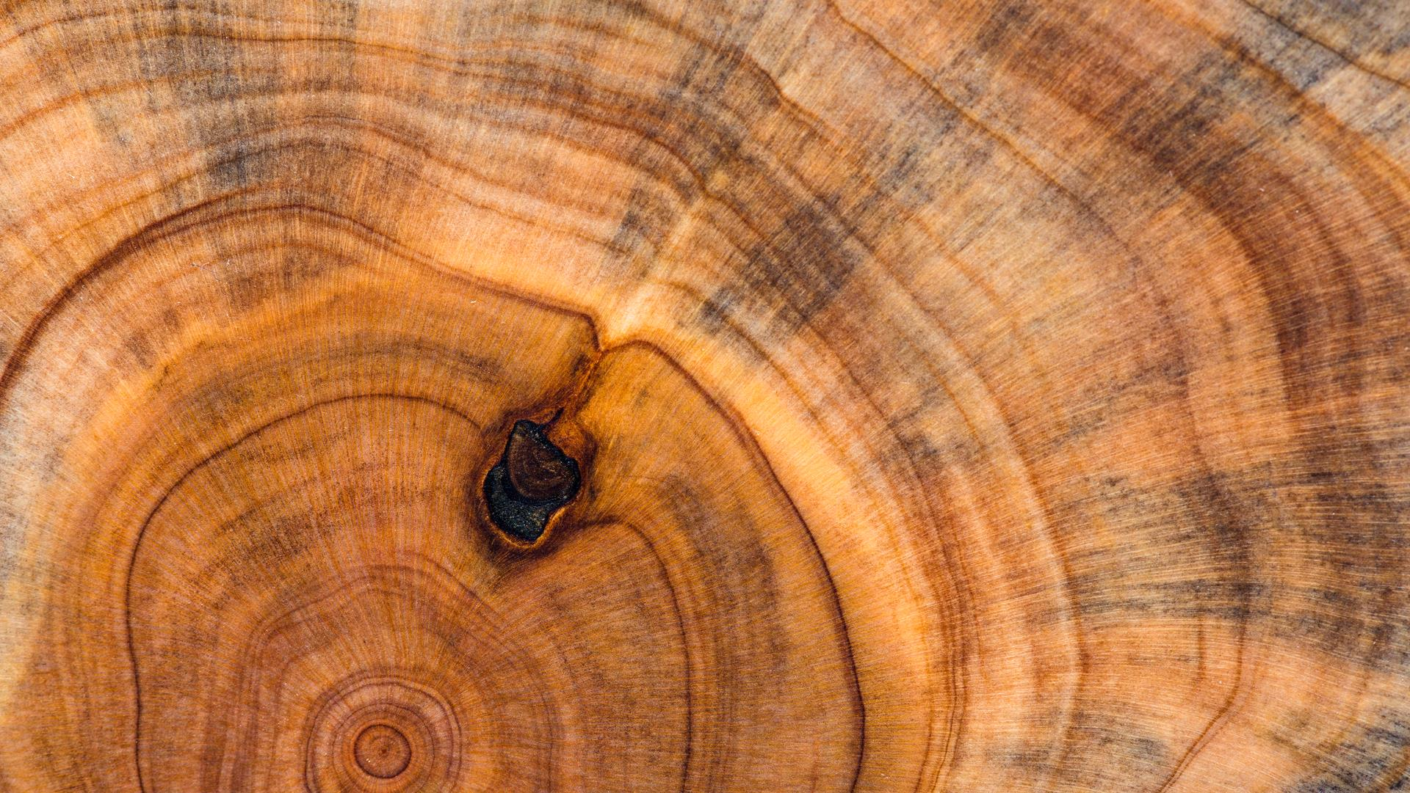
THE PURITANS
November 11, 1620: Mayflower lands on Plymouth Rock
November 1621: Thanksgiving
European separatism: “Pilgrims”, the “saints”, the “Elect”, the “New Israel”, the “Chosen People”→Goodie, Goodman
American Adam, New Jerusalem, City on a Hill
Teleology, predestination, saving grace, typology
Puritan work ethic
Crafts and education, but also America as the “Devil’s Territory,” the Salem Witch trials (1692-93)
Influence practically gone by the start of the 18th century
No theatre, but journals, letters, memoirs/narratives, religious poetry

Slide 7
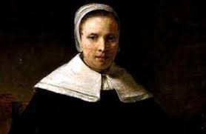
Anne bradstreet (1612-72)
1st American (woman) poet, 1st female writer to be published with The Tenth Muse Lately Sprung Up in America (1650)
She and her husband emigrated with John Winthrop’s group in America in 1630 (Massachusetts Bay Colony)
Educated; her father and husband were among the founders of Harvard; two of her sons graduates
Faced starvation, many difficult relocations, her house burning down, the death of her daughter-in-law and three grandchildren, smallpox paralysis, tuberculosis
Poetry themes: personal, religious, on mortality, on women’s worth, on philosophical issues

Slide 8
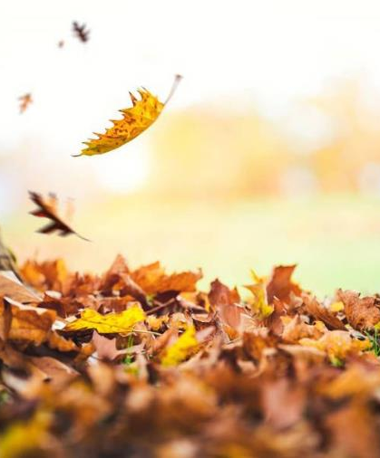
“In Memory of My Dear Grandchild, Elizabeth Bradstreet, Who Deceased August, 1665, Being a Year and a Half Old”
Farewell dear babe, my heart's too much content,
Farewell sweet babe, the pleasure of mine eye,
Farewell fair flower that for a space was lent,
Then ta'en away unto eternity.
Blest babe, why should I once bewail thy fate,
Or sigh thy days so soon were terminate,
Sith thou art settled in an everlasting state.
By nature trees do rot when they are grown,
And plums and apples thoroughly ripe do fall,
And corn and grass are in their season mown,
And time brings down what is both strong and tall.
But plants new set to be eradicate,
And buds new blown to have so short a date,
Is by His hand alone that guides nature and fate.

Slide 9
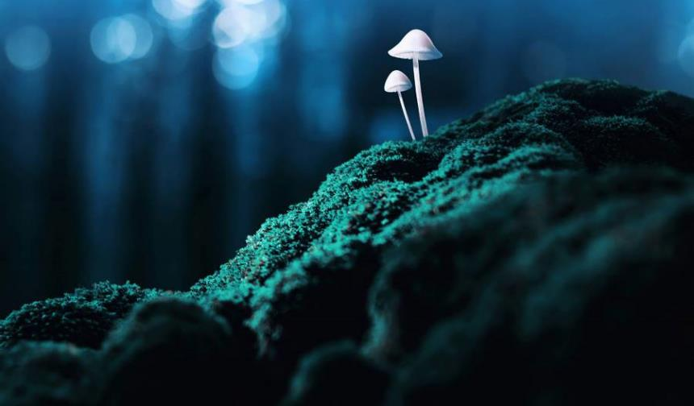
“In Memory of My Dear Grandchild, Elizabeth Bradstreet, Who Deceased August, 1665, Being a Year and a Half Old”
consolatio
Apostrophe, eulogy, Tone
Prefiguration of mourning as human fault:
“too much content”; “was lent”
Form: Variation of 8+6 convention: 7+7—why?
-why rhyming scheme of same last 3 lines? How does the form emphasize the meaning?

Slide 10
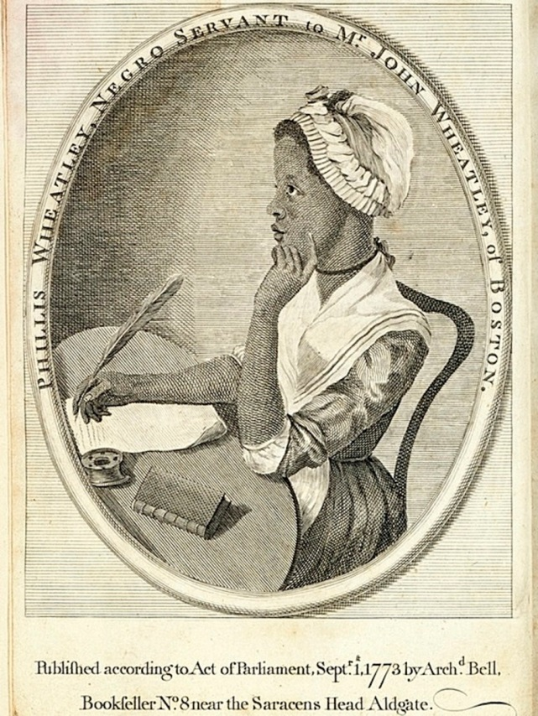
Phillis Wheatley (1753-1784)
First African-American woman poet published (1773)
Brought as slave to America in 1761 (named after her slave ship); the Wheatleys classically educated her and nurtured her talent; success tour in the UK; liberated, but poverty, her husband’s imprisonment, deaths of all her 3 children and illness lead her to an early death.
Themes: elegies, classical, religious ideals -values, freedom
Problem of “Uncle Tomism” (alienated race consciousness): was it compliance, or minority abolitionist rhetoric politics?

Slide 11
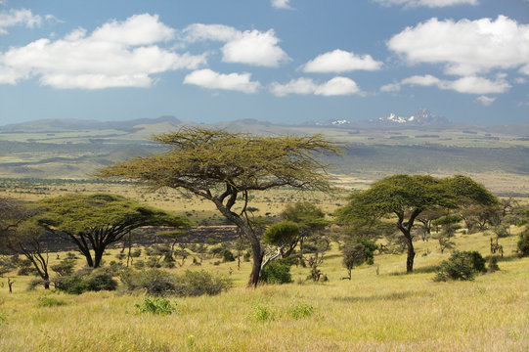
“On Being Brought from Africa to America”
'Twas mercy brought me from my Pagan land,
Taught my benighted soul to understand
That there's a God, that there's a Saviour too:
Once I redemption neither sought nor knew.
Some view our sable race with scornful eye,
"Their colour is a diabolic die."
Remember, Christians, Negros, black as Cain,
May be refin'd, and join th' angelic train.

Slide 12
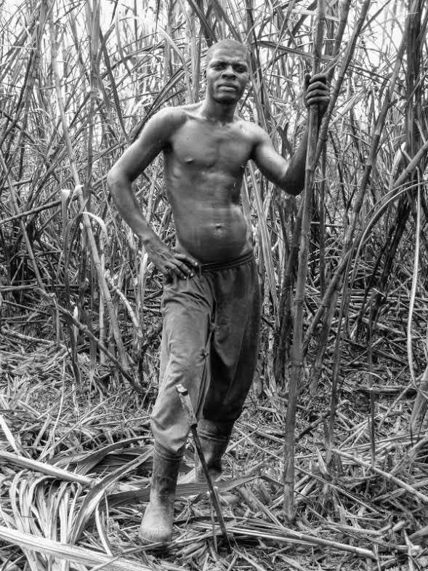
Self-deprecating description of black race—why?
Ambiguous vocabulary (not seeking redemption)→
Irony (“mercy”; “Christians”)
The sugarcane-refining process as metaphor

