Slide 1
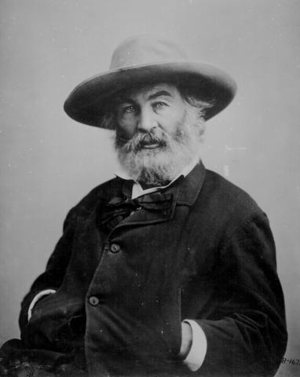
Walt Whitman (1819-1892)

Slide 2
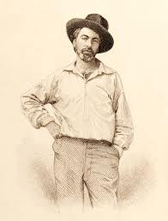
Traits
Teen prodigy, autodidact, man of many trades (journalism, printing, Civil War volunteer nurse)
Democratic activist and abolitionist
Bohemian, unconventional, “rough”, openly gay (Live Oak, with Moss; Calamus)
Influences: transcendentalism, pantheism, romanticism, republicanism
1855 Leaves of Grass, American “epic,” revised and implemented until 1892 (“deathbed” edition)
Unrhymed, long lines; rhythmic repetition, grand, bold epic tone; key presence of nature; “father of free verse”

Slide 3
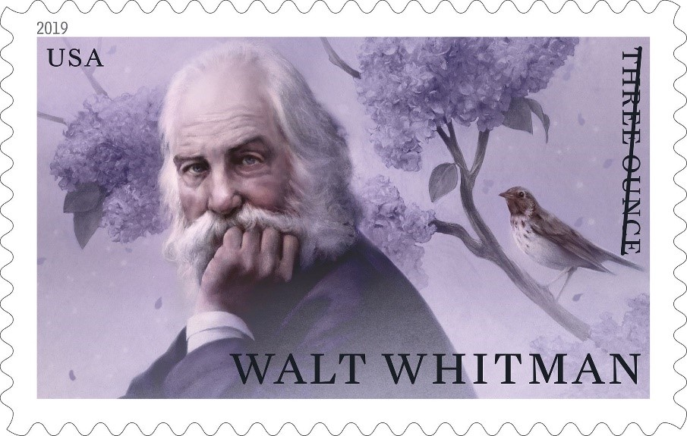
“Out of the Cradle Endlessly Rocking” (1859)
Romantic topos: childhood epiphany revisited by older poet-narrator
Why are there two formats (regular and italic print) for the poem’s stanzas?
Symbols: cradle/ “savage old mother,” bird, boy, summer shore (Transcendentalist Trinity)
Poet as seer, oionoscopos, “translator” of Nature
Why is the bird called a “demon”? What is the boy’s “curse”?
Why is “death” the sweetest word?
What is this poem about?

Slide 4
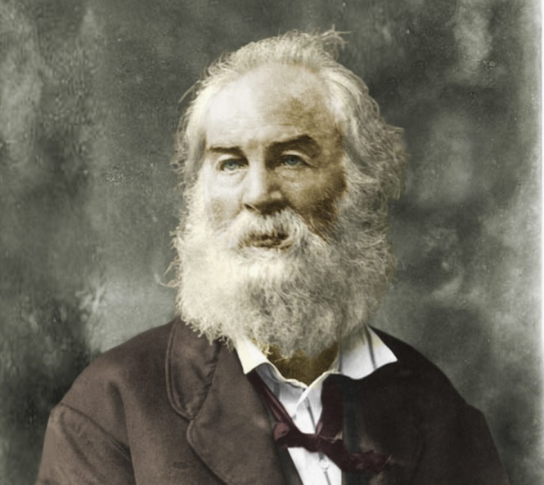
“Song of Myself” (1892 version)
What is “myself”?
Transcendental elements
Relation to nature
“perfumes” vs “atmosphere” (ll.14-17)
Grass as a symbol
Attitude towards books, “creeds and schools” (l. 10)
What is “the origin of all poems” (l.33)
Relation to other people (what kind?) vs “Me Myself” (part 4) vs “the other I am” (part 5)
View of death
How does the poem create rhythm?
How is this poem American?
How is this poem an epic?

