Slide 1
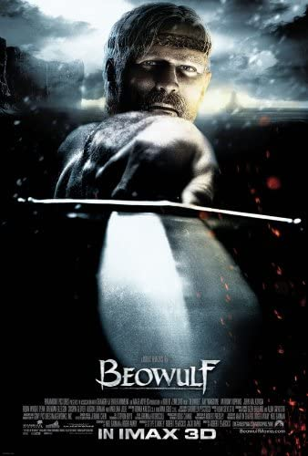
BEOWULF II

Slide 2
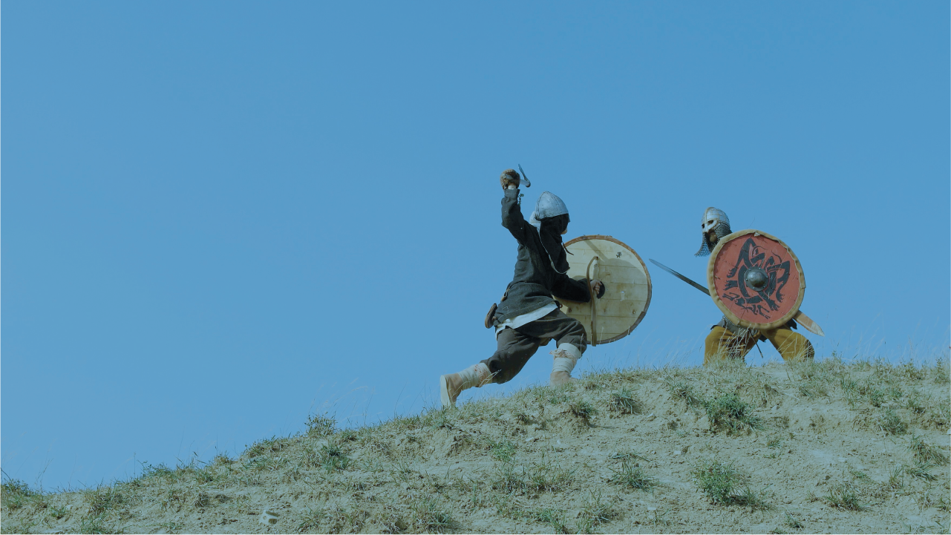
The embedded lays: The Finn saga (ll. 1063-1160)
Why celebrate with a depressing tale?
Pessimistic worldview
Themes related to Beowulf’s journey:
Visiting group of foreigners led by a hero (B. as potential threat?→ Wealtheow’s and Hrothgar’s speeches as forestalling future violence)
Hnaef and his chief thane Hengest as failed B.; if B. had died at the mere, Geats to be “adopted” as retainers by Hrothgar (l. 1474); the impossibility of incorporation; betrayal of thane loyalty vows
Siege inside a great hall; burning of Finnsburg (later, Heorot?)
Hildeburh’s lament for slain brother and son (and later husband)→ Grendel’s mother grief for her son, Wealtheow’s later lament for her sons dead by her nephew Hrothulf (foretold by narrator)

Slide 3
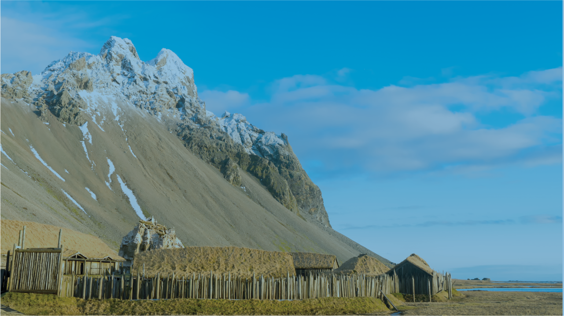
The Heremod saga (ll. 1709-1768)
Lecture against pride, avarice, arrogance of strong warriors
Followed by Hrothgar’s lament for his old age
→ reversal of fortune

Slide 4
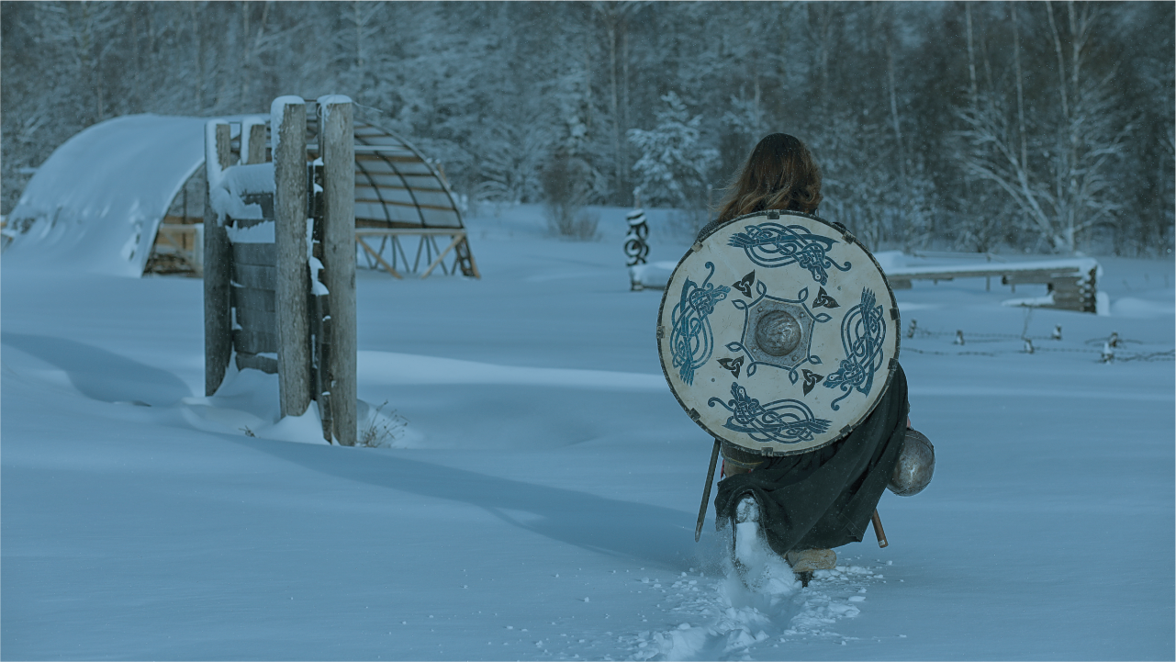
The fight with Grendel’s mother ll. 1494-1625

Slide 5
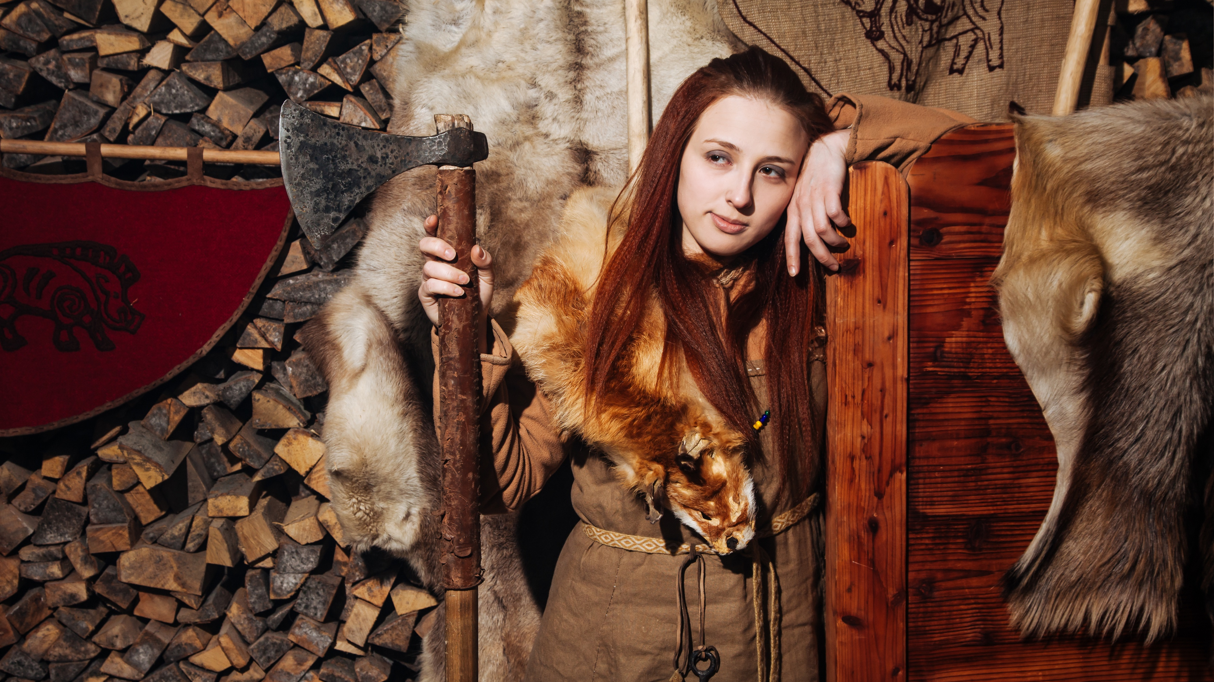
Wealtheow c/c to Grendel’s mother
Both care for their sons, try to protect/avenge them—in vain
Valkyrie name vs “she-wolf of the deep,” “monster-wife”
Weak women in a world of violent men (related to fate of Hildeburh in the Finn saga, Modthrytho in the Offa I tale as opposed to wise and good Hygd—who however cannot save her husband from his folly!)

Slide 6
The mere-cave as anti-Heorot
Both great halls
Cursed natural land vs blessed man-made structure
“Stag” vs wet dark underwater cave=?
Gleaming hall vs ignis fatuus
Guarded by thanes vs sea-monsters (link to Brecca story)
Decorated by weapons, treasures, but also body parts of enemies
Semiotics of the body part: theft of Grendel’s arm; kidnapping of Aeschere whole; two decapitations; only Grendel’s head returned
Bloody churning waters misinterpreted like Grendel’s howls
Danes lose hope and leave; Geats stay (faithful to leader, not like Danes in Finn saga)

Slide 7
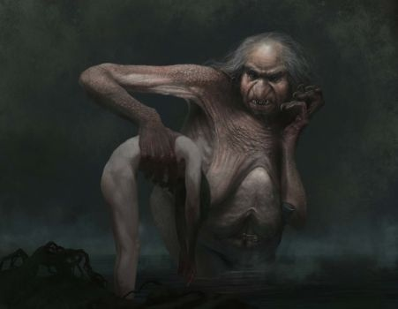
The challenge: kidnapping and killing of Aeschere, Hrothgar’s “right-hand” man
→ appropriate response?
Why does B. call Grendel’s mother as “kinsman,” “he” (ll. 1391-94)?
Why does B. wear his full armor this time?
Choreography of the battle: death-hug, sitting on B.
Why does B. almost lose? How does he win?
Is Grendel’s mother a lesser or a greater opponent than Grendel?

Slide 8
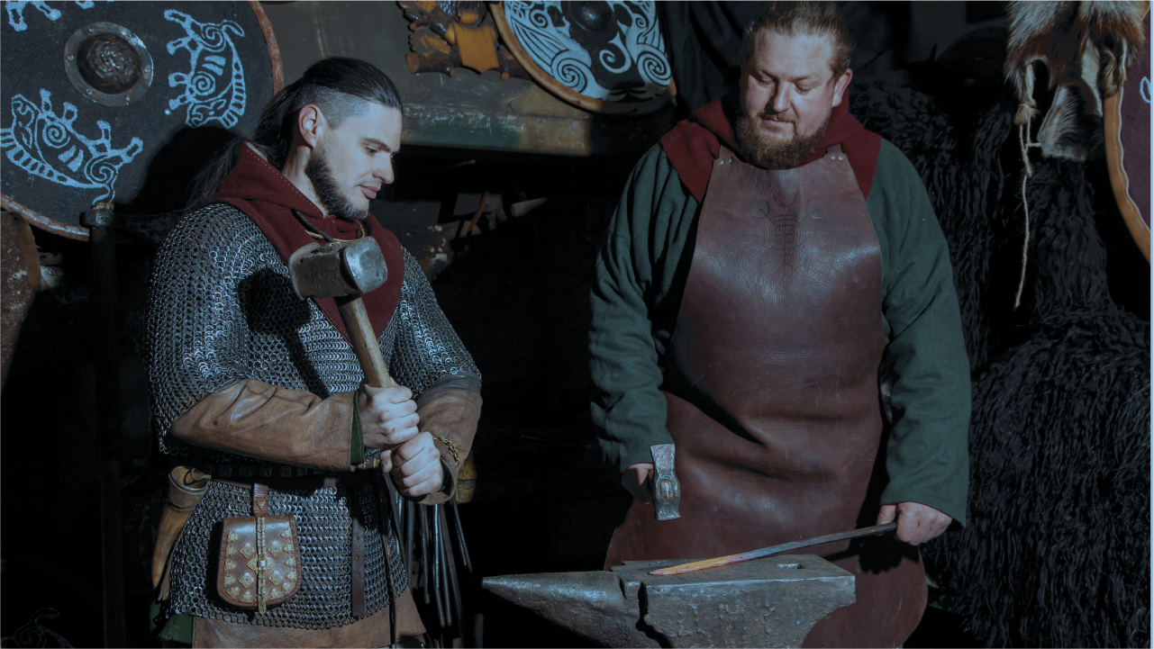
The Sword and the Treasure
Hrunting as a symbol:
Received by/ returned to Unferth
Incapable of harming G’s mother
Giant sword in mere-cave, her own, the only weapon capable of killing her, but melts because of her blood; hilt offered to Hrothgar
Why does B. take back Grendel’s head and the sword-hilt?
The mere-cave’s treasure-trove: why doesn’t B. take any back?
motif of cursed treasure (Nibelungenlied): Wealtheow’s gift necklace won’t protect her or her daughter; gifted to Hygd by B., but won’t protect her: her husband wears it when killed in a foolish raid against the Finns (link to Finn saga)
•
•

Slide 9
The return to Geatland
Emphasis on boat returning laden with treasures, presentation of gift-tribute to Hygelac
Why does Beowulf retell the story? Tale flaw or tale device?
Additional information:
ll. 2022- Freawaru’s tragic story among the Heathobards foreshadowed
Grendel’s pouch
Dead man’s name: Hondscio (“Hand-shoe”) explains his death
Mention of B’s virtues vs his unassuming childhood (ll. 2183-): Joseph Campbell’s “quest cycle” motif in The Hero with a Thousand Faces

