Slide 1
BEOWULF
III

Slide 2
The Fire-Drake (wurm)
Presented as the greatest of the three opponents, scourge of the whole land
Combines Grendel’s (baleful attack at B.’s home) and Grendel’s mother’s (vengeful, fought in his own home ground) traits
Meaning of dragon:
Comet
B’s pride/match
Leftover from another man’s tragic lay (“Last survivor”)
Typical Anglo-Saxon reversal of fate (edwendan)
Satan (with B. as sacrificial Savior, with 12 thanes-Disciples)
Time (symbolic value of his treasure)

Slide 3
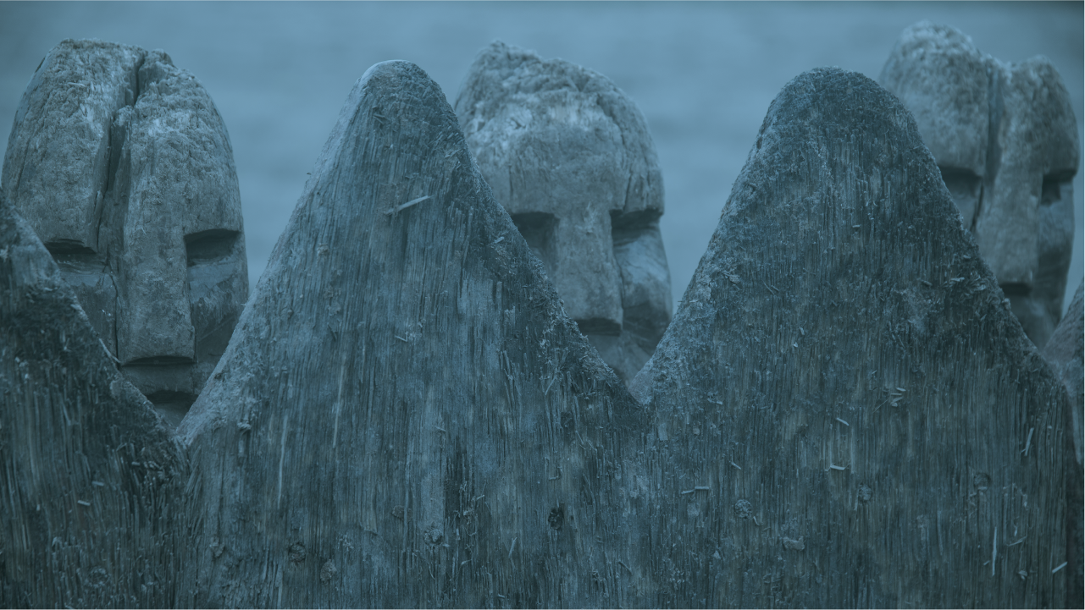
Old and Alone (ān)
No suspense, wyrd (fate) is predetermined by endless blood-feuds, weakening of old age
Similarities between B’s lay and other embedded lays/ characters tie structure together:
B. like Hrothgar, old and “betrayed” by unworthy thanes; home destroyed by monster
B. like Hengest in Finn saga: given his rule by the man who killed his lord, later sly revenge
B. like Heremod, trusted too much in own strength
Cursed treasure motif (allegory for golden youth/prowess?)
B. like Last Survivor, last of the true giants/heros of the Weders
Memories and real-life predictions, not heroic myths, embedded now
Epic begins and ends with a hero-king’s funeral: full life-circle (of hero/epic)

Slide 4
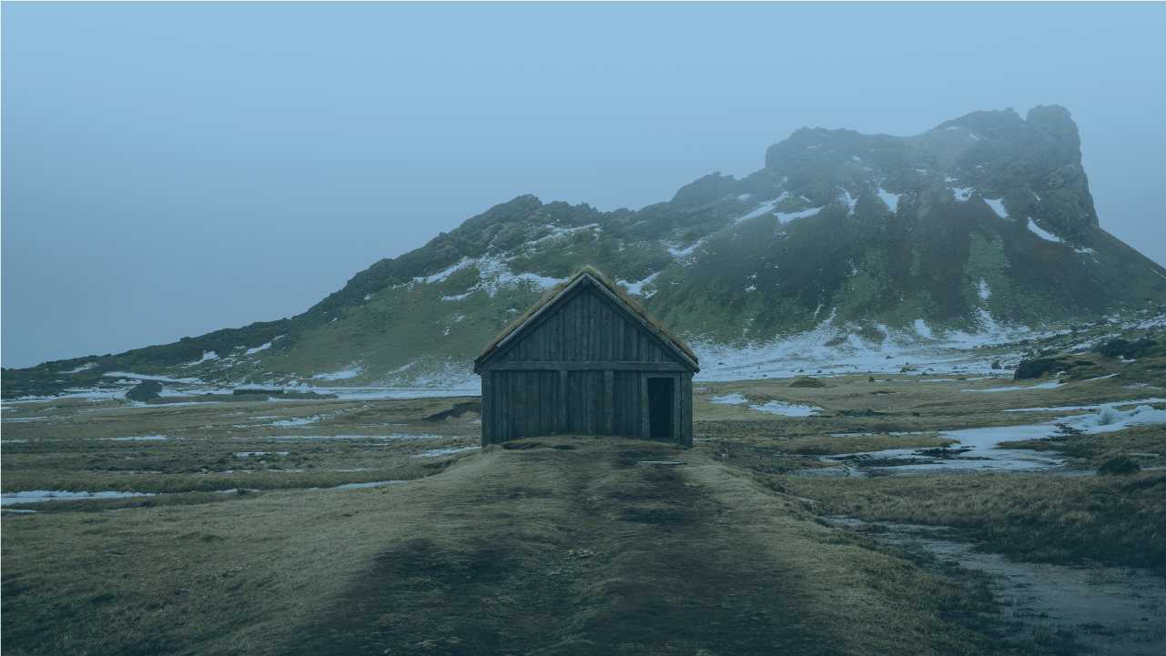
The Warrior Hero’s Death
-Beowulf’s cliffside soliloquy:
prophetic of dark fate of Geats
c/c Hrothgar’s lament
his life flashing before his eyes
the hero doesn’t get overcome, he yields to death (ll. 2419-24)
-Similarities between B. and the dragon:
protect their own (gold/Geats)
both their homes violated
equal adversaries (B. doesn’t know how to fight him—ll. 2519-24), both dead together
Dragon’s scales “scorched,” as if he’d burned himself, not B.
B. incinerated at sea-side, dragon sent off to sea like Scyld Scefing
both buried in a barrow
both buried with dragon-treasure

Slide 5
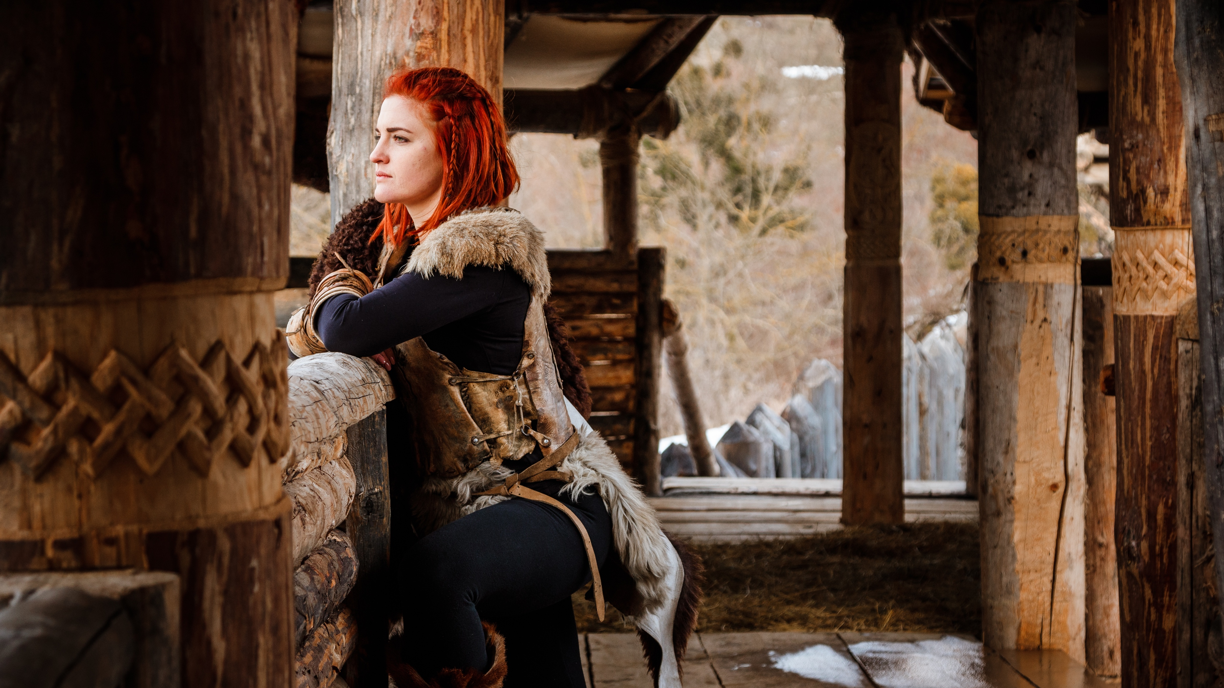
The Role of Wiglaf
Foil to wretched slave (13th in final troupe) who steals the cup and angers dragon
Saves B.’s face: only one who doesn’t betray his Lord (ll. 2599-2601: anti-Judas)
Youngest but most virtuous, inherits the throne and armor of B. (circle of life), metes out laws (ll. 2884-2891)
Three charges against the dragon, three sprinklings with water: baptism and catharsis by fire and water
Also already marked by dark fate (father’s blood-feud with Onela)
Witness and helper to B’s final victory (-laf)
Was he right to bury the hoard with B.?

