Slide 1
BEOWULF

Slide 2
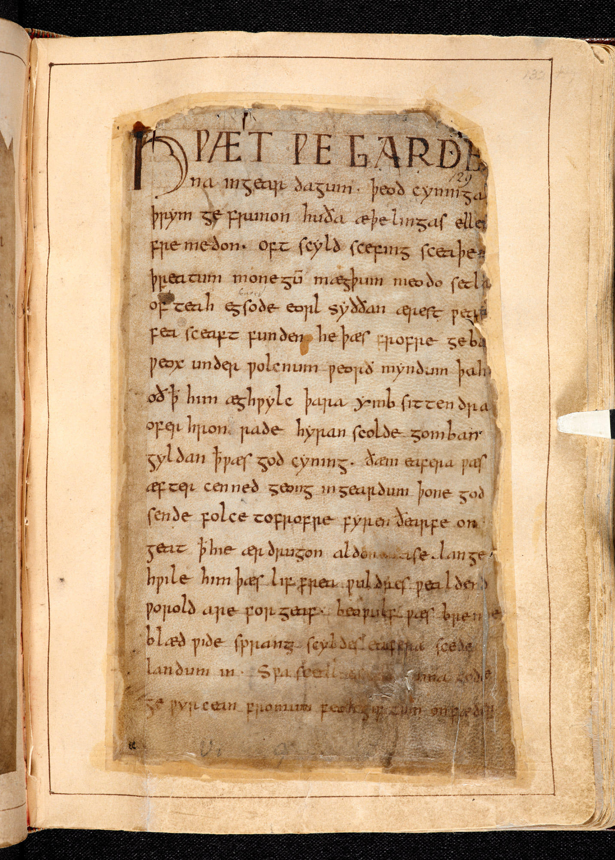
The Beowulf Manuscript
English epic in alliterative verse
Author unknown, title tentative
Oldest and longest poem surviving in Old English; only reference to titular hero
Composed c. 8th century AD; refers to events c. 6th century AD
Only extant copy: Cotton Vitellius A.XV (10th century AD), along with other stories containing monsters

Slide 3
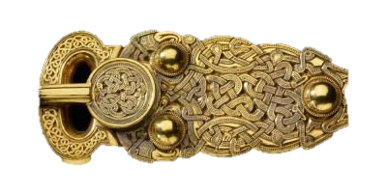
Features of the Poem
Bipartite (rise and fall) or tripartite (3 monsters) structure, interlaced with foreshadowings and references to other sagas (Finn, Sigmund)
Alliteration, synonyms, kenning (“poetical periphrasis,” e.g., “whale-road,” “word-hoard,” “earth-bed”), variation/“ring composition,” symbolic naming (e.g., Beowulf, Ecgtheow), (ironic) litotes, c/c of Beowulf to other saga heroes
Balance between old pagan world and Christian audience values →pessimistic outlook

Slide 4
Beowulf ll. 1-1062
Epic opening: “Hwaet!”, “We have heard of…”
Values: laf, ellen (fame, bravery), thane-lord relationship
Opening with Scyld Scefing’s funeral (esp. ll. 51-52)—why?
Why does Grendel hate Heorot?
Portrait of Beowulf:
a. his motive for helping Hrothgar
b. the challenge of the coast-guard
c. his encounter with Hrothgar
d. his response to Unferth’s challenge: the Breca swimming contest
e. his decision to fight Grendel bare

Slide 5
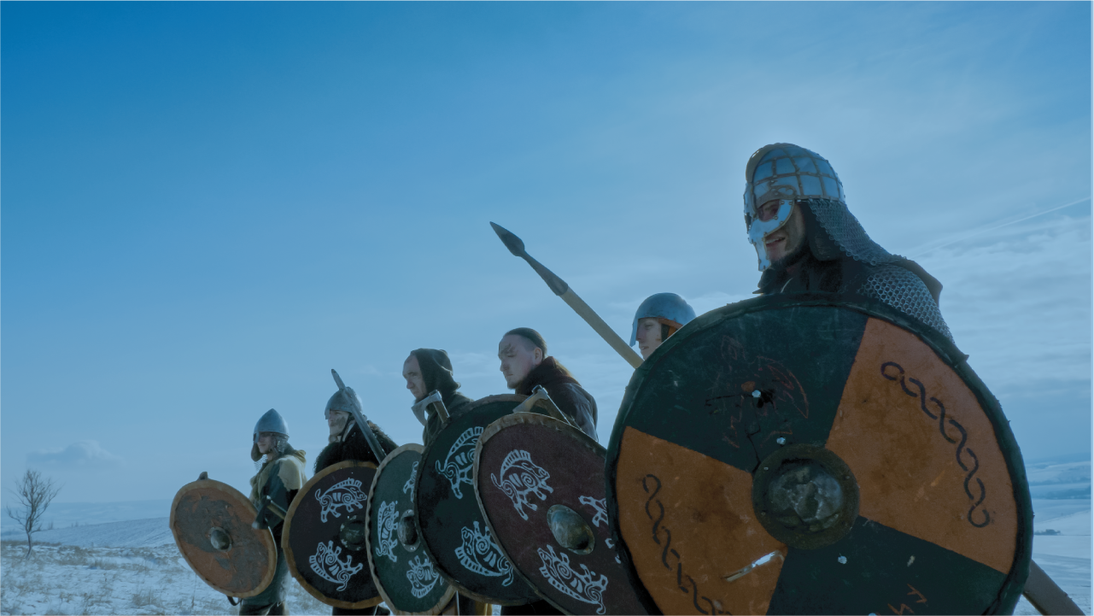
The Fight with Grendel
Similarities between hero and monster (“ellen,” “mund-gripe”)
Battle “direction”: montage of perspectives
Why must one Geat comrade be killed first?
“Forced” theology?
The semiotics of laf
The tracking of the prints by rearing riders
The hanging of the arm for display
Gift-giving and song-praise: Beowulf compared to Sigemund vs. dragon—foreshadowing?

