Slide 1
EVERYMAN
The English Morality Play

Slide 2
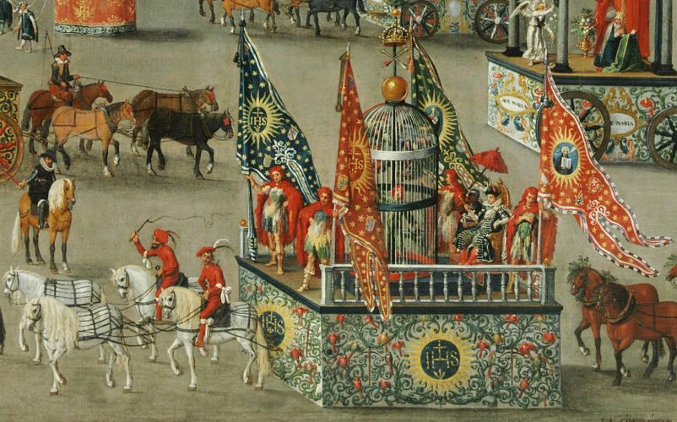
The Origins of British Drama
Pageants and morality/passion plays, usually in cycles
Originally at church altars on Christmas as liturgy plays (10th century), lay versions of biblical episodes; at end of 13th century secularized, become allegories with touches of real life
Acted by guilds-men for rustic audiences; marked by the town/ area in which the craftsmen practiced
Performed on holidays upon perambulating open wagons with 2-story stages on them (like guild-sponsored float parade) or in church yards and town halls, from dawn until dusk

Slide 3
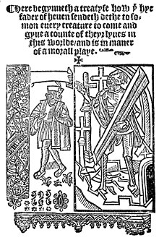
Everyman (c. 1495)
Inspired or translated by a Dutch play by same name, Elckerlijk
“A Treatyse how the hye fader of heven sendeth dethe to somon every creature to come and gyve a counte of theyr lyves in this worlde”
Marked by the 10-year experience of the plague (esp. 1348): rapid decline, tortuous demise, belief it was punishment for humankind’s sins
Unlike other moralities (where God/Jesus trounces the Devil), this has (Every)man at its center (prefiguring the Renaissance); even the church is only tangential
Plot

Slide 4
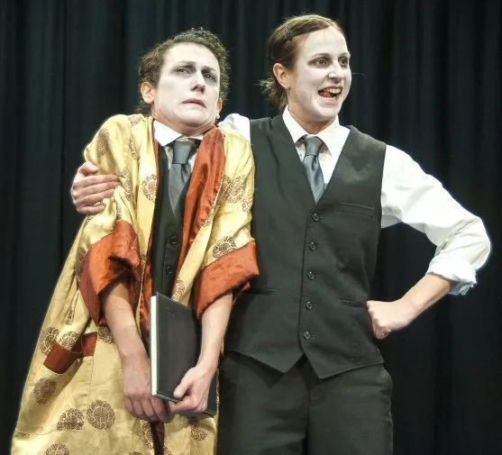
Characters
God—almost humanized (despairing, almost fallible)
Humans—given to riches and pleasures
Death—a useful and honest functionary
Fellowship—a fair weather friend only, hypocrite
Cousin, Kindred—comic relief (“I have the cramp in my toe”; “Ye shall have my maid…”)
Goods—cruel, lazy, corruptive, opposite of salvation
Good Deeds—helpful though weak; healed by E’s penitence; gives him garment of contrition
Knowledge—assured
Confession—holy man/ “cleansing river”; gives E. scourge for penance
Beauty, Discretion and Strength—why those “persons of great might”? Forsake E. at the sight of grave, along with Five Wits
Priesthood (not seen)—holds the keys to heaven (holy sacraments, teaching Holy Scripture); but evil priests are castigated
Angel—announces happy metaphysical conclusion
Doctor—gives moral of the story (authority)

Slide 5
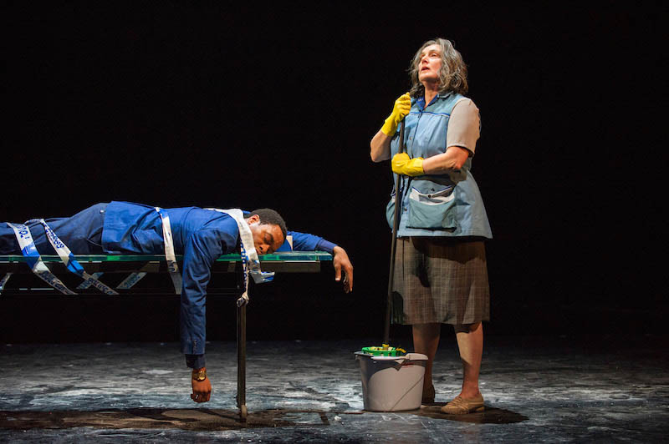
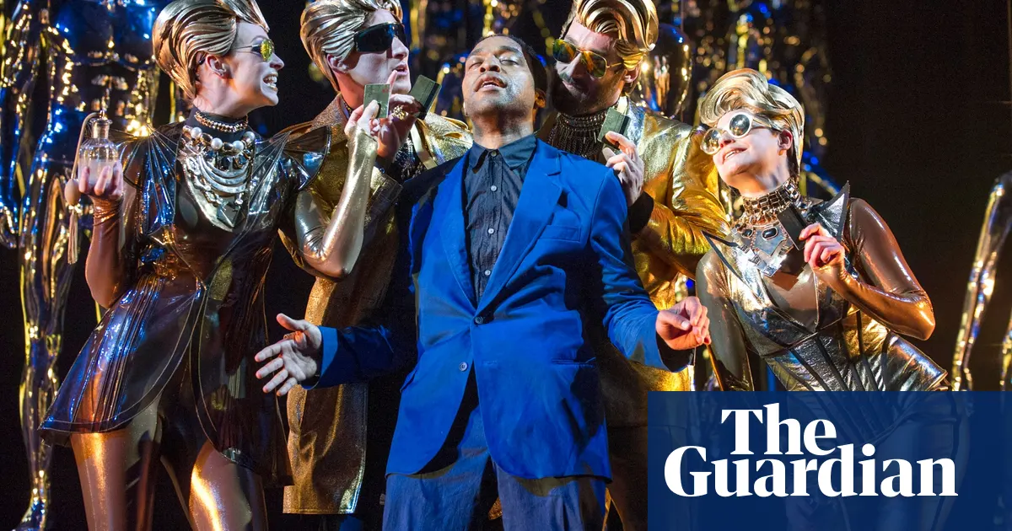
Themes
Life as a journey to the grave
Goods, life, joys, capacities, all are lent
Irony: only good deeds (that we do for others) stay with us; E. must do a good deed for GD to restore it
Riches and joys make one particularly liable for a bad death
Doing penance (scourging) as prayer, preceded by magnificat
The soul as “excellent elect spouse to Jesu” (!); death as “marriage,” “rest,” and “salvation”

Slide 6
Thank you for a wonderful semester! And now, time to evaluate at: https://survey.uoa.gr/L669859

