Slide 1


Le Morte D’Arthur
by Sir Thomas Malory

Slide 2
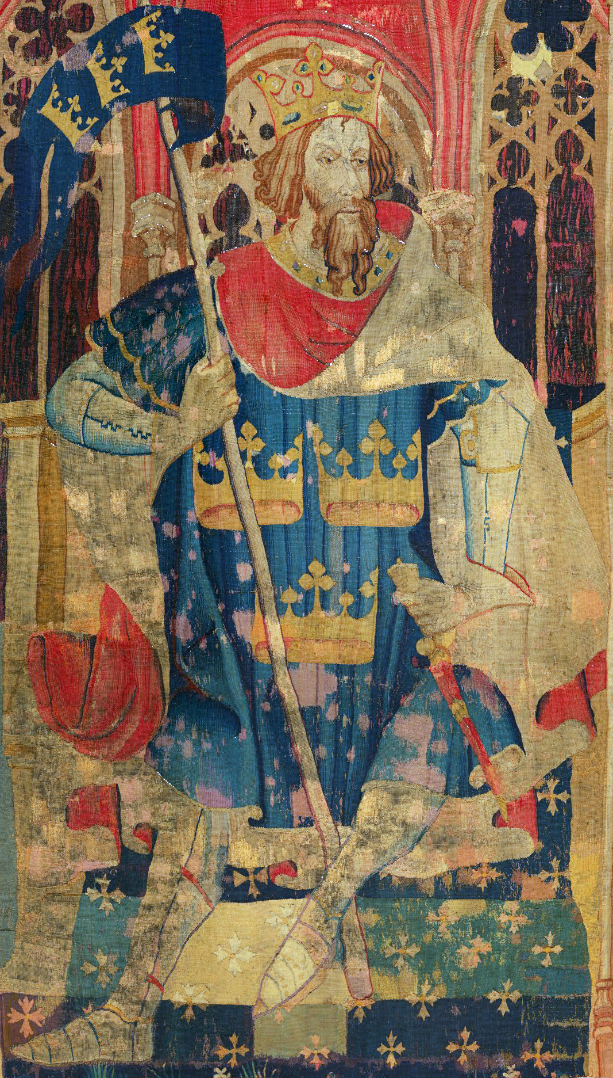
From History to Legend
Historical Arthur:
5th century (Welsh? Roman? Celt?) officer/chieftain who resisted Anglo-Saxon invasion from the south and Pict raids from the North
Earliest mention: The Goddodin in Old Welsh, by Scottish bard Aneirin (c.600 AD)
Welsh chronicle of Nennius, History of the Britons, in Latin (early 9th century)
Exponential proliferation of story, now claimed all over the UK

Slide 3
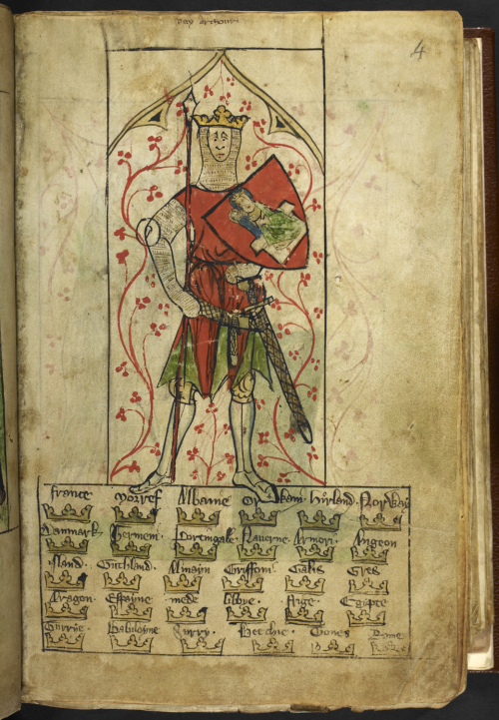
Sources for Le Morte
Arthur as “king” first in Geoffrey of Monmouth’s Welsh pseudo-chronicle
Historia Regum Britanniae (c.1136 AD); along with Geoffrey’s poem,
Vita Merlini (1150AD) source for:
  - Marie de France’s late-12th c. lais and the French post-/vulgate cycles
  -Chrétien de Troyes’s Arthurian Romances (added Lancelot and
  Gwenevere’s romance)
  -(Robert) Wace’s Le Roman de Brut (c.1155; added Round Table, Excalibur)
  -Layamon’s alliterative Brut (end of 12th c.)→ The Alliterative Morte Arthure (c.1400)
  -Robert de Boron’s poem Merlin (end of 12th-beginning of 13th century)
Thomas of Britain’s Anglo-Saxon Tristan (1173 AD) compiling 6th-century Irish and Cornish legends
Wolfram von Eschenbach’s Parzival in Middle High German (c. 13th c.)
The Mabinogion (collection of 13th c. Celtic stories in Middle Welsh).

Slide 4
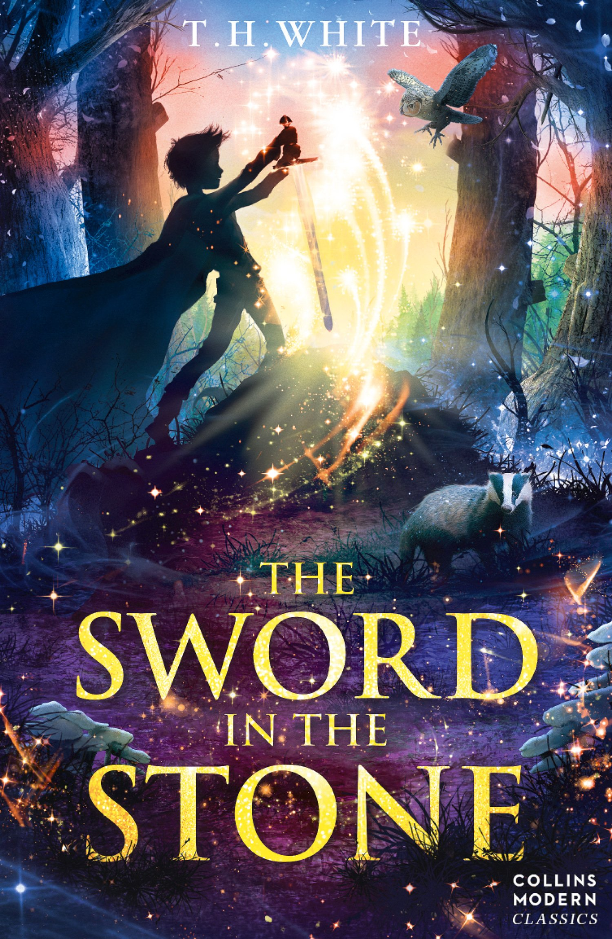
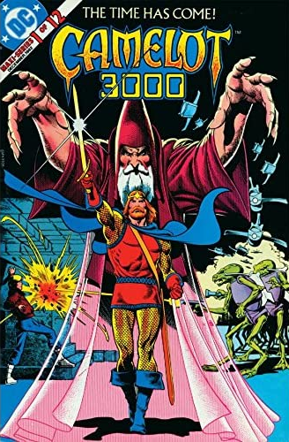
Post-malory greatest hits
Literature:
Edmund Spenser, The Faerie Queene (1590-96)
Alfred, Lord Tennyson, The Idylls of the King (1859-85)
Mark Twain, A Connecticut Yankee in King Arthur’s Court (1889)
T.S. Eliot, The Waste Land (1922)
T. H. White, The Once and Future King Trilogy (1958)
John Steinbeck, The Acts of King Arthur and His Noble Knights (1976)
Bolland, Brian (art) and Mike W. Barr (story), Camelot 3000 (graphic novel, 1982-85)
Marion Zimmer Bradley, The Mists of Avalon (1983)

Slide 5
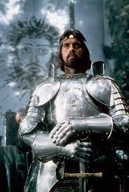
Films
Camelot by Alan Jay Lerner and Frederick Loewe (musical, 1960)
Monty Python and the Holy Grail by Monty Python (spoof 1975)
Excalibur by John Boorman (epic 1981)
King Arthur by Antoine Fuqua (historicized 2004)
Tristan & Isolde by Ridley Scott (2006)
King Arthur: Legend of the Sword by Guy Ritchie (2017)

Slide 6
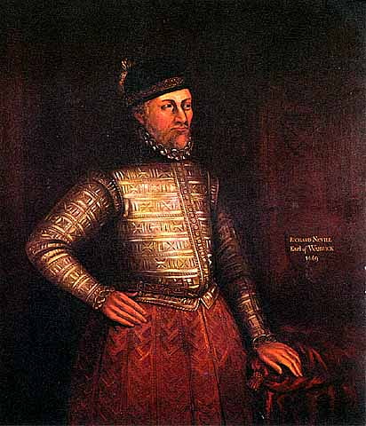
Sir Thomas Malory (c. 1400-70)
Disgraced, imprisoned knight supporting the House of Lancaster
Compiles (monumental task!) and composes Morte in jail in the middle of the War of the Roses (1453-85), c.1469-70
Perhaps originally intended as 8 books, Le Morte was eventually published posthumously as a single, heavily edited volume by William Caxton in 1485).

Slide 7

Inter pretations
Historical (defeat of the House of Lancaster in War of the Roses; decline of civil war-torn England)
Historico-allegorical (the wars between France and Britain; Roman Empire claim)
Christian allegory (vs Morgana le Fey)
Nation charter of hope: (“Hic iacet Arthurus, rex quondam, rexque futurus”)

Slide 8

Book I
Chapters I-VII
Miraculous but also lawless conception of Arthur by Uther Pendragon upon Igraine, wife of Gorlois, Duke of Cornwall, at Tintagel
Doubleness and liminality:
Uther beds Igraine in the form of her dead husband; new life out of dead (?) body
trouble between old and new family ties (three half-sisters, one evil necromancer)
Arthur raised, nourished and christened outside of his home (commoner—and proclaimed by commoners—AND king)
Arthur proclaimed by dying king and God (on Christmas-New Year in London in cathedral churchyard) as next king
Semiology of sword in the stone
Miracle vs political machinations, grievances: commoners proclaim Arthur king!

Slide 9
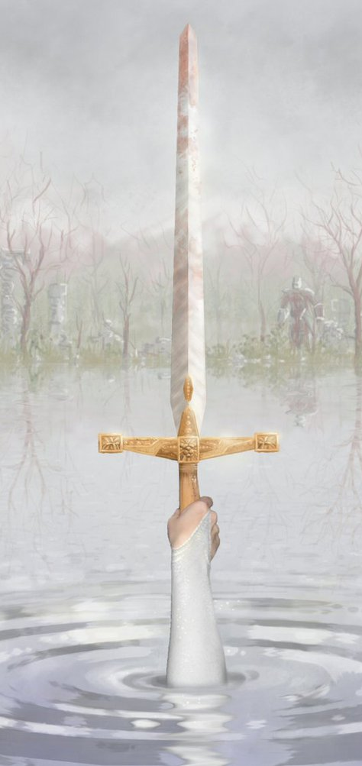
Book I
Chapters XXV, XXVII, XIX
Arthur’s birthright sword destroyed in jousting match with King Pellinore
Sword by Lady of Lake (deal c/c to that of Uther with Merlin) and magic scabbard
Arthur unknowingly sleeps with his sister Morgause, begets Mordred
Prophecy of his son destroying him and his realm (the question of Fate)
“Herod” solution to problem: mass infanticide (portrayed as “fortune,” so no blame)
“Questing Beast” allegory: unquenchable desires; magic of land

Slide 10
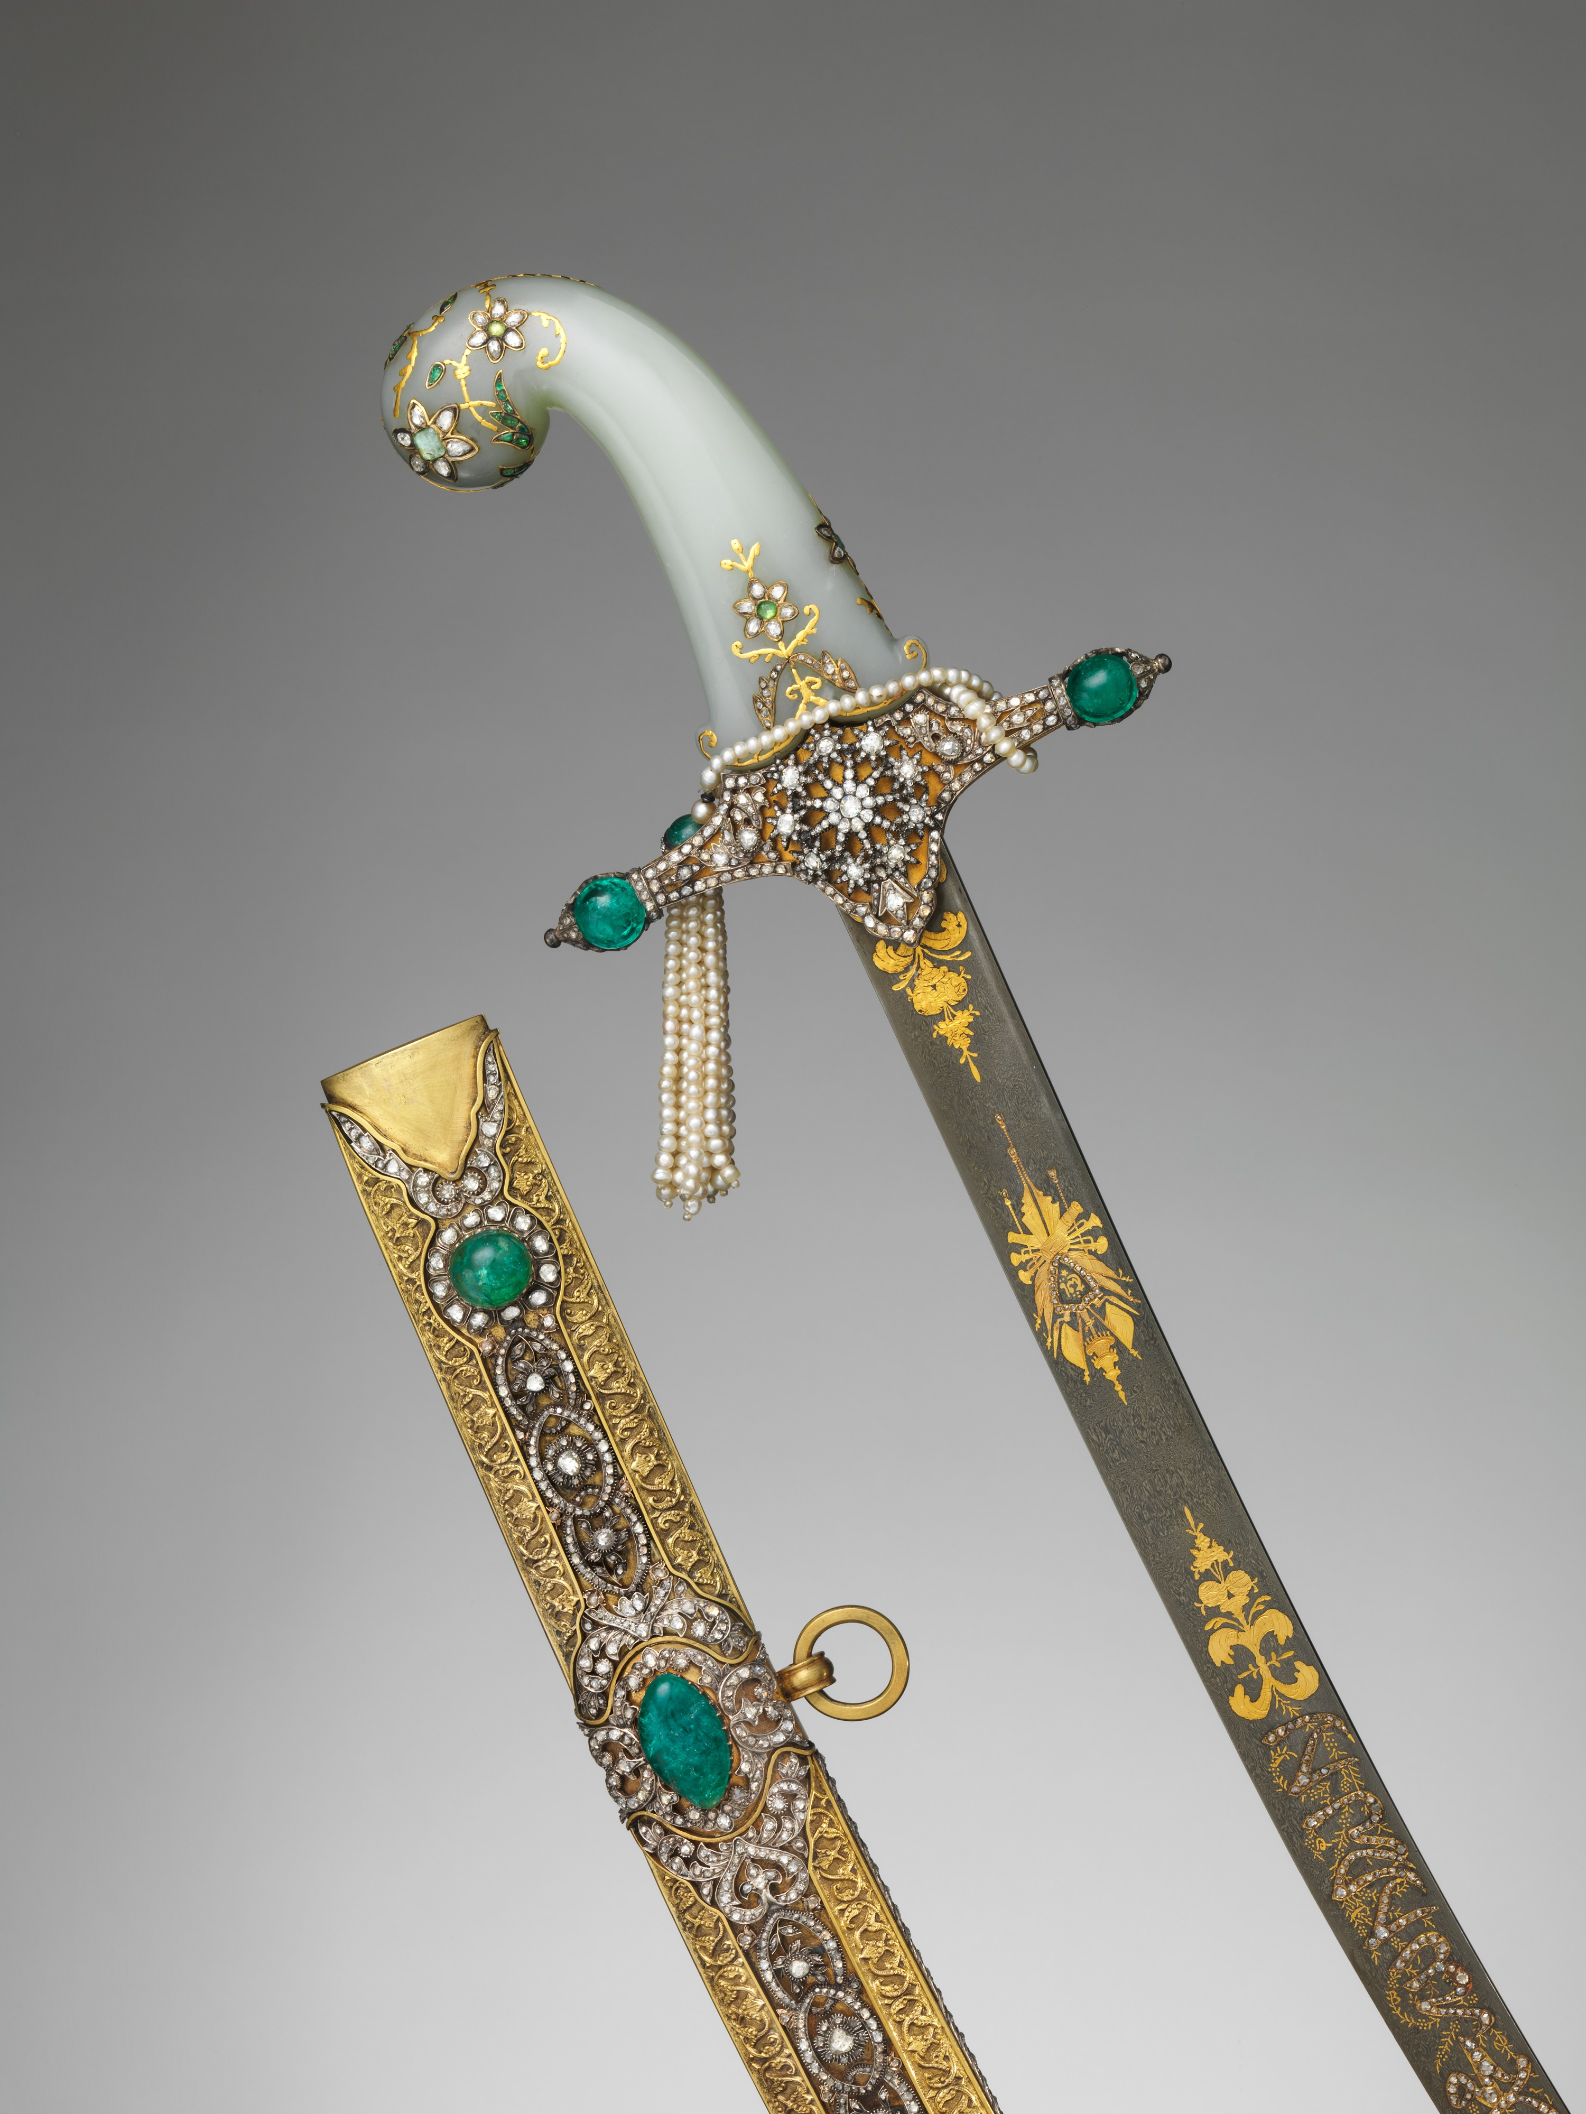
Book Ii
Chapters I-IV
Again, semiology of drawing sword out of the damsel’s scabbard
Knight must be purest possible (though Balin is poor and just out of jail)
Lady has sword hidden inside a “furred” mantle
Balin keeps sword despite warning (“cursed treasure”)
Lady of the Lake asks for a head as payment for Excalibur, loses hers to her victim, Balin
Damsel with sword false, took a lover, wants her own brother slain for killing her lover
→submission of power of women unto men via castration (motif)

Slide 11
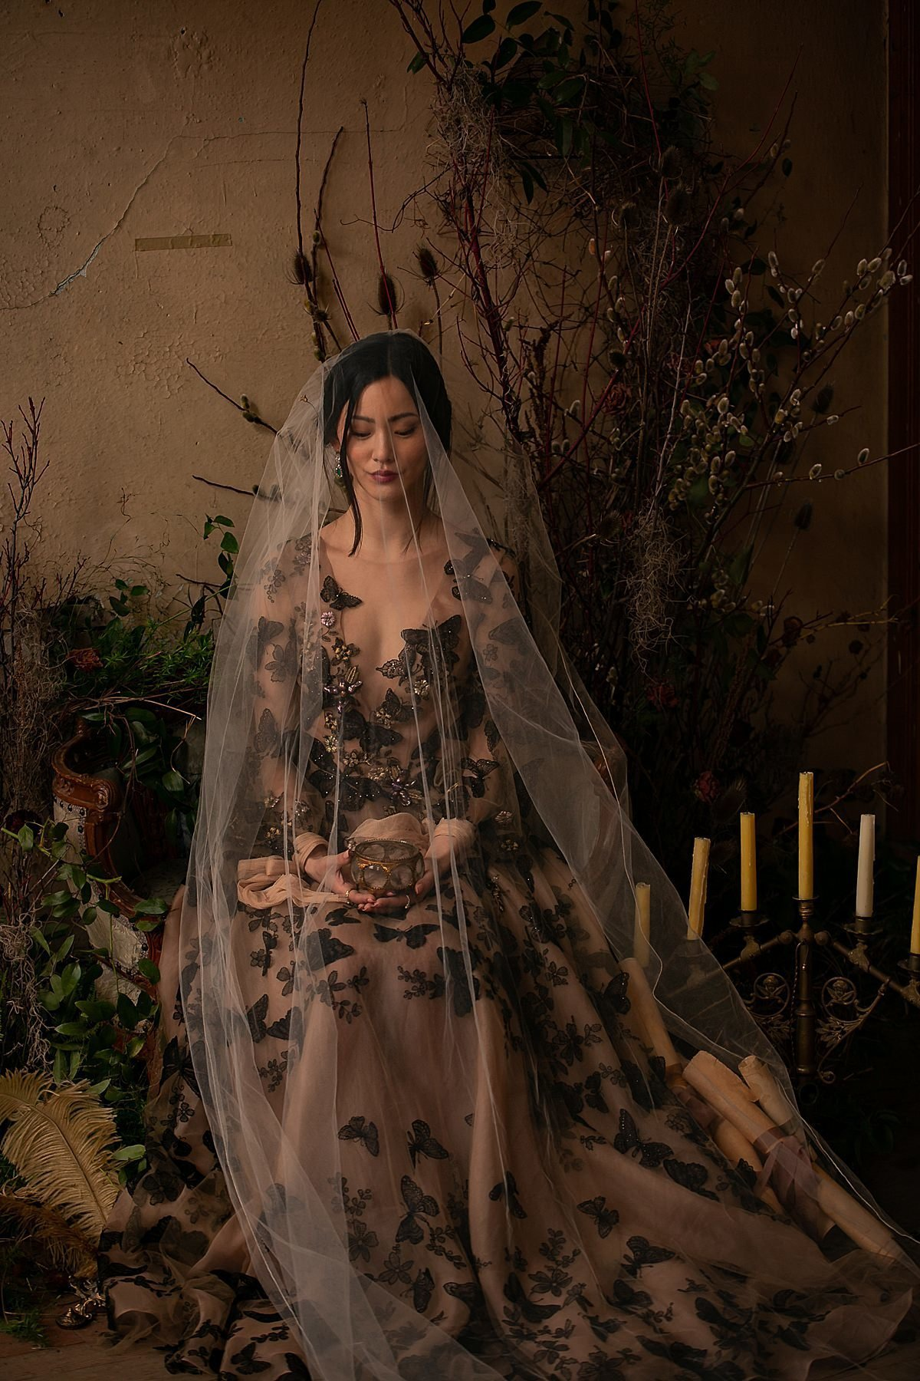
BOOK III
Chapters I-IV
Arthur’s love for Guenever (Merlin’s objections)
Origin of the Round Table: a wedding gift from Leodegrance (originally Uther’s), along with 100 knights; Arthur must provide 50 more, but can only find 28 (why?)
Number symbolism?
The two empty seats (Pellinore’s and Siege Perilous)
Meaning of Sir Tor’s story (bastard son of king Pellinore, raised by cowherd)
Why Tor juxtaposed to Sir Gawain’s knighting?
Family, favors and vendettas (prefiguration?)

Slide 12

BOOK IV
Chapters I, VI-XVI
-Merlin falls for Nimue, ends up under a rock.
-Hart hunt—exhausted hart killed by a hound (symbol?) near water: prefiguration of Arthur’s fate
Three knights enchanted by silk ship: Uriens ends with his wife Morgan le Fay, Arthur in evil Sir Damas’s prison by Le Fay’s scheme
Le Fay gives her lover Accolon Arthur’s sword and scabbard, bids him to kill sb. (Arthur) for her; gives Arthur a fake set
→Power rests with good man, but dominance with good sword!
Accolon redeemed, sent dead as a gift to Morgan
Morgan stopped from killing her sleeping husband by her son, Sir Uwaine
In revenge for her lover’s death, Morgan steals scabbard from Arthur:
gendering of sword and scabbard→ a woman is a man’s best protection?
Morgan sends her brother a poison mantle (Medea); her son Uwaine banished from court: women initiators of quests, magic

Slide 13
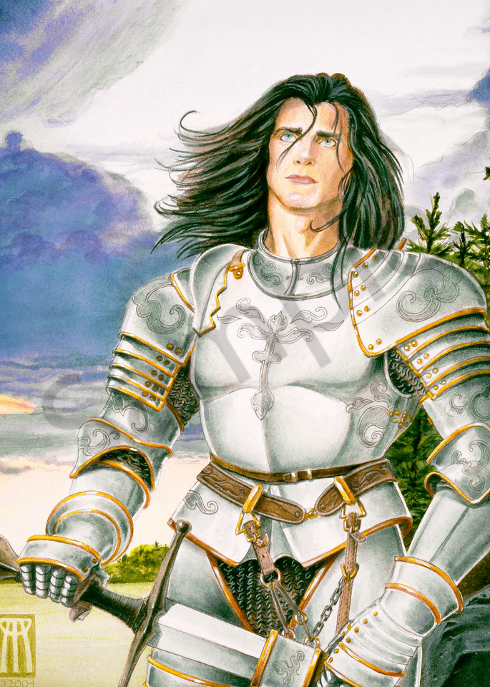
Book VI
Chapters X, XII, XVII-XVIII
Sir Launcelot as a paragon of knightly virtues: prowess and courtesy, charter of knighthood:
-Slays Sir Peris, who abused his power to rob and rape
-Puts knightly adventures over wedded domesticity
-Decries infidelity
-Wins enormous renown through acts of honorable prowess (defeats three brother knights at once, and spares them), but is humble (exchanges armors with Sir Kay, probably the least powerful knight of the RT)

Slide 14
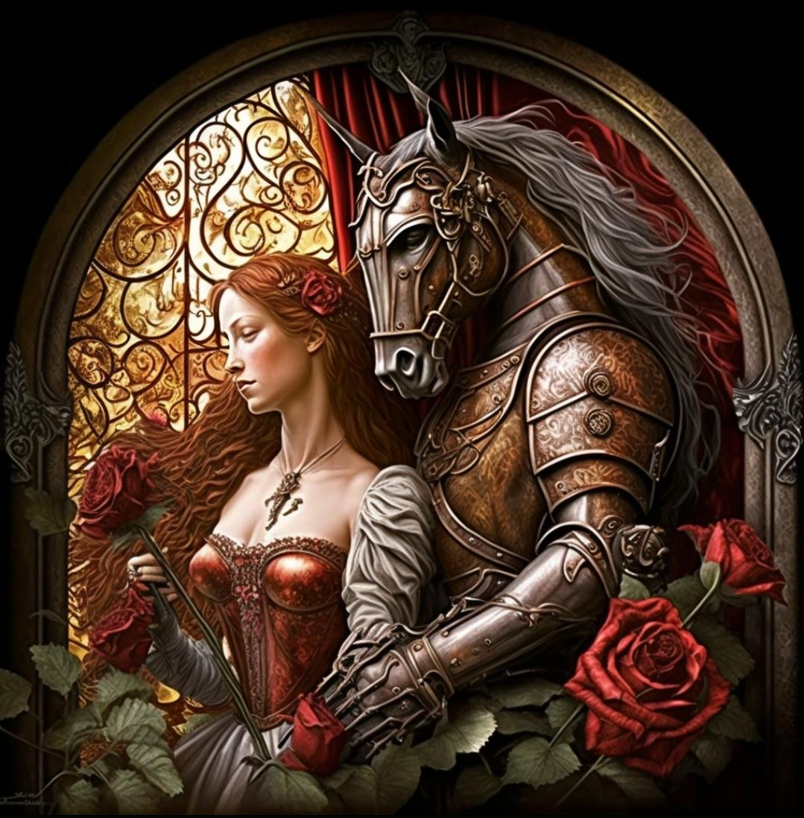
Book X
Chapter XXIV
Sir Lamorak and Queen Margause’s illicit affair:
-Gaheris slays his own mother (vs Uwain forgiving Morgana?)
-the Court’s reaction: a good knight counts more than a queen’s honor (foreshadowing)
-the inevitability of vendetta of Uriens’s sons vs Lamorak (more foreshadowing)

