Slide 1
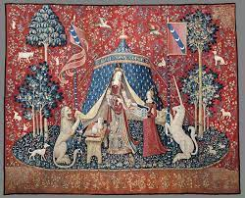
Mediaeval Literature
AN INTRODUCTORY CHRONOLOGY

Slide 2
WHY do we like/hate the Middle Ages?
1

Slide 3
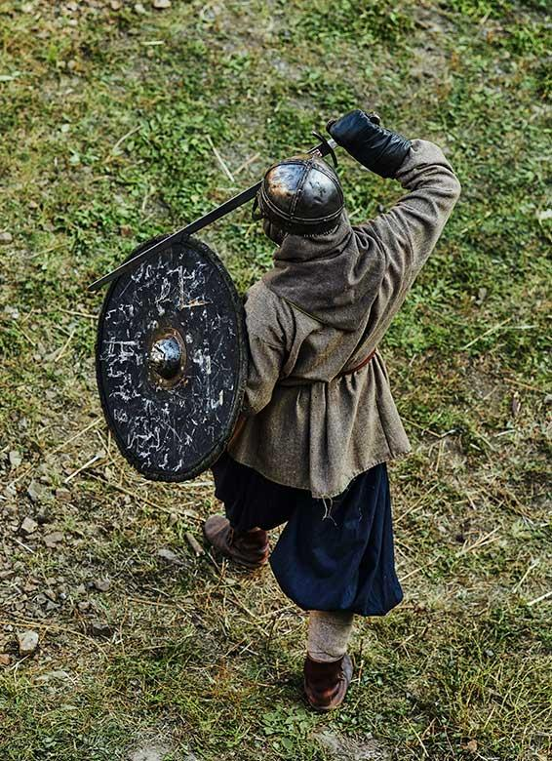
A time of contradictions
From about 500 to 1400–1500 CE
Divided in either early and late; or early, central or high, and late
“…a dynamic period during which the idea of Europe as a distinct cultural unit emerged. During late antiquity and the early Middle Ages, political, social, economic, and cultural structures were profoundly reorganized, as Roman imperial traditions gave way to those of the Germanic peoples who established kingdoms in the former Western Empire” (Encyclopedia Britannica).
.

Slide 4
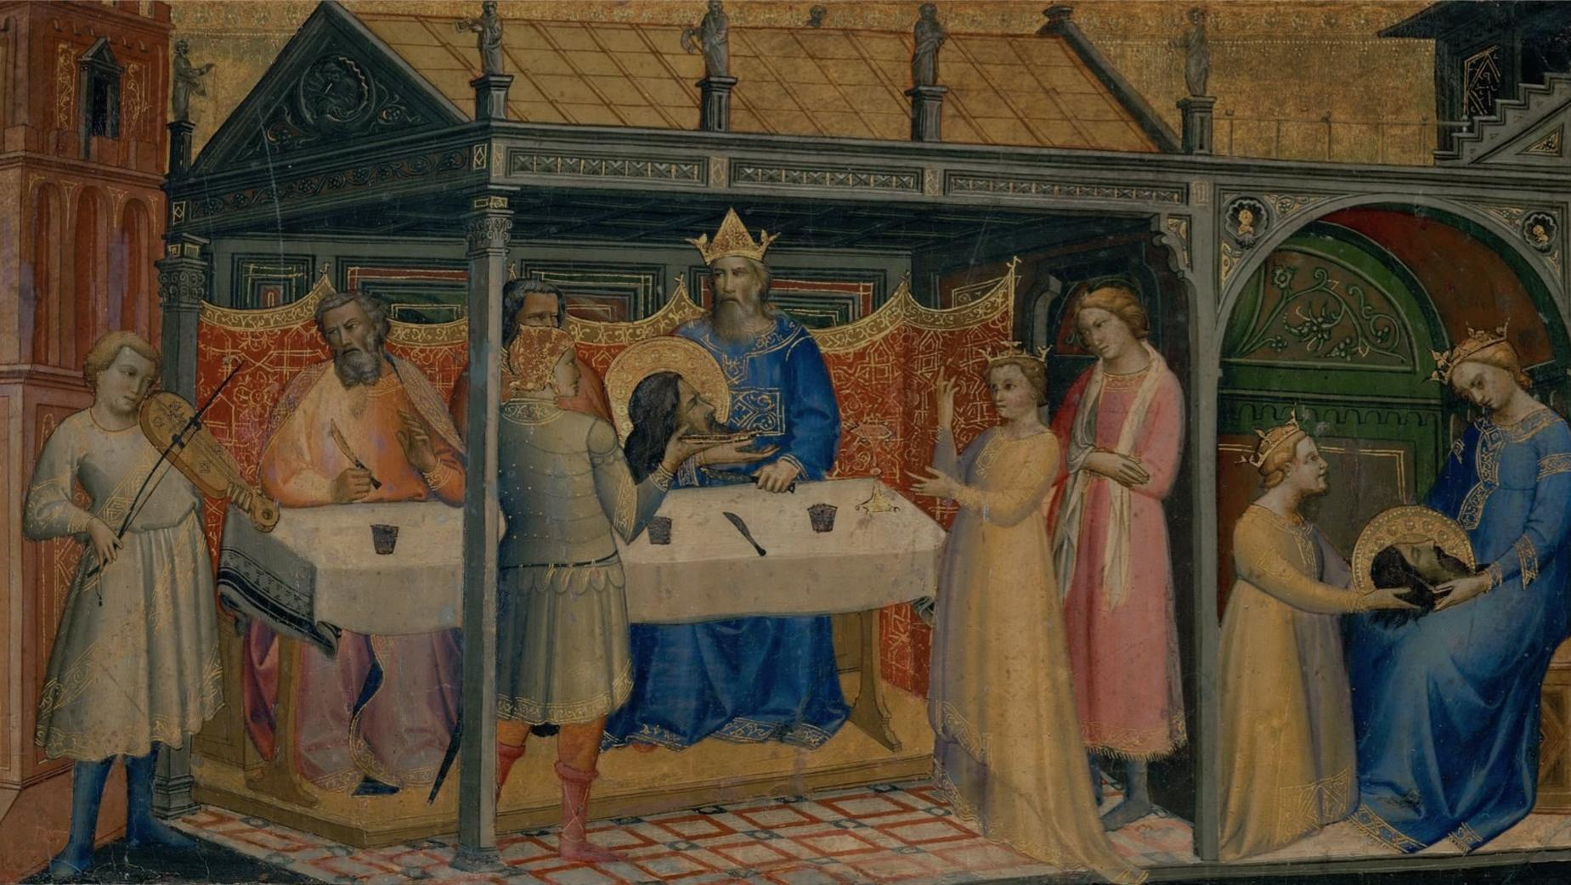
THE THREE AGES OF THE MIDDLE AGES

Slide 5
The Early Middle Ages
The ancient Mediterranean ecumenical world was divided into the civilizations of East Rome, or Byzantium (476CE) and the Western empire. The West was then plundered by invasions by the Huns, Goths and other tribes, leading to the formation of European nationalities (Gothic art and architecture). Arab Islam battled Byzantium for dominance in the Mediterranean and Near Eastern area in the 7th-8th centuries (Merriam-Webster Dictionary)
Serfdom (feudalism) and thanes/nobles/vassals under local lords (“princes”), some of whom later became “kings”
Christianity becomes the dominant religion throughout Europe→the papal monarchy
Named “dark Ages” and dismissively “middle era” by Petrarch who, although a devout Christian, was dismissive of the eras following the glory of classical Rome

Slide 6
The Early Middle Ages
The 8th-century English monk and computist Bede (673–735) introduces the method of counting years from the birth of Jesus, anno Domini (“in the year of our Lord”), which forms the basis of the modern notion of the Common Era
768-814, the Franc king Charlemagne becomes the first European Emperor (his empire was all of central Europe): laws, education, economic expansion →the Carolinean Renaissance
1066 Norman duke William “the Conqueror” defeats Anglo-Saxon king Harold II at Battle of Hastings; French the ruling language until Statute of Pleadings is passed by the Parliament in 1362
1085: The Domesday Book (biggest census of landholdings in Britain until 19th century, by William the Conqueror) is completed.

Slide 7
The Middle period
During the High Middle Ages, massive population growth in Europe, as well as technological advances. Great political changes, feudalism becomes popular
1095: The First Crusade is decreed. 1204 sacking of Constantinople, leading Byzantine scholars to migrate to Europe
1170: Thomas Becket is murdered as part of the struggle between rising monarchy and the power of the Roman Catholic church
1215: Magna Carta is signed by King John (“Lackland”)
1314: Battle of Bannockburn, a victory of the army of King of Scots Robert the Bruce over the army of King Edward II of England in the First War of Scottish Independence. Although it did not end the war (which lasted for 14 years more), Bannockburn is still a major landmark in Scottish history and marked the form of feudal unrest of the times.

Slide 8
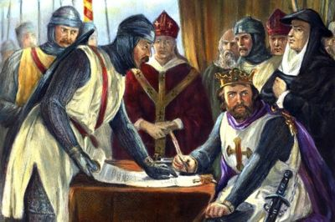

Slide 9
The Middle period
When the Christian kingdoms took control of the Arabic cities in Spain in the 12th century, they opened up the libraries of Cordoba, Seville, and especially Toledo to western scholars–most of whom didn’t speak Greek, but many of whom could read Arabic. Hence Aristotle and his logic came to Europe again, and planted the Renaissance seeds
→the birth of the university, the recovery of ancient Greek thought, and the soaring intellectual achievements of St. Thomas Aquinas (c. 1224–74)

Slide 10
The Late period: decline
Disasters of war, famine, and pestilence
“100 Years’ War”: originated from disputed claims to the French throne between the English royal House of Plantagenet and the French royal House of Valois. Started on 24 May 1337 with a challenge to Edward III’s claims to French lands and lasted 116 years, until 1453, with the victory of the French.
-Important events:
  the Battle of Crécy (August 26, 1346); fought in northern France between a French army commanded by King Philip VI and an English army led by Kind Edward III. The French attacked the English in northern France, but the English won, with heavy loss of life among the French. Crécy established the effectiveness of the longbow as a dominant weapon on the Western European battlefield.
  1415: Henry V soundly defeats superior amounts of French at Agincourt.
  Involvement of Joan of Arc leads to victory in the siege of Orleans in 1429 and turns the tide for France.
  Final event: Battle of Castillon on 17 July 1453, establishing the effectiveness of newly-established field artillery.

Slide 11
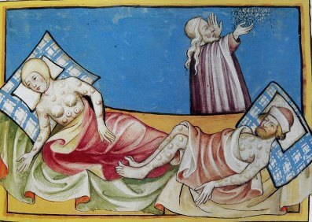

Slide 12
The Late period: decline
The Black Death, 1346-1353; 1347 enters Europe from the Black Sea during the Golden Horde siege of Caffa port, in a year reaches Ireland; tortuous death by bubonic or pneumonic form within 48 hours
1381: The Peasants' Revolt, also named Wat Tyler's Rebellion or the Great Rising, a major uprising in England in 1381. Caused by the multiple tensions generated by the plague in the 1340s, the high taxes resulting from the Hundred Years’ War, the burdens of serfdom, and a 14 year-old Richard II as King in London, the revolt heavily influenced the course of the War, by deterring the raising of more taxes to pay for military campaigns.
1450 Johannes Gutenberg introduces printing to Europe with his invention of the mechanical movable-type printing press. His work started the Printing Revolution in Europe and is regarded as a milestone of the second millennium, ushering in the modern period of human history (“Age of Print/Paper”)
1453 Fall of Constantinople
Controversy concerning heresy within the church, which later led to reformations (Church of England; Protestantism) but many of the underlying social, intellectual, and political structures remained intact. In the 15th-16th centuries, European intellectual and economic revival, conventionally called the Renaissance.

Slide 13
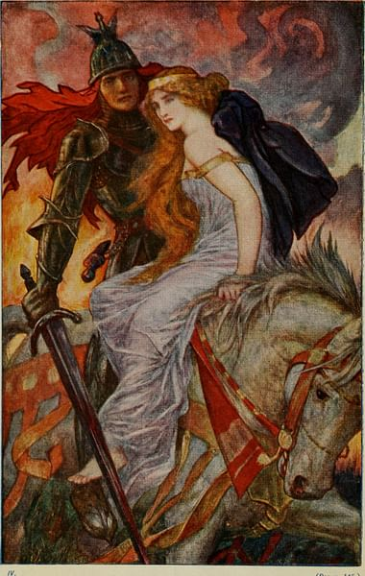
Afterlife:
Dismissed by humanists, the Enlightenment, and the Age of Reason, the Middle Ages experienced a mutated revival in the Romantic spirit of the late 18th-early 19th century.

Slide 14
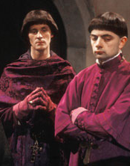
“Jolly Jankin”
By Anonymous (c. 1450AD)
‘Kyrie’, so ‘kyrie’,
Jankin syngeth merie
With ‘aleyson’.
As I went on Yole day
In our prosessyon
Knew I joly Jankin
Be his mery ton:
Kyrieleyson.
Jankin began the Offis
On the Yole day,
And yet me thynketh it dos me good,
So merie gan he say
‘Kyrieleyson’.
Jankin red the Pistil
Ful fair and ful wel,
And yet me thinketh it dos me good,
As ever have I sel.
Kyrieleyson.
Jankin at the Sanctus
Craketh a merie note,
And yet me thinketh it dos me good –
I payed for his cote.
Kyrieleyson.
Jankin craketh notes
An hundred on a knot,
And yet he hakketh hem smaller
Than wortes to the pot.
Kyrieleyson.
Jankin at the Agnus
Bereth the pax-brede,
He twynkeled, but sayd nought,
And on myn foot he trede.
Kyrieleyson.
Benedicamus domino,
Crist fro schame me schilde.
Deo gracias therto –
Alas, I go with childe!
Kyrieleyson.

Slide 15
The carnivalesque
Blend of ecclesiastical Latin with vernacular sing-song English→ result?
Title of poem
Gradual sense of transgression: signs?
Final stanza:
  increased citations from liturgical Latin—double entendre?
  Effect of rhyming punchline
  Effect of final refrain-benediction
Why would such a song be immortalized? Carnivalesque effect?
Concept introduced (originally as “carnivalization” by Russian theoretician Mikhail Bakhtin in Problems of Dostoevsky’s Poetics (1929)
Denotes the—potentially subversive—upending of the status quo and the ritual practice of transgressions for controlled periods of time through parody, carnival, and satire, in order to diffuse social discontent.

