Slide 1
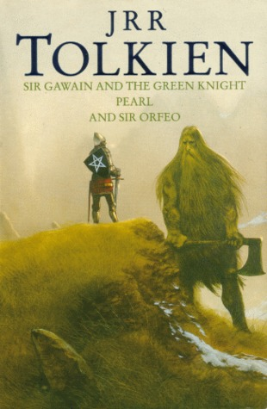
SIR GAWAIN AND THE GREEN KNIGHT, II
Cherchez la femme!

Slide 2
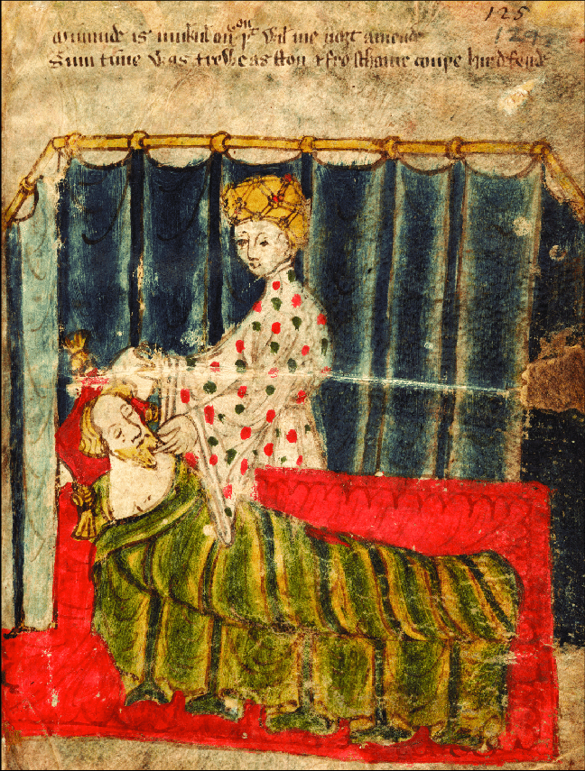
ll. 1126-end
The hunt:
-Lady hunts Gawain three times (chivalric duty of obliging nonviolently—ll.1224-25; 1490-1502; 1770-73)
-The three quarries: does, boar, fox—meaning?
-The “girdle” gift

Slide 3
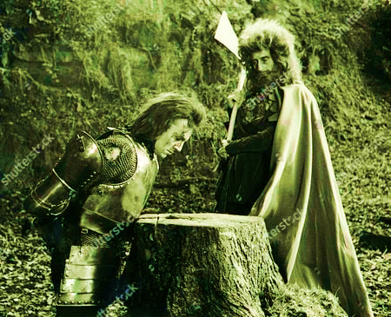
New Year’s snowstorm—symbol of?
The Green Chapel
Elements of horror:
tomb/cave-like “chapel”
grinding of the ax
the three blows (feint and shirk; steady feint; blow with one nick)→meaning?

Slide 4
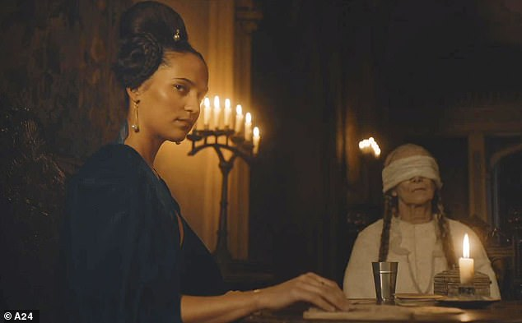
Reversal of values
-Shaming of Gawain’s knightly virtues -Blaming women (ll. 2411-28) vs power of women (ll. 2446-67) -Reclaiming the green badge of “shame” (ll. 2513-19) -Ending: Trojan genealogies, as in beginning—why?

Slide 5
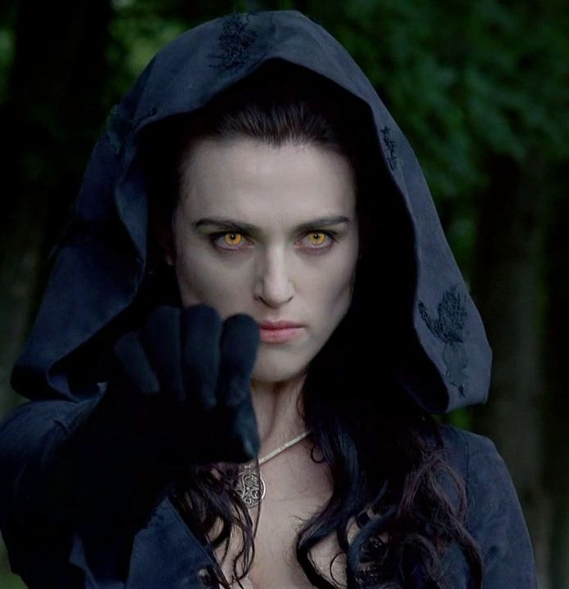
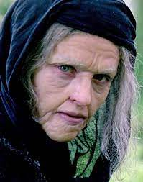
Morgana le Fey, “the (triple) Goddess” (who is the “maiden”?)
Mother (aunt) /lover
Crone

