Slide 1
THE CANTERBURY TALES
By Geoffrey Chaucer

Slide 2
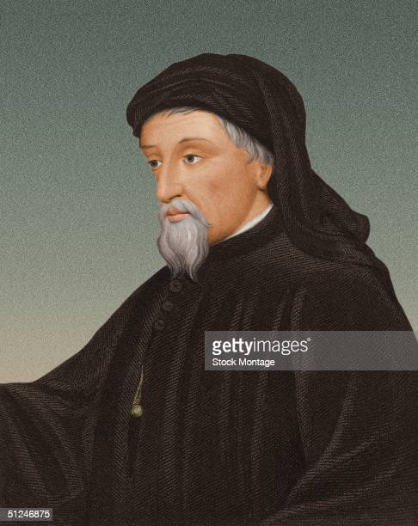
Geoffrey Chaucer (1342-1400)
Page to the Duchess of Clarence; early and almost-steady rise to fame with noble patronage (John of Gaunt, Duke of Lancaster; Edward III pays his ransom)
Prodigious learner and polymath (sciences, religion, European and classical literature)
Poet, satirist, and translator; philosophical allegories and historico-mythological romances
Introduced Renaissance perspective in poetry (from his journeys to Italy), along with courtly romance (from his earliest imprisonment in France), carnivalesque irony, and “novelistic” psychological realism (in Troilus and Criseyde); his diction introduces Early Modern English

Slide 3
The Canterbury Tales (c. 1386)
Chaucer’s unfinished masterpiece, written during a hiatus from duties due to lapse from favor
Embedded narrative: the frame important for (carnivalesque, early-Renaissance, novel-like) interpretation
30 pilgrims x 2+2 tales each= = 120 tales, a synecdoche of 14th-century England
Who would win? The readers
“vote”

Slide 4
The Prologue (ll.1-34)
Idyllic spring nature opening c/c to “religious” urges of the people
VS personal perspective in the tavern fellowship
→(effect of “camera swoop down and in”?)
Introduces them all, with increasing irony (gluttonous nun, luxuriating monk, quack doctor who fleeces his patients, etc…)
The Host, not some king, as judge: a bold gesture!

Slide 5
“Words between the Host and the Miller”
-Miller’s insistence to tell tale interrupts order (first Knight, then Monk) loutishly, drunkenly, brazenly
-His ribald tale of two lovers competing for the wench Alison c/c with Knight’s previous tale of courtly knights competing for love of a lady
-Run-on lines, warring dialogues of interruptions, morals (levels of judgment, including the narrator)
-Caveat reader by poet’s alter ego narrator as reverse advertisement; art reflecting, not only refining, life; plenty of tales to choose from otherwise
→carnivalesque quality AND quantity

Slide 6
The Miller’s Tale
Plot
Characters: John the carpenter, Alison, Nicholas, Absalon
Carpenter couple as parody of Joseph and Mary; Absalon as parody of long-haired rebel Absalom; Nicholas’s “Noah’s flood” trick to remove husband John from wife; kneading troughs for “ark”→ a sacrilege?
Scatological humor: kissing the butthole;
poking the butthole with a phallic coulter;
fart; poking another man
Chaucer’s satire on character types
Why is the carpenter punished most?
Cato: “A man should pick his equal for his mate.”

