Slide 1
The Wife of Bath’s Tale
Chaucer: feminist or misogynist?

Slide 2
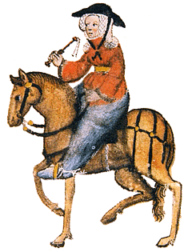
Traditions for the Wife’s creation
Romance type: “the old baud”
The “apologia” (account of one’s life)
Medieval ecclesiastical diatribes on the nature of women
The Bible
Popular superstitions (“gat-toothed” women as favored by Venus; astrology; alchemy)

Slide 3
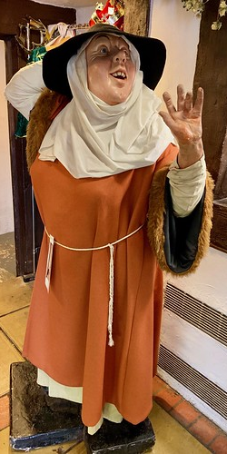
The Surprise Twist
The Wife herself cites those sources as argument for her apologia!
Her Prologue is three times her Tale, and both support her pitch (female “soveraynetee” as key to happy marriage)
Claims “masculine” prerogatives:
argues theology using reason, science, experience
sees biblical admonitions as optional
Debunks theology as created by bitter impotent men
male biblical polygamy as women’s right also
five marriages, goes for sixth
sexually explicit, claims female desire
marries a man half her age (5th “Jankin”)
unapologetically candid about women’s wiles
definition of “good” husband: old, rich, ceding (but no definition of “good” wife)

Slide 4
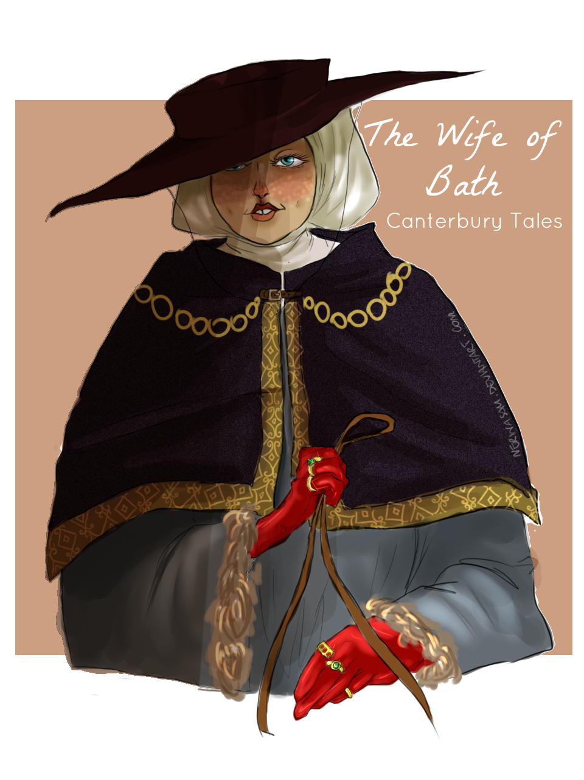
Definition of “smart” wife
*“…to pick the best
For under-purse as well as treasure chest” (ll.45-46)
*“I will not quarrel with virginity;
Let them be loaves of finest wheaten bread,
And we wives be hot barley loaf instead;” (ll. 148-50)
*“I will collect my tribute to the letter
Upon his flesh, while I remain his wife.
I have the power as long as I have life
Over my husband’s body, and not he.” (ll. 162-65)
*“Why should I try to please them, why take heed
Save for my profit and my joy indeed?” (ll. 219-20)
*“Thus shall ye Scold and keep the game in hand;
For there is no, and never was a man
Can swear as boldly as a woman can;
Or lie.” (ll. 232-35)—preemptively!
*Court of allies: “gossip” friend, maid, niece, “Jankin”
*“But by St. Joyce and God above, I paid him!
Of the same wood a bitter stick I made him.” (ll. 490-91)

Slide 5
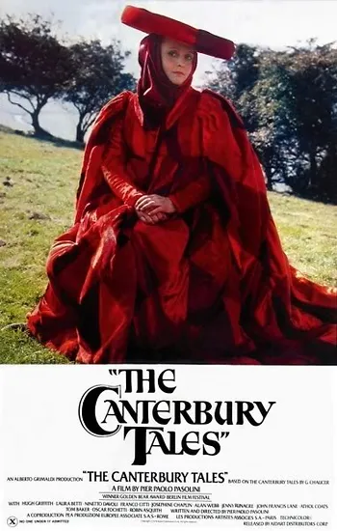
*“And so I made my visits to confessions,
To various pilgrimages and processions,
To plays of miracles and marriage, too,
And heard full many a solemn preachment through,
In dresses made of gallant scarlet cloth.
And never a worm, and never a mite or moth
Upon my peril, marred them with a touch.
And know ye why? They were in use too much!” (ll. 562-69)
*“My feelings spring from Venus, by the stars!
But all my spirit comes from warlike Mars.” (ll. 616-17)
*“Three pages of it suddenly I took,
Even as he read, and tore them from their place,
And with my fist I struck him in the face,
So that he tumbled backward on the fire.” (ll. 798-801)
He strikes her once (deaf; pretending to be dead);
once he apologizes, she slaps him
*“But in the end, with care and trouble thus,
We made a peace between the two of us.
He put the bridle wholly in my hand,
To have the rule alike of house and land…” (ll. 819-22)

Slide 6
One regret…
“But age, alas! That poisons everything
Hath stolen the strength and beauty that I knew;
Go, then, farewell! The devil go with it too!
The flour is gone—there is no more to say—
And I must sell the bran as best I may.” (ll. 481-86)

Slide 7
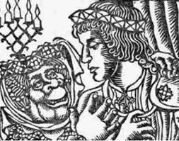
The Wife’s Tale
The “loathsome wife” lay motif (Celtic origin (Shrek); later “The Wedding of Sir Gawain and Dame Ragnelle”)
Power to the queen: “elf-queen” Arcadia, Arthur defers power of judgment to queen:
Quest: “What thing by women is most coveted?”
“Women desire to have the sovereignty
Over their husbands, or of such as love them,
And ever live in mastery above them.” (ll. 1047-49)
Rapist knight’s blind deal with old hag gives him a dose of his own poison:
“Take all my goods, and let my body go.” (l. 1070)
Old lady’s argument with ungracious knight:
-“I am your love, I am your wedded wife;
I am the one to whom you owe your life;
I never did you anything but right;
Why should ye treat me thus on this first night?” (ll. 1100-1104)
-Poverty as character-builder, shows true friends, honest (Penia’s
argument from Aristophanes’ Wealth)
-An ugly wife will not be sought for cuckoldry
Dilemma: ugly and true, or pretty and unchaste? Solution:
  “My lady and my love, my wife so dear,
  Under your wise rule will I gladly rest;
  Choose for yourself that which will please you best,
  And honor you the most, and me as well.” (ll. 2039-42).

Slide 8
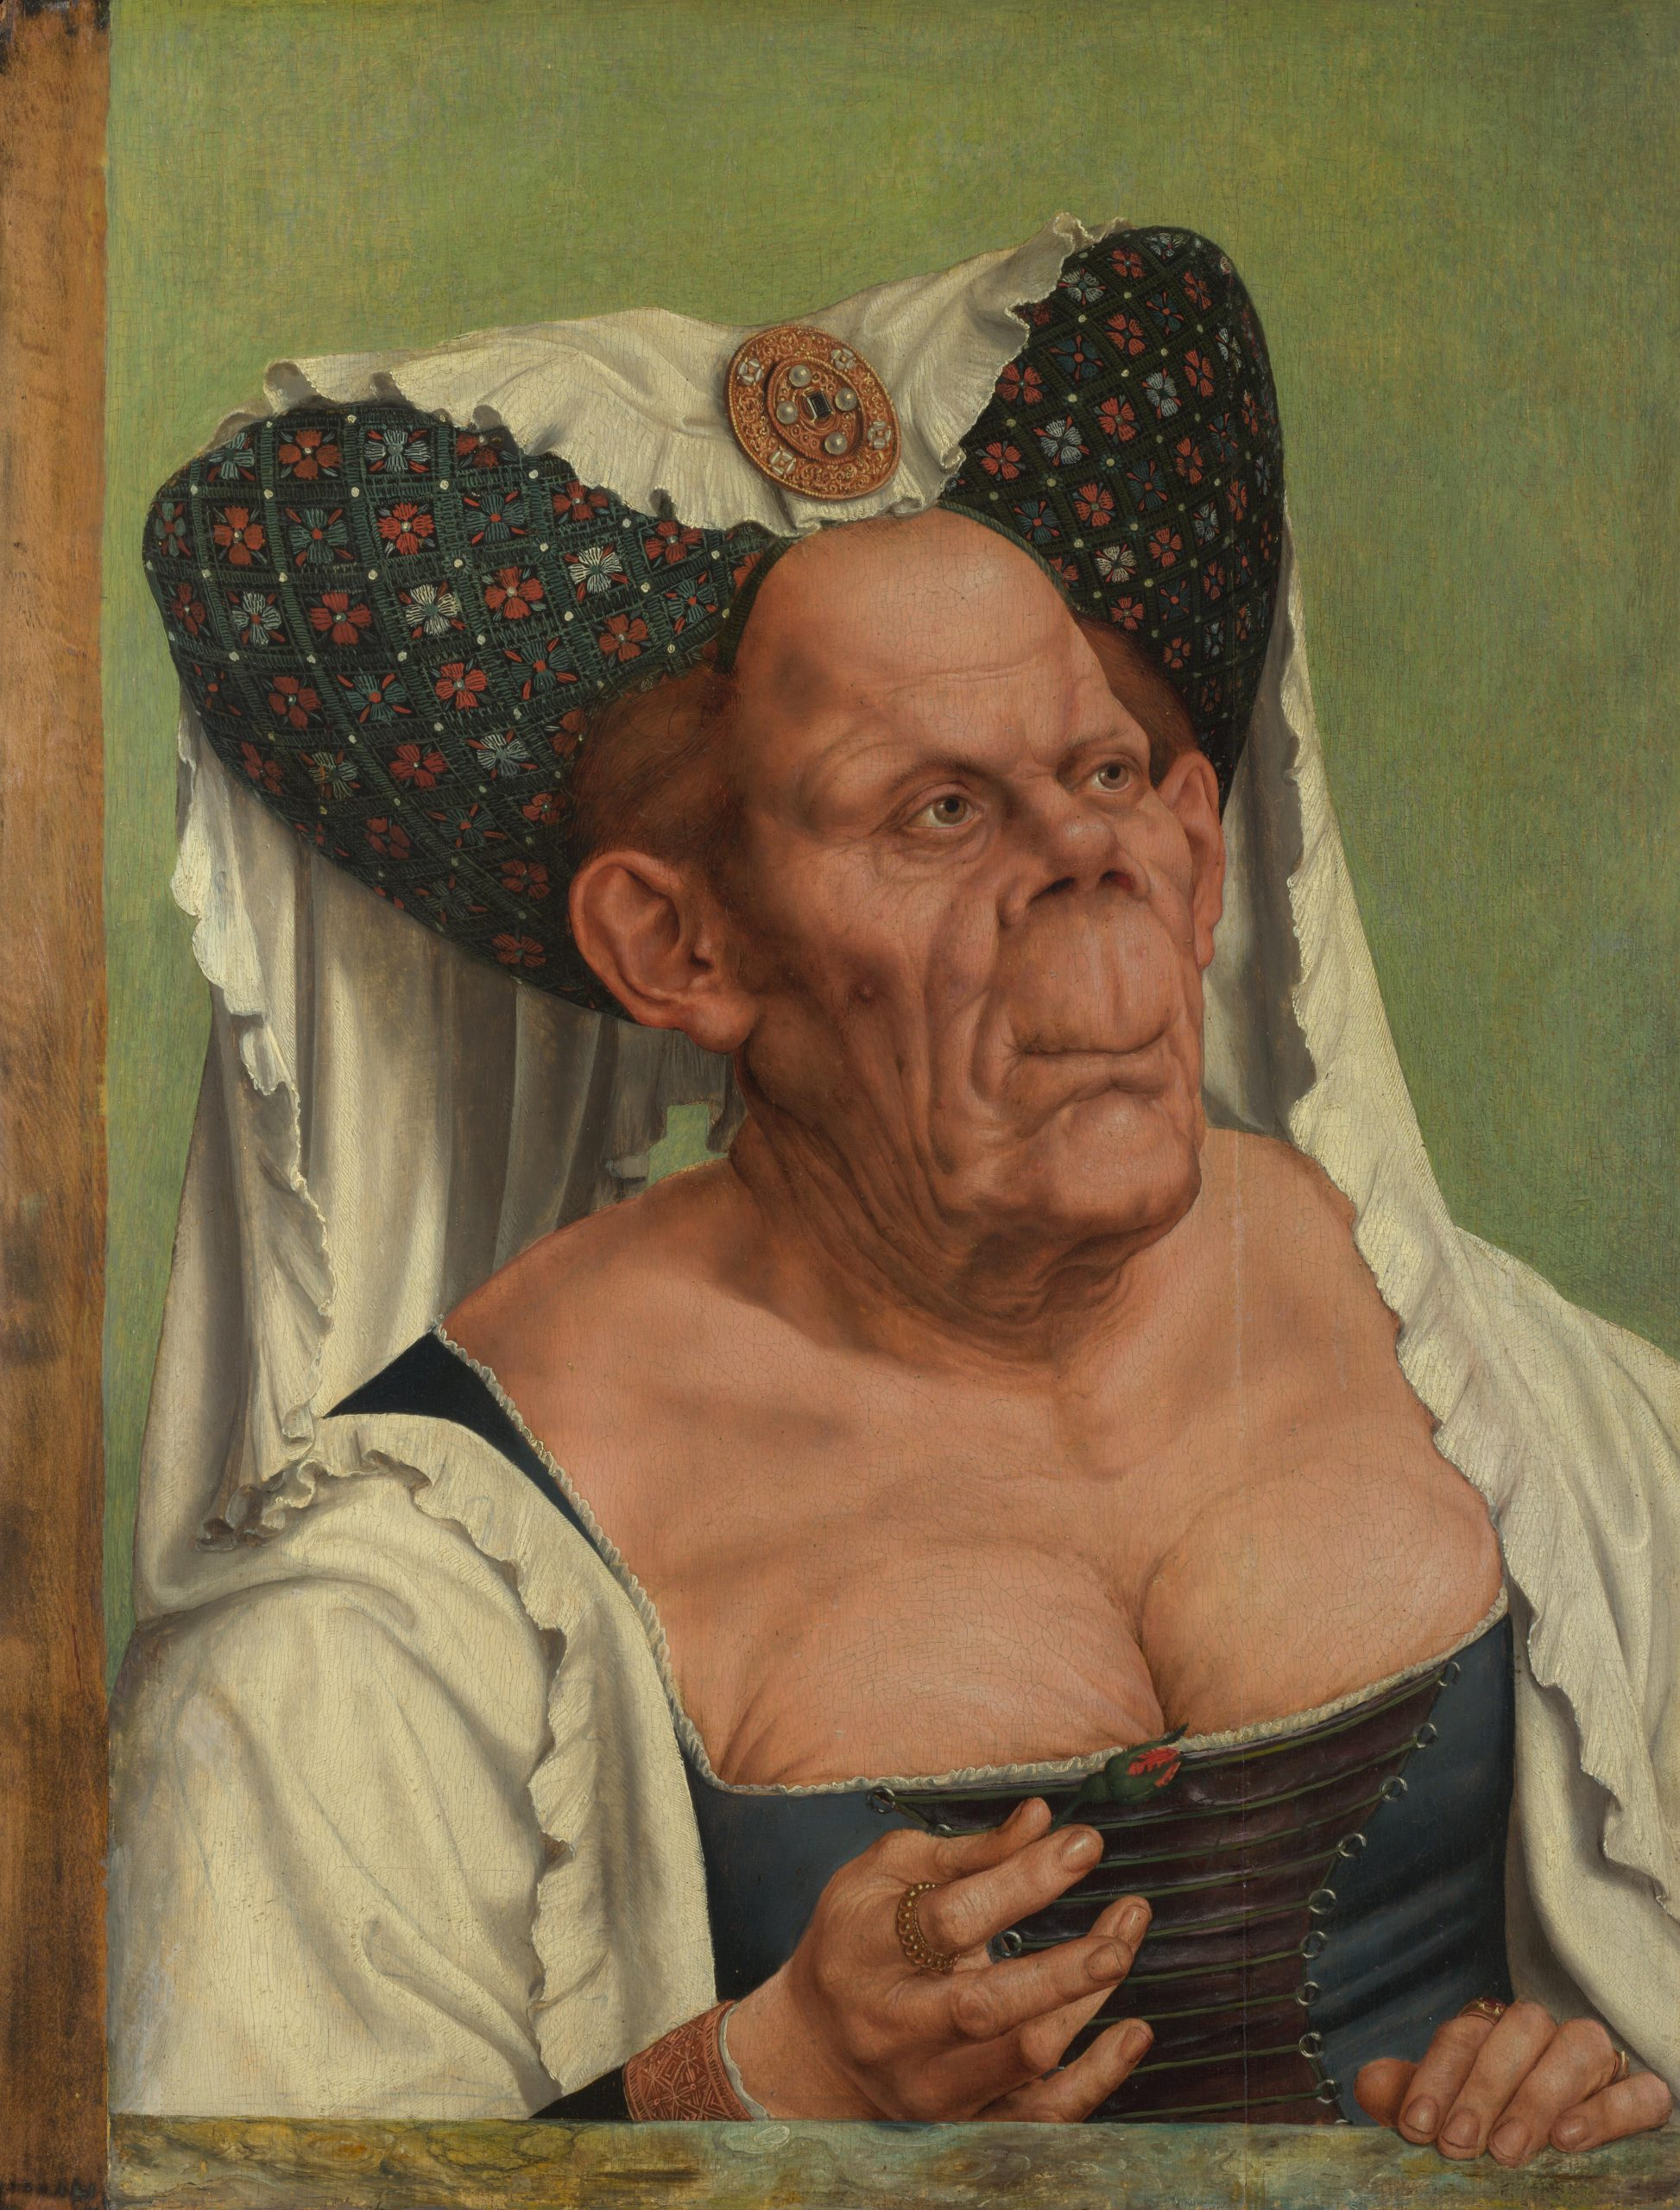
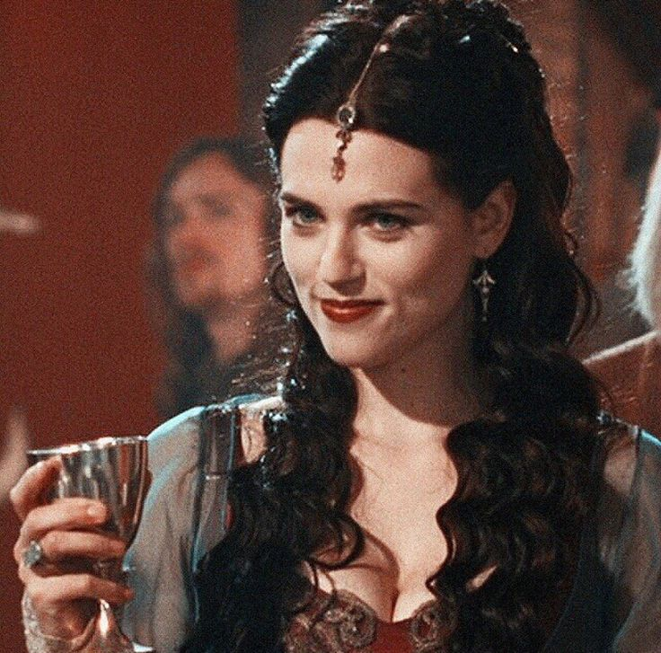
The transformative power of love

Slide 9
And now, it be time to wish thee
A Merrie Yuletide! https://www.instagram.com/reel/DCXYDEMSB8X/?igsh=aG96aDI0NHdna3I5

