Slide 1





Democracy
American-style

Slide 2
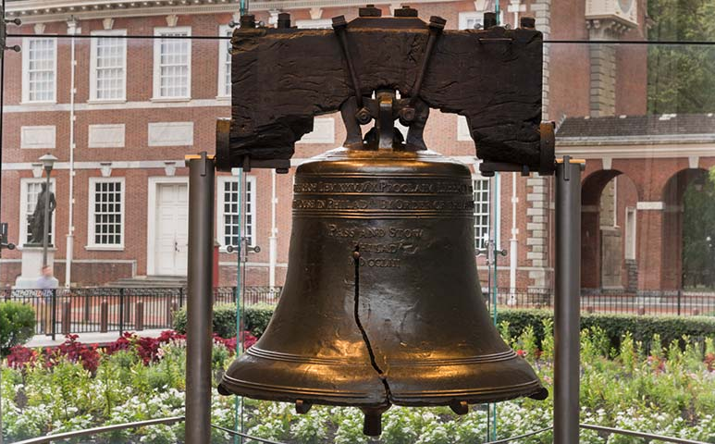
The Particularities of
U.S. Democracy
Established from the start of U.S.A. as a nation
(1774 constitution)
Tied to individualism, anti-federalism, Puritan “virtue”
Multiculturalism: from the “melting pot” to the “salad
bowl”/smorgasbord paradigm
System of “checks and balances”
Two parties alternating
“Marketed” and exported: “America: Love It or Leave It!”,
flag merchandise
“Hero” (made legendary) presidents (George Washington’s “Father, I cannot tell a lie”; “Honest” Abraham Lincoln’s Emancipation Proclamation, Theodore Roosevelt, Franklin Delano Roosevelt’s “New Deal,” Dwight Eisenhower, John Fitzgerald Kennedy’s “Camelot,” Barack Obama)
→ concept abused by Ronald Regan, Donald Trump
→ Presidents as macho heroes in action movies (Independence Day, Olympus Has Fallen, Big Game)

Slide 3
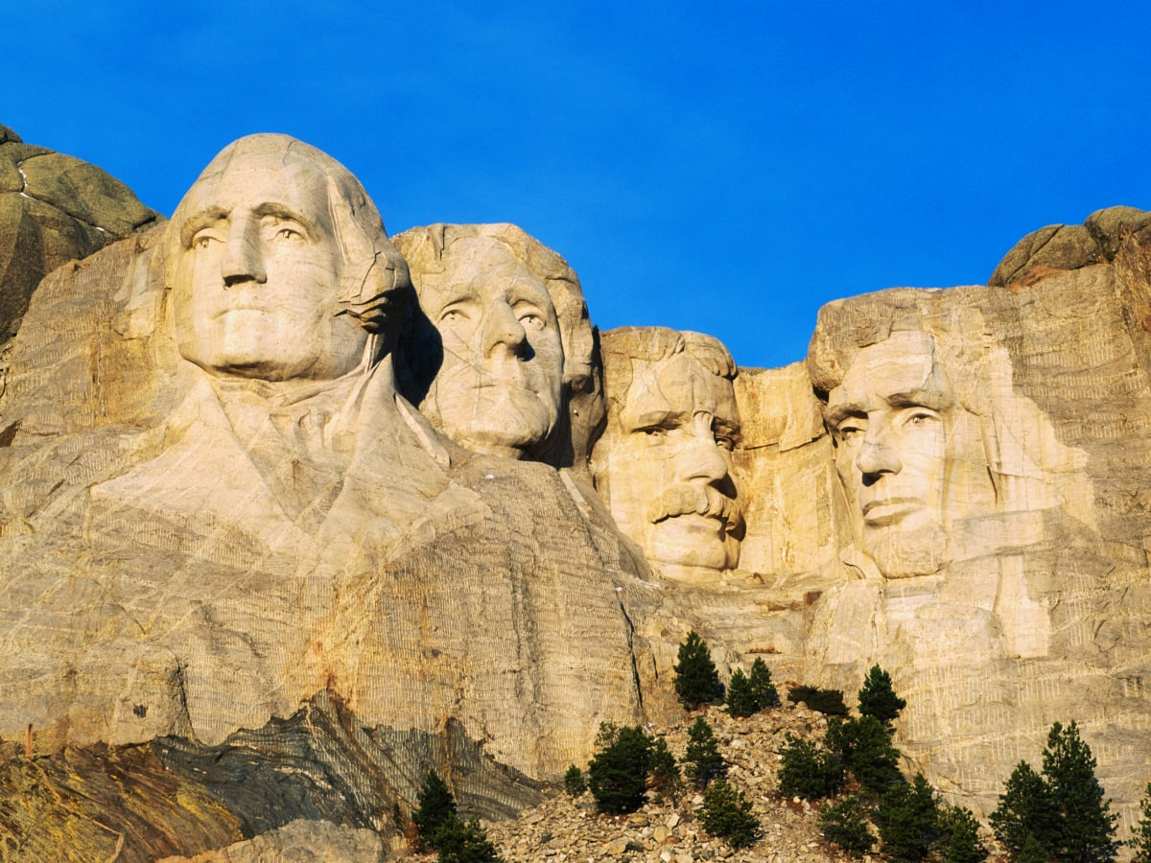

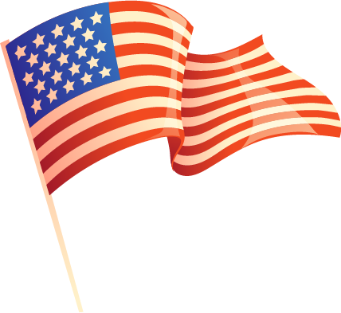
Mt. Rushmore (Black Hills, SD)

Slide 4
Paul Revere
-April 18, 1775, Midnight ride before battle of Lexington, “The British are coming!”
-ride as diagram of nation; the message building “imagined [response-able] community”
-liminality as expressed by Longfellow
Beneath, in the churchyard, lay the dead,
In their night-encampment on the hill,
Wrapped in silence so deep and still
That he could hear, like a sentinel’s tread,
The watchful night-wind, as it went
Creeping along from tent to tent,
And seeming to whisper, “All is well!”
Then he said “Good night!” and with muffled oar
Silently rowed to the Charlestown shore,
Just as the moon rose over the bay,
Where swinging wide at her moorings lay
The Somerset, British man-of-war:
A phantom ship, with each mast and spar
Across the moon, like a prison-bar,
And a huge black hulk, that was magnified
By its own reflection in the tide.
A hurry of hoofs in a village-street,
A shape in the moonlight, a bulk in the dark,
And beneath from the pebbles, in passing, a spark
Struck out by a steed that flies fearless and fleet:
That was all! And yet, through the gloom and the light,
The fate of a nation was riding that night;
And the spark struck out by that steed, in his flight,
Kindled the land into flame with its heat.
So through the night rode Paul Revere;
And so through the night went his cry of alarm
To every Middlesex village and farm,—
A cry of defiance, and not of fear,
A voice in the darkness, a knock at the door,
And a word that shall echo forevermore!

Slide 5
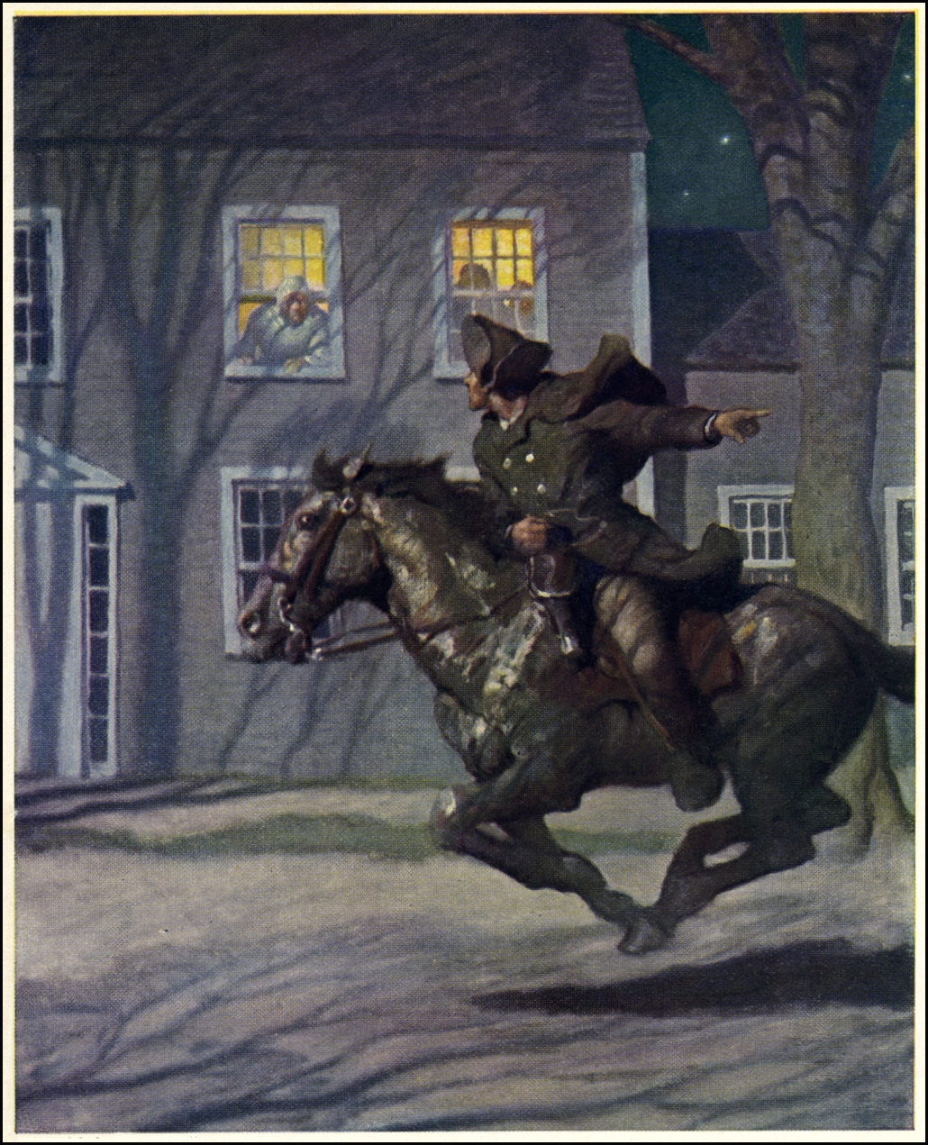
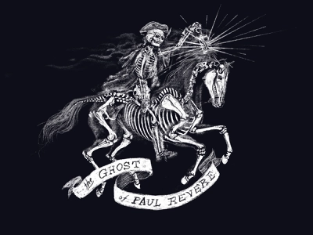
Ghost Rider

Slide 6

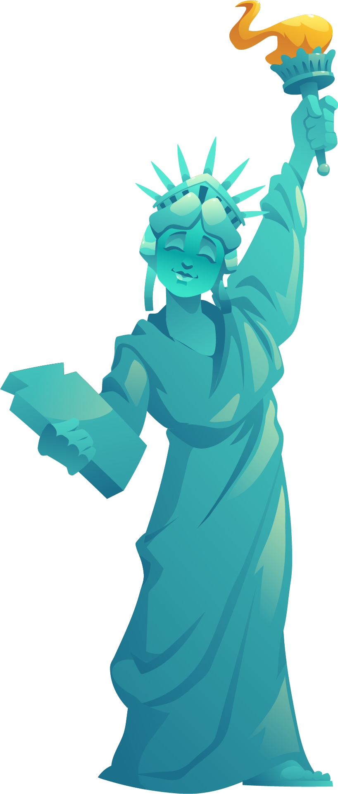
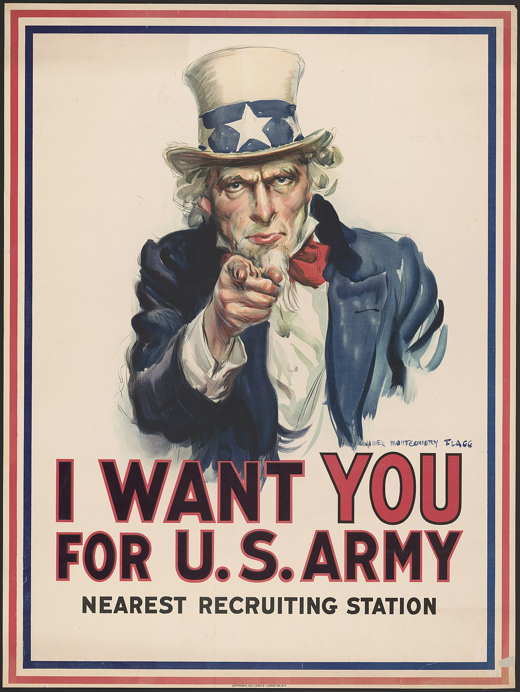

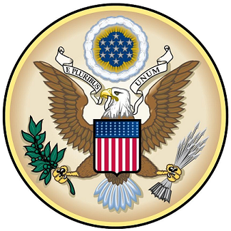
Miss Liberty and Uncle Sam

Slide 7
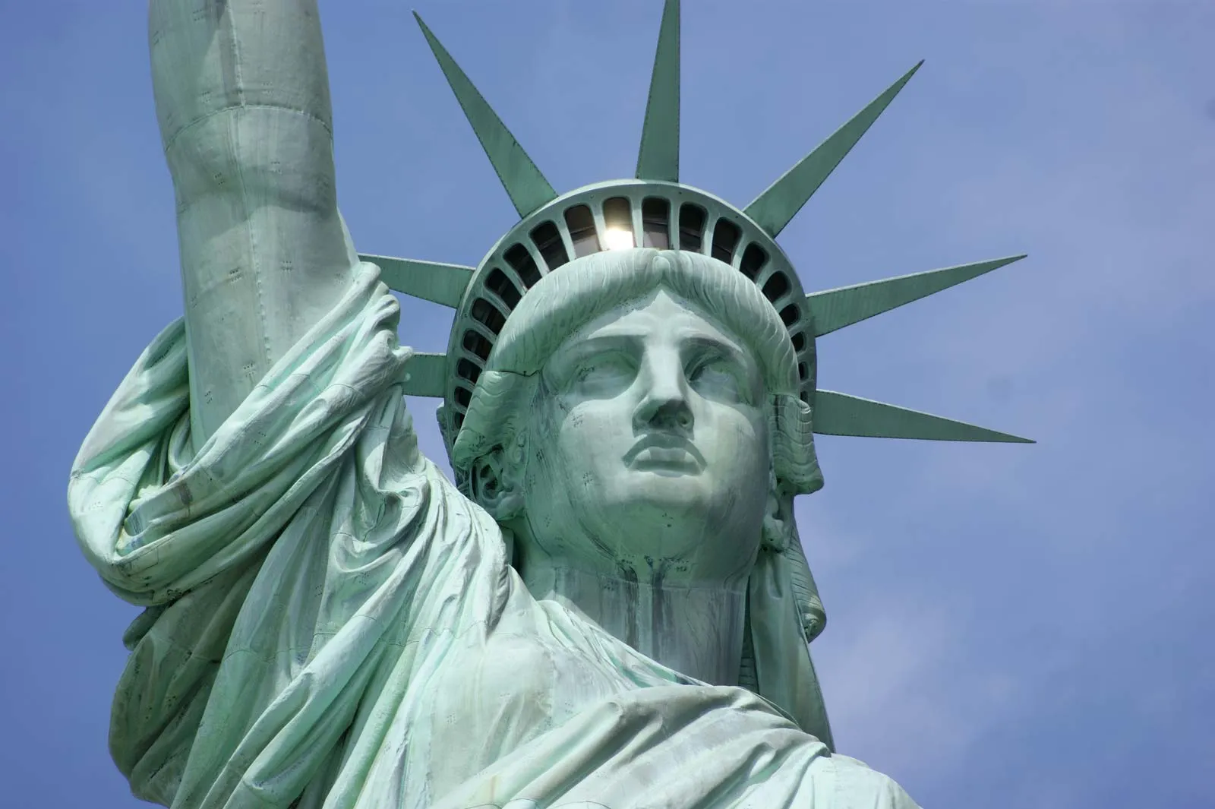
From logos to legends
-Statue of Liberty 1886 by Gustave Eiffel and Fréderic Auguste Bartholdi
-Uncle Sam, bald eagle as symbols of U.S. might (righteous)
(Columbia→ Brother Jonathan→ 1917 recruiting poster by J.M. Flagg)
semiology of symbolism as aggressive expansion:
seven diadem spikes
gigantic size
position, stance
panopticon
predatory nature
“hieros gamos”/ Holy US Trinity

Slide 8

And now, let’s vote!
https://survey.uoa.gr/L289972

