Slide 1
The American Wild West
Kill Bill Thrill

Slide 2
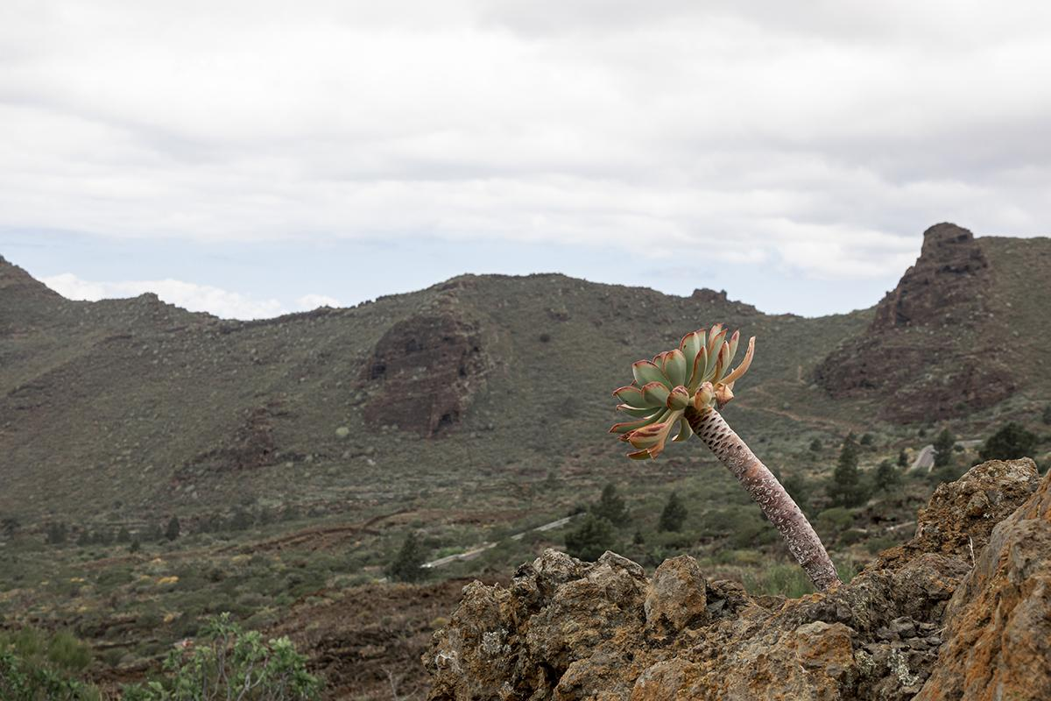
The American Southwest
-After the Lewis and Clark Expedition reached the Pacific (1805), rapid
expansion southwards:
1820, Mason-Dixon line established as North/South cultural border
1836, Texas War of Independence, Battle of the Alamo (1845 U.S. annexes
Texas)
1846-48, Mexican-American War (New Mexico, California)
1863-65, Civil War (Southern “pride”)
1898, Spanish-American War (US control of Caribbean, Mid-America)
-Difference from industrial, urban North and difference of “the South” from “the West”:
Desert, pastureland, swamps vs “the beautiful South,” Dixieland “aristocracy”and plantations
the Pony Express, the stagecoach
French and Spanish influence (New Orleans Cajun, Tex-Mex)
Homesteaders and cowboys VS desperados, gunslingers (pistoleros)
lawlessness (church “fire and brimstone” sermons, sin-busters, gospel sharks VS saloons / brothels, shootouts), ghost towns
→ mistrust of “Yankee” government, local disputes, privateering and vigilantism (Lone Ranger and Tonto, El Zorro, the pirate Jean Lafitte, “hanging” Judge Roy Bean: “The Law West of the Pecos”)

Slide 3
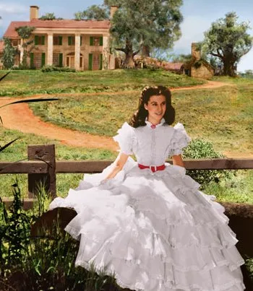
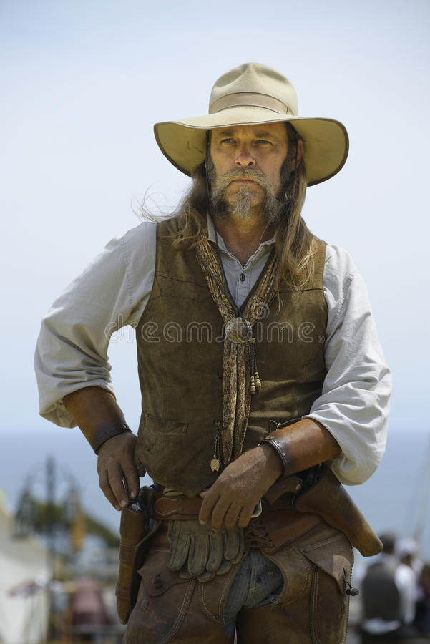
Can you spot the difference?
Southern Belle Southern Pistolero

Slide 4
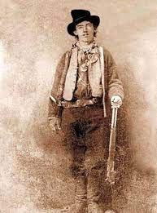
Billy the Kid (El Chivato)
-William H. Bonney (William Henry McCarty), NY 1859-Lincoln, New Mexico, 1881
-child murderer (supposedly at 12), orphan of widowed mother
-slight physique, boyish looks
-Lincoln County “War” (cattle rustling, joined the “underdog” side of Murphy-Dolan VS Chisum-McSwain, death of surrogate “father” initiates crime spree)
-mysterious death in the dark by sheriff Pat Garrett, a former friend.
-extremely loved by the Mexican people and the Easter readers of his “dime hack” pamphlet tales—WHY?

Slide 5
dangerous sociopath
young, with boyish looks, died before old age
legend of dying for love
capable, cool fighter
polite, educated, principled (“gentleman bandit”)
homosociality
no origins (twice orphan) so freedom over growth, bonds of identity, death; Billy=Baudrillard’s “pure simulacrum”
→ frontier “no-holds-barred” capitalism (19th-century “golden boy”?)
→ androgyny as a popular Romantic quality, makes rampant capitalism palatable/moral

Slide 6
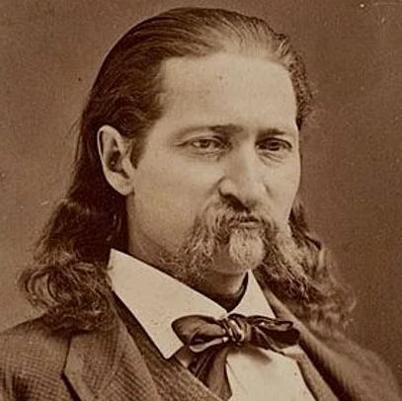
Wild Bill Hickok
-James Butler Hickock, IL, (1837-Deadwood, SD, 1876)
lawman, Union scout, gunfighter and professional gambler
-McCanles brothers murder, duel with gambler Davis Tutt
Shot in gambling duel by Jack McCall (“dead man’s hand”=8+1+1+8)
-c/c to Marshall Wyatt Earp, Doc Holliday (VS Clanton gang in “Battle at the O.K. Corral in Tombstone, AZ, 1881)
-marksmanship, bravery, and physique exaggerated, if not complete lie: why “Adonis” or blond? Why from “Duck Bill” to “Wild Bill”? Why “ideal” husband to Calamity Jane?

Slide 7
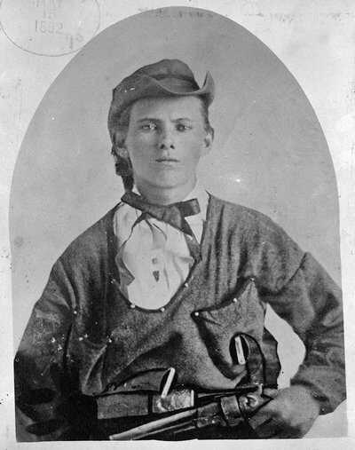
Jesse James
(1847-1882)
1847-1882, ex-Confederate soldier, leader of James-Younger gang, murderer, robber
-legend of Western “Robin Hood,” gentleman—WHY?
-extreme popularity, esp. after death; Robert Ford a “coward,” shot—WHY?
-“Free Soil” conflict btn slaver-state Missouri and undecided Kansas (John Brown murders, “Bleeding Kansas”→Civil War)
-train co. confiscating lands
→James as avenger
-shot in his family home,
while dusting a picture

