Slide 1
/Stealing Men

Slide 2
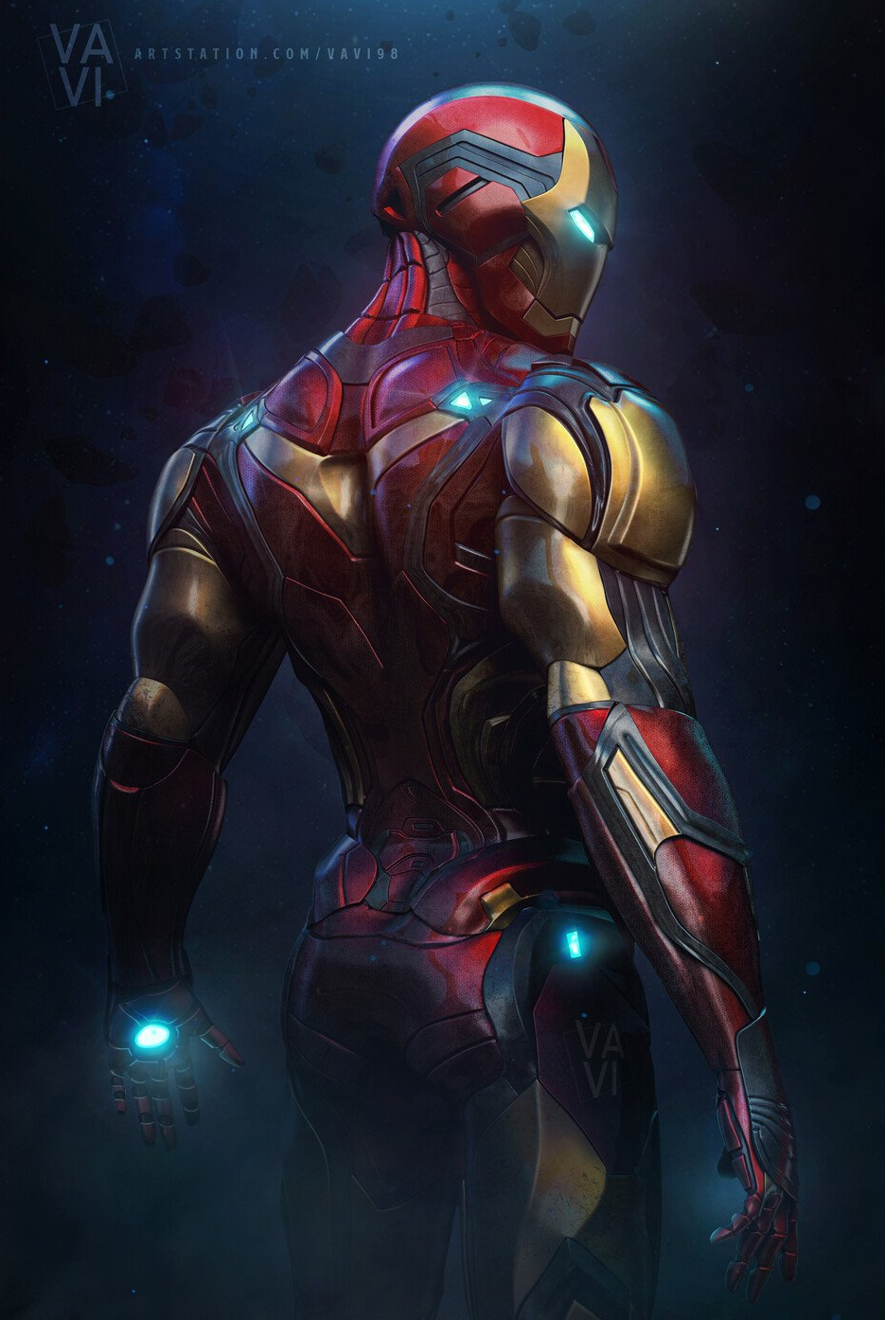
Machine/Flesh
merica as “the astral and the primitive” (Jean Baudrillard, America)
The importance of technology
Cult of the (youthful) body
Futuristic/ posthumanist anxieties

Slide 3
Henry David horeau: “ echnology Apotheosized”
-Disciple of R. W. Emerson, transcendentalism:
intuitive individualism and love of Nature (especially American) as a redeeming force against human culture
-train a stallion, dragon, American monster, thundering cloudmaker “demigod,” has more character and power/stamina than its human “master”
→(awe→ fulfils U.S. hegemony VS fear→ inevitable future/ Atropos)

Slide 4
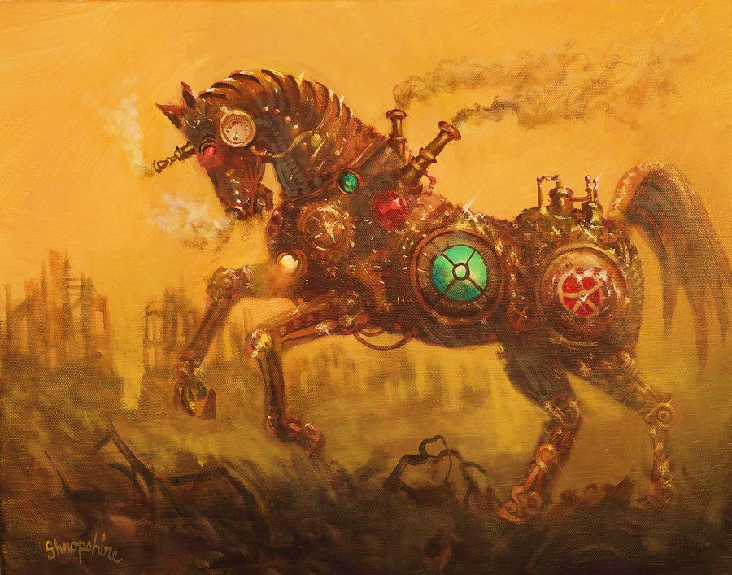
mily Dickinson, poem 383
I like to see it lap the Miles - And lick the Valleys up - And stop to feed itself at Tanks - And then - prodigious step
Around a Pile of Mountains - And supercilious peer In Shanties - by the sides of Roads - And then a Quarry pare
To fit its sides And crawl between Complaining all the while In horrid - hooting stanza - Then chase itself down Hill -
And neigh like Boanerges - Then - prompter than a Star Stop - docile and omnipotent
At it's own stable door -

Slide 5
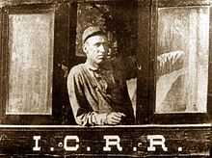
CASEY JONES/ JOHN L THER (1863-1900)
-1900s as time of engine, speed and complexity (might and danger)
-from Puritan work ethic to job pride
-fetish of “getting the job done”
-progress as hubris
-liminality of “arrival” (horizon of progress unreachable?)

Slide 6
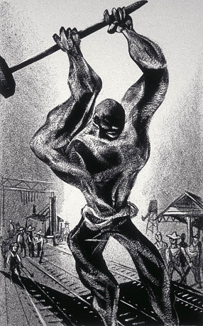
JOHN HE RY
-Afro-American lore: Br’er Rabbit/ Fox/ etc. stories, Aunt Nancy (Ananse), Tar Baby, the blues
-black body fetish: Black Adonis, Black Venus as racist rationalization
-black pride: “Africa in him” as JH’s strength
: ballad as “call-and-response” oral storytelling pattern
: Steel (Superman comic, film with Shaquille O’Neal)

Slide 7
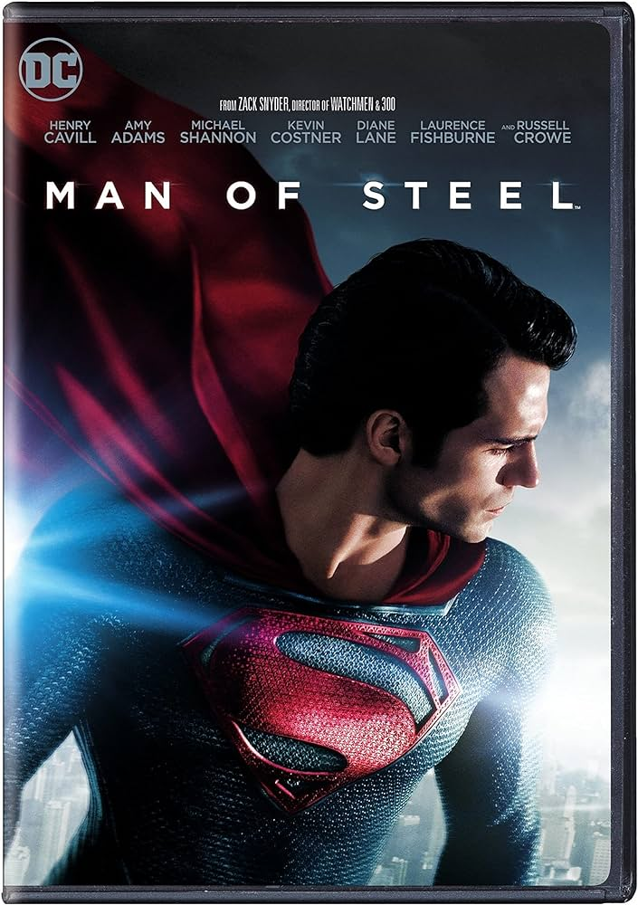
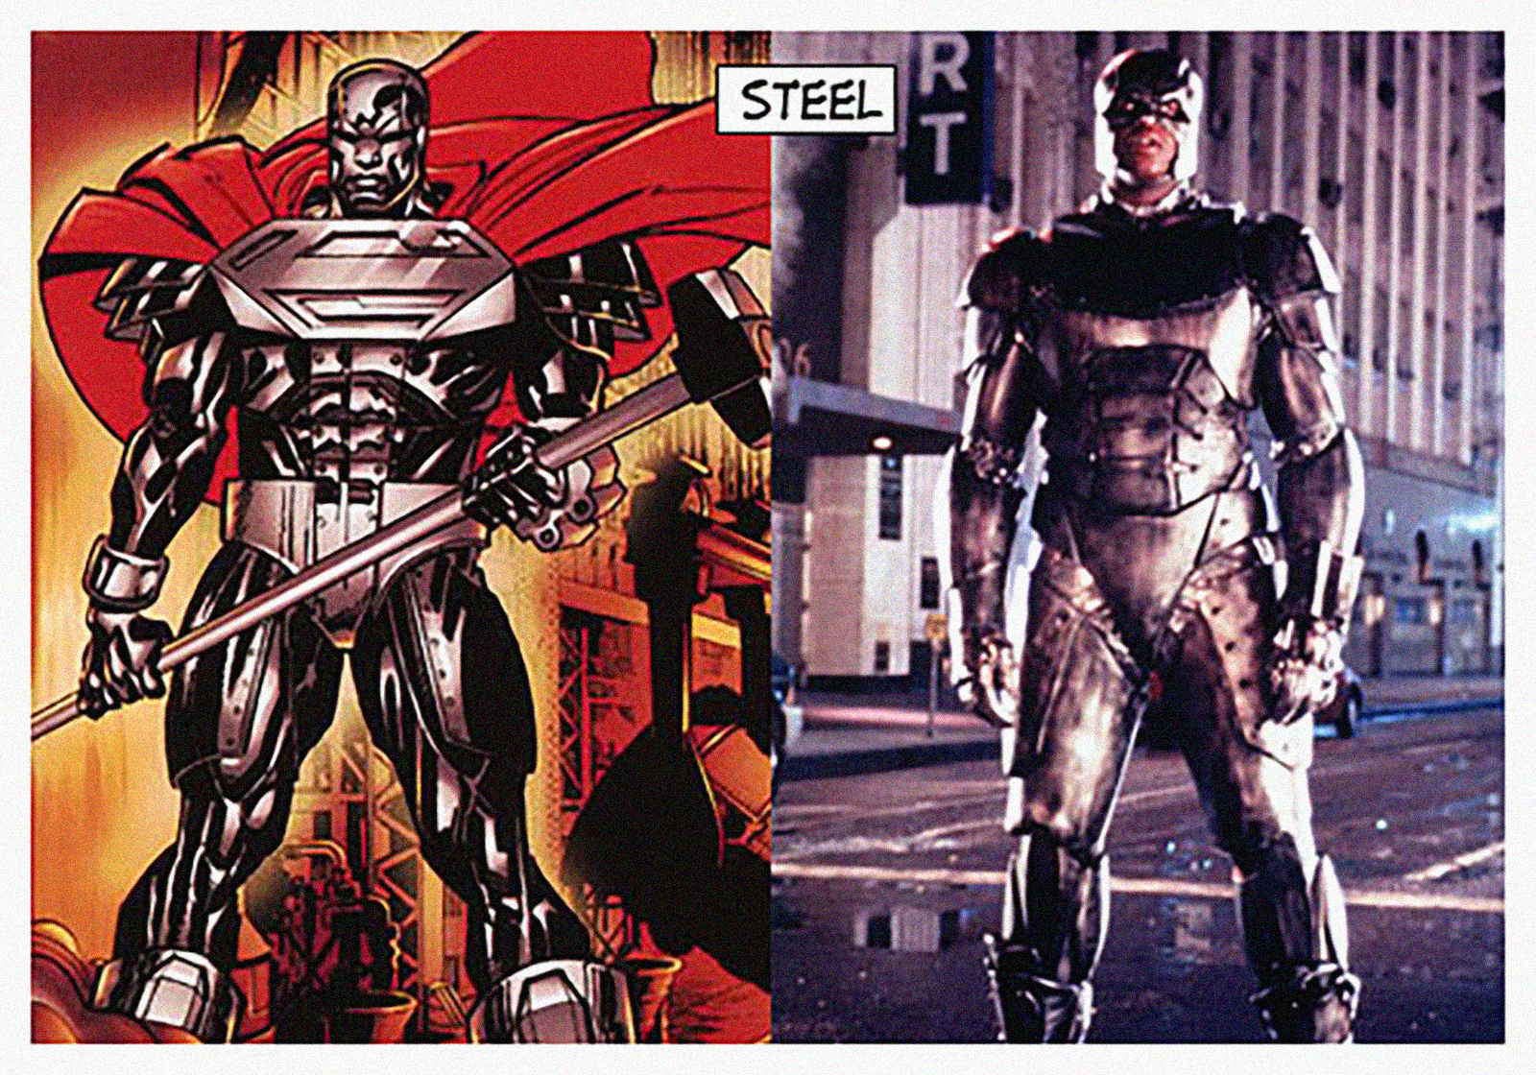

Slide 8
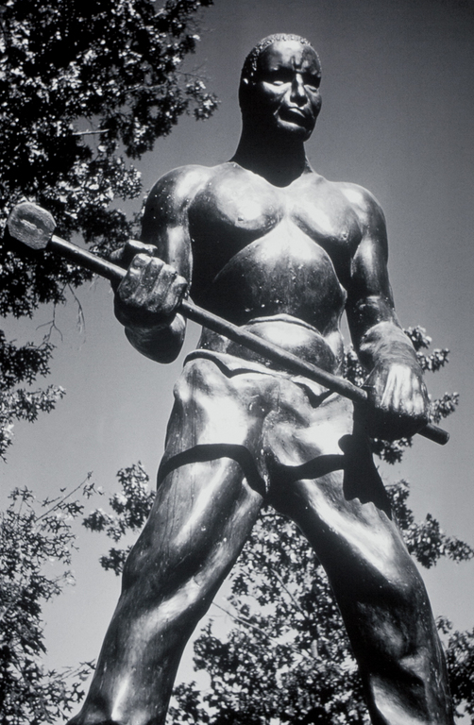
-Big Bend Tunnel of C&O:
steel-driver pride: tough job, built America BEFORE machines
The import of steam technology and the railroad
black labor obliquely acknowledged (community role)
human sacrifice motif (C/c Arta Bridge)
humanity (predicts death, sweats, weeps, falls sick, dies) VS heroism (mythical origin, appetite, physique)
man vs machine (who wins?)

Slide 9
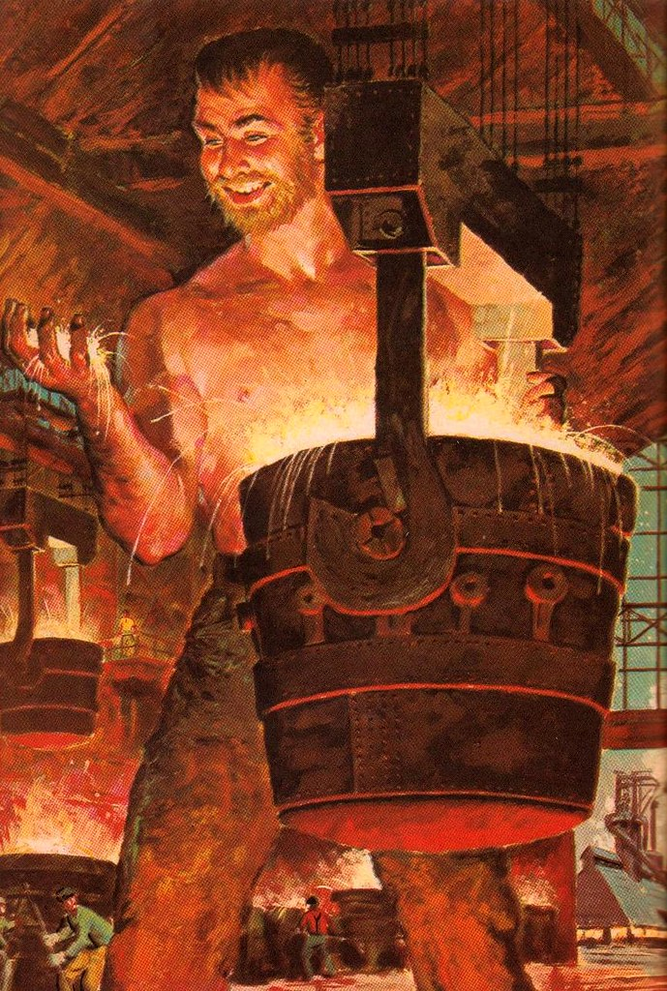
JOE MA ARAC
Fakelore
immigrant ambivalence: “jackass” and backbone of U.S. industry
literal “man of steel”
the “melting pot” assimilation VS threat of closing down mills/ replacing workers with machines
suicide as eternal life, embedding forever in new homeland with no fear of rejection.

Slide 10
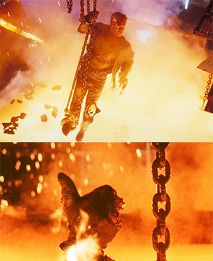

Slide 11
ALTERNATIVE RESOURCES

