Slide 1
Rags to Riches
Two Versions of the American Dream

Slide 2
Cotton Mather, “The Work Ethic”
“It seems a man slothful in business is not a man serving the Lord”
Honest dealing
Work to create the New Jerusalem→ thriving business means God approves of you
“In God We Trust” inscription on the dollar

Slide 3
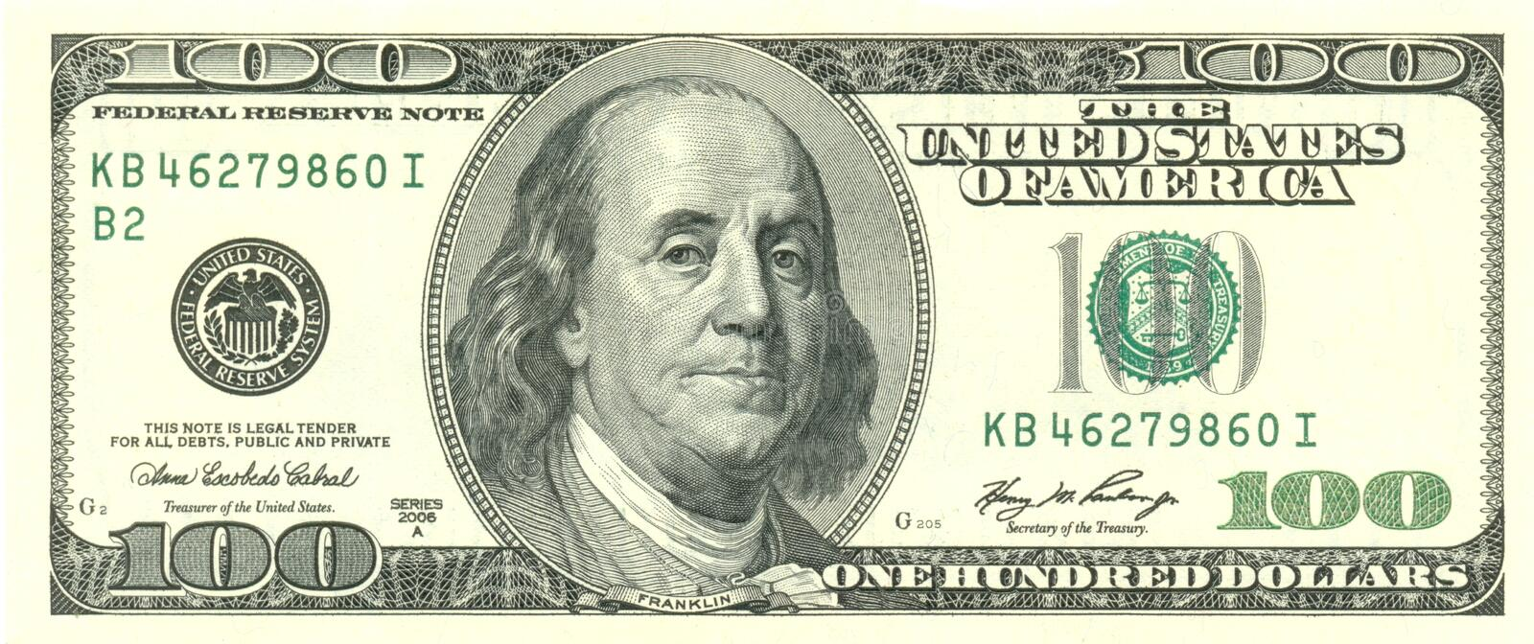
Benjamin Franklin (1705-90)
You can enter a subtitle here if you need it

Slide 4
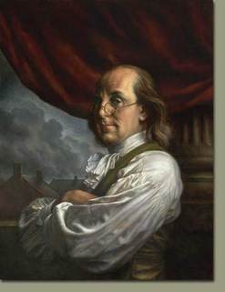
The Original American Dreamer
American “Founding Father,” icon of self-made success, politician, diplomat, inventor, celebrity, genius, author (newspapers, essays, Poor Richard’s Almanack, The Autobiography…), 1st Postmaster General, philosopher of American practical spirit, U.S. version of Enlightenment Man…

Slide 5
The Almighty Dollar
“The Business of America is Business”
From Puritan work ethic (metaphysical)
→ Franklinean work ethic (physical: “industry” and “frugality”), rugged individualism
→ American Dream (capitalist paradox):
must serve public back with money
must acquire it innocently (Horatio Alger’s Raggedy Dick, Little Orphan Annie)

Slide 6
Stackalee

Slide 7
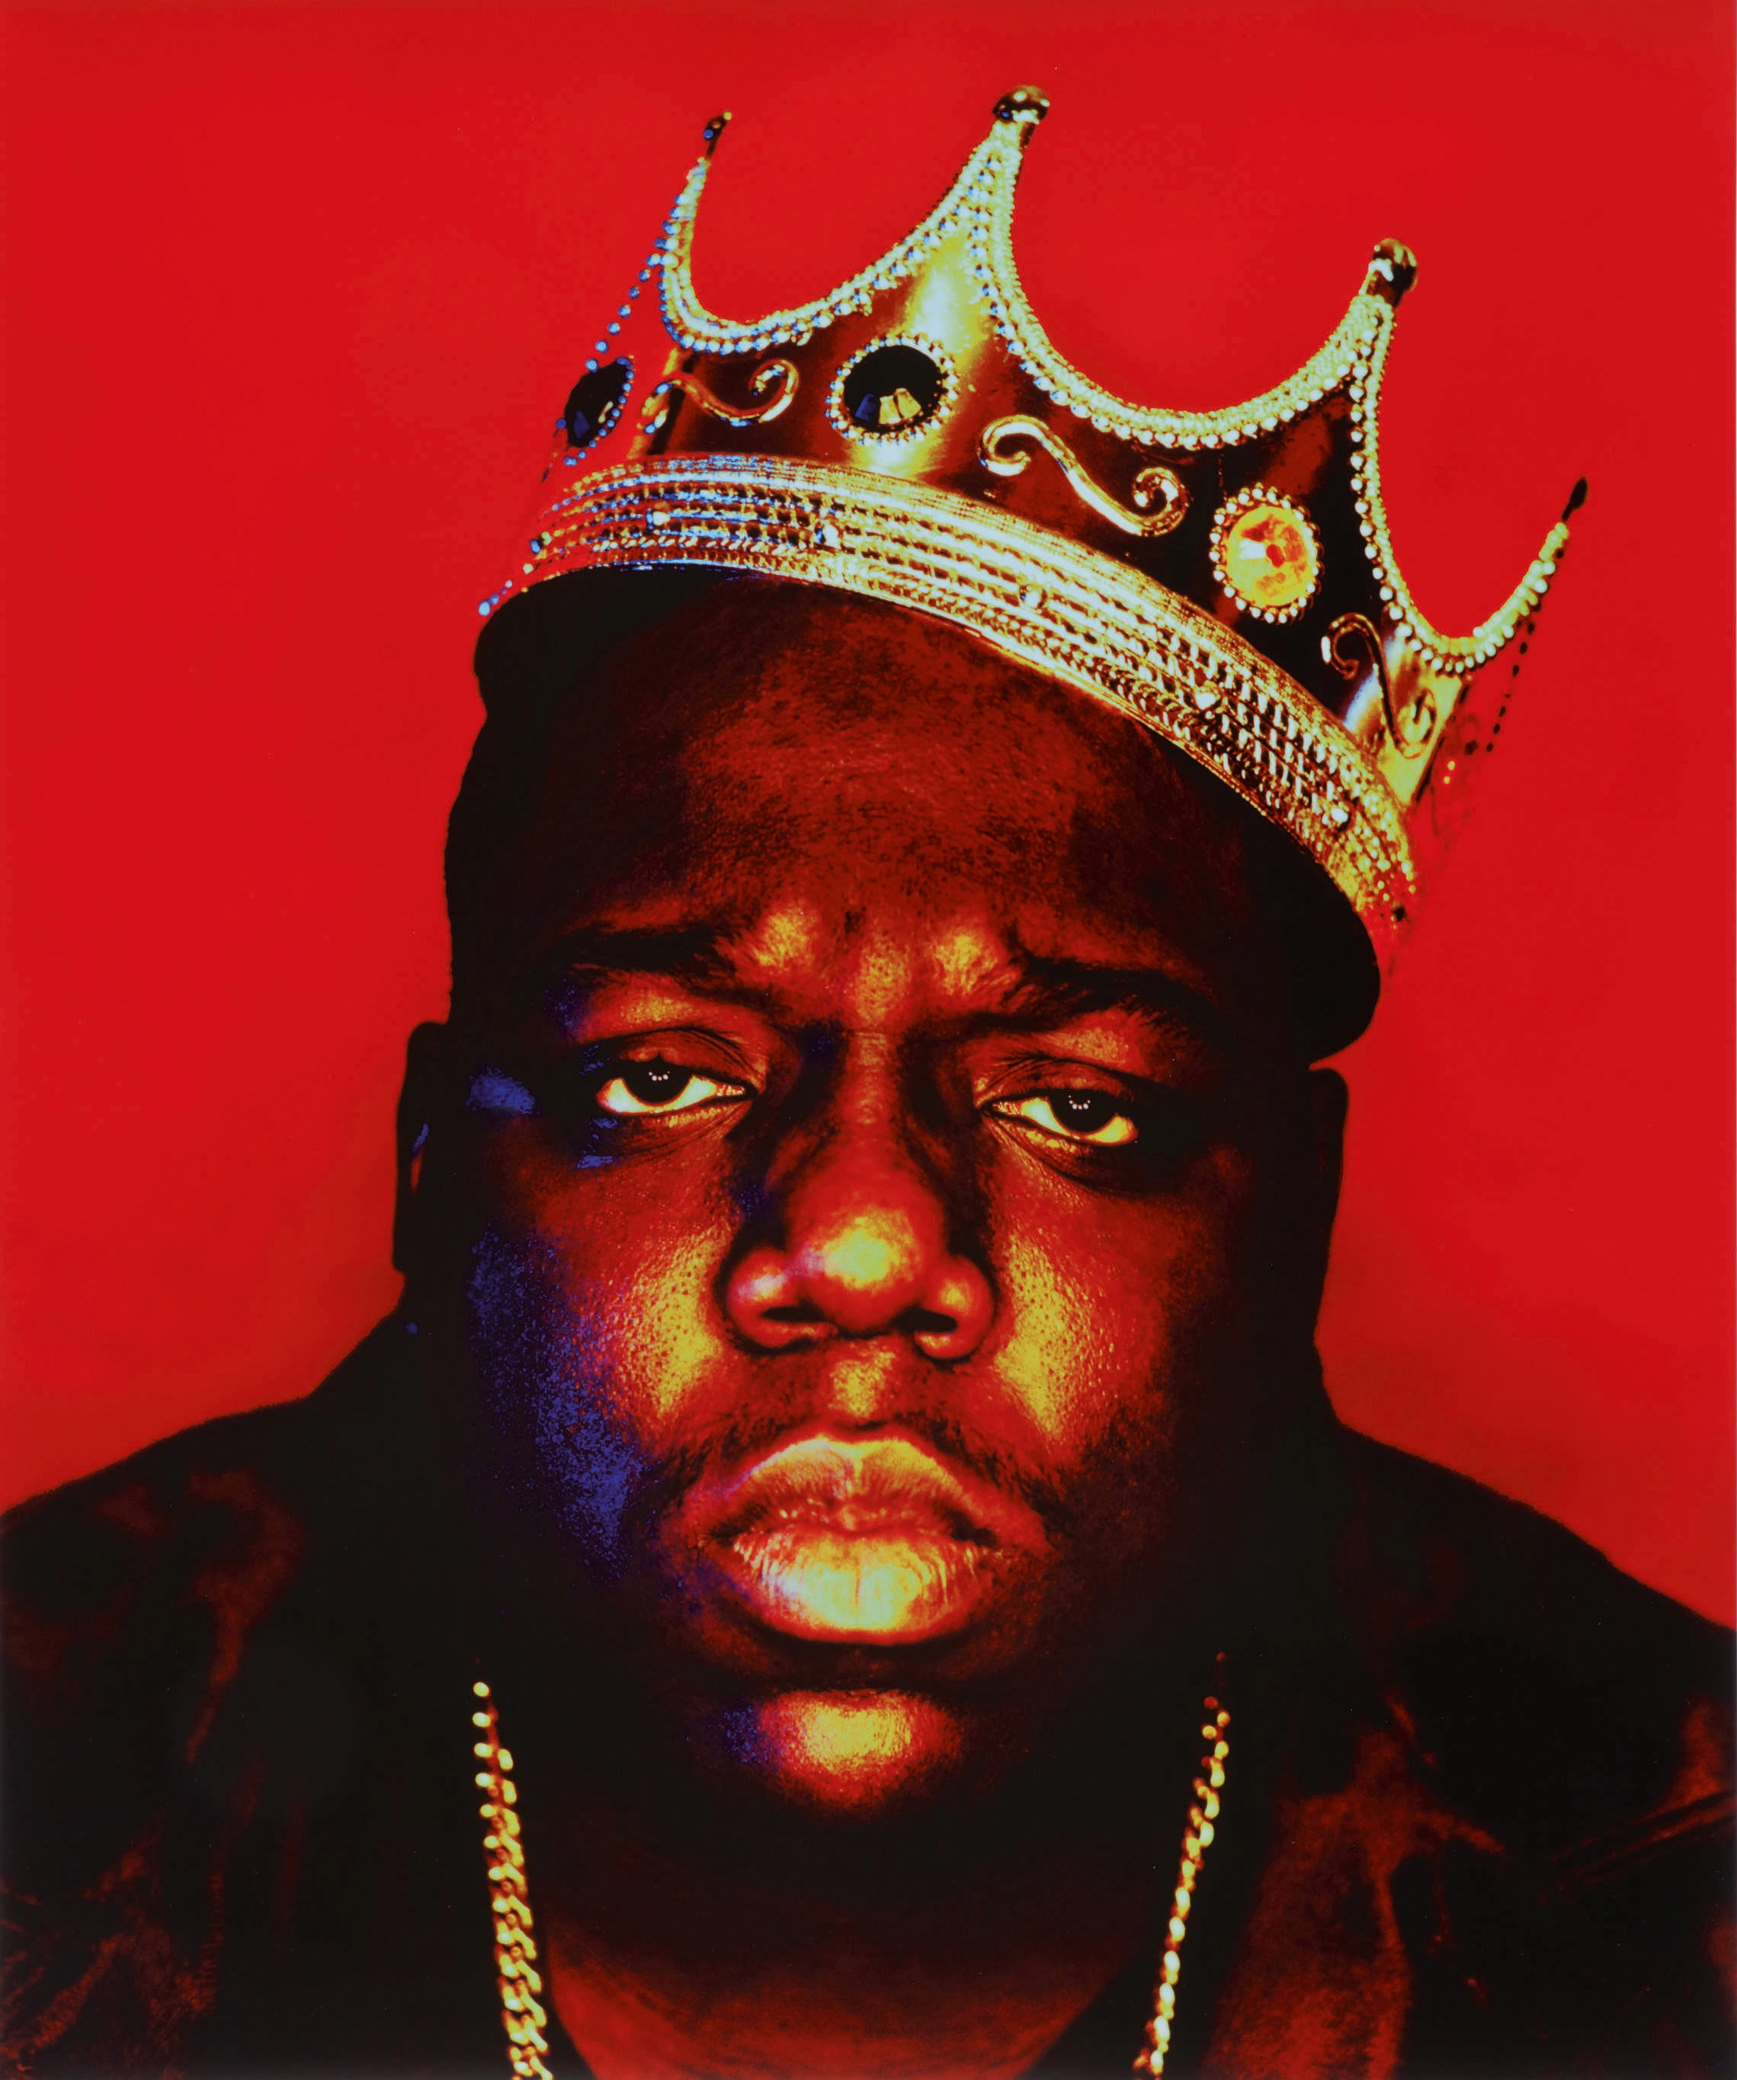
Stackalee/ Stackolee/ Stagolee/ Stagger Lee (1865-1912)
Lee Shelton, African-American cab driver, pimp, gang leader, gambler, murderer of Billy Lyons in St. Louis, Missouri, on Christmas 1895
Why is this criminal heroic?
the “dark” side of capitalism (parody)
Post-Civil-War ethics: emancipation VS racism (first “gangsta” icon)
Semiology of symbols:
Stetson hat as Tarnhelm
Stack O’ Dollars (hieros gamos)
Deal with the Devil—trickster traits
Lyons ghost
The 75-year prison sentence (liminality)

Slide 8
Thank you for a great semester!
(and don’t forget to fill in your evaluations!)

