Slide 1
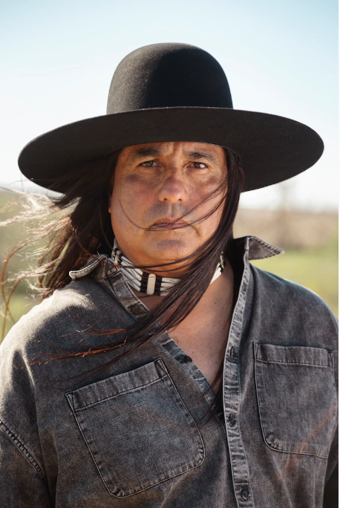
From Nowhere to Eternity
The Romanticization of the Native

Slide 2
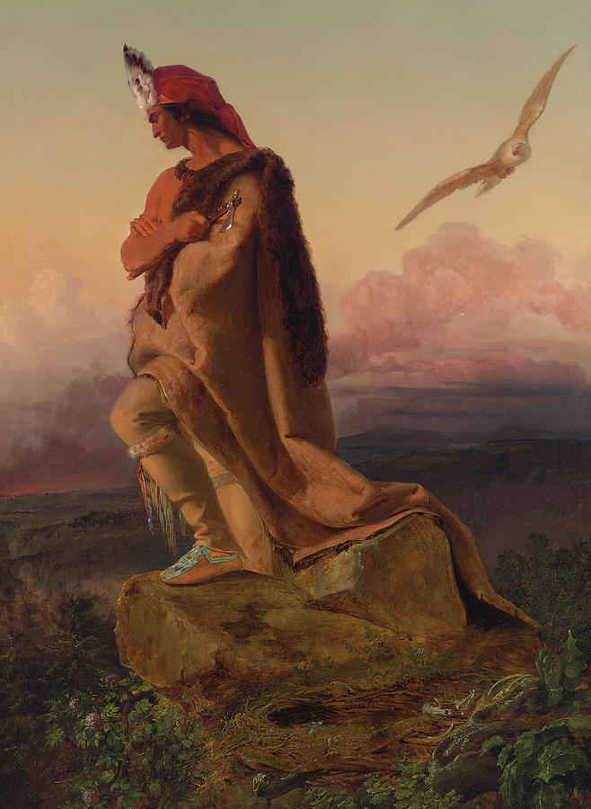
Textualization = Fabulization
From European Romanticism (medieval past)
to American Romanticism
(Native past)
Usurpation after extinction
Genl. Phil Sheridan, “The only good Indian is a dead Indian”

Slide 3
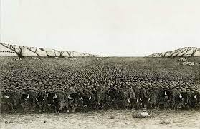
Manifest Destiny
Cited by Congressman Richard Yates, IL, April 23, 1852
-retroactively justified forced uprooting, land grab and outright genocides of Natives (Indian Removal Act of 1830, 4000 Natives dead on Cherokee Trail of Tears)
-tone
-view of the land
-what are the values of the white settlers?

Slide 4

Custer’s Last Stand
-Battle of Little Bighorn (June 15-26, 1876)
-General George Armstrong Custer as a living legend
-History as text, many interpretations-views
-Native account:
-Importance of pipe-smoking ritual: Custer untrustworthy, under perjury: dark attack on Cheyenne peace camp
-Not US politics, but personal hubris
-shameful death vs the bravery of Black Kettle and wife, and Sioux, Cheyenne, Arapaho warriors

Slide 5
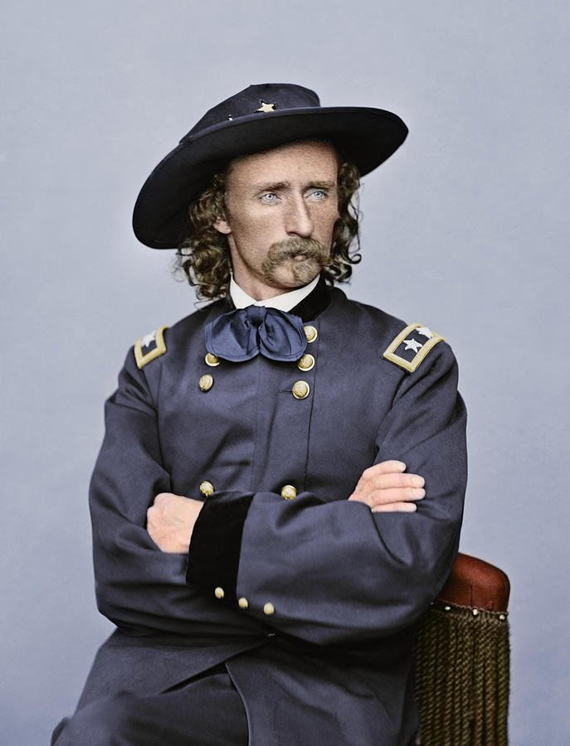
White account:
-Choice of language—propaganda
-c/c with Leonidas
-metaphysical elements: fatalism, defeat as foreordained, “haunting” of battleground
-team spirit, team event

Slide 6
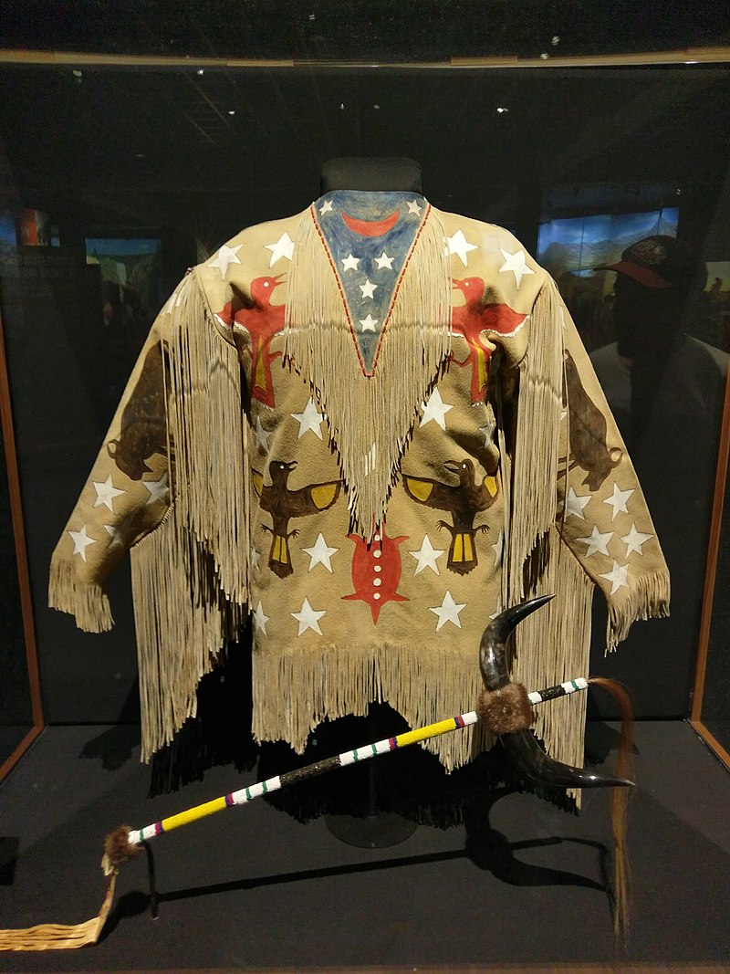
Wowoka of the Paiutes (Jack
Wilson), “The Messiah Letter”
-Messiah vision 1889
-Syncretic nature of ML (1870 vision by earlier shaman and Wowoka’s father
+Second Coming)
-Ghost Dance, “ghost shirts”
—>1890 Massacre at Wounded Knee
(Black Elk chronicles)
-Regeneration motif—spirit world, therapy myth
-why a dance?

Slide 7
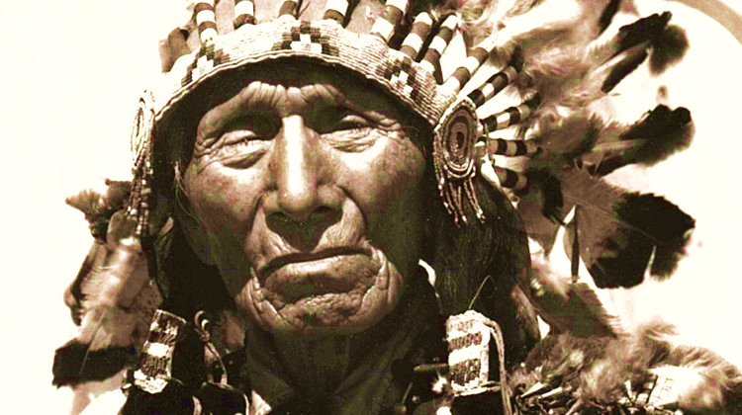
Black Elk Speaks (1932), “The Massacre at Wounded Knee”
-Oglala Lakota medicine man, 2nd cousin of chief Crazy Horse
-fought at Little Big Horn, Wounded Knee
-toured Europe with Buffalo Bill’s Wild West Circus
-in old age, converted to a syncretic “catholicism”; memoirist

Slide 8
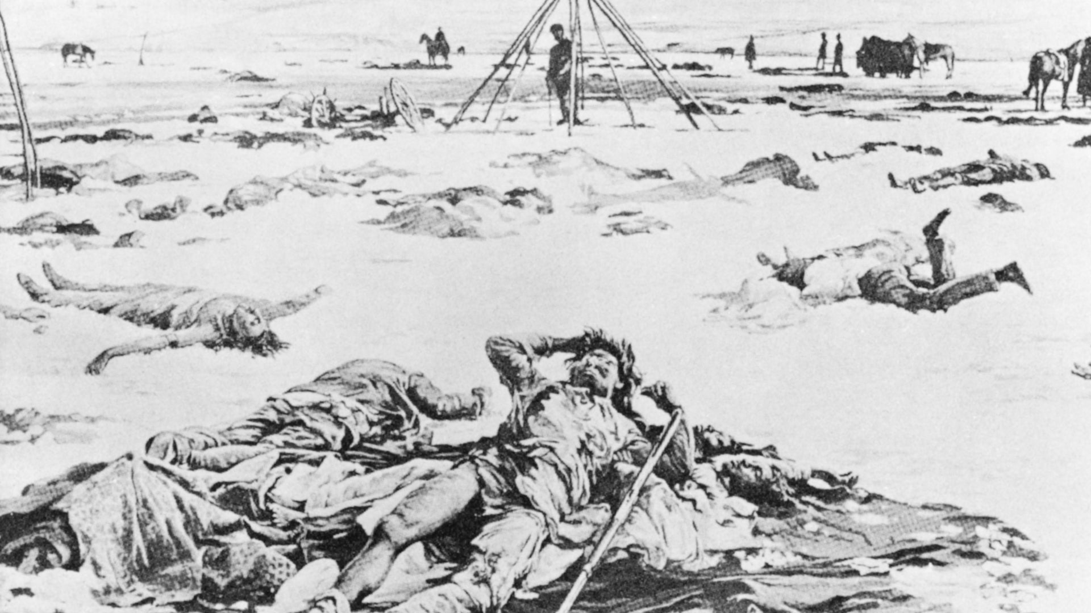
Wounded Knee (December 29, 1890)
-300 unarmed Lakota from Spotted Elk’s tribe dead (from bullets or exposure)
Account of massacre:
-factual tone
-what are the values of the Natives?

Slide 9
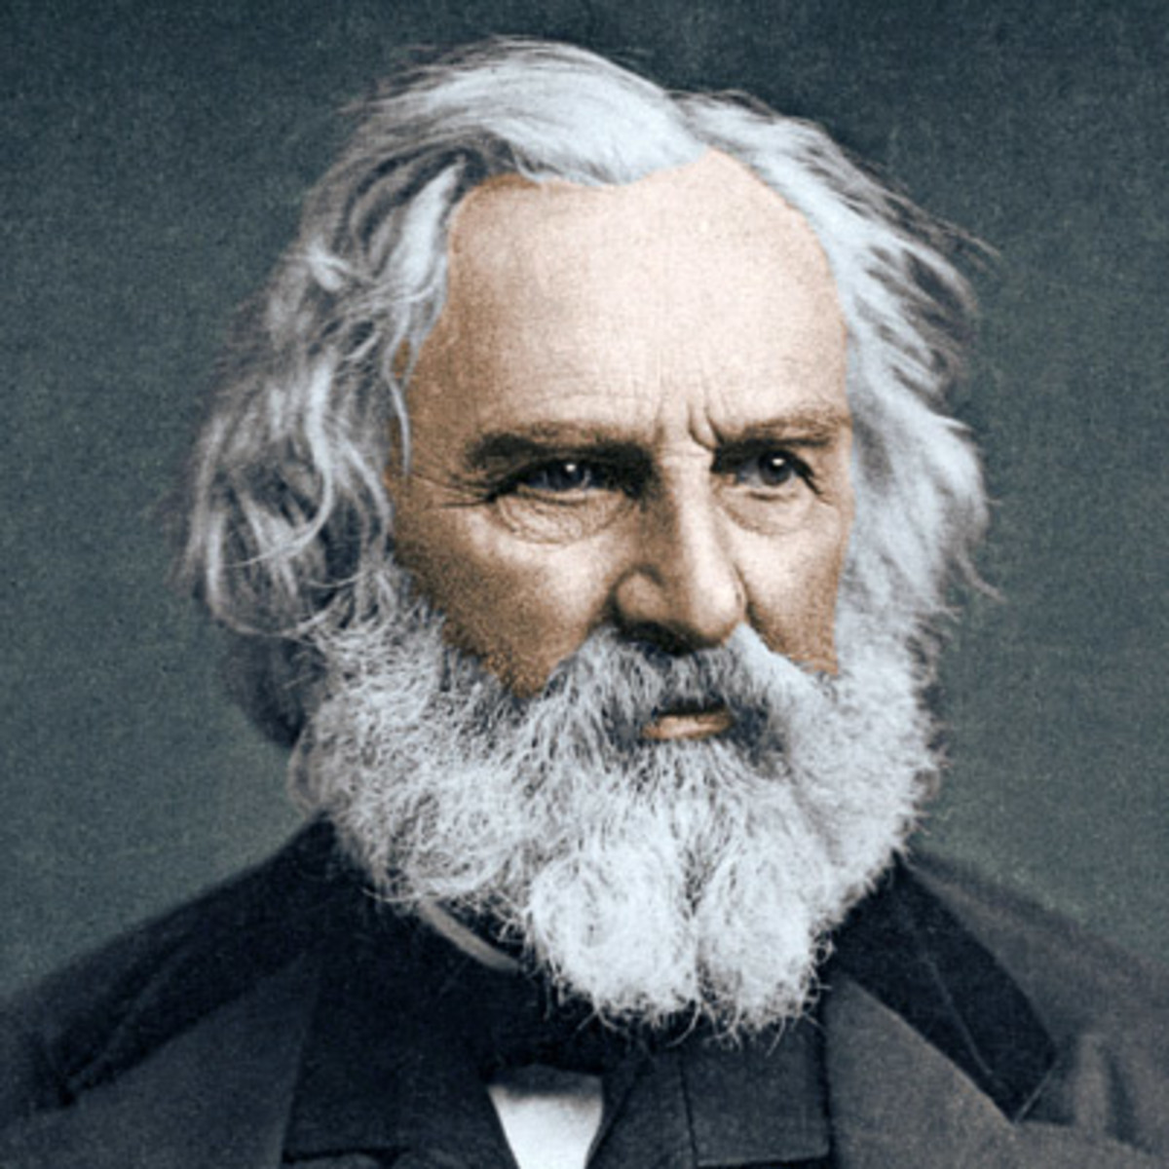
Henry Wadsworth Longfellow (1807-1882)
-One of the 5 “Fireside Poets” of 19th century
-Lyrical themes, myths and legends
-Easy, musical memorable form for mass entertainment
-Skillful adoption of intricate European ballad forms

Slide 10
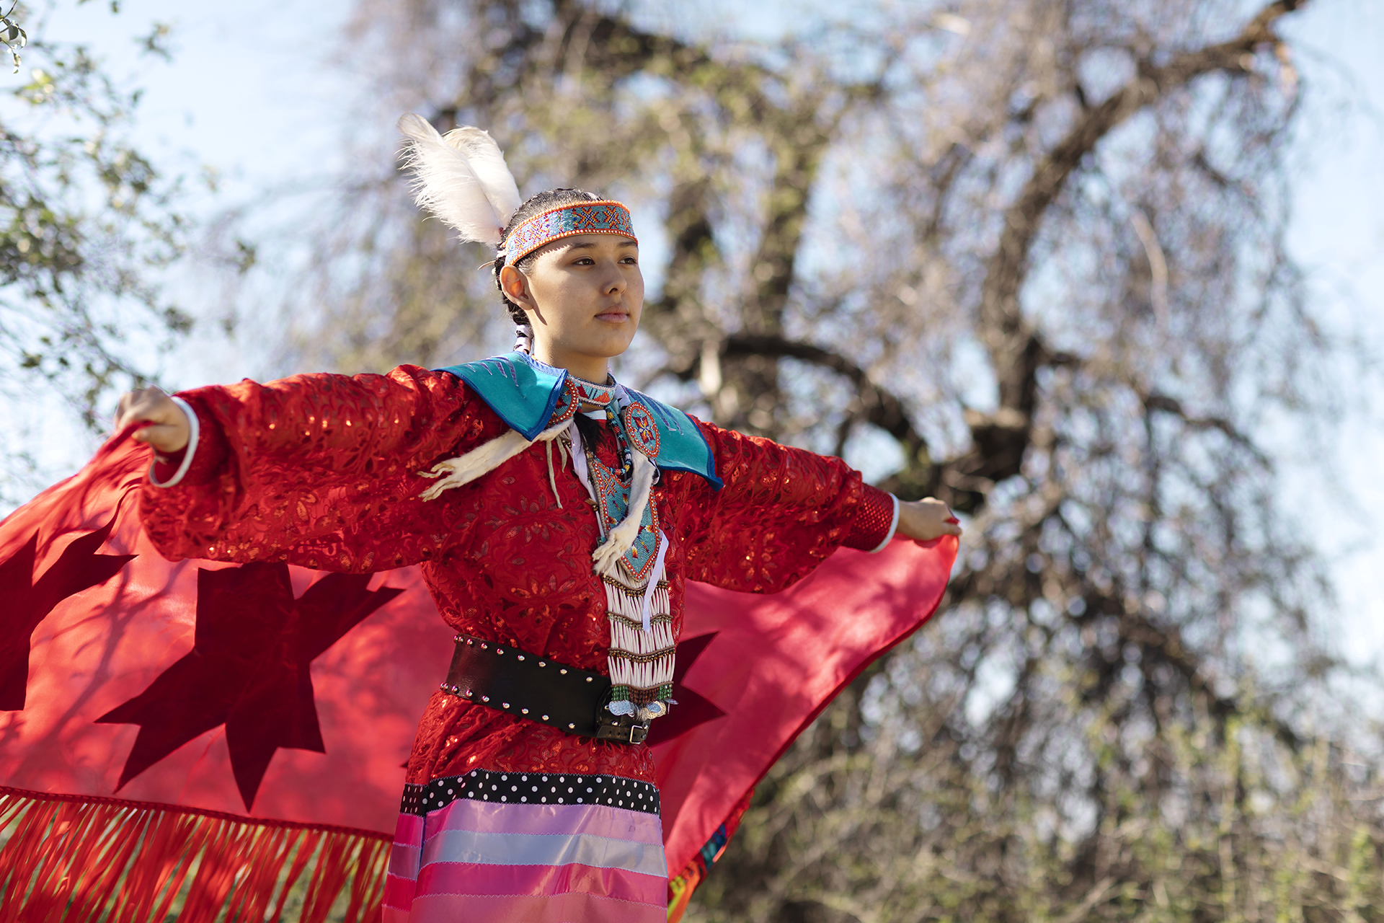
The Song of Hiawatha (1855)
-Composed metrically after the Finnish Kalevala (U.S. quest for an epic)
-Original 16th century Hiawatha an Iroquois 5 nations hero (uniter);
HWL’s “Hiawatha” an Ojibwa trickster/god Manabohzo
-Initial distaste at Indian subject replaced by immense popularity, but also many parodies (e.g. Disney)

Slide 11
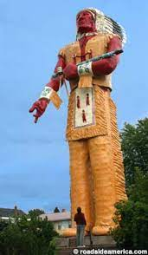
-Hiawatha as: a. trickster (terraformer); aetiology b. liminal hero; charter myth c. Freudian subject (Oedipus complex)
-motif of the exchange of “lethal weapon” secrets
-Hiawatha´s quest cycle (helpers, gifts, the fight, the Boon, the return)
-Poem ending: surrender to coming Christianity (preacher on canoe) BUT…
…if one cannot erase one’s roots (can’t kill father), where does new religion stand?

Slide 12
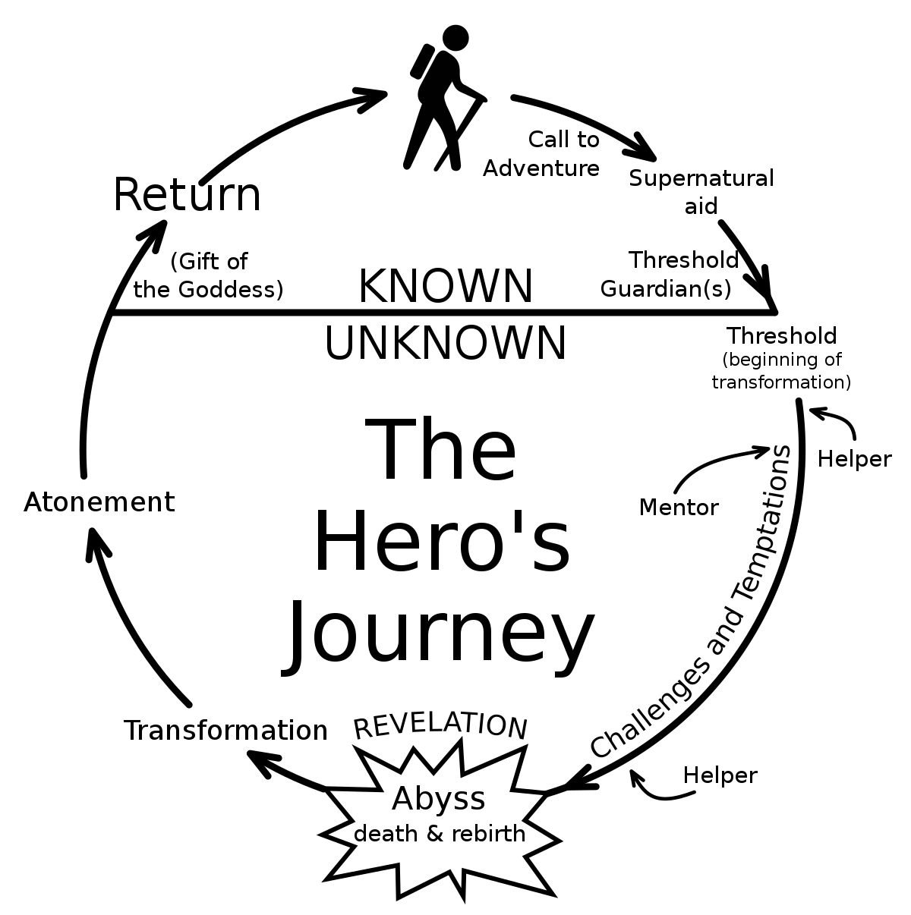
Joseph Campbell’s Heroic Quest Cycle (from The Hero with a Thousand Faces, 1949)
-Based on Lord Raglan’s idea of the monomyth

