Slide 1
Go west, young man
Heroes of the Age of Expansion

Slide 2
Westering
-Pioneers, trailblazers
homesteaders/settlers, pathfinders,
-“Ohio Fever” (c.1815)
-The Prairies
-The Conestoga wagon (“prairie schooner”),
-mule, axe, rifle
-Professional soldiers along with privateers
-Silver and gold discovered in the west coast states—prospecting, “gold fever”

Slide 3
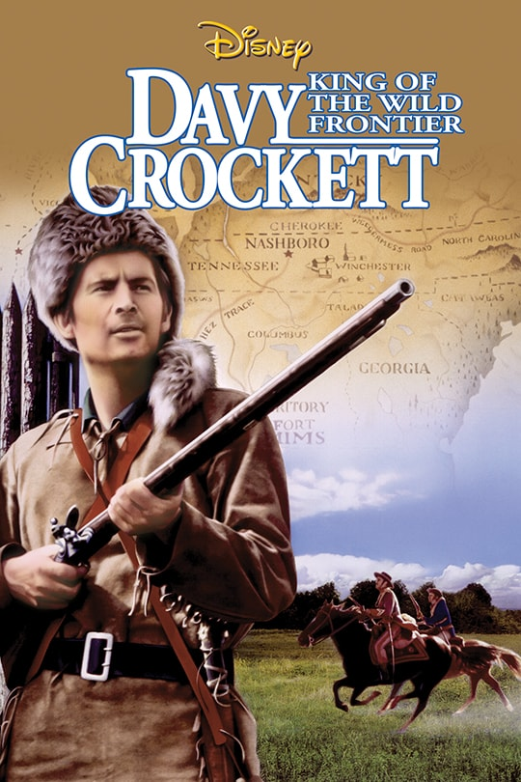
davy crockett (1786-1836)
-Tennessee militia Colonel; “King of the Wild Frontier”
-Tennessee U.S. House of Representatives (1827)
-Died as Alamo defender in the Texas Revolution (February 23-March 6, 1836)
-American society grows: heroes with brains AND brawn:
Coonskin cap→ archetypal rugged backwoodsman, ring-tailed roarer
AND popular orator, “Colonel,” Congressman, more civilized than Mike Fink
-C/c to: Christopher (Kit) Carson, “Monarch of the Prairie”, Rocky Mt. beaver trapper and Jack-of-all-trades
: Daniel Boone, Quaker deerhunter and Indian fighter
: Jim Bowie, Southern gentleman “Colonel”, inventor of the Bowie knife, cutthroat, slaver, business partner of pirate Jean Lafitte (“Lost Bowie mine” a hoax); heroic death while gravely ill at the Alamo
: Sam Colt, inventor of the six-shooter (revolver)

Slide 4
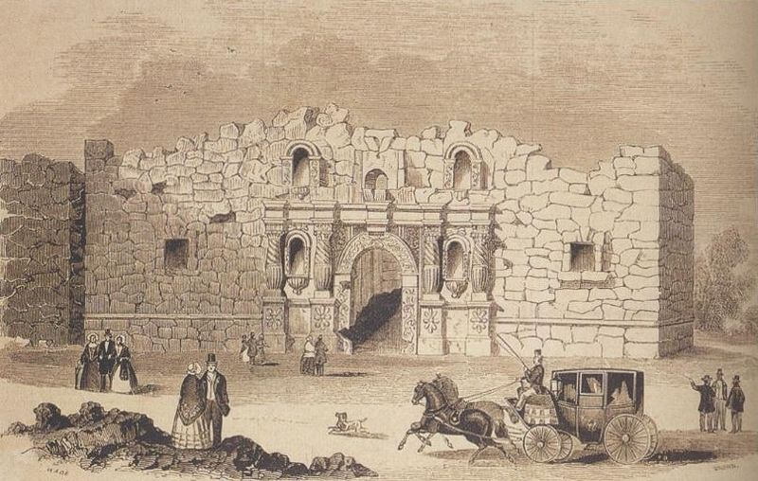
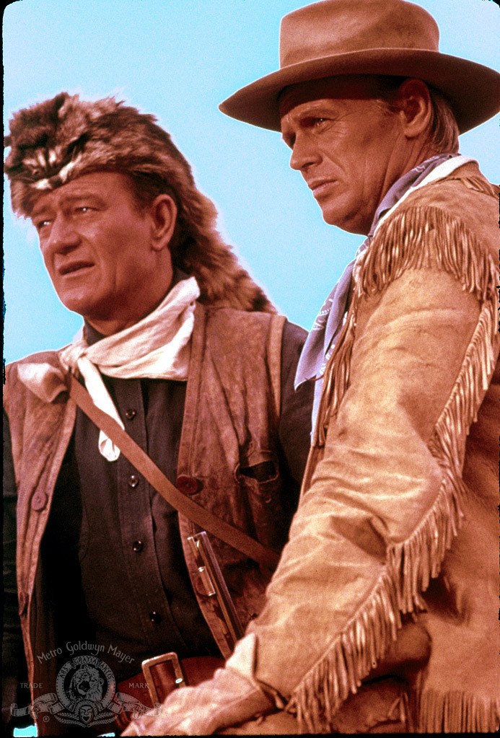
The IMPORTANCE OF THE ALAMO (February 23 – March 6, 1836)
-Texas War of Independence: U.S. moves to acquiring present size
-Marker of closing early settling era with U.S.A. not just survivor, but virtuous
-Heroic past over and martyrized (Battle of San Jacinto (April 1836): “Remember the Alamo!”)

Slide 5
JoHNNY aPPLESEED

Slide 6
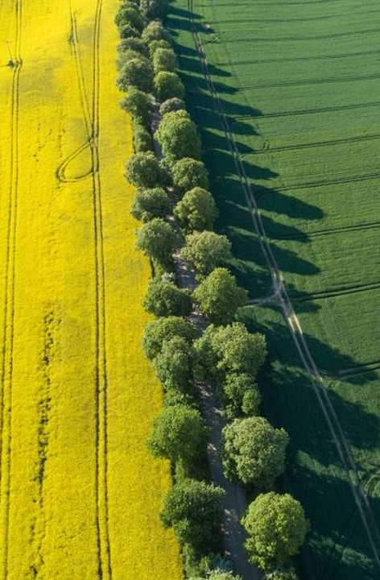
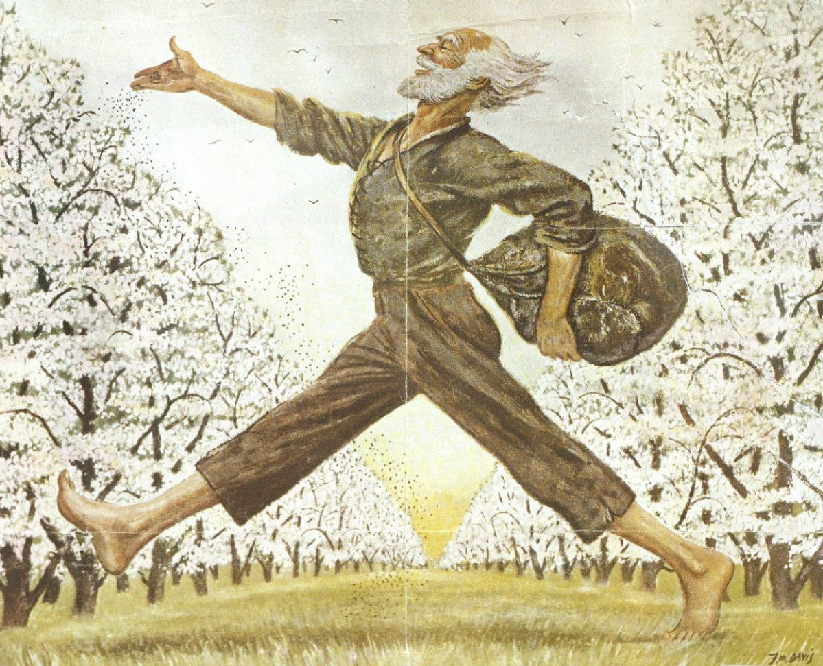
-Jonathan Chapman (1774-1845)
-Pennsylvania→Ohio, Indiana, Illinois, Ontario, Kentucky and West Virginia pioneering nurseryman
-Northeast apple industry
-Puritan missionary spirit→ Swedenborgianism (mystical union with God and acts of charity) → an American saint (“cult” even today)
-Ralph Waldo Emerson’s Transcendentalism
-The first hippie?

Slide 7
…And yet…
-Searching for Johnny by Miroslav Mandic (2009):
Appleseed considered crazy by Natives
Psychological problems for loss of fiancée?
Betrayal of Natives to U.S. Army/ state interests
A comparative fortune in orchards (= land ownership), actually planted ahead of settlers and then sold to them
-The semiology of planting apple orchards into the Wild:
Mythological symbolism of the apple
The act of planting with staff and seed
Tree as “axis mundi” (cosmic axle): blossoms→clouds
The transformation of the land: “hieros gamos”

