Slide 1

The Wild, Wild Words
Bullets and Bullsh…

Slide 2
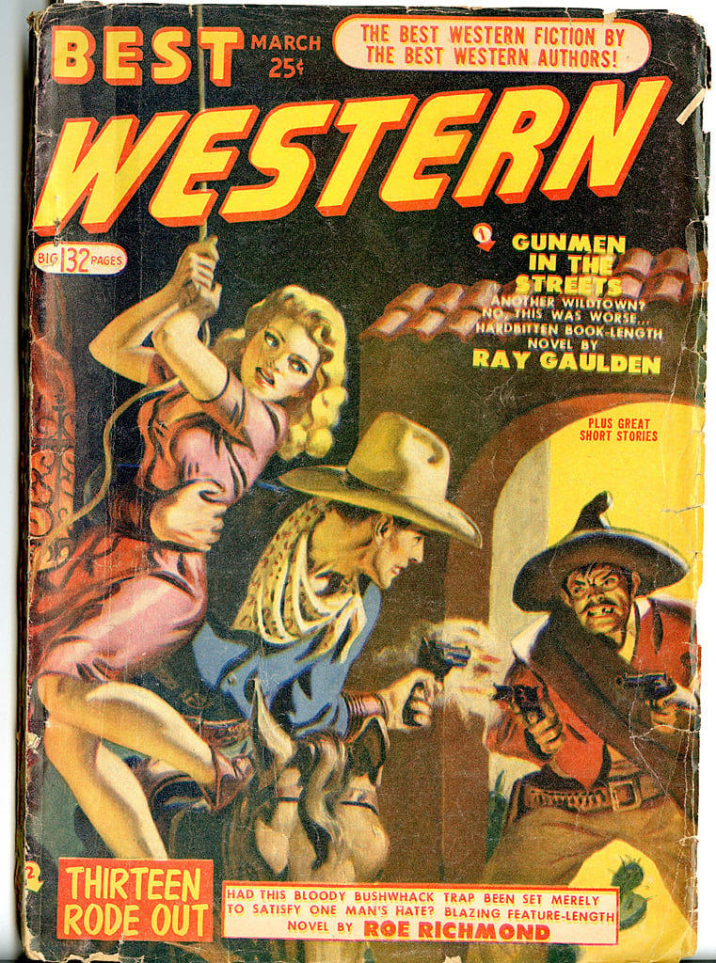
From the Mild East to the Wild West
The “Wild” West VS the urban, cosmopolitan,
“effeminate” East
Penny dreadfuls, pulp fiction, dime novels: legends become COMMERCIAL PRINT
Sight (from “witness” of heroism) VS spectacle, performance/tivity

Slide 3
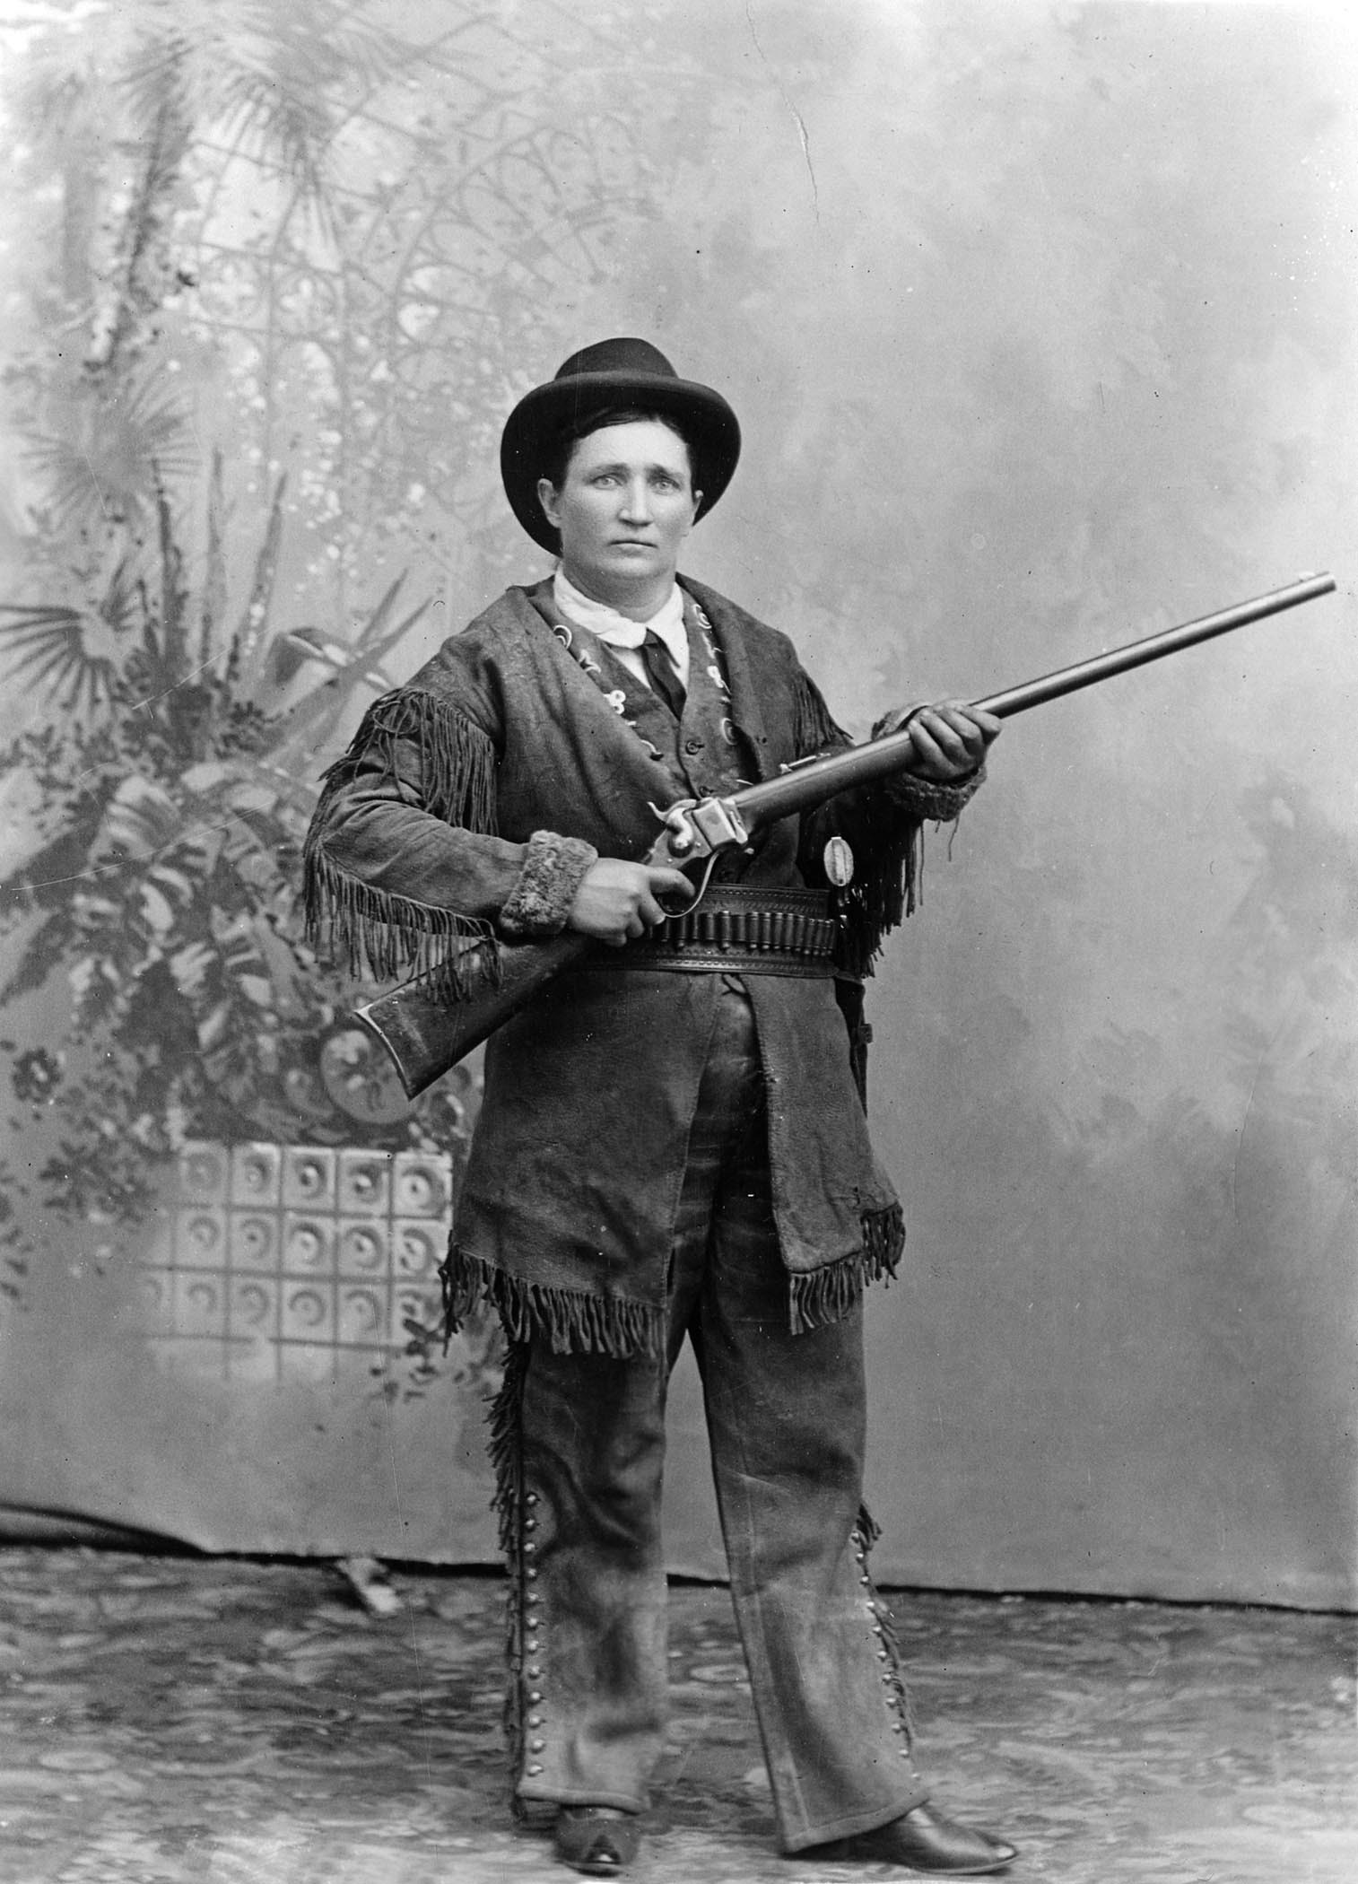
Calamity Jane
-Martha Jane Cannary, 1852-1903
-Deadwood, SD, legend: “widow” of Wild Bill, friend to fakelore Deadwood Dick
-c/c Anne Oakley, shooting champion
-truth vs legend:
prostitute (“soiled doves”, deadly v.d.s)
alcoholic
self-proclaimed hero, local attraction
-“deadliness” of rule/gender-bending, female desire?
-manipulation of signification (prostitute=hero):
Performing androgyny (acc. to Judith Butler)
→shooter and nurse, vigilante and “dream-gal”
Calamity Jane as Jean Baudrillard’s “pure simulacrum”

Slide 4
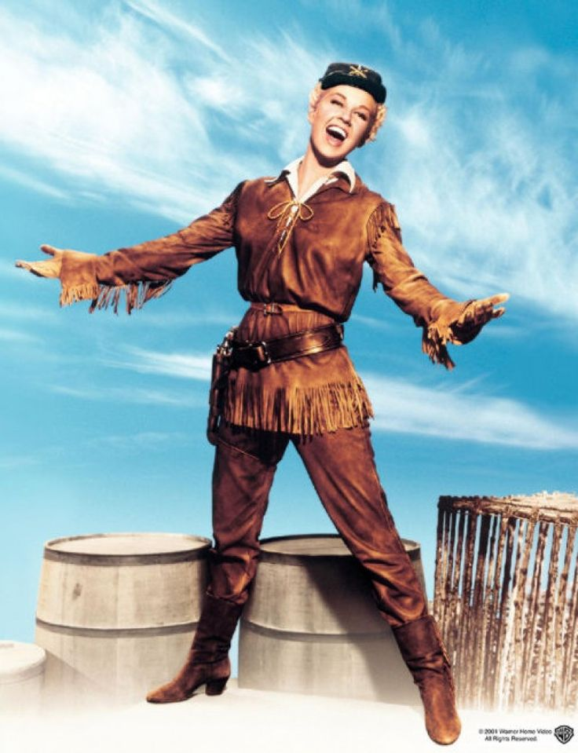
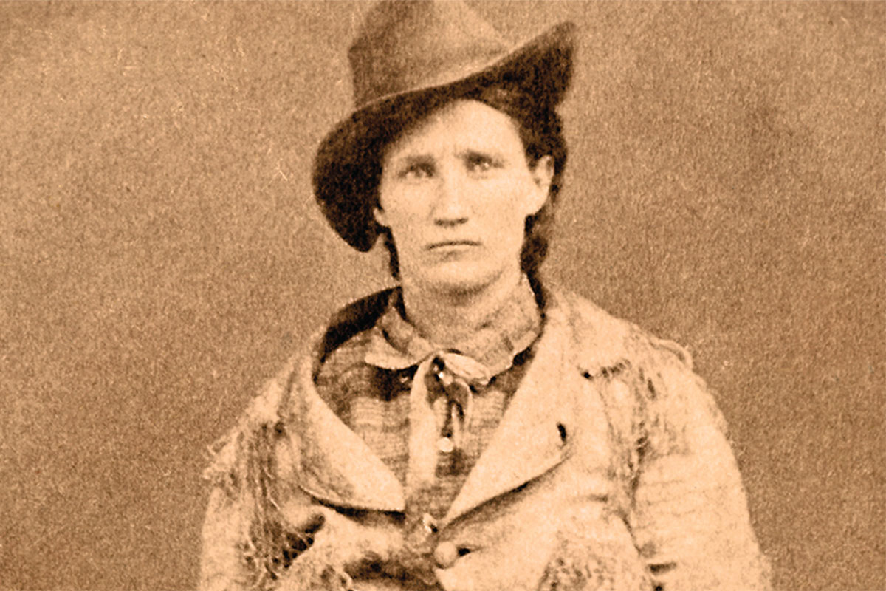
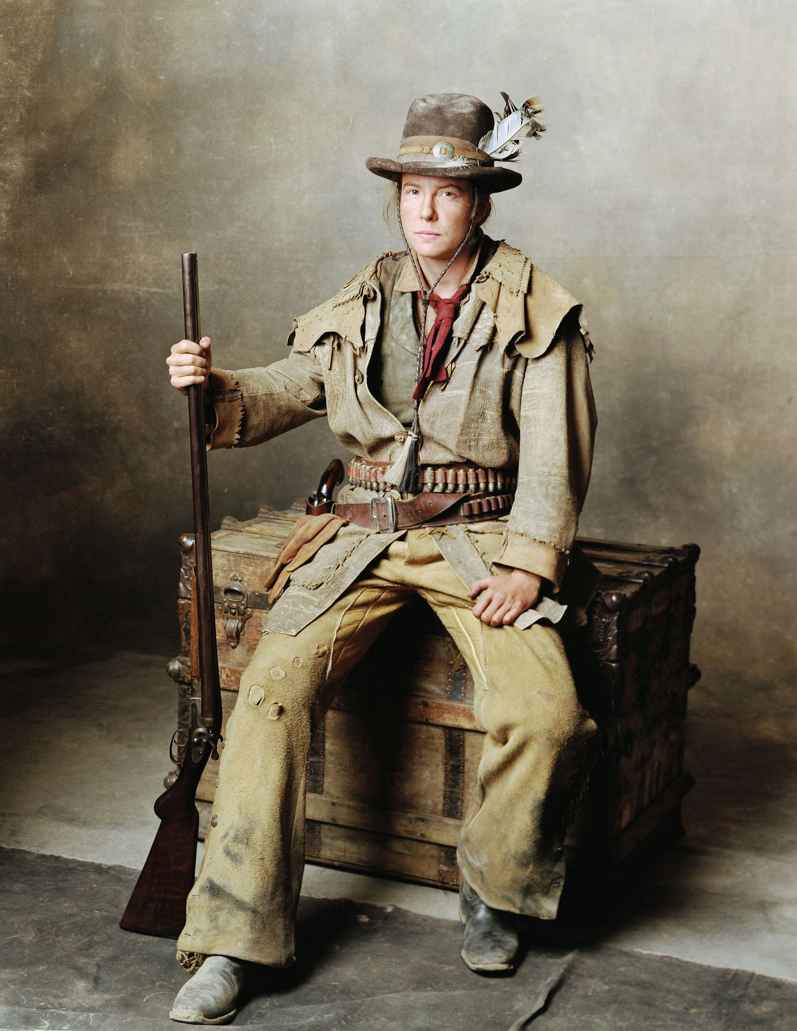
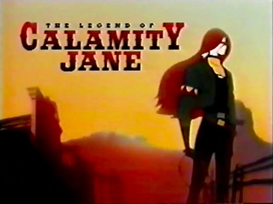
Will the real Calam please stand up?

Slide 5
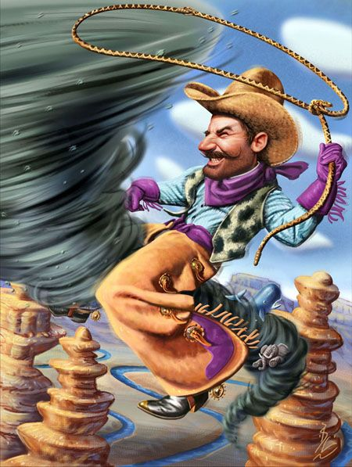
Pecos Bill
fakelore, cowboy icon (invents the job)
West’s combination of trickster and feral child
(c/c Mowgli, Tarzan)
why half-coyote?
homosociality:
troublesome, “bouncing” or dead Slue-foot Sue;
“WiddowMaker”;
“riding the cyclone” (c/c Dorothy in The Wizard of Oz)
drinking feat as male bonding
-the end: “true” cowboy laughs to death over Easterner fake fan
→ the fake kills the fakelore!
Jacques Lacan’s paradigm:
mirror stage (on river next to cowboy) leads to subjecthood, homosocial identification
Father of Enjoyment (Law of the Father)
becomes “lack” of the Real next to the fake cowboy
ascends to Heaven, leaves only standing boots (the Phallus)

Slide 6
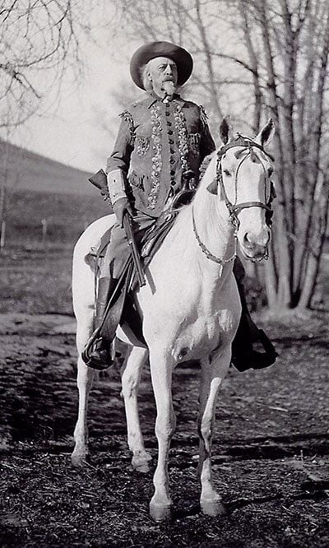
Buffalo Bill
Col. William F. Cody (1846-1917), decorated soldier and scout, buffalo hunter
-Buffalo Bill’s Wild West Show
-oxymoron of “true” spectacle of “true” West via real skills (anti-Aristotelian)
-stereotyping: synecdoche of the West as: danger, fighting, weapon skills
“victorious” white, “entertaining” Mexican, “savage” Indian
white performers identified by job, others by race
-YET: lifelong supporter of slaves’, women’s, and Natives’ rights (employed Sitting Bull); deplored the destruction of wild lands

Slide 7
