Slide 1
American Monsters

Slide 2
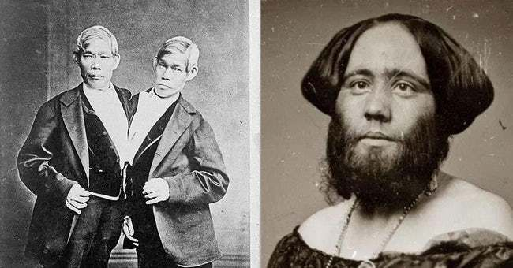
What Is Monstrosity?
-Df. unknown, uncanny (Freud’s unheimlich), terrifying, portentous
-Symbolic monstrosity
-American land
-Otherness (Natives)
-settling hardships
-destruction of the family/societal bonds
-the dark side of the reinvention of the self
-unholy VS holy monstrosity (savage VS awesome nature—the White Beast)
-P.T. Barnum’s Circus freakshow—why so popular?
Tied to history (witches; Frankenstein; zombies; alien/Martian invaders)

Slide 3
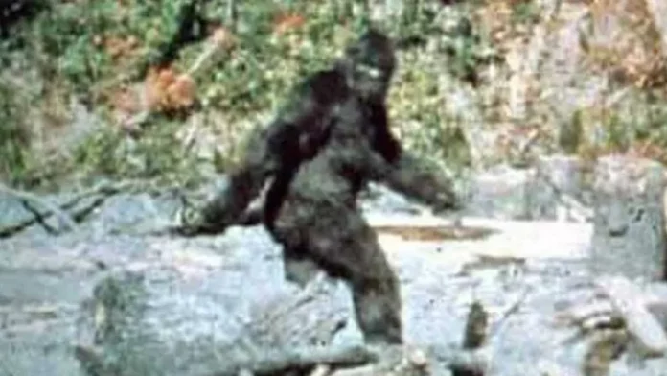
Bigfoot
-If not dangerous, why monstrous?
mysterious
aberrant size
hairy, nonverbal
own species
filmed
female (Nature)
→furry, fleeting, fearsome, fascinating: the incest taboo according to Freud
→our own fear of incest-regression (throwback to abject Primal Mother, primate evolutionary state)

Slide 4
The Wendigo/ “A Loup-Garou…a Carcajou”
-Native origin: the Hopi Ogre, Wendigo lore
-the taboo of cannibalism
-metaphor for:
multiculturalism (theme, language): good or monstrous?
harsh north American winter
loose social ties+ harsh survival → masculinity run wild
precariousness of the division between human/animal

Slide 5
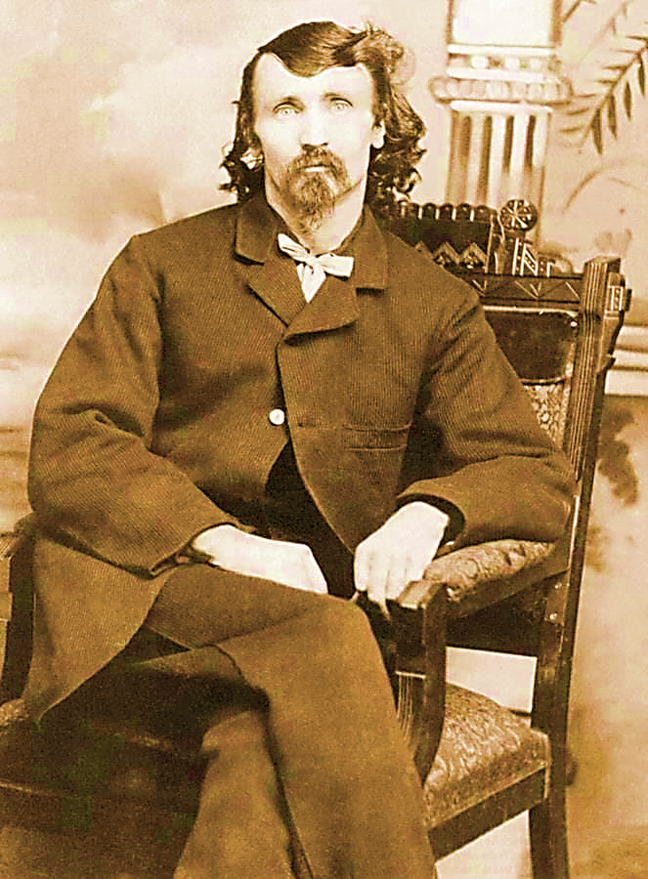
Alferd Packer, the colorado cannibal
-Cannibalism among the early settlers (Packer, Donner party)
-Metaphor for greed, gold fever, rugged VS rampant individualism: Packer a con-man, vs honest Chief Ouray, who saves half of the remaining party
-Why comedic treatment by media?
a. double irony of “he ate all the Democrats”
few Democrats (in the land of “Democracy”!)
democracy not an individualist/ tough enough concept
b. The “Alferd Packer Memorial Grill” of the U of Colorado at Boulder, dining tent at Philadelphia Folk Festival, and “The Packer Saloon and Cannibal Grill” in Lake City, CO
c. Trey Parker’s 1993 play/film Cannibal! The Musical!

