Slide 1
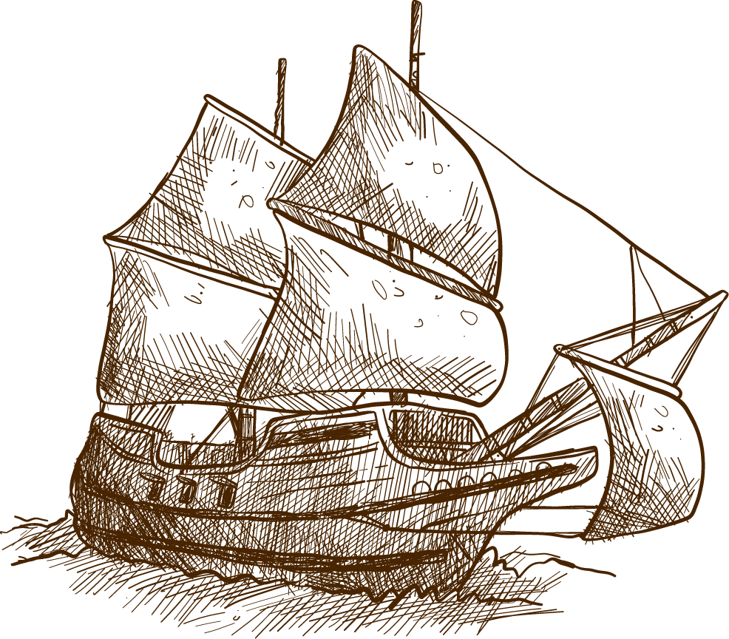

AMERICAN LEGENDS:
AN INTRODUCTION
Dr. Christina Dokou

Slide 2

DEFINITIONS OF MYTH
An anonymous story containing supernatural
elements adopted by a people as part of their cultural heritage; a lie
Folklore (umbrella term)
Myth (systemic, rhizomatic)
Folktale, fable (nonliterary, older)
Fairy-tale (literary, later)
Legend (real basis with added supernatural elements)
Jack Zipes: “the stories worth passing on”; “two-sided”

Slide 3

APPROACHES TO MYTH AND FOLKLORE
Formalist/structuralist (Vladimir Propp, Roman Jacobson, Claude Levi-Strauss):
fabula/story, tradition/performance, mythemes
Psychological (C.G. Jung, Bruno Bettelheim, Northrop Frye): archetypes, psychology of childhood
Cultural (Bronislaw Malinowski, Stephen Greenblatt):
charter myth, gender/class/textuality readings
Narratological/semiotic (Roland Barthes): concealing/naturalizing propaganda mechanisms, commonly-shared unconscious (unclear) signs

Slide 4

USES OF MYTH
entertainment, education, therapy, wish-fulfilment, charter (identity, behavioral codes, history), prestige, existential answers (origin, teleology, humanity/gods)

Slide 5

THE AMERICAN PECULIARITY
No pre-existing mythology/folklore→rapidly made “on-the-go,” mixing items borrowed—European or Native American—or from scratch
Land as fabulistic (immense, rich, wild; reinvention of “better” self)
Tied to bourgeois, Christian ethics (e.g.,
industrial heroes, no epic)
Regional diversity
New forms of narrative (short story, tall tale, US humor)

Slide 6
U.S.A.: A BRIEF CHRONOLOGY 15TH-19TH CENTURY
1492-1532 | Cristopher Columbus lands on Hispaniola (Taino islands, Caribbean), discovers America–conquistadores, Eldorado myth Extermination of the Tainos, destruction of Inca-Aztec empires by F. Pizarro, H. Cortés (La Malinché legend, Black Legend)
c1500 | First African slaves brought over
1584 | Sir Walter Ralegh "discovers" Virginia
1620 | Pilgrims land on Plymouth Rock--The Mayflower Compact/ Thanksgiving
1776-83 | War of Independence (Boston Tea Party 1773)--The Declaration of Independence signed by George Washington, Benjamin Franklin, et al. (July 4, 1776)
1830 | Indian Removal Act-- “Manifest Destiny” dogma
1848 | California Gold Rush--The American Dream--Wild West
1861-65 | The Civil War--The Emancipation Proclamation signed by President “Honest Abe” Lincoln in 1863--The Gettysburg Address in 1865
1845-1890 | Massive immigration from Europe--expansion of territories, cities, industry
1890 | Massacre at Wounded Knee--The end of Native American culture

